Slide 1
A Centre for Solutions using Software of a Scientific Nature
AKA the SSSC
Geoffrey Squire
1 September 2016
Data61

Slide 2
Introduction
Lots of datasets are being published online
Using standard registries, vocabularies and services they can be:
Discoverable
Accessible
Useable
Trustable
Citeable
What about scientific software and workflows?
The Scientific Software Solution Centre (SSSC) works with Virtual Labs and others to make this happen
Yes, we’ll probably change the name

Slide 3
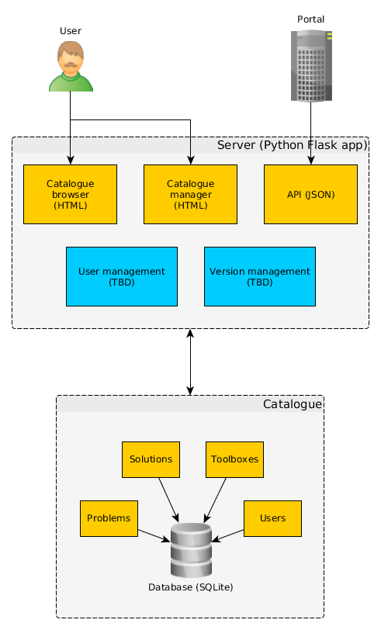
Overview (slightly out of date)
Plus:
external links
LD view
PROV

Slide 4
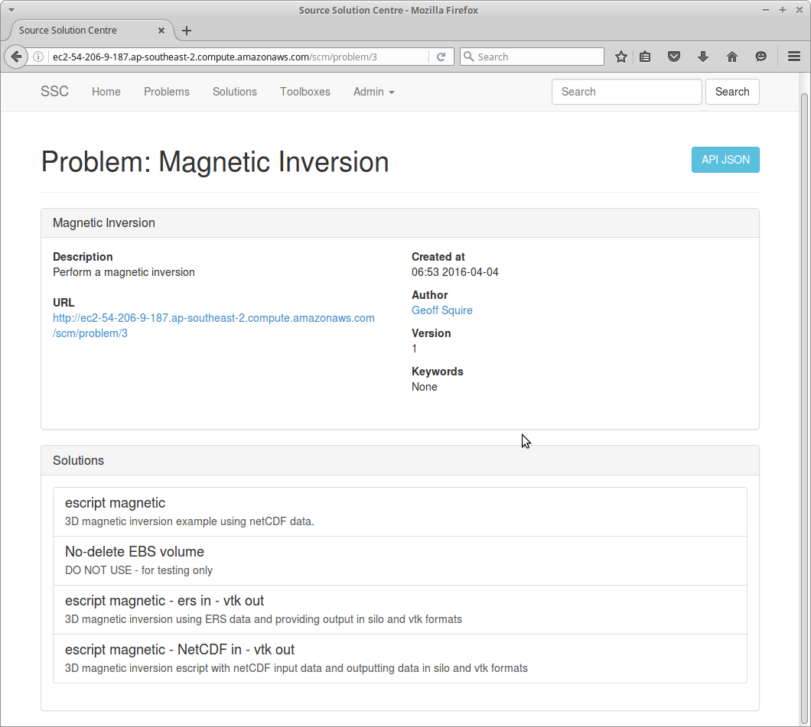
Everyone has problems

Slide 5
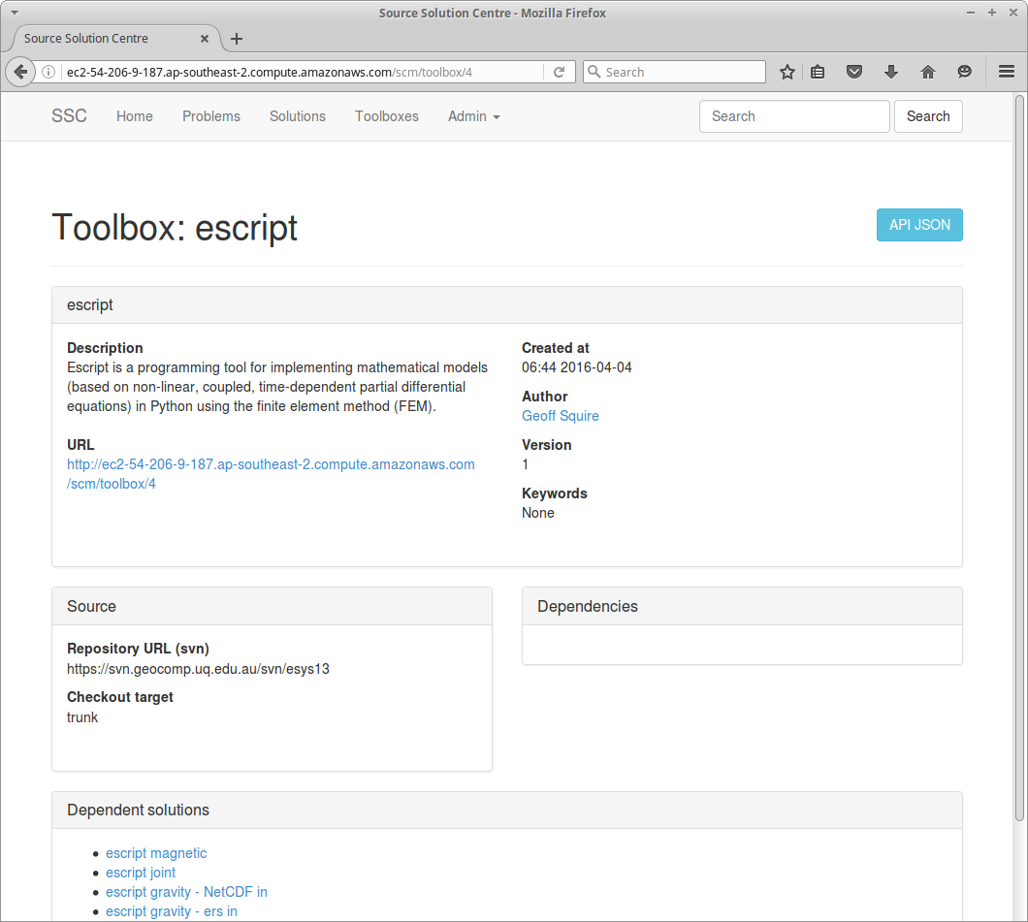
Scientists write software...

Slide 6
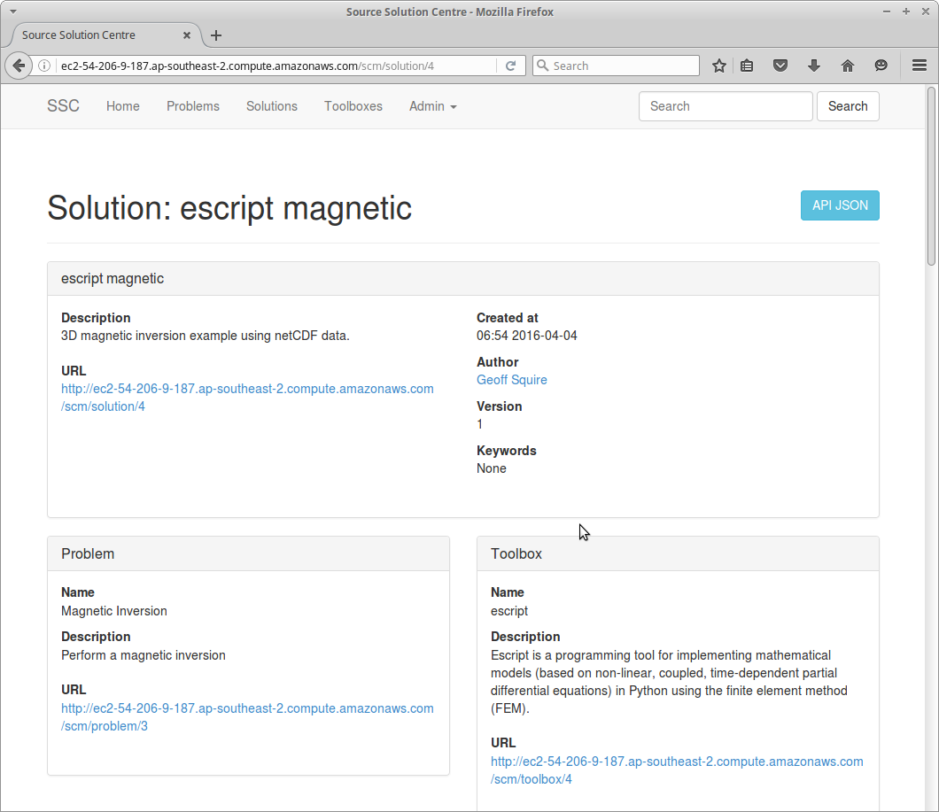
...and use it to solve the problems!

Slide 7
We make published software more useful
Scientific software is published as usual (e.g. Github)
A Toolbox can be published in the SSSC
A Toolbox includes:
Description of the software (findable)
Links to the published software (accessible)
URI identifies the Toolbox (citeable)
(coming soon) Can be hashed and signed (trustable)
An automatable software environment (useable)
Puppet module
Dependencies on other Toolboxes or external packages

Slide 8
Everyone likes Solutions
Someone has a workflow that solves a Problem
They can publish it as usual (e.g. Bitbucket)
Then publish a Solution in the SSSC
A Solution includes:
Link to a Problem and a description (findable)
Link to the workflow script (accessible)
URI to identify the Solution (citeable)
(coming soon) hashed and signed (trustable)
An automatable software environment (useable)
Dependencies on Toolboxes and external packages
Specification of inputs and outputs

Slide 9
Useful solutions are even better
SSSC enables automation of Solutions
Find relevant Solution(s)
Assemble software environment to run the Solution
Wrangle inputs and outputs
Execute the job
Prototyped in VHIRL and ANVGL
Other VxLs and WONAMBI coming soon
Provenance can be recorded
SSSC provides basic PROV-O descriptions
Include persistent links to Solutions, Toolboxes etc
Trustworthiness will be implemented
Authorisation
Hashing and signing entries
Review process for submissions

Slide 10
Business Unit Name
Presenter Name Presenter Title
t +61 2 9123 4567
e firstname.surname@csiro.au
w www.csiro.au/lorem
Business Unit Name
Presenter Name Presenter Title
t +61 2 9123 4567
e firstname.surname@csiro.au
w www.csiro.au/lorem
Business Unit Name
Presenter Name Presenter Title
t +61 2 9123 4567
e firstname.surname@csiro.au
w www.csiro.au/lorem
Business Unit Name
Presenter Name Presenter Title
t +61 2 9123 4567
e firstname.surname@csiro.au
w www.csiro.au/lorem
Space for collaborator logos
[delete instructions before use]

