Slide 1
A Scientific Software Solution Centre for Virtual Laboratories
Geoffrey Squire | Senior Software Engineer
October 2016

Slide 2
Introduction
Why we need a Solution Centre
What it does
How it works with VLs
Demo?
What’s with the name? Scientific Software Solutions Centre is a mouthful, so I’ll refer to it as just the Solution Centre (SC) from now on.

Slide 3
Why?
Scientific software and solutions need to be useful:
Discoverable
Accessible
Trustable
Citeable
Usable
Just publishing is easy (e.g. GitHub, PyPI, download)
Needs to be easy to publish so it is easy to use
Especially so it’s easy for machines to use

Slide 4
What does it do?
The Solution Centre makes published software more useful by enabling automation of scientific solutions
All entries include:
Description
Persistent URI
Version
Relationships to other entries
Provenance
(coming soon) hashing and signing

Slide 5
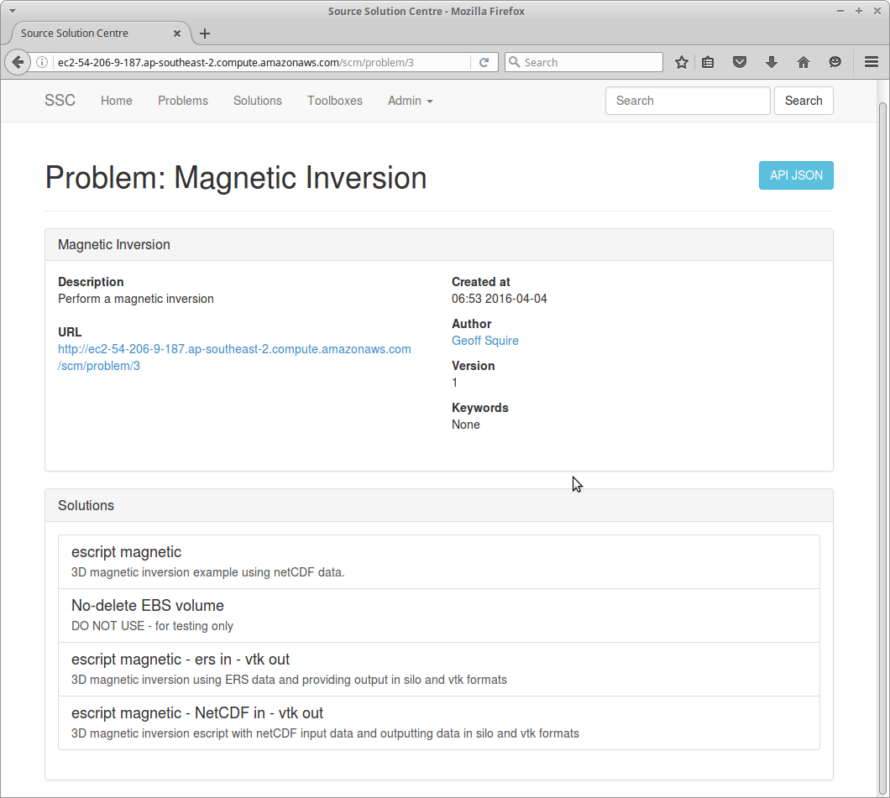
Everyone has problems
Problems:
Descriptive
Classification of entries
Captures what users did
(currently) open to interpretation

Slide 6
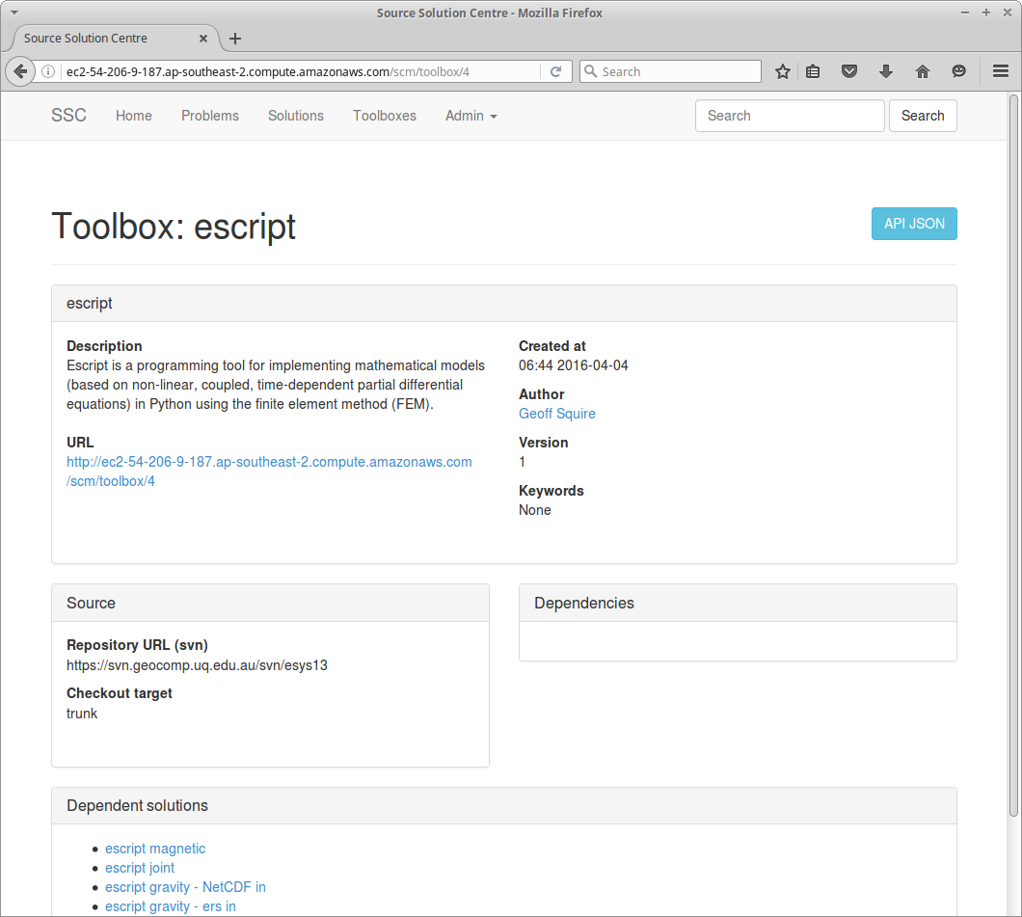
Someone writes software...
Toolboxes:
Describe a software environment
Link to published software
Describe implementation
Puppet module
Snapshot in the cloud
Dependencies
Dependencies can be:
Toolbox(es)
Python modules on PyPI
Puppet modules on PuppetForge

Slide 7
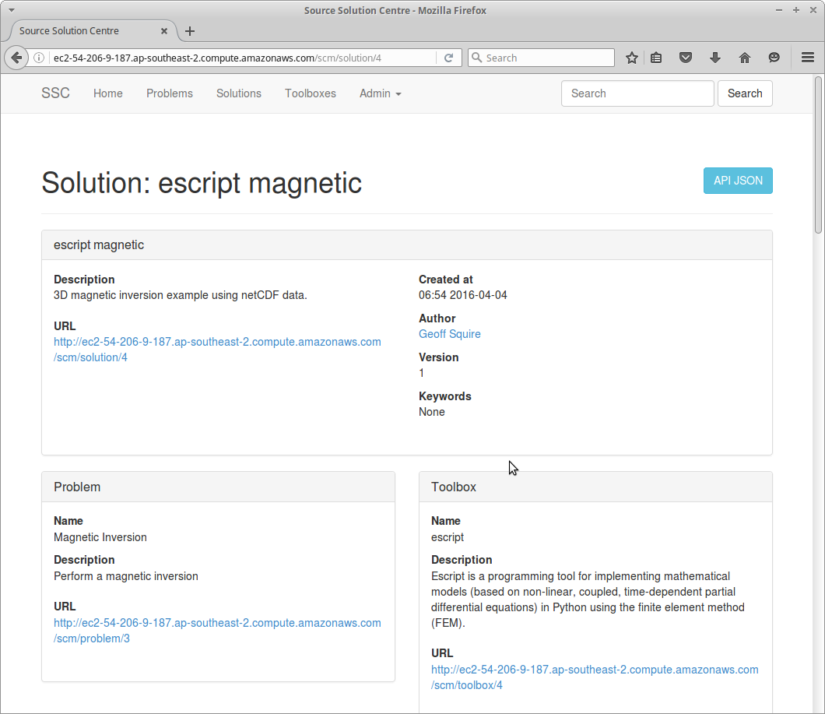
...and someone solves a problem.
Solutions:
Describe a specific workflow
Solve a Problem
Depend on Toolbox(es)
Link to template
Published in the usual way
Implements the method
Specify inputs and outputs

Slide 8
Useful solutions are the best kind
Solution Centre enables clients to:
Find relevant solution(s)
Assemble software environment
Wrangle inputs and outputs
Execute a solution!

Slide 9
Working with VLs
VLs can be clients of the Solution Centre
Published solutions immediately available in VLs
Users select a solution to run
VL generates configuration UI from solution
VL spins up job instance and assembles environment
VL orchestrates job inputs and outputs
Provenance can be recorded
Solution Centre provides basic PROV-O descriptions
Persistent URIs for entries
Prototyped in VHIRL and ANVGL
Openstack (Nectar, NCI) and AWS clouds

Slide 10
Future work with VLs
Other VxLs to follow
More cloud providers
HPC
Parallel or sequential execution on multiple cloud nodes
Automate publishing
WONAMBI to generate solutions
Trustworthiness
Authorisation
Hashing and signing entries
Review process for submissions

Slide 11
Thank you
Data61
Geoffrey Squire Senior Software Engineer
t +61 2 6216 7064
e geoffrey.squire@csiro.au
Mineral Resources
Ryan Fraser Research Manager
t +61 8 6436 8760
e ryan.fraser@csiro.au

