Slide 1
Project Paint Application

Slide 2
Outline
Short description of the project
Explanation
Demo
Color Button
Clear Button
Pen Button
Line Button
Empty and Filled Oval
Empty and Filled Rectangle
Project organization
What was accomplished
Java API/SDK classes and methods
What we have learned during the project
Experience with Java,Eclipse and GitHub
Autohors

Slide 3
Short description of the project
This project is a Paint program
It has some certain options for drawing some specific shapes for example:
Circles
Rectangle
Lines
And drawing with pen

Slide 4
Explanation
This application has certain buttons on the left side with which you can choose what do you wan to draw
There is a frame for drawing
And there is a color chooser button

Slide 5
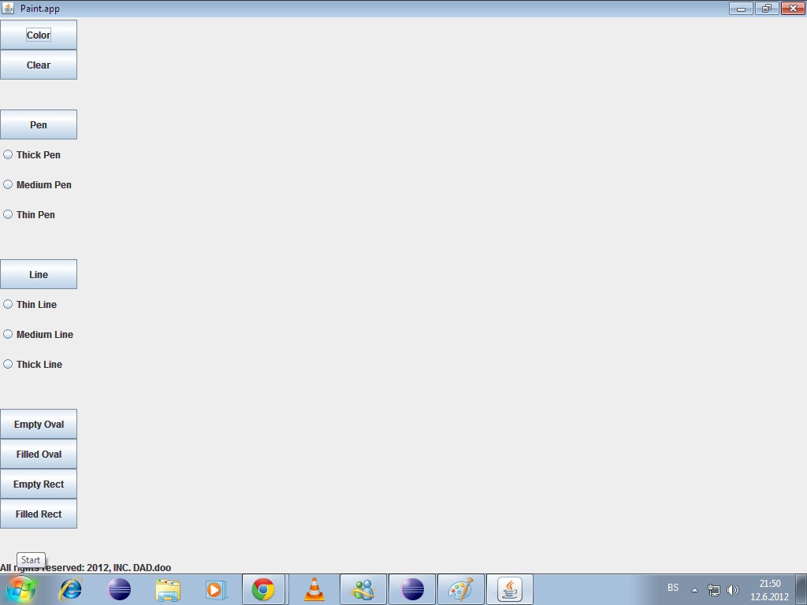

Slide 6
Demo
Paint application

Slide 7
Color Button
On the next slide you will see a picture how you can choose colors for your drawings

Slide 8
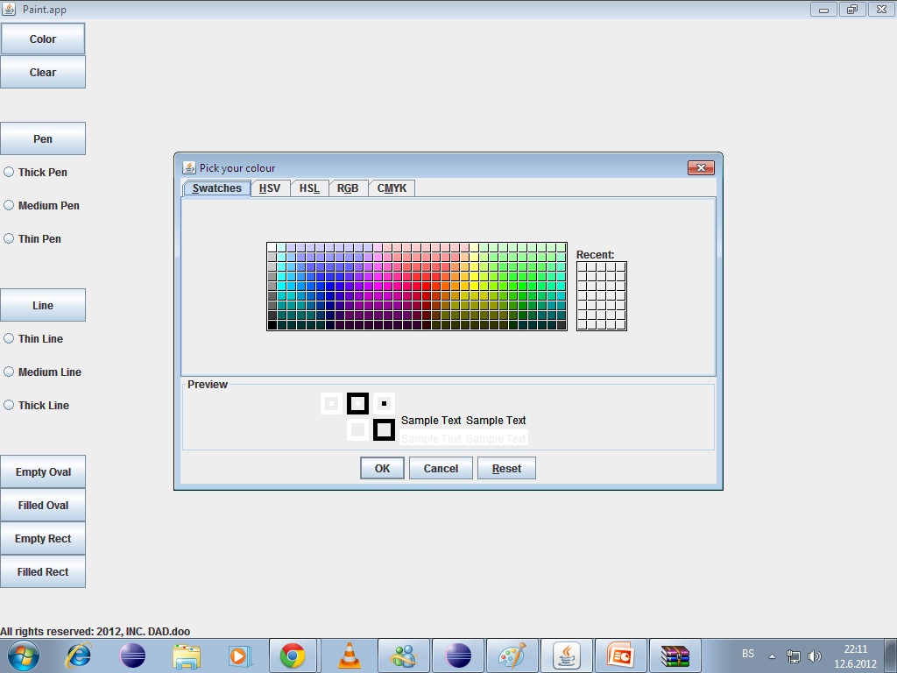

Slide 9
Color Button (cont.)
This is part of the code for this particular part:
public void actionPerformed(ActionEvent e) {
if(e.getActionCommand().equals("Color")) {
Color bgColor = JColorChooser.showDialog(this, "Pick your colour",getBackground());
if (bgColor != null)
gc.setColor(bgColor);
}

Slide 10
Color Button (cont.)
And with this part of the code we created a method that we can call for every object so that we can change colors
public Color getColor() {
Color c = gc.getColor();
gc.setColor(c);
return c;
}

Slide 11
Clear Button
Clear button when pressed is deleating everything drawn on the frame
Part of the code will be shown and explained in further slides

Slide 12
Clear Button Code
case 11: // Clear the frame
repaint();
Color temp = gc.getColor();
gc.setColor(Color.WHITE);
gc.fillRect(0, 0, getWidth(), getHeight()); // clearing the whole
// frame
gc.setColor(temp); // white
repaint();
break;
case 12: // calling to the case 11
if (clear == 1) { // applying the click on the frame clears it
gc.clearRect(xStart, yStart, w, h);
} else {
}
break;

Slide 13
Pen Button
This button when clicked allows you to draw just with dragging the mouse
It has also three options for drawing with thin, medium and thick pen.

Slide 14
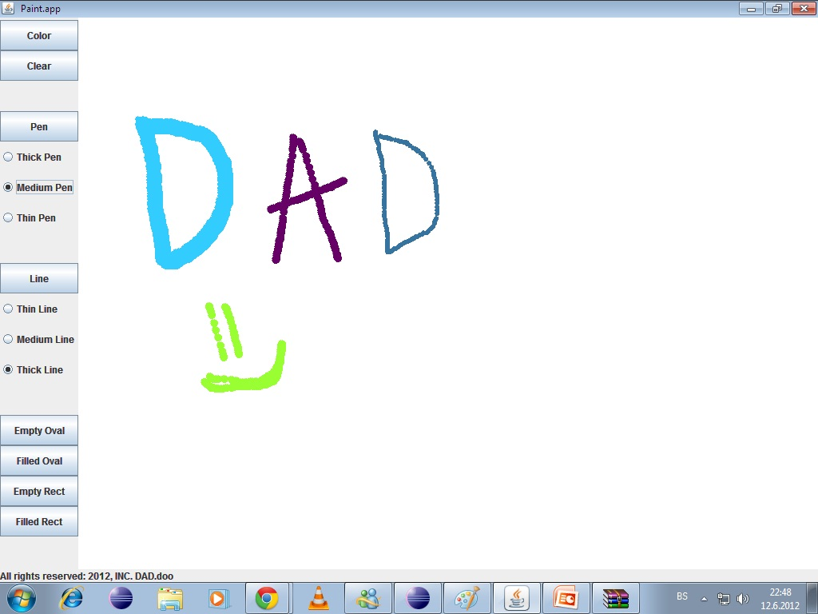

Slide 15
Pen Button Code
class PaintMouseListener extends MouseMotionAdapter {
// mouse dragged events
public void mouseDragged(MouseEvent e) {
switch (choice) {
case 2: // sizes of pen
getColor();
gc.setStroke(new BasicStroke(6));
if (stroke == 3) // thin pen
gc.fillOval(e.getX(), e.getY(), 5, 5);
if (stroke == 4) // medium pen
gc.fillOval(e.getX(), e.getY(), 10, 10);
if (stroke == 5) // thick pen
gc.fillOval(e.getX(), e.getY(), 20, 20);
gc.fillOval(e.getX(), e.getY(), 6, 6); // pen buttons
repaint(); // repainting the frame
break;
}
}
}

Slide 16
Line Button
When this button is clicked you can draw a line
Also in this part you can choose which type of a line you wan to use weather it is thick, medium or eaven thin

Slide 17
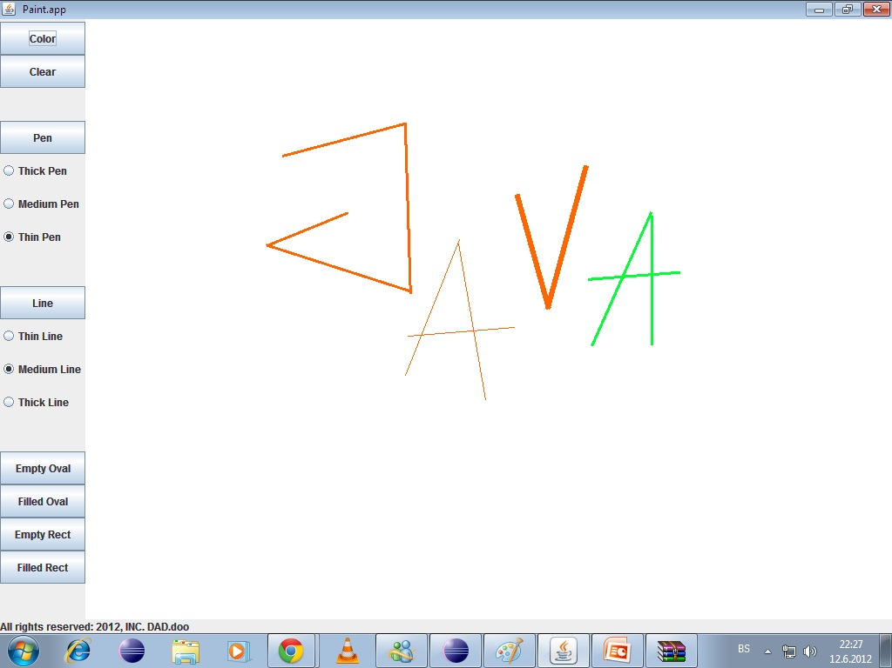

Slide 18
Line Button Code
switch (getChoice()) {
case 3:
getColor();
gc.setStroke(new BasicStroke(6)); // Changes the width and size of
// the mouse stroke, point
if (getStroke() == 0)
gc.setStroke(new BasicStroke(1)); // thin line
if (getStroke() == 1)
gc.setStroke(new BasicStroke(3)); // medium line
if (getStroke() == 2)
gc.setStroke(new BasicStroke(6)); // thick line
gc.drawLine(xStart, yStart, xEnd, yEnd); // drawing the actual line
repaint();
break;

Slide 19
Empty And Filled Oval Buttons
These buttons are used for drawing filled and empty ovals anywhere in the screen
Implementation of these two shapes were maybe the easiest part of the project

Slide 20
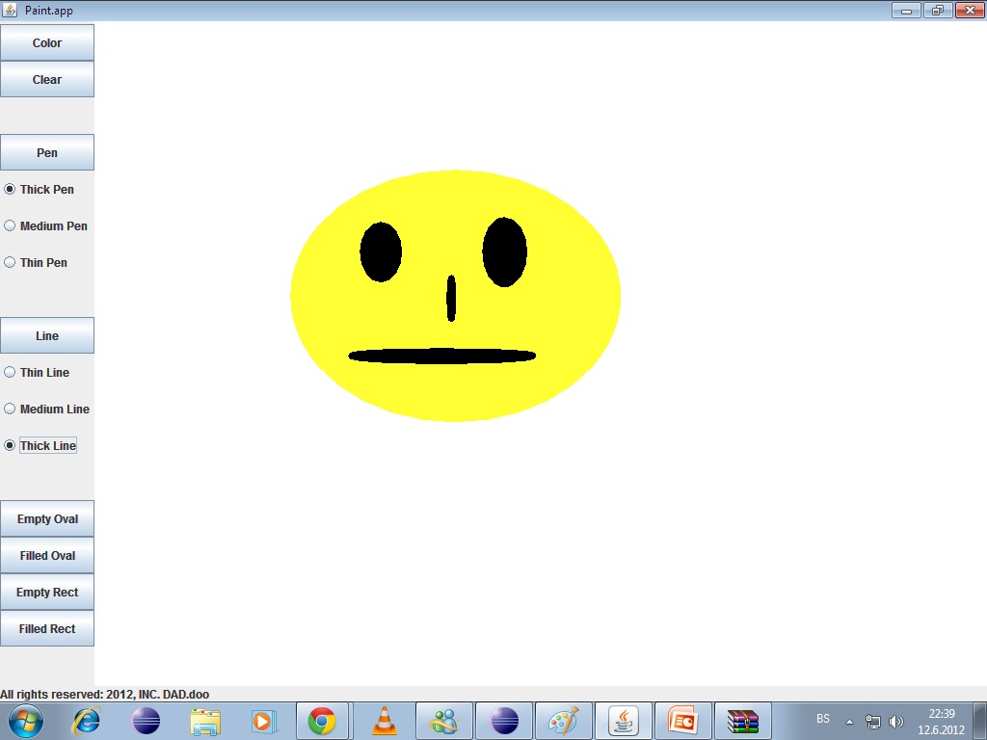

Slide 21
Empty Oval Code
Filled Oval Code
case 7: // drawing empty oval
getColor();
gc.setStroke(new BasicStroke(6));
gc.drawOval(xStart, yStart, w, h);
repaint();
break;
case 9:// drawing filled oval
getColor();
gc.setStroke(new BasicStroke(6));
gc.drawOval(xStart, yStart, w, h);
gc.fillOval(xStart, yStart, w, h);
repaint();
break;

Slide 22
Empty Rectangle and Filled Rectangle Buttons
These buttons allows you to draw rectangles with different colores, weather they are filled or empty

Slide 23
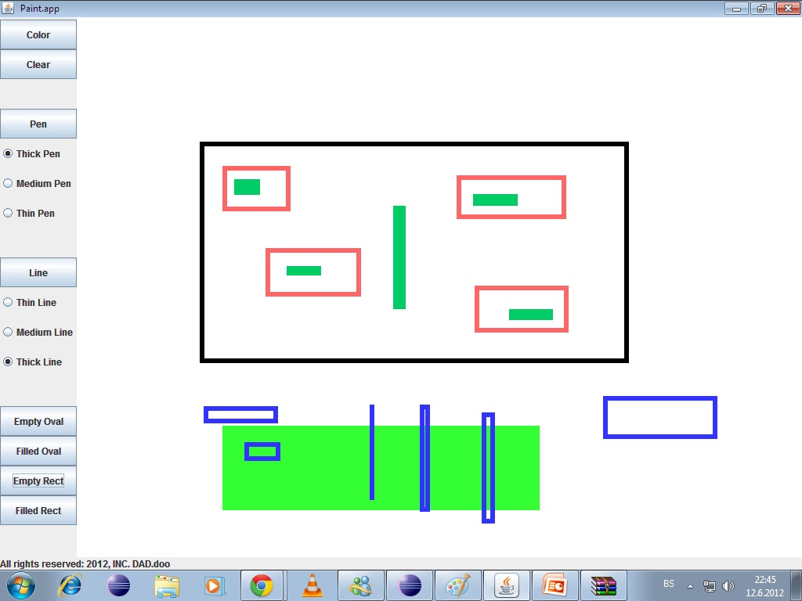

Slide 24
Empty Rectangle Code
Filled Rectangle Code
case 8: // drawing empty rectangle
getColor();
gc.setStroke(new BasicStroke(6));
gc.drawRect(xStart, yStart, w, h);
repaint();
break;
case 10: // drawing filled rectangle
getColor();
gc.setStroke(new BasicStroke(6));
gc.drawRect(xStart, yStart, w, h);
gc.fillRect(xStart, yStart, w, h);
repaint();
break;

Slide 25
Project Organization
Dina:
Implementing buttons
Method Paint Component()
Implementing pen options
Setting actionPreformed method
Dino:
Implementing methods mouseReleased() and mousePressed()
Method getColor()
PaintComponent ()
Global Class
Amela:
PaintComponent()
Test class
Implementing methods check()
Implementing method draw()

Slide 26
What was accomplished?
With our team work and working hard on this project, we accomplished to finish the main parts of the project before deadline, and just to make couple of things for better look of the program in the end.

Slide 27
Java API/SDK classes and methods
Java.awt - Contains all of the classes for creating user interfaces and for painting graphics and images.
Classes we used inside Java.awt package:
BasicStroke;
BorderLayout;
Color;
Cursor;
Dimension;
Graphics2D;
GridLayout;
Graphics;
event.ActionEvent, ActionListener, MouseEvent, MouseListener, MouseMotionAdapter, MouseMotionListener, BufferedImage;
For more info on purposes of each class visit:
<http://docs.oracle.com/javase/1.4.2/docs/api/java/awt/package-summary.html>

Slide 28
Java API/SDK classes and methods
Javax.swing - Provides a set of "lightweight" (all-Java language) components that, to the maximum degree possible, work the same on all platforms.
Classes we used inside Javax.swing package:
Box;
ButtonGroup;
JButton;
JColorChooser;
JFrame;
JPanel;
JRadioButton;
For more info on purposes of each class visit:
<http://docs.oracle.com/javase/1.4.2/docs/api/javax/swing/package-summary.html >

Slide 29
What we have learned during the project
We have learned following things:
Team work is more efficient than solo work if properly planned, organized and executed
Java especially offers wide range of options of which whom one member can not easily found and explore; team work enables members to focus on different things exploring java
Large and complex projects are far more time consuming; deadline awareness among team members is crucial

Slide 30
Experience with Java, Eclipse and GitHub
Java is a very easy programming language, and it has so many already implemented methods that will ease our work
Eclipse is very approachable and easy to work with
GitHub-to complicated, but it was nice thing to see what your collegues had done on project since last time you have pushed it

Slide 31
Questions?

Slide 32
Thank you for your attention!

Slide 33
Team
Bektaš Dino
Hadžić Dina
Hajdarević Amela

