Slide 1



Slide 2



Welcome
Formed in 1965, the CSI has been instrumental in guiding the Indian IT industry down the right path since its formative years. Today, the CSI has 72 chapters all over India, 511 student branches, and more than 1,00,000 members including India's most famous IT industry leaders, brilliant scientists and dedicated academicians.

Slide 3
About CSI
The seed for the Computer Society of India (CSI) was first sown in the year 1965 with a handful of IT enthusiasts who were a computer user group and felt the need to organize their activities. They also wanted to share their knowledge and exchange ideas on what they felt were a fast emerging sector. Today the CSI takes pride in being the largest and most professionally managed association of and for IT professionals in India. The purposes of the Society are scientific and educational directed towards the advancement of the theory and practice of computer science and IT.

Slide 4
About CSI (contd..)
The organization has grown to an enviable size of 1,00,000 strong members consisting of professionals with varied backgrounds including Software developers, Scientists, Academicians, Project Managers, CIO's , CTO's & IT vendors to just name a few. It has spread its branches all over the country. Currently having more than 500 student branches and rooted firmly at 73 different locations, CSI has plans of opening many more chapters & activity centers in smaller towns and cities of the country. The idea is to spread the knowledge, and provide opportunities to as many interested as possible.

Slide 5
Mission Statement
The mission of CSI is to facilitate research, knowledge sharing, learning and career enhancement for all categories of IT Professionals, while simultaneously inspiring and nurturing new entrants into the industry and helping them to integrate into the IT community. The CSI is also working closely with other industry associations, government bodies and academia to ensure that the benefits of IT advancement ultimately percolate down to every single citizen of India.

Slide 6
Mission Statement (contd..)
To help achieve these goals, the CSI has several Special Interest Groups (SIG's), and various initiatives pertaining to affordable computing and the spread of computer literacy.
As a member of the CSI, you will have the satisfaction of knowing that your participation is channeled into accomplishing these noble objectives. While you gain professionally through the CSI’s myriad activities, you also automatically repay to society, in no small measure, the personal enrichment and glory that the IT industry has enabled for you and your family over the years.

Slide 7
Vision Statement
Keeping in mind the interest of the IT professionals & computer users, CSI works towards, making the profession an area of choice amongst all sections of the society. The promotion of Information Technology as a profession is the top priority of CSI today. To fulfill this objective, the CSI regularly organizes conferences, conventions, lectures and gives various awards. And at the same time it also ensures that regular training and skill updation are organized for the IT professionals. CSI also works towards a global approach, by seeking out alliances with organizations overseas who may be willing to come forward and participate in such activities. CSI also helps governments in formulating IT strategy & planning.

Slide 8
Trivandrum Chapter
The activities of the Computer Society of India started in the city of Trivandrum with the annual convention of Computer Society of India CSI 69 in January 1969

Slide 9
Trivandrum Chapter
Activities:
CSI- Trivandrum Chapter along with other sister Professional Organizations in the city, given below, arrange technical talks, by experts in all fields of Engineering/Science and Technology and Management, in Visvesvaraya Bhavan (Institution of Engineers), Thiruvananthapuram, at 5:45 P.M. on every Wednesday of the week. The participant professional bodies are:-
The Institution of Engineers (India), Kerala State Centre
Aeronautical Society of India, Trivandrum Branch
IEEE Kerala Section
IETE Thiruvananthapuram Local Centre
Indian National Society for Aerospace and Related Mechanisms, Thiruvananthapuram Chapter
Project Management Institute – Trivandrum - Kerala Chapter
Systems Society of India, Thiruvananthapuram Chapter
Society of Aerospace Manufacturing Engineers, Thiruvananthapuram

Slide 10
Trivandrum Chapter
The Chapter gives the following awards to the students of local Engineering Colleges every year on the occasion of the annual general body meeting. All the awards carry certificates and cash.
Prof. R. Venkitakrishna Iyer Memorial Award
Prof. S. Krishnan Kutty Memorial Award
Best Student Project Award
Address:
CSI Trivandrum Chapter, Cherian's Square
Ambujavilasam Road, Thiruvananthapuram
Kerala, India
695 001
email: csitvm@dataone.in / csitvm@gmail.com
ph:0471-2479282
For more information visit: http://www.csi-india.org/web/trivandrum-chapter

Slide 11
Trivandrum Chapter
The Chapter gives the following awards to the students of local Engineering Colleges every year on the occasion of the annual general body meeting. All the awards carry certificates and cash.
Prof. R. Venkitakrishna Iyer Memorial Award
Prof. S. Krishnan Kutty Memorial Award
Best Student Project Award
Address:
CSI Trivandrum Chapter, Cherian's Square
Ambujavilasam Road, Thiruvananthapuram
Kerala, India
695 001
email: csitvm@dataone.in / csitvm@gmail.com
ph:0471-2479282
For more information visit: http://www.csi-india.org/web/trivandrum-chapter

Slide 12


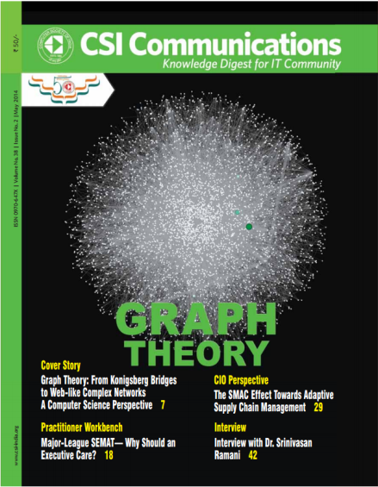
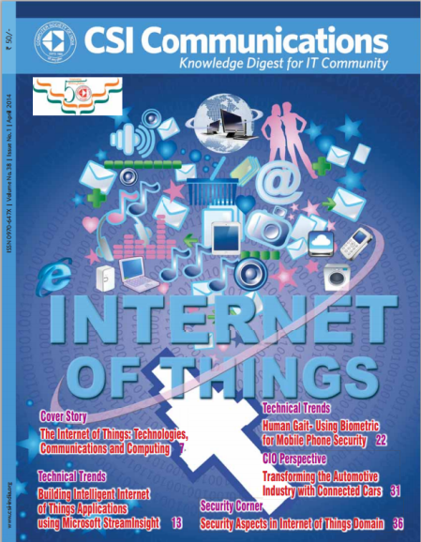
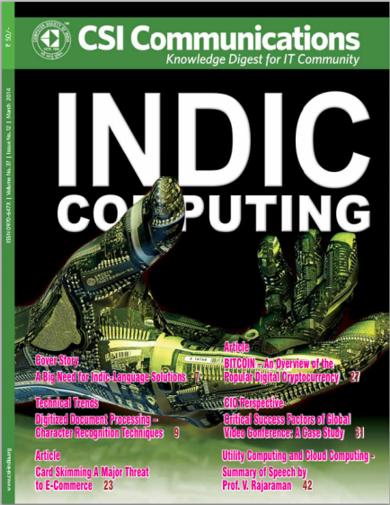
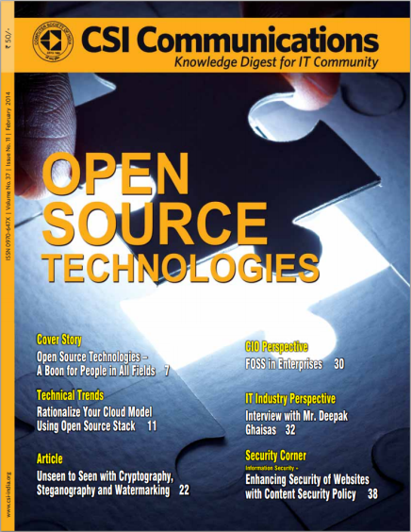
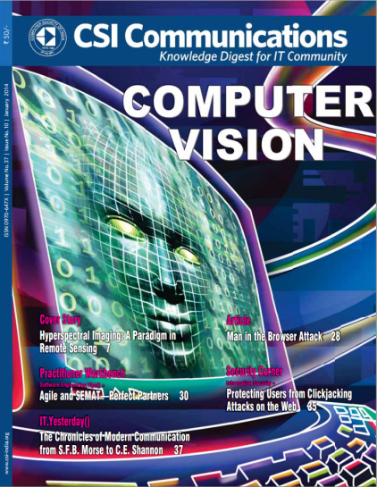

CSI Communications

