Slide 1
Loan Eligibility
By: Caitlin Sizemore

Slide 2
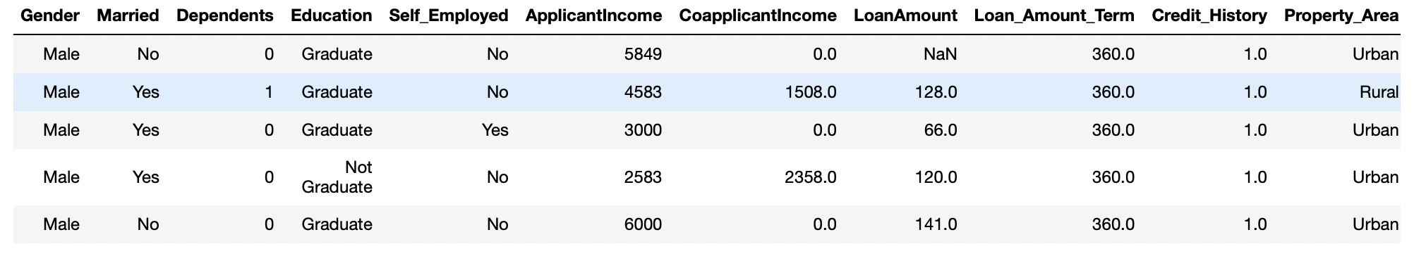
Dataset
Predicts: Loan eligibility
Based on applicant information and loan request information
Purpose: Apply logistic regression model to automate the loan eligibility process
614 entries
6 discrete variables
5 continuous variables
Reason: As a young adult who will be applying for loans, knowing this process is important

Slide 3
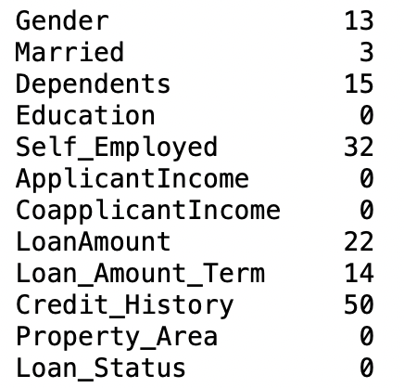
Preparation
Remove “Loan_ID” column
Unique key to identify each loan – no relation to eligibility
7 columns containing missing values
4 discrete: Impute with mode
3 continuous: Impute with median
pd.get_dummies
Assign numerical values to categorical data

Slide 4
Steps and Experiments
Determine
Determine Independent and Dependent
Dependent=Loan_Status
Split
Split into Train and Test
Apply
Apply LogisticRegression
max_iter=1000
Experiment 1: 80/20 split
Experiment 2: 75/25 split
Experiment 3: 65/35 split

Slide 5
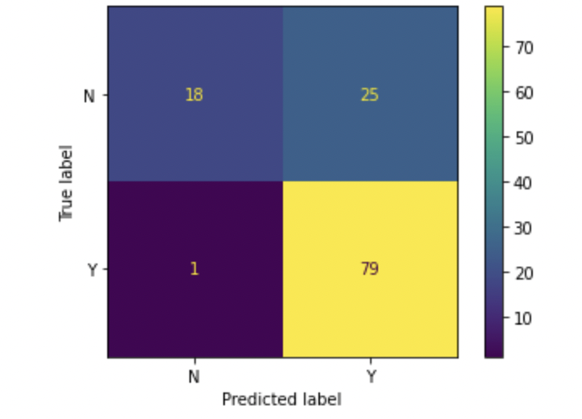
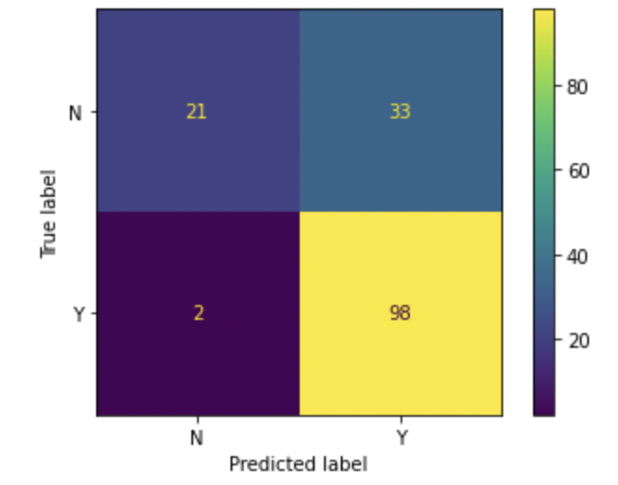
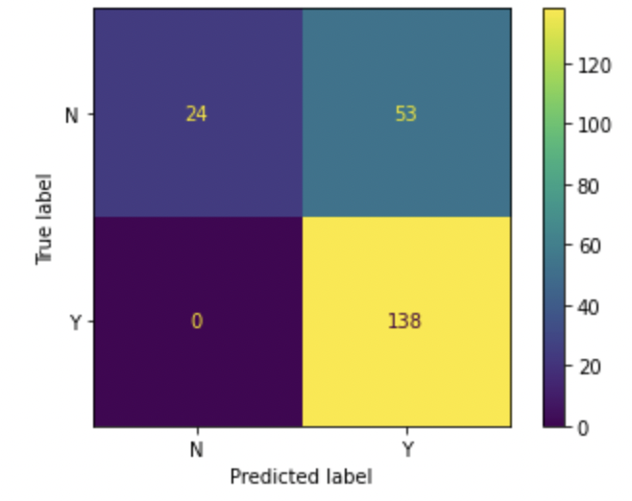
Results
Experiment 1:
Accuracy: 79%
Experiment 2:
Accuracy: 77%
Experiment 3:
Accuracy: 75%
Problems Encountered: False Positive 2nd highest prediction for each

Slide 6
Conclusion
Logistic Regression model applied to predict loan eligibility
Based upon 11 variables describing applicant information and loan request information
Required the removal of one column and the imputation of 7 other columns
3 experiments tested of varying splits
Overall accuracy of 75%+
Confusion matrices were largely successful despite the False Positives

