Slide 1


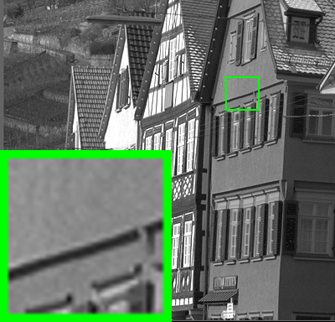
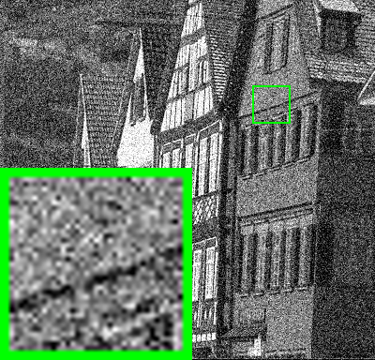
Multi-channel Weighted Nuclear Norm Minimization for Real Color Image Denoising Jun Xu¹, Lei Zhang¹, David Zhang¹, Xiangchu Feng² 1 Department of Computing, Hong Kong Polytechnic University, Hong Kong, China 2 Department of Applied Mathematics, Xidian University, Xi’an, China
Insights
One Fact: The noise in standard RGB (sRGB) space has different variances for different channels.
New Solution: Introduce weight matrix to balance the noise difference in different channels.

