Slide 1



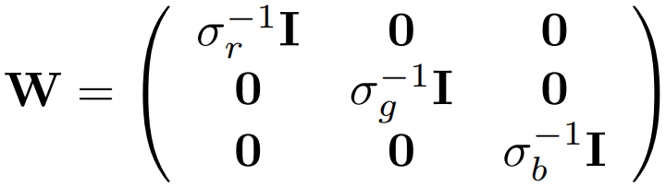
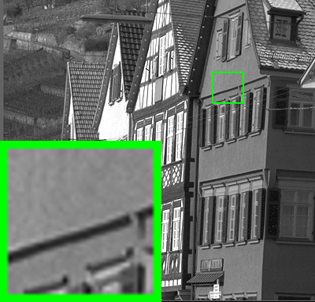
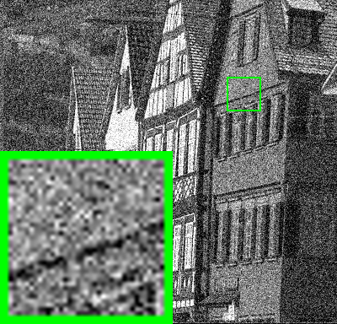
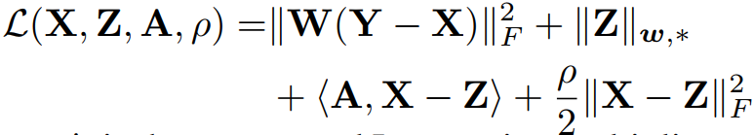
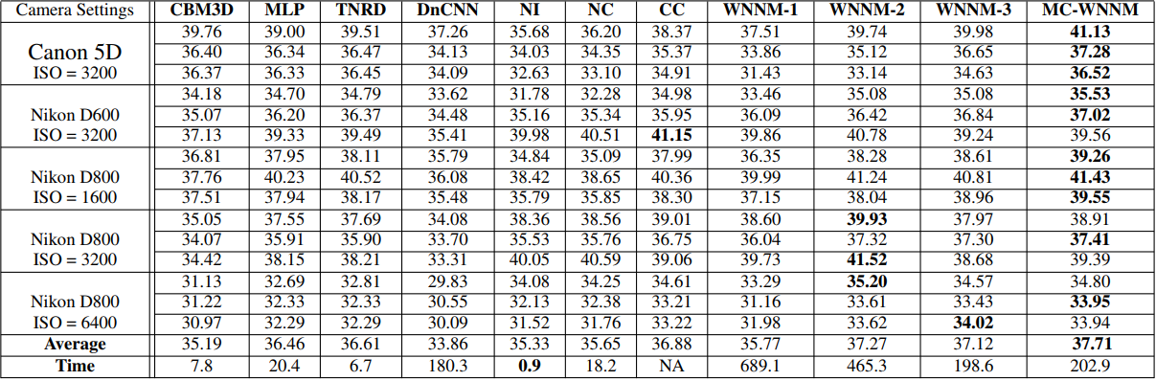
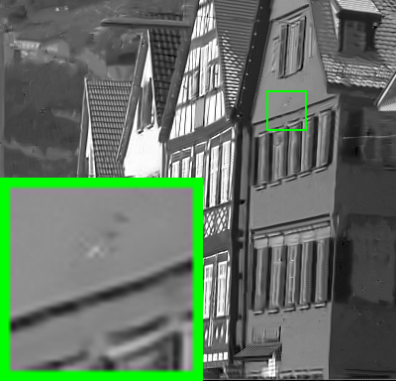




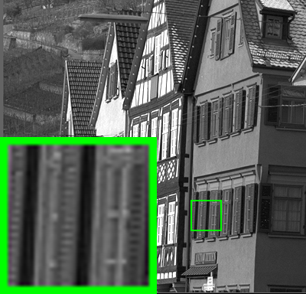

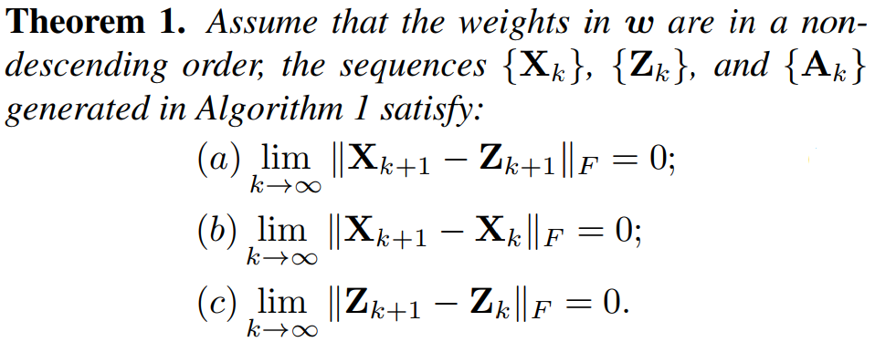
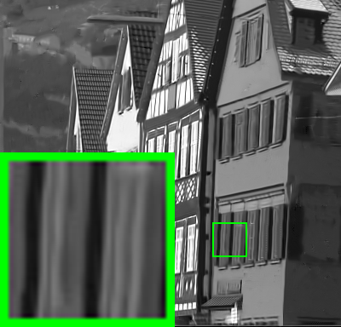

Multi-channel Weighted Nuclear Norm Minimization for Real Color Image Denoising Jun Xu¹, Lei Zhang¹, David Zhang¹, Xiangchu Feng² 1 Department of Computing, Hong Kong Polytechnic University, Hong Kong, China 2 Department of Applied Mathematics, Xidian University, Xi’an, China
Insights
The MCWNNM Model
Experiments
One Fact: Noise in sRGB space has different variances for different channels.
Model:
PSNR Results on Kodak 24
CBM3D | MLP | TNRD | DnCNN
27.13 | 28.54 | 28.68 | 20.58
NI | NC | WNNM | MCWNNM
25.24 | 26.19 | 28.84 | 29.31
Solution: Introduce weights to balance the noise difference in different channels.
Weights:
Variable Splitting:
Lagrangian:
PSNR Results on Real Color Images
ADMM:
Convergency:

