Slide 1



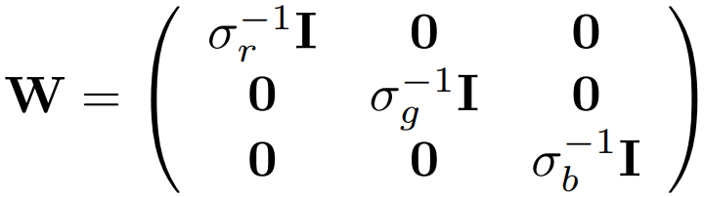
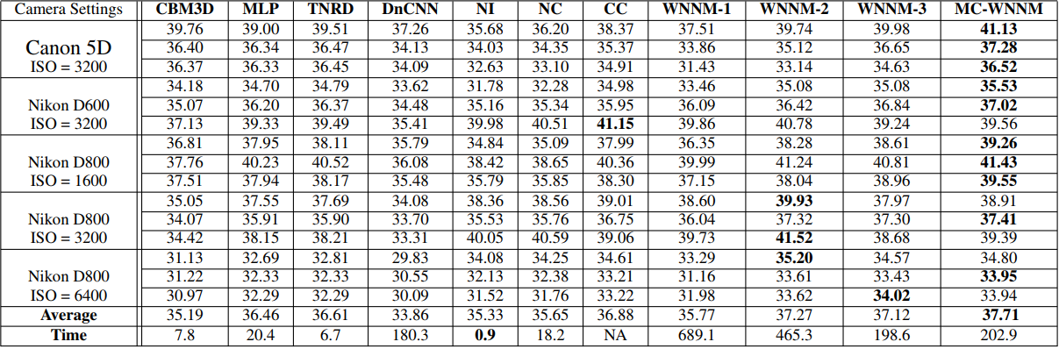
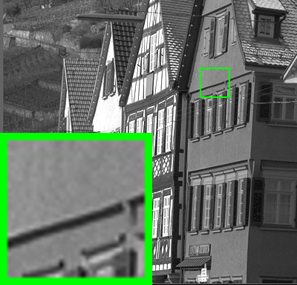
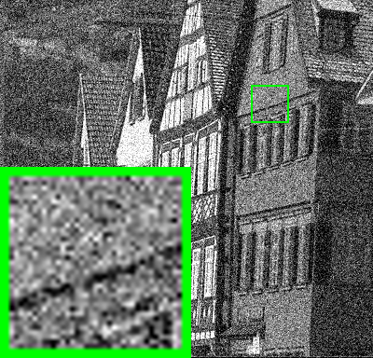
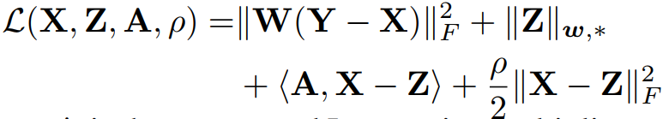
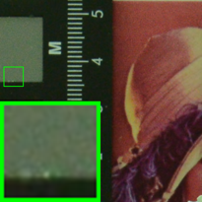

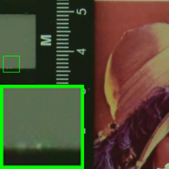
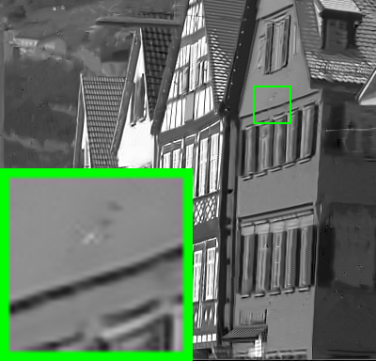



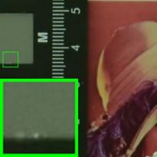
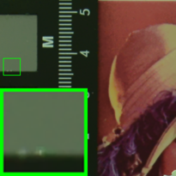


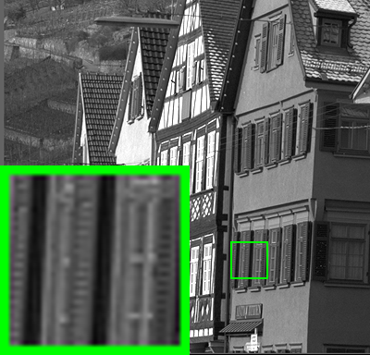




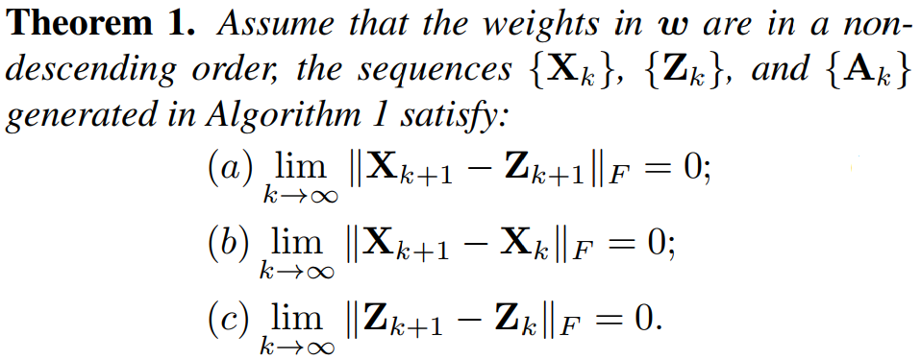
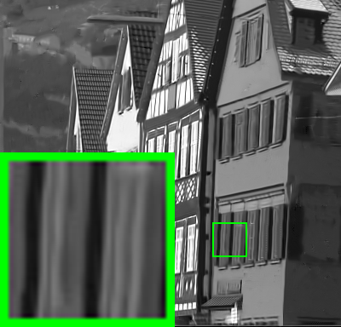


Multi-channel Weighted Nuclear Norm Minimization for Real Color Image Denoising Jun Xu¹, Lei Zhang¹, David Zhang¹, Xiangchu Feng² 1 Department of Computing, Hong Kong Polytechnic University, Hong Kong, China 2 Department of Applied Mathematics, Xidian University, Xi’an, China
Insights
The MCWNNM Model
Experiments
One Fact: Noise in sRGB space has different variances for different channels.
Model:
PSNR Results on Real Color Images
Solution: Introduce weights to balance the noise difference in different channels.
Weights:
Variable Splitting:
Lagrangian:
Visual Quality Comparison
ADMM:
CBM3D 37.76dB
TNRD 40.52dB
NC 38.65dB
Convergency:
NI 38.42dB
CC 40.36dB
WNNM2 41.24dB
WNNM3 40.81dB
MCWNNM 41.24dB
Mean Image
Matlab Code & More Details
Available @ Github

