Slide 1



An Unsupervised Approach for Discovering Relevant Tutorial Fragments for APIs
Reporter: Jingxuan Zhang
Dalian University of Technology, China
May. 2017
He Jiang, Jingxuan Zhang, Zhilei Ren, and Tao Zhang. An Unsupervised Approach for Discovering Tutorial Fragments Explaining APIs. In Proc. of 39rd IEEE International Conference on Software Engineering (ICSE'17), 2017.

Slide 2
Agenda
1
Introduction
2
Framework
3
Experimental Setup
4
Experimental Results
5
Conclusion

Slide 3
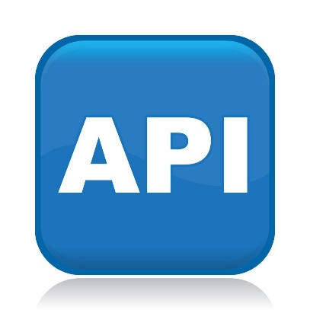
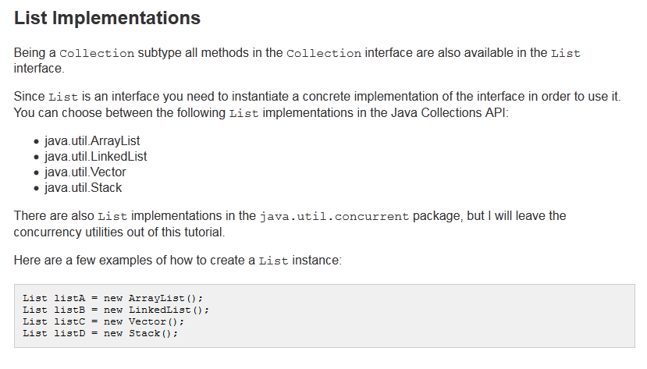


Introduction
It is critical for developers to search and use APIs in existing libraries and frameworks properly.
API Reuse
API tutorial is one of the most important API documents.
API Tutorial
Explanation
Code Example
How to recommend relevant API tutorial fragments explaining unfamiliar APIs?
Problem

Slide 4
Introduction
Related Work
Challenges:
Pronoun and variable resolution. Pronouns and variables are widely used in API tutorials, and they may be ambiguous.
Non-explanatory fragment identification. 10% ~ 50% fragments belong to non-explanatory fragments.
Existing Approaches:
 | IR¹ | GMR¹ | FITSEA²
Input | Unfamiliar APIs
Output | Relevant API tutorial fragments explaining unfamiliar APIs
Method | Information Retrieval | Text Classification | Text Classification
Details | Cosine similarities are calculated between fragments and API specifications. | Twenty features are defined to measure linguistic and structural characteristics between fragments and APIs. | It introduces some new sources to extend APIs. Besides, co-occurrence APIs are proposed.
Drawbacks | Precision is low | Different corpora require their corpus-specific annotated data. The effectiveness of supervised approaches depends on the features.
REF:
1. G. Petrosyan, M. P. Robillard, and R. de. Mori, “Discovering Information Explaining API Types using Text Classification,” In Proceedings of the 37th International Conference on Software Engineering (ICSE 15), 2015, pp. 869-879.
2. H. Jiang, J. X. Zhang, X. C. Li, et al. “A More Accurate Model for Finding Tutorial Segments Explaining APIs,” In Proceedings of the 23rd IEEE International Conference on Software Analysis, Evolution, and Reengineering (SANER 16), 2016, pp. 157-167.

Slide 5
Agenda
1
Introduction
2
Framework
3
Experimental Setup
4
Experimental Results
5
Conclusion

Slide 6
Framework
Model: We propose an unsupervised approach, i.e., Fragment Recommender for APIs with PageRank and Topic model (FRAPT).
Details: FRAPT consists of two phases, namely the Relevance Discovery Phase and the Fragment Recommendation Phase.
Tutorials
Unfamiliar APIs
Relevant Fragments for Unfamiliar APIs
Relevance Discovery Phase: This phase aims to find the relevance between fragments and APIs.
1
2
Tutorial Segmentation
API Discovery
Pronoun & Variable Resolution
Relevant Fragment Recommender
Fragments
Sentence Type Identification
Sentence Identification
Fragment Parser
Fragment Recommendation Phase: The goal of this phase is to recommend relevant fragments for the unfamiliar APIs queried by developers.
Relevance Between fragments and APIs
Parsed
Fragments
Topic Based Correlation Score Calculation
Topic Based Scores
Fragment Filter
Retained Fragments
Relevance Identification
PageRank Based Correlation Score Calculation
1
Relevance Discovery Phase
PageRank Based Scores
2
Fragment Recommendation Phase
FRAPT

Slide 7
Framework
Tutorial Segmentation
Goal:
Segment tutorials into coherent fragments.
Tutorials
Unfamiliar APIs
Relevant Fragments for Unfamiliar APIs
1
2
Tutorial Segmentation
API Discovery
Pronoun & Variable Resolution
Procedure:
Relevant Fragment Recommender
Fragments
We split tutorials into a series of paragraphs.
We iteratively merge sibling paragraphs until the length of the paragraphs reaches within a specified range (100 words to 300 words).
Sentence Type Identification
Sentence Identification
Fragment Parser
Relevance Between fragments and APIs
Parsed
Fragments
Topic Based Correlation Score Calculation
Topic Based Scores
Fragment Filter
Retained Fragments
Relevance Identification
PageRank Based Correlation Score Calculation
1
Relevance Discovery Phase
PageRank Based Scores
2
Fragment Recommendation Phase
FRAPT

Slide 8
Framework
Fragment Parser
Goal:
Detect APIs, resolve pronouns in sentences and variables in code examples, and identify sentences with their types.
Tutorials
Unfamiliar APIs
Relevant Fragments for Unfamiliar APIs
1
2
Tutorial Segmentation
API Discovery
Pronoun & Variable Resolution
Procedure:
Relevant Fragment Recommender
Fragments
Detect APIs surrounded by <href> tags.
Replace all the pronouns and variables with their ontologies and APIs.
Detect sentence boundaries to identify sentences.
Define two sentence types, i.e. marginal sentences and principal sentences.
Sentence Type Identification
Sentence Identification
Fragment Parser
Relevance Between fragments and APIs
Parsed
Fragments
Topic Based Correlation Score Calculation
Topic Based Scores
Fragment Filter
Retained Fragments
Relevance Identification
PageRank Based Correlation Score Calculation
1
Relevance Discovery Phase
PageRank Based Scores
2
Fragment Recommendation Phase
FRAPT

Slide 9
Framework
Fragment Filter
Goal:
Filter out those non-explanatory fragments which do not explain any APIs by some detection rules.
Tutorials
Unfamiliar APIs
Relevant Fragments for Unfamiliar APIs
1
2
Tutorial Segmentation
API Discovery
Pronoun & Variable Resolution
Detection Rules:
Relevant Fragment Recommender
Fragments
Non-explanatory fragments usually contain only one API, and this API appears only once.
The lengths of non-explanatory fragments are usually less than five sentences.
The proportion of sentences containing APIs is less than 20% in non-explanatory fragments.
All the APIs in non-explanatory fragments only appear in marginal sentences.
Non-explanatory fragments have some good indicator terms and phrases.
Sentence Type Identification
Sentence Identification
Fragment Parser
Relevance Between fragments and APIs
Parsed
Fragments
Topic Based Correlation Score Calculation
Topic Based Scores
Fragment Filter
Retained Fragments
Relevance Identification
PageRank Based Correlation Score Calculation
1
Relevance Discovery Phase
PageRank Based Scores
2
Fragment Recommendation Phase
FRAPT

Slide 10
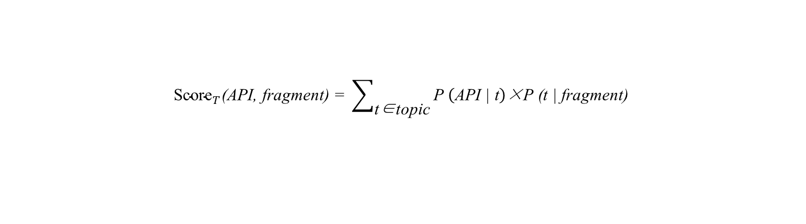
Framework
Topic Based Correlation Score Calculation
Goal:
Achieve a correlation score between fragments and APIs according to the results of topic model.
Tutorials
Unfamiliar APIs
Relevant Fragments for Unfamiliar APIs
1
2
Tutorial Segmentation
API Discovery
Pronoun & Variable Resolution
Procedure:
Relevant Fragment Recommender
Fragments
Each tutorial fragment is treated as a document to put into LDA.
LDA outputs the topic probability distribution for each fragment as well as the term probability distribution for each topic.
Sentence Type Identification
Sentence Identification
Fragment Parser
Relevance Between fragments and APIs
Parsed
Fragments
Topic Based Correlation Score Calculation
Topic Based Scores
Fragment Filter
Retained Fragments
Relevance Identification
PageRank Based Correlation Score Calculation
1
Relevance Discovery Phase
PageRank Based Scores
2
Fragment Recommendation Phase
FRAPT
$${\text{Score}}_{T}\text{(}\text{API}\text{, }\text{fragment}\text{) = }\sum_{\text{t}\text{∈}\text{topic}}{\text{P} \left(\text{API}\text{ | }\text{t}\right)\text{×}\text{P}\text{ (}\text{t}\text{ | }\text{fragment}\text{)}}$$

Slide 11
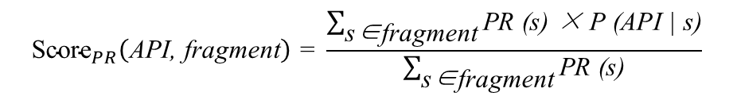
Framework
PageRank Based Correlation Score Calculation
Goal:
Obtain another correlation score
between fragments and APIs based on the PageRank value of
each sentence.
Tutorials
Unfamiliar APIs
Relevant Fragments for Unfamiliar APIs
1
2
Tutorial Segmentation
API Discovery
Pronoun & Variable Resolution
Procedure:
Relevant Fragment Recommender
Fragments
Calculate cosine similarity with TF-IDF term weight between sentences.
Build a directed graph based on sentences and their similarities.
Sentence Type Identification
Sentence Identification
Fragment Parser
Relevance Between fragments and APIs
Parsed
Fragments
Topic Based Correlation Score Calculation
Topic Based Scores
Fragment Filter
Retained Fragments
Relevance Identification
PageRank Based Correlation Score Calculation
1
Relevance Discovery Phase
PageRank Based Scores
2
Fragment Recommendation Phase
FRAPT
$${\text{Score}}_{PR}\left(\text{API}\text{, }\text{fragment}\right)\text{ = }\frac{\sum_{\text{s}\text{∈}\text{fragment}}{\text{PR}\text{ (}\text{s}\text{) × }\text{P}\text{ (}\text{API}\text{ | }\text{s}\text{)}}}{\sum_{\text{s}\text{∈}\text{fragment}}{\text{PR}\text{ (}\text{s}\text{)}}}$$
$$\text{P}\text{ (}\text{API}\text{ | }\text{s}\text{) = }\left\{ \begin{aligned}&\text{1 } \text{if} \text{s} \text{contains} \text{API} \\ &\text{0 }\text{if} \text{s} \text{does} \text{not} \text{contain} \text{API}\end{aligned}\right.$$

Slide 12
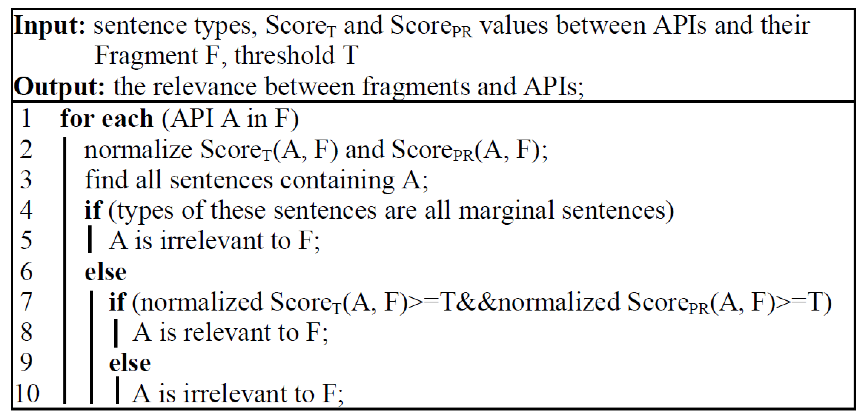
Framework
Relevance Identification
Goal:
Design a relevance identification scheme to detect the relevance between fragments and APIs
Tutorials
Unfamiliar APIs
Relevant Fragments for Unfamiliar APIs
1
2
Tutorial Segmentation
API Discovery
Pronoun & Variable Resolution
Relevance identification scheme:
Relevant Fragment Recommender
Fragments
Sentence Type Identification
Sentence Identification
Fragment Parser
Relevance Between fragments and APIs
Parsed
Fragments
Topic Based Correlation Score Calculation
Topic Based Scores
Fragment Filter
Retained Fragments
Relevance Identification
PageRank Based Correlation Score Calculation
1
Relevance Discovery Phase
PageRank Based Scores
2
Fragment Recommendation Phase
FRAPT
$$T_{0}\text{ = 1 − }\frac{\text{\# }\text{sentences} \text{in} \text{a} \text{tutorial} \text{containing} \text{APIs} \text{and} \text{their} \text{methods}}{\text{\# }\text{all} \text{the} \text{sentences} \text{in} \text{a} \text{tutorial}}$$

Slide 13
Framework
Relevant Fragment Recommender
Goal:
Recommend relevant fragments
for unfamiliar APIs.
Tutorials
Unfamiliar APIs
Relevant Fragments for Unfamiliar APIs
1
2
Tutorial Segmentation
API Discovery
Pronoun & Variable Resolution
Procedure:
Relevant Fragment Recommender
Fragments
Developers input the unfamiliar API into FRAPT.
FRAPT looks up the relevance between fragments and APIs, and recommends relevant tutorial fragments to the developers.
Sentence Type Identification
Sentence Identification
Fragment Parser
Relevance Between fragments and APIs
Parsed
Fragments
Topic Based Correlation Score Calculation
Topic Based Scores
Fragment Filter
Retained Fragments
Relevance Identification
PageRank Based Correlation Score Calculation
1
Relevance Discovery Phase
PageRank Based Scores
2
Fragment Recommendation Phase
FRAPT

Slide 14
Agenda
1
Introduction
2
Framework
3
Experimental Setup
4
Experimental Results
5
Conclusion

Slide 15
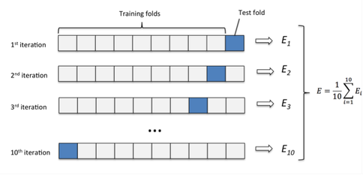
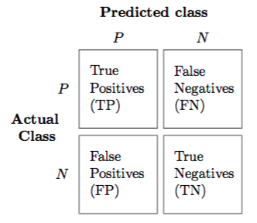

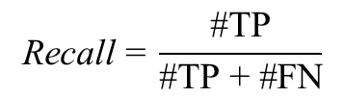
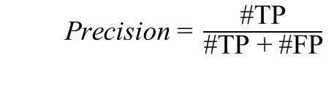
Experimental Setup
1. Tutorial Corpora
McGill corpus consists of five tutorials and Android corpus is composed of four tutorials. These corpora have been manually annotated into relevant and irrelevant fragments with their APIs.
Corpus | Tutorial | API | Explanatory fragment | Non-explanatory fragment | Fragment with code | Fragment without code
McGill Corpus | JodaTime | 36 | 19 | 10 | 21 | 8
 | Math Library | 73 | 31 | 10 | 16 | 25
 | Col. Official | 59 | 31 | 26 | 17 | 40
 | Col. Jenkov | 28 | 34 | 35 | 42 | 27
 | Smack | 40 | 42 | 5 | 31 | 16
Android Corpus | Graphics | 70 | 26 | 12 | 19 | 19
 | Resources | 63 | 40 | 6 | 34 | 12
 | Data | 37 | 18 | 7 | 9 | 16
 | Text | 31 | 12 | 12 | 10 | 14
2. Baseline Approach
IR: uses an Information Retrieval method to find relevant fragments for APIs
GMR: is the first work to find relevant fragments for APIs
FITSEA: is the state-of-the-art method to find relevant fragments for APIs
3. Evaluation Method & Metrics
$\text{Precision} \text{=} \frac{\text{\#}\text{TP}}{\text{\#}\text{TP} \text{+}\text{ \#}\text{FP}}$
$$\text{Recall} \text{=} \frac{\text{\#}\text{TP}}{\text{\#}\text{TP} \text{+}\text{ \#}\text{F}\text{N}}$$
$$\text{F}\text{−}\text{Measure}\text{ = }\frac{\text{2 × }\text{Precision}\text{ × }\text{Recall}}{\text{Precision}\text{ + }\text{Recall}}$$

Slide 16
Agenda
1
Introduction
2
Framework
3
Experimental Setup
4
Experimental Results
5
Conclusion

Slide 17
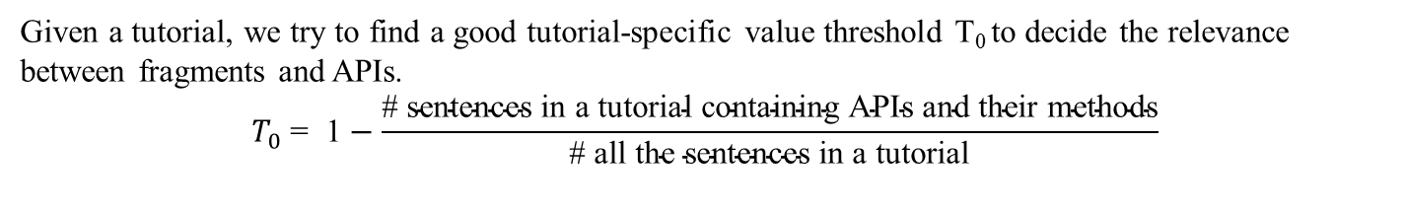
Experimental Results
RQ1: How does the threshold T influence FRAPT’s performance?
Given a tutorial, we try to find a good tutorial-specific value threshold T₀ to decide the relevance between fragments and APIs.
$$T_{0}\text{ = }\text{1}−\frac{\text{\# }\text{sentences} \text{in} \text{a} \text{tutorial} \text{containing} \text{APIs} \text{and} \text{their} \text{methods}}{\text{\# }\text{all} \text{the} \text{sentences} \text{in} \text{a} \text{tutorial}}$$
Precision shows upward trends
Recall shows downward trends
F-Measure is relatively stable
The threshold T may influence the performance of FRAPT.
The tutorial-specific threshold T0 is close to the optimal value.

Slide 18
Experimental Results
RQ2: To what extent is FRAPT superior to the three baseline approaches over the two tutorial corpora?
FRAPT and the three baseline approaches are implemented and tested over the two tutorial corpora to compare the results.
Corpus | Tutorial | Precision (%) |  |  |  | Recall (%) |  |  |  | F-Measure (%)
 |  | FRAPT | FITSEA | GMR | IR | FRAPT | FITSEA | GMR | IR | FRAPT | FITSEA | GMR | IR
McGill Corpus | JodaTime | 85.19 | 69.00 | 58.82 | 73.00 | 76.67 | 74.17 | 50.00 | 73.00 | 80.70 | 70.24 | 54.05 | 73.00
 | Math Library | 84.78 | 67.89 | 52.00 | 67.00 | 73.58 | 72.70 | 49.06 | 65.00 | 78.79 | 61.53 | 50.49 | 66.00
 | Col. Official | 62.03 | 55.74 | 62.69 | 30.00 | 87.50 | 48.62 | 31.79 | 94.00 | 72.59 | 48.10 | 42.18 | 45.00
 | Col. Jenkov | 61.19 | 90.44 | 82.14 | 33.00 | 97.62 | 85.17 | 58.97 | 88.00 | 75.23 | 85.17 | 68.66 | 48.00
 | Smack | 77.94 | 83.38 | 70.00 | 74.00 | 94.64 | 88.33 | 93.33 | 52.00 | 85.48 | 83.90 | 80.00 | 61.00
Android Corpus | Graphics | 49.21 | 50.42 | 45.60 | 35.80 | 75.61 | 42.52 | 44.50 | 67.44 | 59.62 | 43.73 | 45.04 | 46.77
 | Resources | 65.22 | 75.83 | 55.00 | 40.32 | 66.67 | 66.17 | 21.11 | 55.56 | 65.93 | 66.80 | 30.51 | 46.73
 | Data | 71.43 | 56.52 | 19.29 | 33.33 | 55.56 | 52.00 | 14.76 | 44.00 | 62.50 | 54.17 | 16.72 | 37.93
 | Text | 57.58 | 36.19 | 66.67 | 37.21 | 76.00 | 48.33 | 22.22 | 57.14 | 65.52 | 39.56 | 33.33 | 45.07
As an unsupervised approach, FRAPT can achieve better results than the state-of-the-art supervised approach verified by TFCV.
Considering the advantages of unsupervised approaches, it is a better choice to use FRAPT for discovering relevant tutorial fragments for APIs.

Slide 19
Experimental Results
RQ3: What is the impact of Fragment Filter on detecting non-explanatory fragments and improving results of FRAPT?
We compare FRAPT against a variant of FRAPT, namely FRAPT-Filter which removes Fragment Filter and keeps the other components the same. By comparing FRAPT against FRAPT-Filter, the impact of Fragment Filter can be further shown.
Corpus | Tutorial | Precision (%) |  | Recall (%) |  | F-Measure (%)
 |  | FRAPT | FRAPT-Filter | FRAPT | FRAPT-Filter | FRAPT | FRAPT-Filter
McGill Corpus | JodaTime | 85.19 | 60.00 | 76.67 | 80.00 | 80.70 | 68.57
 | Math Library | 84.78 | 65.63 | 73.58 | 79.25 | 78.79 | 71.79
 | Col. Official | 62.03 | 38.30 | 87.50 | 96.43 | 72.59 | 54.82
 | Col. Jenkov | 61.19 | 37.84 | 97.62 | 100.00 | 75.23 | 54.90
 | Smack | 77.94 | 75.00 | 94.64 | 96.43 | 85.48 | 84.38
Android Corpus | Graphics | 49.21 | 43.24 | 75.61 | 78.05 | 59.62 | 55.65
 | Resources | 65.22 | 61.82 | 66.67 | 75.56 | 65.93 | 68.00
 | Data | 71.43 | 51.52 | 55.56 | 62.96 | 62.50 | 56.67
 | Text | 57.58 | 42.55 | 76.00 | 80.00 | 65.52 | 55.56
McGill Corpus
True Irrelevant | False Irrelevant
66 | 9
Android Corpus
True Irrelevant | False Irrelevant
27 | 9
Fragment Filter can detect a great number of non-explanatory fragments at the cost of a small fraction of explanatory fragments.
It can balance Precision and Recall effectively, thus improve the results of FRAPT.

Slide 20
Experimental Results
RQ4: How does pronoun and variable resolution impact on the performance of FRAPT?
We define a variant of FRAPT, namely FRAPT-PronsRes which deletes the subcomponent of pronoun and variable resolution from FRAPT. We compare the results of FRAPT against FRAPT-PronsRes to show the impact of pronoun and variable resolution.
Corpus | Tutorial | Precision (%) |  | Recall (%) |  | F-Measure (%)
 |  | FRAPT | FRAPT-PronsRes | FRAPT | FRAPT-PronsRes | FRAPT | FRAPT-PronsRes
McGill Corpus | JodaTime | 85.19 | 80.00 | 76.67 | 93.33 | 80.70 | 86.15
 | Math Library | 84.78 | 79.31 | 73.58 | 86.79 | 78.79 | 82.88
 | Col. Official | 62.03 | 56.18 | 87.50 | 89.29 | 72.59 | 68.97
 | Col. Jenkov | 61.19 | 50.00 | 97.62 | 97.62 | 75.23 | 66.13
 | Smack | 77.94 | 71.62 | 94.64 | 94.64 | 85.48 | 81.54
Android Corpus | Graphics | 49.21 | 53.45 | 75.61 | 75.61 | 59.62 | 62.63
 | Resources | 65.22 | 65.12 | 66.67 | 62.22 | 65.93 | 63.64
 | Data | 71.43 | 71.43 | 55.56 | 55.56 | 62.50 | 62.50
 | Text | 57.58 | 55.17 | 76.00 | 64.00 | 65.52 | 59.26
Pronoun and variable resolution will enhance the influence of relevant APIs. At the same time, the influence of irrelevant APIs may also be strengthened.
Pronoun and variable resolution is an effective text transformation operation to improve the results.

Slide 21
Experimental Results
RQ5: Does FRAPT achieve better results by aggregating topic model and PageRank algorithm than by any of them alone?
We set up two variants of FRAPT. The first one is FRAPT-Topic which only considers the correlation scores from PageRank algorithm. The second variant is FRAPT-PR which only takes the correlation scores from topic model into account.
Corpus | Tutorial | Precision (%) |  |  | Recall (%) |  |  | F-Measure (%)
 |  | FRAPT | FRAPT-Topic | FRAPT-PR | FRAPT | FRAPT-Topic | FRAPT-PR | FRAPT | FRAPT-Topic | FRAPT-PR
McGill Corpus | JodaTime | 85.19 | 68.29 | 67.50 | 76.67 | 93.33 | 90.00 | 80.70 | 78.87 | 77.14
 | Math Library | 84.78 | 82.35 | 71.64 | 73.58 | 79.25 | 90.57 | 78.79 | 80.77 | 80.00
 | Col. Official | 62.03 | 56.18 | 52.63 | 87.50 | 89.29 | 89.29 | 72.59 | 68.97 | 66.23
 | Col. Jenkov | 61.19 | 55.41 | 50.00 | 97.62 | 97.62 | 97.62 | 75.23 | 70.69 | 66.13
 | Smack | 77.94 | 69.23 | 68.35 | 94.64 | 96.43 | 96.43 | 85.48 | 80.60 | 80.00
Android Corpus | Graphics | 49.21 | 42.35 | 43.33 | 75.61 | 87.80 | 95.12 | 59.62 | 57.14 | 59.54
 | Resources | 65.22 | 60.38 | 49.25 | 66.67 | 71.11 | 73.33 | 65.93 | 65.31 | 58.93
 | Data | 71.43 | 48.89 | 51.06 | 55.56 | 81.48 | 88.89 | 62.50 | 61.11 | 64.86
 | Text | 57.58 | 55.88 | 50.00 | 76.00 | 76.00 | 88.00 | 65.52 | 64.41 | 63.77
Only relaying on topic model and PageRank algorithm could also detect the relevance between fragments and APIs.
By aggregating both topic model and PageRank algorithm, FRAPT can better detect relevant fragments for APIs.

Slide 22
Agenda
1
Introduction
2
Framework
3
Experimental Setup
4
Experimental Results
5
Conclusion

Slide 23
Conclusion
Problem: Finding or recommending tutorial fragments explaining APIs is significant to the developers.
Model: We propose an unsupervised model, namely FRAPT to help developers finding tutorial fragments when facing an unfamiliar API.
Advantage 1: A Fragment Filter with a set of non-explanatory detection rules is proposed to remove non-explanatory fragments.
Advantage 2: FRAPT leverages both topic model and PageRank algorithm to find the relevance between fragments and APIs.
Results: FRAPT improves the state-of-the-art approach by 8.77% and 12.32% respectively in terms of F-Measure.

Slide 24
Thanks!
An Unsupervised Approach for Discovering Relevant Tutorial Fragments for APIs
Reporter: Jingxuan Zhang
Dalian University of Technology, China
May. 2017
He Jiang, Jingxuan Zhang, Zhilei Ren, and Tao Zhang. An Unsupervised Approach for Discovering Tutorial Fragments Explaining APIs. In Proc. of 39rd IEEE International Conference on Software Engineering (ICSE'17), 2017.

