Slide 1

A More Accurate Model for Finding Tutorial Segments Explaining APIs
OSCAR Research Group
Presented by Jingxuan Zhang
Dalian University of Technology, China
Mar. 2016
He Jiang, Jingxuan Zhang, Xiaochen Li, Zhilei Ren and David Lo. ” A More Accurate Model for Finding Tutorial Segments Explaining APIs”, In Proc. of 23rd IEEE International Conference on Software Analysis, Evolution, and Reengineering.

Slide 2
Agenda
Background & Introduction
Tutorial Datasets
Framework&
Evaluation
Results& Conclusion
1
2
3
4

Slide 3
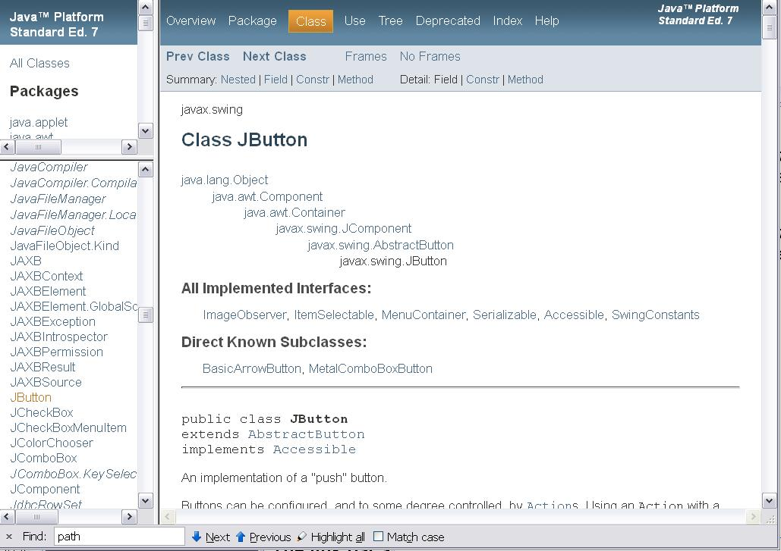
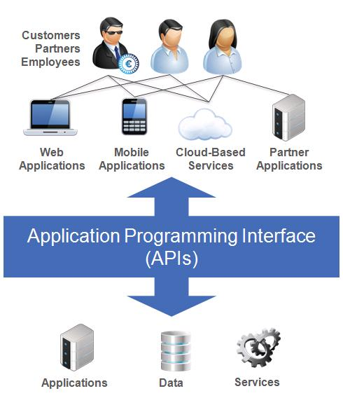
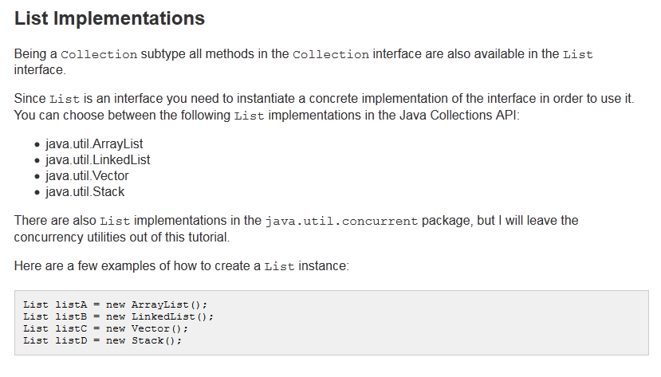
Background
Learning Resource:
API Specification
API Tutorial
Explanation
Code Example

Slide 4
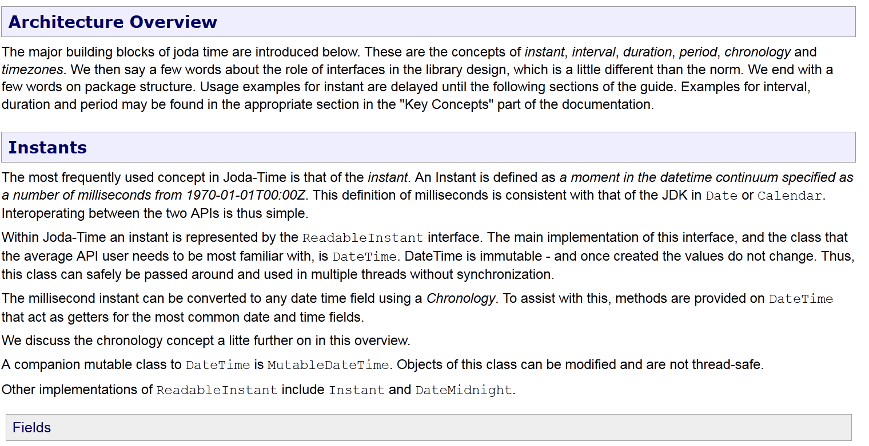
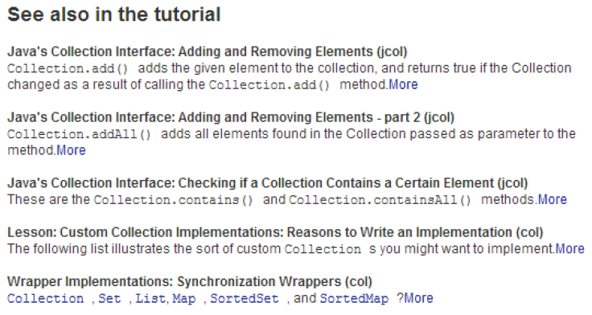
Problem Statement
Text Classification Model
Collection
A bunch of tutorials
Fragments which explain specific API

Slide 5

Barriers
Challenges:
APIs are scattered in different parts of the tutorial.
APIs are often mentioned in a fragment without being the topic of it.
Literature Shortcomings:
The existing models do not consider the domain specific knowledge of APIs effectively:
The co-occurrence APIs are important indicators to discover fragments explaining an API.
The API usage experience shared in some technical forums can be leveraged.
The specifications written by some experienced developers can be exploited.

Slide 6
Agenda
Background & Introduction
Tutorial Datasets
Framework&
Evaluation
Results& Conclusion
1
2
3
4

Slide 7

Tutorial Datasets
McGill Tutorial Dataset：
Android Tutorial Dataset：
 | Tutorial | URL (Verified Aug. 2014) | Length (Words) | # API | # Fragment | # Pair | # Relevant
 | JodaTime | http://joda-time.sourceforge.net/userguide.html | 4659 | 36 | 29 | 68 | 30
 | Math Library | http://commons.apache.org/proper/commons-math/userguide/ | 28971 | 73 | 41 | 98 | 54
 | Col. Official | http://docs.oracle.com/javase/tutorial/collections/implementations | 23583 | 59 | 57 | 220 | 56
 | Col. Jenkov | http://tutorials.jenkov.com/java-collections/index.html | 12915 | 28 | 69 | 150 | 42
 | Smack | http://www.igniterealtime.org/builds/smack/docs/latest/documentation/ | 19075 | 40 | 47 | 86 | 56
Available at : http://cs.mcgill.ca/swevo/icse2015/
 | Tutorial | URL (Android 4.4) | Length (Words) | # API | # Fragment | # Pair | # Relevant
 | Graphics | http://developer.android.com/guide/topics/graphics/index.html | 15618 | 70 | 38 | 138 | 43
 | Resources | http://developer.android.com/guide/topics/resources/index.html | 31004 | 63 | 46 | 140 | 45
 | Text | http://developer.android.com/guide/topics/text/index.html | 8448 | 31 | 24 | 76 | 25
 | Data | http://developer.android.com/guide/topics/data/index.html | 9125 | 37 | 25 | 76 | 28
Available at : http://oscar-lab.org/paper/API/

Slide 8




Tutorial Construction Steps
1
2
3
4
Tutorial Download
Tutorial Fragmentation
API
Identification
Manual
Annotation
We employ 6 master students to annotate the Android tutorial dataset.
Each annotator is given a detailed annotation guide.
Each API-fragment pair is annotated by two annotators. If there is a conflict between them when judging one API-fragment pair, they should discuss to reach a consensus.
The contents in each fragment should be cohesive.
A basic idea is to split the tutorials based on HTML header tags organized in four levels.
We split the tutorials based on the lowest level.
Selection Criteria:
1. They explain basic Android development topics which are relevant to many developers.
2. They are easy to understand so that can be annotated quickly and accurately.
3. They have different lengths and formats which can simulate different situations.
We download the webpages of these tutorials from Android development websites.
The HTML files have already given the links to specific APIs.
By analyzing the <href> link addresses, we can identify the exact APIs a fragment contains.

Slide 9
Agenda
Background & Introduction
Tutorial Datasets
Framework&
Evaluation
Results& Conclusion
1
2
3
4

Slide 10
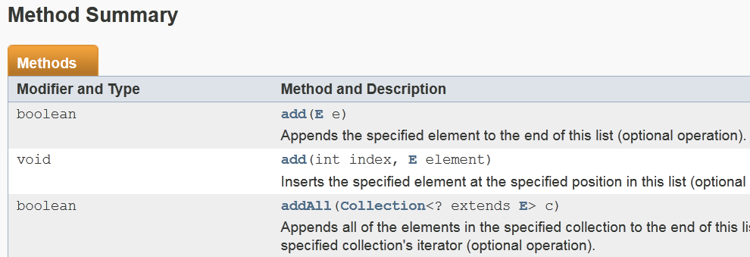
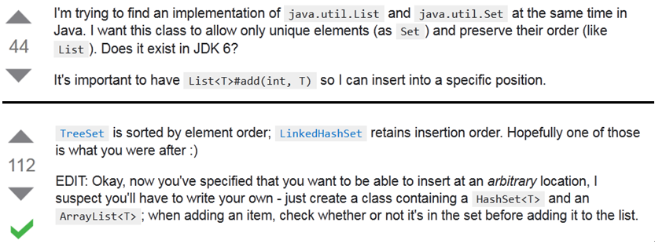

Framework
Model: We propose a new model of FInding Tutorial Segments Explaining APIs (FITSEA).
Details: FITSEA is a typical text classification model which contains three stages, namely preprocessing, training and testing.
1
Preprocessing
Knowledge Base
API Specification
2
Training
API | Fragment | Label
java.util.Iterator | Each of the … | relevant
java.util.Vector | The fact that … | irrelevant
java.util.Hashtable | If you need… | Relevant
… | … | …
APIFre | CodeFre | SubjectFre | … | Label
5 | 19 | 11 | … | relevant
7 | 35 | 5 | … | irrelevant
16 | 2 | 1 | … | relevant
… | … | … | … | …
Feature Extractor
Learn Model
3
Testing
API | Fragment | Label
java.util.List | As a rule… | ?
java.util.Set | This section … | ?
java.util.HashSet | As you can … | ?
… | … | …
APIFre | CodeFre | SubjectFre | … | Label
5 | 19 | 11 | … | ?
7 | 35 | 5 | … | ?
16 | 2 | 1 | … | ?
… | … | … | … | …
APIFre | CodeFre | SubjectFre | … | Label
5 | 19 | 11 | … | relevant
7 | 35 | 5 | … | relevant
16 | 2 | 1 | … | irrelevant
… | … | … | … | …
Feature Extractor
Classifier

Slide 11





Text Similarity Approaches
Lexical Similarity
Semantic Similarity
Character-based
Term-based
Knowledge-based
Bi-Gram Similarity
Levenshtein Similarity
Jaccard Similarity
Cosine Similarity
1. Word2Vec
$$\text{S}\left(\text{T}\text{1,}\text{T}\text{2}\right)\text{=}\frac{\text{2×|}\text{Bi}\text{(}\text{T}\text{1)∩}\text{Bi}\text{(}\text{T}\text{2)|}}{\text{|}\text{Bi}\text{(}\text{T}\text{1)|+|}\text{Bi}\text{(}\text{T}\text{2)|}}$$
$$\text{S}\left(\text{T}\text{1,}\text{T}\text{2}\right)\text{=}\frac{\text{|}\text{S}\text{(}\text{T}\text{1)∩}\text{S}\text{(}\text{T}\text{2)|}}{\text{|}\text{S}\text{(}\text{T}\text{1)}\text{∪}\text{S}\text{(}\text{T}\text{2)|}}$$
$$\text{S}\left(\text{T}\text{1,}\text{T}\text{2}\right)\text{=}\frac{\sum_{\text{i}\text{=1}}^{\text{n}}{V({\text{T}\text{1)}}_{\text{i}}V({\text{T}\text{2)}}_{\text{i}}}}{\sqrt{\sum_{\text{i}\text{=1}}^{\text{n}}{{\text{V}\text{(}\text{T}\text{1)}}_{\text{i}}^{\text{2}}}}\sqrt{\sum_{\text{i}\text{=1}}^{\text{n}}{{\text{V}\text{(}\text{T}\text{2)}}_{\text{i}}^{\text{2}}}}}$$
$$\text{S}\left(\text{T}\text{1,}\text{T}\text{2}\right)\text{=1}\text{−}\frac{\text{MinOper}\text{(}\text{T}\text{1,}\text{T}\text{2)}}{\text{Max}\text{(}\text{T}\text{1,}\text{T}\text{2)}}$$
$$\text{cos}\left(\text{θ}\right)\text{=}\frac{\sum_{\text{i}\text{=1}}^{\text{n}}{{\text{T}\text{1}}_{\text{i}}{\text{T}\text{2}}_{\text{i}}}}{\sqrt{\sum_{\text{i}\text{=1}}^{\text{n}}{{\text{T}\text{1}}_{\text{i}}^{\text{2}}}}\sqrt{\sum_{\text{i}\text{=1}}^{\text{n}}{{\text{T}\text{2}}_{\text{i}}^{\text{2}}}}}$$

Slide 12
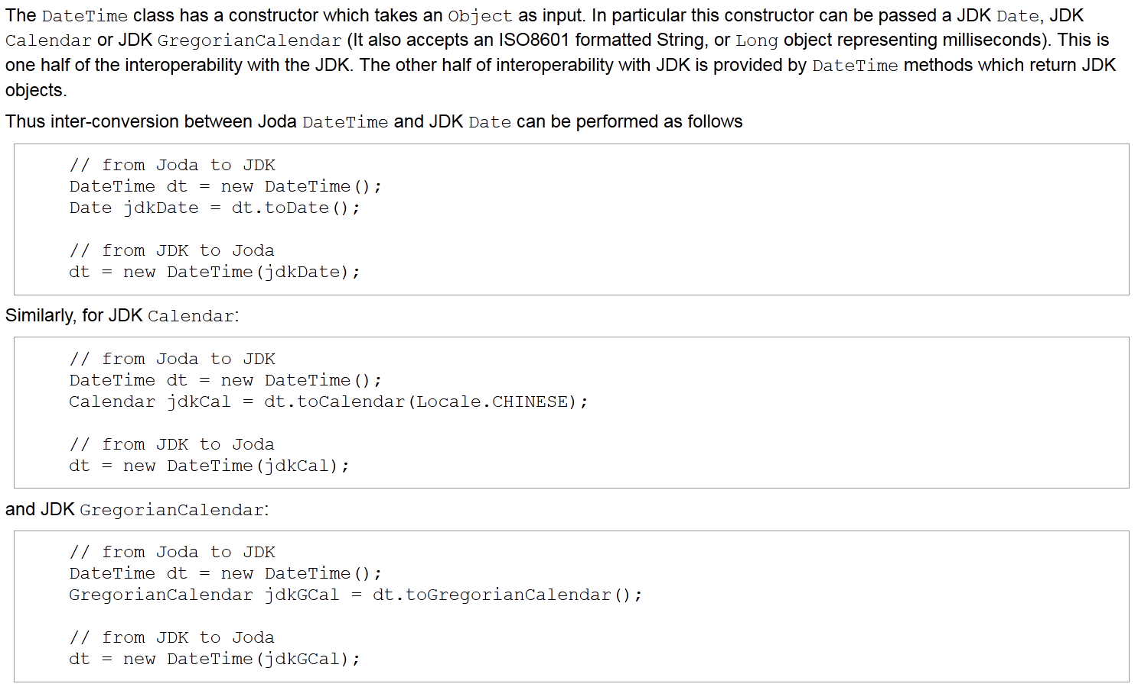
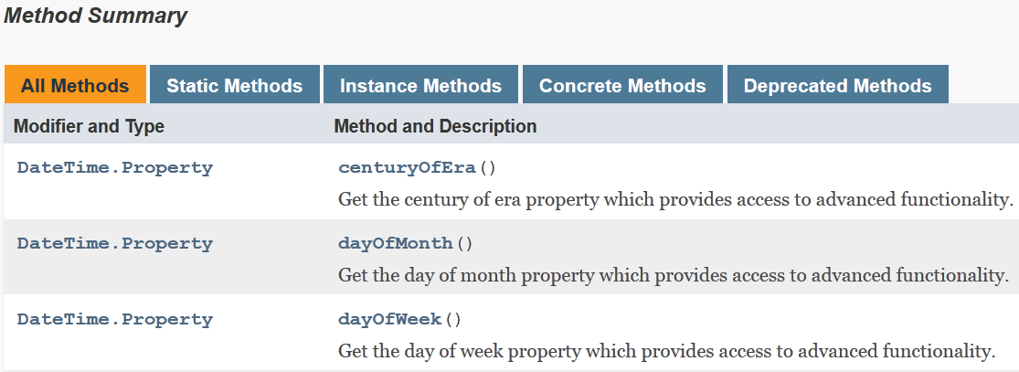
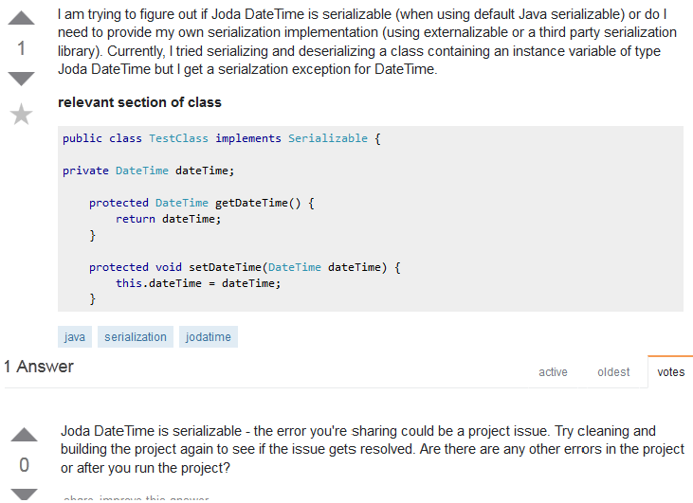
Feature Design
Raw API
Feature | Description
Group 1: Raw API features
WholeAPIFre | How strongly a whole API is associated to the fragment.
PartAPIFre | How strongly a part API is associated to the fragment.
ContainCodeFre | How many code snippets the fragment contains.
InstantiationFre | Frequency with which an API is initialized as an object.
SubjectFre | How many times the API acts as subject of each sentence.
InConditionSen | Whether the API appears in the condition sentences.
EmergeParaLoc | The minimum location the API appears in each paragraph.
Word2VecSimi | Word2Vec similarity between API and fragment.
Group 2: Co-occurrence API features
CoAPIFre | How many co-occurrence APIs are contained in the fragment.
CoAPIFreInCode | How many co-occurrence APIs are contained in code snippets.
wholeCoAPIFre | How strongly co-occurrence APIs are associated to the fragment.
CoAPISenPro | The proportion of sentences which contain co-occurrence APIs.
CoWord2VecSimi | Word2Vec similarity between sentences containing co-occurrence APIs and not.
Group 3: API extension features
MethodFre | How many methods in specification based API extension are contained in the fragment.
IsMethodInTitle | Whether the methods in specification based API extension are contained in the title.
ClueWordCount | How many clue words occurred in the Stack Overflow based API extension.
ExWord2VecSimi | Word2Vec similarity between Stack Overflow based API extension and the fragment.
DateTime
Co-occurrence API
Calendar
GregorianCalendar
Object
Date
Specification Extension
Stack Overflow Extension

Slide 13
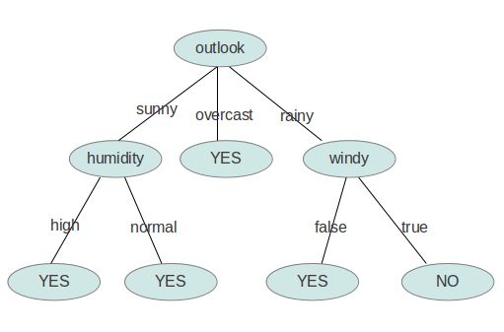
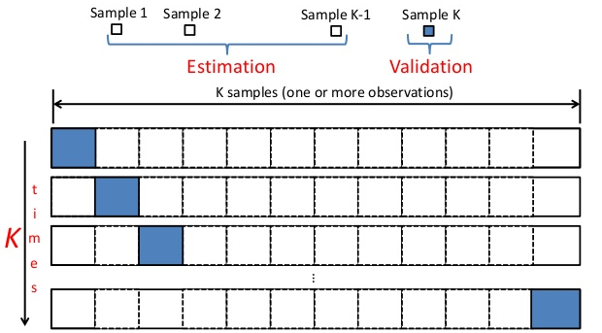



Evaluation
Classifier
Evaluation Methods
Evaluation Metrics
Decision Tree Classifier
Leave-One-Out
Cross Validation
Precision, Recall,
F-Measure
 |  | True Condition
 |  | Positive | Negative
Predicted Condition | Positive | TP | FP
 | Negative | FN | TN
$$\text{Precision}\text{=}\frac{\text{TP}}{\text{TP}\text{+}\text{FP}}$$
$$\text{Recall}\text{=}\frac{\text{TP}}{\text{TP}\text{+}\text{FN}}$$
$$\text{F}\text{−}\text{Measure}\text{=}\frac{\text{2×}\text{Precision}\text{×}\text{Recall}}{\text{Precision}\text{+}\text{Recall}}$$

Slide 14
Agenda
Background & Introduction
Tutorial Datasets
Framework&
Evaluation
Results& Conclusion
1
2
3
4

Slide 15
Research Questions
RQ1: How will FITSEA perform when using different groups of features?
Features are divided into three groups. In this RQ, we want to explore the performances of FITSEA when applying different groups of features.
RQ2: Does it achieve better results when using Word2Vec semantic similarity than the other similarity calculation methods?
In this RQ, we compare Word2Vec against the other four methods, namely Bi-Gram, Levenshtein, Jaccard and Cosine similarity.
RQ3: Can FITSEA perform better than the other models over the two tutorial datasets?
In this RQ, we try to explore whether FITSEA could discover more explaining fragments for APIs than the other models, namely GMR model proposed by Gayane et al [1] and IR model.
[1] G. Petrosyan, M. P. Robillard, and R. de Mori, “Discovering information explaining API types using text classification,” in Proc. of the 37th International Conference on Software Engineering, 2015, pp. 869-879.

Slide 16
Results of RQ1
Motivation: To explore the contributions of different groups of features to the classifier.
Approach: We test various combinations of the three feature groups in each run.
Results:
Answers:
With the increasing of the feature groups, the results get better on average.
Co-occurrence API features and API extension features are good indicators for classification.
They are good complements for raw API features.
Group | JodaTime |  |  | Math Library |  |  | Col. Official |  |  | Col. Jenkov |  |  | Smack
 | P (%) | R (%) | F-M (%) | P (%) | R (%) | F-M (%) | P (%) | R (%) | F-M (%) | P (%) | R (%) | F-M (%) | P (%) | R (%) | F-M (%)
1 | 85.71 | 80.00 | 82.76 | 66.15 | 78.18 | 71.67 | 80.00 | 71.43 | 75.47 | 82.86 | 69.05 | 75.32 | 81.13 | 76.79 | 78.90
2 | 63.33 | 63.33 | 63.33 | 67.11 | 92.73 | 77.86 | 53.13 | 30.36 | 38.64 | 75.00 | 7.14 | 13.04 | 64.29 | 96.43 | 77.14
3 | 42.86 | 30.00 | 35.29 | 75.44 | 78.18 | 76.79 | 36.36 | 7.14 | 11.94 | 81.25 | 30.95 | 44.83 | 70.00 | 100.00 | 82.35
1+2 | 90.00 | 90.00 | 90.00 | 70.59 | 65.45 | 67.92 | 75.51 | 66.07 | 70.48 | 86.84 | 78.57 | 82.50 | 87.27 | 85.71 | 86.49
1+3 | 83.33 | 83.33 | 83.33 | 67.35 | 60.00 | 63.46 | 78.43 | 71.43 | 74.77 | 83.78 | 73.81 | 78.48 | 81.36 | 85.71 | 83.48
2+3 | 51.72 | 50.00 | 50.85 | 84.48 | 89.09 | 86.73 | 52.63 | 35.71 | 42.55 | 58.14 | 59.52 | 58.82 | 68.83 | 94.64 | 79.70
1+2+3 | 90.00 | 90.00 | 90.00 | 76.36 | 76.36 | 76.36 | 76.47 | 69.64 | 72.90 | 87.50 | 83.33 | 85.37 | 87.93 | 91.07 | 89.47
P: Precision, R: Recall, F-M: F-measure 1: raw API feature group, 2: co-occurrence API feature group, 3: API extension feature group

Slide 17
Results of RQ2
Motivation: To explore whether Word2Vec is superior to other similarity measurements.
Approach: We only replace the features which calculate Word2Vec similarity with one of these methods, and the other features stay the same.
Results:
Answers:
As a semantic similarity method, Word2Vec can measure the similarity much better than the other methods.
Word2Vec can be used effectively when the length of two texts is unmatched.

Slide 18
Results of RQ3
Motivation: To explore whether FITSEA is superior to the other two models, namely GMR model proposed by Gayane et al [1] and IR model.
Approach: We implement and run each model respectively on both McGill tutorial dataset and Android tutorial dataset.
Results:
Results on McGill tutorial dataset:
[1] G. Petrosyan, M. P. Robillard, and R. de Mori, “Discovering information explaining API types using text classification,” in Proceedings of the 37th International Conference on Software Engineering, 2015, pp. 869-879.

Slide 19
Results of RQ3 (cont’d)
Results on Android tutorial dataset:
Answers:
FITSEA shows better results than the state-of-the-art model over the two public datasets.
FITSEA can find tutorial fragments explaining APIs more accurately.

Slide 20
Conclusion
Problem: Finding tutorial fragments explaining APIs is significant to the developers.
Model: We propose a more accurate model, namely FITSEA to help developers finding tutorial fragments when facing an unfamiliar API.
Advantage 1: FITSEA fully leverages the domain specific knowledge to find two important indicators for classification, namely co-occurrence APIs and extended APIs.
Advantage 2: FITSEA also introduces the usage of an effective semantic similarity method, namely Word2Vec.
Results: FITSEA can outperform the state-of-the-art model by up to 13% and 30% on McGill tutorial dataset and Android tutorial dataset respectively.

Slide 21
Q & A
Thank you !
Contact: jingxuanzhang@mail.dlut.edu.cn

