Slide 1

International Cognitive Science Affinity Group
Abhilasha Kumar (USA, India) [ECR]
Yoed Kenett (Israel, USA) [ECR]
Vera Kempe (Scotland, USA, Germany, Russia)
Charles Kemp (Australia, USA)

Slide 2
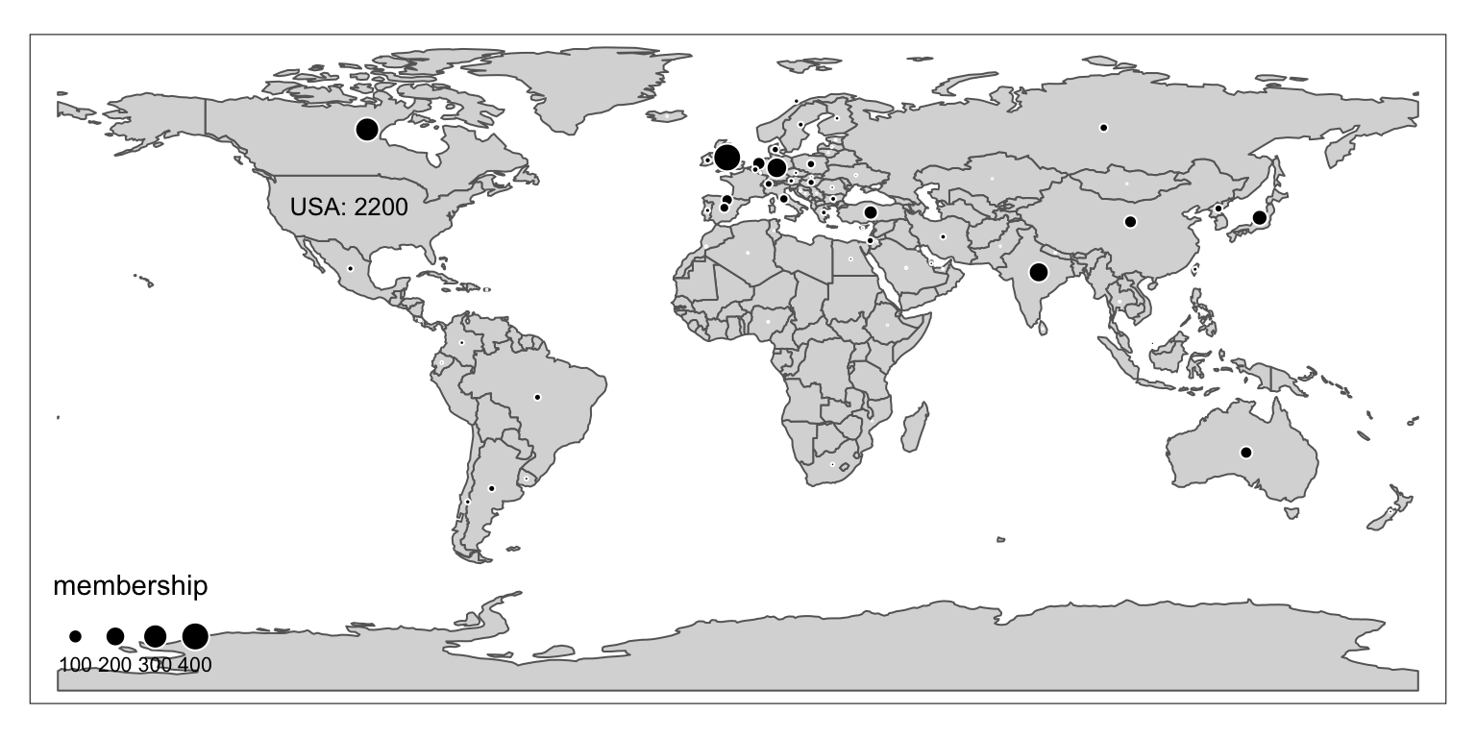
Cognitive Science around the world

Slide 3
Goals
Start a conversation that may continue in future years
Identify issues that we can take to the CSS International Committee and the society’s Governing Board
Provide a forum for you to mention initiatives that you may want to lead or get involved with

Slide 4
Models for inspiration
Linguistics: Abralin talk series
Computational neuroscience: Neuromatch academy
Neuroscience: Brainhack events
Psychology: Psychological Science Accelerator
Psychology: International Cognitive Research Consortium
…

Slide 5
Session Overview
Small groups (5 min)
International Students (Abhilasha; 18 min)
International Research (Yoed; 18 min)
International Publishing + Reviewing (Vera; 18 min)
Local events and communities (Charles; 18 min)
Wrap up (5 min)
Procedure
Please use the Zoom chat and contribute to the Google doc!
Please keep camera on if possible

Slide 6
Local Cognitive Science events and communities
Charles Kemp
University of Melbourne

Slide 7
Questions:
How could the Cognitive Science society help to build community in your area?
How could you help to build community in your area?

Slide 8
Local / Regional chapters
Existing national societies:
The German Society for Cognitive Science
The Chinese Society for Cognitive Science
…
If there is a national society in your area:
How could the CSS better support your society?
If there is no national society in your area:
Would it be worthwhile to set up a local chapter?
If yes, what would this chapter do?

Slide 9

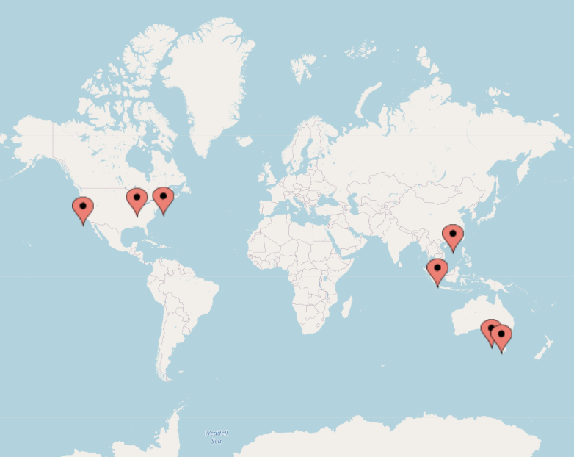
Adjusting the CogSci Conference model
CogSci is likely to retain an online component. How could the conference work better for online participants?
Timezone issues: how to solve?
This year local members are organizing meetup groups in 7 cities around the world. What kind of local conference events should we aim for in the future?

Slide 10
Poll Question
What would you like to discuss first?
How could you build the Cognitive Science community in your area?
Local / Regional societies or chapters
Adjusting the CogSci conference model to better support international researchers

Slide 11
Wrapup
Abhilasha Kumar (USA, India) [ECR]
Yoed Kenett (Israel, USA) [ECR]
Vera Kempe (Scotland, USA, Germany, Russia)
Charles Kemp (Australia, USA)

Slide 12
Wrapup
If you have additional ideas to share please get in touch with any one of the organizers (emails on Google sheet)
The Google sheet will stay up for a while. Please add to it if you have additional ideas after today’s session. This sheet will form the basis for a report that the organizers share with the International Committee of the Cognitive Science Society.
If there’s something specific you’d like to pursue and would like help (e.g. you’d like to be connected with others with similar interests) please let us know.
Thanks for your participation!

