Slide 1
Welcome to Day 1!
Complex Human Data Summer School
Notes:
mainstream

Slide 2
Summer School Overview
Day 0: R bootcamp
Day 1: Workflow, Google App Engine
Day 2: Online Experiments
Day 3: Data wrangling, visualization
Day 4: Statistics, Probabilistic models
Day 5: Experience sampling

Slide 3
Announcements
Piazza
Photo and dinner tonight

Slide 4
Day 1: Workflow, Google App Engine
Git
Project organization
(lunch)
Hosting experiments online
Downloading data

Slide 5
Why workflow matters
A good workflow
  saves time in the long run
  helps you avoid errors
  makes it easy for others to reproduce your work

Slide 6

Replication crisis

Slide 7
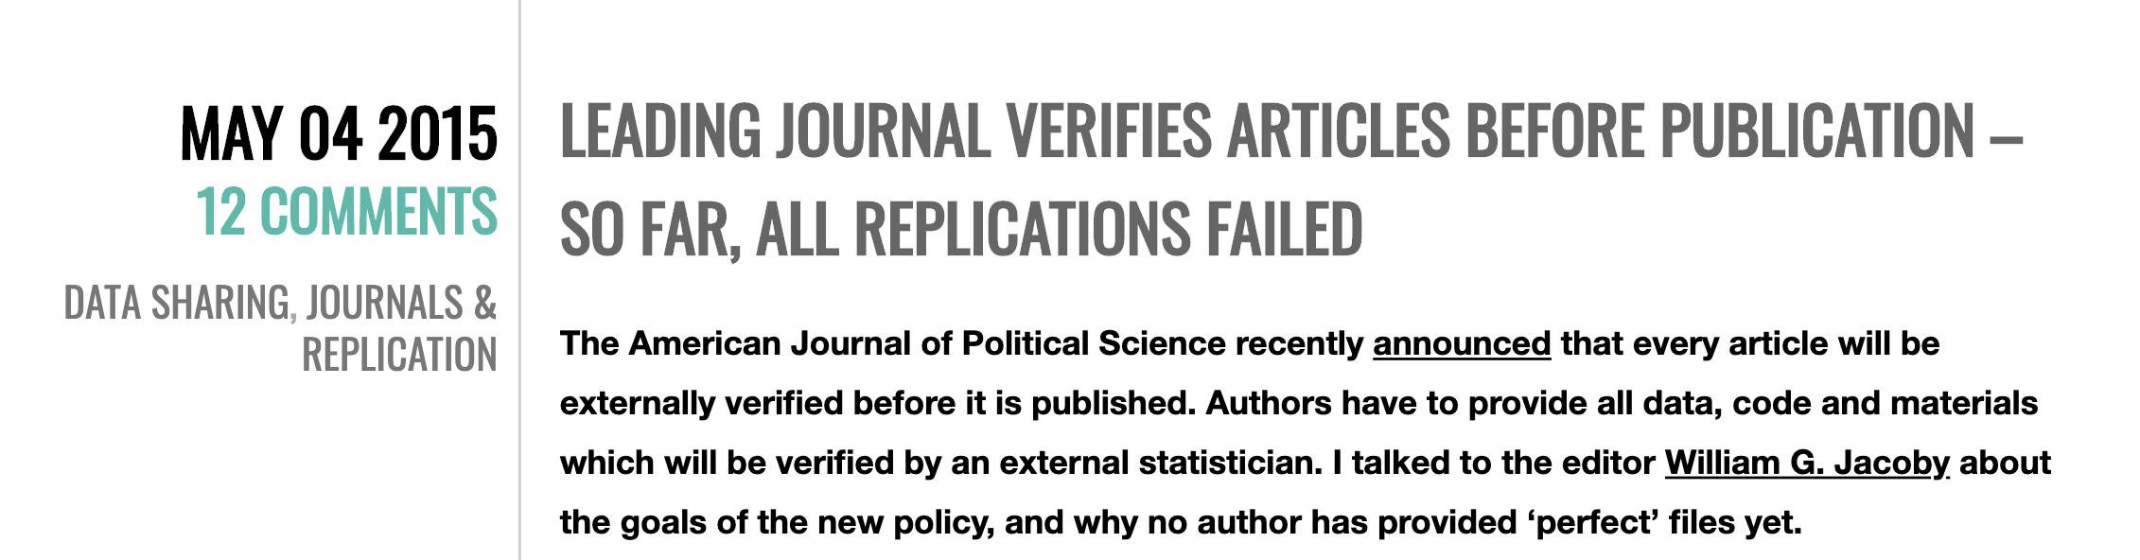
Reproducing computational work

Slide 8
Version control with Git
Why use Git?
  keep a record of what you were doing and thinking during the lifecycle of a project
  “version control is like an undo command for everything”
  have a backup if your laptop dies or is stolen
  collaborate on code and writing (optional)
  release code and data publicly (optional)

Slide 9
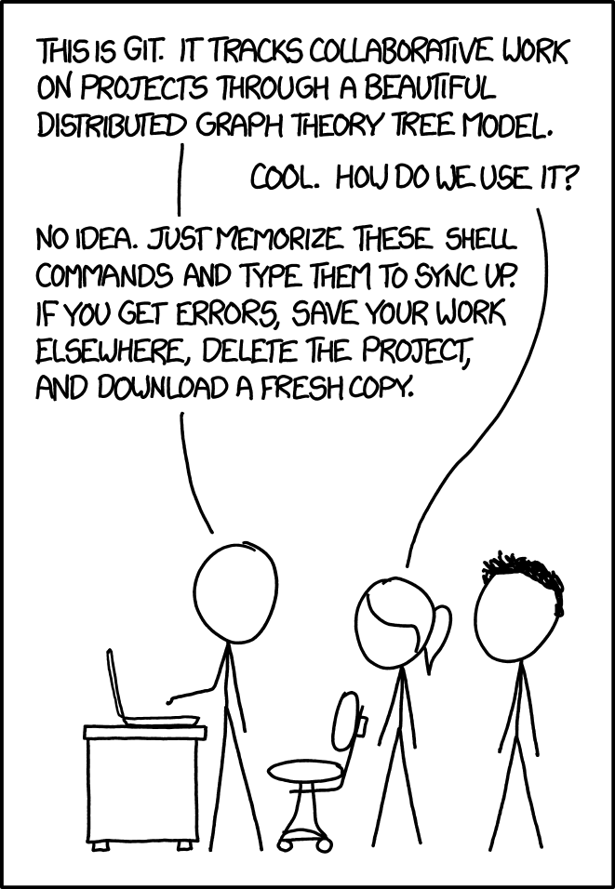

Slide 10
Exercises (follow tutorial)
Install Git
  Mac: install Xcode command line tools from the App Store
  Windows: https://gitforwindows.org/
Check Git is installed
Set user.name and user.email

Slide 11
GitHub
GitHub (and other similar sites) allows you to host repositories remotely.
Exercise:
Sign up for a GitHub account. Use a university email if possible, and choose your username wisely!

Slide 12
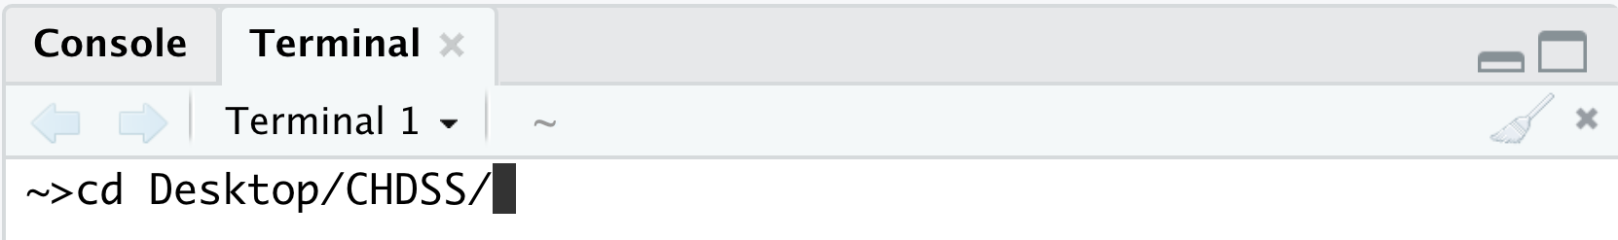
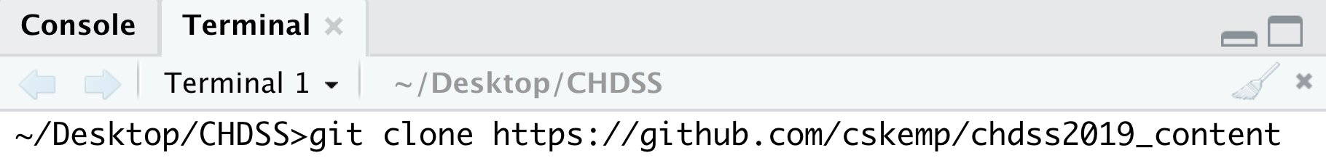
Exercise: Cloning a repository
If you didn’t already, make a folder called CHDSS on your desktop.
Open a terminal and change into your CHDSS folder
Clone the repository for summer school content

Slide 13
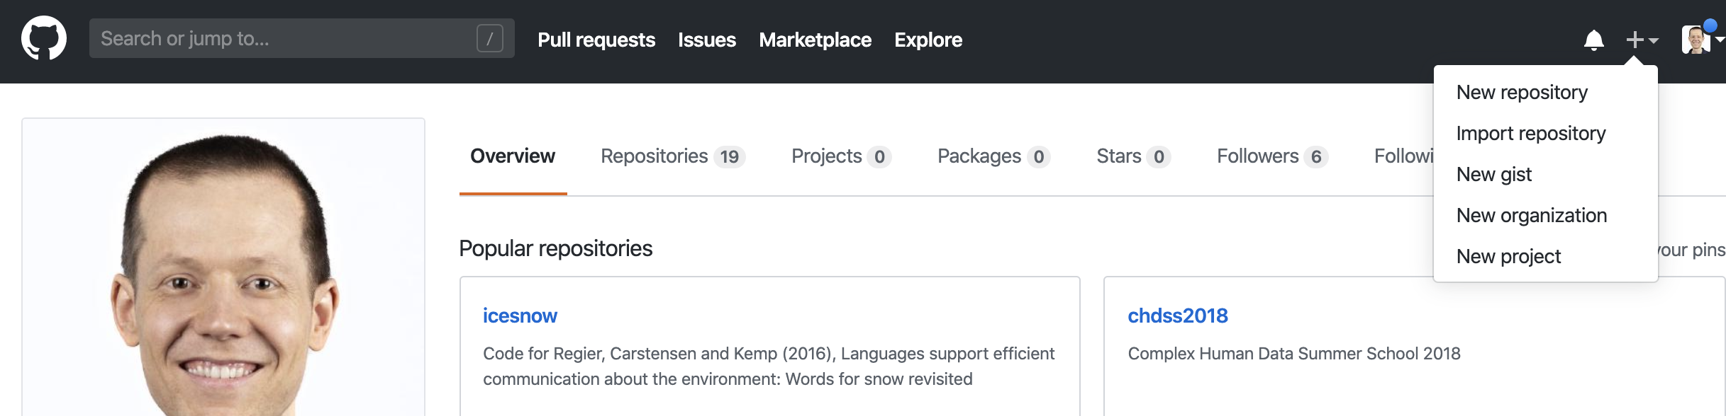
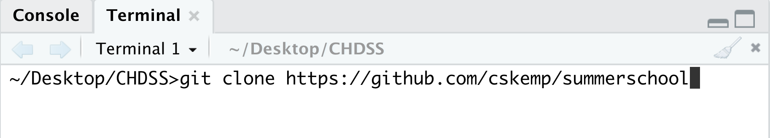
Exercise: make your own repository
  When you’re done, clone your repository:
Replace with your own username

Slide 14
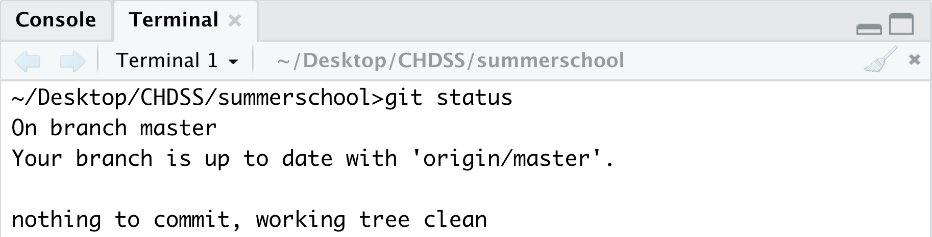
Exercises
Check the status of your repository
Edit README.md and play around with markdown
Check the status again

Slide 15
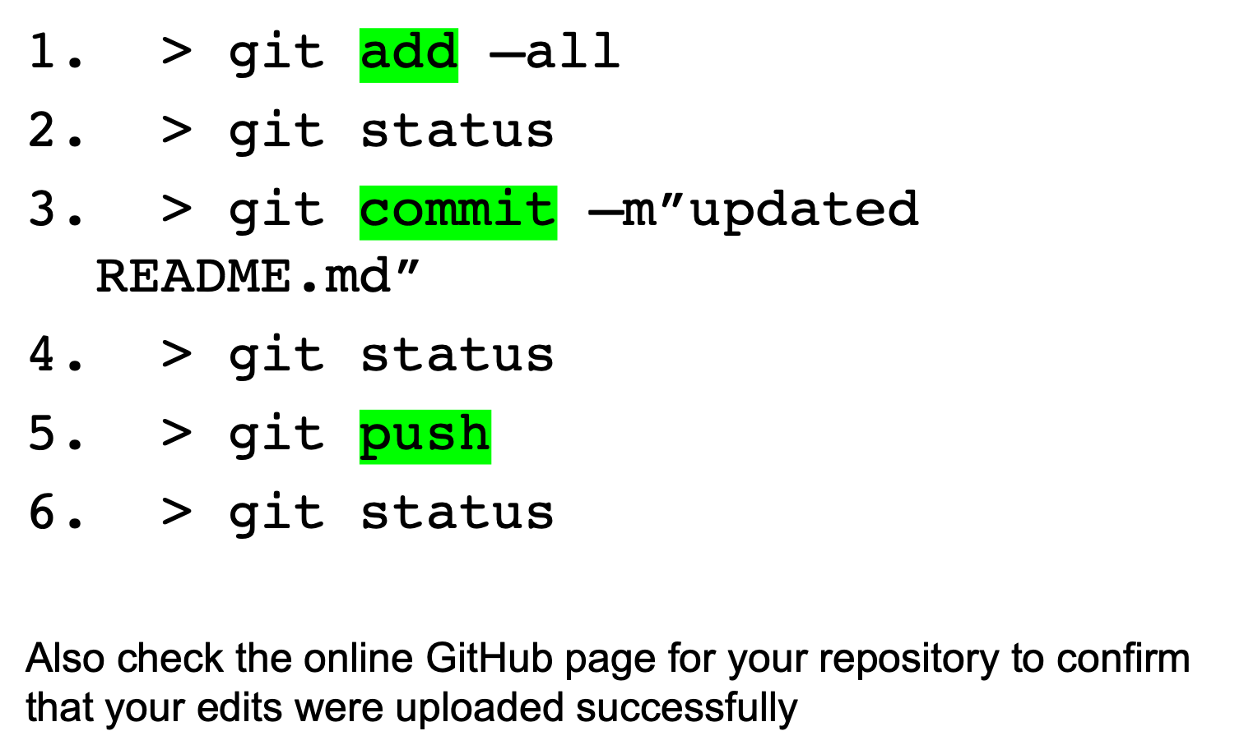
Exercises

Slide 16
Collaborating using GitHub
The tutorial shows how to add a collaborator so that both of you can work on the same set of files.
Exercise (later):
  Find a partner and ask her to add you as a collaborator on her repository. Clone her repository, make a change, and push your edit to her repository.

Slide 17
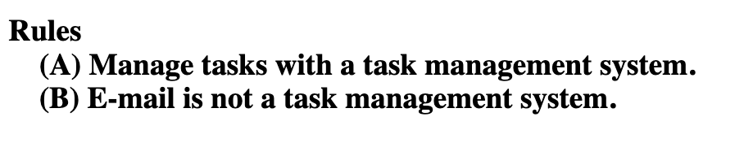
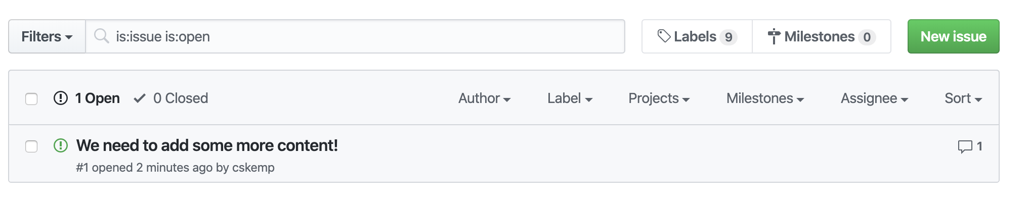
Using the issue tracker
(Gentzkow + Shapiro, Code and Data for the social sciences: a practitioner’s guide

