Slide 1
Welcome to Day 1!
Complex Human Data Summer School
#chdss19
Notes:
mainstream

Slide 2
Post-its: take one yellow and one non-yellow
Wifi name: Visitor wireless (or viswireless)
Username: chd-school Password: #dsG9y

Slide 3
Introductions

Slide 4
Summer School Overview
Day 0: R bootcamp
Day 1: Workflow, Google App Engine
Day 2: Online Experiments
Day 3: Data wrangling, visualization
Day 4: Statistics, Probabilistic models
Day 5: Experience sampling

Slide 5
Announcements
Piazza
Photo today: 4:40 at steps of Melbourne School of Design
Dinner tonight: 5:00 in the courtyard of the Redmond Barry building

Slide 6
Day 1: Workflow, Google App Engine
Git
Project organization (lunch)
Internet and webpages
Deploying to Google App Engine

Slide 7
Why workflow matters
A good workflow
saves time in the long run
helps you avoid errors
makes it easy for others to reproduce your work

Slide 8

Replication crisis

Slide 9
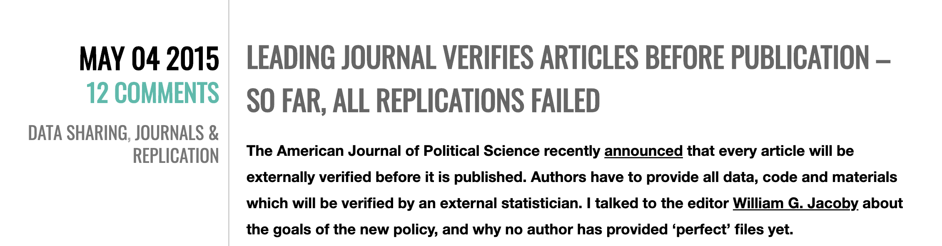
Reproducing computational work

Slide 10
Version control with Git
Why use Git?
keep a record of what you were doing and thinking during the lifecycle of a project
“version control is like an undo command for everything”
have a backup if your laptop dies or is stolen
collaborate on code and writing (optional)
release code and data publicly (optional)

Slide 11
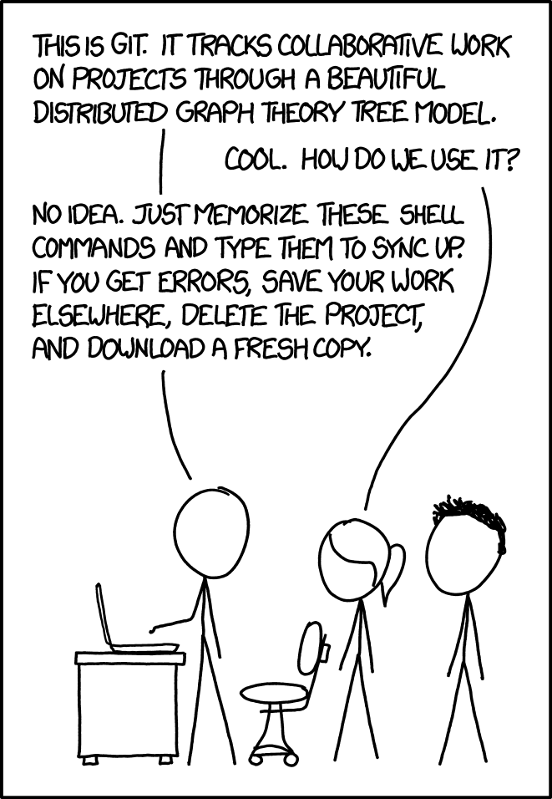

Slide 12
Exercises (follow tutorial)
Install Git
Mac: install Xcode command line tools from the App Store
Windows: https://gitforwindows.org/
Check Git is installed
Set user.name and user.email

Slide 13
GitHub
GitHub (and other similar sites) allows you to host repositories remotely.
Exercise:
Sign up for a GitHub account. Use a university email if possible, and choose your username wisely!

Slide 14
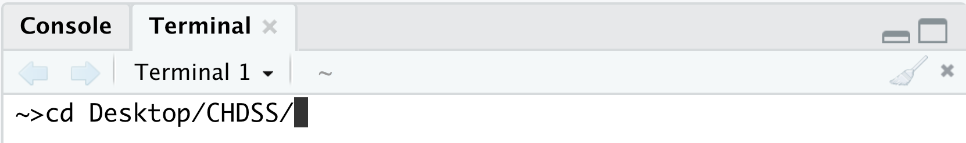
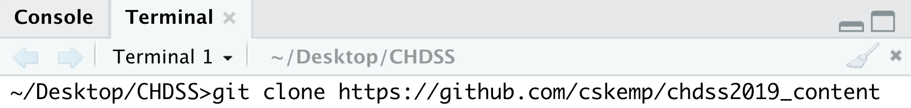
Exercise: Cloning a repository
If you didn’t already, make a folder called CHDSS on your desktop.
Open a terminal and change into your CHDSS folder
Clone the repository for summer school content

Slide 15
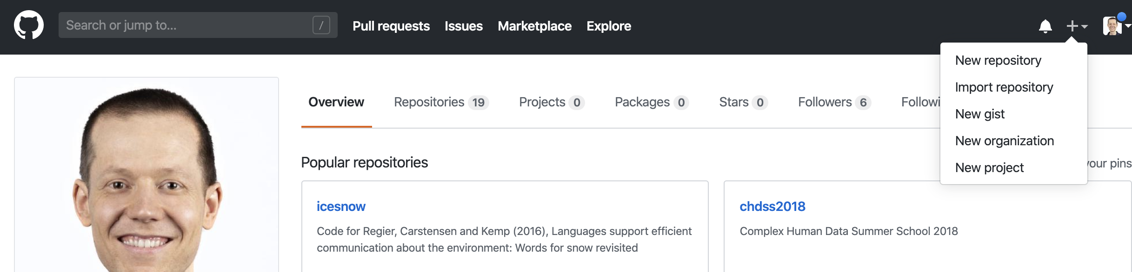
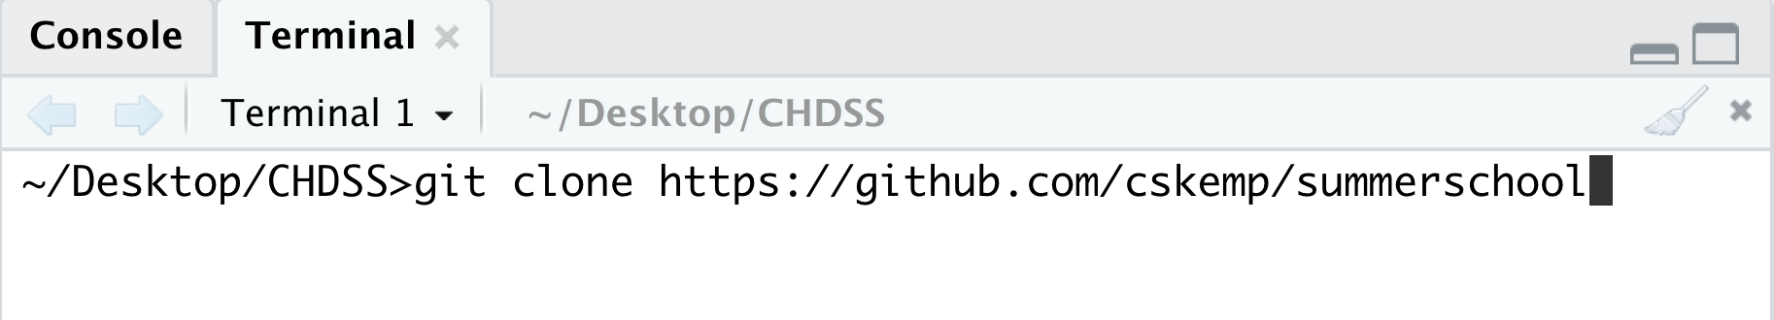
Exercise: make your own repository
When you’re done, clone your repository:
Replace with your own username

Slide 16
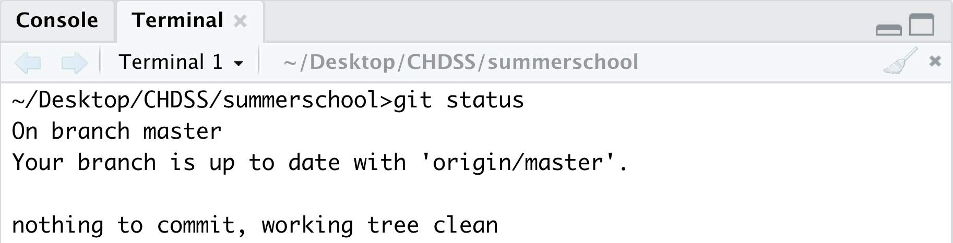
Exercises
Check the status of your repository
Edit README.md and play around with markdown
Check the status again

Slide 17
Exercises
> git add –all
> git status
> git commit –m”updated README.md”
> git status
> git push
> git status
Also check the online GitHub page for your repository to confirm that your edits were uploaded successfully

Slide 18
Collaborating using GitHub
The tutorial shows how to add a collaborator so that both of you can work on the same set of files.
Exercise (later):
Find a partner and ask her to add you as a collaborator on her repository. Clone her repository, make a change, and push your edit to her repository.

Slide 19
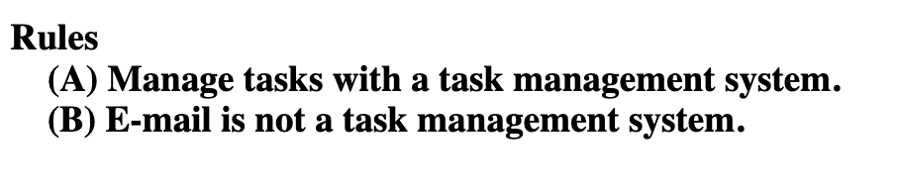
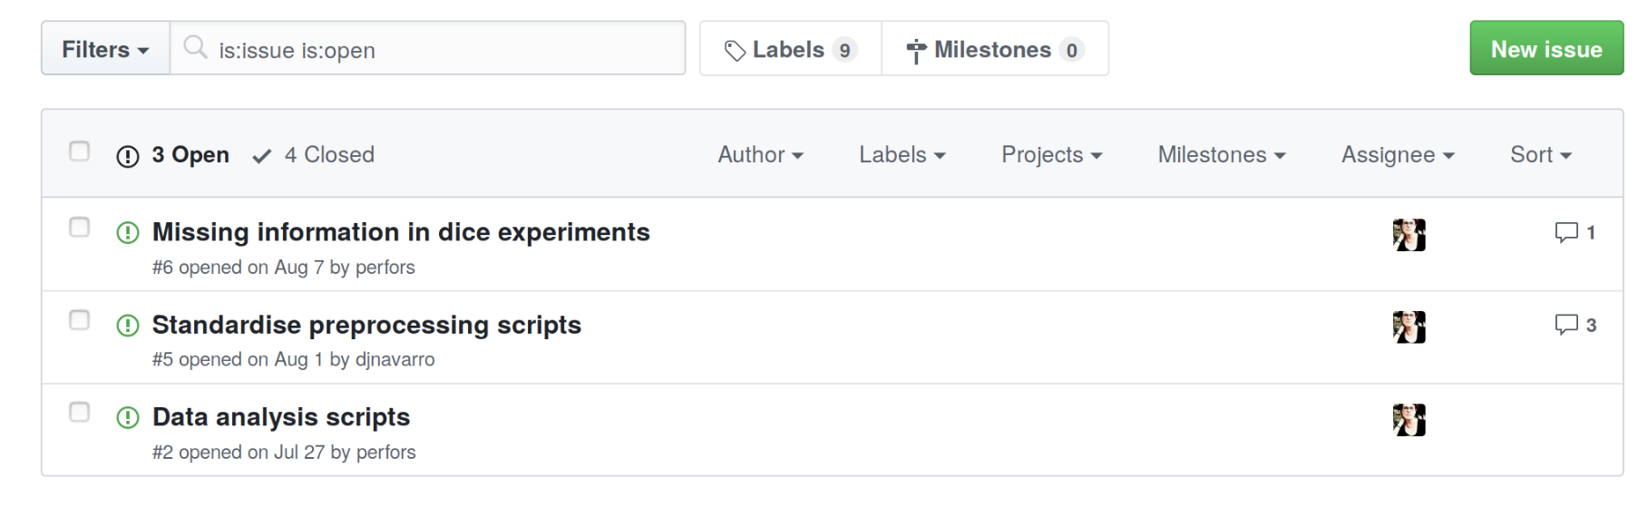
Using the issue tracker
(Gentzkow + Shapiro, Code and Data for the social sciences: a practitioner’s guide

Slide 20
Using the issue tracker
(Gentzkow + Shapiro, Code and Data for the social sciences: a practitioner’s guide
Exercise:
Add an issue to your repository.
Add a comment to the issue
Add a final comment and close the issue

