Slide 1
Virtual Communities and
Gossiping in
Social-Based P2P Systems
Dick Epema
Parallel and Distributed Systems
Delft University of Technology
Delft, the Netherlands
Gossiping Workshop
Leiden, 21 december 2006

Slide 2
The I-Share Research Project (1): P2P-TV
Distributing TV is the killer P2P application in the internet in the next decade
  recorded: millions of PVRs form one huge repository
  (how to find things)
  live: low-cost entry for content distributors
  (how to stream things)
P2P-TV forms a foundation for sharing with your friends (creating virtual communities)
  content (you can have what I have)
  interest profiles (you may like what I like)
In the international arena, P2P-TV is increasingly seen as a viable and innovation-driving alternative to (server-client) IP-TV

Slide 3

The I-Share Research Project (2): Tribler
P2P-TV client is an inspiring and concrete vehicle for multidisciplinary research
Tests in a lab environment are not enough for this research: real users with real networks and real content are needed
Hence the design and implementation of
With P2P-TV/Tribler, we can meet a multitude of generic research challenges:
  Efficient internet protocols Efficient video streaming
  Understandable content navigation User profiling and recommending
  Protection of privacy Protection of rights
  … …

Slide 4
Outline
Introduction (done)
Virtual communities
Tribler
Gossiping in Tribler:
  Content recommendation: Buddycast
  Swarm discovery: Little Bird
  Maintaining a social-based P2P network: NN as yet
Research Questions

Slide 5
Virtual communities (1): internet evolution
Until about 7 years ago, the internet had
  a core of powerful servers
  100s of millions of PCs (the dark matter of the internet) talking to those servers
Currently, the internet is
  a powerful ISP-connected network
  with millions of powerful servers
  and billions of users connected though PCs/ADSL to each other (and those servers)
Those users want to form Virtual Communities:
  fans of Madonna (or Mahler)
  Italy-loving amateur cooks
  fans of Feyenoord
  and myriads of others

Slide 6
Virtual communities (2): issues
What types of VCs are there?
  differences with real communities
  number of participants/interactions
How to create and manage VCs:
  membership management (become a member, prove membership, credentials)
  currently, virtually all VCs are centrally managed
How to behave as a member:
  be a good citizen
  incentives to cooperate
How to store and disseminate information:
  on membership
  information/content maintained by the VC
Gossiping may help here!!!

Slide 7
Tribler (1): main features
Tribler
Is based on the Bittorrent P2P file-sharing system
Looks at the peers as really representing actual users rather than as anonymous computers
Adds social-based functionality
De-anonymizes peers:
  peers have a quasi-unique public permanent identifier, which
  can be used to challenge a peer for its identity
Can show the physical location of peers
Uses gossiping for content recommendation, swarm discovery, and maintaining social networks
Has been released on 17 march 2006

Slide 8
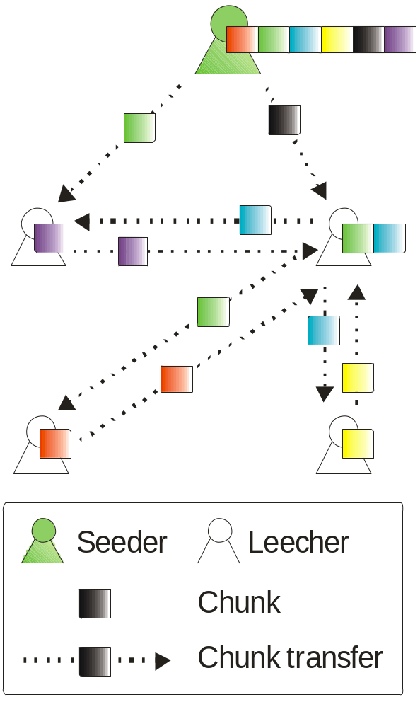
Tribler (2): data distribution model
Borrowed from Bittorrent:
Swarm – the group of peers (VC) downloading the same file
Seeder – a peer who has the complete file and gives it away for free
Leecher – a peer whose download is in progress
Files are divided into chunks
Chunks are exchanged between peers according to a tit-for-tat strategy

Slide 9
Gossiping 1 – BuddyCast: the basic idea
Buddycast is an epidemic protocol for peer and content discovery and recommendation
Peers maintain lists of buddies and of random peers
Buddycast switches between sending a buddycast message to
  a buddy (exploitation) and
  a random peer (exploration)
Exploitation
finding similar peers and discover their files
social network
(your buddies)
Exploration
discover new peers
other (random) peers

Slide 10
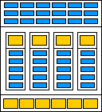
Gossiping 1 – BuddyCast: messages
Message contents
  50 my preferences (torrents)
  10 taste buddies
  + 10 preferences per taste buddy
  10 random peers
Megacache: peers retain context (to replace search by epidemic information dissemination)
Buddycast:
  every peer sends one buddycast message every 15 seconds
  pick a buddy or a random peer with some probability as the destination
  both communicating peers merge their buddy lists based on the information exchanged

Slide 11
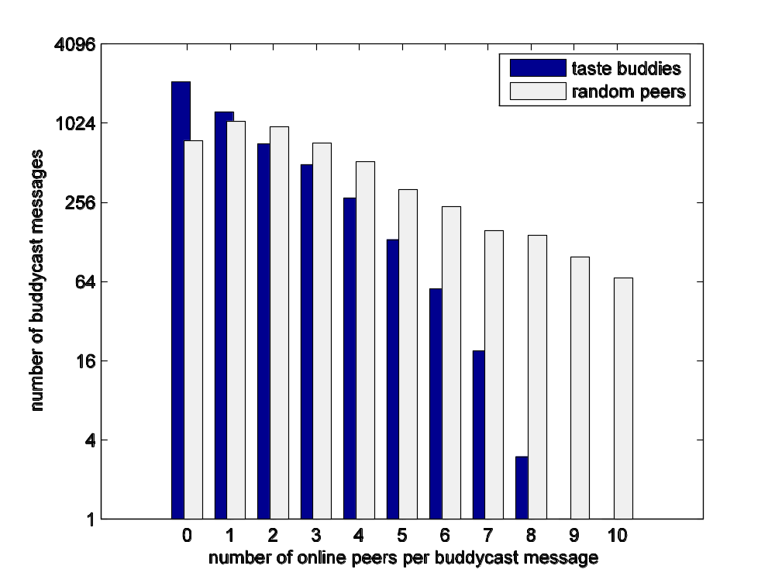
Gossiping 1 – Buddycast: performance
Mortality in VCs: How many buddies recorded in a buddycast message are still online when the message is received?
measurement period:
520 hours
number of messages:
5049
number of
buddycast messages
number of peers still alive
per buddycast message

Slide 12
Gossiping 2 – swarm discovery: in Bittorrent
There is a separate swarm for every file that is being downloaded: all peers downloading that file
These swarms are centrally managed:
  a peer indicates its interest in a file to a tracker
  peers periodically contact a tracker to obtain the IP numbers of other peers downloading the same file
  a peer selects the best other peers as bartering partners
swarm
tracker
bartering

Slide 13
Gossiping 2 – swarm discovery: in Tribler
In Tribler we define a single overlay swarm that contains all peers
The overlay swarm is used for decentralized peer and content discovery
A peer, on install, contacts a bootstrappeer:
  to become members of the overlay swarm
  to get a set of initial contacts
bootstrappeer
overlay swarm
swarms

Slide 14
Gossiping 2 – swarm discovery: Little Bird
Peers maintain a swarm database in which they cache information on the swarms of which they have been a member (over the last 10 days)
Two message types:
  GetPeers: request for peers in the swarm (contains swarm id and known peers in the swarm; check before you tell)
  PeerList: reply with a list of peers in the swarm (represented with a Bloom filter)
Phase 1: Bootstrapping (find initial peers):
  direct GetPeers at peers with the same interests as derived from buddycast exchanges
Phase 2: Find additional peers in the swarm
Peer selection for GetPeers based on contributions of peers in the past (connectivity, activity)
work by Jelle Roozenburg

Slide 15
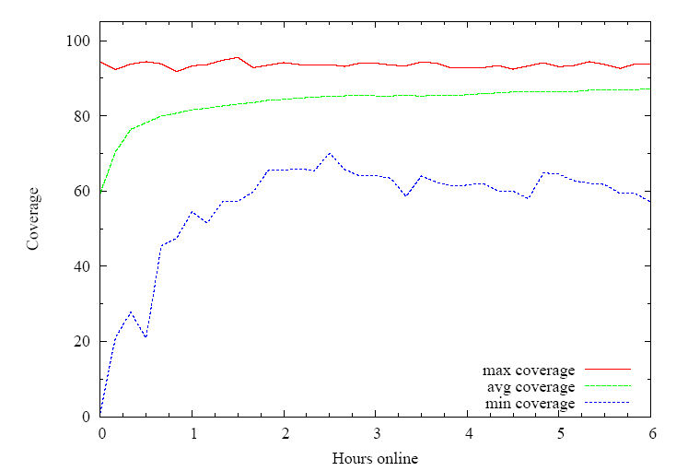
Gossiping 2 – Little Bird: Swarm Coverage
fraction
coverage
number of hours online
Evaluation with emulations
Notes:
Swarm database effective

Slide 16
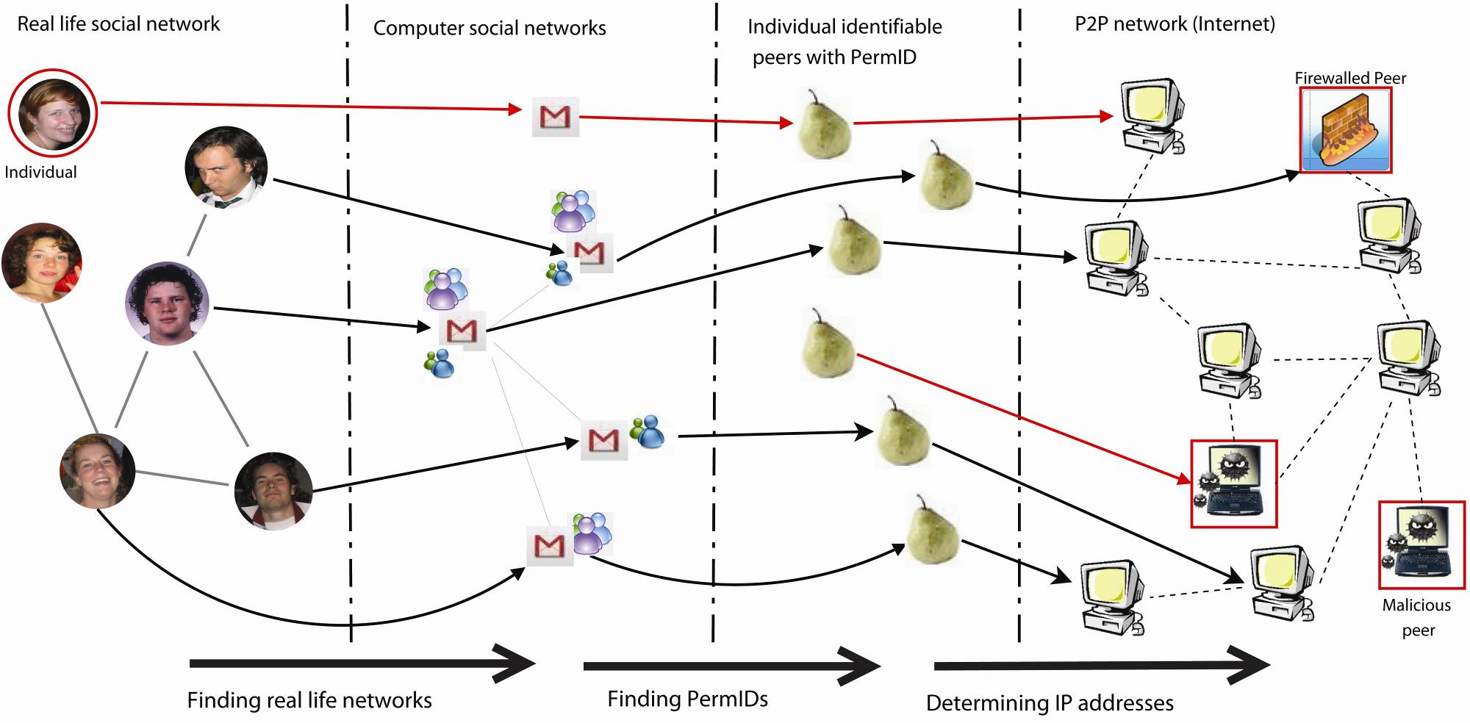
Gossiping 3 – social P2P networks: overview
Known mechanisms:
GMail
MSN Messenger
…
PermIDs:
spreading
storing
searching
Mapping PermIDs
onto IP addresses
work by Steven Koolen

Slide 17
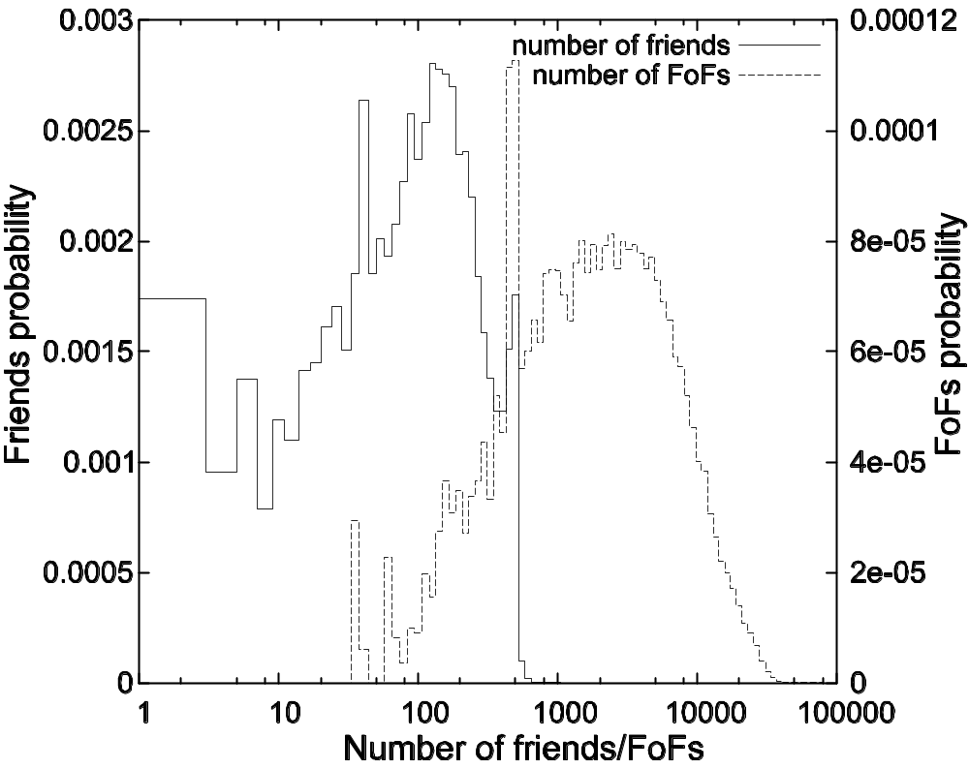
Gossiping 3 – social P2P networks: statistics
friendster.com
friends probability
friends-of-a-friend probability
Average number of
friends: 243
friends-of-a-f: 9147
number of friends/friends-of-a-friend

Slide 18
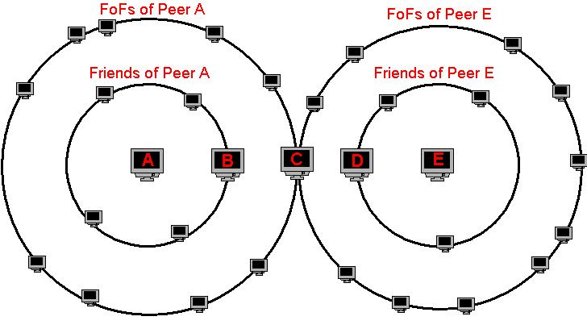
Gossiping 3 – social P2P networks: message types
Two message types (SET and GET) to exchange PermID-IP address information
Only exchanges two hops away (friends and friends-of-friends)
Results in a distance of 4

Slide 19
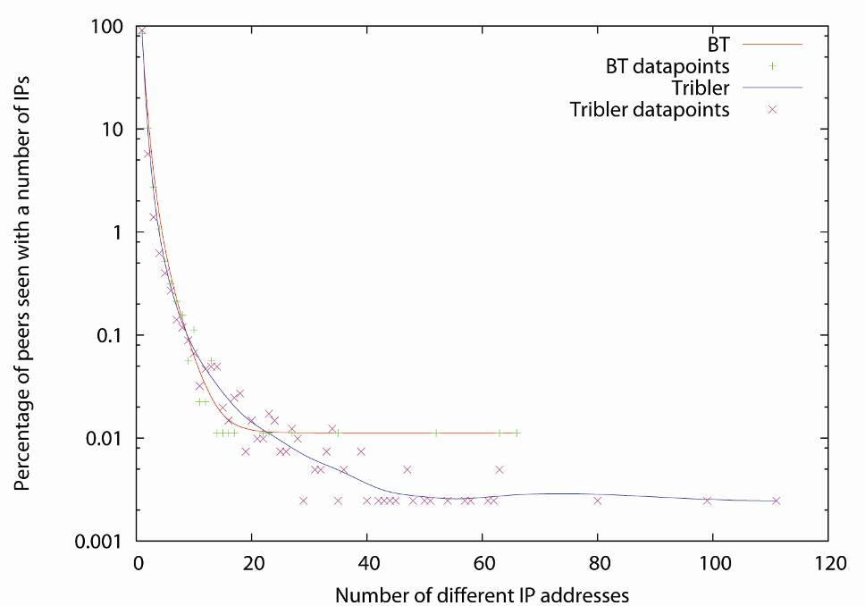
Gossiping 3 – social networks: IP dynamics (1)
percentage of peers with
number of IP addresses
number of different IP address
1% of the peers has been seen
with more than 4 IP addresses
Conclusion:
IP addresses of peers are not very dynamic

Slide 20
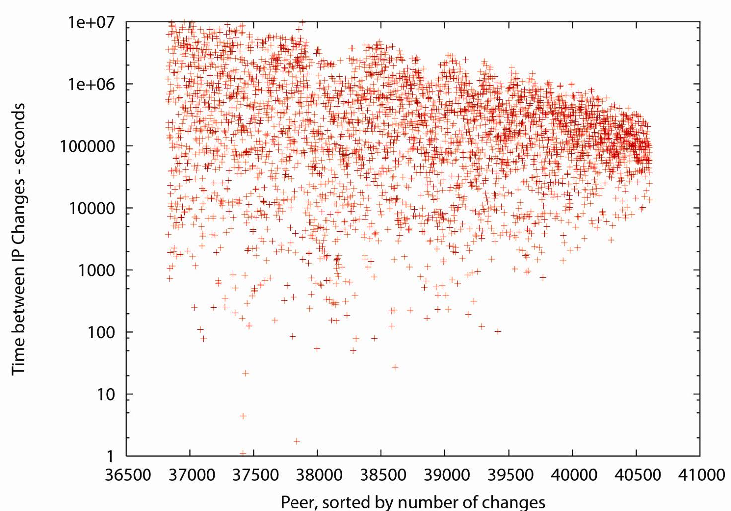
Gossiping 3 – social networks: IP dynamics (2)
time between
IP changes (s)
in Tribler
peers sorted by number of changes
Conclusion:
  inter-IP-change time on the order of 3-300 hours

Slide 21
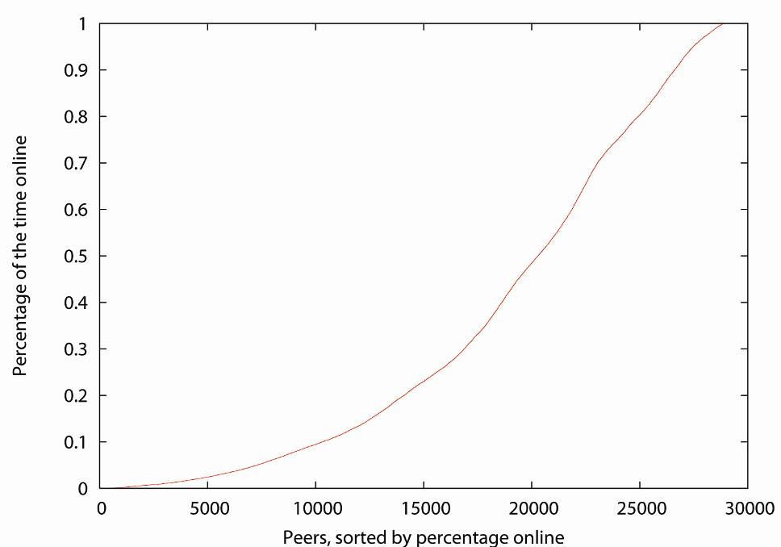
Gossiping 3 – social networks: peers online??
fraction of the
time online
in Tribler
peers sorted by fraction online
Conclusion:
Unavailability of peers is high
Peers are unconnectable because of NAT and firewalls (+/- 41% in a BitTorrent community, not shown)

Slide 22
Cooperative downloads: basic idea
Problem:
  most users have asymmetric upload/download links
  because of the tit-for-tat mechanism of Bittorrent, this restricts the download speed
Solution: let your friends help you for free
bartering
equal
upload download
friend
for
free
= 1/2
256 Kbps
peer
1024 Kbps
contributions
from friends
bartering
work by Pawel Garbacki and Alex Iosup

Slide 23
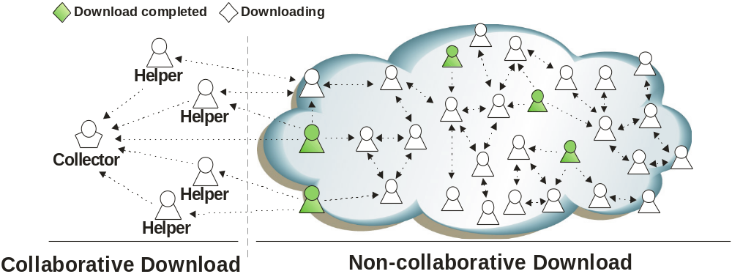
Collaborative downloads: another view
Collaboration established between collector and helpers
Collector aims at obtaining a complete copy of the file
Helpers download distinct chunks and send them to the collector, not requesting any other chunk in return

Slide 24
Future Gossiping Research in I-Share/Tribler
Thorough analysis of Buddycast, Little Bird, and NN:
  what is the connectivity among peers?
  how fast is new information propagated?
  what parameters should be used for deciding on:
    peer selection for gossiping
    frequency of gossiping
    which and how much information to gossip
There are more opportunities for gossiping
Let gossiping research be driven be real,
specific applications
Design real systems, deploy them in a real
environment, and then analyze them

Slide 25
Contributors
TU Delft-EEMCS-ICT
Inald Lagendijk
Marcel Reinders
Jacco Taal
Jun Wang
Maarten Clements
TU Delft-EEMCS-PDS
Johan Pouwelse
Henk Sips
Pawel Garbacki
Alexandru Iosup
Jan David Mol
Jie Yang
Maarten ten Brinke
Freek Zindel
Jelle Roozenburg
Steven Koolen
TU-Delft-ID
Jenneke Fokker
Huib de Ridder
Piet Westendorp
More information:
www.cs.vu.nl/ishare
www.tribler.org
dev.tribler.org
www.ewi.pds.tudelft.nl
(publication database)
VU
Maarten van Steen
Arno Bakker

