Slide 1
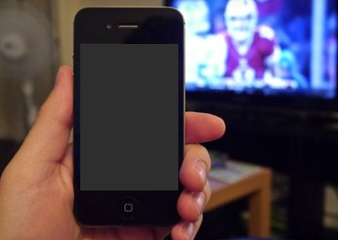
AURUX
A smart phone app
to measure TV
viewership habits.

Slide 2


THE TEAM
Varma has worked extensively in machine learning and optimization problems.
He has co-founded a startup named Matherix Labs in 2011 and was interviewed
by Y-Combinator in 2012. He has worked with major technology companies
such as Yahoo! labs and Amazon, and has experience building large scale systems.
LinkedIn: http://www.linkedin.com/in/cskvarma
Photo
Sai Krishna has worked for 3 years in the market research industry and 4 years in
software development. He has founded a startup named Olytor in 2009. He has
experience in panel research and client-servicing and worked with
major companies such as Nielsen and the Kantar group.
LinkedIn: http://in.linkedin.com/pub/sai-krishna-balivada/48/702/5a6
Photo

Slide 3
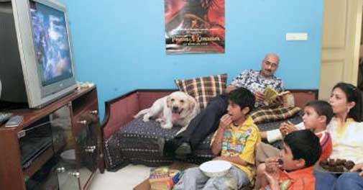
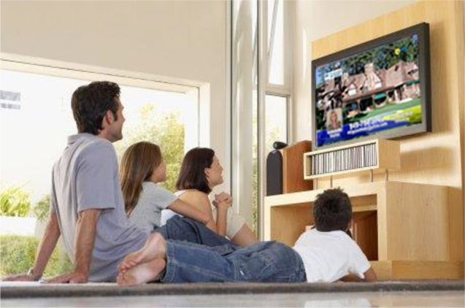

What is the business problem we want to solve?
To measure television viewership habits of a viewer within a household using smart phone app
as a means of measurement.
What people watch and for how long?

Slide 4


What is the customer problem ?
TV Advertisers want to have
robust and richer data at cheaper prices.
Current solutions such as Peoplemeter
are costlier and non-scalable.
Richer
data
Lower
Marketing
Spends
Using consumer smart phones
is scalable, cheaper, and more
personalized means of measurement.

Slide 5



Current Stage of Prototype
When the phone is placed
right next to the TV
When the phone is placed
far (>1.5 mtr) from the TV
TV Audio
TV Audio
With an error of 6-16 secs to detect channel change.

Slide 6
Size of Market and Go-To-Market Strategy
Major Players
3-5 billion in annual revenues
Nielsen TV Ratings
Kantar Media
CSM Media Research
Gfk
Gallup
Rentrak
$
Methodology Validation
Product/Market Fit
5-20 Users
3-4 Weeks
1-2 hrs/day
Demonstrate the capabilities and product/market fit.
Discuss with Mediacom, Nielsen, and FMCG Advertisers.
By end of March’14
By Apr-May’14

Slide 7


Prototype Video
AURUX

Slide 8
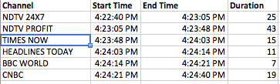
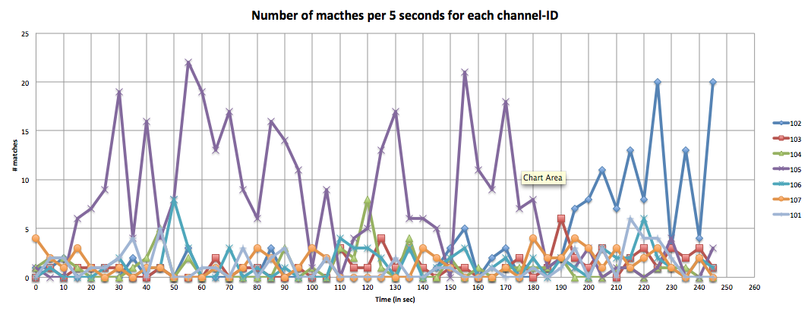
Sample Output

Slide 9
Thank you

Slide 10
Slide 1 - Company Name, Logo, Founder details Slide 2 - A brief one liner description of the product/solution Slide 3 - Customer problem that you are aiming to solve Slide 4 - What have you solved that is defensible (proprietary data) / some insights on this business that a layman can’t get in 6 months? Slide 5 - Traction and metrics to substantiate it Slide 6 - Size of market and Go-to-market strategy Slide 7 – Product/Application Demo or Visualization or Video

Slide 11
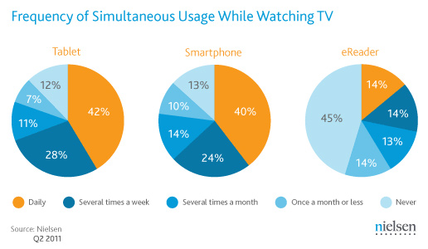

Slide 12
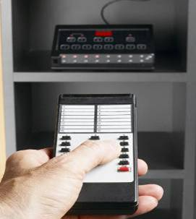
TAM
9650 peoplemeters covering 36000 respondents
Covers 165 cities (all 1 Lakh plus towns), from
2012 TAM started to include less than 1 lakh towns
TAM is likely to stop by 15 Feb’14

Slide 13
51 million smartphone users in Urban India in 2013 (89% growth over 2012)
17% of the Urban mobile phone market
Big Metros (23%), Tier 1 and Tier 2 cities (13%)
SEC A (18%), SEC B (8%), SEC C (6%), SEC D/E (4%)
<18 ( 22%), 18-24 (13%), 25-30 (8%), 31-35 (8%), 36-40 (8%),
Male (20%), Female (11%)

Slide 15
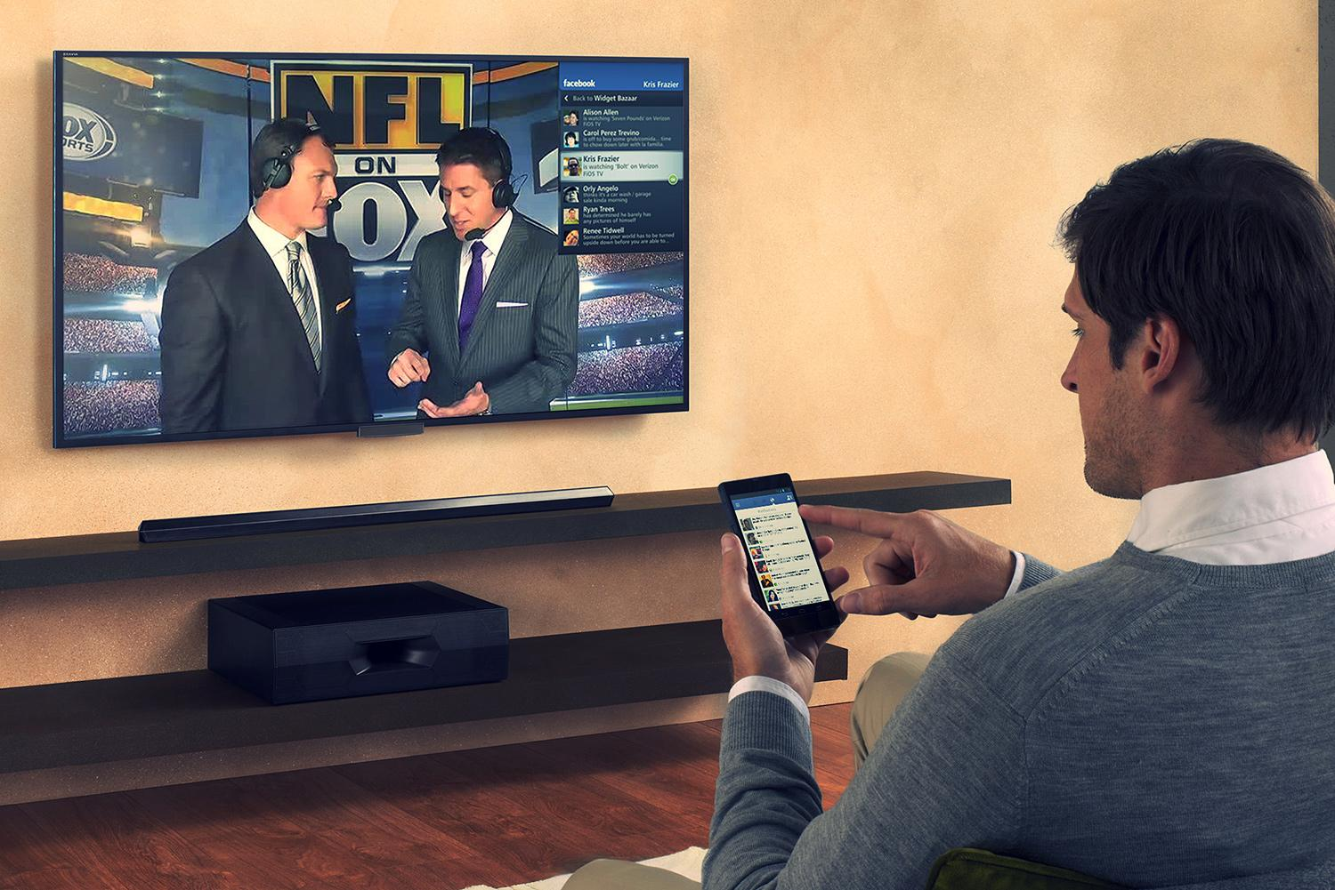


Slide 16

