Slide 1
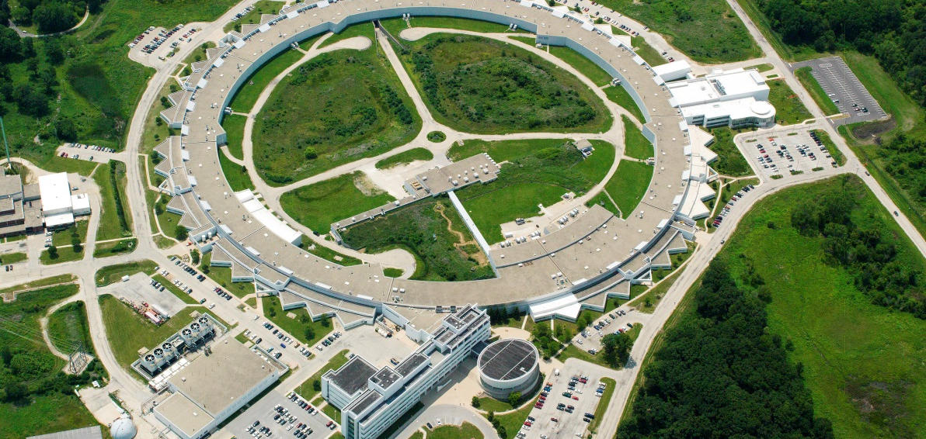
Advanced Photon Source – Upgrade
The Advanced Photon Source (APS) at the U.S. Department of Energy Office of Science’s Argonne National Laboratory provides this hemisphere’s most brilliant high-energy x-ray beams for research in almost all scientific disciplines.
erhtjhtyhy
Cory Lam
SULI Intern
April 28, 2022

Slide 2
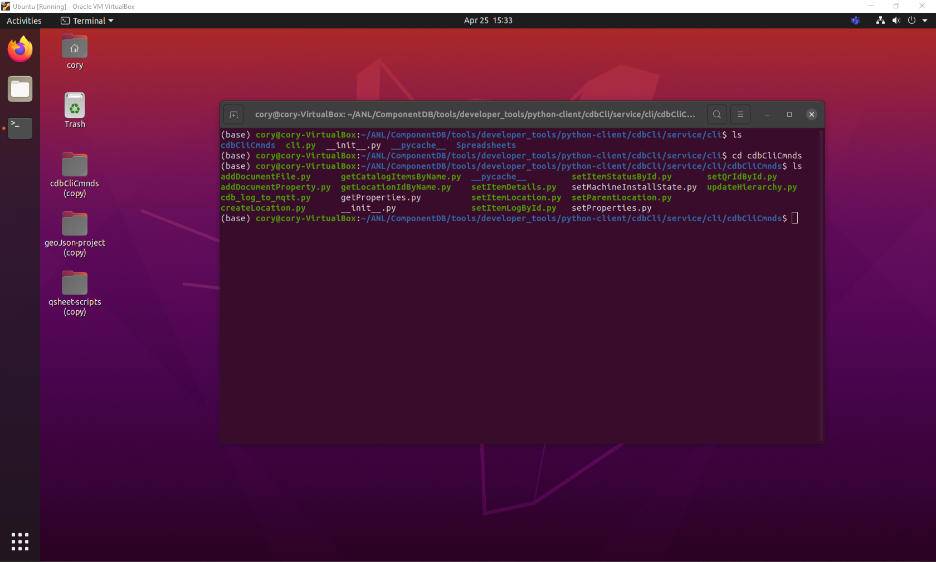
Command line interface
What are they and why are they important?
Text-based user interface
Increases control and flexibility
Allows for easier automation
Screenshot of Ubuntu’s graphical user interface and command line interface
Notes:
Text based compared to typical graphical based

Slide 3
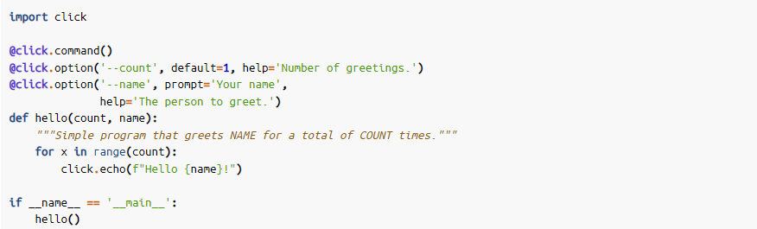
Command line interfaces
Python Module - Click
Easy-to-use
Arbitrary nesting of commands
Automatic help page generation
Screenshot of Ubuntu’s graphical user interface and command line interface

Slide 4
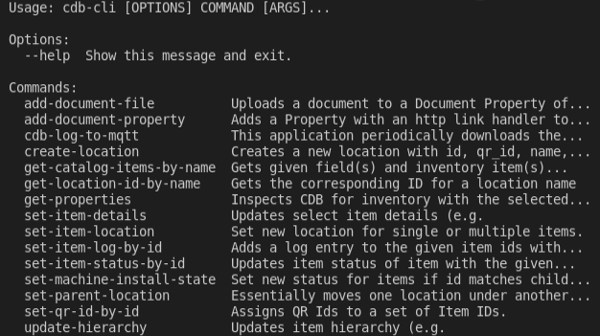
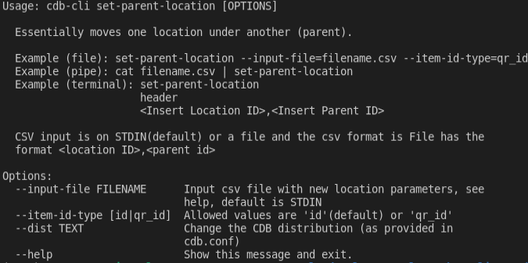
Scripting Framework
Interact with main equipment management system (Component Database) using Python
Goal is to create Unix pipeline

Slide 5

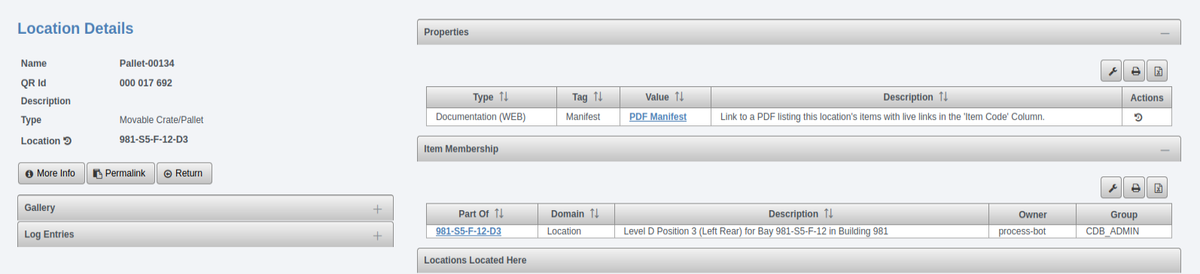
Example Command
Example input command on the terminal
Example csv content
Component Database (CDB) web view of the given location item

Slide 6
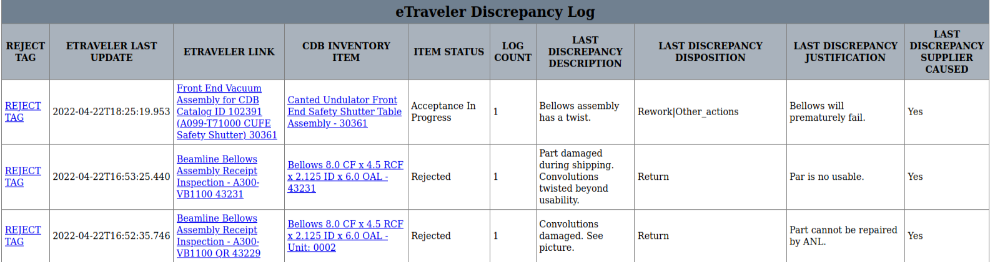
Export discrepancy logs
Allows easier navigation
Allows filtering
Consistent formatting
Screenshot of the three most recent discrepancy logs

Slide 7
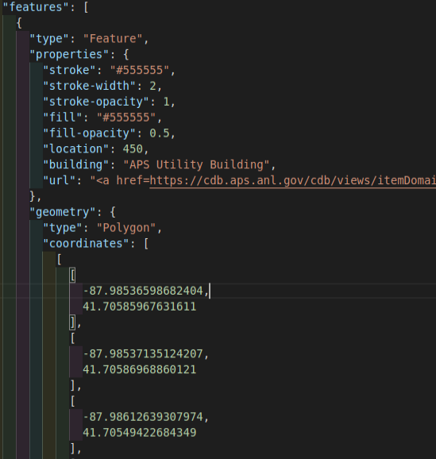
Proof of concept: Visualizing inventory
Utilize existing geographic information system tools
Export data from CDB in GeoJSON
Compile data to create different maps
Leverage existing python libraries for data visualization
Data contained inside GeoJSON file

Slide 8
Inventory Visualization using GIS tools
Folium and GeoPandas
GeoPandas
Builds upon a common python module (pandas)
Popular documentation
Folium
Builds on popular open-source JavaScript library for web mapping applications (Leaflet)
Popular documentation

Slide 9
Topics
Advanced Photon Source (describe what it is and how it is used)
Describe the goal of the upgrade project as well as its hurdle
Purpose of my appointment was to assist in the configuration management of components, systems, and operations of the APS-U project
Continuing the development of a scripting framework for engineers to interact with CDB
Exporting generations of discrepancy logs from the CDB/eTraveler databases for operations
Utilizing open-source GIS tools to visualize inventory data and status updates

