Slide 1
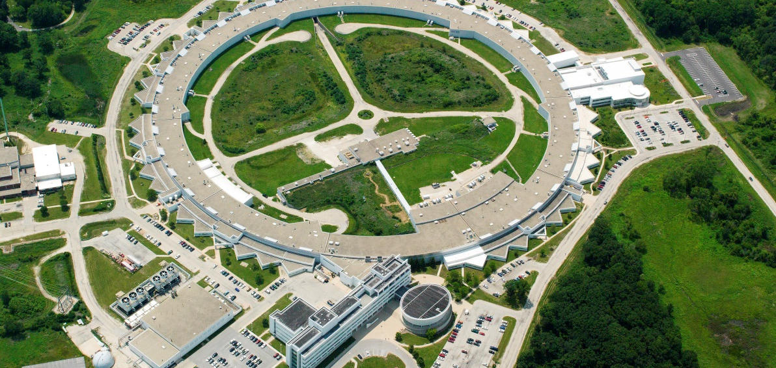
Advanced Photon Source – Upgrade
The Advanced Photon Source (APS) at the U.S. Department of Energy Office of Science’s Argonne National Laboratory provides this hemisphere’s most brilliant high-energy x-ray beams for research in almost all scientific disciplines.
erhtjhtyhy
Cory Lam
John Quintana
SULI Intern
April 28, 2022
Photon Sciences (PSC)

Slide 2
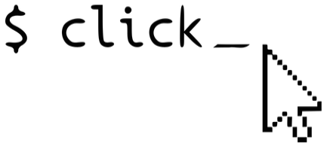
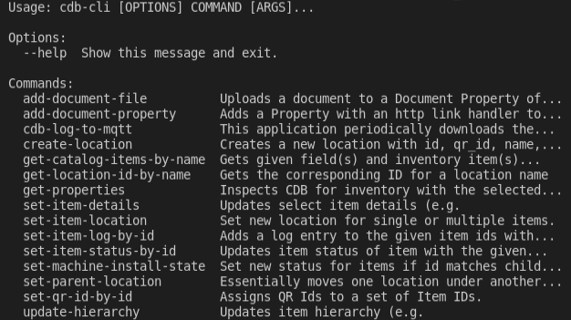
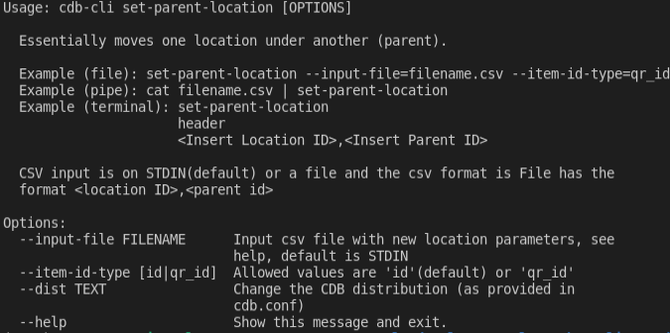
Scripting Framework
Interact with main equipment management system (Component Database) using Python
Create Unix pipeline
Set of commands in created cdb-cli tool
Help documentation for set-parent-location, cdb-cli command

Slide 3

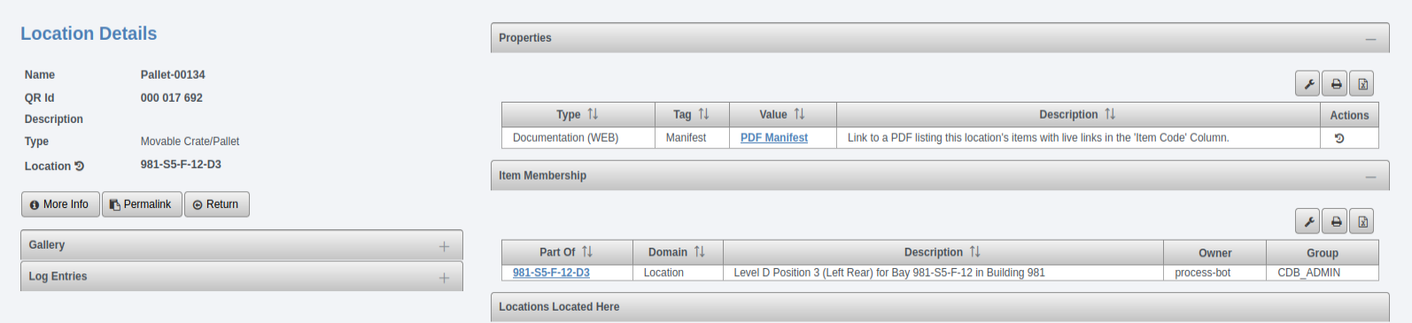
Example Command
Example input command on the terminal
Example csv content
Help documentation for given cdb-cli command
Component Database (CDB) web view of the given location item

Slide 4
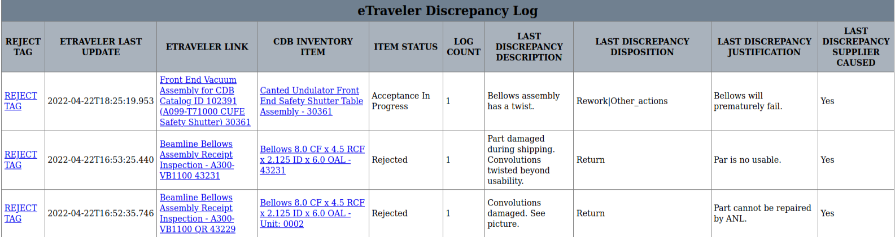
Export discrepancy logs
Easier navigation
Filtering
Consistent formatting
Screenshot of the three most recent discrepancy logs

Slide 5


Proof of concept: Visualizing inventory
Utilize existing geographic information system tools
Export data from CDB in GeoJSON
Compile data to create different maps
Leverage existing python libraries for data visualization
Proof-of-concept map link

Slide 6
Acknowledgements
John Quintana, Dariusz Jarosz, Diane Wilkinson
Argonne National Laboratory, Department of Energy

