Slide 1
Zynq/Linux Training SKO 2016
Software Anatomy of a Zynq System

Slide 2
Outline
Elements of a Zynq System
Boot Process Overview
Zynq Image Overview
System Customization
Notes:
Outline
Elements of a Zynq system
Boot process overview
Zynq image overview
System customization

Slide 3
Learning Outcomes
Students will gain an understanding of:
The software components of a Zynq® system
How the components are created
What can be customized and where
How the components are combined to form a system image
Notes:
Learning Outcomes
The attendee will gain an understanding of:
The software components of a Zynq system
How the components are created
What can be customized and where
How the components are combined to form a system image

Slide 4
Elements of a Zynq System
ROM
First Stage Bootloader
Xilinx FSBL
U-Boot SPL
Second Stage Bootloader
U-Boot
OS
Linux
VxWorks
Least
Generic
Most
Generic
Notes:
Elements of a Zynq System
ROM: Fixed boot code. Locates and executes First Stage Bootloader (FSBL)
First Stage Bootloader (FSBL): This software is responsible for a range of tasks including:
Configuring the device based on user choices / PCB layout
Setting up the DDR3
Configuring ARM I/O pins
The standard FSBL for MathWorks® is Xilinx® FSBL. The alternative is the U-Boot Serial Pre-loader (SPL), which is used on Altera® SoC platforms.
Second Stage Bootloader (SSBL): Intermediate software to bridge between the First Stage Bootloader (device-specific) and the OS (generic). This allows the OS to boot in a standard way, regardless of the hardware platform. It may also read in customization files such as a Device Tree, or make decisions about the boot source (SD card vs. flash vs. network boot)
Operating System: The runtime environment for user-software. This includes the scheduler to execute user software and drivers to communicate with hardware. The standard OS for MathWorks Zynq systems is Linux.

Slide 5
Zynq Boot Process
ROM
Sample MIO pins to determine boot source (SD/NAND/SPI)
Handoff to FSBL
FSBL
Configure DDR3
Handoff to U-Boot
U-Boot
Load Device Tree, OS Kernel and Userspace
[Optionally] Program FPGA Bitstream
Route ARM Peripherals (MIO vs. FPGA Fabric)
Handoff to the OS
Linux
Load device drivers
Run application software
[Optionally] Program FPGA
Provide user-space libraries
Notes:
Zynq Boot Process
ROM: The overall goal of this code is to locate and launch the FSBL. The boot source is chosen by sampling MIO[5:3] to select between JTAG, NAND, NOR, SPI or SD (see table 6-4 in Xilinx ug585). The boot ROM does some minimal checking of a header/checksum to ensure that the chosen boot source is valid. The boot ROM also has provisions for secure boot, using encrypted code in the FSBL.
FSBL: The overall goal of the FSBL is to prep the system to run more generic code, such as a baremetal application or secondary boot loader (U-Boot). It does this by enabling the DDR3 and configuring the peripheral routing (e.g. USB, Ethernet, etc.) either to the dedicated ARM I/O pins (MIO) or into the FPGA fabric (EMIO). Once this is done, the FPGA can optionally be programmed and then the next stage is launched.
U-Boot: U-Boot’s primary role is to load the operating system (and any configuration files), wherever it may reside. U-Boot can load the OS from a different location than it was launched from. For example, U-Boot could have been launched from NAND flash and load the OS via Ethernet.
Linux: Linux uses the Device Tree to determine which drivers to load as it boots the system. Once the OS is up and running, it provides a standard environment for running applications such as software generated from Embedded Coder.

Slide 6
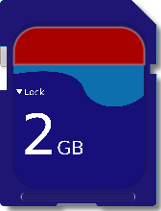
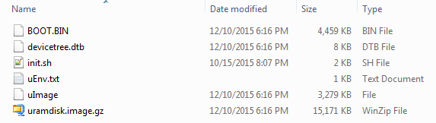
Zynq Image Overview
Notes:
Zynq Image Overview
SD Card: The size is arbitrary as long as it can hold the files. The entire SD card is formatted as a FAT32 (DOS) partition, enabling easy access from Windows.
BOOT.BIN: Zynq boot image, comprised of the FSBL, U-boot, and [optional] Bitstream. This is generated from the Xilinx SDK.
devicetree.dtb: Compiled Device Tree file, describes hardware for Linux. U-Boot will load this file into memory before booting Linux.
init.sh: Linux script that runs on each boot. This script will run after Linux has finished booting, and can be customized by the user.
uEnv.txt: [Optional] User customizable U-Boot environment variables and macros
uImage: Linux kernel in U-Boot format.
Uramdisk.image.gz: User space image that will be loaded into RAM as a volatile filesystem. The entire Linux filesystem is volatile with the exception of the /mnt directory, which points to the SD card.

Slide 7
Zynq Image Customization (1)
Motivation
Need to interact with a new hardware device (sensor, A/D, etc)
Need to interact with 3rd party software (libraries, etc)
Need to add support for a new board
Where we’re starting from
Default Vivado design
Default Kernel Config
Default Buildroot Config
Notes:
Zynq Image Customization
There are a number of reasons why a user might need to customize the Zynq image. For example, they might need to:
Interact with a new hardware device (sensor, A/D, etc.)
Interact with 3rd party software (libraries, etc.)
Add support for a new board
To do so, the user must start from the following:
Default Vivado Design: This is a “base” Vivado project that defines the default FSBL and Bitstream that we ship with the Zynq EC HSP. This project is built out of our FSBL tool that will be described in the next session.
Default Kernel Config: A Linux kernel configuration that defines the available drivers and settings in our shipping Linux kernel [1].
It can also be found on a running Zynq board via the following command:
cat /proc/config.gz | gunzip
Default Buildroot Config: A selection of packages that determine what applications / libraries are available on our systems. This is most easily explored by building a default image via Buildroot and then examining the configuration file. This will be described in more detail in the next session.
Before starting the customization work, it is important to review what has already been configured in the shipping images.
[1]: http://insidelabs-git.mathworks.com/EmbeddedLinux/xilinx-linux/blob/master/arch/arm/configs/mw_zynq_defconfig

Slide 8
Zynq Image Customization (2)
Common Modifications
Vivado: FSBL / Bitsteam
Linux: Drivers / Libraries / Init script
Uncommon Modifications
U-Boot: Boot device control
Notes:
Zynq Image Customization
Common Modifications:
Vivado: FSBL / Bitsteam
Turning on/off peripherals on the Zynq node
Adding additional peripherals to the FPGA fabric
Linux: Drivers / Libraries / Init script
Enabling/disabling drivers
Editing the Device Tree to describe new hardware
Adding in additional software libraries
Modifying the init script to automate a task at startup
Uncommon Modifications:
U-Boot:
Adding support for a new board (usually performed by the board vendor)
Customizing the boot behavior (e.g. booting from Ethernet)

Slide 9
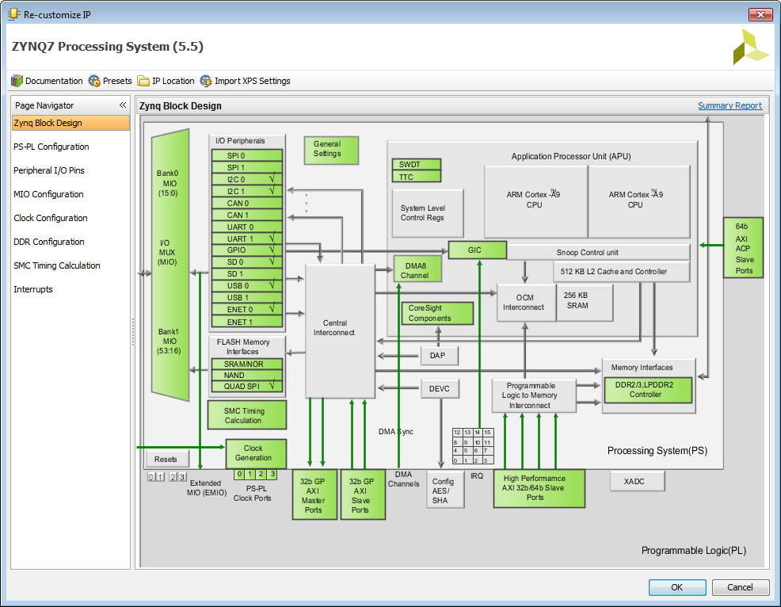
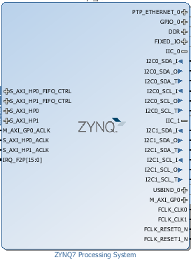
FSBL: Customization in Vivado
Notes:
FSBL Customization in Vivado
Customization begins at the Zynq block in Vivado IP Integrator.
Here, we can configure things such as:
DDR3 Pinout / Timing
ARM Input clock configuration
ARM PLL Settings
Peripheral Use / Routing

Slide 10
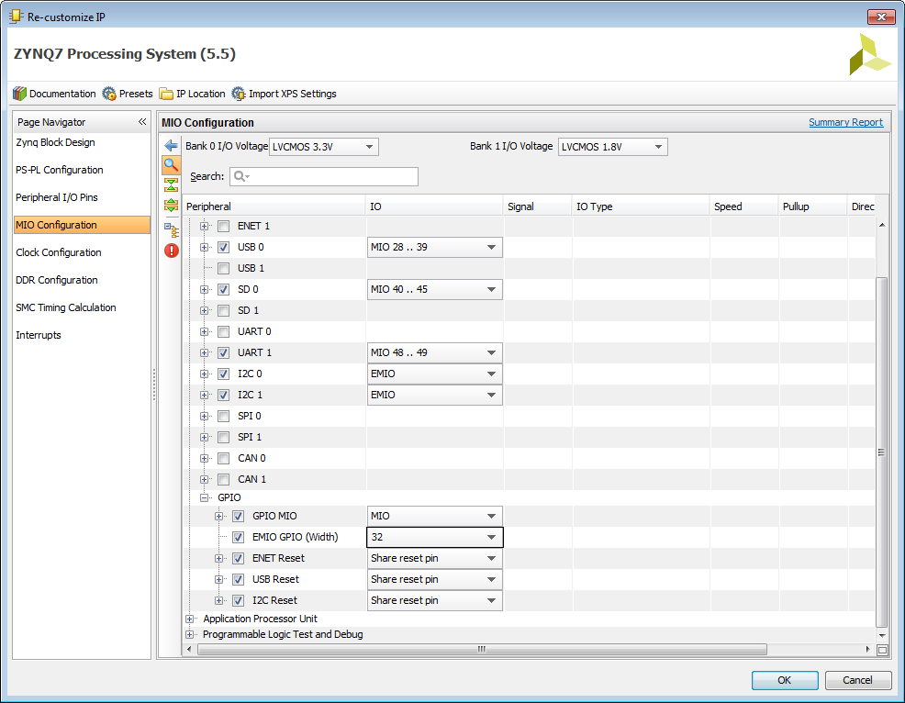
FSBL: Zynq Peripherals
1
2
3
Notes:
FSBL: Zynq Peripherals
The most common customization action performed will be to enable / map the ARM peripherals. On a custom Zynq board, this is generally a one-time task based on the pinout of the PCB. On a dev-kit, this is a common customization action based on the plug-in cards installed and the customer application.
MIO: Dedicated ARM I/O pins that have some multiplexing capability between peripherals. Any MIO pins not used for a peripheral are available as GPIO.
EMIO: ARM peripheral routed to the FPGA fabric where it can be terminated, modified, or passed through to FPGA I/O pins.
Note that when an EMIO is used for a peripheral, the FPGA must be programmed in order for the peripheral to operate. MIO peripherals can operate without any FPGA image being present.
Examples:
UART mapped to specific MIO pins– this is the serial port used for the console.
I2C mapped to EMIO– this could then get routed out of the FPGA via regular FPGA I/O pins.
GPIO configuration– this selects the number of GPIO pins routed into the FPGA fabric. These pins could then be used to provide software control for FPGA peripherals (e.g. 1-bit inputs) or routed to FPGA I/O pins.

Slide 11
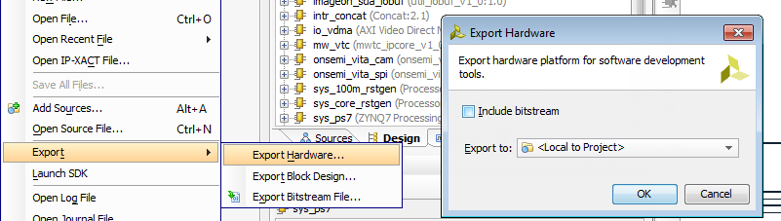
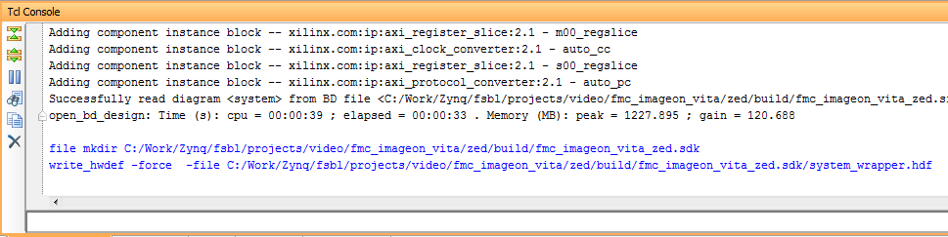
FSBL: Export Hardware
Notes:
FSBL: Export Hardware
From Vivado, we can export the IP Integrator project to the Xilinx SDK, which will be used to generate the FSBL.
The Vivado export will take the form of a hardware definition file (HDF) that describes the selections made on the Zynq node. The Xilinx SDK will use this to automatically generate the software to configure the ARM I/O, DDR3 controller, etc. We can see the location of the generated file / folder in the TCL Console.
To generate a MathWorks SD Card image, this process is automated by our Zynq FSBL scripts.

Slide 12
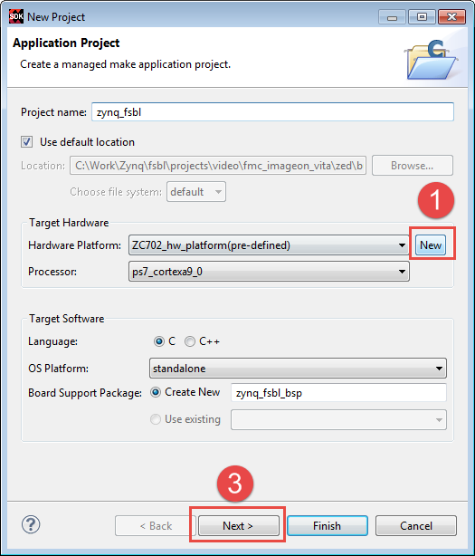
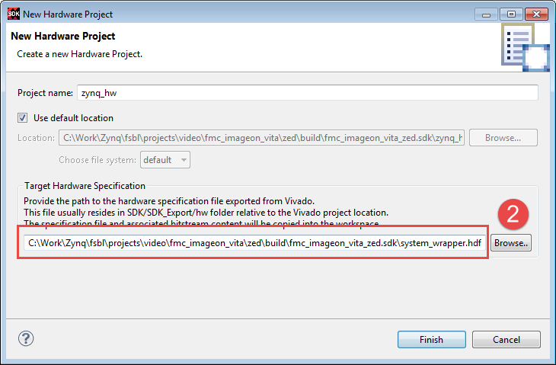
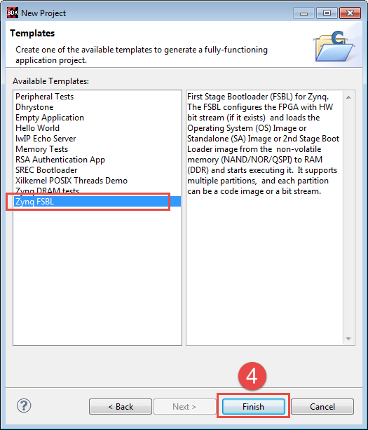
FSBL: New SDK Application
Notes:
FSBL: New SDK Application
To create a new Vivado SDK application, follow these steps:
Create a new application project (File à New à Application Project).
In the Target Hardware section, click the New button to open the New Hardware Project dialog.
In the New Hardware Project pane, choose the HDF file generated from Vivado for the Target Hardware Specification.
Back in the New Project dialog, click the Next button to bring up the Application Templates dialog, choose Zynq FSBL, and then click Finish.
At this point, the Xilinx SDK should automatically generate and build the FSBL. To generate a MathWorks SD Card image, this process is automated by our Zynq FSBL scripts.

Slide 13



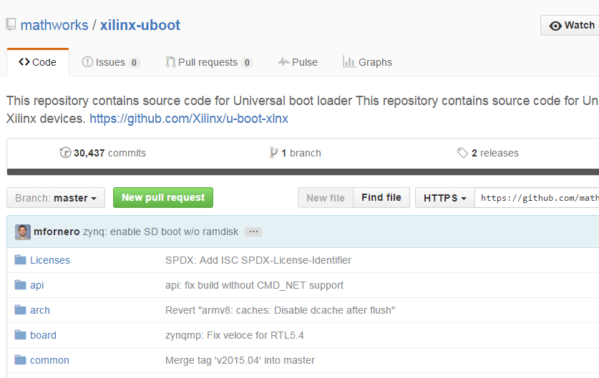
U-Boot Customization
Notes:
U-Boot Customization
Minimal customization is done to U-Boot itself; it is primarily built from the sources on github.com.
If you are using a development board supported by Xilinx, all of the necessary customization should already be completed in the U-Boot repository. However, if you are using a board from another vendor, they should supply the necessary U-Boot source / modifications to build for their platform. For the most part this involves creating a config file at:
include/configs/zynq_BOARDNAME.h

Slide 14
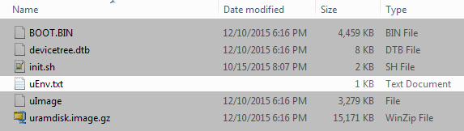
U-Boot Environment
bitstream_image=system.bit
mmc_loadbit=echo Loading bitstream from SD/MMC/eMMC to RAM.. && mmcinfo && load mmc 0 ${loadbit_addr} ${bitstream_image} && fpga loadb 0 ${loadbit_addr} ${filesize}
sd_bitstream_existence_test=test -e mmc 0 /${bitstream_image}
uenvcmd=if run sd_bitstream_existence_test; then run mmc_loadbit; fi;
Notes:
U-Boot Environment
Upon booting from an SD card, U-boot will:
Check for the existence of a file uEnv.txt.
If found, load any variables/macros defined in the file (overriding any variables of the same name already defined)
If a variable uenvcmd was defined, execute before proceeding with the boot sequence (Note: this variable could command U-Boot to boot to the OS, thus ending the U-Boot boot sequence).
In this example, the uEnx.txt defines the following:
Variable bitstream_image with the value system.bit.
A command mmc_loadbit that will load the bitstream into memory and then program the FPGA.
A command sd_bitstream_existence_test that checks if the bitstream_image file exists.
A command uenvcmd that checks runs the sd_bitstream_existence_test command and if successful, runs the mmc_loadbit command/
The result of this is that U-Boot will program the FPGA before booting into Linux if a file named system.bit is placed on the root of the SD card. This is useful if Linux drivers attempt to access FPGA peripherals during OS boot.
bitstream_image=system.bit
mmc_loadbit=echo Loading bitstream from SD/MMC/eMMC to RAM.. && mmcinfo && load mmc 0 ${loadbit_addr} ${bitstream_image} && fpga loadb 0 ${loadbit_addr} ${filesize}
sd_bitstream_existence_test=test -e mmc 0 /${bitstream_image}
uenvcmd=if run sd_bitstream_existence_test; then run mmc_loadbit; fi;

Slide 15
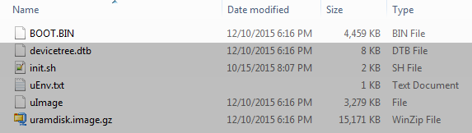
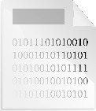
Creating a System Image
FSBL
U-Boot
Bitstream
BOOT.BIN
Xilinx SDK
(Bootgen)
Notes:
Creating a System Image
Once both the FSBL and the U-Boot binaries have been built, they need to be combined into a BOOT.BIN file in order to boot from the SD card. The binaries and the optional bitstream file are combined together via the Bootgen tool from the Xilinx SDK. When booting, the ROM will look for a file named BOOT.BIN on the first partition of the SD Card.
For generating a MathWorks SD Card image, this process is automated by our Buildroot scripts.

Slide 16


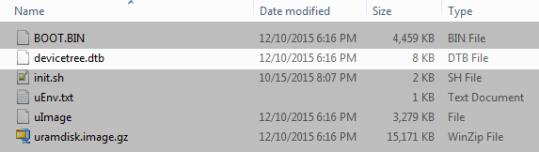
Linux Device Tree (1)
DTC
.dts
.dtb
Notes:
The Linux Device Tree
The Device Tree describes the hardware/FPGA to Linux so that it can load the correct drivers. The most common type of modification involves adding content to the Device Tree.
Device Tree files come in two forms:
.dts: Source files, which are structured text files.
.dtb: Binary files, which are compiled from the source and used during the boot process.
A tool, DTC, can be used to convert between the two formats.
In general, Device Trees are compiled in a hierarchical fashion, with multiple .dts files used to generate a single .dtb. This allows a .dts file to describe the base platform (e.g. the internals of the ARM core) and additional .dts files to describe the board and/or application specific components.

Slide 17
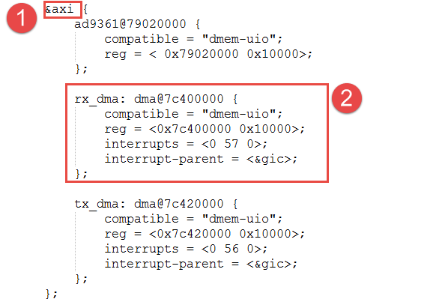
Linux Device Tree (2)
Notes:
The Linux Device Tree
The Device Tree snippet contains the following:
The node to insert the new devices under (in this case, it is the FPGA AXI Bus)
The device itself
In this case:
rx_dma: dma@7c400000 is the name/address of the new device.
compatible = "dmem-uio" dma@7c400000 is the compatibility string used to identify the Linux driver.
reg = <0x7c400000 0x10000> is the base address and range of the registers.
interrupts = <0 57 0> is the interrupt number.
interrupt-parent = <&gic> is the interrupt controller that the device is attached to.
The content for a given device entry will vary based on the device itself and the Linux driver. You can usually find an example of the Device Tree content for a given device either by searching on line or reviewing the Linux kernel source /Documentation/devicetree/bindings/.
We will explore an example of this in the next session.

Slide 18
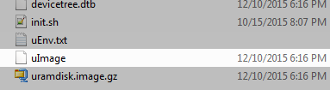
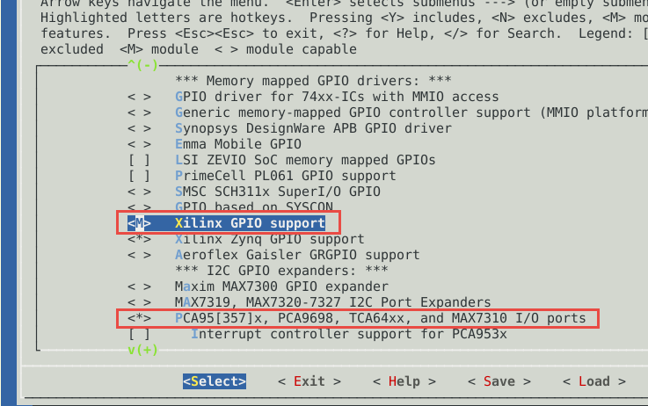
Linux Kernel Drivers
Notes:
Linux Kernel Drivers
The Linux kernel contains support for many pieces of hardware and/or FPGA IP. In order to make use of this hardware, we must build the driver for it. In the image below, we can see the GPIO drivers page of the Linux kernel configuration (menuconfig).
The <M> next to the Xilinx GPIO support line indicates that the driver will be built as a module.
The <*> next to the PCA95[357]x… line indicates that the driver will be built into the kernel (uImage).
Kernel modules are loadable drivers which are not built into the kernel image itself. These drivers are built as .ko files, and are included on the root filesystem image (uramdisk.image.gz). Before they can be used, they must be loaded with either the insmod or modprobe commands. Built-in drivers are always present in memory.
In both cases, the Device Tree must contain the corresponding node (with matching compatible string) in order for the driver to be used.
When building a MathWorks SD Card image, the default kernel configuration must be updated or a kernel configuration must be supplied to the Buildroot environment.

Slide 19
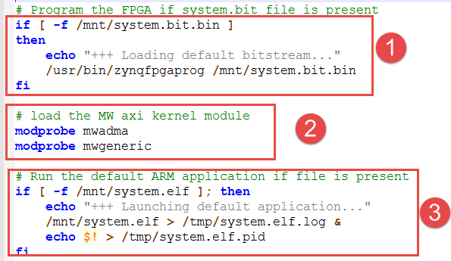
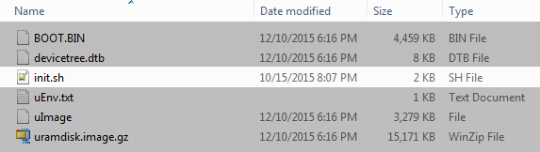
Linux Init Script
Notes:
Linux Init Script
The init.sh script is executed by Linux after the operating system has loaded. It can be used to load drivers, run custom programs, or any other action the user wants to happen on each boot.
Note In the MathWorks Linux image, the SD card is mounted at /mnt.
In this example, we can see the following:
Check for the existence of a file named system.bit.bin on the root of the SD card. If found, use it to program the FPGA.
Load the mwadma (AXI4-Lite / AXI4 Stream) and mwgeneric drivers.
Check for the existence of a file named system.elf on the root of the SD card. If found, execute it (and log the output / PID).

Slide 20
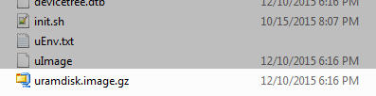
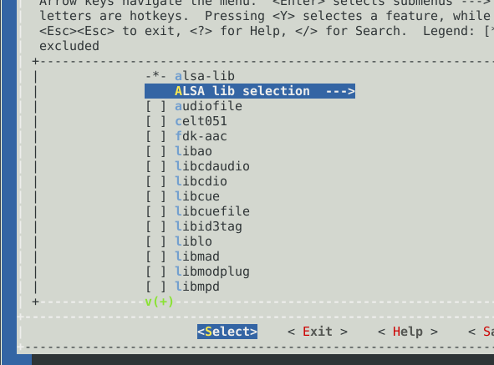
Linux: Libraries
Notes:
Linux: Libraries
Linux is comprised of both the kernel and the user-space programs that run on top of it. In addition to customizing the kernel, some applications may require additional user-space software to be present in the system.
To build up the user-space system, we use a tool called Buildroot. Buildroot:
Automatically downloads the source for libraries, applications, etc.
Compiles them.
Packs them into our ramdisk image.
In the image, we can see the menuconfig interface (similar to that of the Linux kernel) of buildroot. Here packages can be turned on and off for inclusion in the user space image.
When building a MathWorks SD card image, Buildroot is also used to automate the compilation of the Linux kernel, U-boot and the packing of all the files into a single disk image.

