Slide 1
Zynq/Linux Training SKO 2016
Zynq Build System

Slide 2
Outline
Overview of the Vivado Build System
Overview of the Buildroot Build System
Notes:
Outline
Overview of the Vivado build system
Overview of the Buildroot build system

Slide 3
Learning Outcomes
Students will gain an understanding of:
The system used to build default Vivado projects, bitstreams and FSBLs
The system used to build Linux, U-Boot and package the SD Cards
Notes:
Learning Outcomes
The attendee will gain an understanding of:
The system used to build default Vivado projects, bitstreams, and FSBLs
The system used to build Linux, U-Boot, and package the SD cards

Slide 4
Vivado Build
Vivado / SDK is responsible for creating the bitstream and FSBL
Also used to make an IP Integrator template, for use in an HDL Coder Reference Design
Can we automate this process? – Yes!
Notes:
Vivado Build
Vivado/SDK is responsible for creating the bitstream and FSBL.
It is also used to make an IP Integrator template that will be used in an HDL Coder reference design.
Note It is possible to automate this process!

Slide 5
Vivado Build System
Zynq FSBL Project
  http://insidelabs-git.mathworks.com/mfornero/zynqfsbl
Automates the following:
  Project creation
  Use of additional IP Cores
  Export of HDL Coder RD TCL script
  Building of bitstream
  Building of FSBL
Notes:
Vivado Build System
The Zynq FSBL Project can be found at:
http://insidelabs-git.mathworks.com/mfornero/zynqfsbl
This automates the following:
Project creation
Use of additional IP Cores
Export of HDL Coder RD TCL script
Building of bitstream
Building of FSBL

Slide 6
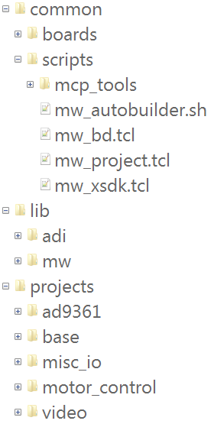
Vivado Build System
Common scripts
  Block diagram functions
  Vivado project functions
  SDK automation script
IP and 3rd Party Libraries
  ADI HDL Repo
  MW IP
Projects
  AD9361 Projects
  Base (e.g. HDL Coder shipping RD) projects
  Video Projects
Notes:
Vivado Build System
The Vivado Build System is a collection of Vivado TCL scripts. These scripts automate the entire Vivado build process, from generating IP cores to building entire projects.
By encapsulating the projects in TCL scripts, we are able to re-use IP and entire designs between boards, reducing redundant work and ensuring a common environment between dev kits.
Most projects can be built by navigating to the board specific project directory and running the following command:
vivado -mode batch -source system.tcl
where system.tcl is the name of the TCL script in the board-specific project directory.
To view the project as it is created, the following command can also be used:
vivado -mode gui -source system.tcl
Both commands run the same TCL script, but the GUI mode will launch the Vivado GUI to run it.
The resulting project is placed in the ./build directory, relative to the system.tcl file. The FSBL, bitstream, and exported RD TCL files are all located at ./build/output

Slide 7
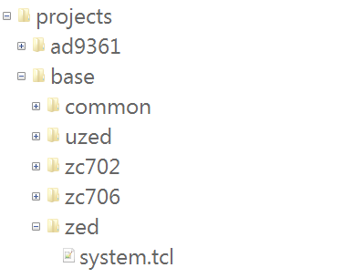
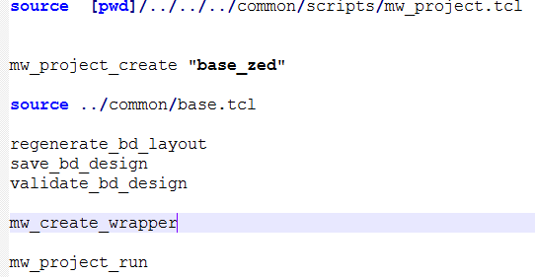
Vivado Base Projects
Notes:
Vivado Base Projects
The base projects are used to create the default AXI4-Lite project for each of the boards. The output of these projects is used to build our default SD card images, and they represent a good starting point for customization.
To build the base zed project:
Navigate to projects/base/zed
Run the following command:
vivado -mode batch -source system.tcl
Note: By default, the build script will generate the all of the outputs (FSBL and bitstream). The build script can also take an additional argument to cause the build to stop earlier (useful if you are going to do additional customizations).
To only generate the IP integrator project:
vivado -mode batch -source system.tcl –tclargs –target bd
To only generate generate the FSBL (but no bitstream):
vivado -mode batch -source system.tcl –tclargs –target fsbl

Slide 8
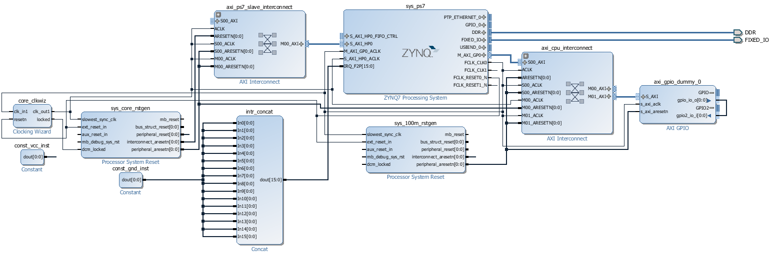
Vivado Base Projects
Notes:
Vivado Base Projects
After the build script completes, the generated project can be opened to review or perform additional modifications. Note that modifications made to the project will not automatically be reflected in the contents of the output directory; the modifications must be extracted to TCL scripts and the system.tcl script re-run.
When looking to perform customizations, the generated base project is a good place to start, and the modified block diagram can easily be exported to TCL for use in a custom build.

Slide 9
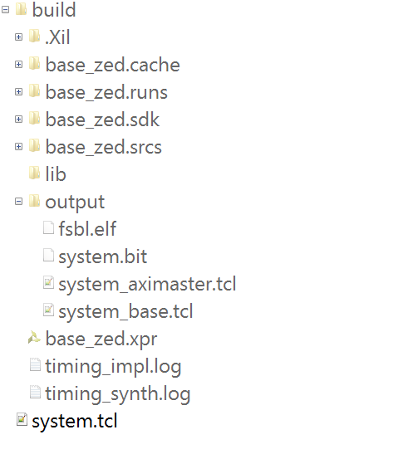
Base Project Artifacts
Build directory
  Output Directory
    FSBL
    Bitstream
    Default TCL export
Notes:
Base Project Artifacts
The FSBL and the Bitstream will be used later by the Buildroot system when constructing the SD card image.
The Default TCL export can be used by HDL Coder to author a reference design.
Build directory
Output directory
FSBL
Bistream
Default TCL export

Slide 10
System Images
Once we have the FSBL and Bitstream, we still need a number of items to create a system image:
  Linux Kernel
  Linux Userspace
  U-Boot Bootloader
  Device Tree
  Packaging into a SD Card image
Can we automate this? – Yes!
Notes:
System Images
Once we have the FSBL and Bitstream, we still need a number of items to create a system image:
Linux Kernel
Linux Userspace
U-Boot Bootloader
Device Tree
Packaging into a SD card image
It is also possible to automate this process.

Slide 11
Buildroot Build System
Open-source system for compiling the Linux Kernel, Linux userspace and U-Boot
  http://buildroot.uclibc.org
Wrapped in pre-/post- processing scripts to configure for a specific board / application and package into a system image
  http://insidelabs-git.mathworks.com/EmbeddedLinux/buildroot/
Notes:
Buildroot Build System
The Buildroot Build system is an open-source system for compiling the Linux Kernel, Linux userspace, and U-Boot. To access it, go to the following link:
http://buildroot.uclibc.org
We have a version of buildroot that can generate full SD card images for a number of platforms. To do so, it is wrapped in pre/post processing scripts to configure for a specific board/application and package into a system image:
http://insidelabs-git.mathworks.com/EmbeddedLinux/buildroot/

Slide 12
MathWorks Buildroot
Config
BOOT.BIN(s)
Package
User-space Libs/Applications
Linux Kernel
Build
Common/Platform/Board-specific files
Configuration XML
U-Boot
Devicetree(s)
Disk Image
Device Trees
Notes:
MathWorks Buildroot
The Config step takes in a platform/board/application specification and generates a Buildroot configuration file
The Build step is the standard Buildroot build, using the configuration file (.config) to build the binary images listed above
The Package step takes the outputs of the Buildroot build and packs them into a disk image.

Slide 13
MathWorks Buildroot: Config
Common Config
Custom Config
Build Config
Platform (Zynq) Config
Board (ZedBoard) Config
Notes:
MathWorks Buildroot: Config
The build system begins by creating a Buildroot configuration file, based on a hierarchy of configuration sources.
The sources are combined from least-specific (e.g. common to all MathWorks images) to most-specific (e.g. specified for the specific build), with the more-specific source capable of overriding the less-specific sources.
The resultant configuration file is a standard Buildroot .config file, used to drive the build.
Full documentation can be found here:
http://insidelabs-git.mathworks.com/
EmbeddedLinux/buildroot/blob/next/board/mathworks/doc/readme.md

Slide 14
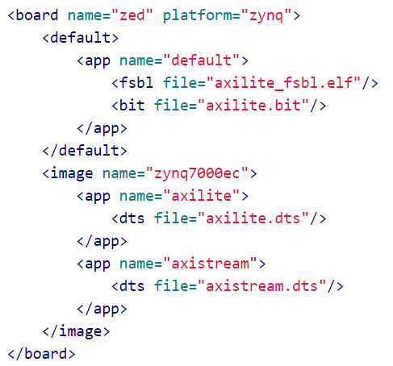
MathWorks Buildroot: Config
Notes:
MathWorks Buildroot: Config
The primary means for configuring the build flow is via the XML catalog file. This file specifies:
The board and platform being built (e.g. ZedBoard / zynq)
The disk image(s) to create
The application(s) to include in the disk image (i.e. BOOT.BIN / devicetree combinations)
The files to use in constructing the applications (devicetree source / FSBL / bitstreams)
In addition to the items shown above, the catalog file can also specify:
A Linux kernel configuration file to use (instead of the default)
A directory to use for copying files onto the SD card
A Buildroot config file to add / override any Buildroot options
Full documentation can be found here:
http://insidelabs-git.mathworks.com/EmbeddedLinux/buildroot/blob/next/board/mathworks/doc/catalog.md

Slide 15
MathWorks Buildroot: Packaing
Linux
BOOT.BIN(s)
Device Tree(s)
Disk Image
Notes:
MathWorks Buildroot: Packaging
Based on the catalog file, the build system will automatically package the components into a disk image.
For the Zynq platform, this disk image will take the form of a .zip file suitable for copying onto the root of a FAT32 formatted SD card.

Slide 16
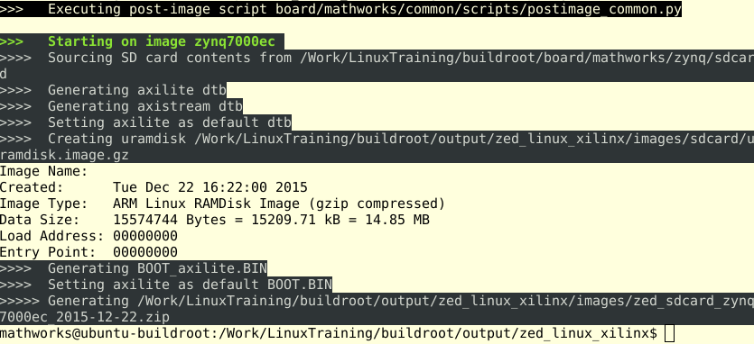
MathWorks Buildroot: Build
Notes:
MathWorksBuildroot: Build
To run the MathWorks build system, use the build.py script. One of the following two syntaxes can be used:
./build.py -b <board> -p <platform>
or
./build.py -c <path to catalog file>
The former syntax uses the board (e.g. Zed) and platform (e.g. Zynq) to locate the catalog file within the Buildroot tree. The later syntax explicitly specifies the catalog file, and is the only way to build out-of-tree (i.e. custom) catalog files.
The build system will display the path of the generated SD card image when complete, as shown below.

