Slide 1
Embedded Linux and System Integration for ARM on SoCs
Zynq Customization Exercise

Slide 2
Outline
Modifying the Vivado Project
Updating the Device Tree
Updating the Kernel Configuration
Configuring Buildroot
Generating and Testing the Image
Notes:
Outline
Modifying the Vivado project
Updating the Device Tree
Updating the Kernel configuration
Configuring Buildroot
Generating and testing the image

Slide 3
Learning Outcomes
Students will be able to:
Connect to external hardware
Update Device Trees and Kernels to describe new hardware
Generate new SD Card images based on the modifications
Communicate with hardware from MATLAB/Simulink
Notes:
Learning Outcomes
The attendee will be able to:
Connect to external hardware
Updated Device Trees and Kernels to describe new hardware
Generate new SD card images based on the modifications
Communicate with hardware from MATLAB/Simulink
To demonstrate the above concepts, we will connect an I2C gyroscope to ZedBoard, and connect to it from MATLAB/Simulink.

Slide 4
Training Materials
fsbl/ <-- The FSBL tools
buildroot/ <-- The buildroot tools
hdlbsp/ <-- Helper functions for programming SD card
matlab/ <-- MATLAB examples and tools
vivado/ <-- Vivado content
golden/ <-- The final version of the Vivado project
template/ <-- A starting point for the Vivado project
sdcard/ <-- SD Card content
golden/ <-- The final version of the SD card project
template/ <-- A starting point for the SD card project
Notes:
Training Materials
The repository includes both Buildroot^{[1]} and the some Vivado automation (“FSBL”) tools used to automate the image generation process. It includes a set of templates to use as starting points for customization, as well as golden examples that show what the finished modifications look like.
Throughout this tutorial, we will refer to a working folder. This should be a copy of the template folder made at the same level of the hierarchy.
For example:
vivado/
golden/
template/
working/ ← The working folder
We will use one working folder for the Vivado portion of the build, and one working folder (under the sdcard directory) for the Buildroot portion (devicetree, kernel configuration, Buildroot configuration).
[1]: https://github.com/mfornero/buildroot/
fsbl/ <-- The FSBL tools
buildroot/ <-- The buildroot tools
hdlbsp/ <-- Helper functions for programming SD card
matlab/ <-- MATLAB examples and tools
vivado/ <-- Vivado content
golden/ <-- The final version of the Vivado project
template/ <-- A starting point for the Vivado project
sdcard/ <-- SD Card content
golden/ <-- The final version of the SD card project
template/ <-- A starting point for the SD card project

Slide 5
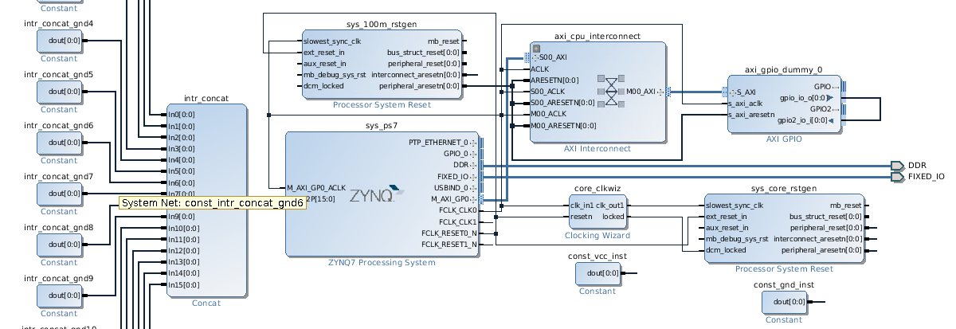
Start with the Base Vivado Project
Notes:
Starting with the Base Vivado Project
To generate the base Vivado project, the Vivado FSBL tool can be used. The base projects for each of the supported boards can be found at:
fsbl/projects/base/<board name>
In this case, we will use:
fsbl/projects/base/zed
To generate the project, we will have Vivado execute the TCL script within the project directory:
vivado -mode gui -source system.tcl -tclargs –target bd
This will generate a Vivado project in the build directory, but will not generate any artifacts (FSBL, bitstream). Once the project generation process is complete, we can customize the BD from there. By specifying the gui mode, Vivado will open the project for us during the generation process.
Note: To launch a Vivado command prompt, use the tool below:
>> LinuxTraining.VivadoShell

Slide 6
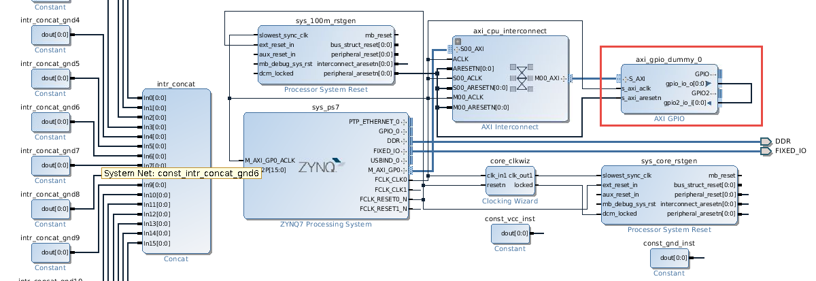
Remove the “dummy” AXI GPIO
Notes:
Remove the “dummy” AXI GPIO
The default project will insert an AXI GPIO core as a placeholder for the HDL Coder DUT (this allows Vivado’s timing analysis to run when generating the bitstream). In order to use the generated project as a template, we’ll need to remove the GPIO core.
Simply select the core and press delete to remove it.

Slide 7
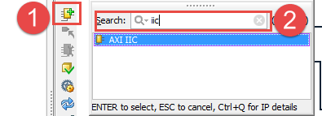
Add AXI IIC IP
Notes:
Add AXI IIC IP
In order to communicate with the gyroscope, we will need to add an I2C controller. We can use the IP provided by Xilinx to do so. Start by clicking on the “Add IP” icon (1) and then searching for iic (2).

Slide 8
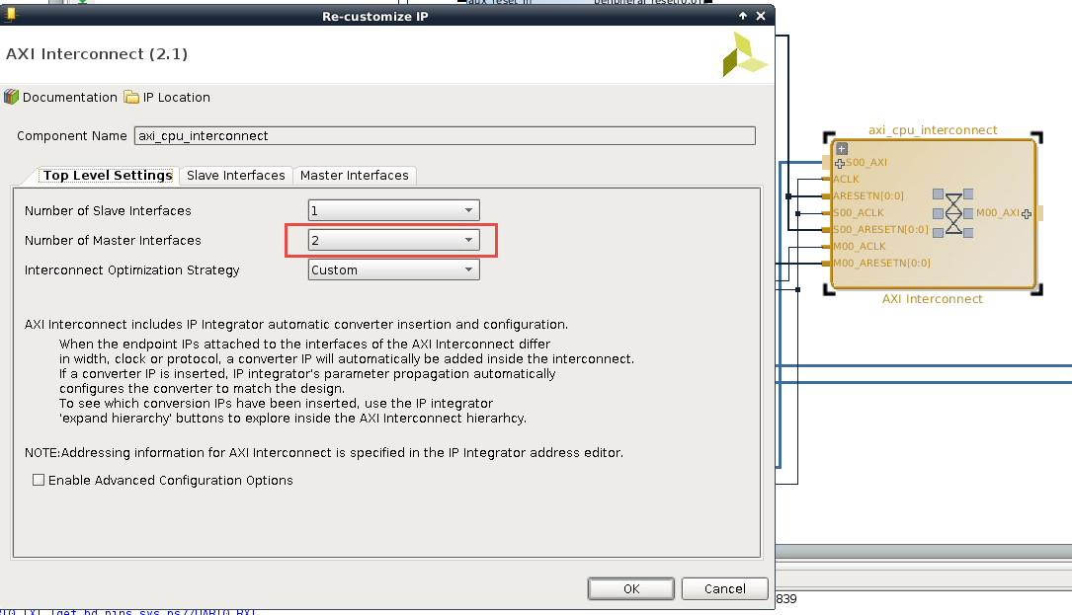
Update the AXI Interconnect IP
Notes:
Update the AXI Interconnect IP
In order to connect to our new IIC IP Core and still have a free connection point for HDL Coder generated IP, we will add an additional AXI master port to the AXI interconnect IP.

Slide 9
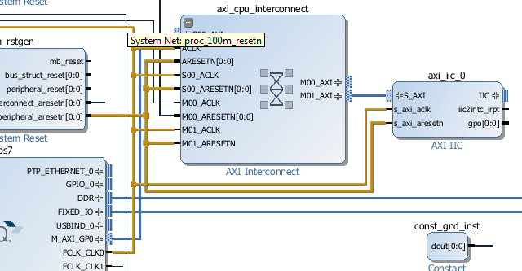
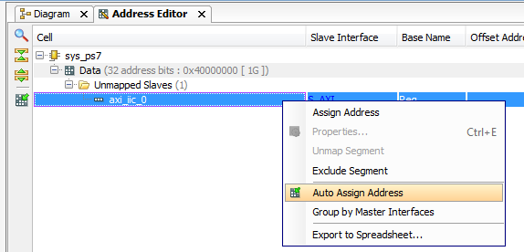
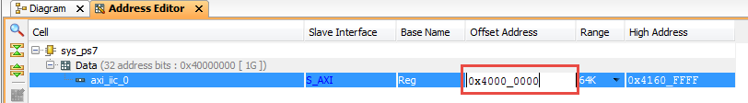
Connect the AXI IIC IP
Notes:
Connect the AXI IIC IP
We now need to wire up the AXI and clock interfaces of the AXI IIC core
Connect the clock used to drive the interconnect’s ACLK pin to the following nodes:
Interconnect/M01_ACLK
axi_iic_0/s_axi_aclk
Connect the reset used to drive the interconnect’s S00_ARESETN pin to the following nodes:
Interconnect/M01_ARESETN
axi_iic_0/s_axi_areset_n
Connect the Interconnect’s M01_AXI port to the AXI IIC’s S_AXI port.
We will also need to assign a base address to the AXI IIC core. We can do this by doing the following:
Open the Address Editor tab.
Right click on the AXI IIC core and select Auto Assign Address to populate default settings.
Update the base address to use 0x40000000.

Slide 10
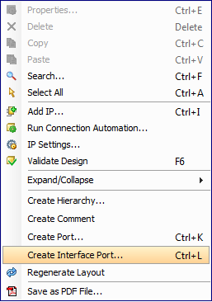
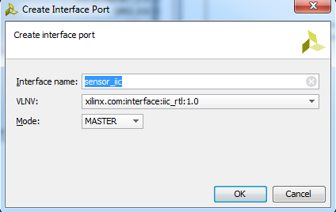
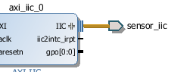
Create & Connect IIC Ports
Notes:
Create & Connect IIC Ports
We now need to create a port to connect to the IIC pins, so create an interface port as follows:
Port Name: sensor_iic
VLNV: xilinx.com:interface:iic_rtl:1.0
Mode: MASTER
We can then connect this port to the IIC interface of the AXI IIC IP core.

Slide 11
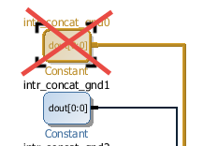
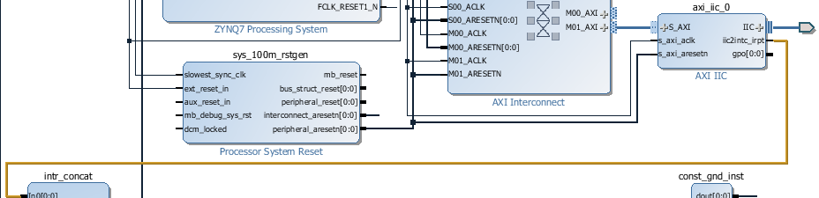
Connect IIC Interrupt
Notes:
Connect IIC Interrupt
The AXI IIC core uses an interrupt to communicate with the processor in addition to the AXI bus, so we’ll need to attach that as well. The default Zedboard project wires all of the unused interrupts to GND, so we’ll need to remove that first.
First, select the intr_concat_gnd0 constant block and delete it.
Next, connect the i2cintc_irpt pin from the AXI IIC core to the In0[0:0] pin of the intr_concat core.

Slide 12
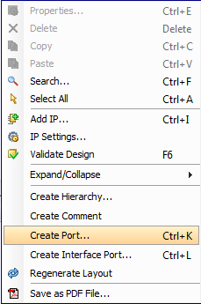
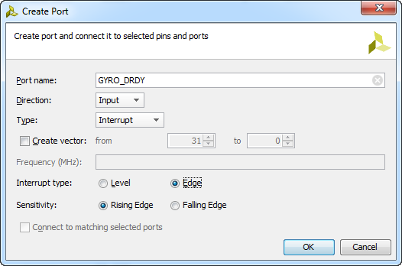
Add the RDY Ports
Notes:
Add the RDY Ports
The gyroscope and accelerometer on the IMU board use an additional interrupt (RDY) pin each to indicate that data is available. We’ll need to attach these pins to the processor as well in order to use the devices. While we’ll only be adding support for the gyroscope in this exercise, we’ll add the accelerometer’s RDY pin as well for future use.
Create a port with the following settings:
Port Name: GYRO_DRDY
Direction: Input
Type: Interrupt
Interrupt type: Edge
Sensetivity: Rising Edge
Create a second port with the same setting, but named ACCEL_DRDY

Slide 13
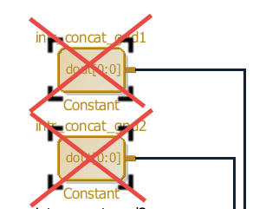
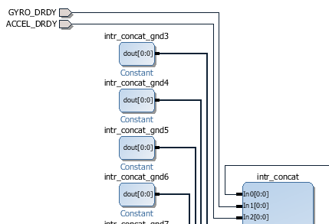
Connect the RDY Ports
Notes:
Connect the RDY Ports
The RDY ports act as interrupts, so we’ll need to connect them to the processor. As with the AXI IIC interrupt, we’ll need to first disconnect the GND pins.
Delete the intr_concat_gnd1 and intr_concat_gnd blocks from the model.
Connect GYRO_DRDY to intr_concat port In1[0:0]
Connect ACCEL_DRDY to intr_concat port In2[0:0]

Slide 14
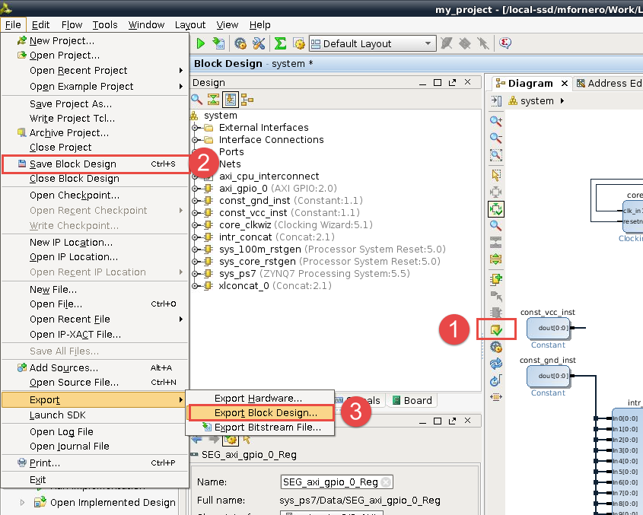
Export the Design
Notes:
Export the Design
At this point, we have completed our modifications to the Vivado project. We can now:
Run validation to ensure there are no errors in the project. Pay special attention to critical warnings that may be issued here as well.
Save the block design.
Export the block design to a TCL file.
We should store the TCL file in our working folder, as it will be used by the FSBL automation scripts.
The following instructions will assume we have exported the block design as system.tcl in our working folder

Slide 15
Constrain the IIC and RDY Pins
set_property -dict {PACKAGE_PIN AA9 IOSTANDARD LVCMOS33} [get_ports sensor_iic_scl_io] ; ## JA4
set_property -dict {PACKAGE_PIN Y10 IOSTANDARD LVCMOS33} [get_ports sensor_iic_sda_io] ; ## JA3
set_property -dict {PACKAGE_PIN AA11 IOSTANDARD LVCMOS33} [get_ports GYRO_DRDY] ; ## JA2
set_property -dict {PACKAGE_PIN Y11 IOSTANDARD LVCMOS33} [get_ports ACCEL_DRDY] ; ## JA1
Notes:
Constrain the IIC and RDY Pins
As we add pins to the project, we will need to constrain them to the actual FPGA pins connected to the IIC and RDY signals.
We can do so by creating an XDC file with the above contents (or simply copying the sensor_iic.xdc file from the golden directory).
The following instructions will assume that we have created a file sensor_iic.xdc located in our working folder.
set_property -dict {PACKAGE_PIN AA9 IOSTANDARD LVCMOS33} [get_ports sensor_iic_scl_io] ; ## JA4
set_property -dict {PACKAGE_PIN Y10 IOSTANDARD LVCMOS33} [get_ports sensor_iic_sda_io] ; ## JA3
set_property -dict {PACKAGE_PIN AA11 IOSTANDARD LVCMOS33} [get_ports GYRO_DRDY] ; ## JA2
set_property -dict {PACKAGE_PIN Y11 IOSTANDARD LVCMOS33} [get_ports ACCEL_DRDY] ; ## JA1

Slide 16
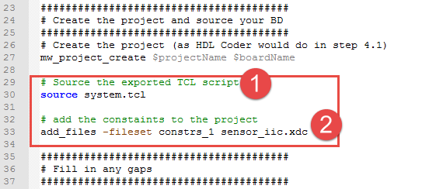
Build the Vivado Project
Notes:
Build the Vivado Project
Now that we have all the sources completed, we will setup a TCL script to automate the entire build process. The template folder contains a starting point for this script, build.tcl, which should have been copied to our working folder.
The build script has a customization area where we can make changes, but for the purpose of this project is almost complete. We only need to do the following:
Ensure the name of the script being sourced matches the name of the script we exported
Add the XDC constraint file to the project, by adding the following line:
add_files -fileset constrs_1 sensor_iic.xdc
where sensor_iic.xdc is the name of the constraint file that we created.
We can now navigate in our shell to the working folder and run the following command to start the build:
vivado -mode batch -source build.tcl
The result of this command will be a FSBL and bitstream, located at ./build/output.

Slide 17
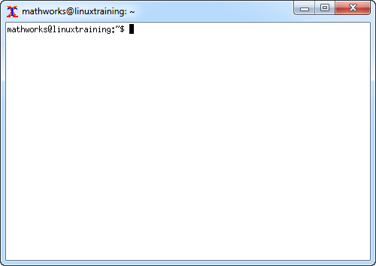
Launch the Linux Virtual Machine
>> vm = LinuxTraining.BuildVM
VMRepoPath: {}
LocalRepoPath: {}
User: {}
Pass: {}
IP: {}
VirtualBoxPath: {}
VcxsrvBin: {}
VMName: {}
vm =
BuildVM with properties:
VMRepoPath: '/Work/LinuxTraining'
LocalRepoPath: 'C:\Work\Zynq\LinuxTraining\repo'
User: 'mathworks'
Pass: 'mathworks'
IP: '192.168.56.101'
VirtualBoxPath: 'C:\Program Files\Oracle\VirtualBox'
VcxsrvBin: 'C:\Program Files\VcXsrv\vcxsrv.exe'
VMName: 'Linux_Training'
>> vm.openShell
Notes:
Launch the Linux Virtual Machine
While the Vivado portion of this process is cross-platform, the Buildroot portion can only be run on Linux. In order to facilitate this exercise, we’ve provided a Linux Virtual Machine (VM) to run the Buildroot scripts, as well as some helper functions to automate the launching of the VM and the movement of files back and forth.
To launch the VM, run the following commands in MATLAB:
>> vm = LinuxTraining.BuildVM
VMRepoPath: {}
LocalRepoPath: {}
User: {}
Pass: {}
IP: {}
VirtualBoxPath: {}
VcxsrvBin: {}
VMName: {}
vm =
BuildVM with properties:
VMRepoPath: '/Work/LinuxTraining'
LocalRepoPath: 'C:\Work\Zynq\LinuxTraining\repo'
User: 'mathworks'
Pass: 'mathworks'
IP: '192.168.56.101'
VirtualBoxPath: 'C:\Program Files\Oracle\VirtualBox'
VcxsrvBin: 'C:\Program Files\VcXsrv\vcxsrv.exe'
VMName: 'Linux_Training'
>> vm.openShell
This will power up the VM, boot Linux, and open a remote shell.
The following sections will involve editing some files on the Linux VM. This can be done using the medit tool as a text editor.

Slide 18
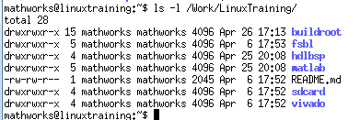

Copy the Vivado Outputs
>> cd C:\Work\Zynq\LinuxTraining\repo\vivado\working\build\output
>> ls
. .. fsbl.elf system.bit
>> vm.copyRepoDir(pwd)
Notes:
Copy the Vivado Outputs
The Linux VM contains a mirror of the training repository described at the beginning of this section. In order to continue the build process on the VM, we’ll need to copy over the results of our Vivado build.
In order to automate some of the file copying, we’ll need to tell the LinuxTraining.BuildVM object how the paths match up between the Windows host and the LinuxVM.
>> vm
vm =
BuildVM with properties:
VMRepoPath: '/Work/LinuxTraining'
LocalRepoPath: 'C:\Class\LinuxTraining\repo'
User: 'mathworks'
Pass: 'mathworks'
IP: '192.168.56.101'
VirtualBoxPath: 'C:\Program Files\Oracle\VirtualBox'
VcxsrvBin: 'C:\Program Files\VcXsrv\vcxsrv.exe'
VMName: 'Linux_Training‘
The LocalRepoPath property should be set to the root of the repository being used for the class. Once this is done, we can navigate to the Vivado working output directory:
>> cd vivado\working\build\output
>> ls
. .. fsbl.elf system.bit
We can now tell the LinuxTraining.BuildVM object to copy the contents of this directory to the corresponding location on the VM:
>> vm.copyRepoDir(pwd)
We can see the results on the VM by listing the directory contents:

Slide 19
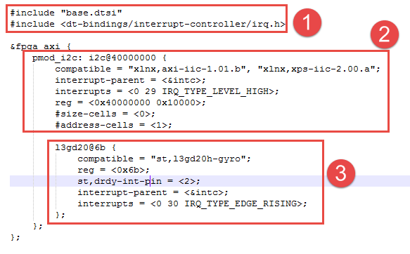
Updating the Device Tree
Notes:
Updating the Device Tree
In order to inform the kernel about the hardware changes we made, we need to update the device tree. To do so, we will create a new file linuxtraining.dts in our sdcard working folder (or copy it from the golden folder).
The file will contain the following sections:
A #include of the base ZedBoard device tree from Buildroot– this allows us to start from the basic settings and simply override / add content from there. We’ll also include some IRQ definitions from the Linux kernel.
Adding the AXI IIC controller to the AXI bus. Here we use the label fpga_axi to add content at that node, without having to recreate the hierarchy. The values settings for the pmod_i2c ndoe can be found in the kernel documentation^{[1]}.
Adding the l3gd20h device under to the AXI IIC controller. The settings for the l3gd20 node can be found from kernel documentation^{[2]} and examples^{[3]}.
[1]: http://lxr.free-electrons.com/source/Documentation/devicetree/bindings/i2c/i2c-xiic.txt?v=4.4
[2]: http://lxr.free-electrons.com/source/Documentation/devicetree/bindings/iio/st-sensors.txt?v=4.4
[3]: http://lxr.free-electrons.com/source/arch/arm/boot/dts/ste-href-tvk1281618.dtsi?v4.4#L142

Slide 20
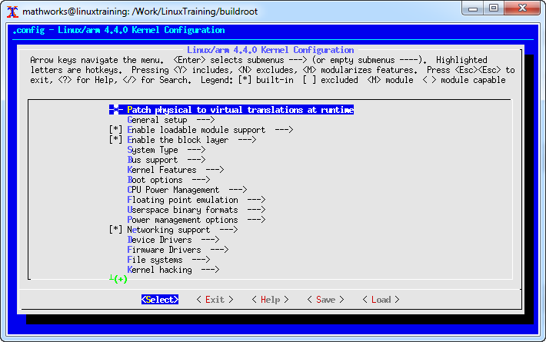
Update Kernel Configuration
Notes:
Update Kernel Configuration
To modify the kernel configuration, the best place to start is the base configuration. To review this, we will run a standard Buildroot build for the ZedBoard
Navigate to the buildroot/ directory on the Linux VM and run the following command:
./build.py -b zed -p zynq --target linux-menuconfig
This command will start a build for the Zed board on the Zynq platform. The output will be in:
buildroot/output/zed_linux_xilinx
Rather than building a full image, it will simply launch into the Linux Kernel config as shown below.

Slide 21
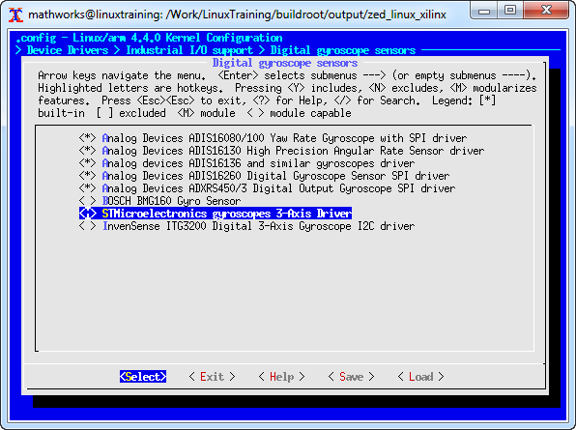
Enable the Gyroscope Driver
Notes:
Enable the Gyroscope Driver
From the main menu, navigate to
Device Drivers →
Industrial I/O Support →
Digital gyroscope sensors.
From there, select STMicroelectronics gyroscopes 3-Axis Driver and press the space-bar to set it to <M>.

Slide 22
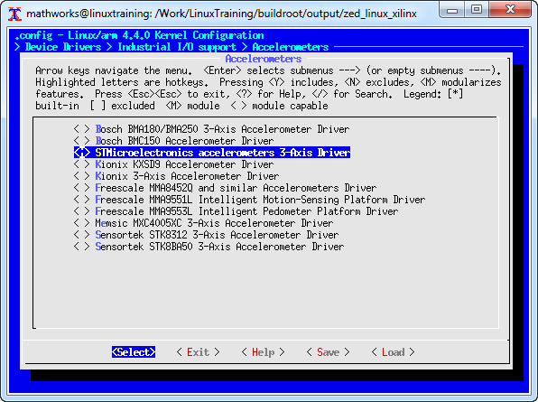
Enable the Accelerometer Driver
Notes:
Enable the Accelerometer Driver
From the main menu, navigate to
Device Drivers →
Industrial I/O Support →
Accelerometers.
From there, select STMicroelectronics accelerometers 3-Axis Driver and press the space-bar to set it to <M>.
From the bottom menu, select <Exit> repeatedly, until you are asked to save, at which point select <Yes>.
After saving the configuration file, we will copy it to the working directory.
Copy from :
buildroot/output/zed_linux_xilinx/build/linux-xilinx-16a/.config
to :
sdcard/working/kernel_config
where kernel_config is the name of the file we are copying it to, within the working directory.

Slide 23
Extra SD Card Init Scipts
#!/bin/sh
#
# Load user specified modules
#
source /etc/init.d/start_only.sh
# Load extra modules for the system
modlist="st_gyro_i2c"
modprobe -aq $modlist
Notes:
Extra SD Card Init Scripts
In order to load our gyroscope driver at boot, we’ll need to add an additional script to the SD Card. Buildroot allows us to specify additional contents for the SD card, and is also set up to automatically execute scripts located in the <sd card>/init.d/ folder.
In the sdcard’s working directory, create the following folder hierarchy:
sdfiles/init.d
The sdfiles folder represents the root of the SD card, for the extra files we want to add.
In this folder, we’ll create a new file named S10modprobe, with the contents shown to the right. We also need to make this script executable, using the command below:
chmod +x S10modprobe
Alternatively, we can copy the file over from:
golden/sdfiles/init.d/S10modprobe
#!/bin/sh
#
# Load user specified modules
#
source /etc/init.d/start_only.sh
# Load extra modules for the system
modlist="st_gyro_i2c"
modprobe -aq $modlist

Slide 24
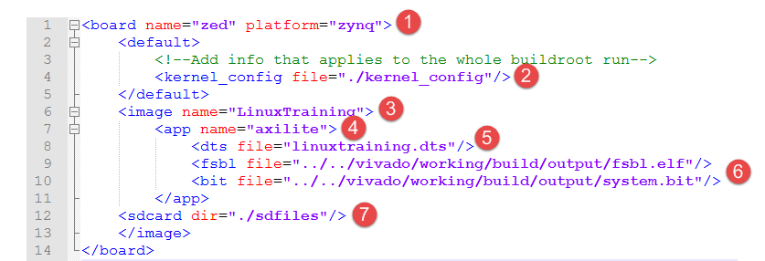
Buildroot Configuration
Notes:
Buildroot Configuration
In order to have Buildroot use our newly generated FSBL, bitstream, DTS and kernel configuration, we’ll need to setup an XML to point to each of them. Note that all paths are relative to the XML file.
In the working folder, create an XML file catalog.xml with the above contents. An example of this file (with paths pointing to the golden Vivado directory) can be seen in the sdcard/golden folder.
We specify that the board that we are targeting is zed and the platform is zynq.
We tell Buildroot to use our custom kernel config file
We give a name to our image, which will impact the name of the generated .zip file.
We give a name to our (only) application, which will impact the name of the generated BOOT.BIN and devicetree DTB files.
We specify the DTS file to use for our application.
We specify the FSBL and Bitstream to use for our application.
We specify the location of our custom SD card contents (our init script).

Slide 25
Run Buildroot
#!/bin/bash
# First, find the directory we're executing out of
SCRIPT_DIR=$( cd "$( dirname "${BASH_SOURCE[0]}" )" && pwd )
# Set up the relative paths
BR_ROOT=${SCRIPT_DIR}/../../buildroot/
BUILD_SCRIPT=${BR_ROOT}/board/mathworks/common/scripts/build.py
# The directory to put the SD card images
IMAGE_DIR=${SCRIPT_DIR}/images
# The directory to run the build out of
BUILD_DIR=${SCRIPT_DIR}/build
# The catalog file
CATALOG_FILE=${SCRIPT_DIR}/catalog.xml
mkdir $IMAGE_DIR
$BUILD_SCRIPT -c $CATALOG_FILE -o $BUILD_DIR -d $IMAGE_DIR -u
Notes:
Run Buildroot
In order to more easily run Buildroot in our training environment, we have provided a script, build.sh to automate the build process. While it is possible to run Buildroot with only the following command:
<buildroot dir>/build.py -c <catalog XML>
It can be useful to pass a few additional arguments to the tool to control:
Where the build is run out of
Where the generated images are placed
Whether or not we do a full build each time a change is made
In the above script, we call build.py and set the build directory as ./build, the output directory as ./images and inform Buildroot to do an update build (i.e. do not run make clean beforehand, speeding up subsequent builds).
To perform the build, simply run the following command:
./build.sh
At the completion of the build, your new image will be located in the ./images directory.

Slide 26
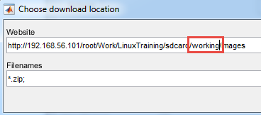
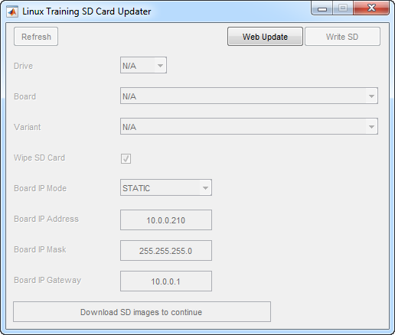
Program the SD Card
>> LinuxTraining.tools.SDUpdater
Notes:
Program the SD Card
In order to test the new image, we will need to program it to the SD card. A utility to automate the process of (1) copying the image from the Linux VM and (2) installing it on the SD card has been provided.
>> LinuxTraining.tools.SDUpdater
To use the tool, first click on the Web Update button. In the dialog that is loaded, change the Website field to point to the working directory instead of the golden directory.
After the tool downloads the resulting image, press the Write SD button to program the SD card. If no SD card is available from the Drive dropdown, press the Refresh button to rescan for SD cards.

Slide 27
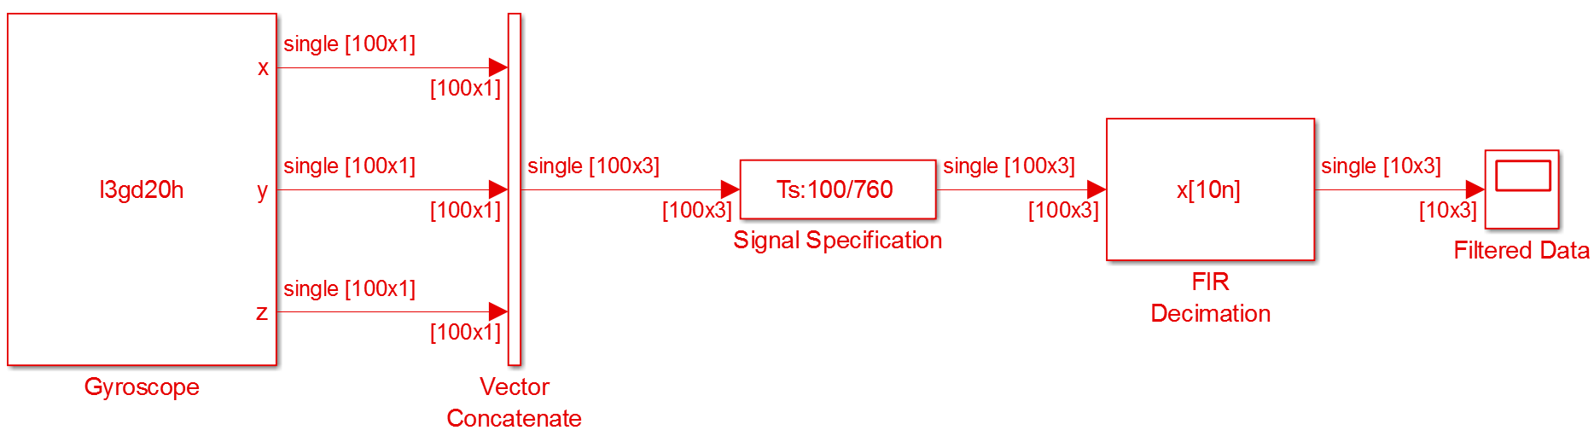
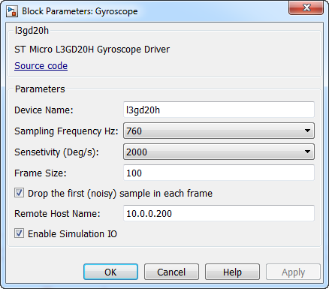
Test the SD Card
Notes:
Test the SD Card
In order to test our new SD card image, we will use the gyroscope as a data source for both MATLAB/Simulink simulation and embedded C code generation.
The model shown below implements the connection to the gyroscope as a System Object.
This model can be used in the following ways:
Run in Normal mode, to pull live data from the gyroscope into the simulation via Ethernet.
Run in External mode (or used for standalone code generation) to generate C code that will access the gyroscope on the target.

Slide 28
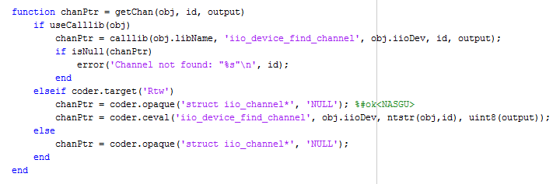
The Gyroscope via libIIO
Notes:
The Gyroscope via libIIO
To communicate with the gyroscope hardware, we’ll author a System Object. This enables us to interact with the gyroscope in a number of different ways:
From MATLAB scripts as a data source
From Simulink simulations on the host PC as a data source
In a Simulink model for C code generation (resulting in the gyroscope being used as a data source for the generated embedded application)
The ability to access the gyroscope both from the host PC and the embedded target is provided, in part, by the cross-platform nature of libIIO^{[1][2]}, a library from Analog Devices that provides support for the ST Micro gyroscope. Because libIIO can be run both on Windows (accessing the gyroscope across an Ethernet link) and on the embedded target (accessing the gyroscope locally), we can use the same API regardless of which mode we’re planning to use it in.
Within the system object itself, we’ll use slightly different calls depending on whether we’re running on the host or generating code.
If we’re running on the host, we’ll use the calllib() API to access the libIIO functions.
If we’re generating C code, we’ll use the coder.ceval() API to access the libIIO functions.
[1]: https://wiki.analog.com/resources/tools-software/linux-software/libiio
[2]: https://wiki.analog.com/resources/tools-software/linux-software/libiio_internals

Slide 29
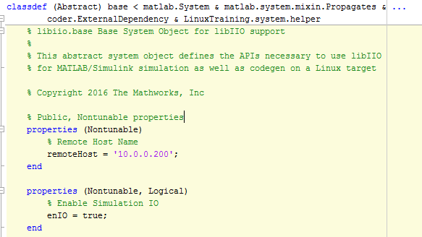
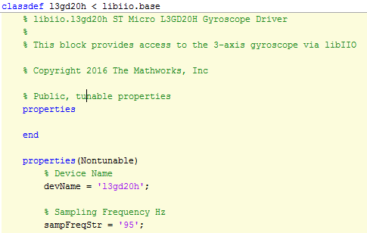
The Gyroscope System Object
Notes:
The Gyroscope System Object
The gyroscope driver is implemented as a set of system objects using object-oriented programming methods:
A base libIIO support class (libiio.base) providing common functions for all libIIO-based devices
A device-specific class (libiio.l3gd20h) that inherits from the base class, and implements the specific support for the gyroscope

