Slide 1

Random Forest Imputation
missing values to learn
potential features
We regularly deal with incom-plete data, but there are oppor-tunities to learn missing data from other observations.
The black column is the current target; the open circles, missing data.
Potential features are columns fully populated along the rows where the target data is missing.
Useful features are those columns that are also fully dense where the target column is labeled.*
useful features
$\hat{y}=y_{pred}+{𝒩(0, σ}_{CV}^{2}$)
*A subset of the target labels may be used, to identify useful features that are not, themselves, fully dense.

Slide 2
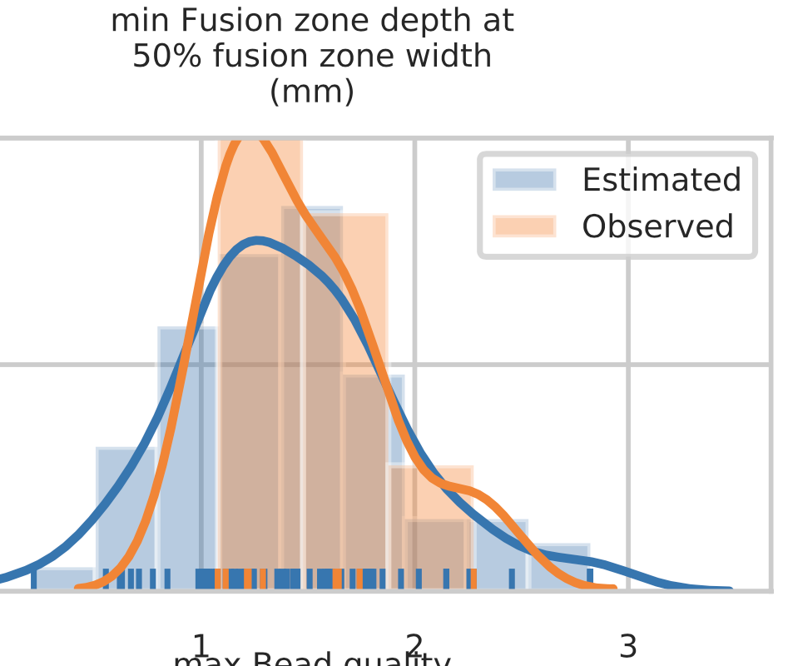
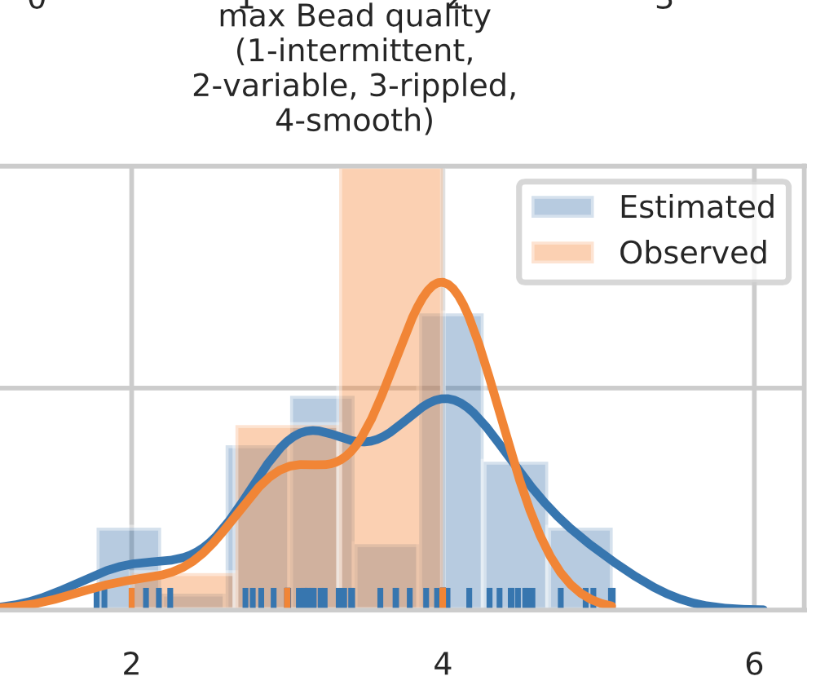
RFN imputation captures multimodal behavior

Slide 3
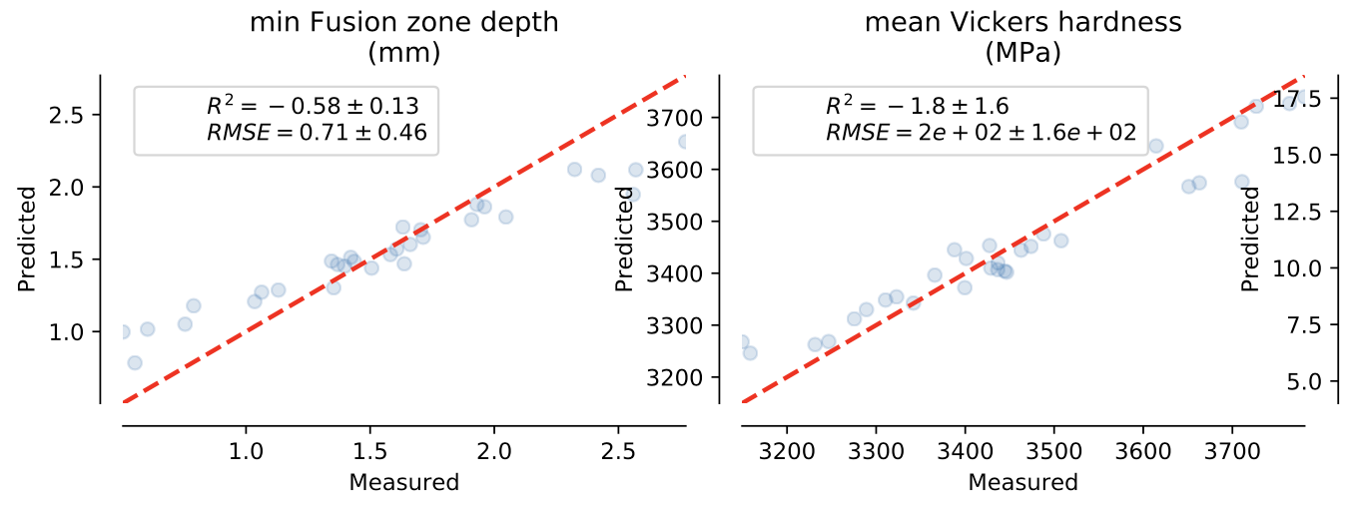
Estimators fit to imputed data are lower variance, improving ensemble R²

Slide 4
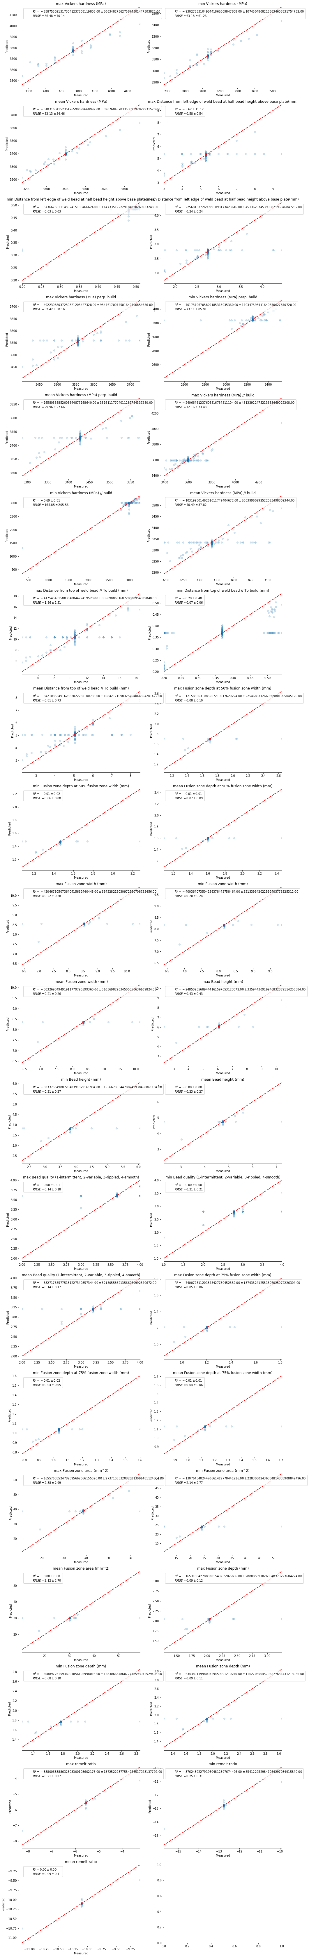

RFN imputation increases RMSE through normal error in $\hat{y}=y_{pred}+𝒩(0, σ_{CV}^{2})$
RMSE_{exp} = 0.08
RMSE_{exp} = 52
RMSE_{RFN} = 0.71
RMSE_{RFN} = 200

Slide 5
Data Exploration, Imputation, and Modeling
#!/usr/bin/env python
# coding: utf-8
# # Summary
#
# A method for estimating, or anticipating, the results of a physical build from simulation data is needed. The approach proposed uses machine learning to connect these two data streams as the metaphorical glue, as shown in the included figure,
#
# <img src="figs/modeling framework.png" alt="ML model to join experimental and simulation results">
#
# This figure shows two models. The top models simulated input (build parameters) to simulated output (properties), that is, $\hat{y}_\text{sim} = f({\bf X})$. The lower models experimental input (build parameters) to experimental output (properties), $\hat{y}_\text{expt} = g({\bf X})$. In general, and for various reasons ranging from incomplete simulation physics to imperfect knowledge of the experimental conditions, $\hat{y}_\text{sim} \neq \hat{y}_\text{expt}$.
#
# ## Hypothesis
#
# Property estimates from simulation vary systematically with experimental property measurements, that is, a functional relationship exists between $\hat{y}_\text{sim}$ and $\hat{y}_\text{expt}$, $\hat{y}^\prime_\text{expt} = h(\hat{y}_\text{sim})$. The functional form of this correlation is not known *a priori*. A model to estimate this functional relationship can range from a univariate regression to a complex point estimation ML model.
#
# ## Approach
#
# 1. $\hat{y}_\text{expt}$ is fit using a random forest network (RFN) with bootstrap aggregating (bagging).
# 2. $\hat{y}_\text{sim}$ is fit using an RFN with bagging.
# 3. $\hat{y}^\prime_\text{expt}$ is fit using **regression**.
# In[70]:
import numpy as np
import pandas as pd
import seaborn as sns
import time
from matplotlib import pyplot as plt
# # Structures/Function Definitions
# In[44]:
def is_array_like(vec):
return (hasattr(vec, '__iter__') and not isinstance(vec, str))
class Data:
def __init__(self):
self._filename = None
self._dataframe = pd.DataFrame()
self._inputs = None
self._outputs = None
@property
def filename(self):
return self._filename
@property
def dataframe(self):
return self._dataframe
def reset_input_columns(self):
self._inputs = None
def get_input_columns(self):
if self._inputs is None:
return self.dataframe
return self.dataframe[self._inputs]
def set_input_columns(self, key=None, reset=True):
"""
Set which columns are the input columns.
:param key (int, str, or list of either): If an int, or a list of int, specifies
the column index/indices. If a string, list of stings, these refer to column names.
:returns: This object.
"""
if reset:
self._inputs = []
# inputs are being set, make sure it is a list.
if self._inputs is None:
self._inputs = []
if key is None:
# by default, all remaining entries are inputs.
if self._outputs is None:
self._inputs = self._dataframe.columns.to_list()
else:
self._inputs = list(set(self._dataframe.columns.to_list()) -
set(self.get_output_columns()))
elif isinstance(key, (list, np.ndarray, range)):
# if a list, add one-at-a-time
for k in key:
self.set_input_columns(k, reset=False)
else:
# if an int, add that column name by its index, otherwise, add the index
if isinstance(key, int):
self._inputs.append(self._dataframe.columns.to_list()[key])
else:
if key not in self._dataframe:
raise KeyError(f"{key} is not a column name in {self.__name__}.")
self._inputs.append(key)
return self
def reset_output_columns(self):
self._outputs = None
def get_output_columns(self):
if self._outputs is None:
return self.dataframe
return self.dataframe[self._outputs]
def set_output_columns(self, key=None, reset=True):
"""
Set which columns are the output columns.
:param key (int, str, or list of either): If an int, or a list of int, specifies
the column index/indices. If a string, list of stings, these refer to column names.
:returns: This object.
"""
if reset:
self._outputs = []
# outputs are being set, make sure it is a list.
if self._outputs is None:
self._outputs = []
if key is None:
# by default, all remaining entries are outputs.
if self._inputs is None:
self._outputs = self._dataframe.columns.to_list()
else:
self._outputs = list(set(self._dataframe.columns.to_list()) -
set(self.get_input_columns()))
elif isinstance(key, (list, np.ndarray, range)):
# if a list, add one-at-a-time
for k in key:
self.set_output_columns(k, reset=False)
else:
# if an int, add that column name by its index, otherwise, add the index
if isinstance(key, int):
self._outputs.append(self._dataframe.columns.to_list()[key])
else:
if key not in self._dataframe:
raise KeyError(f"{key} is not a column name in {self.__name__}.")
self._outputs.append(key)
return self
def read_excel(self, filename, *args, **kwds):
self._filename = filename
self._dataframe = pd.read_excel(filename, *args, **kwds)
return self
# In[297]:
class Model:
def __init__(self, estimator, input_labels=None, output_label=None):
self._X = None
self._y = None
self._score = None
self._inputLabels = input_labels
self._outputLabel = output_label
self.estimator = estimator
@property
def labels(self):
return {"input": self._inputLabels, "output": self._outputLabel}
def fit(self, X, y, **kwds):
self._X = np.asarray(X)
self._y = np.asarray(y)
# fit estimator
self.estimator.fit(X, y)
# error estimation
opts = dict()
opts['scoring'] = kwds.get('scoring', ['r2', 'neg_mean_squared_error'])
opts['n_jobs'] = kwds.get('n_jobs', -1)
opts['verbose'] = kwds.get('verbose', 0)
if 'cv' in kwds:
opts['cv'] = kwds['cv']
self._score = cross_validate(self.estimator, X, y, **opts)
# done, allow functions to be daisy-chained
return self
def predict(self, X):
return self.estimator.predict(X)
# In[82]:
def plot_regression_results(ax, y_true, y_pred, title, scores):
"""Scatter plot of the predicted vs true targets."""
ax.plot([y_true.min(), y_true.max()],
[y_true.min(), y_true.max()],
'--r', linewidth=2)
ax.spines['top'].set_visible(False)
ax.spines['right'].set_visible(False)
ax.get_xaxis().tick_bottom()
ax.get_yaxis().tick_left()
ax.spines['left'].set_position(('outward', 10))
ax.spines['bottom'].set_position(('outward', 10))
ax.set_xlim([y_true.min(), y_true.max()])
ax.set_ylim([y_true.min(), y_true.max()])
ax.set_xlabel('Measured')
ax.set_ylabel('Predicted')
extra = plt.Rectangle((0, 0), 0, 0, fc="w", fill=False,
edgecolor='none', linewidth=0)
ax.legend([extra], [scores], loc='upper left')
ax.set_title(title)
# # Read data
# ## Simulation data
# In[52]:
simulation = Data() .read_excel("data/simulation data plan_complete.xlsx",
skiprows=2,
usecols=range(16),
index_col=0)\
.set_input_columns(range(5))\
.set_input_columns(range(12, 15), reset=False)\
.set_output_columns()
# In[53]:
fig, ax = plt.subplots(1, 1, figsize=(12, 10));
sns.heatmap(simulation.dataframe[simulation._inputs + simulation._outputs].corr('pearson'),
ax=ax, square=True, annot=True,
vmin=-1, vmax=1, cmap=plt.cm.Spectral_r,
cbar_kws={'label': 'Pearson'});
# In[54]:
# drop degenerate data
simulation.set_input_columns(
simulation.get_input_columns().corr('pearson').dropna(axis=1, how="all").columns.to_list(),
reset=True)
fig, ax = plt.subplots(1, 1, figsize=(12, 10))
sns.heatmap(simulation.get_input_columns().corr('pearson'),
ax=ax, square=True, annot=True,
vmin=-1, vmax=1, cmap=plt.cm.Spectral_r,
cbar_kws={'label': 'Pearson'});
simulation.set_output_columns(
simulation.get_output_columns().corr('pearson').dropna(axis=1, how="all").columns.to_list(),
reset=True)
fig, ax = plt.subplots(1, 1, figsize=(12, 10))
sns.heatmap(simulation.get_output_columns().corr('pearson'),
ax=ax, square=True, annot=True,
vmin=-1, vmax=1, cmap=plt.cm.Spectral_r,
cbar_kws={'label': 'Pearson'});
# ## Experimental data
# In[108]:
experimental = Data().read_excel("data/qualitymade-20200423.xlsx", index_col=0)
# In[123]:
columns = [col for col in experimental.dataframe.columns.to_list()
if ((col.startswith('Summary:') or
col.startswith('Pre-Weld Data:') or
col.startswith('Weld Ignition Stage Data:') or
col.startswith('Weld Main Stage Data:') or
col.startswith('Weld Fill Stage Data:') or
col.startswith('Weld End Stage Data:') or
col.startswith('Post-Weld Data:')) and not
(col.endswith('Program') or
col.endswith('(Hz)')))]
experimental.set_input_columns(columns)
experimental.set_input_columns(
experimental.get_input_columns().corr('pearson').dropna(axis=1, how="all").columns.to_list(),
reset=True)
fig, ax = plt.subplots(1, 1, figsize=(12, 10))
sns.heatmap(experimental.get_input_columns().corr('pearson'),
ax=ax, square=True,
vmin=-1, vmax=1, cmap=plt.cm.Spectral_r,
cbar_kws={'label': 'Pearson'});
# In[111]:
columns = [col for col in experimental.dataframe.columns.to_list()
if ((col.startswith('mean') or
col.startswith('min') or
col.startswith('max')) and
not col.endswith('Notes'))]
experimental.set_output_columns(columns)
experimental.set_output_columns(
experimental.get_output_columns().corr('pearson').dropna(axis=1, how="all").columns.to_list(),
reset=True)
fig, ax = plt.subplots(1, 1, figsize=(12, 10))
sns.heatmap(experimental.get_output_columns().corr('pearson'),
ax=ax, square=True,
vmin=-1, vmax=1, cmap=plt.cm.Spectral_r,
cbar_kws={'label': 'Pearson'});
# # Build $\hat{y}_\text{expt}$ model
# ### Random Forest Imputation
#
# Build a series of models to estimate missing values. Set each column, in turn as the target column:
#
# 1. Identify rows in the target column that are not NaN. Keep these rows.
# 2. Identify those columns fully populated in those rows.
# 3. Fit a model to predict target.
# 4. Predict missing target values.
# In[227]:
import time
from sklearn.ensemble import RandomForestRegressor
from sklearn.model_selection import cross_validate, LeaveOneOut
def as_dataframe(obj, prefix='x'):
if not isinstance(obj, (pd.Series, pd.DataFrame)):
obj = np.asarray(obj)
try:
nx, ny = obj.shape
return pd.DataFrame(obj, columns=[f'{prefix}{i}' for i in range(nx)])
except ValueError:
return pd.Series(obj, name=f'{prefix}1').to_frame()
else:
try:
# converting Series to DataFrame
return obj.to_frame()
except AttributeError:
# object is a DataFrame
return obj
data = experimental.dataframe[experimental._inputs + experimental._outputs]
filled = data.copy()
for targetKey in data.columns.to_list():
# rows that are not NaN in the target
target = data[targetKey]
isnanIndex = np.where(np.isnan(target))[0]
labelIndex = np.where(~np.isnan(target))[0]
# model data: features that are not NaN where label is not NaN
df = data.iloc[labelIndex, :].dropna(axis=1)
featureKeys = [col for col in df.columns.to_list() if col != targetKey]
modelData = data[featureKeys + [targetKey]]
# iterate over missing value
print(f"Predicting {targetKey}")
start = time.time()
for i in isnanIndex:
# get the subset of feature columns that are not NaN
df = modelData.iloc[i, :].to_frame().transpose().dropna(axis=1)
columns = df.columns.to_list()
if df.shape[1] == 0:
continue
# set the feature and label data
X = modelData[columns].iloc[labelIndex, :].values
y = modelData.iloc[labelIndex, -1].values
# fit the model
model = Model(RandomForestRegressor(n_estimators=300,
criterion="mse",
max_features=0.8)).fit(X, y, cv=LeaveOneOut())
# use the valid feature values
x = modelData[columns].iloc[i, :].values[np.newaxis, :]
# predict the y-value
ypred = model.predict(x)[0]
# use the score to esimate the error
score = model._score['test_neg_mean_squared_error']
rmse = np.sqrt(-np.mean(score))
error = np.random.normal(scale=rmse)
# insert the value + error
filled[targetKey][i] = ypred + error
elapsed = time.time() - start
print(f"Elapsed time filling {targetKey}: {elapsed:.03f} s")
# #### Compare the imputed dataset with the original dataset
# In[272]:
nx, ny = (9, 8)
with sns.axes_style("whitegrid"):
fig, axes = plt.subplots(nx, ny, sharey=True, figsize=(24, 14))
axes = axes.ravel()
fontsize = 48/max(nx, ny)
for ax, col in zip(axes, filled.columns):
sns.distplot(filled[col].dropna(), rug=True, label="Estimated", ax=ax);
sns.distplot(experimental.dataframe[col].dropna(), rug=True, label="Observed", ax=ax);
# set title, splitting column name at 24 characters/line
title = col
lines = [line.strip() for line in title.split(':')]
rows = []
for line in lines:
for word in line.split():
if not rows:
rows.append(word)
elif len(word) + len(rows[-1]) > 24:
rows.append(word)
else:
rows[-1] = ' '.join((rows[-1], word))
ax.set_title('\n'.join(rows));
ax.legend(fontsize=fontsize);
ax.set_ylim(0, 1);
ax.set_xlabel("");
for label in ([ax.title, ax.xaxis.label, ax.yaxis.label] +
ax.get_xticklabels() + ax.get_yticklabels()):
label.set_fontsize(fontsize)
fig.subplots_adjust(top = 0.99, bottom=0.01, hspace=1.5/np.sqrt(nx), wspace=0.1)
fig.savefig("figs/rfn-imputation.pdf", bbox_inches="tight")
# #### Save the imputed dataset to avoid future recalculation (until the model is updated).
# In[275]:
filled.to_excel("data/rfn-imputed-qualitymade-20200423.xlsx")
# ## Fit Experimental Data
# ### Use filled data from RFN imputation
# In[298]:
from sklearn.ensemble import RandomForestRegressor
from sklearn.model_selection import cross_validate
featureKeys = list(set(experimental._inputs).intersection(set(filled.columns.to_list())))
targetKeys = list(set(experimental._outputs).intersection(set(filled.columns.to_list())))
df = filled[featureKeys + targetKeys].dropna()
X = df[featureKeys].values
experimentalModels = dict()
for key in df:
print(f"Fitting {key}")
y = df[key].values
model = Model(RandomForestRegressor(n_estimators=300,
criterion="mse",
max_features=0.8),
input_labels=featureKeys,
output_label=key).fit(X, y, cv=5)
experimentalModels[key] = model
# In[288]:
nx, ny = (8, 5)
fig, axes = plt.subplots(nx, ny, figsize=(24, 24))
axes = axes.ravel()
# fontsize = 48/max(nx, ny)
for ax, (name, model) in zip(axes, experimentalModels.items()):
y_true = model._y
y_pred = model.predict(model._X)
scores = model._score
scores = (r'$R^2={:.2g} \pm {:.2g}$' + '\n'
r'$RMSE={:.2g} \pm {:.2g}$')\
.format(np.mean(scores['test_r2']),
np.std(scores['test_r2']),
np.sqrt(-np.mean(scores['test_neg_mean_squared_error'])),
np.sqrt(np.std(scores['test_neg_mean_squared_error'])))
# set title, splitting column name at 24 characters/line
title = name
lines = [line.strip() for line in title.split(':')]
rows = []
for line in lines:
for word in line.split():
if not rows:
rows.append(word)
elif len(word) + len(rows[-1]) > 24:
rows.append(word)
else:
rows[-1] = ' '.join((rows[-1], word))
title = '\n'.join(rows);
plot_regression_results(ax, y_true, y_pred, title, scores)
# ax.legend(fontsize=fontsize);
# ax.set_ylim(0, 1);
# ax.set_xlabel("");
# for label in ([ax.title, ax.xaxis.label, ax.yaxis.label] +
# ax.get_xticklabels() + ax.get_yticklabels()):
# label.set_fontsize(fontsize)
fig.subplots_adjust(top = 0.99, bottom=0.01, hspace=1.5/np.sqrt(nx), wspace=0.1);
fig.savefig("figs/rfn-impute-experimental-fits.pdf", bbox_inches='tight');
# ### Use a simple imputer to fill in missing data
from sklearn.ensemble import RandomForestRegressor
from sklearn.model_selection import cross_validate
from sklearn.impute import SimpleImputer
imp = SimpleImputer(missing_values=np.nan, strategy='mean')
X = experimental.get_input_columns().values
imp.fit(X)
X = imp.transform(X)
df = experimental.get_output_columns()
experimentalModels = dict()
for key in df:
print(f"Fitting {key}")
y = df[key].values
imp.fit(y[:, np.newaxis])
y = imp.transform(y[:, np.newaxis]).ravel()
model = Model(RandomForestRegressor(n_estimators=300,
criterion="mse",
max_features=0.8)).fit(X, y, cv=5)
experimentalModels[key] = modelfig, ax = plt.subplots(20, 2, figsize=(16, 94))
ax = ax.ravel()
for ax, (name, model) in zip(ax, experimentalModels.items()):
y_true = model._y
y_pred = model.predict(model._X)
scores = model._score
scores = (r'$R^2={:.2f} \pm {:.2f}$' + '\n'
r'$RMSE={:.2f} \pm {:.2f}$')\
.format(np.mean(scores['test_r2']),
np.std(scores['test_r2']),
np.sqrt(-np.mean(scores['test_neg_mean_squared_error'])),
np.sqrt(np.std(scores['test_neg_mean_squared_error'])))
plot_regression_results(ax, y_true, y_pred, name, scores)
plt.subplots_adjust(top = 0.99, bottom=0.01, hspace=0.25, wspace=0.2)
# # Build $\hat{y}_\text{sim}$ model
# In[299]:
from sklearn.ensemble import RandomForestRegressor
from sklearn.model_selection import cross_validate, LeaveOneOut
X = simulation.get_input_columns().values
df = simulation.get_output_columns()
simulationModels = dict()
for key in df:
print(f"Fitting {key}")
y = df[key].values
model = Model(RandomForestRegressor(n_estimators=100,
criterion="mse",
max_features=0.8),
input_labels=simulation._inputs,
output_label=key).fit(X, y, cv=LeaveOneOut())
simulationModels[key] = model
# In[300]:
fig, ax = plt.subplots(3, 2, figsize=(16, 14))
ax = ax.ravel()
for ax, (name, model) in zip(ax, simulationModels.items()):
y_true = model._y
y_pred = model.predict(model._X)
scores = model._score
scores = (r'$R^2={:.2f} \pm {:.2f}$' + '\n'
r'$RMSE={:.2f} \pm {:.2f}$')\
.format(np.nanmean(scores['test_r2']),
np.nanstd(scores['test_r2']),
np.sqrt(-np.mean(scores['test_neg_mean_squared_error'])),
np.sqrt(np.std(scores['test_neg_mean_squared_error'])))
plot_regression_results(ax, y_true, y_pred, name, scores)
plt.subplots_adjust(top = 0.99, bottom=0.01, hspace=0.25, wspace=0.2)
# # Estimate $\hat{y}_\text{expt}$ and $\hat{y}_\text{sim}$ from random inputs
#
# The two models are fit over different phase spaces, $A$ and $B$, forming a joint phase space, $P = A \cup B$. However, these models may be compared if there exists an intersection in those phase spaces, $C = A \cap B$. The difference in their phase spaces, $D_A = A - B$ and $D_B = B - A$, act as a source of uncontrolled error.
#
# Therefore, to develop a model that maps between the $\hat{y}_\text{expt}$ and $\hat{y}_\text{sim}$, uniformly sample from multivariate distributions in $C$, $D_A$, and $D_B$. The sample vector in the phase space of the experimental model (model A) is $Q_A = C_A + U(D_A)$ and in the phase space of the simulation model (model B) is $Q_B = C_B + U(D_B)$ under the condition that $C_A = C_B = U(C)$. $U(\cdot)$ indicates randomly sampling from a uniform distribution.
#
# 1. Uniformly sample data in the range of all input parameters. For variables common to both, $C$, there are two options:
# 1. The domain is the intersection of the domains of the experimental and simulation, i.e. $\max(\min A, \min B)$ to $\min(\max A, \max B)$.
# 2. The domain is the union of the experimental and simulation domains, i.e. $\min(\min A, \min B)$ to $\max(\max A, \max B)$.
# 2. Predict estimates.
# 3. Examine estimates to intuit functional relationship.
# In[321]:
outputs = pd.DataFrame(np.zeros((len(experimentalModels), len(simulationModels)),
dtype=bool),
index=list(experimentalModels),
columns=list(simulationModels),
dtype=bool)
# map between CMU/CSM characterization naming convention and CMU modeling naming convention
outputs.loc['mean Bead height (mm)', 'Bead height (mm)'] = True
outputs.loc['mean Fusion zone width (mm)', 'Bead width (mm)'] = True
outputs.loc['mean Fusion zone depth (mm)', 'MP depth (mm)'] = True
outputs.loc['mean Fusion zone width (mm)', 'MP width (mm)'] = True
# In[337]:
outputs[outputs].dropna(how="all").dropna(axis=1, how="all")
# In[347]:
index = set(sum([m.labels["input"] for m in experimentalModels.values()], []))
columns = set(sum([m.labels["input"] for m in simulationModels.values()], []))
inputs = pd.DataFrame(np.zeros((len(index), len(columns)), dtype=bool),
index=index, columns=columns, dtype=bool)
# map between Lincoln Electric naming convention and CMU modeling naming convention
inputs.loc["Weld Main Stage Data: Laser Power (W)", "Laser power (W)"] = True
inputs.loc["Summary: Measured Weld Time", "Layer Time (s)"] = True
inputs.loc["Weld Main Stage Data: Travel Speed (mm/s)", "Travel speed (mm/sec)"] = True
# In[348]:
inputs[inputs].dropna(how="all").dropna(axis=1, how="all")
# In[353]:
selectionMatrix = inputs.join(outputs, how="outer").fillna(False)
selectionMatrix[selectionMatrix].dropna(how="all").dropna(how="all", axis=1)
# In[397]:
class PhaseSpace:
def __init__(self, modelA, modelB, selection, domain="union"):
self._A = None
self._B = None
self._left = None
self._intersection = None
self._right = None
self._keyMap = None
self._minLeft = None
self._minIntersection = None
self._minRight = None
self._maxLeft = None
self._maxIntersection = None
self._maxRight = None
self._assign(modelA, modelB, selection)
self._limits(domain)
def _assign(self, modelA, modelB, selection):
if isinstance(modelA, Model):
dfA = pd.DataFrame(modelA._X, columns=modelA.labels["input"])
else:
dfA = modelA
if isinstance(modelA, Model):
dfB = pd.DataFrame(modelB._X, columns=modelB.labels["input"])
else:
dfB = modelB
if not isinstance(modelA, pd.DataFrame):
raise TypeError("(A) is not a valid PhaseSpace type.")
if not isinstance(modelB, pd.DataFrame):
raise TypeError("(B) is not a valid PhaseSpace type.")
# selection
if isinstance(selection, pd.DataFrame):
keyMap = [(selection.index[i], selection.columns[j])
for i, j in zip(*np.where(selection))]
else:
keyMap = selection
# row and col are defined by the degree of coincidence between
# model A, model B and the selection matrix index and columns
setA = set(dfA.columns.to_list())
setB = set(dfB.columns.to_list())
rowSet = set([k[0] for k in keyMap])
colSet = set([k[1] for k in keyMap])
row, col = dfA, dfB
if ((len(setA.intersection(rowSet)) > len(setA.intersection(colSet))) and
(len(setB.intersection(rowSet)) < len(setB.intersection(colSet)))):
pass
elif ((len(setA.intersection(rowSet)) < len(setA.intersection(colSet))) and
(len(setB.intersection(rowSet)) > len(setB.intersection(colSet)))):
keyMap = [(k2, k1) for k1, k2 in keyMap]
else:
raise ValueError("The selection matrix does not appear to map the two models.")
# define domain
self._A = row
self._B = col
self._keyMap = keyMap
def _limits(self, domain="union"):
# START HERE--SPLIT MIN AND MAX TO LEFT, RIGHT, AND INTERSECTION
A, B = self._A, self._B
keyMap = self._keyMap
Amin, Amax = A.min(axis=0, skipna=True), A.max(axis=0, skipna=True)
Bmin, Bmax = B.min(axis=0, skipna=True), B.max(axis=0, skipna=True)
if domain.lower() == "union":
self._min = pd.Series({key: min(Amin[ik], Bmin[jk])
for ik, jk in keyMap
for key in (ik, jk)})
self._max = pd.Series({key: max(Amax[ik], Bmax[jk])
for ik, jk in keyMap
for key in (ik, jk)})
elif domain.lower() == "intersection":
self._min = pd.Series({key: max(Amin[ik], Bmin[jk])
for ik, jk in keyMap
for key in (ik, jk)})
self._max = pd.Series({key: min(Amax[ik], Bmax[jk])
for ik, jk in keyMap
for key in (ik, jk)})
def gets(self, key):
if key in self._left:
return self._left[key]
elif key in self._right:
return self._right[key]
else:
for k in self._intersection:
if key in k:
return self._intersection[k]
raise KeyError(f"{key} not found")
def sets(self, row, col, value):
if col in self._left:
if isinstance(row, int):
row = self._left.index.iloc[row]
self._left.loc[row, col] = value
return self
elif col in self._right:
if isinstance(row, int):
row = self._right.index.iloc[row]
self._right.loc[row, col] = value
return self
else:
for k in self._intersection:
if key in k:
if isinstance(row, int):
row = self._intersection.index.iloc[row]
self._intersection.loc[row, k] = value
return self
raise KeyError(f"({row}, {col}) not found")
@property
def left(self):
columns = self._left.columns.to_list() + [k[0] for k in self._intersection.columns.to_list()]
df = pd.concat((self._left, self._intersection), axis=1)
df.columns = columns
return df
@property
def right(self):
columns = self._right.columns.to_list() + [k[1] for k in self._intersection.columns.to_list()]
df = pd.concat((self._right, self._intersection), axis=1)
df.columns = columns
return df
def random_sample(modelA, modelB, selection, size=1, domain="union"):
"""
def random_sample(modelA, modelB, selection, size=1, domain="union"):
"""
Generates a random sample across the feature domain defined in models A and B.
:param modelA, Model: One trained model.
:param modelB, Model: The other trained model.
:selection, pd.DataFrame: A binary matrix that idenfies which keys from modelA
are semantically equivalent (matched) to keys from modelB.
:param size, int, tuple: The number of random samples to generate. If an integer,
then generate `size` number of samples. If a tuple, (nX, nNull), generate
nNull replicas in the space of the variables not shared between the two
models.
:param domain, str: How the matched domains are to be combined. Acceptable values
are:
"union" domain = min(min A, min B), max(max A, max B))
"intersection" domain = max(min A, min B), min(max A, max B))
:returns: List of features, (X_A, X_B)
:rtype: list of tuples
"""
dfA = pd.DataFrame(modelA._X, columns=modelA.labels["input"])
dfB = pd.DataFrame(modelB._X, columns=modelB.labels["input"])
# row and col are defined by the degree of coincidence between
# model A, model B and the selection matrix index and columns
setA = set(dfA.columns.to_list())
setB = set(dfB.columns.to_list())
rowSet = set(selection.index)
colSet = set(selection.columns.to_list())
if ((len(setA.intersection(rowSet)) > len(setA.intersection(colSet))) and
(len(setB.intersection(rowSet)) < len(setB.intersection(colSet)))):
row, col = dfA, dfB
elif ((len(setA.intersection(rowSet)) < len(setA.intersection(colSet))) and
(len(setB.intersection(rowSet)) > len(setB.intersection(colSet)))):
row, col = dfB, dfA
else:
raise ValueError("The selection matrix does not appear to map the two models.")
# define domain
indexMap = [(selection.index[i], selection.columns[j]) for i, j in zip(*np.where(selection))]
rowMin, rowMax = row.min(axis=0, skipna=True), row.max(axis=0, skipna=True)
colMin, colMax = col.min(axis=0, skipna=True), col.max(axis=0, skipna=True)
if domain.lower() == "union":
intersectionMin = pd.Series({key: min(rowMin[ik], colMin[jk])
for ik, jk in indexMap
for key in (ik, jk)})
intersectionMax = pd.Series({key: max(rowMax[ik], colMax[jk])
for ik, jk in indexMap
for key in (ik, jk)})
elif domain.lower() == "intersection":
intersectionMin = pd.Series({key: max(rowMin[ik], colMin[jk])
for ik, jk in indexMap
for key in (ik, jk)})
intersectionMax = pd.Series({key: min(rowMax[ik], colMax[jk])
for ik, jk in indexMap
for key in (ik, jk)})
else:
raise ValueError("Choose 'union' or 'intersection' to define "
"the domain of matching features.")
rowMin = rowMin[[name for name in rowMin.index if (name not in intersectionMin.index)]]
rowMax = rowMax[[name for name in rowMax.index if (name not in intersectionMax.index)]]
colMin = colMin[[name for name in colMin.index if (name not in intersectionMin.index)]]
colMax = colMax[[name for name in colMax.index if (name not in intersectionMax.index)]]
# sample row
# sample column
# In[398]:
modelA = list(experimentalModels.values())[0]
modelB = list(simulationModels.values())[0]
lo, hi = random_sample(modelA, modelB, selectionMatrix)
# In[425]:
df = pd.DataFrame({'a': range(5), 'b': range(5), 'c': range(5)}, index=['u', 'v', 'w', 'x', 'y'])
df
# In[428]:
df['a']['x']
# In[420]:
s.index
# In[412]:
s
# In[ ]:
simulation = Data().read_excel("data/simulation data plan_complete.xlsx",
skiprows=2,
usecols=range(16),
index_col=0)\
.set_input_columns(range(5))\
.set_input_columns(range(12, 15), reset=False)\
.set_output_columns()
The balance:
Identifies non-degenerate features,
Builds models (thousands) to impute missing values,
Propagates error on imputed values,
Builds models to comparable experimental and simulated features,
TODO: Sample over a randomized set of variables unique to experiment/simulation inputs and outputs.
# constructs the model
model = Model(RandomForestRegressor(n_estimators=300,
criterion="mse",
max_features=0.8)).fit(X, y, cv=LeaveOneOut())
# use the valid feature values
x = modelData[columns].iloc[i, :].values[np.newaxis, :]
# predict values from the trained model
ypred = model.predict(x)[0]

