Slide 1
Latent Experience Modeling for Counterfactual Reasoning in Agents
Presenter: Chris Mangum | CIMC Research Proposal
Notes:
Set context and credibility.
Emphasize: bridging reactive behavior and reflective cognition via latent experience models.

Slide 2
Motivation & CIMC Alignment
CIMC focus areas (aligned)
Architectures for conscious agents
Methodology of modeling consciousness
Emergence & role of self in learning agents
Environments for intelligent behavior
Problem: Agents are reactive; lack introspective memory and counterfactual imagination
Fit: Architectures for conscious agents; methodology of modeling consciousness
Goal: From reactive to reflective agents via editable latent memories
CIMC Call for Proposals
Notes:
Tie to CIMC focus: computational models of consciousness, self, episodic memory.
Visual cue: Reactive → Reflective diagram.

Slide 3
Objectives & Key Questions
Key questions
What latent structures preserve semantic + temporal coherence?
How to fuse multimodal signals into aligned representations?
Can we perform meaningful counterfactual transformations?
What diagnostics reveal cognitive usefulness?
Objectives: vectorized episodic memory; smooth latent trajectories; counterfactual editing
Outcome: reusable substrate for introspective reasoning
Notes:
Anchor to proposal sections: Research Objectives and Key Research Questions.

Slide 4
Novelty vs Prior Work
Feature | Our Model | PlaNet | RWM
Modalities | Visual, proprio, reward, actions | Visual only | Visual, action
Hierarchy | 3-tier HVAE | None (flat) | 2-layer nets
Fusion | Cross-attention + dropout | Concat/shared | Concat + LSTM
Counterfactuals | Latent trajectory editing | Rollouts only | Limited imagination
Affect | Reward valence encoding | Scalar reward | Scalar reward
Cross-attention fusion over simple concatenation
Reward–affect encoding with valence shaping
3-tier HVAE for multi-scale memory
Latent trajectory editing (counterfactuals)
Notes:
Comparison: PlaNet, recurrent world models.
Stress counterfactual interventions + hierarchy.

Slide 5
Approach Overview
Multimodal encoding
Temporal continuity & segmentation
Hierarchical abstraction
Evaluation & diagnostics
Sensors
Encoders
HVAE
Counterfactuals
Decoder
Notes:
Show system diagram: sensors → encoders → HVAE → counterfactuals → decoder.

Slide 6
Multimodal Encoding
Visual
Cross-attention fusion; modality dropout
Reward–affect encoder with contrastive valence loss
Full-tuple reconstruction to avoid channel neglect
Proprio
Cross-Attn
Fusion
Action
Reward
Notes:
Add schematic of cross-attention; show valence separation in latent space.

Slide 7
Temporal Continuity & Segmentation
Sequence encoders with smoothness regularization
Surprise-based event boundaries; attention pooling
DTW/Soft-DTW latent trajectory alignment
Episode segmentation (phases)
Notes:
Include episode trajectory plot with colored segments.

Slide 8
Hierarchical Abstraction
z3: Conceptual
3-tier HVAE: z1 sensorimotor; z2 segments; z3 conceptual
Attention-based abstraction and auxiliary tasks
Drill-down/roll-up consistency checks
z2: Segments
z1: Sensorimotor
Notes:
Ladder VAE diagram; annotate levels and semantics.

Slide 9
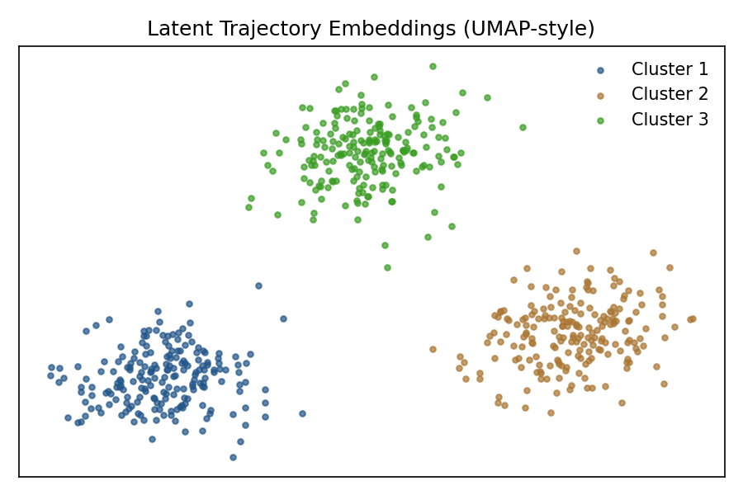
Evaluation & Diagnostics
Reconstruction, clustering (NMI), temporal coherence
Traversal & perturbation tests; retrieval@K
Counterfactual success: plausibility, human ratings, reward Δ
Notes:
Show UMAP plot, metric table, traversal example.

Slide 10
Implementation Plan & Timeline (40 Weeks)
Phases: Foundations; Core; Temporal+Hierarchy; Eval; Demo
Tools: PyTorch, Optuna, W&B; UMAP/t-SNE
Environment: custom 2D gridworld (AgentFarm-compatible)
Foundation
Core Dev
Temporal+Hierarchy
Eval & Validation
Integration & Demo
Notes:
Present as 5-bar Gantt; call out key milestones.

Slide 11
Deliverables, Impact, and Demo
# Embedding API embedding = model.encode(experience) episodes = model.query(predicate="reward>threshold and danger") edited = model.counterfactual(episode, objective="avoid obstacle; reach goal")
Deliverables: model, toolkit, dashboard, dataset, meta-embedding, report
Impact: introspective agents; multimodal fusion advances; evaluation standards
API example shown on right
Notes:
Include dashboard mock and simple API snippet.

Slide 12
Budget, Risks, and Team
Budget summary: stipend, compute, tools, dissemination, contingency
Risks & mitigations: fusion alignment; fidelity vs imagination; generalization; interpretability
Team: prior latent trajectory work; narrative phases
Notes:
Pie chart for budget; concise risk table; brief bio.

Slide 13
Q&A
Evaluation rigor & thresholds
Counterfactual criteria & constraints
Generalization & transfer tests
Dashboard demo plan
Notes:
Keep 1–2 minutes buffer; be ready with backup slides.

Slide 14
Backup: Metrics & Thresholds
SSIM/MSE for recon
NMI/Silhouette for clustering
Curvature/ISTD for smoothness
Retrieval Precision@K
Notes:
Use only if questioned on evaluation details.

Slide 15
Backup: Counterfactual Editing
Gradient-based latent optimization
Constraints for plausibility
Success rate & reward delta
Notes:
Keep formulae in speaker notes if needed.

