Slide 1
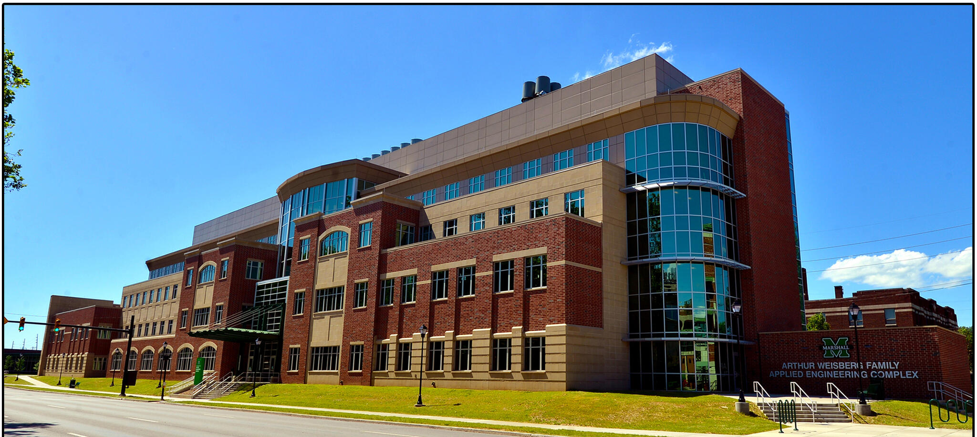
April 25, 2021
Marshall University, Huntington, WV

