Slide 1
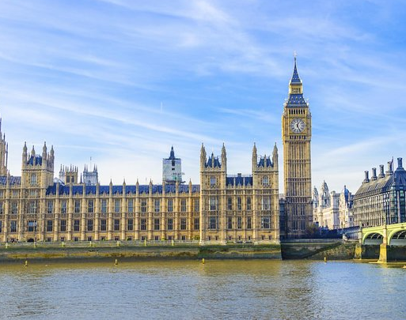
Westminster Shorter Catechism
Questions 99-103
February 13, 2022
Calvary OPC, La Mirada, CA

Slide 2
Question #99
Q. What rule hath God given for our direction in prayer?
A. The whole word of God is of use to direct us in prayer; but the special rule of direction is that form of prayer which Christ taught his disciples, commonly called the Lord’s Prayer.

Slide 3
What does the Bible say?
“Now this is the confidence that we have in Him, that if we ask anything according to His will, He hears us.” (1John 5:14)
“In this manner, therefore, pray: Our Father in heaven, Hallowed be Your name. Your kingdom come. Your will be done on earth as it is in heaven. Give us this day our daily bread. And forgive us our debts, as we forgive our debtors. And do not lead us into temptation, But deliver us from the evil one. For Yours is the kingdom and the power and the glory forever. Amen.” (Matthew 6:9-13, also see Luke 11:2-4)

Slide 4
How should we pray?
The Lord’s Prayer is a suggested outline, not a prescribed rot form of prayer.
Nevertheless you may pray it in rote manner so long as it is heartfelt prayer.
Q: why does the text of Matthew 6 and Luke 11 differ?
Simply because Jesus repeated His teaching on several occasions and in Luke He chose slightly different but essentially the same words.
Q: Why do we start with God in the Lord’s Prayer?
See answer to WSC Q#1!

Slide 5
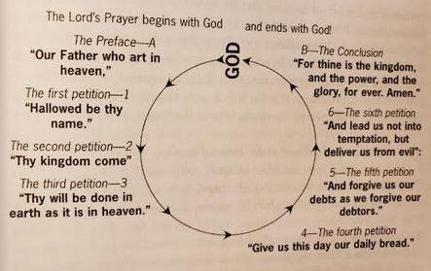
The Lord’s Prayer

Slide 6
A model prayer
Remember last class: the characteristics of true prayer is also true of the Lord’s Prayer.
It is short and simple, yet covers major needs.
It begins and ends with God: God’s name, His kingdom, His will.
Then our needs: physical sustenance and need of forgiveness.
We need not add “spiritual frosting” as though reciting a poem.
Remember Matthew 6:7: we are not heard because of our lengthy words.
It is not a spiritual performance, like the Pharisee in Luke8.
Rather we must pray unosteentatiously (pun intended).

Slide 7
Question #100
Q. What doth the preface of the Lord’s Prayer teach us?
A. The preface of the Lord’s Prayer (which is, Our Father which are in heaven), teacheth us to draw near to God with all holy reverence and confidence, as children to a father, able and ready to help us; and that we should pray with and for others.

Slide 8
What does the Bible say?
“He will fulfill the desire of those who fear Him; He also will hear their cry and save them.” (Psalm 145:19)
“in whom we have boldness and access with confidence through faith in Him.” (Ephesians 3:12)
“For you did not receive the spirit of bondage again to fear, but you received the Spirit of adoption by whom we cry out, ‘Abba, Father.’” (Romans 8:15)

Slide 9
What does the Bible say?
“Now to Him who is able to do exceedingly abundantly above all that we ask or think, according to the power that works in us.” (Ephesians 3:20)
“If you then, being evil, know how to give good gifts to your children, how much more will your Father who is in heaven give good things to those who ask Him!” (Matthew 7:11)
“praying always with all prayer and supplication in the Spirit, being watchful to this end with all perseverance and supplication for all the saints” (Ephesians 6:18)

Slide 10
The Lord’s Prayer is for believers
It is addressed to our Father: those who do not believe in Christ are the sons of the devil (Matthew 8:44-45)
Read Matthew 10:34-36!
We leave our own biological family behind, even and join a spiritual family!
God is transcendent (entirely other) but also immanent (very near)
Not a distant and cold god like Allah
But also not Santa Claus

Slide 11
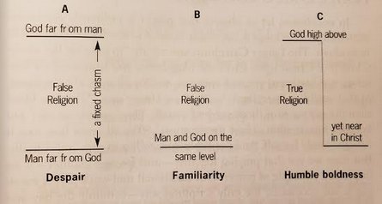
Hebrews 4:14-16!!
Islam
Isaiah 40:18

Slide 12
Both far and near
God is sovereign and majestic and has the power to help us.
If He was only near we might despair of His power.
If He were only far we would despair of His loving kindness.
In Christ these two are in harmony.
Prayer is also corporate
Our Father
And they continued steadfastly in the apostles’ doctrine and fellowship, in the breaking of bread, and in prayers. (Acts 2:42)
“Son of David, have mercy on us!” (Matthew 9:27)

Slide 13
Question #101
Q. What do we pray for in the first petition?
A. In the first petition (which is Hallowed be thy name), we pray that God would enable us and others to glorify him in all that whereby he maketh himself known; and that he would dispose all things to his own glory.

Slide 14
What does the Bible say?
“God be merciful to us and bless us, And cause His face to shine upon us, Selah That Your way may be known on earth, Your salvation among all nations.
Let the peoples praise You, O God; Let all the peoples praise You.” (Psalm 67:1-3)
“For of Him and through Him and to Him are all things, to whom be glory forever. Amen.” (Romans 11:36)

Slide 15
What is a name?
A name is a true description of what a person is like?
Names of God: El Elyon (God most high), El Roi (the God who sees), El Shaddai (God Almighty), Yahweh Yireh (God will provide)
Q: Do you know some other names of God?
To hallow God’s name: to honor and glorify God’s good name.
“A good name is to be chosen rather than great riches” (Proverbs 22:1)
“’Father, glorify Your name.’ Then a voice came from heaven, saying, ‘I have both glorified it and will glorify it again.’” (John 12:28)

Slide 16
Honoring God’s name
We pray truly if we seek God’s honor first above all else!
That is why taking God’s name in vain is forbidden in the Third Commandment
God is a jealous God and protects His name.
“But seek first the kingdom of God and His righteousness, and all these things shall be added to you.” (Matthew 6:33)
Read Exodus 32:9-14!
Q: Why does God relent because of Moses’ request?
Q: How was God’s name honored?

Slide 17
David Brainerd
David Brainerd’s prayer (missionary to the Indians):
“My heaven is to please God, and to glorify Him, and give all to Him, and to be wholly devoted to his glory: that is the heaven I long for, that is my religion, and that is my happiness, and always was, I suppose, ever since I had any true religion; and all those that are aware of that religion shall meet me in heaven. I do not go to heaven to be advanced, but to give honour to God.”
“that, as it is written, ‘He who glories, let him glory in the Lord.’” (1Corinthians 1:31)

Slide 18
Question #102
Q. What do we pray for in the second petition?
A. In the second petition (which is Thy Kingdom come), we pray that Satan’s kingdom may be destroyed, and that the kingdom of grace may be advanced, ourselves and others brought into it, and kept in it, and that the kingdom of glory may be hastened.

Slide 19
What does the Bible say?
“Let God arise, Let His enemies be scattered; Let those also who hate Him flee before Him.” (Psalm 68:1)
“Yes, all kings shall fall down before Him; All nations shall serve Him.” (Psalm 72:11)
“Finally, brethren, pray for us, that the word of the Lord may run swiftly and be glorified, just as it is with you.” (2Thessalonians 3:1)
“He who testifies to these things says, ‘Surely I am coming quickly.’ Amen. Even so, come, Lord Jesus!” (Revelation 22:20)

Slide 20
A spiritual kingdom
“He does according to His will in the army of heaven And among the inhabitants of the earth. No one can restrain His hand Or say to Him, ‘What have You done?’” (Daniel 4:35)
God is sovereign, and everything is under His control, even Satan.
“And the Lord said to Satan, ‘Behold, all that he has is in your power; only do not lay a hand on his person.’” (Job 1:12)
Manichaeism: the idea that there are two co-equal spiritual entities, God and the devil, good and evil, yin and yang.
It is not a political kingdom; problems always arose in church history when the church ruled over or with the state.
Jesus rejected the Jews wanting to make Him king: “My kingdom is not of this world. If My kingdom were of this world, My servants would fight, so that I should not be delivered to the Jews; but now My kingdom is not from here.” (John 18:36)

Slide 21
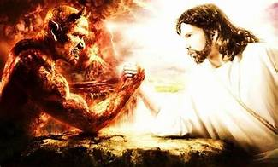
“And then the lawless one will be revealed, whom the Lord will consume with the breath of His mouth and destroy with the brightness of His coming.” (2Thessalonians 2:8)

Slide 22
An antithetical kingdom
God’s kingdom is antithetical to this world, which is ruled by Satan, the ‘god’ of this world.
Satan is allowed to rule this world only temporarily and with limits.
We must be transferred from Satan’s kingdom to God’s kingdom: “And I heard another voice from heaven saying, “Come out of her, my people, lest you share in her sins, and lest you receive of her plagues.” (Revelation 18:4)
The myth of neutrality: the myth that the world is neutral.
There is always a ruling worldview in every society (ours is materialism)
We are either with Jesus or against Him.
The educational system is not neutral.
We must be different from the world in all respects!

Slide 23
An eschatological kingdom
Though Jesus’ kingdom is different from a political kingdom, it is a real, true kingdom nonetheless and will come at the end of this age.
“But he said, ‘No, lest while you gather up the tares you also uproot the wheat with them. Let both grow together until the harvest, and at the time of harvest I will say to the reapers, “First gather together the tares and bind them in bundles to burn them, but gather the wheat into my barn.”’” (Matthew 13:29-30)
The kingdom of God is being built steadily and surely, though it may not seem that way. But Jesus builds His church! (Matthew 16:18)
History is not a set of haphazard random events!
“The kingdoms of this world have become the kingdoms of our Lord and of His Christ, and He shall reign forever and ever!” (Revelation 11:15)

Slide 24
Question #103
Q. What do we pray for in the third petition?
A. In the second petition (which is Thy will be done), we pray that God by his grace, would make us able and willing to know, obey, and submit to his will in all things, as the angels do in heaven.

Slide 25
What does the Bible say?
“for it is God who works in you both to will and to do for His good pleasure.” (Phil. 2:13)
“Open my eyes, that I may see wondrous things from Your law.” (Ps. 119:18)
“O My Father, if this cup cannot pass away from Me unless I drink it, Your will be done.” (Matthew 26:42)
“So when he would not be persuaded, we ceased, saying, ‘The will of the Lord be done.’” (Acts 21:14)
“The Lord gave, and the Lord has taken away; Blessed be the name of the Lord.” (Job 1:21)
“Bless the Lord, you His angels, who excel in strength, who do His word, heeding the voice of His word.” (Psalm 103:20)

Slide 26
The secret and revealed will of God
“The secret things belong to the Lord our God, but those things which are revealed belong to us and to our children forever, that we may do all the words of this law.” (Deuteronomy 29:29)
God’s secret, or decretive will is what God has planned to happen from eternity past, it is unchangeable.
Read Ephesians 1:11!
God’s revealed will to mankind describes what He commands men to do
The Law
It can be abrogated, i.e. as in the ceremonial law
God sometimes ‘repents’, see Exodus 32:9-14

Slide 27
How do you seek God’s will?
Q: So, how?
We do not have to seek the “inner light”, or a voice, or flashing lights, or “put out Gideon’s fleece” – this is gnosticism
All we have to do is know what the Bible says and follow it!
“I beseech you therefore, brethren, by the mercies of God, that you present your bodies a living sacrifice, holy, acceptable to God, which is your reasonable service. And do not be conformed to this world, but be transformed by the renewing of your mind, that you may prove what is that good and acceptable and perfect will of God.” (Romans 12:1-2)
We don’t have to seek God “through the backstage door”!

Slide 28
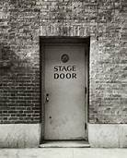

“The rest of us”
(the Bible)
Christian “superstars”

Slide 29
Sola Scriptura
“All Scripture is given by inspiration of God, and is profitable for doctrine, for reproof, for correction, for instruction in righteousness, that the man of God may be complete, thoroughly equipped for every good work.” (2Timothy 3:16-17)
“Now these things, brethren, I have figuratively transferred to myself and Apollos for your sakes, that you may learn in us not to think beyond what is written, that none of you may be puffed up on behalf of one against the other.” (1Corinthians 4:6)

Slide 30
Is it God’s will?
Getting an emotional surge
Waiting for a sign
You hear a voice
Telepathy
Listening to a sermon
Reading the Bible
No
No
No
Noooooo!!!!!
Yes
Yes!!!

