Slide 1

Westminster Shorter Catechism
Questions 73-75
October 31, 2021
Calvary OPC, La Mirada, CA

Slide 2
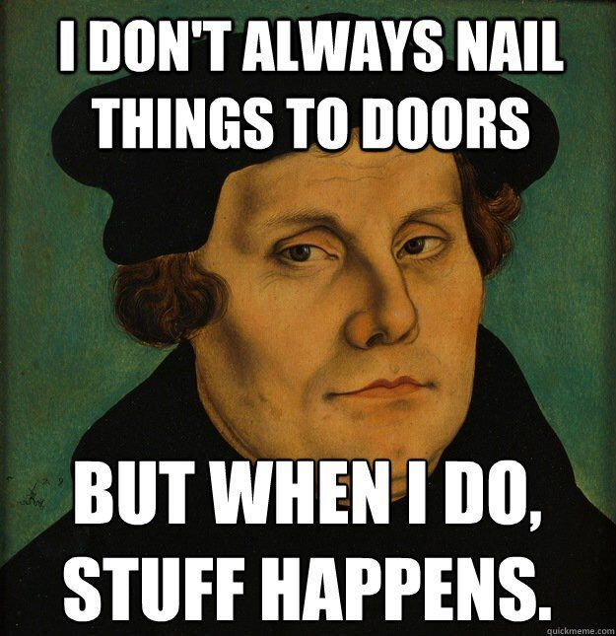
Happy Reformation Day! Fröhliches Reformationstag!

Slide 3
Question #73
Q. Which is the eighth commandment?
A. The eighth commandment is, Thou shalt not steal. (Exodus 20:15)

Slide 4
What does the Bible say?
“Provide things honest in the sight of all men” (Romans 12:17)
“Be thou diligent to know the state of thy flocks, and look well to thy herds” (Proverbs 27:23)
“If thy brother be waxen poor, and fallen in decay with thee; then though shalt relieve him” (Leviticus 25:35)

Slide 5
What does the Bible say?
“Look not every man to his own things, but every man also on the things of others” (Philippians 2:4)
“If any provide not for his own, and specially for those of his own house, he hath denied the faith, and is worse than an infidel” (1Tim. 5:8)
“Let him that stole steal no more: but rather let him labour, working with his hands the thing which is good, that he may have to give to him that needeth” (Ephesians 4:28)

Slide 6
In general
“The heavens are Yours, the earth also is Yours; The world and all its fullness, You have founded them” (Psalm 89:11)
Be humble, because you own nothing
everything was given to you by God (all is grace!)
God has given us things to be stewards over them
“And He has made from one blood every nation of men to dwell on all the face of the earth, and has determined their pre-appointed times and the boundaries of their dwellings” (Acts 17:26)
We also glorify God in our being stewards over His creation

Slide 7
The creation mandate
“Then God blessed them, and God said to them, ‘Be fruitful and multiply; fill the earth and subdue it; have dominion over the fish of the sea, over the birds of the air, and over every living thing that moves on the earth.’ And God said,’ See, I have given you every herb that yields seed which is on the face of all the earth, and every tree whose fruit yields seed; to you it shall be for food.’” (Genesis 1:28-29)

Slide 8
Note about the scientific mandate
Since God commands us to rule over the earth and subdue it, we must be able to study and know about nature to fulfill this command.
To study nature is nothing less than doing science.
Hence, the Bible is not anti-science, but rather commands us to study nature in Genesis.

Slide 9
Be diligent
Read Proverbs 6:6-11
It is good to take every opportunity you have that is given to you by the Lord, because it is a blessing
This way you are also a good steward and you use your talents for God’s glory
Sloth is also a form of theft, you receive wages for nothing
“If any would not work, neither should he eat” (2Thess. 3:10)

Slide 10
Private property or “Christian Communism”?
Q: What does the Bible teach? Private property or a commonwealth of all goods?
If Socialism is true, then there would be no money and everyone owns everything, nothing really belongs to anyone
Thus, stealing loses its meaning, because one must own something in order for it to be stolen from them
Historical note: Workplace thefts was common in former Communist countries

Slide 11
“All things in common”
“Now all who believed were together, and had all things in common, and sold their possessions and goods, and divided them among all, as anyone had need.” (Acts 2:44-45)
Read Acts 5:1-11. Verses 3-4: “But Peter said, “Ananias, why has Satan filled your heart to lie to the Holy Spirit and keep back part of the price of the land for yourself? While it remained, was it not your own? And after it was sold, was it not in your own control?”
Selling your land for common use was not mandatory, Ananias’ property could have remained in his own hands.

Slide 12
What is Socialism?
Big government ownership and administration of the means of production
The government becomes God
No private property, wage redistribution
Confiscation of inheritance
Forced equality of economic output
Theft and intimidation of rich people (i.e. kulaks)
persecution of the intelligentsia
Price regulation and abolishment of the market economy
Hi taxes

Slide 13
Why is Socialism not in the Bible?
Acts 18:3: Paul and his associates were tent makers
“Let each one remain in the same calling in which he was called. Were you called while a slave? Do not be concerned about it; but if you can be made free, rather use it. For he who is called in the Lord while a slave is the Lord’s freedman. Likewise he who is called while free is Christ’s slave. You were bought at a price; do not become slaves of men.” (Acts 7:20-23)
This demonstrates that each man made his own living
Do not become the slaves of a Socialist plantation

Slide 14
Naboth’s vineyard
“And it came to pass after these things that Naboth the Jezreelite had a vineyard which was in Jezreel, next to the palace of Ahab king of Samaria. So Ahab spoke to Naboth, saying, ‘Give me your vineyard, that I may have it for a vegetable garden, because it is near, next to my house; and for it I will give you a vineyard better than it. Or, if it seems good to you, I will give you its worth in money.’ But Naboth said to Ahab, ‘The Lord forbid that I should give the inheritance of my fathers to you!’” (1Kings 21:1-3)
Not even the king of Israel had the power to take the private property of a common citizen.

Slide 15
Inheritance
“A good man leaves an inheritance to his children’s children, but the wealth of the sinner is stored up for the righteous.” (Proverbs 13:22)
Numbers 27, 32-36 all describe in detail inheritance laws of the Jewish people
In the New Testament: 2 Corinthians 12:14; Ephesians 4:28; Philippians 4:18

Slide 16
Christianity and Communism
Q: Can a Christian be a Communist?
Q: Can a Communist be a Christian?
A: Yes, if he repents.
Communism is one of the great competitors of the Christian religion
Marx believed that belief in God is a lie, a mental drug to dampen the feeling of injustice due to inequality
Communism denies God and biblical authority
Marxism’s eschatology is a utopian society, a worker’s paradise where everyone is equal and the church has been abolished
It is utopia or a-topia (no-place) because it does not exist, because it is unachievable

Slide 17
Communism is institutionalized theft
A Socialist/Communist system takes away all goods and redistributes them to ensure equality of outcome, no matter how hard you try
In the United States, this equates to the quota system
Whatever a man produces by his own labor, he should also be allowed to enjoy
“The man who produces the corn should also be able to eat the corn” (Abraham Lincoln)

Slide 18
Legitimate ways to acquire money or property
Q: What are these ways?
Inheritance or Labor
Labor:
“Let him who stole steal no longer, but rather let him labor, working with his hands what is good, that he may have something to give him who has need.” (Eph. 4:28)
“But if anyone does not provide for his own, and especially for those of his household, he has denied the faith and is worse than an unbeliever.” (1Tim. 5:8)
For young men especially it is important to get a career to establish yourself and support your family. Study and work hard first, relax and party later.
Or in Ozzie’s case, study theology later

Slide 19
The lottery
Since you produce nothing through your own performance, gaining money via the lottery is immoral
Theft: many other people are losing their money for no reason
A tax on the poor
A form of vanity that “Lady Luck will favor me”
Winning the lottery is trust in mere chance, not in God who can provide for you

Slide 20
Game shows, disproportionate salaries
Some politicians charge upwards of $100,000 for merely giving a one-hour speech
Baseball/soccer players, actors, politicians receive salaries in the millions of dollars and euros
Amazon sells books for $1000 to trick unwitting purchasers
Game shows: game shows award large sums of money for trivial feats of intelligence
Right to award mental performance
Problematic if it is disproportionate
More in Abraham Kuyper: “Christianity and modernity”

Slide 21
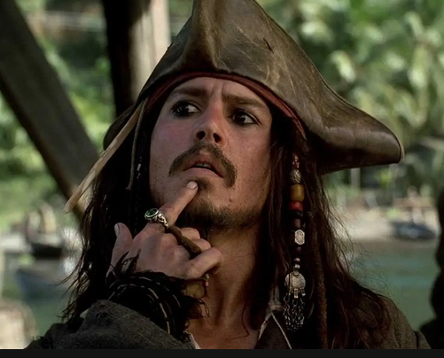
Just for Tim: pirated videos?
People put together a video on Rumble or YouTube
It took them work to write the script, put together the pictures in the slides, etc.
It depends:
If they made free content, then you may use the video
However, if it is monetized, then it would be wrong, because the author intended it to be sold for his own profit
Bottom line: don’t be a pirate

Slide 22
The question of money
“For the love of money is a root of all kinds of evil, for which some have strayed from the faith in their greediness, and pierced themselves through with many sorrows.” (1Timothy 6:10)
Money itself is not evil
It is necessary in order to pay the bills, buy food and clothes, etc.
It is not wrong even to have much money
But God should be in the first place, and the focus should be on pleasing Him, not acquiring more money
On average, people are content with a salary of around $75,000
Not too much, not too little

Slide 23
The love of money
“For what will it profit a man if he gains the whole world, and loses his own soul?” (Mark 8:26)
You can’t take your money with you into heaven where it will be worthless
“And I will say to my soul, ‘Soul, you have many goods laid up for many years; take your ease; eat, drink, and be merry.’ But God said to him, ‘Fool! This night your soul will be required of you; then whose will those things be which you have provided?” (Luke 12:19-20)

Slide 24
Surety
Read Proverbs 6:1-5
The borrower is slave to the lender (Proverbs 22:7)
If you take surety for someone, you are putting yourself under their control
If they make a financial blunder, then you are responsible
You may have to pay through the nose

Slide 25
Questions for open discussion
Q: Is it okay to take part in a drug trial where all you do is take pills and sit around at you leisure?
Q: What if the pill is potentially dangerous?
Q: What if you know it’s dangerous? Is this violating the sixth commandment?
Q: Are extremely high tax rates theft?
Q: What is the only case when stealing is actually allowed?
A: During the world series when a man is on base.

Slide 26
Some corrections
The sin of Ananias and Sapphira was not theft. Acts 5:4 says “While it remained, was it not your own? And after it was sold, was it not in your own control? Why have you conceived this thing in your heart? You have not lied to men but to God.”
Ananias and Sapphira owned the property, but lied about how much they had given to the church (all, not part). This was a lie, not theft.
Questions about taxation and bungee jumping were for open discussion, not factual statement
Taxes must be paid to the government however high they may be

Slide 27
The basis for possessions
“Then God blessed them, and God said to them, “Be fruitful and multiply; fill the earth and subdue it; have dominion over the fish of the sea, over the birds of the air, and over every living thing that moves on the earth.” (Genesis 1:28)
God determines the portions and boundaries of all nations on earth (Acts 17:26)
if we steal, we contradict God’s appropriation of goods
We were made in God’s image, and God entrusted the physical world to us to rule over and subdue it, as servants, stewards, vice-regents
Just as God is an active God, so must we also be active.
God also wants to bless us with material possessions as well because He is good and merciful.

Slide 28
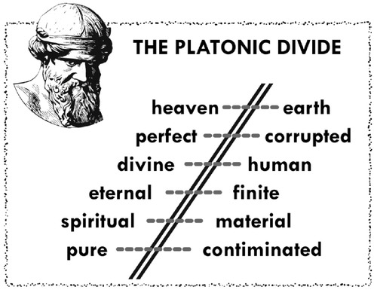

Slide 29
The physical world is good!
“Then God saw everything that He had made, and indeed it was very good. So the evening and the morning were the sixth day.” (Genesis 1:31)
God doesn’t create anything deformed, bad, evil or sick
Hence God did not use evolution to create
God is not the author of sin

Slide 30
Revelation 21:1-3
Now I saw a new heaven and a new earth, for the first heaven and the first earth had passed away. Also there was no more sea. Then I, John, saw the holy city, New Jerusalem, coming down out of heaven from God, prepared as a bride adorned for her husband. And I heard a loud voice from heaven saying, “Behold, the tabernacle of God is with men, and He will dwell with them, and they shall be His people. God Himself will be with them and be their God.”
“But the meek shall inherit the earth, And shall delight themselves in the abundance of peace.” (Psalm 37:11, see Matthew 5:5)

Slide 31

PLATONISM

Slide 32
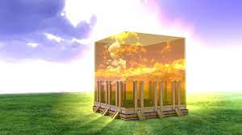

Slide 33
God shall provide
Trust in God’s providence, that He can provide for all of our needs, we do not need to resort to stealing
God created all things, thus what is it for Him to provide for us?
“But seek first the kingdom of God and His righteousness, and all these things shall be added to you.” (Matthew 6:33)
God comes first in all things, but if we trust in Him, He shall take good care of us, because He is good and gracious
“Therefore do not worry about tomorrow, for tomorrow will worry about its own things. Sufficient for the day is its own trouble.” (Matthew 5:34)

Slide 34
Talents
God created each man with certain talents (intelligence, wit, strength, courage, etc.)
Read Matthew 25:19-46
We should use them for God’s glory but also for our own benefit
If we do not use our talents, we are casting a bad light upon God
We should each seek an occupation that makes good use of our talents as stewards (remember Genesis 1:28)

Slide 35
Do not favor the rich or the poor
Read James 2:1-12
It is unjust to favor the rich because of perceived benefits by being their friend
We must take care of the poor, especially those in the church to show God’s love
But poor is not necessarily pure
“You shall not show partiality to a poor man in his dispute.” (Exodus 23:3)

Slide 36
Question #74
Q. What is required in the eighth commandment?
A. The eight commandment requireth the lawful procuring and furthering the wealth and estate of ourselves and others.

Slide 37
Larger Catechism #141
Truth
Faithfulness
Justice in contracts
Rendering just due
Restitution of stolen property
Giving and lending freely
Moderation of our judgement, wills and affections towards worldly goods
Study to get, use and keep those things which sustain our nature
Lawful calling and diligence in it
Frugality
Avoiding unnecessary lawsuits
Suretyship
An endeavor to further the wealth and outward estate of others

Slide 38
Giving and lending freely
“Give to everyone who asks of you. And from him who takes away your goods do not ask them back.” (Luke 6:30)
God gave to us, therefore we should give to others
“But whoever has this world’s goods, and sees his brother in need, and shuts up his heart from him, how does the love of God abide in him?” (1John 3:17)
If we do not help out our brother in need, why should we expect God’s blessings?
“But whoever has this world’s goods, and sees his brother in need, and shuts up his heart from him, how does the love of God abide in him?” (2Cor. 7:9)

Slide 39
Moderation of our judgements
“Moderation of our judgements, wills, and affections concerning worldly goods” (LC text)
“Now godliness with contentment is great gain. For we brought nothing into this world, and it is certain we can carry nothing out. And having food and clothing, with these we shall be content.” (1Tim. 6:6-8)
We should always place God in the first place before ourselves
This is a sign of true trust and faith in God

Slide 40
Unnecessary lawsuits
Read 1Corinthians 6:1-10
Let’s focus on verses 7-8!
People in the Corinthian church were taking each other to court before unbelievers
This was bad enough because this caused others to think God’s Word was insufficient to deal justice
In support, read Matthew 5:38-42
If the other man is wicked enough to take you to court, rather suffer loss instead of tarnishing God’s image (fighting within the church)
Jesus lost His life on the cross even though it was our sin, not His
We shall become more like Christ this way through suffering

Slide 41
Question #75
Q. Which is forbidden in the eighth commandment?
A. The eight commandment forbiddeth whatever doth or may unjustly hinder our own or our neighbour’s wealth or outward estte.

Slide 42
Larger Catechism #142
Theft and robbery
Man-stealing
Receiving stolen goods
Fraudulent dealings
False weights and measures
Removing landmarks
Unfaithful contracts
Oppression
Distortion
Usury, bribery
Vexatious lawsuits
Depopulations
Overpricing goods
Unlawful callings
Any form of taking or withholding what is our neighbour’s
Covetousness
Inordinate lust after worldly goods
Distrustful cares
Envying the prosperity of others
Idleness and gaming

Slide 43
Unlawful calling
Read Acts 19:19, 24, 25
The people in these verses practiced magic and idolatry, both are sins forbidden by the Bible
Also the selling of indulgences before and during the Reformation
The practitioners amassed fifty thousand pieces of silver and made a profit from making idols
Today 1 oz. of silver is around $25, meaning $1.25M
Sin can only destroy a man’s life, and having them pay for it is theft

Slide 44
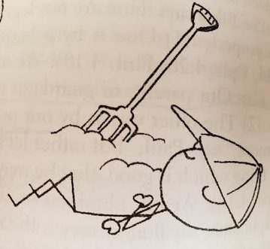
Idleness, sloth
Sloth is becoming more and more of a problem
Taking too many short breaks on the job
According to estimates if you add up all the unnecessary breaks people take while on the job, it adds up to something like one day in a month
Your boss pays you money while you do nothing nor do you produce anything

Slide 45

Waste
“He who is slothful in his work is a brother to him who is a great destroyer” (Proverbs 18:9)
Waste means that you do not use property, objects properly
i.e. people do not take car of rental cars as though they were their own by jamming the breaks more than they ought to
There are costs in restoring broken, wasted good, i.e. repairing rental cars

Slide 46
The antidote to theft
Bondservants, be obedient to those who are your masters according to the flesh, with fear and trembling, in sincerity of heart, as to Christ; not with eyeservice, as men-pleasers, but as bondservants of Christ, doing the will of God from the heart, with goodwill doing service, as to the Lord, and not to men, knowing that whatever good anyone does, he will receive the same from the Lord, whether he is a slave or free. And you, masters, do the same things to them, giving up threatening, knowing that your own Master also is in heaven, and there is no partiality with Him. (Ephesians 6:5-9)

Slide 47
The antidote to theft
As workers we should seek not to please men, but rather God, who is the ultimate Lord of all things.
We must ultimately give account to Him.
But employers must also realize that they cannot oppress, distort or disenfranchise employees, because they also have a master
As masters their responsibility is even greater

