Slide 1

Westminster Shorter Catechism
Questions 49 - 50
May 30, 2021
Calvary OPC, La Mirada, CA

Slide 2
Question #49
Q. Which is the second commandment?
A. The second commandment is, Thou shalt not make unto thee any thing that is in heaven above, or that is in the earth beneath, or that is in the water under the earth: thou shalt not bow down thyself to them nor serve them: for I the Lord thy God am a jealous God, visiting the iniquity of the fathers upon the children unto the third and fourth generation of them that hate me, and showing mercy unto thousands of them that love me and keep my commandments.

Slide 3
What does the Bible say?
“Teaching them to observe all things whatsoever I have commanded." (Matthew 28:20)
“What thing soever I command you, observe to do it: thou shalt not add thereto, nor diminish from it." (Deuteronomy 12:32)
“See that you make all things according to the pattern shown you on the mountain” (Hebrews 8:5)

Slide 4
How do the 1st and 2nd commandments relate?
The second commandment is the greatest commandment after the first.
The first commandment tells us who to worship.
The second deals with how we worship God.
The first commandment leads to the second, but if we break the second commandment, we will break the first as well!
If we worship somebody who we made up, this is idolatry

Slide 5
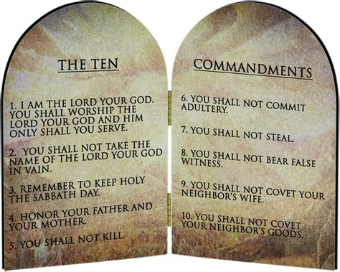
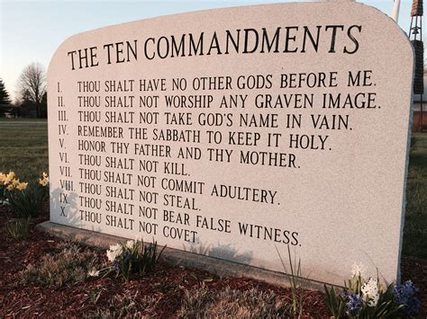
How are the Ten Commandments divided?

Slide 6
How are the Ten Commandments divided?
Tenth commandment: “You shall not covet your neighbor’s house; you shall not covet your neighbor’s wife, nor his male servant, nor his female servant, nor his ox, nor his donkey, nor anything that is your neighbor’s.” (Exodus 20:17)
The tenth commandment cannot be split (same topic -- coveting)
But the second commandment is distinct from the first in that it tells us how to worship

Slide 7
To serve is to worship
Let’s review Exodus 20:4-5: “Thou shalt not make unto thee any thing that is in heaven above, or that is in the earth beneath, or that is in the water under the earth: thou shalt not bow down thyself to them nor serve them: for I the Lord thy God am a jealous God”
No image is to be made like anything in heaven, earth, or under the earth, anywhere
Not even Jesus or the Father in heaven
Do not bow down to them in worship nor serve them
English | Latin | Greek | Hebrew
To honor | latria | λατρεία | אָבֹ֧ת (avat)
To serve | dulia | δουλεία

Slide 8
To serve is to worship
“Do not go after other gods to serve them and worship them, and do not provoke Me to anger with the works of your hands; and I will not harm you.” (Jeremiah 25:6)
“So they left all the commandments of the Lord their God, made for themselves a molded image and two calves, made a wooden image and worshiped all the host of heaven, and served Baal.” (2Kings 17:16)

Slide 9
Numbers 21:7-9
“Therefore the people came to Moses, and said, ‘We have sinned, for we have spoken against the Lord and against you; pray to the Lord that He take away the serpents from us.’ So Moses prayed for the people. Then the Lord said to Moses, ‘Make a fiery serpent, and set it on a pole; and it shall be that everyone who is bitten, when he looks at it, shall live.’ So Moses made a bronze serpent, and put it on a pole; and so it was, if a serpent had bitten anyone, when he looked at the bronze serpent, he lived.”
Q: Does this verse teach the veneration of images?

Slide 10
Numbers 21:7-9
King Hezekiah removes the bronze serpent in his day:
“He removed the high places and broke the sacred pillars, cut down the wooden image and broke in pieces the bronze serpent that Moses had made; for until those days the children of Israel burned incense to it, and called it Nehushtan.” (2Kings 18:4)
The bronze serpent was being misused
Let’s review Exodus 20:4: “You shall not make for yourself a carved image—any likeness of anything that is in heaven above…”
The bronze serpent was for one time corporate use
The 2nd commandment forbids personal use of image for worship

Slide 11
Question #50
Q. Which is required in the second commandment?
A. The second commandment requireth the receiving, observing and keeping pure and entire, all such religious worship and ordinances as God hath appointed on his Word.
Larger Catechism 108.

Slide 12
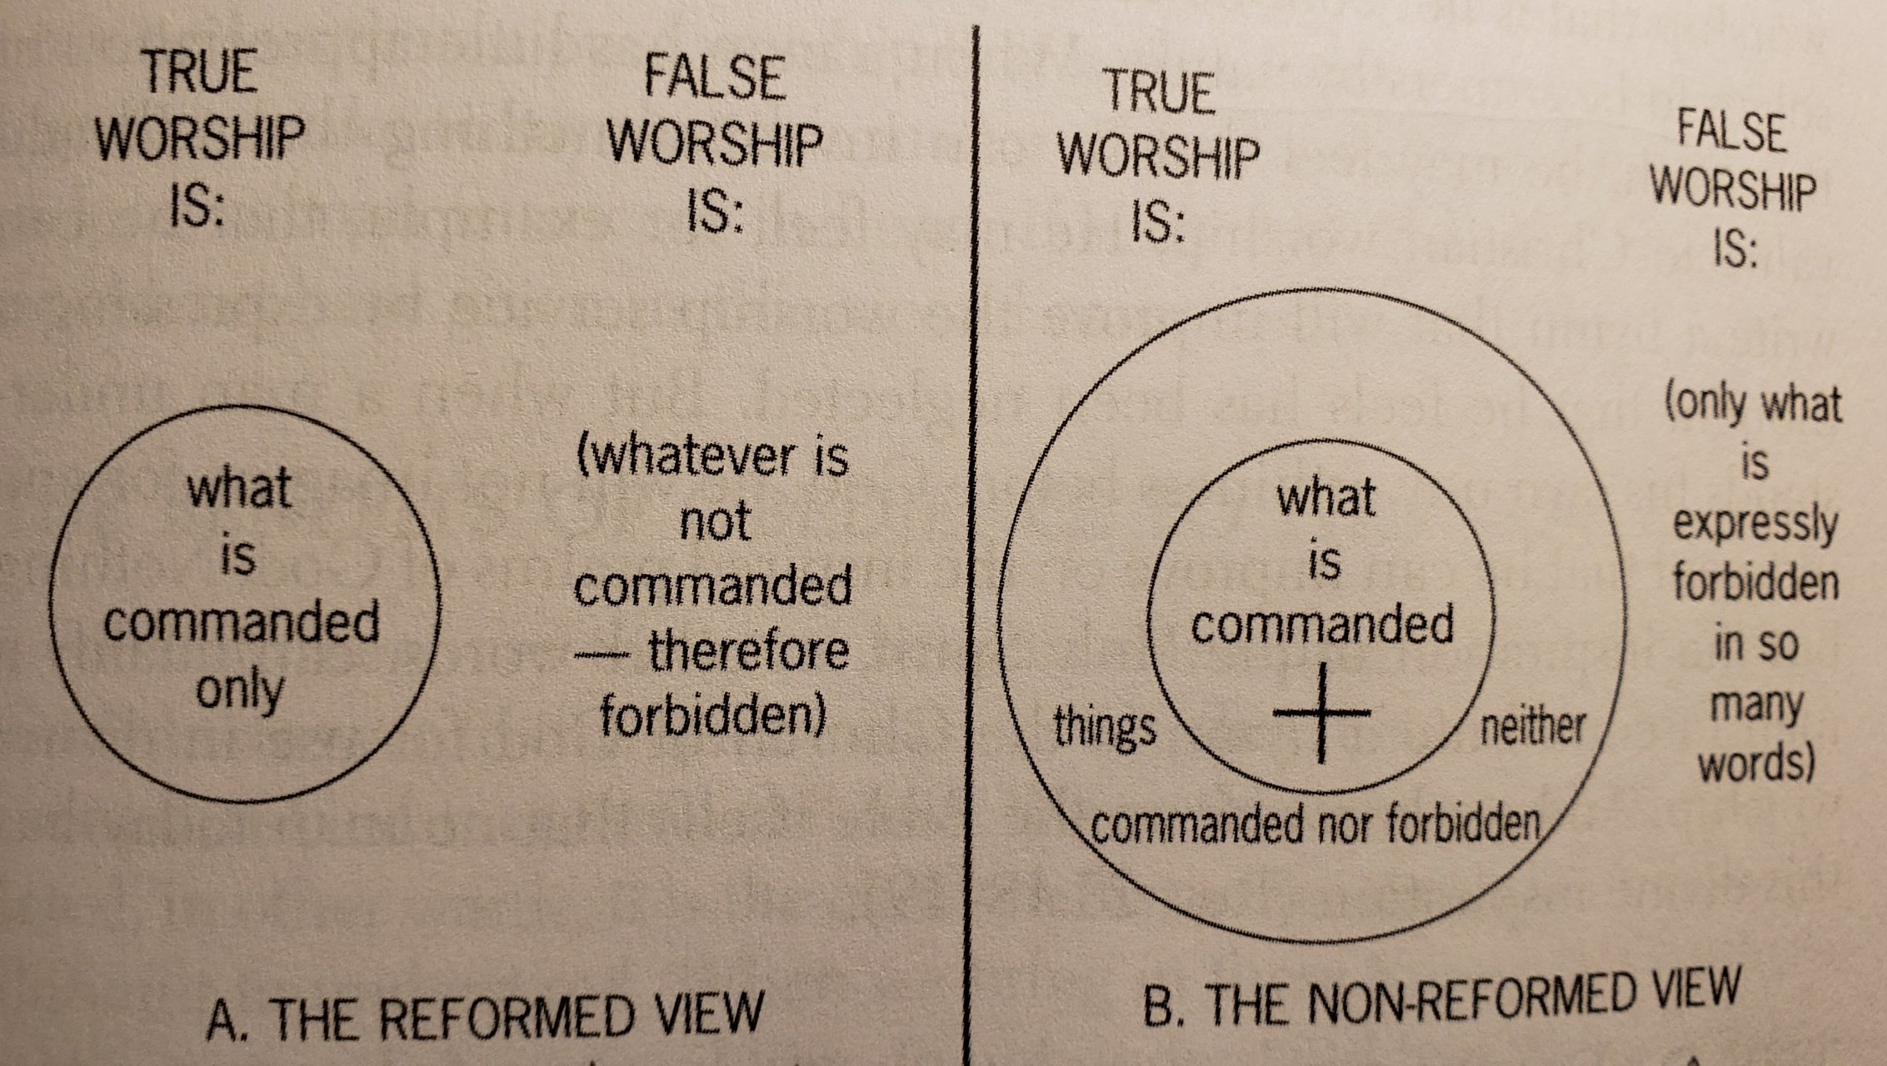
The regulative principle of worship

Slide 13
The regulative principle of worship
We worship according to what Scripture says
Sola Scriptura
The list would be too long to list how not to worship
Non-Reformed: “neutral” elements cmay be added
Myth of neutrality
Nothing is neutral in God’s world
“He who is not with Me is against Me, and he who does not gather with Me scatters.” (Luke 11:23)
Whatever is not commanded is forbidden
Q: Can’t we tolerate if someone worships unbiblically, but with good intentions?
No, being ignorant of the law doesn’t excuse you

Slide 14
A warning from Revelation 22:18-19
“For I testify to everyone who hears the words of the prophecy of this book: If anyone adds to these things, God will add to him the plagues that are written in this book; and if anyone takes away from the words of the book of this prophecy, God shall take away his part from the Book of Life, from the holy city, and from the things which are written in this book.”
We must learn not to think of God as men have imagined that He might be. They should rather learn to think of Him as He has shown Himself to be.
Look not to mens’ images but recieve God’s Word

Slide 15
Objectionable worship
Q: what do you think is objectionable in worship?
Not preaching from the Word
Rock music, bands (secular)
Unbiblical lyrics
Example: “and I know God as no other has known”
Songs focusing on the worshiper as opposed to the One worshiped
Being “slain in the Spirit”
Carrying around the Torah so that people may touch it
(Messianic church service)
Common element: things done in order to excite people
False teaching of Charles Finney

Slide 16


Slide 17
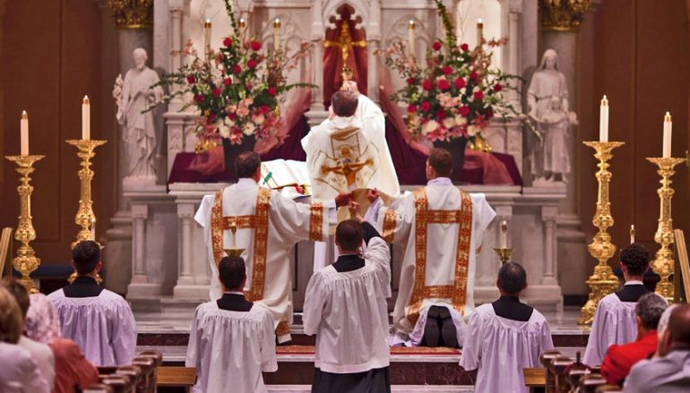
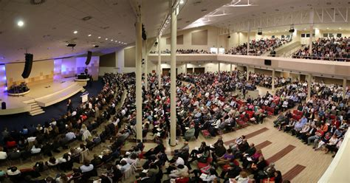
Is Reformed worship inferior?
Q: What kind of feelings do you have about worshipping at Calvary OPC? Do you feel jealous of more ornate churches? Or more ‘lively’ churches?

Slide 18
Reformed worship
Consider:
Jesus lived a simple life and never took part in elaborate, ornamental ceremonies, and He wore simple clothes
When we worship we are in the very presence of God and His angels
“Be silent in the presence of the Lord God; For the day of the Lord is at hand, For the Lord has prepared a sacrifice; He has invited His guests.” (Zephaniah 1:7)

Slide 19
Verse of the week
“God is Spirit, and those who worship Him must worship in spirit and truth.”
(John 4:24)

