Slide 1
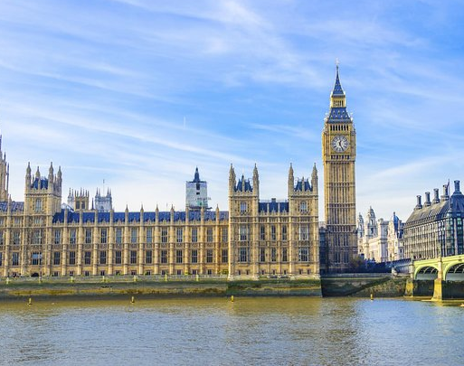
Westminster Shorter Catechism
Questions 51 - 52
June 6, 2021
Calvary OPC, La Mirada, CA

Slide 2
Question #51
Q. What is forbidden in the second commandment?
A. The second commandment forbiddeth the worshipping of God by images, or any other way not appointed in his word.

Slide 3
Question #51
Q. What are the reasons annexed to the second commandment?
A. The reasons annexed to the second commandment are, God’s sovereignty over us, his propriety in us, and the zeal he hath to his own worhsip.

Slide 4
What does the Bible say?
“Take ye therefore good heed unto yourselves; for ye saw no manner of similitude on the day that the Lord spake unto you in Horeb out of the midst of the fire: lest ye corrupt yourselves, and make you a graven image, the similitude of any figure, the likeness of male or female.” (Deuteronomy 4:15-16)
“What thing soever I command you, observe to do it: thou shalt not add thereto, nor diminish from it.” (Deuteronomy 12:32)

Slide 5
What does the Bible say? - 2
“O come, let us worship and bow down; let us kneel before the Lord our maker” (Psalm 95:6)
“…he is thy Lord, and worship thou Him.” (Psalm 45:11)
“But ye shall destroy their altars, break their images, and cut down their groves… for the Lord, whose name is Jealous, is a jealous God” (Exodus 34:13-14)

Slide 6
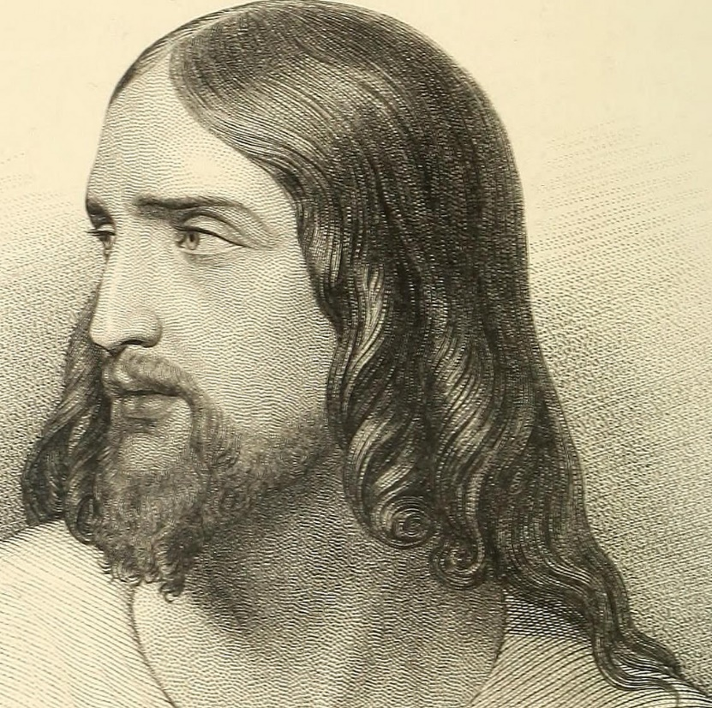
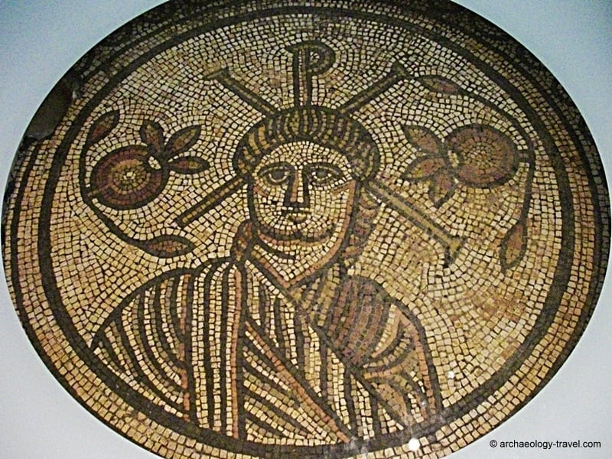
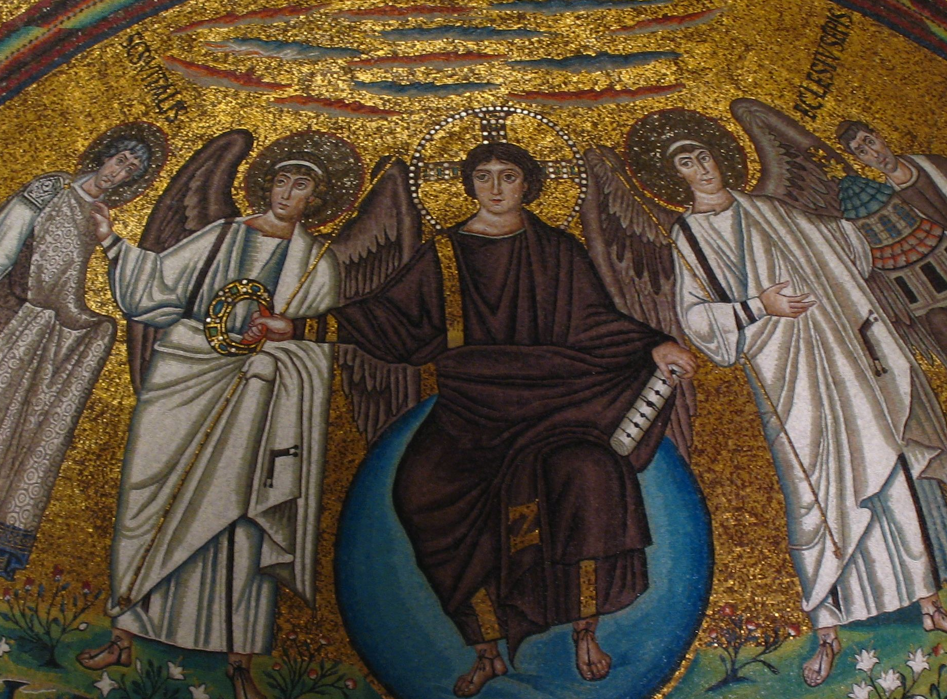
Do we know what Jesus looked like?
Q: Is this Jesus?
Q: Is it important to know what Jesus looked like?

Slide 7
What about images of Jesus?
“Therefore, since we are the offspring of God, we ought not to think that the Divine Nature is like gold or silver or stone, something shaped by art and man’s devising.” (Acts 17:29)
“Everyone is dull-hearted, without knowledge; every metalsmith is put to shame by an image; for his molded image is falsehood, and there is no breath in them. They are futile, a work of errors; in the time of their punishment they all perish.” (Jeremiah 10:14-15)

Slide 8
Images and the hypostatic union
The hypostatic union: Jesus Christ has a distinct divine and a human nature in one person
The two natures do not mix, nor are they separate (Jesus isn’t schizophrenic)
Neither does one nature subsume, encompass or subordinate the other (the divine doesn’t subsume the human nature)
Councils of Ephesus and Chalzedon
Q: How can you depict Jesus the ‘God-man’?
Trick question; you can’t – images are of men, but Jesus is not merely a man
“To whom then will you liken God? Or what likeness will you compare to Him?” (Isaiah 40:18)

Slide 9
section summary
Man cannot ever fully comprehend God (not even in heaven), we can only apprehend him
Our minds are dulled by sin
To claim that we can depict God in an image or statue is arrogant
Jesus is God and man in two natures, in one person
This is yet another mystery
“He is the image of the invisible God, the firstborn over all creation” (Colossians 1:15)
Read 2 Corinthians 3:18, 1 Corinthians 13:12
Beatific vision

Slide 10
A short history of images in worship
Artistic depictions started only in the third century, expanded in the sixth century
In the Middle Ages the cult of the saints enjoyed an upsurge
Protectors of cities, ships, and different places
Manifested in artistic depictions
Pilgrimages
Libri Carolini: 790: images shouldn’t be worshiped, but the cross can be venerated, art can be used for decoration

Slide 11
A short history of images in worship
Pope Gregory I (6th century): libri pauperum: images teach the illiterate
Until the 14th century the Franciscans and Cistercians rejected lavish imagery
Bonaventure: images have three uses: pedagogical, inspirational, commemorative
Aquinas: three grades of honor accommodated to images: latria (worship), dulia (reverence, saints), hyperdulia (Virgin Mary)
John of Damascus: the devotion to the material object ascends to the spiritual reality that it represents
Same argument in voodoo religions, voodoo dolls

Slide 12
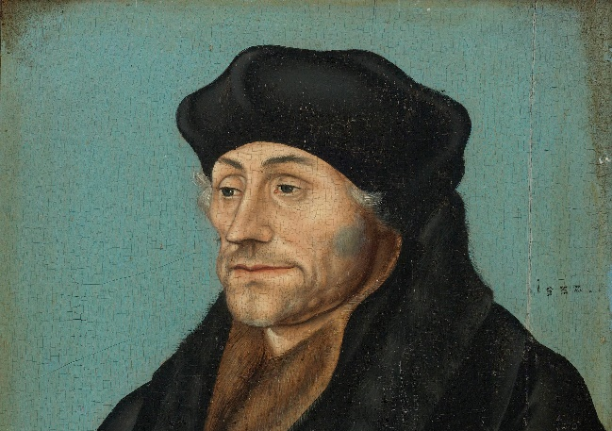
Erasmus
Critiqued medieval piety, but never gave it up fully
Half-way between the Roman Catholic church and Protestantism
Influenced by Origen, Neoplatonism: body is a brute beast
Devotio Moderna, Brethren of the Common Life: Imitation of Christ: “learn to despise outward things and to give yourself to inward things”
Fancy cathedrals and artwork took away funds from feeding the hungry, the true temples of God
Images cannot even approach the holiness that they seek to represent
God alone is the source of true spiritual power, images are worthless

Slide 13
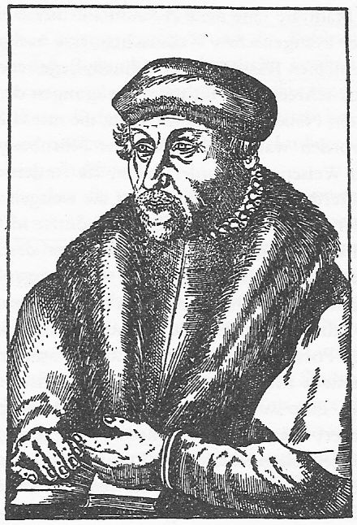
Historical Protestant arguments against images
Andreas Bodenstein von Karlstadt: “On the Abolition of Images” (1522)
The Spirit works through the Word and not material objects
So then faith comes by hearing, and hearing by the word of God. (Rom. 10:17) – nit by viewing an image
The image is only a guess, and can’t objectify spiritual reality
People should learn how to read, not be kept ignorant with images
Images have no spiritual value
“God is Spirit, and those who worship Him must worship in spirit and truth” (John 4:24)

Slide 14
“On the Abolition of Images” – con’t
“ Nor is there salvation in any other, for there is no other name under heaven given among men by which we must be saved” (Acts 4:12)
Jesus is the only Savior, not the saints
If the saints can’t help us, neither can their mere images
“God, who made the world and everything in it, since He is Lord of heaven and earth, does not dwell in temples made with hands. Nor is He worshiped with men’s hands, as though He needed anything, since He gives to all life, breath, and all things.” (Acts 17:24-25)

Slide 15
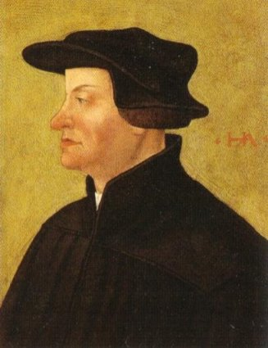
Zwingli on the psychology of idolatry
Zwingli describes how material idols are an external manifestation of an inner idol
abgott (‘strange god’): an inner idol (money, glory, car, false god)
The mental process materializes the abgott since man tries to comprehend reality through material means
The abgott is manifested in material form, an image or statue, which are idols (götzen)
“There is no one who, as soon as he hears God spoken of, or any other thing which he has not already seen, does not picture a form for himself” (Eire, p. 84)
Ecclesiastes 7:29: man made upright but sought out many schemes

Slide 16
Other views
Wyclif, Hus uttered grievances against saints, relics, images
Others: Guibert Nogent Jean Gerson, Pierre D’Ailly
Sometimes led to iconoclasm (Taborites, Czechia)
Bullinger (Zwingli’s successor at Zurich): the cause of idolatry is that men seek the divine and infinite in the material and visible world
Bucer (Strassburg)
criticized the cult of images as taking away from those in need
False miracles associated with images (i.e. crying images of Mary) not from God

Slide 17
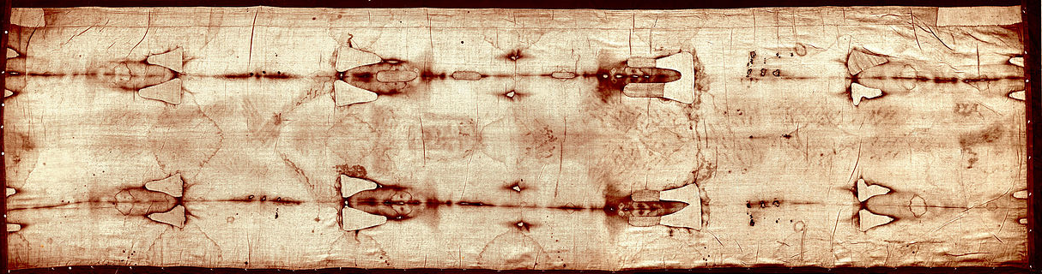
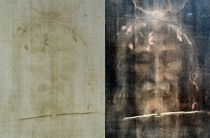
The Shroud of Turin
creation.com/turin-shroud

Slide 18
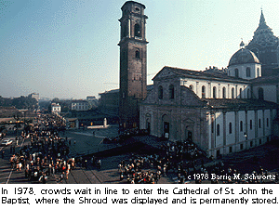
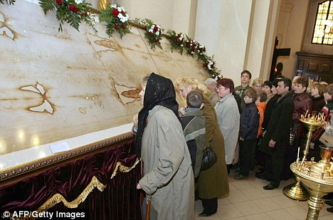
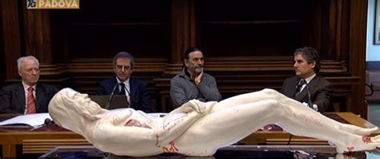

Slide 19
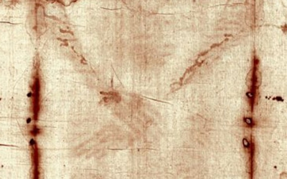
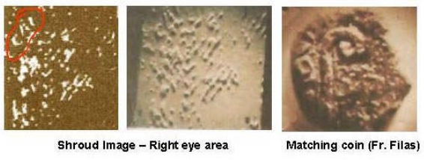
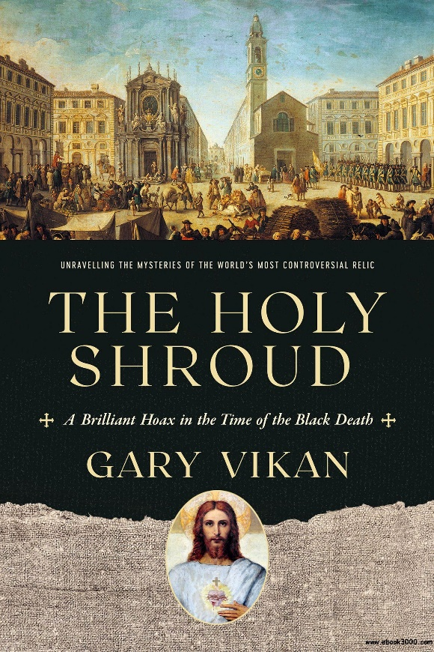
“TIBERIOY KAICAROC” (Tiberius Caesar)
“and the handkerchief that had been around His head, not lying with the linen cloths, but folded together in a place by itself.” (John 20:7)
“Does not even nature itself teach you that if a man has long hair, it is a dishonor to him?” (1Cor. 11:14)
The man in the Shroud is around 6 feet tall, much taller than the Jews in Jesus’ time
If the shroud was wrapped around a person’s bloody face, it would be distorted
Carbon dating from 1989 puts the Shroud at 1260-1390, around the time it was first publicly displayed

Slide 20

Children’s books
Bad practice to have books depicting cartoon versions of Jesus
Gives the impression that Jesus is powerless, diminutive, controllable, fake and unreal
Children become used to it at an early age

Slide 21
Verse of the week
“To whom then will you liken God? Or what likeness will you compare to Him?”
(Isaiah 40:18)

