Slide 1
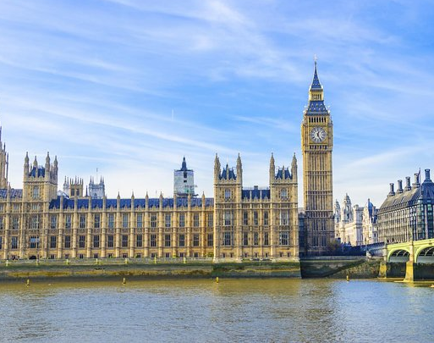
Westminster Shorter Catechism
Questions 57 - 59
September 1, 2021
Calvary OPC, La Mirada, CA

Slide 2
Question #57
Q. What is the fourth commandment?
A. The fourth commandment is, Remember the sabbath-day to keep it holy. Six days shalt though labour, and do all thy work: but the seventh day is the sabbath of the Lord they God: in it thou shalt not do any work, thou, nor thy son, nor they daughter, thy man-servant, nor they maid-servant, nor they cattle, nor they stranger that is within thy gates: for in six days the Lord made the heaven and the earth, the sea, and all that in them is, and rested on the seventh day: wherefore the Lord blessed the sabbath, and hallowed it.

Slide 3
Question #58
Q. What is required in the fourth commandment?
A. The fourth commandment requireth the keeping holy to God such set times as he hath appointed in his word: expressly one whole day in seven, to be a holy sabbath to himself.

Slide 4
Question #59
Q. Which day of the seven hath God appointed to be the weekly Sabbath?
A. From the beginning of the world to the resurrection of Christ, God appointed the seventh day of the week to be the weekly Sabbath; and the first day of the week, ever since, to continue to the end of the world, which is the Christian Sabbath.

Slide 5
What does the Bible say?
“And on the seventh day God ended his work which he had made; and he rested on the seventh day from all his work which he hath made. And God blessed the seventh day, and sanctified it.” (Genesis 2:2-3)
“On the first day of the week let each one of you lay something aside, storing up as he may prosper, that there be no collections when I come. ” (1Corinthians 16:2)
“Now on the first day of the week, when the disciples came together to break bread, Paul, ready to depart the next day, spoke to them and continued his message until midnight.” (Acts 20:7)
Parallel in Deuteronomy 5:12-14

Slide 6
What does the Sabbath mean?
“If you turn away your foot from the Sabbath, From doing your pleasure on My holy day, And call the Sabbath a delight, The holy day of the Lord honorable, And shall honor Him, not doing your own ways, Nor finding your own pleasure, Nor speaking your own words, Then you shall delight yourself in the Lord; And I will cause you to ride on the high hills of the earth, And feed you with the heritage of Jacob your father. The mouth of the Lord has spoken.” (Isaiah 58:13-14)

Slide 7
What is the Sabbath?
שַׁבָּת (Shabath): to cease, desist, rest; an intermission
The Sabbath is a whole day of rest when we refrain from our worldly employments and recreations and spend the whole day in worship of the Lord and fellowship with one another
Not inactivity or sleep or watching TV
Worldly does not mean not engaging in sinful activity
Rather, it means refraining from work, employment – matters of this world
Stoning for work on the Sabbath (Numbers 15:32-36)
Trade and commerce is also prohibited on the Sabbath (Nehemiah 13:15-20)

Slide 8
The importance of the Sabbath
Q: Why do we need the Sabbath?
Dennis Prager, a Jew recognizes the importance of keeping the Sabbath, and that the church has lost so much by disregarding the Sabbath.
According to his estimates, 50% of Christians think that the Sabbath is outdated!!
This is flagrant violation of the Fourth Commandment, one of the ten moral laws (not ceremonial).
According to Rabbi Herschel, “A world without the Sabbath is a world without a soul.”

Slide 9
The importance of the Sabbath
The first commandment says God is the only god, there is no other.
The second commandment states how to worship God properly.
The third commandment describes how God’s name is associated with God’s titles, attributes, Word, works, etc.
The fourth commandment says we must keep the Sabbath regularly
“For this cause everyone who is godly shall pray to You in a time when you may be found” (Psalm 32:6)
If regular worship is not mandated, we would walk our own way and forget about God.
This is the great plague of the modern church.

Slide 10
The highlight of the Christian faith
Bible study: 1Corinthians 11:23-26 & 33: Therefore, my brethren when you come together to eat, wait for one another.
The Sabbath is the focal point of the Christian faith, when God’s people worship together corporately.
“not forsaking the assembling of ourselves together, as is the manner of some, but exhorting one another, and so much the more as you see the Day approaching.” (Hebrews 10:25)
We must gather despite difficulties
Covid19
The Roman Catholic authorities in the 16th century (Huguenots)
God is more important than our own life

Slide 11
A creation ordinance
Just as God laboured six days and rested on one day, so shall we
One whole day, not half a day
Morning and evening worship
We must follow God’s pattern, not our own
Exodus 25:9 & 40; Exodus 26:30; Numbers 8:4
God appointed not only a place, but also a time for Him to meet with His people

Slide 12
A part of the moral law
The Sabbath is part of the moral law and thus it is God’s will for all men at all times, not just the Old Testament Jews
Never abrogated
Matthew 5:17: Jesus came not to destroy the law
Rom 3:31: Paul does not make the law void but rather establishes it
We don’t make up our own form of worship, this is idolatry
Five day week? Four day week? Ten day week?

Slide 13
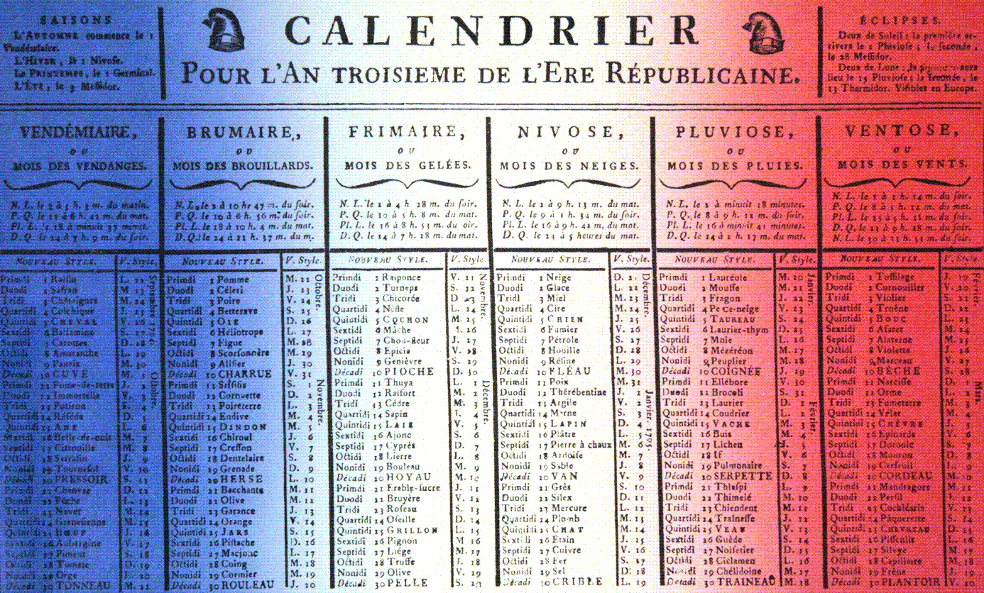
Seven days, not ten!
Late 18th, early 19th century, post Revolution
Primdi
Duodi
Tridi
Quartidi
Quintidi
Sextidi
Septidi
Octidi
Nonidi
Decadi

Slide 14
Which exact day of the week?
The resurrection happened on the first day of the week
Matt 28:1; Mk 16:2; Luke 24:1; John 20:!
The resurrection was such a momentous event that the day of worship was moved to the first day of the week
Always best to start the week with the Lord
“Now on the first day of the week, when the disciples came together to break bread, Paul, ready to depart the next day, spoke to them and continued his message until midnight.” (Acts 20:7)
Breaking bread is the Lord’s Supper
See also 1Cor. 16:2

Slide 15
Seventh Day Adventists
Is the Sabbath really the seventh day in order from 1 to 7?
Let’s look at exodus 20:8-10 again: “Remember the Sabbath day, to keep it holy. Six days you shall labor and do all your work, but the seventh day is the Sabbath of the Lord your God…”
In mathematical terms, the seven weekdays are a set, not an ordered list
“So let no one judge you in food or in drink, or regarding a festival or a new moon or sabbaths, which are a shadow of things to come, but the substance is of Christ.” (Colossians 2:16-17)
The important thing is worship of God on one day of the week
Saturday is just as good as Sunday

Slide 16
The substance is of Christ
Paul warns his listeners coming out of Judaism that there are some who wish to perpetuate Jewish religious customs (i.e. Sabbath being the seventh day in order)
“You observe days and months and seasons and years. I am afraid for you, lest I have labored for you in vain.” (Gal. 4:10-11)
“One person esteems one day above another; another esteems every day alike. Let each be fully convinced in his own mind. He who observes the day, observes it to the Lord; and he who does not observe the day, to the Lord he does not observe it. He who eats, eats to the Lord, for he gives God thanks; and he who does not eat, to the Lord he does not eat, and gives God thanks.” (Rom. 14:5-6)

Slide 17
For Q 60-62
Q: How do you spend the Sabbath?
Football?
Are you idolizing the Dodgers?
If you could pick between watching the Superbowl or going to worship, which would you choose?

Slide 18
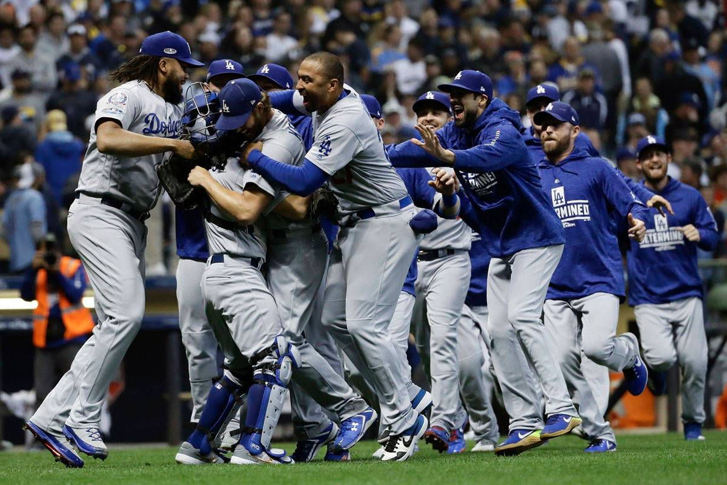
Q: Are you more excited that they won the World Series or that Christ rose from the dead?

