Slide 1
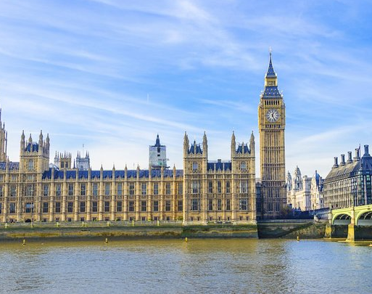
Westminster Shorter Catechism
Questions 60 -62
September 19, 2021
Calvary OPC, La Mirada, CA

Slide 2
Question #60
Q. How is the Sabbath to be sanctified?
A. The Sabbath is to be sanctified by a holy resting all that day, even from such worldly employments and recreations as are lawful on other days; spending the whole time in public and private exercises of God’s worship, except so much as is to be taken up in the works of necessity and mercy.

Slide 3
Question #61
Q. What is forbidden by the fourth commandment?
A. The fourth commandment forbiddeth the omission or careless performance of the duties required, and the profaning the day by idleness, or doing that which is in itself sinful, or by unnecessary thoughts, words, or works, about our worldly employments or recreations.

Slide 4
Question #62
Q. What are the reasons annexed to the fourth commandment?
A. The reasons annexed to the fourth commandment are, God’s allowing us six days of the week for our own employments, his challenging a special propriety in the seventh, his own example, and his blessing the Sabbath-day.

Slide 5
What does the Bible say?
Lengthier texts to read:
Exodus 16:25-28: no work on the Sabbath
Nehemiah 13:15-22: no commerce on the Sabbath
Matthew 12:1-13: works of necessity, piety and mercy

Slide 6
Do you bring your best?
You also say, ‘Oh, what a weariness!’ And you sneer at it,” Says the Lord of hosts. “And you bring the stolen, the lame, and the sick; Thus you bring an offering! Should I accept this from your hand?” Says the Lord. (Malachi 1:13)
Q: How much of a tip would you leave at a restaurant if they served you stale bread or soup with a fly in it?

Slide 7
Neutrality in worship?
Q: is anything neutral in worship?
Adiaphora: things that are in and of themselves neutral
Lutheran view: such things exist in worship
Reformed view: no adiaphora
Q: As such, are images neutral?
All things that we do are part of worship
Even our profession and our recreation (i.e. Stahanov)
How we interact with others
Luther even said that changing a baby’s diapers is a holy act

Slide 8
How important is the Sabbath?
Q: How do you spend the Sabbath?
Football?
Are you idolizing the Dodgers?
If you could pick between watching the Superbowl or going to worship, which would you choose?

Slide 9
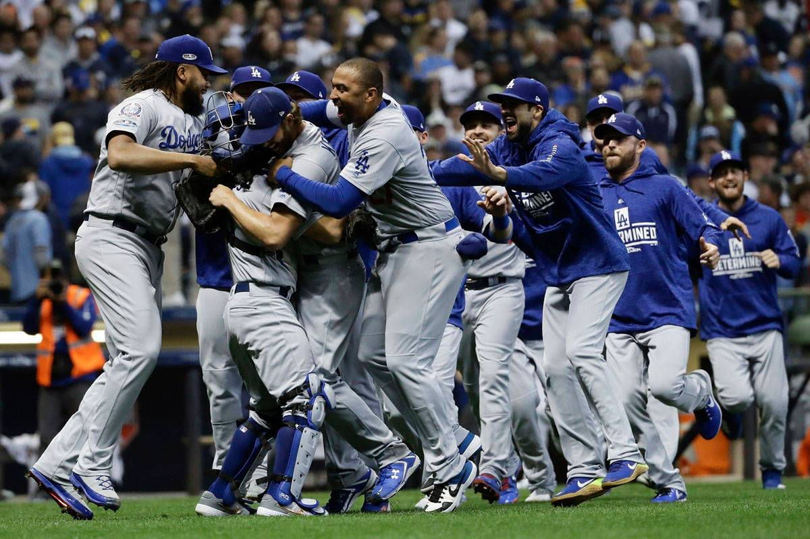
Q: Are you more excited that they won the World Series or that Christ rose from the dead?

Slide 10
Worldliness
Worldliness is human activity without God (Joel Beeke)
But not only atheists can be worldly people
A professing Christian can in reality be a practical atheist
When his mind is constantly upon the things of this world
It is present in believers more or less
But it consumes and characterizes the non-believer
HW: At home calculate how much time you spend reading the Bible or in prayer, witnessing or talking about spiritual things with others

Slide 11
Worldliness, expanded
Two causes of worldliness (Jeremiah Burroughs)
Some evil may deprive us of something of value
We cannot prevent such an evil from happening
These two things indicate that we trust our possessions more than God; that God is too weak to provide
Read Matthew 6:31-34
“For the love of money is a root of all kinds of evil, for which some have strayed from the faith in their greediness, and pierced themselves through with many sorrows.” (1Timothy 6:10)

Slide 12
A warning: 1John 2:15-16
“Love not the world, neither the things that are in the world. If any man love the world, the love of the Father is not in him. For all that is in the world, the lust of the flesh, and the lust of the eyes, and the pride of life, is not of the Father, but is of the world.”
The Pharisees also had a zeal for God (Rom. 10:2)
But this zeal was misguided in that the Pharisees were very covetous, and broke the Tenth Commandment
They wanted honor from men rather than God

Slide 13
The Sabbath exposes worldliness
Worldliness
True worship
A hard heart towards God
Indifference to God and others at church
Lack of joy in worship
Lack of stamina
Church attendance is a chore
You can’t wait for lunch/to get home
A soft heart towards God
Eagerness to learn
Joy and stamina in worship
You can’t wait to get to church
You linger around after church
You want to serve at church
You love fellow believers

Slide 14
Works of piety,
Let’s go back to Matthew 12:1-13:
Works of piety: Or have you not read in the law that on the Sabbath the priests in the temple profane the Sabbath, and are blameless? (verse 5)
Such works involve work that is to be done by pastors, elders and deacons on the Sabbath to conduct worship

Slide 15
Works of mercy,
Then He said to them, “What man is there among you who has one sheep, and if it falls into a pit on the Sabbath, will not lay hold of it and lift it out? Of how much more value then is a man than a sheep? Therefore it is lawful to do good on the Sabbath.” (verse 11)
Such are acts when we must save someone’s life or tend to or care for someone in danger
But don’t make everything a work of mercy
i.e. don’t just stay home if you have a slight cough

Slide 16
Works of necessity
But He said to them, “Have you not read what David did when he was hungry, he and those who were with him: how he entered the house of God and ate the showbread which was not lawful for him to eat, nor for those who were with him, but only for the priests?” (v. 3-4)
Such are works of necessity that must be done in order to keep things in order
If your car breaks down on the Lord’s Day you have to fix it
People have to operate public transport

Slide 17
Works of piety, necessity and mercy
Q: What kind of work is Jesus’ disciple eating the shewbread in the temple?
A: Work of mercy
Q: What kind of work is it when the pastor preaches a sermon?
A: Work of piety
Q: When we shovel the sand away from the entrance of the church so people can come in?
A: Work of piety

Slide 18
Works of piety, necessity and mercy, part 2
Q: What kind of work is it when we get gas to get to church?
A: Work of necessity
Q: What kind of work is it when we need to take someone to the hospital if they get sick on the Lord’s Day?
A: Work of mercy
Q: When a fireman saves peoples’ lives by putting gout a fire on the Lord’s Day?
A: Work of mercy

Slide 19
The main point
“But if you had known what this means, ‘I desire mercy and not sacrifice,’ you would not have condemned the guiltless. For the Son of Man is Lord even of the Sabbath.” (Matthew 12:7-8)
We don’t worship God in a legalistic manner: content over form
It is more important for Him that we love Him from our heart

