Slide 1

Westminster Shorter Catechism
Questions 67-69
October 10, 2021
Calvary OPC, La Mirada, CA

Slide 2
Question #67
Q. Which is the sixth commandment?
A. The sixth commandment is, Thou shalt not kill. (Exodus 20:13)
What does the Bible say?
“So ought men to love their wives as their own bodies… for no man ever yet hated his own flesh; but nourisheth and cherisheth it” (Ephesians 5:28-29)

Slide 3
What does the Bible say?
“Defend the poor and fatherless:… deliver the poor and needy” (Psalm 82:3-4)
“Paul cried out with a loud voice, saying, Do thyself no harm” (Acts 16:28)
“If thou forebear to deliver them that are drawn unto death, and those that are ready to be slain; if thou sayest, behold, we know it not; doth not he that pondereth the heart consider it?” (Proverbs 24:11-12)

Slide 4
The origin of the sixth commandment
The sixth commandment is part of the Mosaic covenant when Israel becomes a nation and has laws codified which governs peoples’ behavior.
But the sixth commandment, as part of the moral law has its origins before that time.
Just like the fifth commandment
“Whoever sheds man’s blood, by man shall his blood be shed; for in the image of God He made man.” (Genesis 9:6)

Slide 5
The Noachic Covenant
The Noachic Covenant was made between God and Noah, representing the new mankind, and all living creatures, even the animals.
Read Genesis 9:9
It was a covenant of general benevolence towards mankind in general, to protect and preserve life.
Indirectly, this also benefits the godly seed as well to preserve their lineage throughout OT history

Slide 6
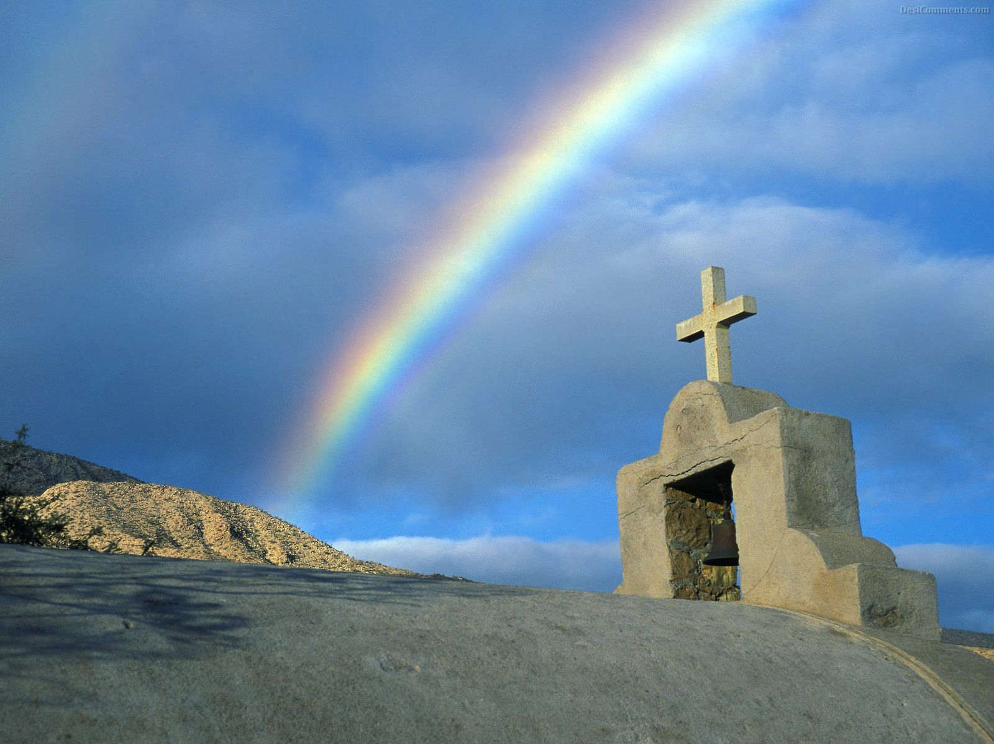
I establish my covenant with you, that never again shall all flesh be cut off by the waters of the flood, and never again shall there be a flood to destroy the earth.” And God said, “This is the sign of the covenant that I make between me and you and every living creature that is with you, for all future generations: I have set my bow in the cloud, and it shall be a sign of the covenant between me and the earth. (Genesis 9:11-13)

Slide 7
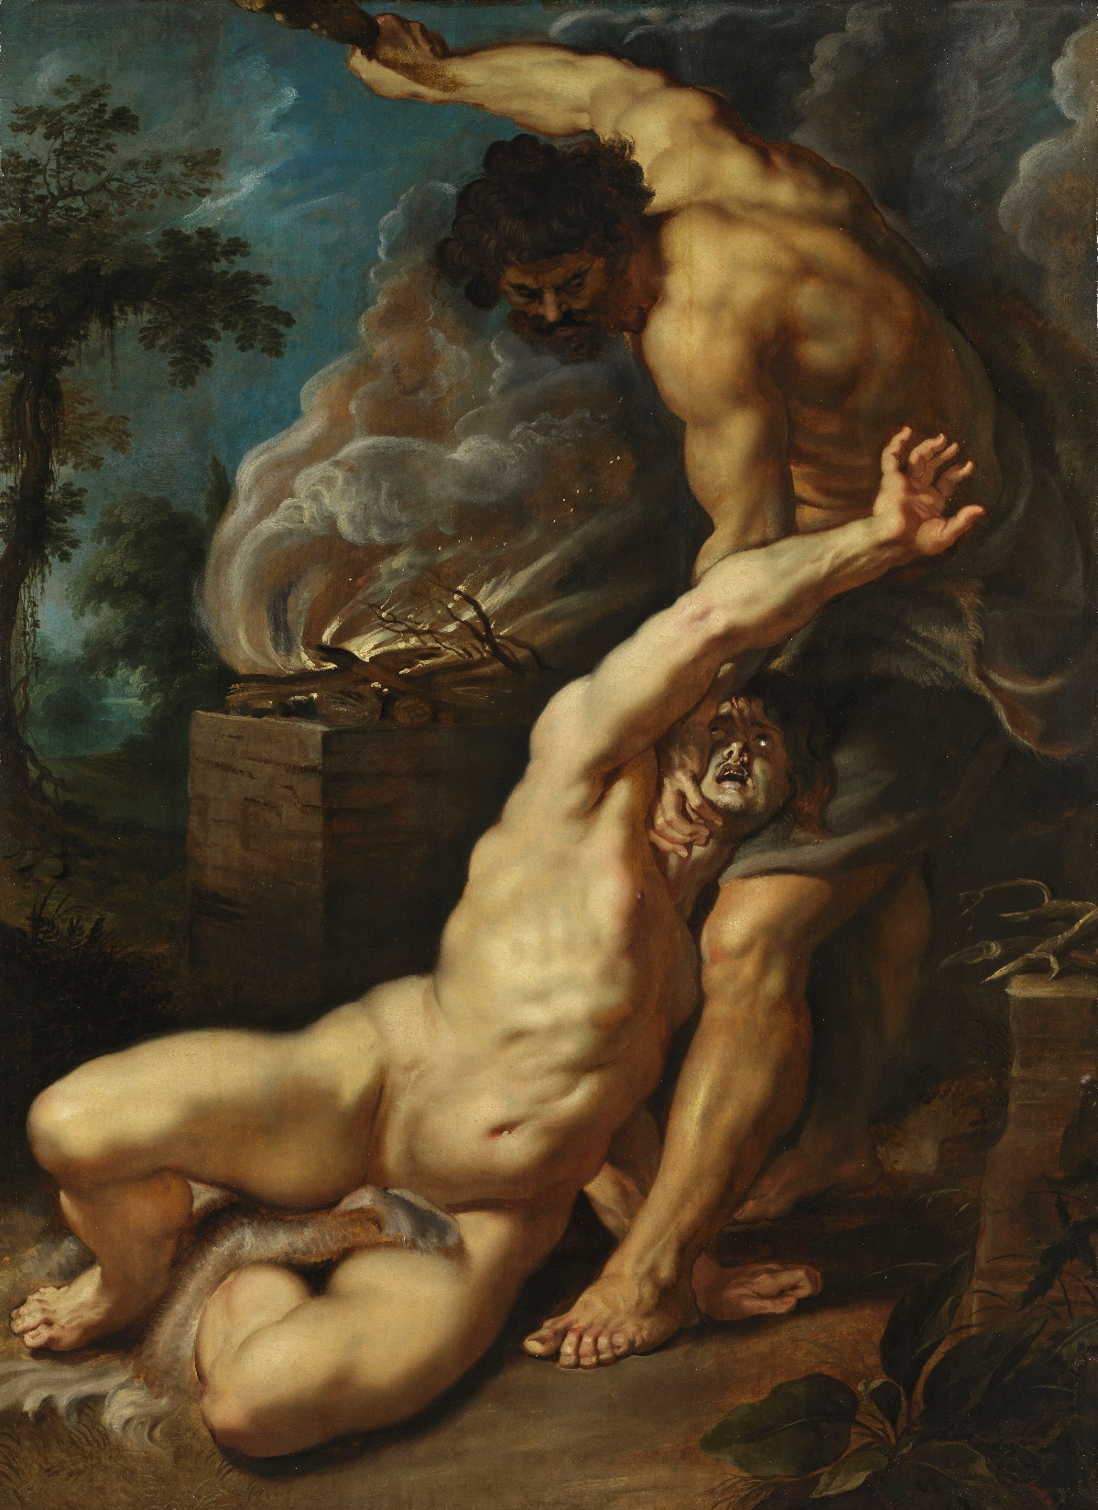
Cain and Abel
Genesis 4:8-15

Slide 8
Cain and Abel
Cain’s killing of Abel is the first murder, which is unjust killing of another person
But Cain bore the image of God, therefore no person could punish him or take revenge on him
God could have, this shows God’s mercy even to Cain
Murderers were to be put to death only after the Flood
Institution of capital punishment
Q: Who did Cain marry?

Slide 9
Made in the Image of God…
It is important that we have worth as humans because we were made in God’s own image
We have a special relationship with God
We are above the animals
Animals were created to serve man
Animals are food for us (Genesis 9:3)
Q: What happens if we affirm this? Or if this is denied?

Slide 10
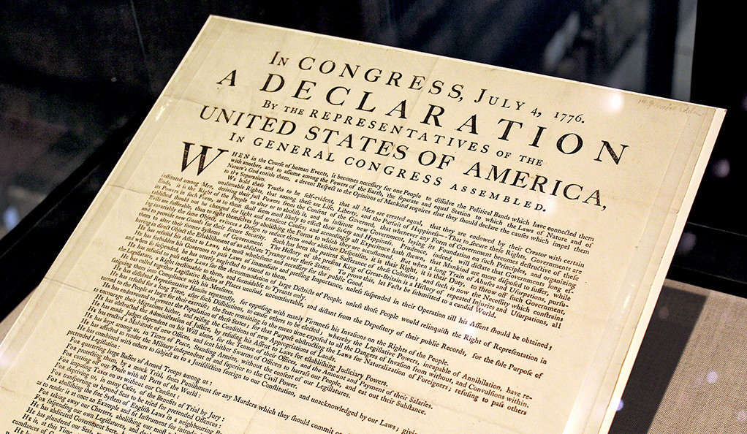
We hold these truths to be self-evident, that all men are created equal.

Slide 11
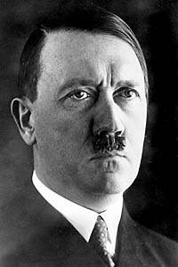
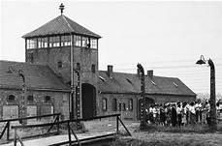

Slide 12
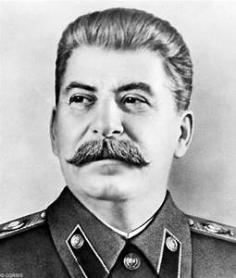
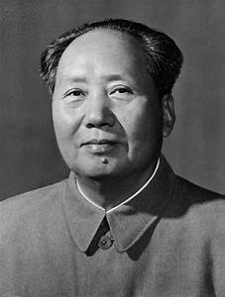
OVER 100 MILLION DEAD

Slide 13


Slide 14
Some abortion statistics
61.8 million surgical abortions in America between 1973 and 2018
610 million chemical abortions between 1965 and 2009
More babies have been aborted than all the soldiers who have died in all of America’s wars combined
2362/day, 100/hour, 1 every 37 seconds
Between 2010 and 2014, one-fourth of all pregnancies ended in abortion worldwide
Approximately 2.2 billion worldwide to date
Without abortion there would be half a billion Americans today and 10 billion people on earth
“Their feet are swift to shed blood” (Romans 3:15)

Slide 15
Image of God
Communist doctrine held that man is merely animate matter
They transform one form of matter into another form of matter because to them it doesn’t matter
Abortion ‘counselors’ try to convince prospective ‘patients’ that their fetus is merely in the fish stage and that they shouldn’t feel guilty about the abortion
They’re not terminating a human, only something sub-human

Slide 16
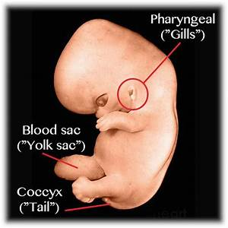
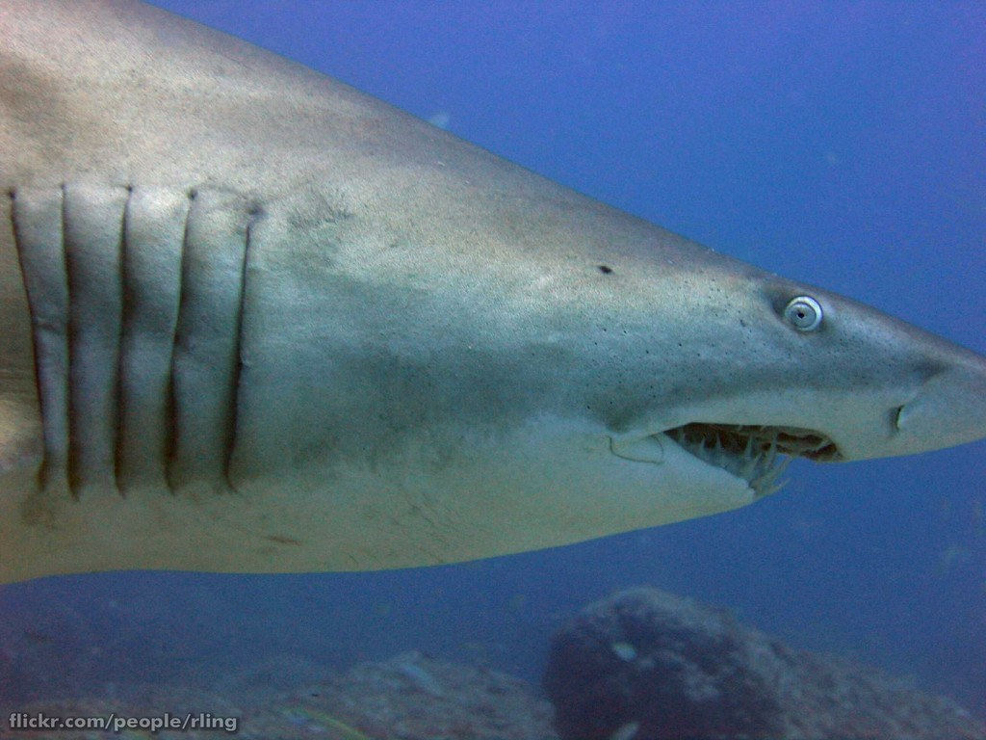
Alleged gill slits…

Slide 17
Gill slits?
Correlation does not mean causation: pouches on the neck of a human embryo may serve different functions
Interesting fact: the “gill slits” never actually break through to form actual slits
Also, with scientific progress, it has been shown that the early development of different animal groups is very divergent
i.e. insects, humans, tunicates (‘sack animals’)

Slide 18
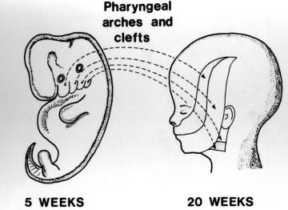
Not gill slits!
Different sets of genes are involved in neck area tissue differentiation in fish and humans
Different sections of the neck area form the middle ear in different vertebrate groups
Innervation is also different

Slide 19
Question #68
Q. What is required in the sixth commandment?
The sixth commandment requireth all lawful endeavours to preserve our own life, and the life of others.

Slide 20
Question #69
Q. What is forbidden in the sixth commandment?
A. The sixth commandment forbiddeth the taking of our own life, or the life of our neighbour unjustly, or whatsoever tendeth thereunto.

Slide 21
Prevention of death and preservation of life
By preventing death it is also implied that we must do everything to preserve and promote life and well-being
Whatever command is implied, the contrary is also forbidden
Prevent death
Preserve life
Q: have you ever killed anyone?
“Whoever hates his brother is a murderer, and you know that no murderer has eternal life abiding in him.” (1John 3:15)
Even the slightest, hidden intent of hatred is murder
We have a thrice-holy God.

Slide 22
Larger Catechism Q 135
Preservation of life
Subduing passions
Resisting temptations
Defense against violence
Patiently bearing God’s hand
Quietness of mind
Cheerfulness of spirit
Sober use of meat, drink, phsyick, sleep, labor and recreation
Charitable thoughts
Love, compassion, meekness
Gentleness, kindness, peacefulness
Mild and courteous speech and behavior
Forbearance and readiness to reconcile
Comforting the distressed
Protecting the innocent

Slide 23
A look at the Larger Catechism Q 136
Suicide
Murder
Withdrawing means of preserving life
Envy
Desire for revenge
Excessive passions
Distracting cares
Immoderate use of meat, labor recreation
Provoking words
Oppression
Quarreling
Striking
Wounding

Slide 24
LC 36
You can kill someone slowly even!
A married couple bickering with each other for a long period of time…
Not taking care of your health is murder too!
Gluttony, workaholism!
“You have heard that it was said to those of old, ‘You shall not murder; and whoever murders will be liable to judgment.’ But I say to you that everyone who is angry with his brother will be liable to judgment; whoever insults his brother will be liable to the council; and whoever says, ‘You fool!’ will be liable to the hell of fire. ” (Matthew 5:21-22)
Jesus does not do away with the law, He made it much stricter!

Slide 25
Envy?
Proverbs 14:30: "A sound heart is life to the body, but envy is rottenness to the bones“
"A joyful heart makes a cheerful countenance, but sorrow of the heart crushes the spirit." (Proverbs 15:13)
"A wife of noble character is her husband's crown, but she who causes shame is like decay in his bones." (Proverbs 12:4)
Envy takes away our peace
we want to outdo the other
It saps us of our time and energy and even resources, shortens lifespan
Sin causes mental pressure which affects our body as well
i.e. Jay Adams, man cheating on taxes

Slide 26
Capital punishment and self defense
“Whoever sheds man’s blood, By man his blood shall be shed; For in the image of God He made man.” (Genesis 9:6)
“If the thief is found breaking in, and he is struck so that he dies, there shall be no guilt for his bloodshed.” (Exodus 22:2)
Zero sum game: either you or the attacker dies. You choose who dies. Lesser of two evils
God commanded Abraham to sacrifice his son, Isaac (Genesis 22:1-19)
Jephthah sacrifices his own daughter as a part of the vow he made to God (Judges 11:29-40)

Slide 27
What is murder?
Murder in the Sixth Commandment refers to the unjust taking of life, not self defense
You may defend yourself with deadly force if:
The attacker presents a weapon
And states intent of killing you

Slide 28
Christian opposition to capital punishment
God is a God of love and is predisposed to forgiving peoples’ sins
Not to execute a criminal would demonstrate the Gospel to him that he may be saved; if we execute him he automatically goes to hell
But God has commanded capital punishment, and God is sovereign
If God wills to save the criminal before execution, He has means to save him
i.e. Wilhelm Keitel, Nazi general executed at Nuremberg
If we let loose a criminal onto society, he himself may take further lives; many repeat offenders proves this point

Slide 29
Animal control laws
“If an ox gores a man or a woman to death, then the ox shall surely be stoned, and its flesh shall not be eaten; but the owner of the ox shall be acquitted. But if the ox tended to thrust with its horn in times past, and it has been made known to his owner, and he has not kept it confined, so that it has killed a man or a woman, the ox shall be stoned and its owner also shall be put to death.” (Exodus 21:28-30)
Negligence resulting in the death of other people
We have to be careful of other people as well!

Slide 30
Suicide
De civitas Dei, book I, ch. 22: Suicide in all cases is wrong
It means you have no courage or strength to overcome hardships or wrongdoing
Indirectly you are saying that God has no ability to help you
Q: What about suicide to avoid falling into the enemies’ hands?
“When they persecute you in this city, flee to another. For assuredly, I say to you, you will not have gone through the cities of Israel before the Son of Man comes.” (Matthew 10:23)

Slide 31
Suicide
There is no positive example of suicide being good.
Read 2Samuel 1:1-17
Saul had himself killed because God disfavored him and had taken the kingdom away from him, and he died in shame
His death was a mix of suicide and murder
King David so honored Saul despite his oppression of him that he punished the Amalekite who assisted in Saul’s suicide

Slide 32
Suicide
Some women committed suicide in Rome because they were violated
Augustine responds by saying that no voluntary unchastity was committed, thus they were wrong to commit murder
Otherwise suicide could be viewed as punishment for consent in the act
Others committed suicide to forego another type of sin
But sin is not the answer to sin, don’t add death to i.e. lust
Yet others commit suicide to escape pain and even pleasure
Euthanasia is murder

Slide 33
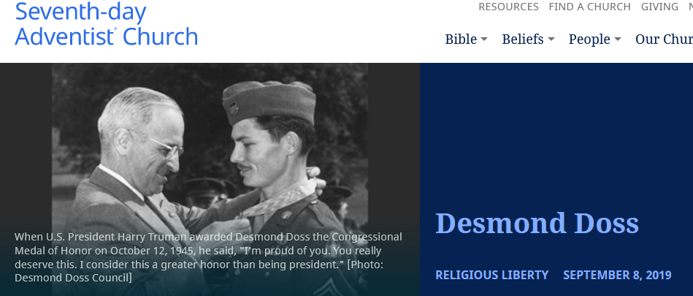
War and self-defense

Slide 34
Just war?
“For he is God’s minister to you for good. But if you do evil, be afraid; for he does not bear the sword in vain; for he is God’s minister, an avenger to execute wrath on him who practices evil.” (Romans 13:4)
The apostles all had swords: “Then Simon Peter, having a sword, drew it and struck the high priest’s servant, and cut off his right ear. The servant’s name was Malchus.” (John 18:10)
The government must protect its own citizens from an aggressive occupying force

Slide 35
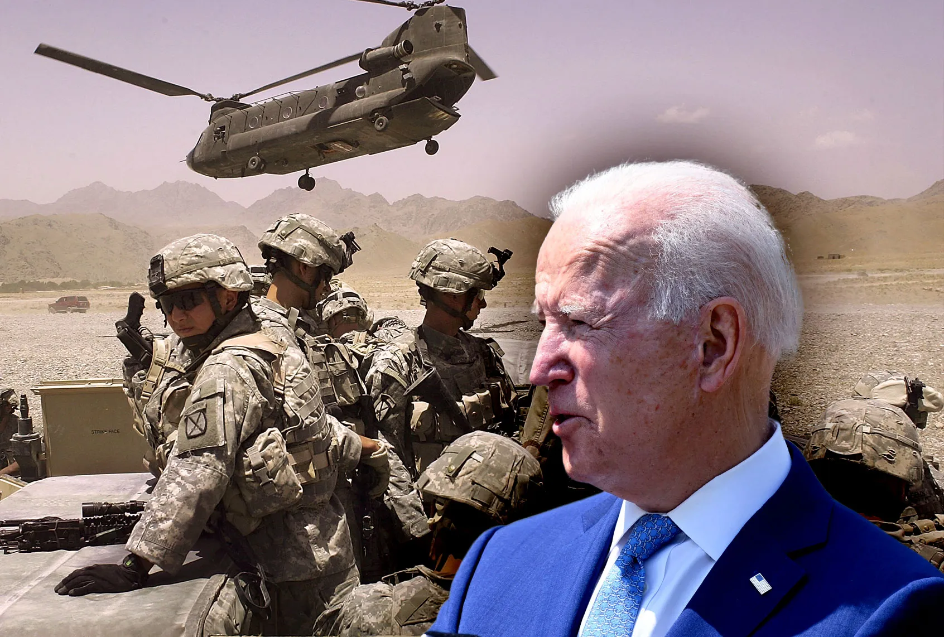

Slide 36
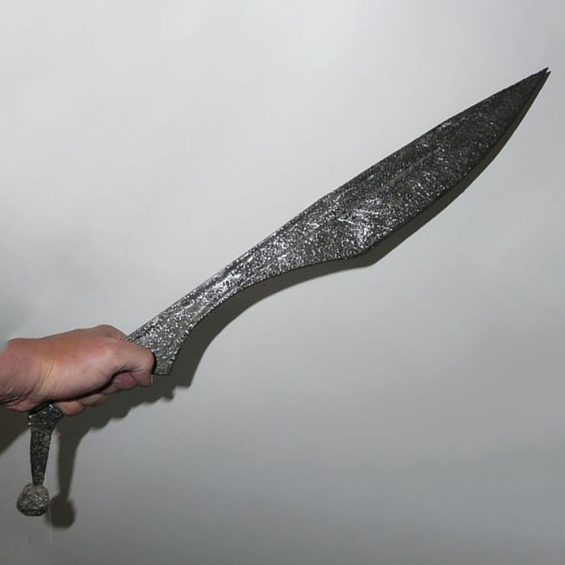
Swords in the New Testament
According to some views, the word for sword in the Greek (machaira) does not denote a sword used for self-defense, but rather a shorter weapon for chopping vegetables or cutting meat.
“Then He said to them, “But now, he who has a money bag, let him take it, and likewise a knapsack; and he who has no sword, let him sell his garment and buy one.” (Luke 22:36)

Slide 37
Swords in the New Testament
It depends on the context:
And while He was still speaking, behold, Judas, one of the twelve, with a great multitude with swords and clubs, came from the chief priests and elders of the people. … And suddenly, one of those who were with Jesus stretched out his hand and drew his sword, struck the servant of the high priest, and cut off his ear. But Jesus said to him, “Put your sword in its place, for all who take the sword will perish by the sword.” (Matthew 26:47, 51-52)
“Do not think that I came to bring peace on earth. I did not come to bring peace but a sword.” (Matthew 10:34)
King David waged war against Israel, and the Lord Himself was with the Israelites in many of their battles

Slide 38
Preemptive and preventive war
Augustine, Civitas Dei I.30.
Just as we can defend ourselves from a would-be attacker, so can nations protect themselves against invading nations
Israel against Egypt in the 1967 war
Taiwan against China!!
Caveats:
A war can cause much more collateral damage than a one-on-one attack
Proportionality: the defender’s response must be proportional to the damage inflicted by the attacker
How can we measure this when the attacker has not yet invaded?

Slide 39
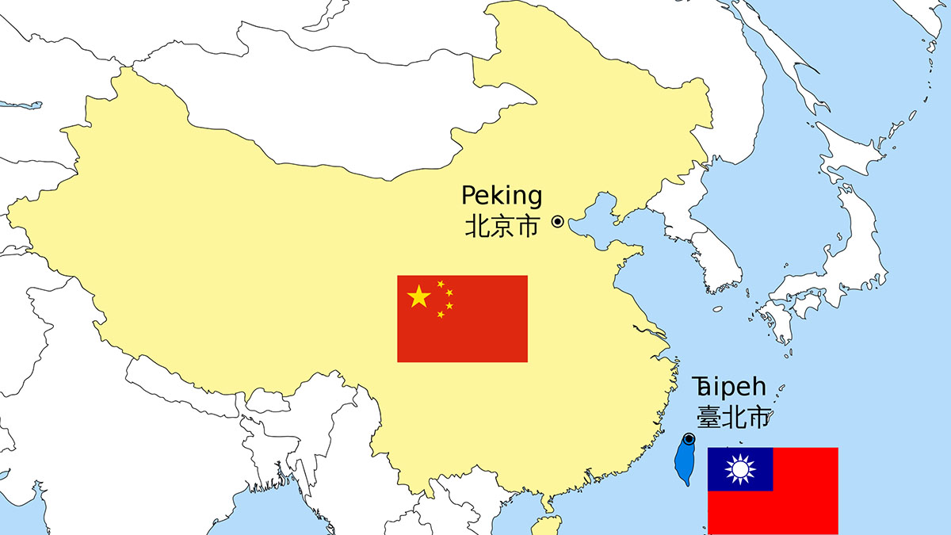
China versus Taiwan
China is building up its military
Even building up space weapons
And is regularly invading Taiwan’s airspace
Has also built artificial islands with military facilities just outside Taiwan’s maritime boundaries
If Taiwan were to declare independence from China, then China would automatically invade
However, Japan has promised to mobilize its self-defense force
Q: What would you do if you were the prime minister of Taiwan?

Slide 40
Indirect violations of the sixth commandment
Q: Has anyone of you ever been bungee-jumping? Does this violate the sixth commandment?
It violates the sixth commandment because you are in effect careless with your life
He that loveth danger shall perish therein (Ecclesiasticus 3:26)
Then the devil took him to the holy city and set him on the pinnacle of the temple and said to him, “If you are the Son of God, throw yourself down, for it is written, “‘He will command his angels concerning you,’ and “‘On their hands they will bear you up, lest you strike your foot against a stone.’” Jesus said to him, “Again it is written, ‘You shall not put the Lord your God to the test.’” (Matthew 4:5-7)

Slide 41
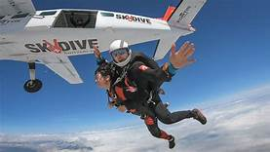
Q: What about skydiving?
Q: With a professional? Alone? As a soldier? Eight feet above ground?

Slide 42
What about wine and coffee?
Some Christians (some with good intentions) go so far as to say that drinking wine or even coffee is bad, because it can lead to bad habits.
“I know and am persuaded in the Lord Jesus that nothing is unclean in itself, but it is unclean for anyone who thinks it unclean.” (Rom. 14:14)
You must become good at practicing self control
You can’t make a long, long, long, loooong list of what you can or cannot eat and drink
You have Christian liberty to decide for yourself what is clean or unclean

Slide 43
Did Jesus ever drink wine?
Some fundamentalist Baptists would say He never drank wine and thus all wine is bad
Noah began to be a man of the soil, and he planted a vineyard. (Genesis 9:20)
Ex. 23:11; Lev. 19:10; Num 16:14; Deut 6:20;
…Who plants a vineyard without eating any of its fruit? Or who tends a flock without getting some of the milk? (1Cor. 9:7)
And with the first lamb a tenth measure of fine flour mingled with a fourth of a hin of beaten oil, and a fourth of a hin of wine for a drink offering. (Ex 29:40)

Slide 44
Wine
Part of the Nazirite vow: “he shall separate himself from wine and strong drink.”
“Everyone serves the good wine first, and when people have drunk freely, then the poor wine. But you have kept the good wine until now.” (John 2:10)
Ephesians 5:18: Do not be drunk with wine (oinow)
1Tim. 5:23: …but use a little wine for your stomach’s sake (oinow)
Gen. 14:18: wine (yayin) and bread

Slide 45
A fence in front of the real fence
Fence = God’s Word/Law
house
Secondary fence – man’s law
Middle area: God says this is good, but man says it is bad
but of the fruit of the tree which is in the midst of the garden, God has said, ‘You shall not eat it, nor shall you touch it, lest you die.’ ” (Genesis 3:3)

Slide 46
“Live and let live”?
Q: What if God just let us live? We’d die in our sins!
The greatest service we can do for a person is to introduce them to the Lord Jesus Christ
We must actively seek to do good for our neighbor
“Let him know, that he which converteth the sinner from the error of his way shall save a soul from death, and shall hide a multitude of sins.” (James 5:20)
Preserving life also means promoting eternal life

Slide 47
“Live and let live”?
Read Ezekiel 33:1-7
Preservation of physical and also spiritual life
Not only preaching the Gospel to non-believers so they may be saved, but also to the house of God
We must always be examining ourselves to see whether we are in the faith

