Slide 1
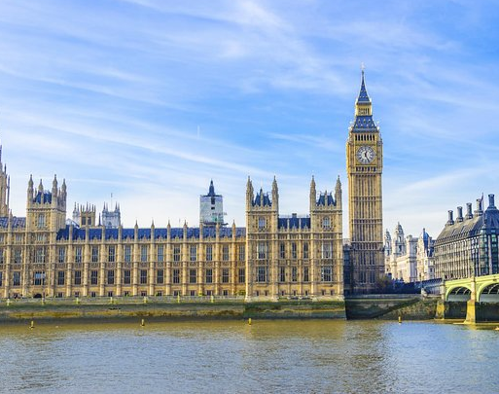
Westminster Shorter Catechism
Questions 36 - 38
April 25, 2021
Calvary OPC, La Mirada, CA

Slide 2
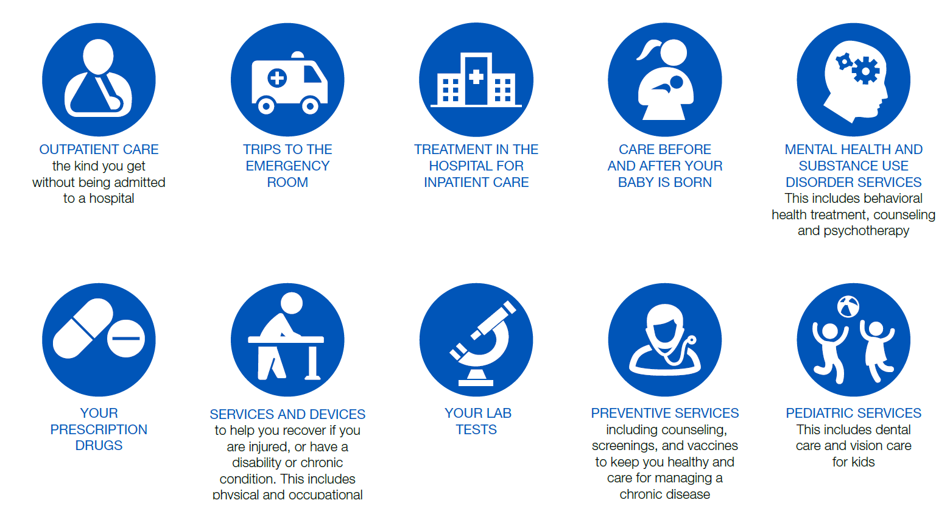

Slide 3
Question #36
Q. What are the benefits which in this life do accompany or flow from justification, adoption, and sanctification?
A. The benefits which in this life do accompany or flow from justification, adoption, and sanctification, are, assurance of God's love, peace of conscience, joy in the Holy Ghost, increase of grace, and perseverance therein to the end.

Slide 4
Chief benefits:
justification, adoption, sanctification
Other benefits:
Peace, joy, assurance, etc.

Slide 5
What does the Bible say?
"Therefore, having been justified by faith, we have peace with God through our Lord Jesus Christ, through whom also we have access by faith into this grace in which we stand, and rejoice in hope of the glory of God. … Now hope does not disappoint, because the love of God has been poured out in our hearts by the Holy Spirit who was given to us." (Romans 5:1-2,5)
"But the path of the just is like the shining sun, that shines ever brighter unto the perfect day." (Prov. 4:18)
"Therefore, brethren, be even more diligent to make your call and election sure, for if you do these things you will never stumble." (2Peter 1:10)

Slide 6
Assurance
Q: Do all believers always have assurance?
Q: Why is assurance so important?
Q: Why do some believers doubt their assurance?
Peter and Paul both exhort believers to attain assurance
New believers may not have immediate assurance
When a believer sins, he grieves the Holy Spirit, who will withdraw and leave them without full assurance
Read Psalm 51:8-13

Slide 7
Assurance, part 2
Q: How can you get full assurance?
Look not at yourself: not at your works nor your faith, but look to Christ alone and his atoning blood
For a righteous man may fall seven times and rise again, but the wicked shall fall by calamity (Proverbs 24:16)
Assurance engenders peace with God and good works, and good works engender more assurance and peace, etc…
Assurance
Good works
Peace

Slide 8
Peace with God
Tied up with assurance is that we have peace with God
We have peace because we also have assurance of God’s love
There is nothing better than a peaceful conscience, untroubled by sin
Sin can be the cause of mental problems
Example: man who cheated on his taxes couldn’t sleep
Q: Have you ever had a mental problem cause by sin? ☺
“I thank God, whom I serve with a pure conscience, as my forefathers did, as without ceasing I remember you in my prayers night and day” (2Timothy 1:3)
More verses: Psalm 46:10; Matthew 11:28-30; Psalm 62:8; Isaiah 41:10; Isaiah 43;1

Slide 9
Perseverance
Q: Can a true believer fall?
A true believer can fall, but not finally, and not fully
For a righteous man may fall seven times and rise again…
Remember: we do good not to be saved, but because we are saved and since we love God.
God preserves us, so we shall persevere (R.C. Sproul)
God elected us for salvation and so He is carrying out His plan
Romans 8:31-39: read verses 37-39
“And I give them eternal life, and they shall never perish; neither shall anyone snatch them out of My hand.” (John 10:28)

Slide 10
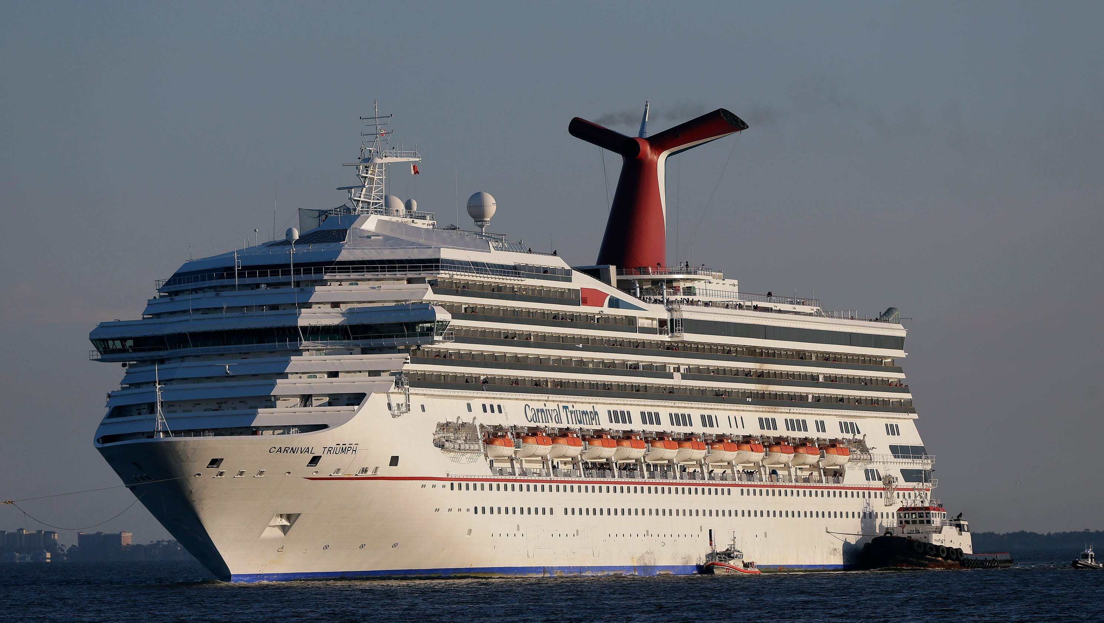
You are deep inside

Slide 11
What about apostates?
“They went out from us, but they were not of us; for if they had been of us, they would have continued with us; but they went out that they might be made manifest, that none of them were of us.” (1John 2:19)
Judas, Ravi Zacharias, Szabolcs Bader
God preserves you, thus you must also persevere
A believer cannot keep going on sinning
“Whoever has been born of God does not sin, for His seed remains in him; and he cannot sin, because he has been born of God.”
The sin unto death is unrepentant sin (1John 5:16), the only reason for excommunication

Slide 12
Question #37
Q. What benefits do believers receive from Christ at death?
A. The souls of believers are at their death made perfect in holiness, and do immediately pass into glory; and their bodies, being still united to Christ; do rest in their graces till the resurrection.

Slide 13
What does the Bible say?
“…the spirits of just men made perfect” (Hebrews 12:23)
“And Jesus said unto him, ‘verily I say unto thee, today shalt thou be with me in paradise’” (Luke 23:43)
“…them also which sleep in Jesus” (1Thessalonians 4:14)
“…they shall rest in their beds” (Isaiah 57:2)
“…the hour is coming, in which all that are in the graves shall hear his voice, and shall come forth” (John 5:28-29)

Slide 14
False views about death
Soul sleep: soul unconscious after death and before the resurrection
A dead person may seem to be asleep, but sleep in the Bible is different
When you dream you are still conscious
“and He was transfigured before them. His face shone like the sun, and His clothes became as white as the light. And behold, Moses and Elijah appeared to them, talking with Him.” (Matthew 17:2-3)
Cold hell theory: hell is not hot, and thus not so painful (but see Deut. 32:22; Matthew 5:22; 18:9)
Annihilationism: Adventist teaching that after a certain time, the souls of those in hell shall be destroyed
“It is better for you to enter into life maimed, rather than having two hands, to go to hell, into the fire that shall never be quenched—” (Mark 9:43)

Slide 15
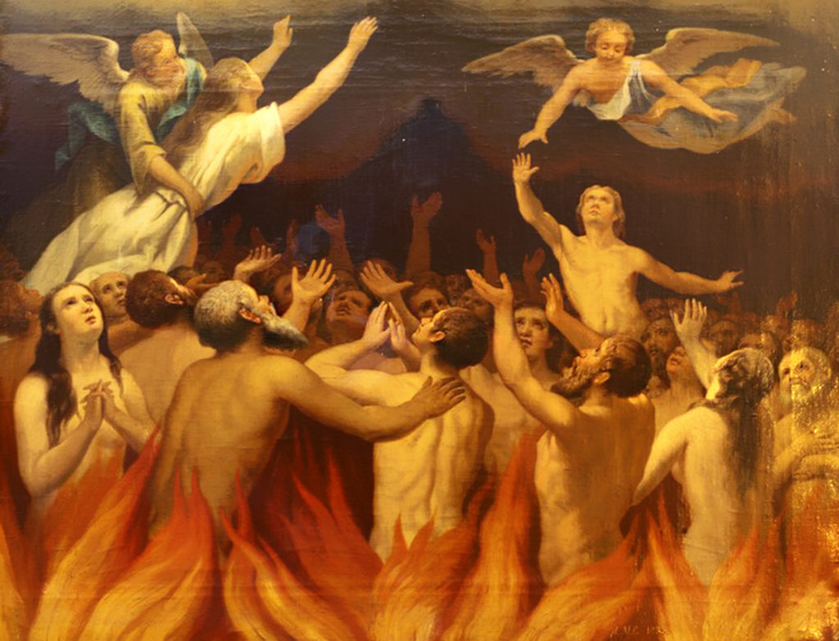

Slide 16
Refutation of Purgatory
Purgatory (Romanism): the place where the soul is purged of its remaining sin through suffering
Their suffering can allegedly be shortened by prayers, Masses, indulgences, or by transferring merits of the saints to their account
“So when Jesus had received the sour wine, He said, “It is finished!” And bowing His head, He gave up His spirit.” (John 19:30)
“Most assuredly, I say to you, he who hears My word and believes in Him who sent Me has everlasting life, and shall not come into judgment, but has passed from death into life.” (John 5:24)
Salvation is by faith alone and by grace alone (thief on the cross)

Slide 17
Why do believers also have to die?
Death is the wages [consequences] of sin, not punishment thereof
Jesus took the punishment for our sins
A repentant drug addict may still suffer from the after-effects of his sinful life
Just as Jesus rose from the dead, so shall we also conquer death
“O Death, where is your sting? O Hades, where is your victory?” (1Cor. 15:55)

Slide 18

We were meant to live forever!
Soniah Shah, popular science writer in ‘Pandemic’ writes:
Microbes could live forever by contantly dividing
Trees also get stronger as they age
Clams and lobsters don’t age – they get eaten ☺
The presence of senescence and cell death genes cause our bodies to wear out
Death was a way to prevent sinners from becoming infinitely sinful for an eternity

Slide 19
Question #38
Q. What benefits do believers receive from Christ at the resurrection?
A. At the resurrection, believers being raised up in glory, shall be openly acknowledged and acquitted in the day of judgement, and made perfectly blessed in the full enjoying of God to all eternity.

Slide 20
What does the Bible say?
“…the hour is coming, in which all that are in the graves shall hear his voice, and shall come forth” (John 5:28-29)
“Whosoever therefore shall confess me before men, him will I confess also before my Father which is in heaven” (Matthew 10:32)
“Well done, good and faithful servant… enter thou into the joy of they Lord” (Matthew 25:23)
“…we know that, when he shall appear, we shall be like him; for we shall see him as he is” (1John 3:2)
“…so shall we ever be with the Lord” (1Thessalonians 4:17)

Slide 21
The Resurrection
“But if there is no resurrection of the dead, then Christ is not risen. And if Christ is not risen, then our preaching is empty and your faith is also empty. … And if Christ is not risen, your faith is futile; you are still in your sins!” (1Corinthians 15:13,14,17)
Some think that the resurrection is unscientific, but life after death is beyond the purview of science
The empty tomb is the best evidence for the resurrection (pastor Martin’s Resurrection Day sermon)

Slide 22
We will also be resurrected
Just as assuredly that Jesus rose from the dead, so shall we
“And what you sow, you do not sow that body that shall be, but mere grain—perhaps wheat or some other grain.” (1Corinthians 15:37)
Our bodies in the resurrection will not be the exact same body, but not entirely different
Different in quality, a glorified body, unfettered by sin, completely under our control (Boston, Fourfold State)
This shall happen instantaneously (read 1John 3:2)
At that time no more sin, cancer, covid19, masks, mental retardation

Slide 23
Resurrection and judgement
We shall be openly acknowledged to be righteous before all men and acquitted of our sins
Read Matthew 26:34-36
Q: How can you be acquitted for your sins?
Q: If we are saved by grace, why do we receive a reward?
“And the dead were judged according to their works, by the things which were written in the books.” (Revelation 20:12)
Believers rewarded according to their good deeds done for the love of God, unbelievers for their rejection of Christ
God Himself is the believer’s exceedingly great reward
“Do not be afraid, Abram. I am your shield, your exceedingly great reward.” (Genesis 15:1)

Slide 24
Good works and salvation
“For we are His workmanship, created in Christ Jesus for good works, which God prepared beforehand that we should walk in them.” (Ephesians 2:10)
Even our good works are of God’s grace, like everything else!
“the twenty-four elders fall down before Him who sits on the throne and worship Him who lives forever and ever, and cast their crowns before the throne, saying: You are worthy, O Lord, To receive glory and honor and power” (Revelation 4:10-11)
The 24 elders (12 tribes, 12 apostles, meaning the church) ‘reject’ their reward because they know they haven’t deserved it

Slide 25
Good works and salvation, part 2
”For no other foundation can anyone lay than that which is laid, which is Jesus Christ. Now if anyone builds on this foundation with gold, silver, precious stones, wood, hay, straw, each one’s work will become clear; for the Day will declare it, because it will be revealed by fire; and the fire will test each one’s work, of what sort it is. If anyone’s work which he has built on it endures, he will receive a reward.” (1Corinthians 3:11-14)
No-one can do anything pleasing to God without God
Such a work is hay and straw
You can only do good once you are saved, and thus get a reward

Slide 26
Bible verse of the week
“And I give them eternal life, and they shall never perish;
neither shall anyone snatch them out of My hand.”
(John 10:28)

