Slide 1
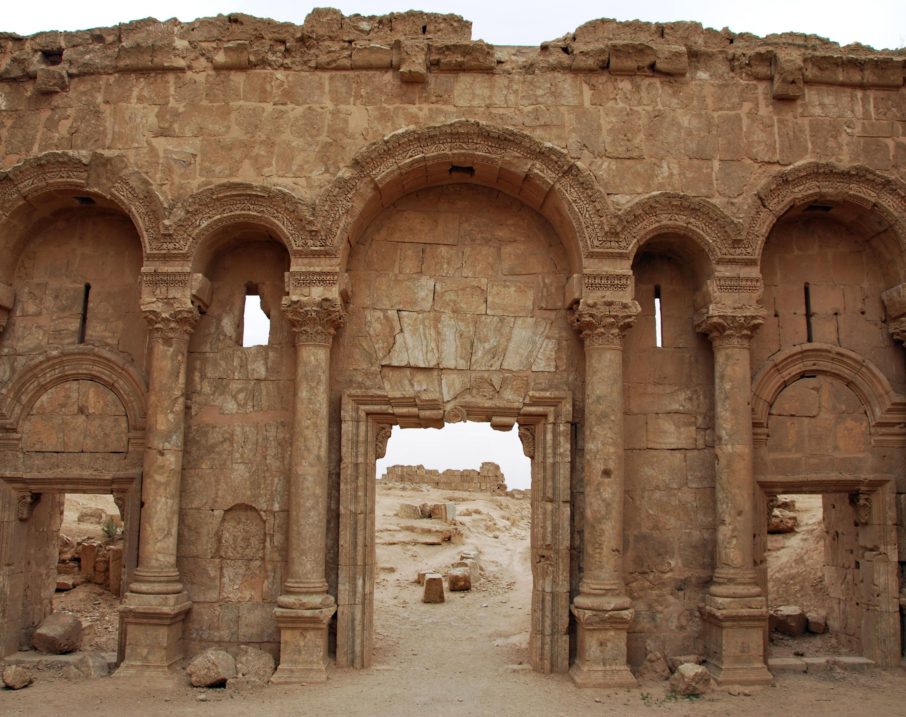
Nehemiah
Sunday School
Calvary OPC, La Mirada, CA
October 23, 2022

Slide 2
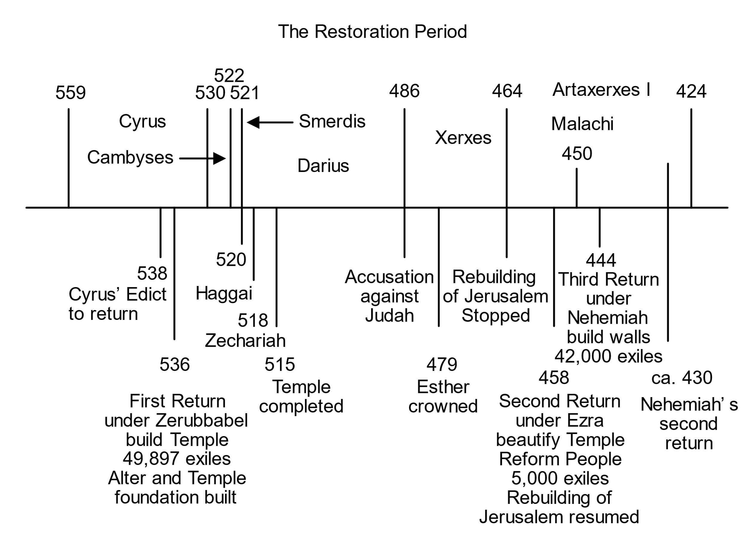

Slide 3
Nehemiah
The last historical book of the Old Testament.
Together with Malachi, the last prophet of the Old Testament.
Nehemiah came back to Israel under Artaxerxes I, in the year 445-4 BC.
Xerxes dies in 464 BC, which leads to an Egyptian uprising on the western flank of the Babylonian Empire.
Victory against Babylon at Papremis in the Nile delta.
The Greek Delian League also attacks Babylon.
Thus, it is only good if Artaxerxes fortifies his western flank: Judah.

Slide 4
General trends
Elite leaders => community
Narrow holiness => spreading holiness
Oral authority => written documents
A holy people dwelling in a holy city
A foretaste of heaven
Solomon’s sin is mentioned in Nehemiah 13:26
His sin brought in many foreign wives and turned Israel’s heart away from the Lord and led to the exile in the first place.
If even wise Solomon sinned, then how could others not?
This cliffhanger at the end makes the reader think about this important issue in the life of the nation/his own heart.

Slide 5
The significance of the wall
Nehemiah’s story is about a physical wall, that separates the people from the Gentiles.
Ezra had built a temple, which is a spiritual wall between the people and the pagan religions surrounding them.
The wall symbolizes the law, which keeps sin away from God’s people, separating clean from unclean.
A forward-looking symbol of heaven where God’s people follow God’s law inside God’s house.
Revelation 21 is a New Testament eschatological parallel

Slide 6
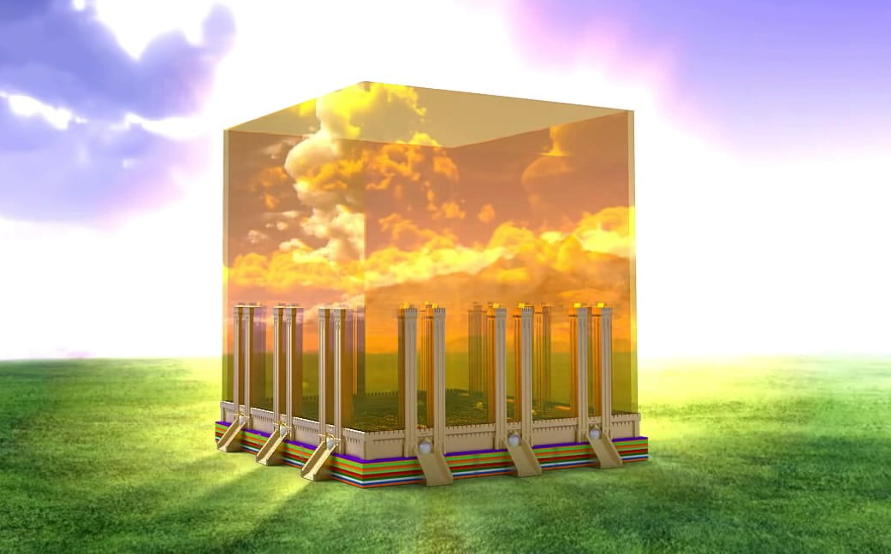
The New Jerusalem
Rev. 21:3-4: “Behold, the tabernacle of God is with men, and He will dwell with them, and they shall be His people. God Himself will be with them and be their God. And God will wipe away every tear from their eyes; there shall be no more death, nor sorrow, nor crying. There shall be no more pain, for the former things have passed away.”
Verse 8: cowards, unbelievers, murderers will be all outside.
Rev. 22:14: blessed are those who keep the commandments.
Rev. 22:15: sinners will be cast out.
Verse 21: nothing shall defile the New Jerusalem
A new and final resting place for God’s people for all eternity without foreign rulers to oppress them.

Slide 7
Introduction
1-2: news from Jerusalem + commission from the king
3-4: building the wall and opposition
5: addressing grievances
6: finishing the wall
7: account of the people
8-10: renewing the covenant
11-12: replenishing Jerusalem
13: reforming abuses

Slide 8
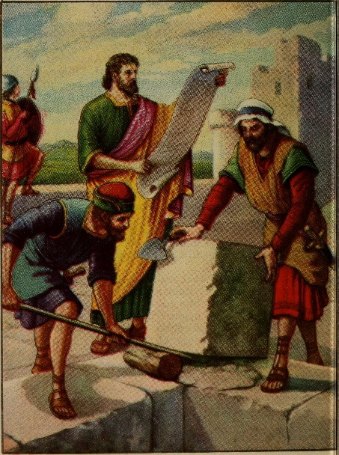
Who was Nehemiah?
Read Nehemiah 1:1-4!
His origin is unknown, but possibly a priest, because he offered sacrifices.
Still residing in Babylon, news comes to him concerning Jerusalem:
The survivors are in distress and reproach
The wall of Jerusalem is broken
The gates of the city are burnt
Nehemiah breaks down and weeps for several days.

Slide 9
The walls lie in ruin
Why were the walls in ruin?
Refresher: Re-read Ezra 4:12-23
12. Let it be known to the king that the Jews who came up from you have come to us at Jerusalem, and are building the rebellious and evil city, and are finishing its walls and repairing the foundations. 13. Let it now be known to the king that, if this city is built and the walls completed, they will not pay tax, tribute, or custom, and the king’s treasury will be diminished. …
23. Now when the copy of King Artaxerxes’ letter was read before Rehum, Shimshai the scribe, and their companions, they went up in haste to Jerusalem against the Jews, and by force of arms made them cease. 24. Thus the work of the house of God which is at Jerusalem ceased, and it was discontinued until the second year of the reign of Darius king of Persia.

Slide 10
Nehemiah’s sorrow
Nehemiah was a man of high rank, yet he inquires about his countrymen’s burden.
Herodotus: Ahikar was not only cup-bearer but also the chief minister of Esarhaddon, king of Assyria.
Just like Moses before him, who was in Pharaoh’s palace
Read Exodus 2:11!
Or Obadiah in the court of king Ahab (1Kings 18:1-4)
Or Esther in king Ahaseuros’ throne room (Esther 5:1-3)
Fellow believers with higher offices have heightened responsibility towards their fellow believers
How will history judge you in such a situation?
He broke down and could not be consoled for many days.
the lot of his countrymen occupied his thoughts constantly.

Slide 11
A type of Christ
Nehemiah is a type of Christ, who left his comfortable estate to help his countrymen in distress.
Read Romans 12:10!
Read 1John 4:7-11!
Neh. 2:19-20: Opposed by enemies surrounding him, just like Jesus was opposed by the Jewish leaders.
Nehemiah was not deterred to keep building the wall (Neh. 6:2-3), just like Jesus kept on doing His Father’s will.
Nehemiah cleansed the temple in Neh. 13 just like Jesus did in John 2:13-22.

Slide 12
The unfaithfulness of the people
Obviously, the people have been unfaithful to the Lord, yet again.
They did not keep the commandments, statutes and ordinances that God had commanded them.
This is nothing new, just because the exiles came back from Babylon does not mean their heart is automatically changed.
Holy land => Temple (+Wall)
Holy people => Law
Holy God => living relationship

Slide 13
A constant back and forth
Nehemiah 1 (and Ezra 9) is just another chapter of rebellion and repentance in the life of the Jewish nation.
“When all that generation had been gathered to their fathers, another generation arose after them who did not know the Lord nor the work which He had done for Israel.” (Judges 2:10)
Relationship
Relationship
Relationship
Rebellion
Rebellion

Slide 14
Examples of rebellion and repentance
Genesis 6:1-4: The sons of God went into the daughters of men and had children by them.
Even in the early chapters of human history the godly lineage turns away from marrying only in the Lord.
Numbers 25:1-15: The Jews commit harlotry with the women of Moab who enticed them to bow down to their gods and sacrifice to Baal Peor
Moses hands the leaders of the rebellion and kills all men who worshipped Baal Peor, 24,000 men!!
Then the wrath of God was turned away from Israel.
Compared to this, the Israelites in Ezra 9 had it easy, God mercifully did not deal with them according to their sins.

Slide 15
Examples of rebellion and repentance
Judges 2:10-18: In the days of the judges the people would:
Quickly forget their God who delivered them from Egypt (verse 17)
Break God’s commandments
And follow other Gods
But God raised judges who delivered the people from their oppression (verse 18)
By the end of the intertestamental period, the Jewish people had again almost forgotten the Lord and almost did not recognize Jesus as the Messiah when He came.
The Pharisees opposed Jesus.
“The 400 Silent Years” (H. A. Ironside)

Slide 16
Rebellion and repentance
Rebellion
Read Leviticus 26:23-33!
Verses 31-33: “I will lay your cities waste and bring your sanctuaries to desolation, and I will not smell the fragrance of your sweet aromas. I will bring the land to desolation, and your enemies who dwell in it shall be astonished at it. I will scatter you among the nations and draw out a sword after you; your land shall be desolate and your cities waste.
Repentance
Read Deuteronomy 30:2-5!
Verses 2-3: “and you return to the Lord your God and obey His voice, according to all that I command you today, you and your children, with all your heart and with all your soul, that the Lord your God will bring you back from captivity, and have compassion on you, and gather you again from all the nations where the Lord your God has scattered you.”

Slide 17
Nehemiah’s prayer: 1:5-11
Nehemiah pours out his heart to his God.
Confesses his peoples’ sin, and also includes himself among them.
Appeals to God’s promises that though the people have sinned, if they repent and do God’s will they obtain mercy.
Even if they are in the farthest part of heaven.
Why should the surrounding people triumph over an infinite God?
Nehemiah goes first to God and then second to the king to receive commission to help repair Jerusalem.
Nehemiah was somewhat afraid to request help from the king.
“‘…and grant him mercy in the sight of this man’ For I was the king’s cupbearer”

Slide 18
Ezra’s and Nehemiah’s Prayers
Ezra 9
Nehemiah 1
Fasted
Ashamed and humiliated
Tore garments and fell on his knees
Acknowledges the people’s sin also as his own
Appeals to God’s mercy, to always have a remnant
Fasted
Mourned for many days
Acknowledges the people’s sin also as his own
Jeremiah 14:20
Appeals to God’s mercy if the people repent

Slide 19
The next step: audience with the king
Verse 11: Nehemiah goes before the king to ask permission to take leave and go to Jerusalem.
This is a different king than before in the time of Yeshua, Zerubbael and Ezra.
In Nehemiah 2 we read that the king asks the length of his absence.
Who knows how he will be inclined? Whether it will be permitted?
To be continued…

Slide 20
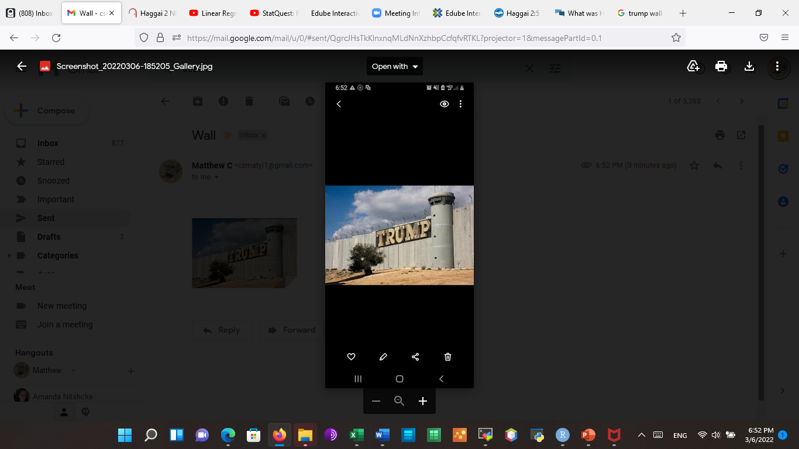

Slide 21
Nehemiah 2: audience with the king
Read Nehemiah 2:1-8!
Going about requesting absence of leave was a delicate matter.
Nehemiah waited from Chislev to Nissan, or November until March.
Possibly to wait for better weather
Esther 4:11: requesting a big thing from a king is not without its difficulties.
But as children of God we always have access to the Father:
“Let us therefore come boldly to the throne of grace, that we may obtain mercy and find grace to help in time of need.” (Hebrews 4:16)

Slide 22
Why is this so dangerous?
Q: Why do you think it was dangerous to make a request of the king?
Read Esther 4!
Apparently the Jews weren’t allowed to enter the throne room with sack clothes on.
The king is powerful and can provide for his subjects; someone with a sad countenance indicates that the king is unable and weak
But there is a time for all things, even sadness (Eccl. 3:4)

Slide 23
In the book of Daniel
Bible study: Daniel 1:8-10 (10): And the chief of the eunuchs said to Daniel, “I fear my lord the king, who has appointed your food and drink. For why should he see your faces looking worse than the young men who are your age? Then you would endanger my head before the king.”
Also read Daniel 2:5, 11-13:
“The king answered and said to the Chaldeans, ‘My decision is firm: if you do not make known the dream to me, and its interpretation, you shall be cut in pieces, and your houses shall be made an ash heap.’”
Verses 11-13…
Kings could be capricious; they were leaders of totalitarian regimes

Slide 24
The believer’s joy
Q: what makes you joyful?
We should have joy in the Lord.
Possessions, accomplishments, blessings are only fleeting.
We always want something bigger and better.
“Now may the God of hope fill you with all joy and peace in believing, that you may abound in hope by the power of the Holy Spirit.” (Rom 15:13)
“Delight yourself also in the Lord, And He shall give you the desires of your heart.” (Psalm 37:4)
“But seek first the kingdom of God and His righteousness, and all these things shall be added to you.” (Matthew 6:33)
Do not disfigure your face like the Pharisees.
We may be glad that our sins are forgiven.

Slide 25
The positive response
Verses 2, 4: the king inquires of Nehemiah’s sorrow and asks his request.
Verses 6, 8: the king is a benevolent one and grants Nehemiah’s request.
Perhaps he may have calculated in the geopolitical situation.
Greece and Egypt on the western flank of the empire.

Slide 26
Larger Catechism, Q 129
Q. 129. What is required of superiors towards their inferiors?
A. It is required of superiors, according to that power they receive from God, and that relation wherein they stand, to love, pray for, and bless their inferiors; to instruct, counsel and admonish them; countenancing, commending, and rewarding such as do well; and discountenancing, reproving, and chastising such as do ill; protecting, and providing for them all things necessary for soul and body: and, by grave, wise, holy, and exemplary carriage, to procure glory to God, honor to themselves, and so to preserve that authority which God hath put upon them.
Col. 3:19; Titus 2:4; 1 Sam. 12:23; Job 1:5; 1 Kings 8:55-56; Heb. 7:7; Gen. 49:28; Deut. 6:6-7; Eph. 6:4; 1 Pet. 3:7; 1 Pet. 2:14; Rom. 13:3; Esther 6:3; Rom. 13:3-4; Prov. 29:15; 1 Pet. 2:14; Job 29:12-17; Isa. 1:10, 17; Eph. 6:4; 1 Tim. 5:8; 1 Tim. 4:12; Titus 2:3-5; 1 Kings 3:28; Titus 2:15.

Slide 27
The trek to Jerusalem
Read Nehemiah 2:9-20!
Nehemiah goes with escort back to Jerusalem under the hand of his good God.
Q: why did Ezra refuse the escort (Ezra 8:22) and why does Nehemiah accept it?
Christian freedom, if you can make use of it, then do so, otherwise God can still defend you.
God’s provision (Nehemiah)/God’s power (Ezra)
Q: Why does Nehemiah seek out the destroyed walls at night?
So as not to be ostentatious and to respect the Jewish leader’s authority, he views the damage to the walls in private. (verses 12-16)

Slide 28
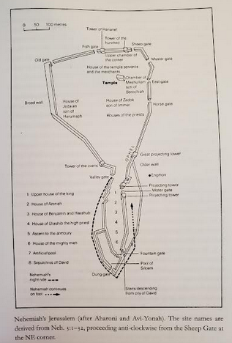
Valley Gate
Old wall
King’s Pool
Fountain Gate
Dung Gate

Slide 29
Notifying the Jewish leaders
Verses 16-18: only after surveying the walls does Nehemiah make a suggestion to the Jewish nobles and officials.
“Do not exalt yourself in the presence of the king, and do not stand in the place of the great; For it is better that he say to you, ‘Come up here,’ Than that you should be put lower in the presence of the prince, Whom your eyes have seen.” (Proverbs 25:6-7)
The church is not led by a single charismatic leader, but by many.
One man was needed to break the ice and make a suggestion for action, and to actually start doing it.
“Come and let us build the wall of Jerusalem” (verse 17)

Slide 30
How much can a wall help?
Read 2Samuel 5:6-7!
“Unless the Lord builds the house, They labor in vain who build it; Unless the Lord guards the city, The watchman stays awake in vain.”
(Psalm 127:1)
The wall itself cannot save a people, because the greatest resource of a city are the people itself within it.
50 brave soldiers are worth more than 500 cowards

Slide 31
The walls in your life…
We are God’s temple, the temple of the Holy Spirit.
But just like the walls of Jerusalem, parts of our spiritual life may be in disrepair.
Which walls and gates need repair in your life?
Your marriage?
Your children?
Your Eye gate?
What shows do you watch, where do you look?
Come and let us build the wall of Jerusalem, that we may no longer be a reproach.

Slide 32
How can we build Calvary OPC?
Q: So, how?
More prayer (monthly prayer meeting)
More attendance at:
Sunday School
Catechize our children
Ground them in apologetics
Evening Bible study
Weekly Bible study
Friday outreach
Book studies

Slide 33
New enemies
Just as in Ezra, the devil never ceases to tempt, harass, assault the people of God
Be sober, be vigilant; because your adversary the devil walks about like a roaring lion, seeking whom he may devour. (1Peter 5:8)
With the Christian life there is no coasting, no rest, it is a constant struggle.
This time it is
Sanballat the Horonite
Tobiah the Ammonite official
Q: Why were they grieved?
They esteemed the Jewish people not to be much, not fit to live.
So they were grieved when the king of Babylon upheld them and protected them.

Slide 34
New enemies
They saw that their first attempt to destroy the city of the Jews would be in vain.
They saw faithfulness to God as rebellion against the secular authorities
See Daniel 6, but also in our own day (lockdowns)
They scoffed at the Jews that they would not be able to finish what they started to build.
But they are really scoffing at God, because it was His plan to carry it through.
“being confident of this very thing, that He who has begun a good work in you will complete it until the day of Jesus Christ” (Philippians 1:6)

Slide 35
The duel of words
Verses 19-20
But when Sanballat the Horonite, Tobiah the Ammonite official, and Geshem the Arab heard of it, they laughed at us and despised us, and said, “What is this thing that you are doing? Will you rebel against the king?”
So I answered them, and said to them, “The God of heaven Himself will prosper us; therefore we His servants will arise and build, but you have no heritage or right or memorial in Jerusalem.”
Just like God prospered Joseph or Daniel (see Bible study)
It was God’s plan, and God will carry it through, trust in God’s promises!
And so the Jews began to build: to be continued…

Slide 36
Nehemiah 3: let the building begin!
Read Nehemiah 3! (2 people)
This was a common cause, a community affair
The whole people, the whole church
People of all classes took part in it
Priests and Levites (v. 1, 17, 22, 28)
Leaders and their families (v. 12, 15, 16)
Goldsmiths (v. 8, 31, 32)
Perfumers (v. 8)
Merchants (v. 31, 32)

Slide 37
Old gate
Fish gate
Sheep gate
3. Hassenaah
1. Eliashib, priests
6. Jehoiada
2. Jericho, Zaccur
4. Meremoth
7. Melatiah, Jadon, Gibeon + Mizpah
Tower of Hananel
Tower of the 100
32. Goldsmiths and merchants
4. Meshullam
4. Zadok
Muster (miphkad) gate
5. Tekoites
31. Malchijah, goldsmith
Temple
30. Hananiah + Hanun
House of Jedaiah
Chamber of Meshullam
East gate
Broad wall
House of Zadok
30. Meshullam
29. Shemaiah
29. Zadok
8. Uzziah, Hananiah
House of priests
9. Rephaiah
Ophel
Horse gate
10. Jedaiah + Hattush
11. Malchijah of Harim
28. priests
12. Shallum + daughters
26. Nethinim
Tower of the ovens
Great projecting tower
House of Azariah
27. Tekoites
Valley gate
24. Binnui
13. Hanun
20. Baruch
Projecting tower
House of high priest
21. Meremoth
25. Palal, Pedaiah
JERUSALEM
23. Benj., Hashub, Azariah
Water gate
19. Ezer
17. Rehum + Levites
Projecting tower
Ascent to the armory
17. Hashabiah
16. Nehemiah of Azbuk
18. Bavai
Tombs of David
Pool of Shiloam
15. Shallun
Fountain gate
14. Malchijah of Rechab
Dung (refuse) gate

Slide 38
The priests and the sheep gate
Eliashib the high priest and the other priests lead by example and repaired the sheep gate.
This gate was used to bring in the sheep for the sacrifices.
It also led to the Temple.

Slide 39
The nobles
The nobles, also named after several cities in Israel also took up the task of building.
An exception is the nobles of the Tekoites: they sinned and marred this great undertaking.
But as nobles building the house of God should never be beneath them.
“But we are all like an unclean thing, and all our righteousnesses are like filthy rags” (Isaiah 64:6)
As believers even our best intentions are tainted by sin.

Slide 40
Larger Catechism, Q 129
Q. 129. What is required of superiors towards their inferiors?
A. It is required of superiors, according to that power they receive from God, and that relation wherein they stand, to love, pray for, and bless their inferiors; to instruct, counsel and admonish them; countenancing, commending, and rewarding such as do well; and discountenancing, reproving, and chastising such as do ill; protecting, and providing for them all things necessary for soul and body: and, by grave, wise, holy, and exemplary carriage, to procure glory to God, honor to themselves, and so to preserve that authority which God hath put upon them.

Slide 41
The artisans
Goldsmith, merchants, perfumers: they did not think it a loss to take part in the building of the wall, if it was for the Lord.
God can make up for whatever loss they may suffer in their business.
The daughters of Shallum: even though not as physically strong as men they could also help out.
Contribution of money
Women fellow laborers in the Gospel: “And I urge you also, true companion, help these women who labored with me in the gospel, with Clement also, and the rest of my fellow workers, whose names are in the Book of Life.” (Phill. 4:3)

Slide 42
Women in ministry?
Q: does this mean that women can partake in ministry?
Romans 16:1: Phoebe was a servant in the church of Cenchrea
She is designated as a diakonon, a ‘deacon’
But so is also the governing authority
See Romans 13:4: “For he is God’s minister to you for good”
Minister: diakonos

Slide 43
Those who repaired their own houses
Some people made repairs to their own houses
10: Jedaiah, Hattush
23: Benjamin, Hasshub, Azariah
28: the priests
29: Zadok
Q: why did they repair their own houses? Why not other houses?
Everyone should do their own part
Sweep before your own house, pull the beam out of your own eye first (Matthew 7:3-5)

Slide 44
Hananiah and the Tekoites
30: Hananiah, the sixth son of Shelemiah started the repairs
Even though he was not the greatest son, still he took to the repairs despite the wavering leaders
If the leaders fail to do the good, we should not follow this bad example
27: another example: though the Tekoite leaders did not set about the work, their people did not follow their bad example and built up two sections of the wall.
See also verse 5 where the Tekoites themselves made the repairs.

Slide 45
Miscellaneous notes
7: the residence of the governor was repaired, even the throne (kiseh), indicating that they were building Jerusalem back in full
15-16: they repaired the wall of the pool, apparently they built back the nicer buildings
The tombs
The man-made pool

Slide 46
Nehemiah’s part
Nehemiah of Azbuk (verse 16) is not the same as the Nehemiah, son of Hachaliah.
Q: What part did Nehemiah himself do?
We may assume three things:
Oversight, direction, encouragement
At times stepping in to lay down bricks
Watching out for the enemy
Nehemiah was like a general directing his army.
A more practical man than Ezra, who was more theoretical.

Slide 47
The big picture
“And I also say to you that you are Peter, and on this rock I will build My church, and the gates of Hades shall not prevail against it. And I will give you the keys of the kingdom of heaven, and whatever you bind on earth will be bound in heaven, and whatever you loose on earth will be loosed in heaven.” (Matthew 16:18-19)
Jesus says that He will build His church: it shall be accomplished, because He said so, and He is powerful to carry out His plan.
But we are all to do our own part, not to relax and coast.
Each church ministry is important: teaching, Bible study, deaconate, teaching children, ushering, clearing away the Lord’s Table, playing the piano, sound, cooking food, hosting a garage sale, folding the bulletins, turning on the screen, cleaning the bathroom or the coffee pot.

Slide 49
Nehemiah 5: trials from within
Read Nehemiah 5:1-19! (1-5; 6-13; 14-19)
Whereas Nehemiah 4 describes adversity on the outside, in this chapter the Israelites face several trials:
Famine
Poverty
Division
The devil, our enemy tries all methods in order to make us fall.
It is a constant battle that only ends when Christ comes again.

Slide 50
Famine (verses 3-4)
As the previous chapter showed us, the Israelites were surrounded on all sides.
It could be that their enemies cut off the trading routes, so this increased poverty and scarcity of food.
Furthermore, many personnel shifted from other areas to Jerusalem to build the wall.
Less people to farm.
Guards were also needed.
This would lead to dire consequences as malnourished people cannot build so fast. A vicious cycle.
Q: have you ever had to live on meager rations? How did you survive? (tell your testimony)

Slide 51
Poverty (verses 4-5)
The Jews paid debts with goods: grain, wine and oil.
This was running out, and their debts were mounting, since they had to pay the tax to the king of Babylon.
So they mortgaged their fields, their vineyards and their houses to other Jews so that they could pay the tax money.
If they could not pay the taxes, then their foes’ malevolent prediction would “come true”:
Let it now be known to the king that, if this city is built and the walls completed, they will not pay tax, tribute, or custom, and the king’s treasury will be diminished. (Ezra 4:13)
This would be seen as rebellion, and the Babylonians could punish them…

Slide 52
Historical documents
“Documents from Babylon show that many inhabitants of this province too had to mortgage their fields and orchards to get silver for the payment of taxes to the king. In many cases they were unable to redeem their property, and became landless, hired labourers; sometimes they were compelled to give away their children into slavery.” (chief researcher at the Institute for Oriental Manuscripts)
Interest rates at the time were up to 20%.
By the end of the 5th century BC they were 40-50%.
Q: Why do you think God allowed a famine to happen in the land?

Slide 53
Debt slavery
What a sad state of affairs that some of the Jews had to even sell their own sons or daughters into servitude!
The children of the poorer Jews played the same games, sang the same songs as the children of those richer Jews to whom they were now indebted.
What was the basis of these laws? Read Exodus 21:1-11!
This was a form of indentured service: the servant had to work six years, but went free in the seventh year.
Just as in the 50th year, the year of Jubilee all slaves were set free and their lands were returned.
This was similar to indentured servants who had little money but wanted to move from England to America.

Slide 54
Lessons on handling wealth
“He who oppresses the poor reproaches his Maker, but he who honors Him has mercy on the needy.” (Proverbs 14:31)
If you have means, you should be generous.
“Go to the ant, you sluggard! Consider her ways and be wise, which, having no captain, overseer or ruler, Provides her supplies in the summer, and gathers her food in the harvest.” (Proverbs 6:6-8)
Work hard and save in times of plenty to prepare for want.
“So let each one give as he purposes in his heart, not grudgingly or of necessity; for God loves a cheerful giver.” (2Cor. 9:7)
Give abundantly.
Don’t feel guilty, feel grateful.
Think ahead and be prudent. Imitate God in His grace.

Slide 55
Why?
Q: Why do you think all this was happening?
Read Deuteronomy 28:30-33!
It could well be that the people again, were not following the Lord, because these things (poverty, famine, losing their children) are punishment coming from God.
The Lord brings poverty and gives great wealth. (1 Sam 2:7)
Remember the Ten Plagues when the Jews survived the famine while the rest of the country hungered.
All of these issues as well as the building of the wall and the external enemies demanded a response from Nehemiah…

Slide 56
Nehemiah’s response (verses 6-11)
The moneylenders were charging their fellow Jews interest on the money that they lent them.
But Mosaic law condemned charging interest on loans, rather the poverty-stricken man must be helped.
Read Exod. 22:25, Lev. 25:25!
After serious thought, Nehemiah rebukes the nobles and the officials, so that they were silent.
The lands must be returned immediately, plus 1% of the goods.
Q: Why did the nobles have to do this immediately?
Because it was a great sin, and sin of such magnitude (any magnitude) must be dealt with immediately!

Slide 57
The oath (verses 12-13)
Q: What do we see in these two verses that show how seriously Nehemiah took the situation so seriously?
He made the nobles swear an oath before the priests that they would do as Nehemiah commanded them. And he shook his robes as a sign.
Q: What did Nehemiah’s shaking the fold of his robe symbolize?
In Israel it was a practice during oaths to perform some physical sign to show what would happen if the oath was broken.
Just as the sign was tangible, so also was the reality that would surely follow if the oath was broken.
Read 1 Samuel 15:24-28!

Slide 58
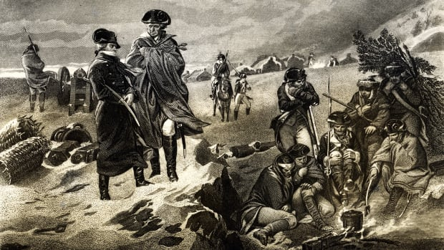

Slide 59
Nehemiah’s generosity (verses 14-19)
Previous governors and even their servants laid burdens on the people and extorted them.
Bread, wine, 40 shekels of silver (1 lbs, about $320)
But Nehemiah was different, he did not take the governor’s provisions, so as to lessen the load on the people.
He also did not take land (verse 16).
Q: what motivated Nehemiah to do so?
And you shall love the Lord your God with all your heart, with all your soul, with all your mind, and with all your strength.’ This is the first commandment. (Mark 12:30)

Slide 60
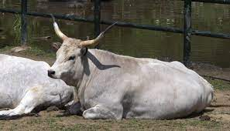
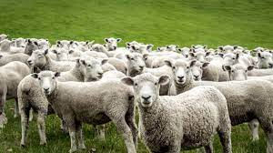
Nehemiah’s wealth
Verse 18: Nehemiah could have sacrificed an ox and six choice sheep every day.
Nehemiah was ruler for 12 years, making this 4,380 oxen and 26,280 sheep, a vast flock.

Slide 61
Nehemiah’s generosity
Read James 2:1-8!
You cannot truly love your neighbor if you do not love God first.
Nehemiah truly loved his fellow citizens.
He came down from the courts of Babylon (or like Moses in Egypt) to partake of the same plight as his countrymen.
He is a figure of Christ who came down from Heaven to be with His people.
Our God is a loving God.

Slide 62
Nehemiah 6
Read Nehemiah 6!
Verses 1-9
Verses 10-14
Verses 15-19
In Nehemiah 4, there are troubles without and in Nehemiah 5 troubles within.
After internal troubles have been resolved, external troubles start all over again.
The devil, our enemy tries all methods in order to make us fall.
It is a constant battle that only ends when Christ comes again.

Slide 63
The church versus the world
Athanasius contra mundum: Athanasius against the world.
The church against the world.
The Jews against the outside world: Sanballat, Tobiah, Geshem the Arab, the Ammonites and the Ashdodites.
Many enemies from a number of surrounding people.
Q: In what ways is the world trying to undo the church?
Liberalism, Socialist Christianity, theistic evolution
Yet we walk by faith and not by sight (2 Corinthians 5:7)

Slide 64
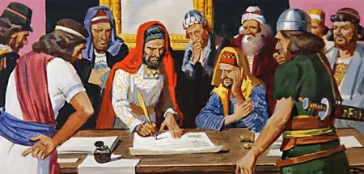
Sanballat = “hatred in secret” (the devil); Geshem = “has material substance/heavy rainfall” (the world)

Slide 65
Sanballat’s messages
Sanballat and Geshem seek to lure Nehemiah away from finishing the wall.
He literally sees his ‘window’/’door’ of opportunity close as the gates are finished and closed.
Otherwise to destroy the Jews meant a military siege.
To a secluded spot in their own territory, the plains of Ono.
Home turf, they have the upper hand
In the walls of Jerusalem Nehemiah is strong
Sanballat is very persistent! He messages Nehemiah five times!!
They obviously want very strongly to get Nehemiah to come.
Goes contrary to etiquette
You cannot force people
There is nothing new under the sun: the devil recycles old tricks all the time.
Read Ezra 4:1-2!

Slide 66
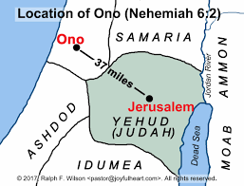

Slide 67
The final message
Just as in Ezra 4:2, Sanballat and his associates feign helpfulness.
But in the end, it is a concocted threat.
Verses 6 & 7: the accusation and the threat:
Nehemiah is building the wall to break away from the king.
The prophets are to be sent to proclaim Nehemiah king.
The threat is that they will be reported to the king.
The world accuses us of trying to establish a theocracy.
Jesus builds His church according to His plan, not us according to our plan.

Slide 68
Why does Nehemiah persist?
Q: What would you do in Nehemiah’s place? Would you give in?
By all worldly accounts, building a wall to fortify a small city (compared to Babylon) makes no sense at all.
Sanballat, Gershem, and the others cannot understand it, because they are worldly.
So they suspect the Jews of some sort of trickery – they want to rebel against the king, even though the king of Persia sponsors this project.
Q: What do you think would have happened had Nehemiah not finished the wall?

Slide 69
“I am doing a great work”
Q: Why is Nehemiah’s work so great?
From a worldly perspective, Nehemiah had a better life in Babylon, why does he squander it just to build the wall around Jerusalem?
Not what, but how, and for whom!
Nehemiah was looking forward to the Messianic king who would come from David’s lineage.
Q: How are you working for God’s kingdom?
Are you easily distracted?
Do other things get in the way?

Slide 70
How do we respond?
When you do God’s work, do not stand down.
We ought to obey God rather than men. (Acts 5:29)
Q: how do we handle rumors about us?
Do not deal too much with rumors.
Deny what’s false, and state clearly what is true. (read verse 8)
Do not react too speedily.
If someone presents an alternative reality to you:
(As with evolutionary ideology)
Analyze the data and think carefully
Seek counsel from others
PRAY

Slide 71
Treachery within the walls
The devil is cunning and will invent anything to discredit, disable, or destroy God’s people.
An external, worldly threat, such as Sanballat and Gershem are more easy to spot and refute.
But an internal enemy is a much graver threat, since he appears to be harmless, one of us.
But: Satan himself transforms himself into an angel of light. (2Corinthians 11:14)
“For certain men have crept in unnoticed, who long ago were marked out for this condemnation, ungodly men, who turn the grace of our God into lewdness and deny the only Lord God and our Lord Jesus Christ.” (Jude 1:4)

Slide 72
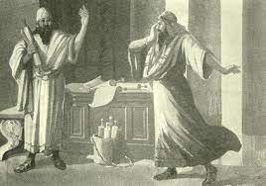
Shemaiah, the false prophet
Read verse 10! “Afterward I came to the house of Shemaiah the son of Delaiah, the son of Mehetabel, who was a secret informer; and he said, ‘Let us meet together in the house of God, within the temple, and let us close the doors of the temple, for they are coming to kill you; indeed, at night they will come to kill you.’”
Q: How did Nehemiah realize that Shemaiah was a false prophet?
Read: Numbers 18:7; Number 3:38
Nehemiah knew that Shemaiah was enticing him to do something forbidden in the law (he as a non-priest to go into the temple)
Just as the Pharisees and their henchmen didn’t know the law when accusing the sinful woman, so Shemaiah doesn’t know God’s law, either.

Slide 73
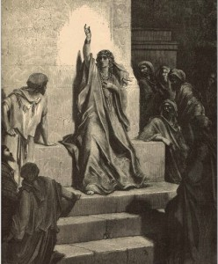
Who was Noadiah the prophetess?
Named alongside Shemaiah and a group of prophets, she was a leader against Nehemiah.
She could have even been the head of the prophets in Jerusalem, and could have wielded power, since she tried to intimidate Nehemiah.
It is problematic that a woman would be taking over the role of a man in leadership.
1Tim. 3:2: bishop man of one wife.
If a woman leads the men who are supposed to truthfully speak forth God’s Word, it means that the priesthood was also in bad shape.

Slide 74
A real-life example
My dad, a physicist knew that I believed in six-day creation.
He thought I was literally insane, stupid, misguided, brainwashed.
“You can always deal with religion when you’re old”
Sent me “Christian” books espousing theistic evolutionism.
i.e. “The triumph of reason”
Became “religious” for a while. “Prayed” even, sang songs, etc. and whatnot.

Slide 75
Tobiah, the Ammonite
An external enemy, but related to several of the nobles through marriage.
Son-in-law to Shechaniah
His son, Jehohanan married the daughter of Meshullam.
He also tries to discourage Nehemiah from building the wall also by sending letters.
Greater treachery than Shemaiah, the false prophet, since even more people are involved.

Slide 76
Triumph: the wall is completed
Verses 15 to 16 describe the finishing of the wall.
It is a small thing to pull off the building of a wall with much savvy.
But only God can move the hearts of sinners so that they can love one another in the face of adversity.
The surrounding nations perceived that this work was done by our God.
“A new commandment I give to you, that you love one another; as I have loved you, that you also love one another. By this all will know that you are My disciples, if you have love for one another.” (John 13:34-35)

Slide 77
Hebrews 11:7
Faith takes God at His Word: Nehemiah came from Babylon to take on this difficult task
Like how Abraham left Ur at the word of God
Faith goes to work: Nehemiah keeps up the work and does not desist from it (verse 3)
Faith divides: Shemaiah, Noadiah, false prophets, unfaithful nobles were willing to side with the enemy, as opposed to Nehemiah’s faithfulness
Just like how the world during Noah’s time wanted to divert his attention from the task at hand, so did the surrounding nations try to divert the Israelites from building the wall.

Slide 78
Conclusions
Have faith and determination like Nehemiah did. God builds His church and carries out His plan.
Always look towards God and not towards man.
Do not let the opponents discourage you from carrying out God’s Word.
Beware that there are also internal enemies as well as external ones.

Slide 79
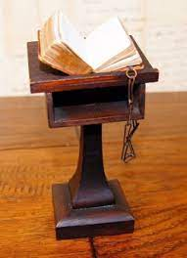
Nehemiah 9: context
Nehemiah 7: the returnees from Babylon are numbered.
Nehemiah 8: The people review the Torah
Festival of Trumpets (Leviticus 23:24)
The Day of Atonement (Leviticus 23:26-28)
The Festival of Booths (Leviticus 23:33-36)
The Law was read for a lengthy period of time, as during the Reformation.
Nehemiah 9: A Day of church/national repentance
A rebuilt people capable of covenantal renewal before God.
Just as the reading of the Torah was lengthy, so was their repentance.

Slide 80
Repentance
Q 87: What is repentance?
Repentance unto life is a saving grace, whereby a sinner, out of a true sense of his sin, and apprehension of the mercy of God in Christ, doth, with grief and hatred of his sin, turn from it unto God, with full purpose of, and endeavour after, new obedience.
Acts 2:37, Joel 2:13, Jeremiah 31:18-19
Read Nehemiah 9:1-21!

Slide 81
Repentance
It is a saving grace: the Holy Spirit must go so far as to open our eyes to understand what sin is and to see our own sin.
Luke 24:31 (Disciples in Emmaus)
To repent: shuv (שׁוּב): to turn, as in turning away from sin unto God.
We have been freed from sin to keep the law.
The “second half” of the Gospel.
“If you love me, keep my commandments.” (John 14:15)
“Neither do I condemn you; go and sin no more.” (John 8:11)

Slide 82
Calvin’s view
Without the Holy Spirit, the law can only condemn us in myriads of different ways.
It tells us what to do, however, we cannot keep it.
“who also made us sufficient as ministers of the new covenant, not of the letter but of the Spirit; for the letter kills, but the Spirit gives life.” (2 Corinthians 3:6)
The Gospel through the Holy Spirit enables us to keep the very same law once inscribed in our hearts.
(Jordan, Christianity and Civilization: Failure of the American Baptist Culture, 199-201)

Slide 83
Some Old Testament descriptions of the law
We maintain that the covenant was one and the same in the Old Testament and the New Testament.
The Mosaic law was given to direct the believer how he should live in obedience to God and do His will.
Repentance was the same in the Old Testament as well as the New.
Psalm 119 is an ode to the wonder of the law.
“Oh, how I love Your law! It is my meditation all the day.” (verse 97)
Read Psalm 19:7-10!

Slide 84
Nehemiah 9:1-4
This day was a monumental day in Jewish history: they had returned from Babylon and had built the wall.
on the same level as the exodus from Egypt.
or receiving the law on Mount Sinai.
The Jews knew they were blessed by God to have come back from Babylon, to have survived the surrounding threats, and built the wall.
They also knew that their rebellion had caused them to be swept into exile, so they must repent of their sins so as not to suffer God’s wrath again.

Slide 85
Separated from foreigners
Q: Why is this important?
Q: Where else does this appear as a problem for the Israelites?
In Ezra 9 we read how the Israelites had intermarried with many of the surrounding nations.
Even the priests and the Levites were guilty of this.
Israel was chosen by God to be His people.
Read 1Kings 1:1-4!
Just as David abstained from temptation, so now the Israelites also abstain.
As did Augustine who was chaste from age 31 to the rest of his life.

Slide 86
Nehemiah 9:1-4
So therefore they put on sack clothes and put dust on their heads, and repent of their sins.
They listened to the Torah a fourth part of the day and confessed and repented, and then worshiped another fourth part of the day.
Hearing the law => confession of sins => rejoicing in forgiveness (worship)
That’s a long time!
Q: how long do you read the Bible? How much do you confess your sins? How long do you pray?
Q: When was the last time you repented?

Slide 87
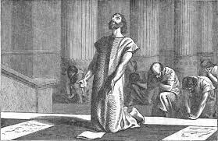

Slide 88
Nehemiah 9:5-21
Next follows a long description of God’s faithfulness to His covenant people in the Old Testament.
The Old Testament interprets itself.
Remember John 16:29-33: though we may be sinners, we must always look to God, not ourselves, otherwise we will be discouraged.
Creation, calling of Abraham, servitude in Egypt, signs and wonders, crossing the Red Sea, giving of the law, sustenance in the wilderness.

Slide 89
Verse 6: creation
God creates the heavens and its host, and the earth and all that is upon it.
Heavens, skies, land, seas: all and everything in the universe. Down to the tiniest ant.
Q: What would happen if God were to annul the natural laws?
God preserves and upholds all creatures and living beings; in this God is shown to continuously be faithful without cease.
Read Job 27:3!
Read Isaiah 42:5!

Slide 90
Verses 7-8: The call of Abraham
Q: What does Abraham’s name mean?
Extra credit: explain it in Hebrew ☺
Av-rah-am: father-many-nation
God made a covenant with Abraham, to be the father of many nations, and to give his descendants a land to dwell in.
This, even though he told Abraham to sacrifice Isaac, still in a miraculous way he would have a seed.
The Israelites now lived in that land, showing how faithful God had been over millennia!

Slide 91
Verses 9-11: servitude in Egypt
God’s greatest act of freeing His people, a historical event, to be forever recounted by the Israelites.
Signs, wonders, miracles, supernatural parting of the Red Sea so that the people could cross, whereas their enemies drowned in the waves.
Ezra/Nehemiah is a second homecoming, like that of Egypt:
Provisions by the king of Babylon
Protection from the surrounding enemies (Sanballat, Geshem, Tobiah, etc.)
Building the temple and the walls.

Slide 92
The wilderness to Mt. Sinai: verses 12-15
Verse 12: a pillar of smoke by day, a pillar of fire by night
Verse 15: God provided them bread (manna), and water on a daily basis, so that they would look to God and not to what they had stored up for themselves.
Read Numbers 20:7-11!
Their shows did not wear out (Deut. 8:4; 29:5)
God prepared beforehand their route into the Promised Land.

Slide 93
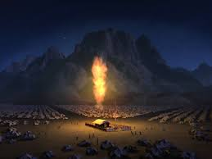
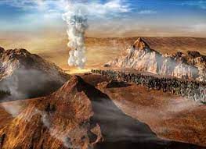

Slide 94
Giving of the Law
Israel becomes a nation with her own laws, ordinances, statutes, and commandments.
The law is good and provides order and structure for a nation.
Also the Sabbath, whereby the Israelites could regularly come and meet with God and worship Him.

Slide 95
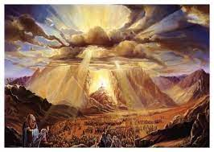

Slide 96
Rebellion of the Israelites: verses 16-18
The Jews were proud, stiff-necked, disobedient, heedless of God’s laws, and unmindful of the miracles that were displayed before them.
Miracle faith does not last for long.
God still tolerated and provided for the Jews despite their rebellion.
Ready to pardon
Gracious and merciful
Slow to anger
Abundant in kindness

Slide 97
Summary
The Israelites continuously sinned and rebelled against God, just like we ourselves do.
But God is long-suffering and merciful, quick to forgive.
Though we sin, we do not remain in our sinful state.
We should not look to ourselves or to our sins, but rather fix our sight always upon Jesus.
May our nation also experience national repentance just like the Israelites did in Nehemiah 9.

Slide 98
Nehemiah 9, second half
Nehemiah 9: A Day of church/national repentance
A rebuilt people capable of covenantal renewal before God.
Just as the reading of the Torah was lengthy, so was their repentance.
Reviewing the providence of God:
Creation
Call of Abraham
Freedom from Egypt
Giving of the Law
Read Nehemiah 9:22-30 and 31-38!

Slide 99
Verses 22-25: possession of the Promised Land
God also led the Israelites into their land to own and possess it, driving out larger peoples and taking in larger cities.
The fall of Jericho (Joshua 6)
Just like the Red Sea parting, the wilderness wandering, the pillar of smoke/fire, Mt. Sinai, this was also a miraculous event.
The fall of Ai (Joshua 8)
God had fought for His people and had conquered these foreign nations and given to the Israelites vineyards, olive groves, fruit trees (verse 25).
So now also God protects and preserves His people among hardships.

Slide 100
Joshua 21:11-13 – a solemn warning
“Therefore take careful heed to yourselves, that you love the Lord your God. Or else, if indeed you do go back, and cling to the remnant of these nations—these that remain among you—and make marriages with them, and go in to them and they to you, know for certain that the Lord your God will no longer drive out these nations from before you. But they shall be snares and traps to you, and scourges on your sides and thorns in your eyes, until you perish from this good land which the Lord your God has given you.”

Slide 101
The time of the judges (verses 26-31)
Previously, in the time of Joshua, the people turned their back upon God and His law, were disobedient and rebelled.
(again)
So the Israelites were given over to their enemies, who had dominion over them.
But as many times as the Israelites cried out to God, He heard them and delivered them according to His mercies
By a judge, a deliverer (verse 27)

Slide 102
The prophets
Q: Why do you think that the prophets testified against the people in verse 30?
So that the people would not attribute their deliverance to their own strength so they would not become prideful.
Just as our salvation is not our own doing (Ephesians 2:8-10)
Read Psalm 44:1-3!

Slide 103
God’s mercy (verse 31)
“Nevertheless in your great mercy you did not utterly consume them or forsake them; for you are God, gracious and merciful.”
Q: Why does God spare a remnant of His people?
Q: Would God have been just in utterly consuming His people?
God shows His glory, power, and mercy in that He can preserve a people for Himself.
Perseverance of the saints: if left to ourselves, Heaven would be empty, but by God’s grace it is He who carries us through.
Read Ephesians 2:8—10!

Slide 104
A picture of paternal forgiveness
The Israelites rebel, are given to their enemies, suffer, cry out to God, and then are delivered.
This happens over and over ad over again in the Old Testament.
Q: Why? What does this remind you of?
Paternal forgiveness on a national/covenantal level.
Judicial forgiveness happens only once, when a man is regenerated, believes, and is pardoned.
Just as God elected Israel once to be His people.
But paternal forgiveness must happen over and over and over again.
Just as family members may offend one another, so they also make peace with one another, over and over and over again.

Slide 105
Total depravity
TULIP: total depravity
The persistent, cyclical, characteristic rebellion of God’s people displays total depravity.
As it is written:
“There is none righteous, no, not one; There is none who understands; There is none who seeks after God. They have all turned aside; They have together become unprofitable; There is none who does good, no, not one.” (Romans 3:10)
Compare to: Matthew 19:17; Mark 10:18; Luke 18:19: why do you call me good?

Slide 106
Total depravity
None righteous: verse 32: kings, princes, priests, prophets, fathers, and all the people.
Verse 34: again, neither the kings, princes, priests nor the fathers have kept God’s law.
If the leaders don’t keep God’s law, then how shall the people?

Slide 107
Total depravity
“And the Lord God commanded the man, saying, ‘Of every tree of the garden you may freely eat; but of the tree of the knowledge of good and evil you shall not eat, for in the day that you eat of it you shall surely die.’” (Genesis 2:16-17)
Spiritual death, linked to physical death.
But still, the world is not as sinful as it could possibly be, because God’s gracious hand restrains many sorts of evil.
If God let go of this world, all would be destroyed.
Total depravity (sin affects all faculties of man: mind, emotions, will) is not the same as utter depravity (everything is as sinful as could possibly be).
See in this how God is active in this world, not passive!

Slide 108
To forgive as God forgives
Verse 33: despite the many, many, many backslidings of the Israelites, God is faithful to His people, to preserve a remnant.
We are also this remnant, but examine yourself that you personally belong to this remnant: “Therefore let him who thinks he stands take heed lest he fall.” (1Cor. 10:12)
God commands us to be holy as He is holy and to be more and more like Jesus, His Son.
Read Matthew 18:21-22!

Slide 109
Servitude (verses 36-37)
Even though the Israelites had built the temple and the wall, they were still in servitude. Their rulers could take:
Its fruit and bounty
Their bodies and cattle
This servitude is due to them for their sins.
Sins may be forgiven but their consequences may still last.
i.e. the Arab man who became Christian still had five wives to deal with.
This world is imperfect, temporary, and passing, we will never find fulfillment in this world alone.

Slide 110
The signing of the covenant (verse 38)
Remember God for all His great deeds.
“Faith comes from hearing, and hearing through the word of Christ” (Romans 10:17)
A formal seal on the covenant between the people and God via the leaders, the priests, and the Levites.
God will come to the rescue of the oppressed Israelites.
God will also save you if you enter into a covenant with Him.

Slide 111
Nehemiah 10: signing on the dotted line…
Read Nehemiah 10:1-27 and 28-39!
Different groups of people signed the covenant:
The leaders, such as Nehemiah
Lead by doing!
The priests and the Levites
The rest of the people
Why this formalism?
Q: Should a church have formal membership?
Q: What kind of arguments do people bring against church formal membership?

Slide 112
No formal church membership?
“If someone is a member of the invisible church, why force them to take up formal membership in the visible church?”
“The letter kills, but the Spirit gives life”
“There’s no example or command in Scripture for it.”
Example: “everybody is a member of this church who shows up at meetings”
What if a group of atheists show up and decide to dissolve the church?

Slide 113
Jesus kept formalities!
Q: in what parts of Scripture did Jesus keep formal requirements? Did He ever dispense with them?
Matthew 3:13-15: Jesus baptized to fulfill righteousness
Matthew 17:24-27: paying taxes with coins from a fish’s mouth
Matthew 26:62-64: high priest adjures Jesus
People keep formalities at their jobs, in legal settings, etc. Why not respect God by formally becoming a member?

Slide 114
You must commit to attending a church
Some people ‘flit’ from one church to another like a social butterfly, tasting the teachings from this church and that.
What would happen or the elders or the pastors did that?
bearing with one another, and forgiving one another, if anyone has a complaint against another; even as Christ forgave you, so you also must do. (Col. 3:13)
We must decide long-term to be members of a church, to bear with others, in easy and difficult times.

Slide 115
If you can go out, you can also go in
“And if he refuses to hear them, tell it to the church. But if he refuses even to hear the church, let him be to you like a heathen and a tax collector.” (Matthew 18:17)
“And you are puffed up, and have not rather mourned, that he who has done this deed might be taken away from among you.” (1Cor. 5:2)
If someone can be removed from the fellowship, so he can also be admitted to it.

Slide 116
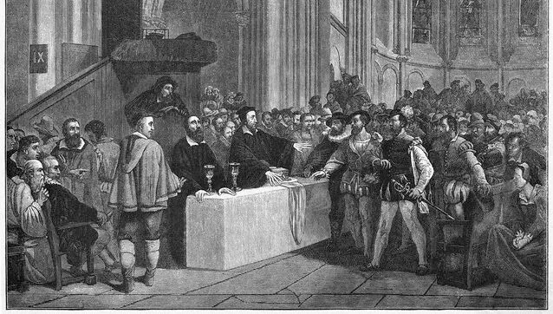

Slide 117
Oaths and vows
Besides Nehemiah 9:38-10:1, Ezra 10:5 and Nehemiah 13:25 also describe oaths.
Oaths and vows were lawful and binding in the Old Testament, so should they also be in the New Testament.
One God, one covenant, one people.
Deut. 6:13; 10:20
But what about Matthew 5:33-37? (Read)
Q: In some cases is this true? Which cases?
Swearing lightly or hastily, to bear false witness or taking God’s name in vain.

Slide 118
Are all oaths bad?
In verse 34 Jesus isn’t adding to the law (remember instead, Jesus fulfilled the law)
Read Numbers 30:1-2! This passage instituted oaths to guard the truth, but sinful minds always seek loopholes!
By Jesus’ time the Pharisees had found so many loopholes that Jesus had to address this common practice in Matthew 5.
i.e. if you swear by Jerusalem, it is not binding, but when facing the city it is binding.

Slide 119
False oaths
Modern examples:
politicians swearing falsely
Liberal pastors swearing by the Westminster Standards
Thus in verse 37 Jesus affirms that it is proper to swear to the truth of something (as in a courtroom)
We must swear true oaths, and not frequent, vain oaths that we forget the next minute.

Slide 120
Matthew Henry on oaths
“The frequent requiring and using of oaths, is a poor reflection on Christians, who should be of such acknowledged fidelity, as that their sober words should be as sacred as their solemn oaths.”
Believers are to be people so known for their truthfulness that they have no need to vow that they will keep their word.
Let us not make promises that we cannot keep and be faithful to do what we say in big and small things.

Slide 121
Parts of the oath
After they have repented, the Israelites must learn to do good.
Also a curse, just like part of Deuteronomy 28 (verse 29).
Not to intermarry.
To keep the Sabbath and refrain from work on that day.
To pay the temple dues.
To give the first fruits of their produce, lands first fruits, and animals to the Lord.
Not to neglect the house of God.

Slide 122
Marry only in the Lord (1 Cor. 7:39)
Q: Why is this important?
Not only is this important for the husband and wife that they be of the same faith (equal yoking).
It is very common that an unbelieving spouse is a source of grief and temptation to believers, to be drawn away from God.
It is also important for the children, that they grow up in the knowledge of the Lord and thus propagate God’s people in this manner

Slide 123
Keeping the Sabbath
To do all that God wills on the Sabbath day, not your will.
Read Isaiah 58:13-14!
To forego the seventh day’s produce: to trust in the Lord that He shall provide for you during the seventh year, just like the Jews trusted in God providing them the daily manna (Exod. 16:31-35).
Keeping the Sabbath is an important issue:
Will you sacrifice your time for God?
Will you keep time God’s way or your way?
Ultimately: do you trust God that His ways are better?

Slide 124
The upkeep of the temple
A third of a shekel for the work of the house of God.
“Let the elders who rule well be counted worthy of double honor, especially those who labor in the word and doctrine. For the Scripture says, ‘You shall not muzzle an ox while it treads out the grain,’ and, ‘The laborer is worthy of his wages.’” (1Tim. 5:17-18)
This also included the first fruits of the ground, the trees, their sons, the cattle, herds and flocks, dough, fruits, wine, and oil. (verses 35-37)

Slide 125
The upkeep of the temple
Pay to God what is due to God to help the upkeep of God’s worship.
Pay the first fruits of all that you have, and not the maimed, the lame, the weak or the sick.
The priests and the Levites were willing and ready to do their part, so must the people.

Slide 126
Conclusion
God pays attention to all details, and therefore formalities are also important for Him, such as church membership.
Oaths are lawful but must be made properly and with care, and not too frequently so as to debase it.
Repentance involves turning from sin, and doing what is good.
If we repent, we must learn from our mistakes to do that which is good instead of that which is sinful. Otherwise we may backslide.

