Slide 1

Westminster Shorter Catechism
Questions 1 & 2
January 10, 2021
Calvary OPC, La Mirada, CA

Slide 2
Question #1
Q: What is the chief end of man?
A: Man's chief end is to glorify God and to enjoy Him forever.

Slide 3
What does the Bible say?
"Therefore, whether you eat or drink, or whatever you do, do all to the glory of God." (1Corinthians 10:31)
"You are worthy, O Lord, To receive glory and honor and power; For You created all things, And by Your will they exist and were created." (Revelation 4:11)
"Whom have I in heaven but You? And there is none upon earth that I desire besides You. My flesh and my heart fail; But God is the strength of my heart and my portion forever." (Psalm 73:25-26)

Slide 4
God-centeredness
In Eden, man's focus was on God in every aspect
His work
Family
Worship
Knowledge (direct revelation from God)
In Eden, there was no suffering, illness, or death
God provided everything for man's need, and there was a loving relationship between God and man
Man glorified God, not himself

Slide 5
Man-centeredness
Adam rejected God's commands by listening to the serpent, and wanted to become like God, knowing and deciding all
When Adam sinned, he lost his relationship with God, and pain, suffering, and death entered the world
Adam then became man-centered, because he sought his own glory
Q: What two problems does the following mentality have?
"To seek the greatest good for the greatest number of people"

Slide 6
The greatest good for the greatest number of people?
It is still man-centered, in that it focuses on what is good for man
Q: which is the first of the two great commandments?
(See Matthew 22:37-38)
How can you know what is good for all 7.5 billion people on the planet?
Only God knows that!
Leave everything in His hands
Q: Is Christian service always God centered?

Slide 7
What does glorifying God look like?
Q: Does God need me to make Him glorious?
"The heavens declare the glory of God; And the firmament shows His handiwork. Day unto day utters speech, And night unto night reveals knowledge." (Psalm 19:1-2)
God already has glory. We glorify God by reflecting His greatness in who we are and all what we do
"I have glorified You on the earth. I have finished the work which You have given Me to do." (John 17:4)
We glorify God when the Holy Spirit leads us to follow the pattern of Jesus Christ

Slide 8
All men glorify God!
" Does not the potter have power over the clay, from the same lump to make one vessel for honor and another for dishonor? What if God, wanting to show His wrath and to make His power known, endured with much longsuffering the vessels of wrath prepared for destruction, and that He might make known the riches of His glory on the vessels of mercy, which He had prepared beforehand for glory..." (Romans 9:21-23)
Despite how some men reject God, they still end up glorifying God. Q: How?

Slide 9
The vessels of wrath and mercy
God is a God of truth and love
"God is not a man, that He should lie, Nor a son of man, that He should repent." (Numbers 23:19)
"He who does not love does not know God, for God is love." (1John 4:8)
God shows His mercy in saving His elect unto salvation
But God also preserves His truth by giving people what they deserve for their sins
You can't get away with living however which way you want

Slide 10
Question #2
Q: What rule has God given to direct us how we may glorify and enjoy Him?
A: The word of God which is contained in the Old and New Testaments, is the only rule to direct us how we may glorify and enjoy Him.

Slide 11
What does the Bible say?
"Then the brethren immediately sent Paul and Silas away by night to Berea. When they arrived, they went into the synagogue of the Jews. These were more fair-minded than those in Thessalonica, in that they received the word with all readiness, and searched the Scriptures daily to find out whether these things were so." (Acts 17:10-11)
"Now these things, brethren, I have figuratively transferred to myself and Apollos for your sakes, that you may learn in us not to think beyond what is written, that none of you may be puffed up on behalf of one against the other." (1Corinthians 4:6)

Slide 12
Two kinds of revelation
Natural revelation (revelatio generalis)
Psalm 19:1 talks about how nature makes it known that God is
Romans 1:20 says that the knowledge of God is clear, but that men did not glorify God because they are sinners

Slide 13
Two kinds of revelation
Special revelation (revelatio specialis)
Q: what is personal revelation? (extra credit)
This is when God reveals Himself to us through His Word
It is unattainable merely by the human mind alone
This is why we need the Holy Spirit enlightening our minds

Slide 14
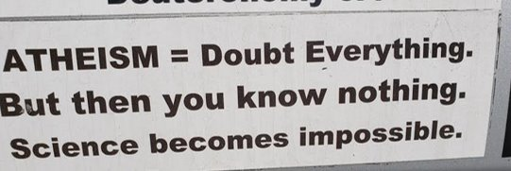

Slide 15
What is sure knowledge? (Calvin)
Man is finite, and we cannot know everything
Everyone must start with a basic set of unproven, subjective axioms about the world
This is our worldview/religion
Atheism/evolution
Bible/creation
Studies show that half of all scientific papers are found to be false after publication
Only God can know for certain: so what is the nature of God's knowledge?

Slide 16
God's knowledge
"However, when He, the Spirit of truth, has come, He will guide you into all truth;" (John 16:13)
Therefore what God says is completely true
The Bible is free of error (it is inerrant)
Moreover, the Bible, by nature cannot err (it is infallible)

Slide 17
The sufficiency of Scripture
We do not need to add to the authority of the Bible
God can get His point across! His Word is clear
Scientific theories
Tradition
A 'word' from God
"All Scripture is given by inspiration of God, and is profitable for doctrine, for reproof, for correction, for instruction in righteousness, that the man of God may be complete, thoroughly equipped for every good work." (2Timothey 3:16-17)

Slide 18
The sufficiency of Scripture - 2
We do not need to add words to the Bible
"For I testify to everyone who hears the words of the prophecy of this book: If anyone adds to these things, God will add to him the plagues that are written in this book; and if anyone takes away from the words of the book of this prophecy, God shall take away his part from the Book of Life, from the holy city, and from the things which are written in this book." (Revelation 22:18-19)
No need for a "Book of Charismatic Sayings"

Slide 19
Sola Scriptura
The entire Scripture, and not any human interpretation of it are the sole highest authority for all people in all questions
No church or individual stands even on par with the Bible (sola)
For all people: Jews and Gentiles
The entire Scripture: we don't divide the Bible, we don't leave out one part (Tota Scriptura)
In all questions, not just doctrine or morals

Slide 20
Solo Scriptura?
"I have endeavored to read the Scriptures as though no one had read them before me, and I am as much on my guard against reading them today, through the medium of my own views yesterday, or a week ago, as I am against being influenced by any foreign name, authority or system whatever" (Alexander Campbell)
Even what the Holy Spirit taught you the last time you had Bible study?

Slide 21
The analogy of faith (analogia fidei)
The Holy Spirit teaches and guides the Christian church ever since the first century
We can build on the previous knowledge of others
Faith is not individualistic
What we learned from previous Bible study, we can use in later study of the Bible
We shouldn't neglect or reject it

Slide 22
Tradition?
"He answered and said to them, “Why do you also transgress the commandment of God because of your tradition?" (Matthew 15:3)
"Therefore, brethren, stand fast and hold the traditions which you were taught, whether by word or our epistle." (2Thessalonians 2:15)
Q: How do we make sense of this?

Slide 23
Roman tradition and sola ecclesia
"As a result the Church, to whom the transmission and interpretation of Revelation is entrusted, 'does not derive her certainty about all revealed truths from the holy Scriptures alone. Both Scripture and Tradition must be accepted and honoured with equal sentiments of devotion and reverence.'" (CCC, par. 82)
"The task of giving an authentic interpretation of the Word of God, whether in its written form or in the form of Tradition, has been entrusted to the living teaching office of the Church alone. Its authority in this matter is exercised in the name of Jesus Christ. This means that the task of interpretation has been entrusted to the bishops in communion with the successor of Peter, the Bishop of Rome." (CCC, par. 85)

Slide 24

Matthew 16:19 & 18:18 (KJV)
"And I will give unto thee the keys of the kingdom of heaven: and whatsoever thou shalt bind on earth shall be bound in heaven: and whatsoever thou shalt loose on earth shall be loosed in heaven."
2nd person singuler
"Verily I say unto you, Whatsoever ye shall bind on earth shall be bound in heaven: and whatsoever ye shall loose on earth shall be loosed in heaven."
2nd person plural
Today's Greek verse! :-)

Slide 25
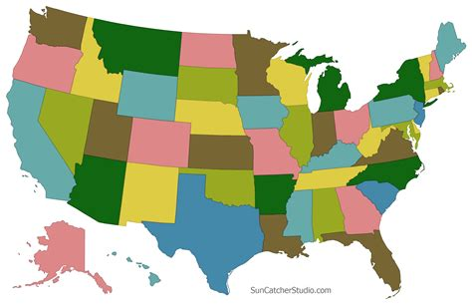

Slide 26
A closer look...
"Therefore, brethren, stand fast and hold the traditions which you were taught, whether by word or our epistle." (2Thessalonians 2:15)
The traditions (παραδόσεις): one single body of knowledge
By word or by letter: transmitted in two forms
You can evangelize someone by:
Giving them literature to read
Explaining to them the Gospel in words

Slide 27
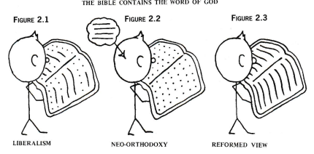
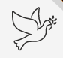
Theological liberalism

Slide 28
Contains or is?
Neo-orthodoxy is also called Barthianism, after Swiss theologian, Karl Barth
Pentecostal form: the Bible comes alive when the Holy Spirit 'interacts with it'
Tota Scriptura: the entire Bible is the Word of God
"It is the Spirit who gives life; the flesh profits nothing. The words that I speak to you are spirit, and they are life." (John 6:63)

Slide 29
Opponents of Sola Scriptura
Roman Catholicism
A counterfeit 'triple cord'
Denial of
Sola Scriptura
Theological liberalism
The Pentecostal movement

Slide 30
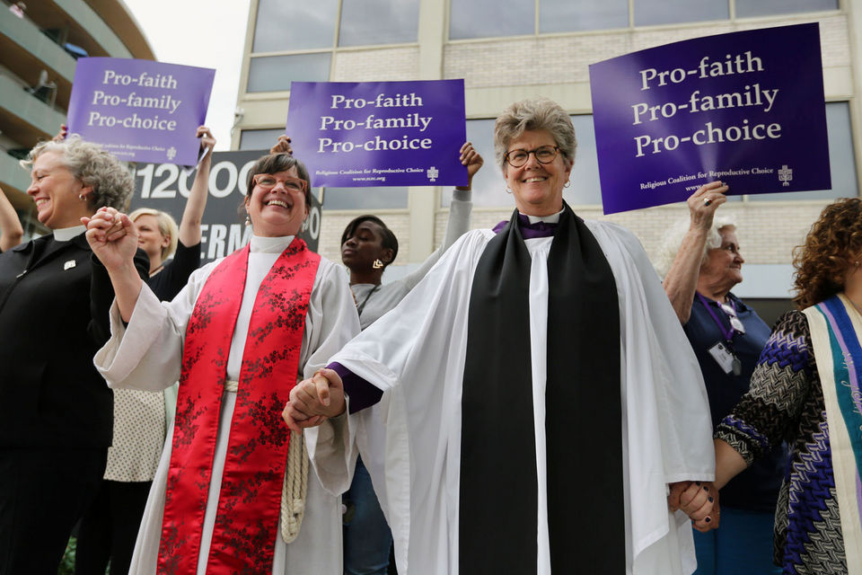
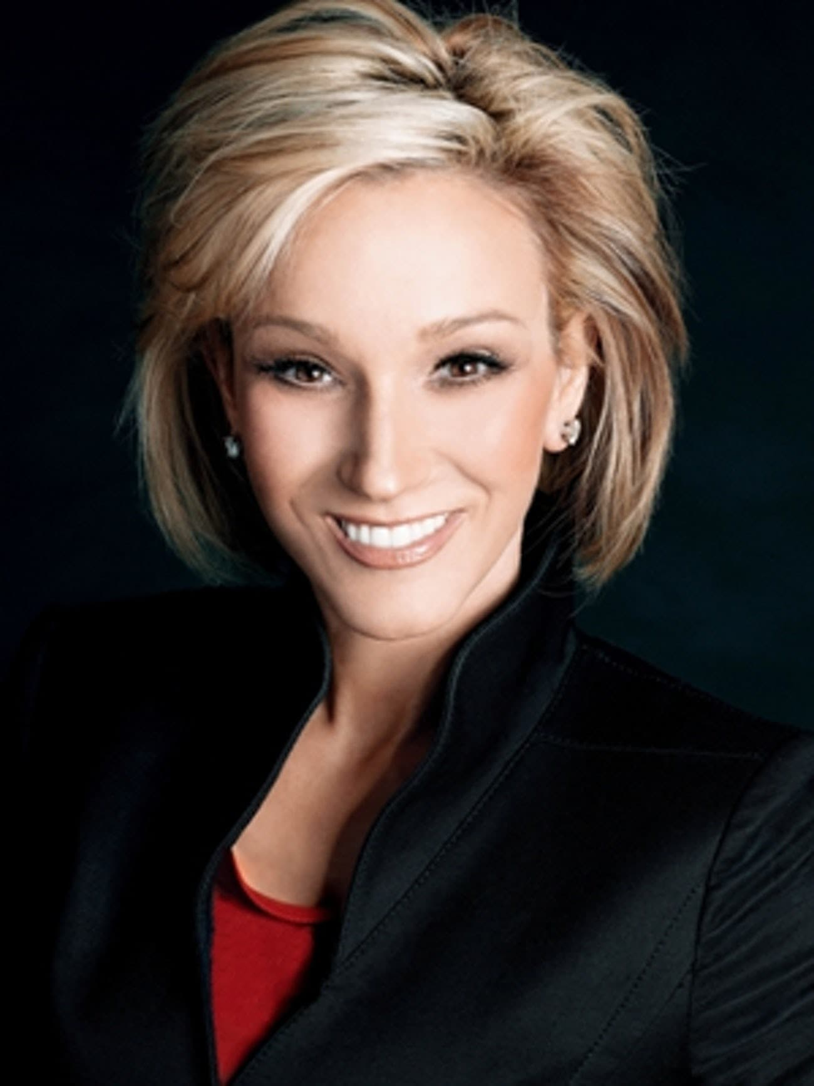
Pentecostal woman 'pastor' Paula White

Slide 31
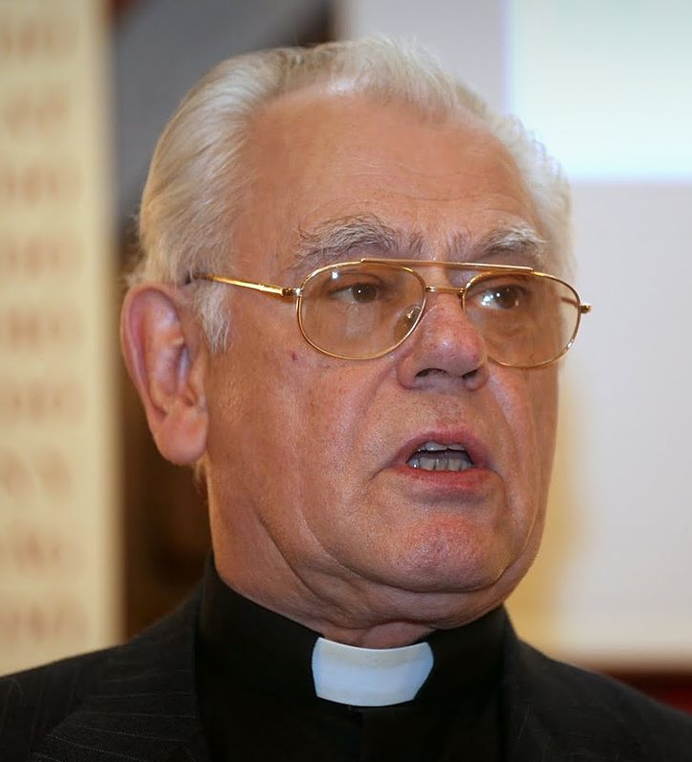
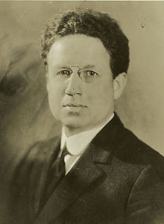
Huba Rozsa, Hungarian RC theologian
Harry Emerson Fosdick, theistic evolutionist and liberal theologian

Slide 32

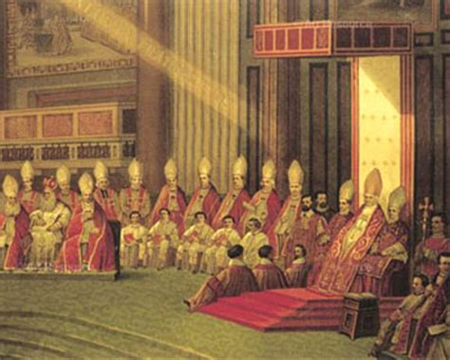

Slide 33
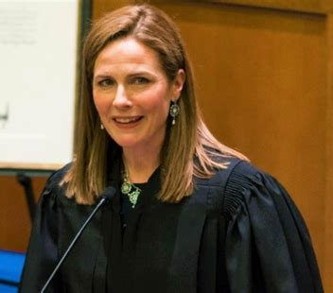
The Catholic charismatic movement
Roughly 10% of all Roman Catholics are charismatic
this number is growing steadily
Very ecumenical
Spiritual 'gifts'
But they focus on becoming more
Roman Catholic rather than evangelical
Supreme Court justice Amy Coney Barrett

Slide 34
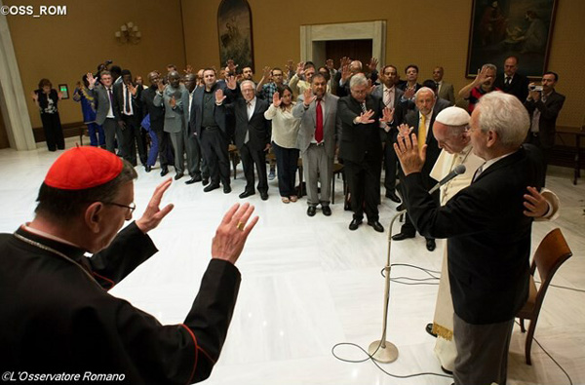

Slide 35
Liberalism, Romanism, Pentecostalism
RCC: The Bible subject to the church (sola ekklesia)
Liberalism: the Bible subject to human reason
Pentecostalism: the Bible subject to human experience and emotions
Dispensationalism
RCC: Scripture plus tradition
Liberalism: Scripture plus scientific theories
Pentecostalism: Scripture plus extra-biblical revelation ("A word from God")
Dispensational presuppositions

Slide 36
Homework
Memorize the following verses for my next class:
Acts 17:10-11
1Corinthians 4:6
2Timothy 3:16-17
Hebrews 1:1-2
Revelation 22:18-19
The main similarities between liberalism, Pentecostalism and Roman Catholicism

Slide 37
Resources
Keith Mathison, The Shape of Sola Scriptura
James White, Scripture Alone
M Barrett, God's Word alone, the authority of Scripture
Gary Crampton, By Scripture Alone, the sufficiency of Scripture
Course paper: "What is the relationship between Scripture and tradition?"

