Slide 1
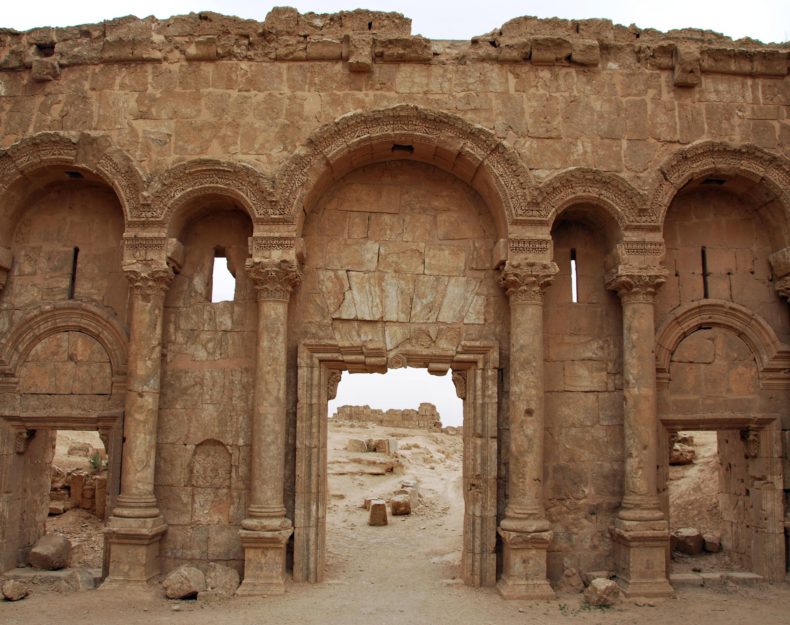
Ezra 4-7
March 20, 2022
Calvary OPC, La Mirada, CA

Slide 2
Ezra 4: the challenge begins
(Recap) From Ezra 3 last week we saw:
The Jewish people were serious about properly worshiping God.
They wanted to follow God’s command exactly when building up the temple.
Exodus 25:40: And see to it that you make them according to the pattern which was shown you on the mountain.
The fear of the (surrounding) people were upon the Jews.
Q: who remembers why?
But now: the hard part begins: as a believer our enemy, the devil starts the attack immediately, after you came to believe, and can be very subtle and also very ferocious…
Read Ezra 4:1-5!

Slide 3
“Let us build with you”
The surrounding people propose to build the temple of God together with the Israelites (Judah and Benjamin)
They claim to seek the same God as the Jews
They also claim to have sacrificed to God since the days of Esarhaddon of Assyria
The adversaries of the Jews begin small, hoping for an easy victory by trying to infiltrate them.
Q: Who were these people of the land?
Read 2Kings 17:24-29!

Slide 4
Samaritans
These people appear to be the Samaritans, who originally were Jews but adopted pagan practices, a mixed, syncretistic religion.
2Kings 19:37: “Now it came to pass, as he [Sennacherib of Assyria] was worshiping in the temple of Nisroch his god, that his sons Adrammelech and Sharezer struck him down with the sword; and they escaped into the land of Ararat. Then Esarhaddon his son reigned in his place.”
Ezra 4:7: the letter was written in Aramaic, the language of the Samaritans
Verses 9-10: The Samaritans are mentioned as the people settled in the cities of Samaria and in the area “beyond the River”

Slide 5
No thank you!
Zerubbabel and Jeshua reject the Samaritan “offer of help”.
Cyrus granted by decree all resources to the Jewish people so that they could build the temple.
You don’t need to “help God out”
It would also look bad to king Cyrus that the Jews were enlisting other people’s help.
Most importantly:
If the Jews were to accept help, it would mean that the people would intermix, marriages would form, something that the Jews wanted to avoid in the first place.
Mixed marriages caused the downfall of Solomon; God wants to preserve a people for Himself and His worship.

Slide 6
1 Kings 1:1-4
“Now King David was old, advanced in years; and they put covers on him, but he could not get warm. Therefore his servants said to him, ‘Let a young woman, a virgin, be sought for our lord the king, and let her stand before the king, and let her care for him; and let her lie in your bosom, that our lord the king may be warm.’ So they sought for a lovely young woman throughout all the territory of Israel, and found Abishag the Shunammite, and brought her to the king. The young woman was very lovely; and she cared for the king, and served him; but the king did not know her.”
King David learned his lesson not to become intimate with another woman after his adultery with Bathsheba.
The Jewish people knew they had been unfaithful and did not wish to be unfaithful again to the Lord.

Slide 7
Examples of religious flattery
The Roman church’s attitude in ecumenism (Vatican II):
Unitatis redintegratio: Rome’s decree on ecumenism:
Calls the Protestant churches “separated brethren”
This is a misnomer, since no earthly power can separate Christian brothers from one another (Christ builds his church)
Vatican II still upholds the council of Trent (mid-16th c.), which puts the major Protestant doctrines under anathema
Rome holds to a false gospel of grace and law (calls assurance of salvation the sin of presumption)
Rome calls all churches to return to her as to the mother church, saying you can only be as Christian as you are Roman Catholic
Maintaining ecumenical relationships with Rome is syncretism.
“I will build my church” (Matthew 16:18), but Rome is another church, another building at another address.
Do not build with Rome.

Slide 8
Atheists also play this game
Unbelieving father in the family
Physicist, believed in evolution
Believed I was completely crazy because I believe in six day creation
Literally wanted to send me to an insane asylum
Played the religious person
Sang songs, “prayed”, even though he never prayed in his life
Sent me books on “The triumph of reason”
In other areas: when the left plays religious
Hillary Clinton becoming a Methodist pastor
Al Gore ad: “My faith sustains me”

Slide 9
A parenthesis
Ezra 4:5-6: “5: and hired counselors against them to frustrate their purpose all the days of Cyrus king of Persia, even until the reign of Darius king of Persia. 6: In the reign of Ahasuerus, in the beginning of his reign, they wrote an accusation against the inhabitants of Judah and Jerusalem.”
Darius I: 522-486
Ahasuerus: 486-465
Ezra 4:1-5 is the main thread of the narrative, dealing with the building of the temple
Verses 6-23 is a parenthesis (another example: Matthew 28:2-4), dealing with later events dealing with the wall (still related)

Slide 10
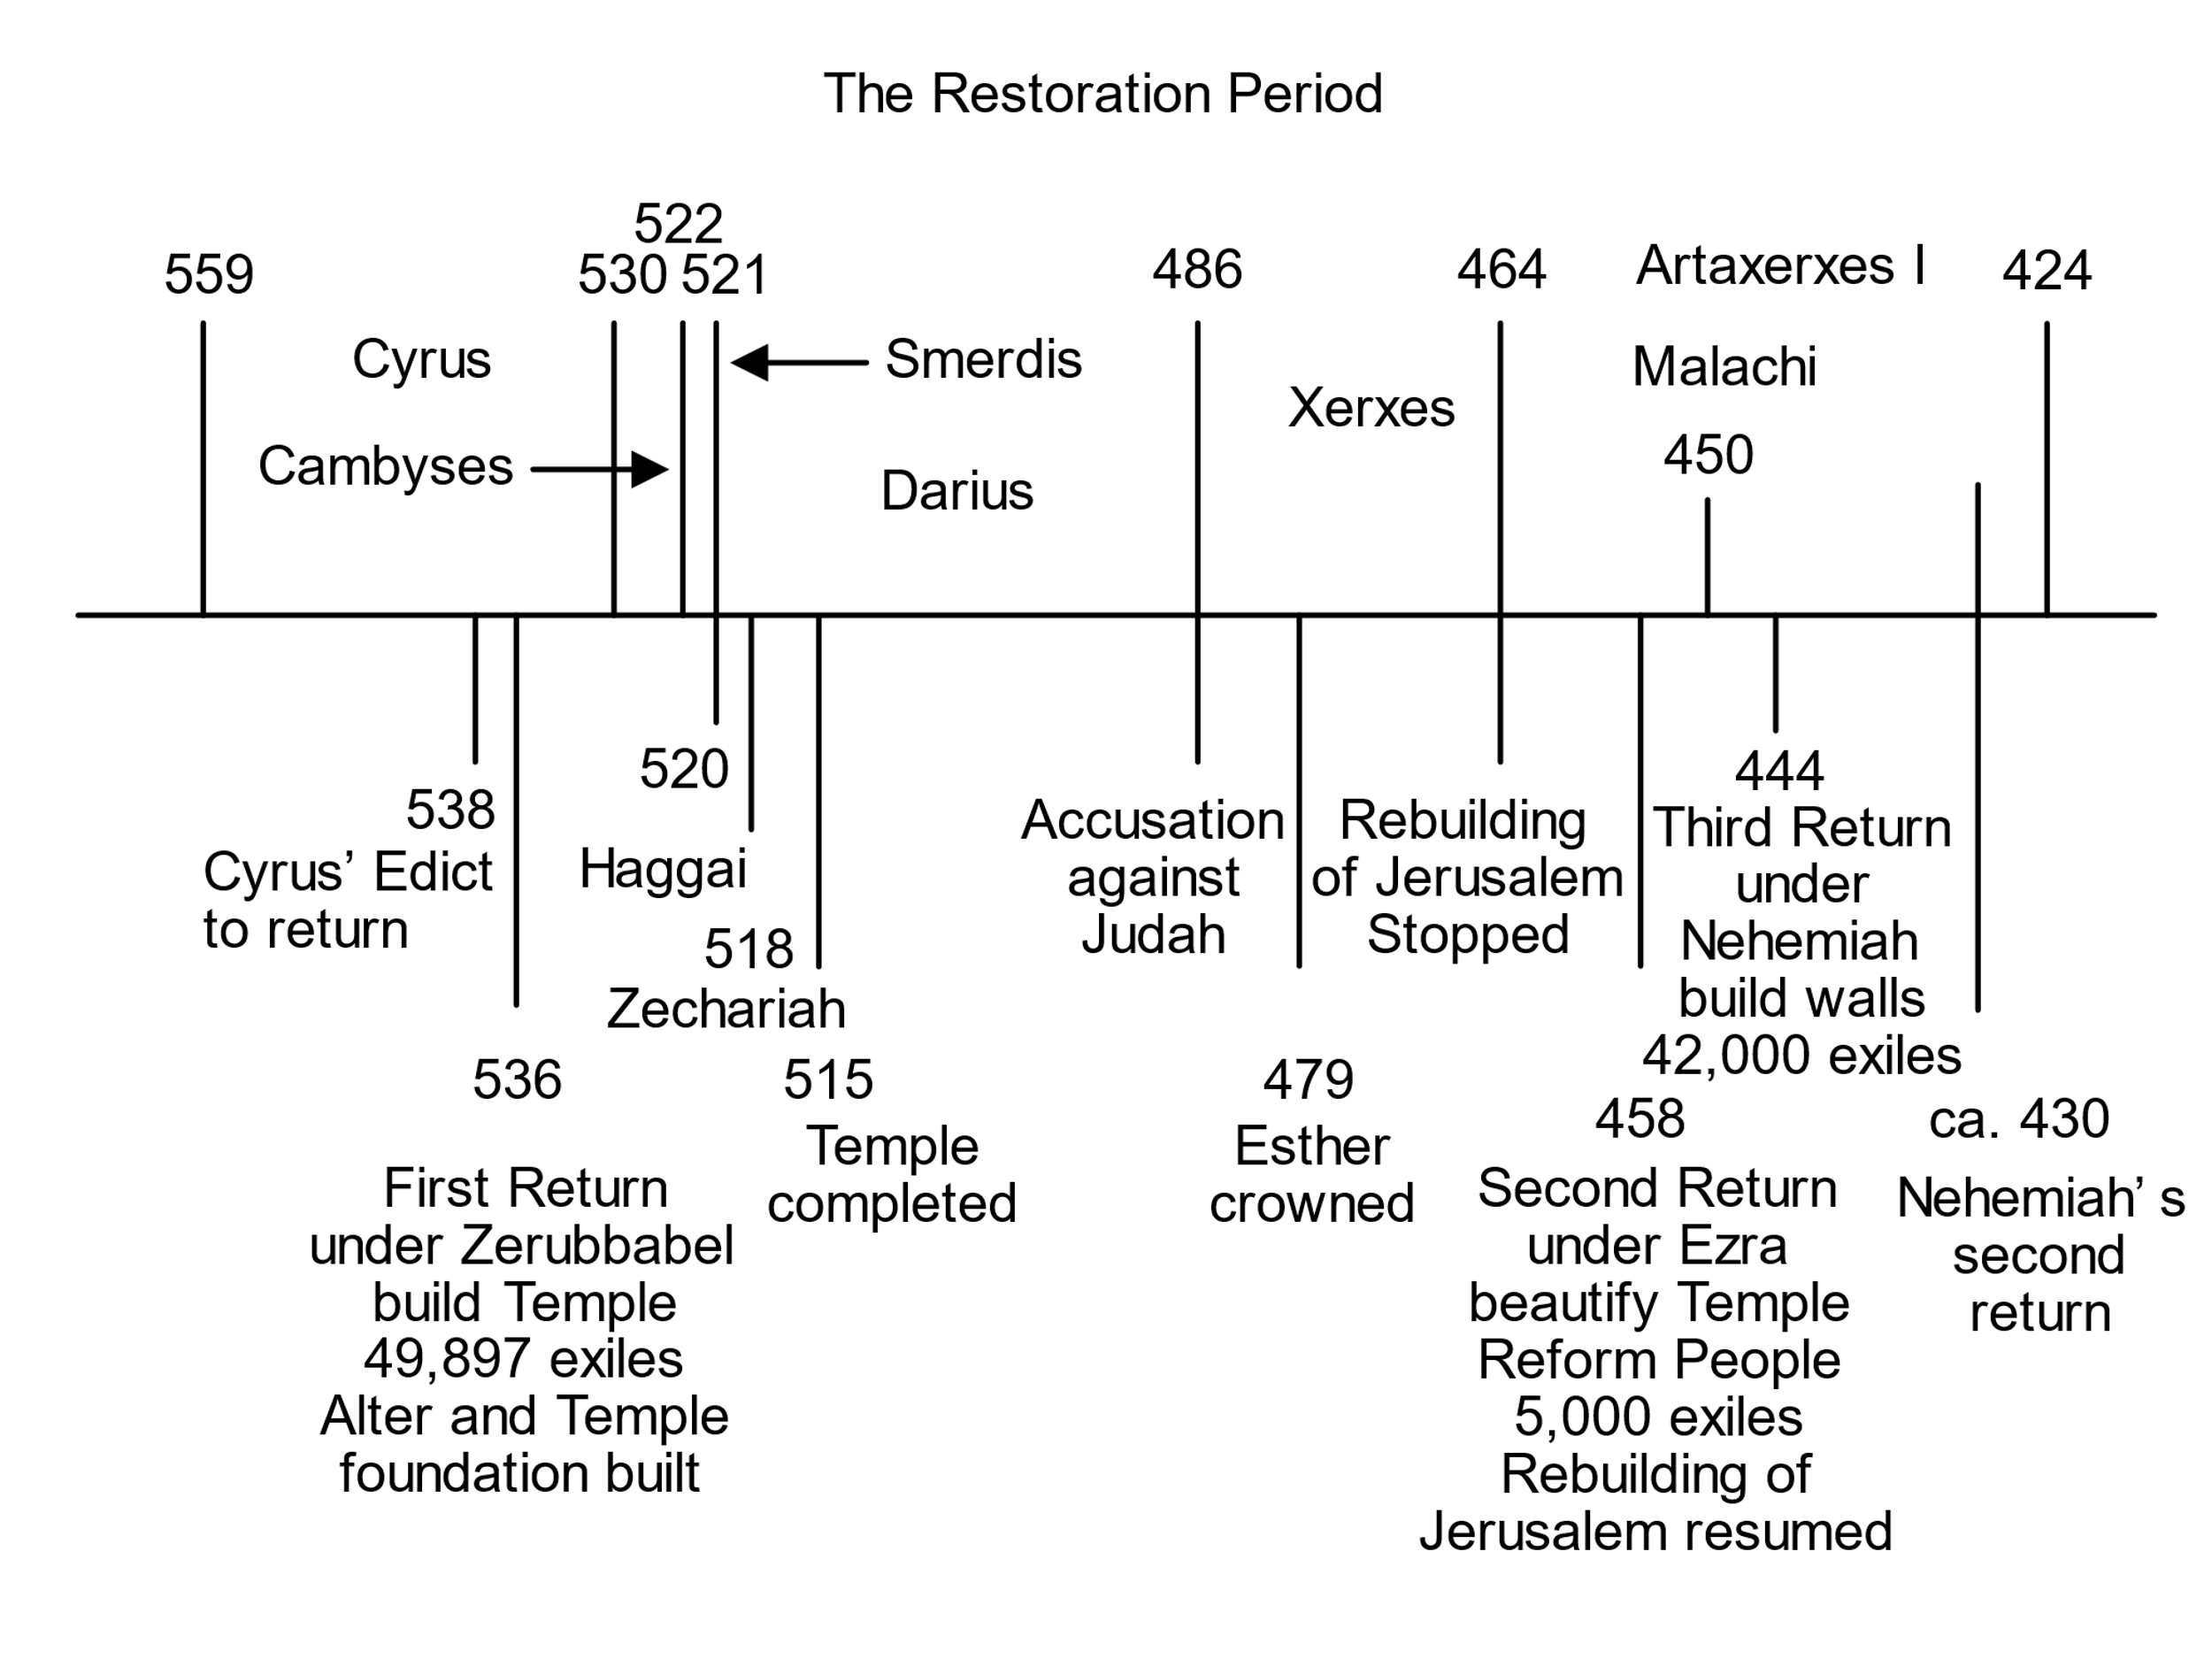
(Ahasueros)
Ezra 4:6-23
Ezra 4:1-5
+24

Slide 11
Ezra 4:6-23
Read Ezra 4:6-24!
A libelous letter by Rehum the commander and Shimshai the scribe to king Ahasuerus (Xerxes).
A king who did not know Cyrus’ decree, just as a new king arose in Egypt who did not know Joseph (Exodus 1:8).
Escalation: the enemy’s lie becomes apparent that they did not want to build the temple together with the Jews.
As the people of God we must be prepared for the enemy to escalate the situation.
A glimmer of hope can be seen in verse 21: the building of the wall ceases, but is not taken down. It can still be built at a later command.

Slide 12
Ezra 5: the building resumes
Read Ezra 5:1-17!
The building of the temple ceased due to a decree of a king.
But who should we listen to, man or God?
Read Acts 5:26-29!
Westminster Confession XXIII.4. It is the duty of people to pray for magistrates, to honour their persons, to pay them tribute or other dues, to obey their lawful commands…
This is a time not to obey the governing authorities!

Slide 13
The prophecy of Haggai
What is the prophecy of Haggai all about? (Buy two get one free)
Verses 1:3-9 are the core of this prophecy:
The refugees are busy building up their own existence.
Everyone is at his own house, but the house of the Lord lies in ruins.
Paneled houses: not just simple huts.
They suffer want because they are not worshipping and glorifying God.
Q: Is this not the same as with us? Building our own future comes before the Lord at times.

Slide 14
Haggai
Read Malachi 1:8 and Leviticus 22:19-23!
“But seek first the kingdom of God and His righteousness, and all these things shall be added to you.” (Matthew 6:33)
John 14:12-14: March 6 Bible study: God will bless us if we seek His glory first!
We should cast first our physical cares upon God first
See Lord’s Prayer to provide us our daily bread

Slide 15
The people are obedient
Haggai 1:12; 2:4-7: The Spirit of the Lord (here in the OT!) is with Zerubbabel and Jehozadak, the high priest to build the temple.
The people are obedient, and bring wood to build the Lord’s temple, which God blesses.
What is this word out of Egypt (verse 5)?
Exodus 19:4: eagle’s wings
Exodus 29:45-46: I will be their God
Out of Babylon is like out of Egypt
God reassures His remnant that He will always be with them, ever since the exodus from Egypt (even Abraham), He is keeping his vows to Israel.

Slide 16
The Lord is good!
Haggai 2:9: “‘The glory of this latter temple shall be greater than the former,’ says the Lord of hosts. ‘And in this place I will give peace,’ says the Lord of hosts.”
The Lord is good! He makes the end even better than the beginning.
The new creation will be greater in glory than the original creation.
What the locusts have eaten, the Lord can replenish in later days (Joel 2:25)
Job was blessed beyond measure in his latter days (Job 42:12-17)
Read 1Kings 8:46-53!
Solomon’s prayer for his people after the first temple had been built, which is now being heard by God!

Slide 17
The prophecy of Zechariah
Zechariah 2:5: Even though Jerusalem has no wall yet, the Lord Himself will be like a wall of fire around His people.
Q: Where else did the Lord appear in the form of fire?
Read Zechariah 4:6-10!
This is a behind the scenes look at God’s plan with the temple.
Verses 6 and 9: God knows the beginning and the end, He has declared that He shall begin building the temple and shall finish it.
There is nothing to stop the Lord!

Slide 18
The cornerstone
Verse 7: though the mountain be great, it shall be made flat. No adversary of the Lord can stand against Him.
The capstone, the chief cornerstone shall build His church.
“The stone which the builders rejected Has become the chief cornerstone.” (Psalm 118:22)
Jesus said to them, “Have you never read in the Scriptures:
‘The stone which the builders rejected Has become the chief cornerstone. This was the Lord’s doing, And it is marvelous in our eyes’? (Matthew 21:42)

Slide 19
Another inquiry: Ezra 5:1-5
Ezra 5:2: Zerubbabel and Jeshua continue building the temple, but again, difficulties arise.
Tattenai, the governor and Shethar-Boznai come to inquire (v. 3-5).
These are different men than the surrounding people.
Apparently, their inquiry is less malevolent.
Since the Jews had postponed building the temple, this activity seems unusual, if not strange in the governor’s eyes.

Slide 20
The report: Ezra 5:6-17
The report from Ezra 4:12-14 was an evil report, claiming that thew Jews would again rebel against Babylon.
But Ezra 5:11-17 (v. 12) says that the temple was destroyed because the Jews had rebelled against God and provoked Him to wrath.
They were building the temple not for war, but for worship.
The introduction to the king of Babylon mentions that the temple is being built to the great God of the Jews (verse 8)

Slide 21
Ezra 6: The king’s response
Read Ezra 6:1-14!
A favorable response:
Just like before, the temple is built at the king’s expense with his own taxes.
Bulls, rams, lambs, wheat, salt, wine, oil for their sacrifices.
Whoever hinders the building of the temple shall be prosecuted.
Hanged, destroyed
The building of the temple thus prospers through the prophecy of Haggai and Zecharaiah.

Slide 22
Ezra 6: the temple rebuilt
It was God’s determined plan to rebuild His temple.
“And he built the inner court with three rows of hewn stone and a row of cedar beams.” (1Kings 6:36)
“with three rows of heavy stones and one row of new timber. Let the expenses be paid from the king’s treasury.” (Ezra 6:4)
And both temples were financed from the king’s treasury!
Furthermore, in verse 5 the most precious gold and silver articles were also restored.
God provides the ways and the means to fulfill His plan for us to carry out.

Slide 23
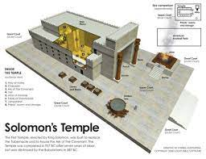
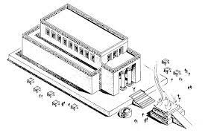

Slide 24
An exhortation
“What then shall we say to these things? If God is for us, who can be against us? He who did not spare His own Son, but delivered Him up for us all, how shall He not with Him also freely give us all things?” (Romans 8:31-32)
“And I also say to you that you are Peter, and on this rock I will build My church, and the gates of Hades shall not prevail against it.” (Matthew 16:18)
The church started with only twelve apostles!
God is our greatest resource, and we must not trust in men, horses, chariots, or kingly decrees, because they may change.

Slide 25
Who is the real king?
“Therefore I exhort first of all that supplications, prayers, intercessions, and giving of thanks be made for all men, for kings and all who are in authority, that we may lead a quiet and peaceable life in all godliness and reverence.” (Proverbs 21:1)
In Daniel 2 we see that God can still speak to King Nebuchadnezzar in his dream, and give the interpretation of it by his servant, Daniel.
Thus God can turn the heart of kings Cyrus and Darius to favor the Jews (Ezra 6:22).
Whether the political situation is for/against us, we need not fear man, but God.

Slide 26
Threats thwarted
Stones, timber, gold, silver, animals, wheat, salt, wine and oil were all to be diligently provided to the Jews so that they could build up the temple without interference (6:8-10), on pain of death (6:11-12).
Esther 7:9-10; 8:7: Haman, the great enemy of the Jews is hanged for trying to kill the Jews.
6:10: So that sacrifices and prayers would be offered to the king and his sons.
“Therefore I exhort first of all that supplications, prayers, intercessions, and giving of thanks be made for all men, for kings and all who are in authority, that we may lead a quiet and peaceable life in all godliness and reverence.” (1Tim. 4:1-2)

Slide 27
The temple is complete!
Read Ezra 6:15-22!
Phase 1, the temple is complete, with great celebration (700 animals sacrificed)
It was only the remnant that came back (see Ezra 1), who were able to celebrate the dedication with joy
Verse 21: the ones who kept themselves from the filth of the nations
Others, nominal Jews remained in Babylon
Imagine, some of the older people coming back who had memories of the house of the Lord. Q: how would you have felt?
A foretaste of the kingdom of heaven! (Revelation 20-22)

Slide 28
Ezra the scribe enters (Ezra 7)
A skilled scribe in the Law of Moses.
Jewish tradition holds him to be a second Moses.
From Moses to Moses there was none like Moses
“MiMoshe L’Moshe ein k’Moshe”
Another parallel with Exodus.
All things he requested were given to him by the king.
He had prepared his heart to
Seek the Law of God (knowledge)
To do it (practice)
And to teach it (pass it on)

Slide 29
Ezra’s ministry
Q: Why was Ezra important?
Only a remnant of the Jewish people had come home from Babylon after many, many years.
Remember, the majority of the Jews wanted to stay in Babylon.
Two generations grew up under secular influence.
The Jewish faith was very vulnerable at this time and someone was needed to keep the faith alive.

Slide 30
Comparison with another situation
Two generations of people went through Communism in Hungary/Eastern Block
It eroded the faith of many, and a “remnant” here also survived
In some places, the old church buildings and schools were returned by the state to the churches.

Slide 31
The good hand of God
The narrative switches to Ezra’s personal narrative of events in ch. 7.
Ezra received:
Authorization to worship as the Jews pleased
Costs of sacrifices covered + Temple vessels
Supplies
Exemption from taxation
Authorization to set up a judicial and punitive system
V. 27: “Blessed be the Lord God of our fathers, who has put such a thing as this in the king’s heart, to beautify the house of the Lord which is in Jerusalem”
Proverbs 21:1: “The king’s heart is in the hand of the Lord, like the rivers of water; he turns it wherever He wishes.”

Slide 32
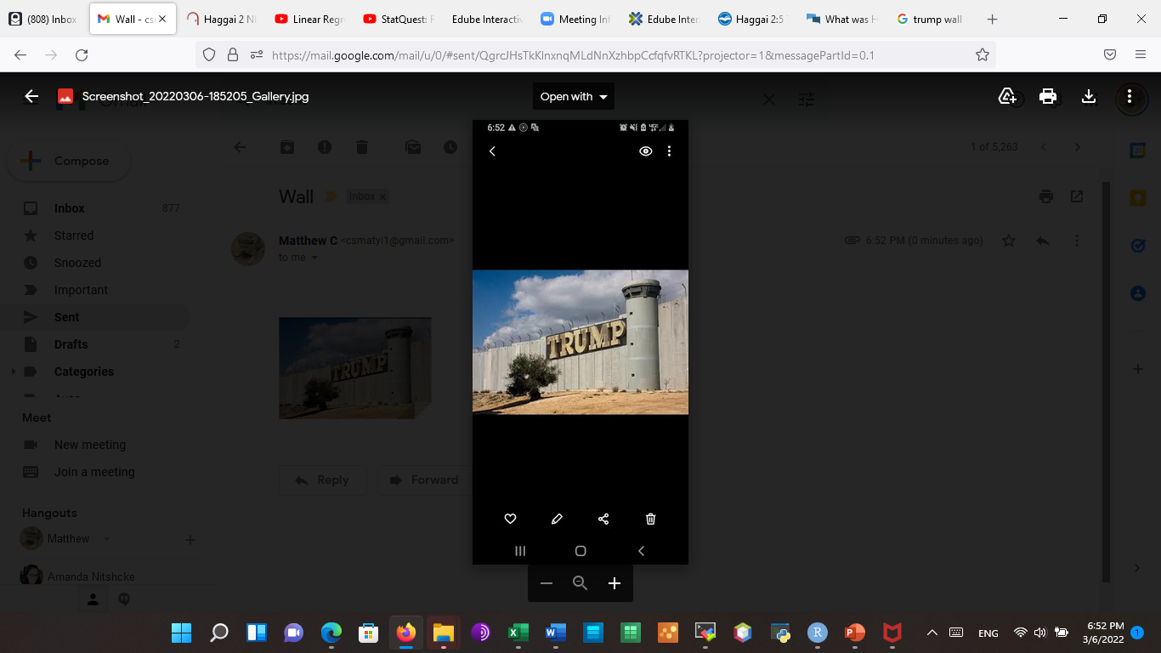

Slide 33
How much can a wall help?
The wall itself cannot save a people, because the greatest resource of a city are the people itself within it.
50 brave soldiers are worth more than 500 cowards
Read 2Samuel 5:6-7!
“Unless the Lord builds the house, They labor in vain who build it; Unless the Lord guards the city, The watchman stays awake in vain.”
(Psalm 127:1)

