Slide 1
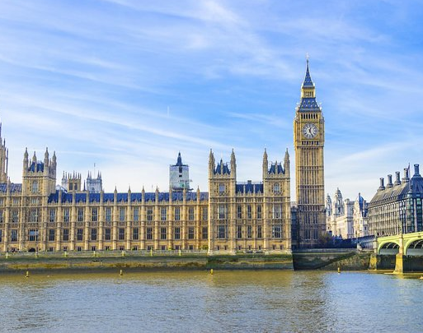
Westminster Shorter Catechism
Questions 86-87, 85 & 88
December 12+19, 2021
Calvary OPC, La Mirada, CA

Slide 2
Continuing the ordo salutis
Faith & Repentance (F)
Justification (J)
Sanctification (S)
Glorification (G)
Regeneration (R)
Adoption (A)
Election (E)
Calling (E)
Lifetime of believer
Historia salutis: the history of salvation; ordo salutis: salvation applied

Slide 3
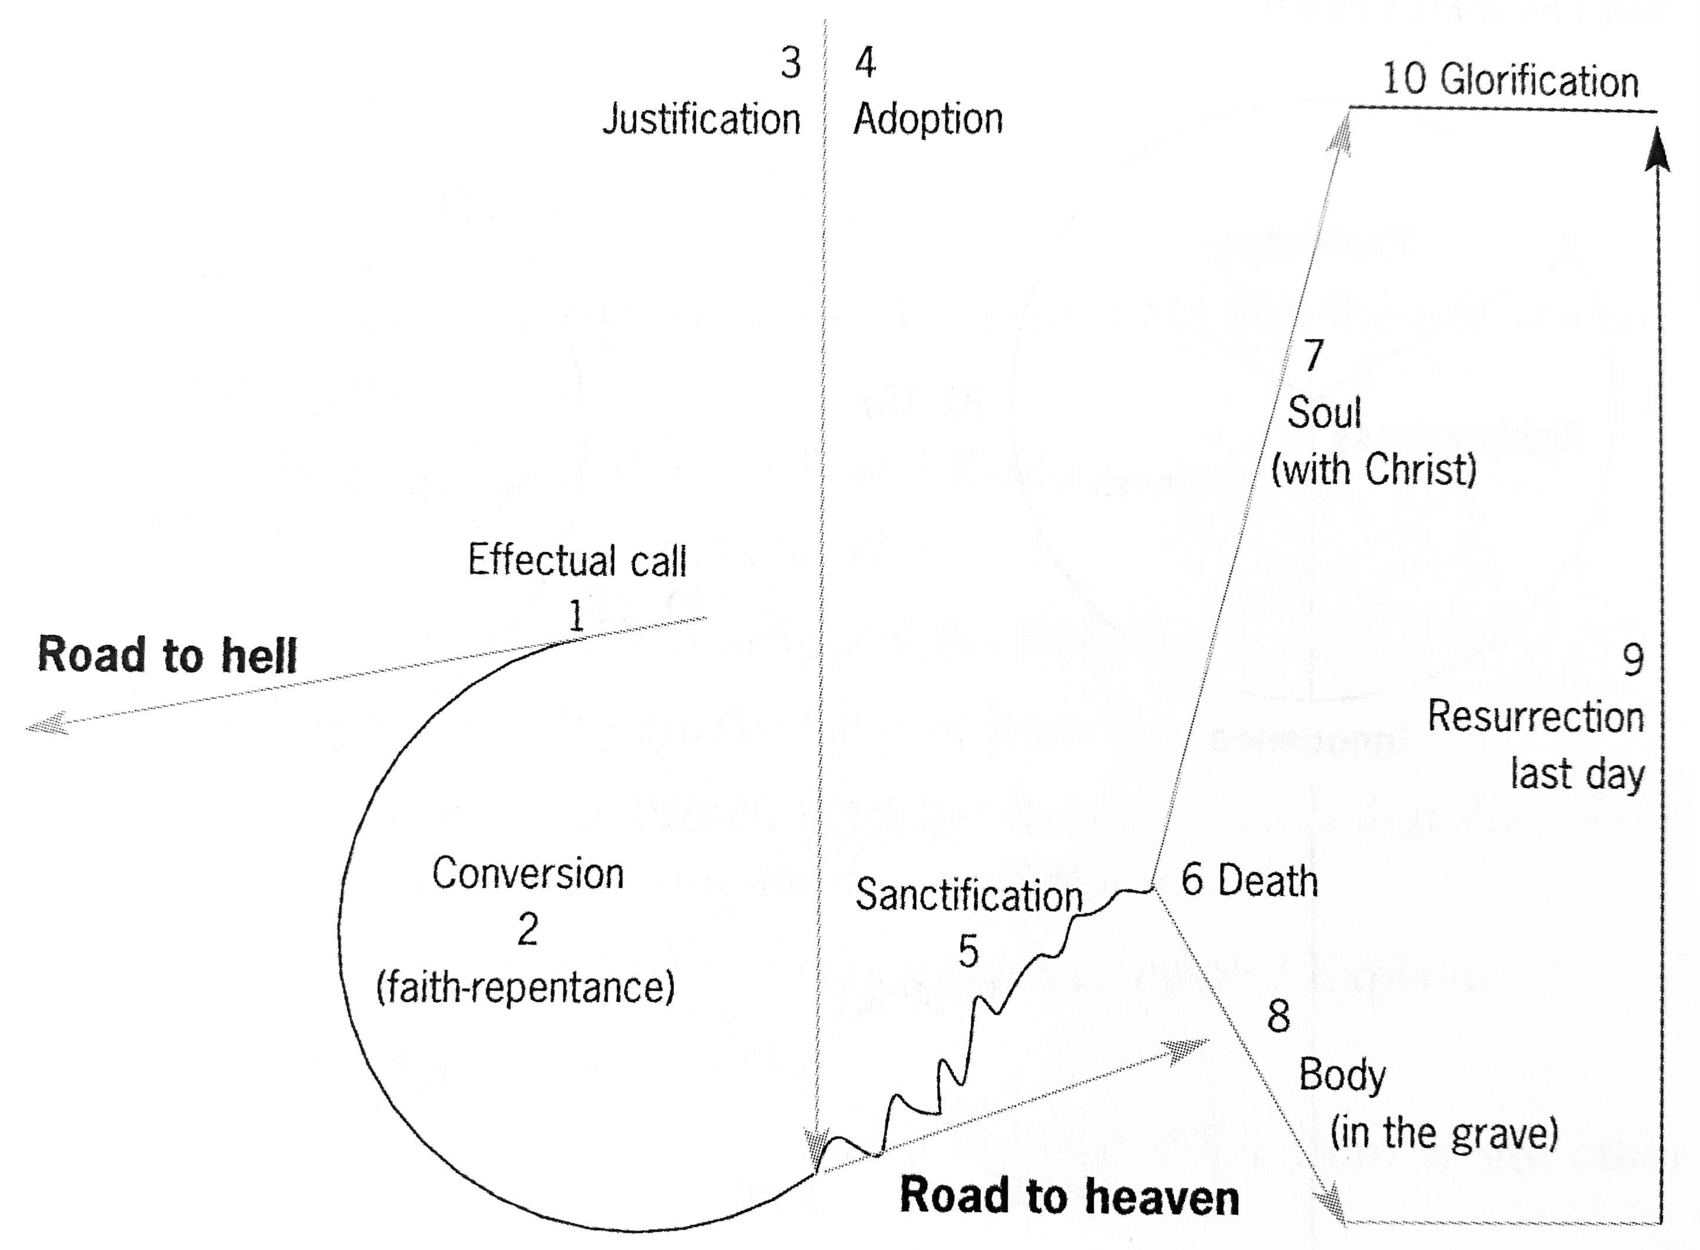

Slide 4
Question #86
Q. What is faith in Jesus Christ?
A. Faith in Jesus Christ is a saving grace, whereby we receive and rest upon him alone for salvation, as he is offered to us in the gospel.

Slide 5
What does the Bible say?
“For by grace you have been saved through faith, and that not of yourselves; it is the gift of God.” (Ephesians 2:8)
“But as many as received Him, to them He gave the right to become children of God, to those who believe in His name” (John 1:12)
“knowing that a man is not justified by the works of the law but by faith in Jesus Christ, even we have believed in Christ Jesus, that we might be justified by faith in Christ and not by the works of the law; for by the works of the law no flesh shall be justified.” (Galatians 2:16) [Sola fide!]

Slide 6
Question #87
Q. What is repentance unto life?
A. Repentance unto life is a saving grace, whereby a sinner out of a true sense of his sin, and apprehension of the mercy of God in Christ, doth, with grief and hatred of his sin, turn from it unto God, with full purpose of, and endeavour after, new obedience.

Slide 7
What does the Bible say?
“When they heard these things they became silent; and they glorified God, saying, ‘Then God has also granted to the Gentiles repentance to life.’” (Acts 11:18)
“Now when they had heard this. They were pricked in their heart, and said… what shall we do? … Then Peter said, Repent…” (Acts 2:37-38)
“Then shall ye remember your own evil ways… and shall loathe yourselves in your own sight…” (Ezekiel 36:31)
“For, behold… ye sorrow after a godly sort… In all things ye have approved yourselves to be clear in this matter.” (2Corinthians 7:11)

Slide 8
Conversion, repentance and faith
Regeneration precedes conversion and is 100% the work of God, and happens only once.
Conversion means turning around, from sin to Christ.
We need to remove sin but put something else in its place
Two aspects of conversion:
Repentance from faith (negative aspect)
Faith in Christ (positive aspect)
Conversion is a work of both man and God, and primary conversion (conversion actualis prima) occurs also only once, but a man may ‘convert’ or return to God more than once

Slide 9
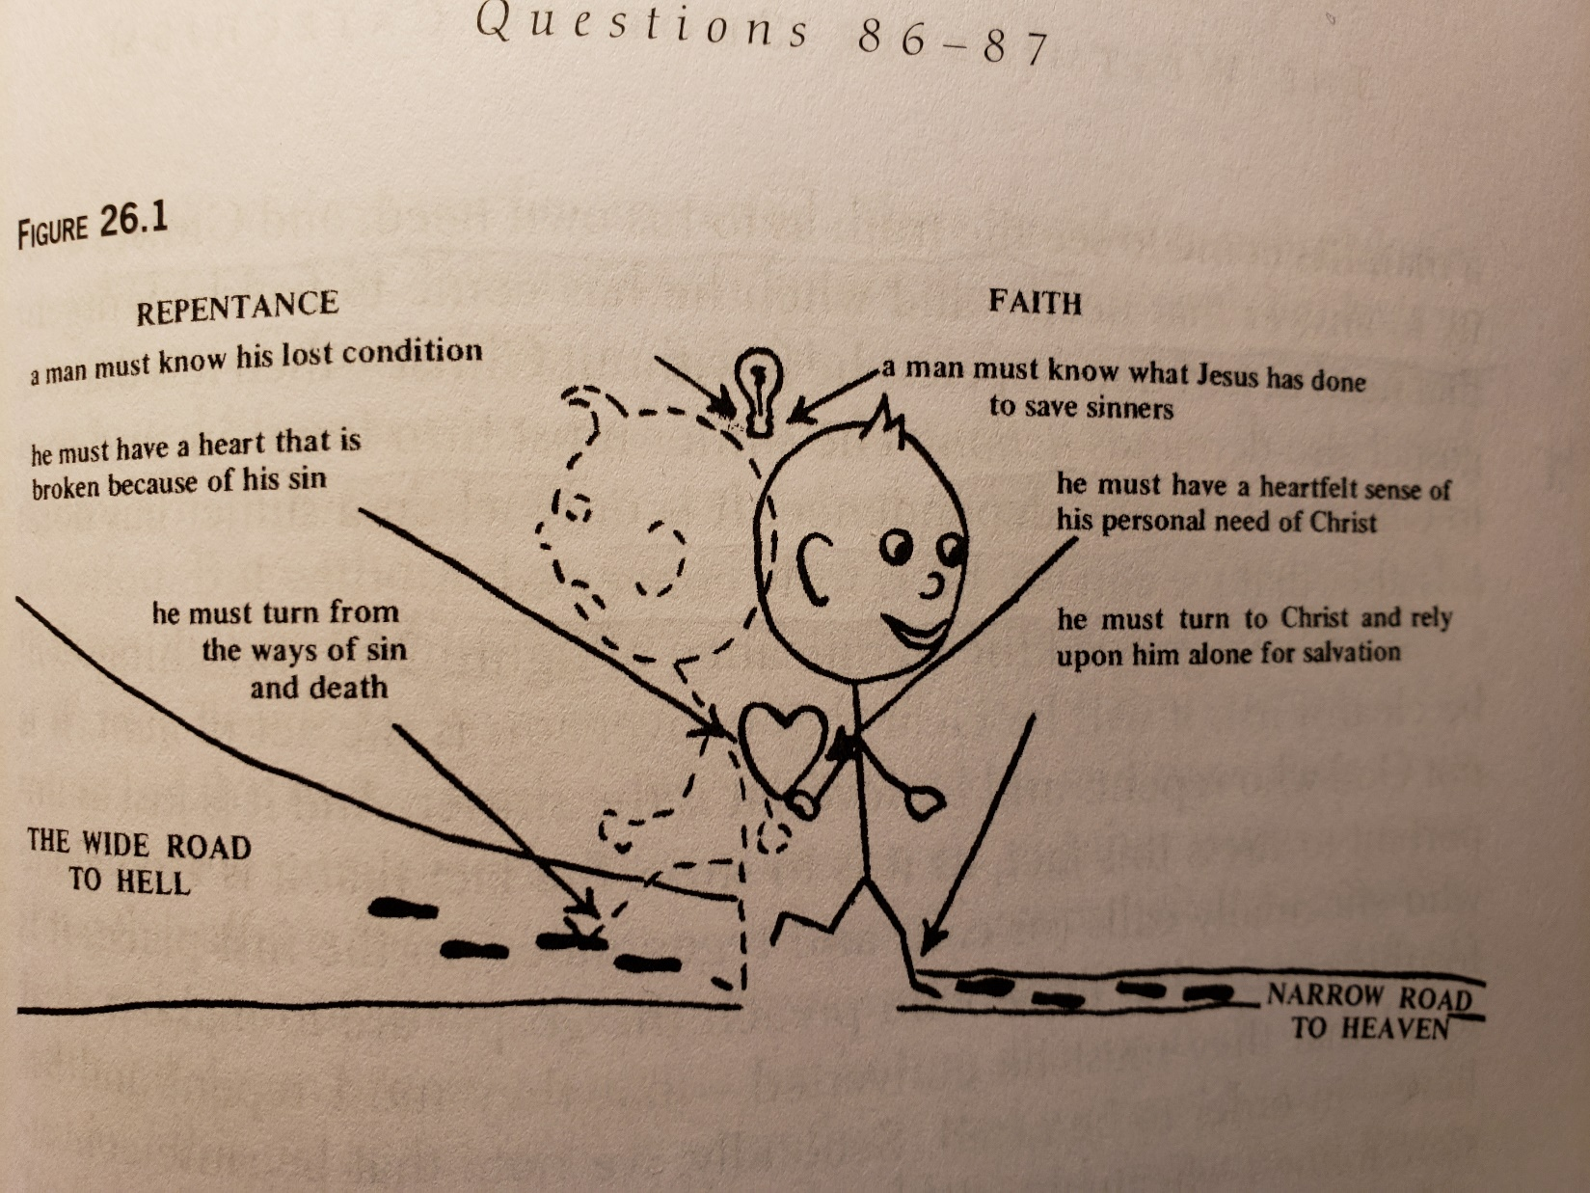
Faith and repentance
Intellect
Emotion
Volition

Slide 10
The levels of faith
Faith has three levels, and all must be present to constitute true faith
Factual knowledge (notitia)
Assent (assensus)
Trust (fiducia)
Factual knowledge of the gospel: a man may sincerely abhor his sin and long after heaven but how can he be saved if he knows not Christ?
So then faith comes by hearing, and hearing by the word of God. (Romans 10:17)

Slide 11
The elements of faith
Assent to the gospel: We must believe that the gospel is factually true.
Faith is not merely assent to the teachings pf the church (Rome)
You believe that there is one God. You do well. Even the demons believe—and tremble! (James 2:19)
A great stumbling block nowadays to faith is evolutionism
Receiving Christ: We must take the step to receive Christ into our hearts by faith
It is putting one’s trust in Christ
“But as many as received Him, to them He gave the right to become children of God, to those who believe in His name” (John 1:12)

Slide 12
Faith is an instrument
Ephesians 2:8-9 states that we are saved by faith.
Q: Is the reception of faith active or passive?
Arminians, Wesleyans and Lutherans say that we need to perform an act of faith in order to be saved
A life of “evangelical obedience”
But remember Ephesians 2:8-9 says that faith is not of ourselves.
Verse 10: God even prepared good work for us to walk in them.
Acts 11:18 also says that God grants us repentance.
Therefore faith is not the reason or the grounds of our salvation, but rather a passive instrument.

Slide 13
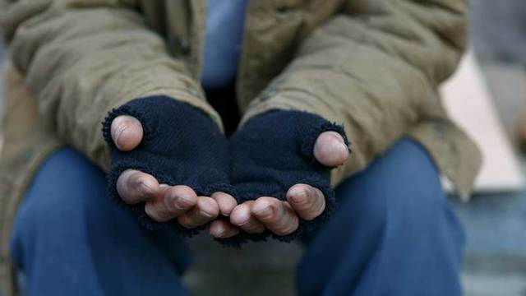
FAITH

Slide 14
Man’s work, God’s work
Faith is an act of man, one must be having faith in order to be saved.
But we have faith ultimately because God is working in us
Acts 11:18; Ephesians 2:8; Philippians 2:12-13
Faith is only the beginning of repentance and sanctification
We must repent and turn to God daily, we cannot coast.

Slide 15
How do people come to faith?
Some people say you absolutely have to remember the time and the day when you came to faith
Just as a baby is born, he realizes that he has come into the world
Q: Is this always true, or can people experience faith in other ways?
The image of a newborn may not reflect true faith 100%
We have salvation not by experience, but rather by faith: “Now faith is the substance of things hoped for, the evidence of things not seen.” (Hebrews 11:1)
Read 2Peter 1:10
For some people, it is a process to tease out the basics of the Gospel
Jesus’ very own disciples did not understand for a long time what Jesus said!

Slide 16
Coming to faith
Q: What about people who say they always knew Jesus and can’t point to an experience?
People can be saved even in the womb! (i.e. Andras Czanik)
Someone can be regenerated before or after being born; God is sovereign in this
As to what happens in the womb between God and an unborn fetus is a mystery, we should be concerned about our own faith.

Slide 17
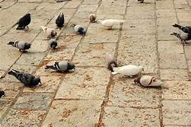
Different kinds of faith
Read the parable of the Sower: Matthew 13:1-23
Non-faith
Hardened unbelievers who are unresponsive to the Gospel: scoffers, liberals, atheists
“For we are the aroma of Christ to God among those who are being saved and among those who are perishing, to one a fragrance from death to death, to the other a fragrance from life to life.” (2Cor. 2:16-17)
We should not give up on these people
John Newton: Amazing Grace

Slide 18
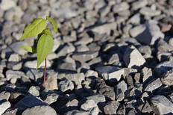
Different kinds of faith
Temporary, enthusiastic faith
They receive the Gospel with great joy
But when persecution comes, they fall away immediately
Neither do they have broad understanding
Their roots are shallow in bad soil
Miracle faith is also temporary

Slide 19
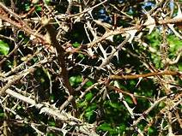
Different kinds of faith
Choked faith (thorns)
People who are overcome by the many cares of this world.
People who may believe for a time, but money, career, material things get in the way of Bible reading, and prayer
Some people are torn from the faith because of this
Demas, 2 Timothy 4:10, who forsook Paul because he loved the present world

Slide 20
Different kinds of faith
True faith
One hears the good news, understands it accepts it and then also acts upon it (all three levels are present: knowledge, assent, trust)
Faith then also brings fruit in their lives, some less, some medium, some much fruit (Matthew 13:8)
The Holy Spirit will keep them in trials, temptations and even persecution
A true believer loves God but also his brothers and sisters and God’s Word
Characterized by
godly sorrow for one’s sins (Psalm 51:2),
and not worldly sorrow (being sorry one was caught in the act)

Slide 21
The “second conversion”
Some people may even undergo a “second conversion”
This happens when their faith is strengthened in great measure
A life-changing experience
Freedom from a particular besetting sin
Recognition of a great truth
Isaiah 6:1-10: Isaiah beheld the Lord in His throne room, in all of His glory, something not given to many men
Call to the creation ministry (it can happen to regular people like you and me)
Q: Has anyone had such a second conversion?

Slide 22
False faith
“They went out from us, but they were not of us; for if they had been of us, they would have continued with us; but they went out that they might be made manifest, that none of them were of us.” (1John 2:19)
Faith is not merely turning over a new leaf: this is only trying to become a better person without the Holy Spirit
We cannot continue in sin: “Whoever has been born of God does not sin, for His seed remains in him; and he cannot sin, because he has been born of God.” (1John 3:9)
False believers fall into error or heresy
They covet gifts, not God Himself
Simon the magician (Acts 8:13-23)

Slide 23
Faith and works
Read James 2:14-26
We are saved by faith alone but not by a faith that stands alone.
Faith is perfected by good works, and we need to produce fruits
Motivationally: We do not do good works to get saved; we do good works because we are saved.
Good works are not
Our own idea
Not done in blind zeal
Compare Genesis 15:6 and Genesis 22: Abraham had faith and it was accredited to him as righteousness, but his faith showed forth in good works (that he was ready to even sacrifice his only son)

Slide 24
☺ Sunday School Test!!! ☺
Two weeks from now we will have a test on all of the ten commandments
Not mandatory, but very highly super encouraged
80% gets you a copy of “Atheism Unravelled”! ☺
Questions 45-81
All power points are available for study at https://github.com/csmatyi/calvary_sunday_school
https://drive.google.com/drive/u/0/folders/1a3eqGjJ-4pE5zd2tCza58RbBLuCjPYtd
Bible verses for memorization: Exodus 20:3-17 (the text of the Ten Commandments)

Slide 25
Question #85
Q. What doth God require of us, that we may escape his wrath and curse due to us for sin?
A. To escape the wrath and curse of God due to us for sin, God requireth of us faith in Jesus Christ, repentance unto lofe, with the diligent use of all the outward means whereby Christ communicateth to us the benefits of redemption.

Slide 26
What does the Bible say?
“Testifying to Jews, and also to Greeks, repentance toward God and faith toward our Lord Jesus Christ. ” (Acts 20:21)
“Therefore, brethren, be even more diligent to make your call and election sure, for if you do these things you will never stumble;” (2Peter 1:10)
“teaching them to observe all things that I have commanded you; and lo, I am with you always, even to the end of the age.” (Matthew 28:20)

Slide 27
Inward and outward means of grace
Remember Q86, which says that faith is an act of God’s grace whereby God regenerates us and brings us to repentance (Acts 11:18)
These are inward graces, but there are outward graces as well!
The Word
Sacraments
Prayer
(Fellowship)
These outward means are channels by which we receive the benefits

Slide 28
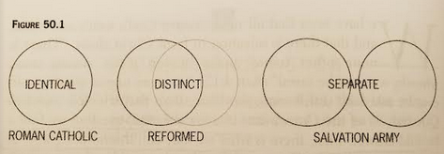
Differing views on the outward means
Church is a storehouse of grace
No sacraments, only the Word

Slide 29
Roman Catholic sacramentalism
Rome interjects herself between the believer and God
Infallible interpretation of the Scriptures
A storehouse and dispenser of grace
Baptismal regeneration: all babies properly baptized have the stain of original sin removed, and places them back into the state where Adam was before the Fall
The Eucharist: a true medicine that can protect against committing sins (magical properties) [reference CCC]
Penance: the Roman priest believes that he truly can forgive sins

Slide 30
Roman Catholic sacramentalism
Rome overemphasizes the outward means
She claim to be Christian because of outward means
“For he is not a Jew who is one outwardly, nor is circumcision that which is outward in the flesh; but he is a Jew who is one inwardly; and circumcision is that of the heart, in the Spirit, not in the letter; whose praise is not from men but from God.” (Romans 2:28-29)

Slide 31
Modern evangelicalism
Sacraments deemphasized: baptism, Lord’s Supper not central, only the Word.
God is not tied to sacraments and is not ruled by them, but God commanded us to observe the sacraments.
And Jesus came and spoke to them, saying, “All authority has been given to Me in heaven and on earth. Go therefore and make disciples of all the nations, baptizing them in the name of the Father and of the Son and of the Holy Spirit, teaching them to observe all things that I have commanded you; and lo, I am with you always, even to the end of the age.” Amen. (Matthew 28:18-20)

Slide 32
Modern evangelicalism
Modern evangelicalism such as the Salvation Army tends to separate the inward and outward means, the physical from the spiritual
The human body is both body and soul, material and immaterial
“So continuing daily with one accord in the temple, and breaking bread from house to house, they ate their food with gladness and simplicity of heart, praising God and having favor with all the people. And the Lord added to the church daily those who were being saved.” (Acts 2:46-47)
God’s blessing usually is seen in those churches that make use of all the means of grace: the Word and the sacraments and church discipline

Slide 33
The visible and invisible church
The invisible church is the church made up of all true, elect believers
This is its inward, saving essence
But these believers congregate into a visible church
An external administration, including the sacraments
Many modern evangelicals tend to separate the invisible church from the visible church, and this is why they de-emphasize the sacraments

Slide 34
Modern evangelical ecclesiastic errors
Since the visible and invisible church is separated from one another, this leads to several errors
Home church: neglect of the fellowship of other believers
“And the eye cannot say to the hand, ‘I have no need of you’; nor again the head to the feet, ‘I have no need of you.’” (1Corinthians 12:21)
In a typical month, 43 million people in the U.S. attend a home church (Barna poll, 2006 WorldNetDaily.com)

Slide 35
Modern evangelical ecclesiastic errors
The Lone Ranger Christian: neglects fellowship with the whole church, the sacraments and preaching
“If the foot should say, “Because I am not a hand, I am not of the body,” is it therefore not of the body?” (1Corinthians 12:15)
Such a person is in utter spiritual peril
Q: How would you counsel such a “Lone Ranger”?
Taking the Lord’s Supper in the inner circle of believers
Even Judas took part in the Last Supper (John 13:26)

Slide 36
Question #88
Q. What are the outward means whereby Christ communicateth to us the benefits of redemption?
A. The outward and ordinary means whereby Christ communicateth to us the benefits of redemption, are his ordinances, especially the word, sacraments, and prayer; all which are made effectual to the elect for salvation.

Slide 37
What does the Bible say?
“And they continued steadfastly in the apostles’ doctrine and fellowship, in the breaking of bread, and in prayers. ” (Acts 2:42)
“I planted, Apollos watered, but God gave the increase. ” (1Corinthians 3:6)

Slide 38
Sacrament or ordinance?
Sacrament: Latin: a pledge, or oath of allegiance (in a military sense).
Ecclesiologically it means something sacred.
Greek mysterion: something unknown until it is revealed.
The use of the word ordinance or sacrament are both acceptable.
The word sacrament may itself not be in the Bible, but neother is the word Trinity.

Slide 39
Diligent use of the outward means
Neither should we overemphasize the sacraments, nor should we underestimate them
As in Leviticus God ordained that Israel should meet God at the tent of meeting at regular times
So should we come regularly to worship every Lord’s Day
Fourth Commandment
“not forsaking the assembling of ourselves together” (Hebrews 10:25)
God is a God of order and regularity
We do not have to go here and there and seek spiritual delicacies, God can be found at church

Slide 40
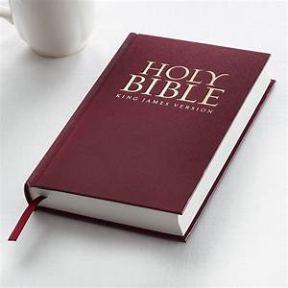
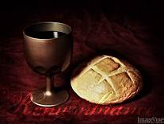
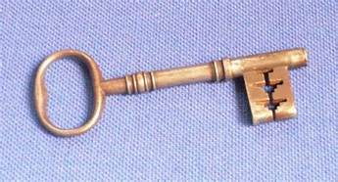
The order of importance
Word, sacraments, prayer, discipline
The Word is primary, because it defines most objectively the doctrine of the sacraments and all the other ordinances

Slide 41
How often should we take the Lord’s Supper?
Q: So, how often?
Only several times a year?
They argue that they don’t want to regularize it so that it becomes a meaningless ritual
However, it is still a channel of grace and they impoverish themselves if they don’t
Every week?
It is a sign of spiritual maturity of a congregation
It is better to examine yourself before you take the Lord’s Supper (we should examine ourselves every day!)
In the Lord’s Supper we meet Christ Himself, and it is only good if we meet with Him as much as possible

