Slide 1


Creation Research Society pre-conference workshop
Biology/Bioinformatics
Dr. Matthew Cserhati
July 24, 2025

Slide 2
Introduction
My last name is pronounced “chair – hat – tea”
Taught computer science at Concordia University Irvine for two years (Introduction to Bioinformatics).
Biology from a creation science perspective and loved it!! ☺
Worked in bioinformatics for 22 years in research, industry and academy.
Around 85 publications in secular and creation journals.
One of my main languages is R, besides Python, Linux and MySQL.

Slide 3
Workshop Overview
Workshop files at https://github.com/csmatyi/crs2025
What is the R programming language?
Downloading and installing the R Studio environment
R programming Basics
Downloading and using packages
Running the hybridogram and matrixcut packages
The molecular baraminology mtDNA protocol
Together with exercises!

Slide 4
What is the R programming language?
A widely used programming language in data analysis, bioinformatics, statistical computing and visualization.
Python has less syntax, but is easy to learn
In comparison, R has many specific functions, not hard to learn
Many, many packages used in bioinformatics
Bioconductor, bioMart
Website: The Comprehensive R Network (CRAN):
https://cran.r-project.org/

Slide 5
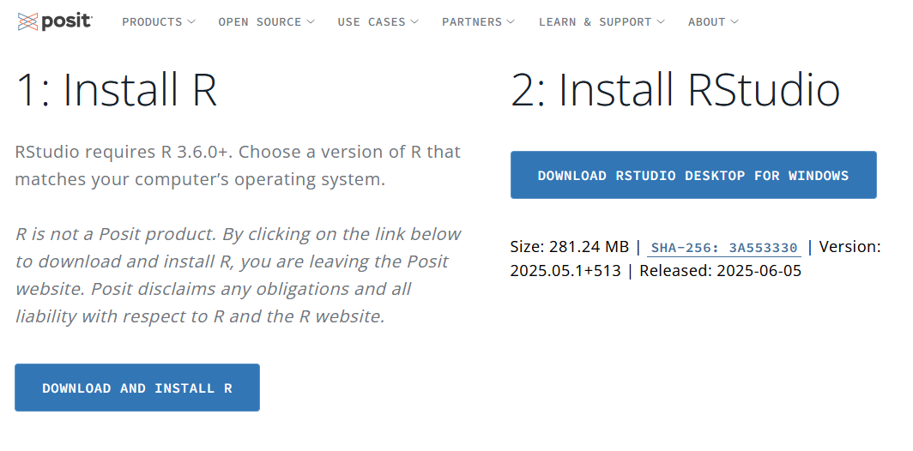
Download and install R Studio
https://posit.co/download/rstudio-desktop

Slide 6
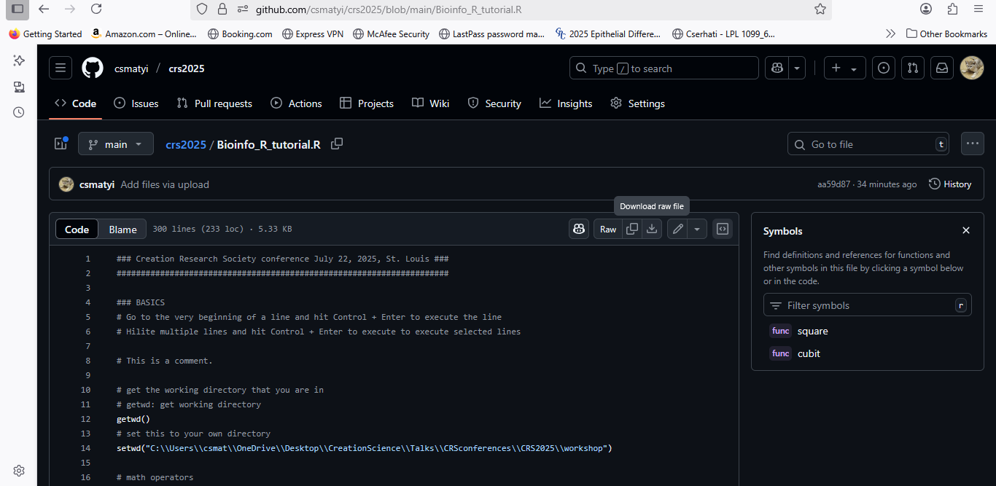
Download files from github

Slide 7
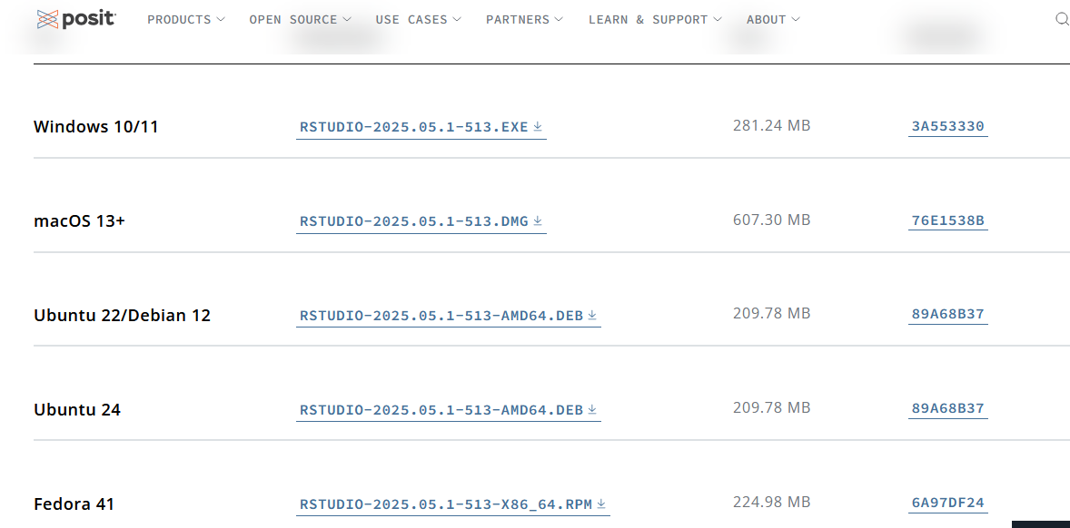
Mac users
First, install R at https://cran.r-project.org/
Then navigate to https://posit.co/download/rstudio-desktop/
Install the macOS 13+ version.

Slide 8

Posit Cloud
Very good for collaborators.
If you work in R on a team, try out Posit Cloud (posit.cloud), which is an online version of R Studio.
(It also supports Python programming)
Save your code, data, result files online for others to use.
(Mac users! If installing R Studio doesn’t work, use this)

Slide 9
Elementary code in R
Math operators
Data types
Variables, variable assignment
Functions
String manipulations
Getting help
Lists and matrices, data frames
Functions
Switch to Bioinfo_R_tutorial.R

Slide 10
Applying functions to lists and data frames

Slide 11
Applying functions
Once we have started to work on complex data types (lists, matrixes, data frames), we can apply functions to them.
Quick and effective, uses a single line of code!
Four classes of function application to data sets:
apply
lapply
sapply
mapply

Slide 12
apply
The ‘apply’ command runs a provided function
Apply has three parameters:
Data set (a matrix)
A number: 1 for applying function to rows, 2 for applying to columns
The function itself
Results shown for each column/row
The function can be:
A built-in R function
A previously defined function by the user
A lambda function (defined in-situ in the apply code)

Slide 13
lapply, sapply
‘lapply’ means ‘list apply’, meaning that the function is executed on all members of a list.
Its output is a bit unwieldy, showing a result for each element of the list.
‘sapply’ is the exact same thing as lapply, except that it provides the result for each list element as a simple, one line list.
Parameters: input, and function
Beware! If you provide a matrix as the input, lapply and sapply will flatten the result into a single list.

Slide 14
mapply
‘mapply’ allows the user to provide simple or line-by-line output (as seen in sapply or lapply)
Parameters: function, data, SIMPLIFY=T/F
Set SIMPLIFY=TRUE to get list output
Go back to Bioinfo_R_tutorial.R

Slide 15
Working with packages

Slide 16
Packages
R packages contain pre-written code you can use in your script.
For this you must download, install and then load these packages.
You can do this in several ways:
Download via Internet
From a package file on the desktop
From github
Using the BioConductor package manager

Slide 17
Install via Internet
The simplest way to install a package.
install.packages(“package name”)
(Multiple packages: install.packages(c(“pkg1”,”pkg2”)) )
This command will download all the files for the package.
You must only install the package once; it will be available afterwards.
Load the package: library(“package name”)
Run installed.packages() to check which packages are already installed on your computer.

Slide 18
Install from source
You can download R packages in tar.gz format from the CRAN website.
At https://cran.r-project.org/ click on ‘Packages’ on the left panel, then “Table of available packages, sorted by name”, then search for your package.
We will download, install and use the ‘hybridogram’ package at
https://cran.r-project.org/web/packages/hybridogram/index.html
install.packages(“path/to/package.tar.gz”,repos=NULL,dependencies=TRUE type=“source”)

Slide 19
Installing from source
install.packages("hybridogram_0.3.2.tar.gz",repos=NULL,dependencies=TRUE,type="source")
Parameters:
Archived package file
Repos=NULL: not downloading from online repository
Dependencies=TRUE: Installing all dependent packages
Type=“source”: installing from source file

Slide 20
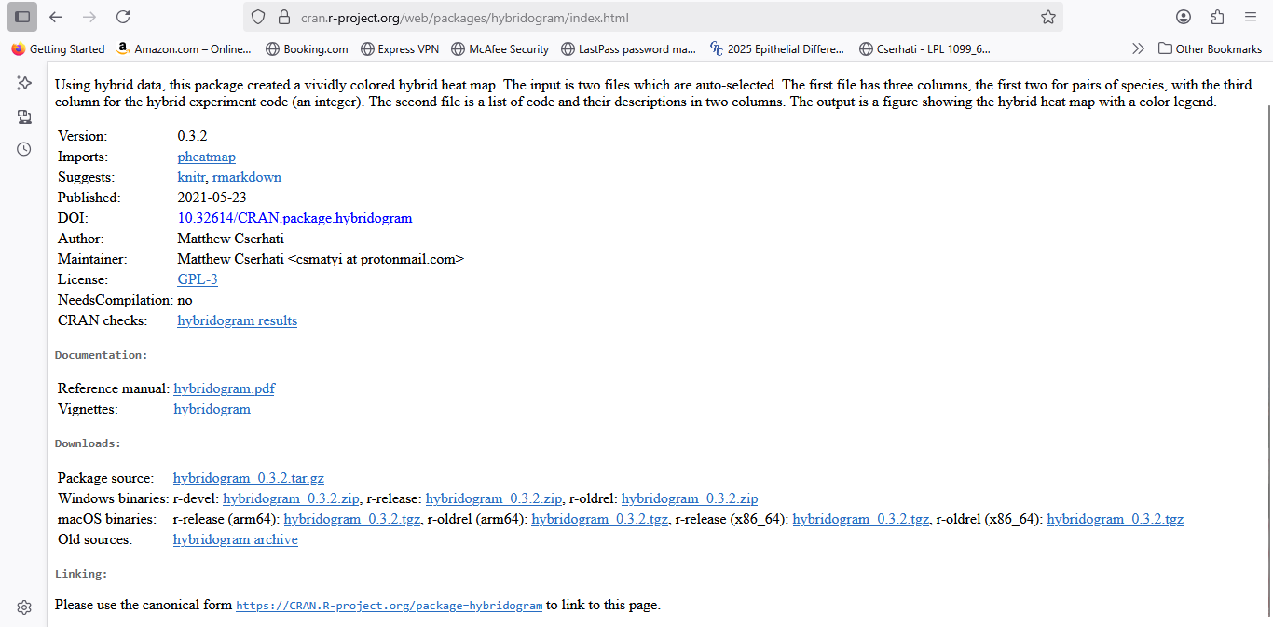
Save this file and then copy the absolute path to it on your computer into the install.packages command.
hybridogram_0.3.2.tar.gz

Slide 21
Install from github
Some R packages are available on github for downloading.
install.packages("install_github") prior to installing a package on github.
install_github(“package")

Slide 22
BioConductor
Website: https://www.bioconductor.org/
A website that specializes in bioinformatics-related packages
Install BioConductor:
if (!require("BiocManager", quietly = TRUE))
install.packages("BiocManager")
BiocManager::install(version = "3.21")
Install a package this way:
BiocManager::install(“PackageName")

Slide 23
Creationist R packages

Slide 24
Hybridogram
Takes two data frames and creates a hybridogram depicting the hybridization relationships between species.
Code data frame columns:
Code numbers, 1-n
N code descriptions
Hybridization data frame columns:
Species 1
Species 2
Corresponding code (from first data frame)

Slide 25
Hybridogram
?hybridogram::hybridogram()
Different levels of hybridization:
Self
Documented hybrid
Hybridization with 3rd species
No hybrid
Result: hybridogram, showing clusters of species/baramins
Determined either visually or by cluster analysis
Example: hybridization data between four seal species
Exercise #4!

Slide 26
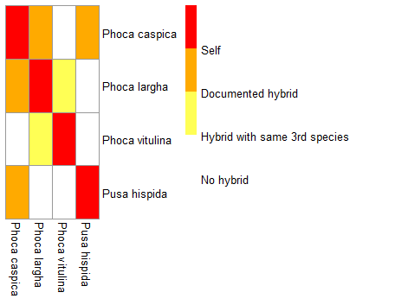

Slide 27
matrixcut
In baraminology many times identity matrixes show how similar each species are to one another (i.e. sequence similarity).
The question always is, what kind of groups (kinds, baramins) are there in the data?
Provide a cutoff value x, where 0 (0%) < x < 1 (100%) similarity, and those species will belong to the same component which are more than x% similar.
At 0% all species are in the same kind (low criterion, same group)
At 100% every species forms its own kind! (tight criterion)

Slide 28
0% similarity criterion: 1 group
100% similarity criterion: 15 groups
In between similarity: optimal grouping

Slide 29
matrixcut
matrixcut function:
This tells you:
how many groups there are for a given cutoff value
Which group each species belongs to
Run: matrixcut::matrixcut(matrix, cutoff)
Exercise: find clusters for the primate identity matrix where the cutoff is 90%!

Slide 30
matrixcut
componentplot function:
This function creates a plot, where:
The x-axis is the running cutoff value
The y-axis shows the corresponding number of components (clusters/kinds)
Run: matrixcut::componentplot(matrix, low, high)
Exercise #5: show the component plot for the 36 primates + opossum between 0 and 100%!
Look for the inflection point! (red line)

Slide 31
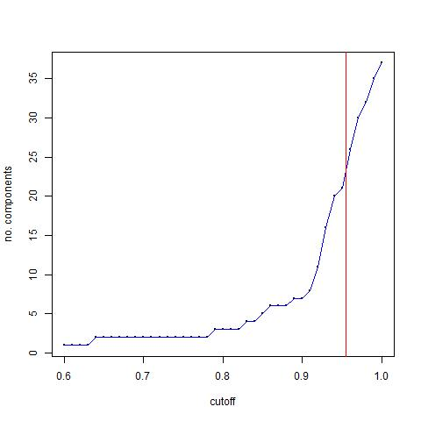

Slide 32
Organelle sequence similarity-based baraminology study

Slide 33
Organelle-based studies
Mitochondrial genome data are useful in molecular baraminology studies.
MtDNA is very abundant, and easy to isolate and sequence.
Many, many species have mtDNA genome data.
MtDNA is easier to align than chloroplast DNA, which is very divergent.

Slide 34
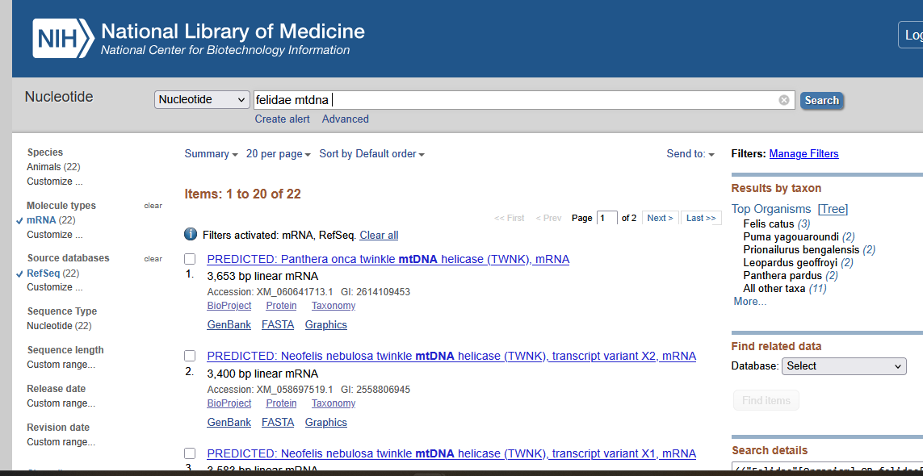
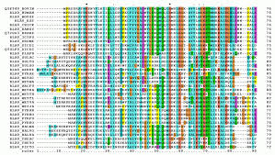
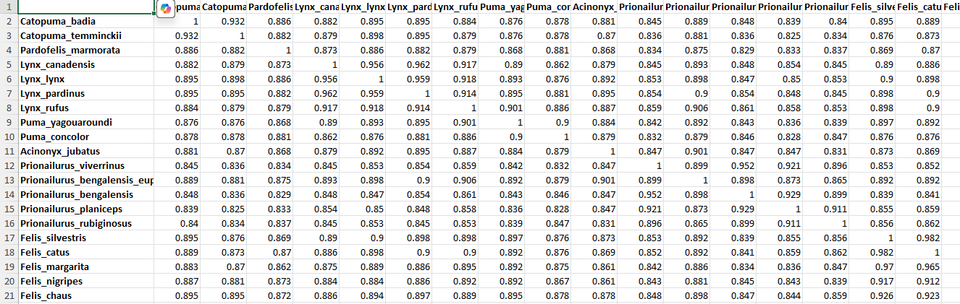
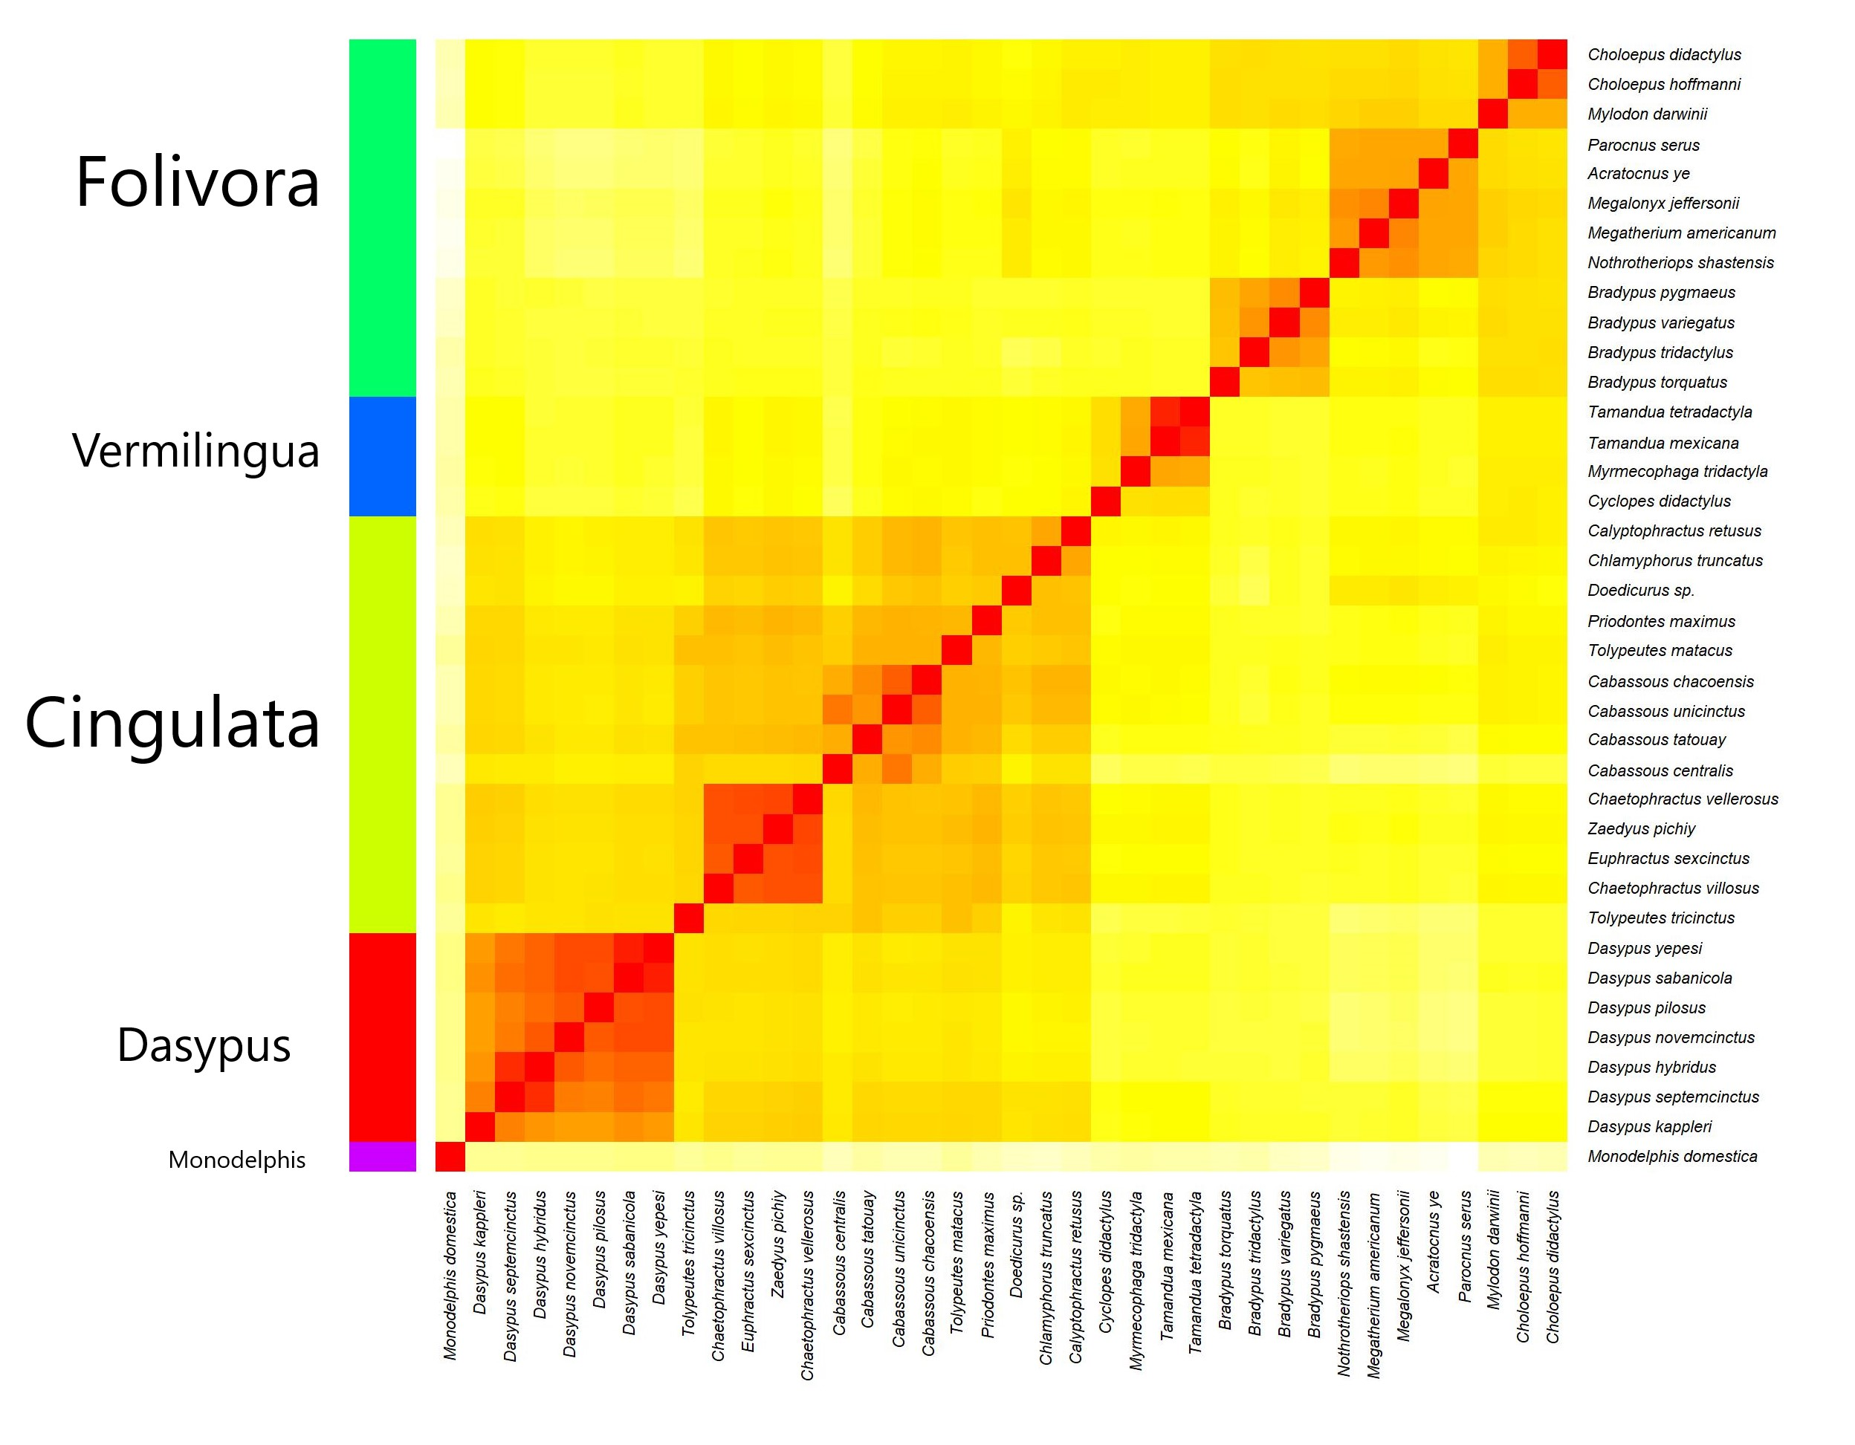
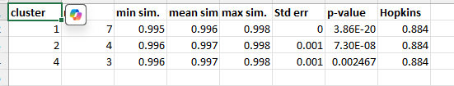
Procedure overview
Download mitochondrial DNA sequences from the NCBI database
Create multiple alignment
using MAFFT or ClustalW
statistics
Calculate sequence similarity matrix
Visualize using heatmap

Slide 35
Sequence download
At the NCBI database select the Nucleotide database, and type in <group name mitochondrial DNA > in the search bar.
Select ‘Mitochondrion’ as the genetic compartment in the left.
Try to use RefSeq sequences, which are high quality.
On the top right select ‘Send to’, then ‘Coding Sequences’.
Then download the FASTA file.
Also, don’t forget to select an outlier species/group.

Slide 36
Multiple alignment/identity matrix
Beforehand edit the header row of each sequence to clearly identify the species.
Windows: Use BioEdit to open FASTA file, and run alignment, then save the alignment file (.aln).
Linux: use the clustalw or MAFFT utility.
Clustalw for mtDNA
MAFFT necessary for chloroplast DNA
The alignment can be transformed into a sequence identity matrix using R code (aln2idmx.R).

Slide 37
Resulting files coming from R analysis
Elbow plot
Silhouette plot
Heatmap
Cluster membership
Cluster statistics
Run Bioinfo_R_kmeansClustering.R!

Slide 38
Elbow plot
An elbow plot is used in k-means clustering to depict ‘total within sum of squares’ (twss) as a function of the number of putative clusters (k).
The inflection point corresponds to a value of k* where the twss value’s drop becomes insignificant.
This is the ‘elbow’ in the elbow plot.
This is an estimate of the number of putative holobaramins (kinds) in the data.

Slide 39
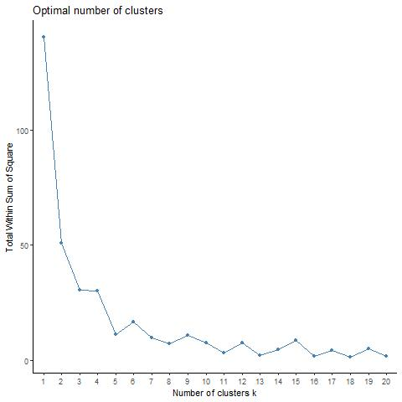

Slide 40
Silhouette plot
A visualization used in cluster analysis to assess the quality of clustering results.
It displays how well each data point fits into its assigned cluster compared to other clusters.
It shows the cohesion within clusters and separation between them, providing a visual representation of cluster "goodness“.

Slide 41
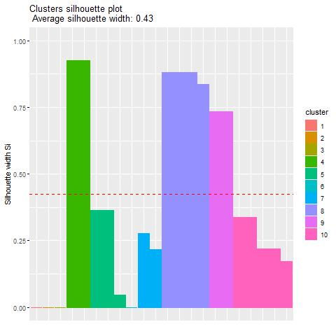
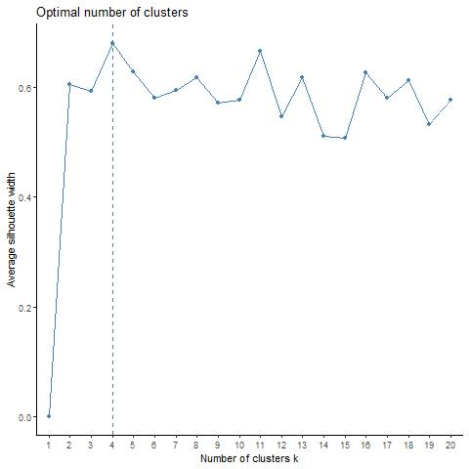

Slide 42
Generating the heatmap
Normalization:
Sequence similarity values might not be different enough.
all sequence similarity values must be scaled to a 0-1 range.
Color palette selection
Clustering based on estimated number of putative baramins
Generation of heatmap

Slide 43
Statistics
The membership of each cluster/holobaramin will be saved to a separate result file.
For each putative cluster:
We get the size of the cluster
An upper triangle is derived from the main sequence similarity matrix (SSM)
The following statistics are calculated:
Minimum, Maximum, Mean
Standard error of the mean
P-value and neglog of the p-value

