Slide 1
BEULAR
Binarization of End User License Agreement Recommendations

Slide 2
Solution Overview
BEULAR - Web Application Frontend
Users can
Upload one or more documents
Review predictions clause-by-clause
Visualize word/phrase influence for a prediction
Submit feedback for model re-training
Optional integration with an AWS backend using Redis as a service worker
Dockerized for flexible deployment options
BEULAR-API & BEULAR-NB - AWS Backend
Optional Integration with Web Application
Contains all model code
A data science workspace and REST API for deployed models on Amazon Web Services
Infrastructure-as-code used to make reproducible
Secure by using a private subnet of a Virtual Private Cloud instance and an internet-disabled SageMaker instance
S3 as a data store
API Gateway and Lambda for a serverless REST API

Slide 3
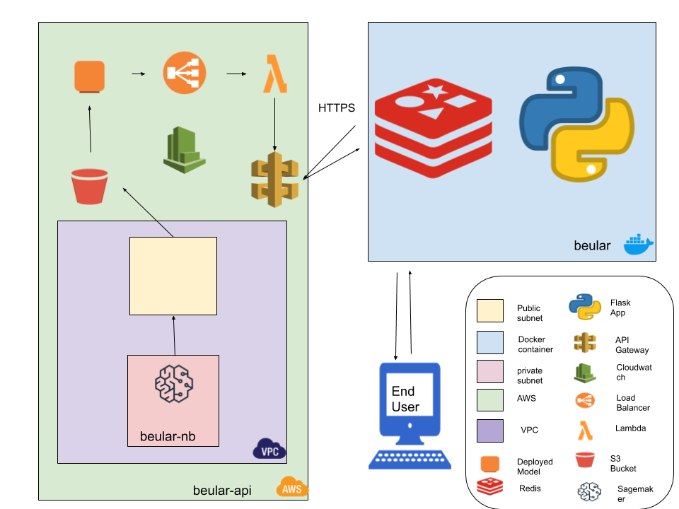
System Architecture

Slide 4
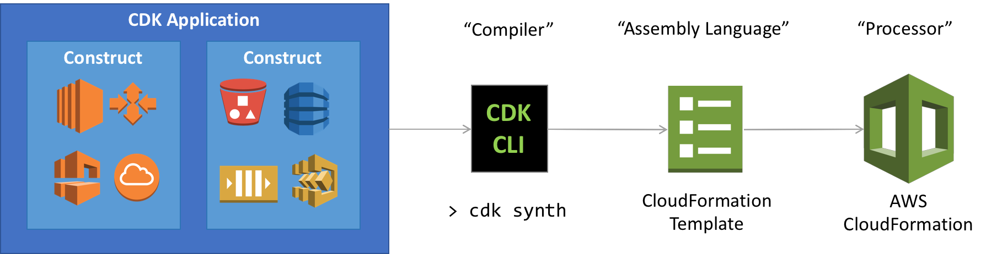
AWS Backend
AWS Cloud Developer Kit used to write AWS infrastructure-as-code using Python
Allows government to quickly reproduce my solution and provide their data scientists with a cloud workspace
Infrastructure
Virtual Private Cloud with private subnet for egress-only internet access
Internet-disabled SageMaker instance for model development and deployment
Non-public S3 bucket for data storage
API Gateway and Lambda for deployed-model REST APIs

Slide 5
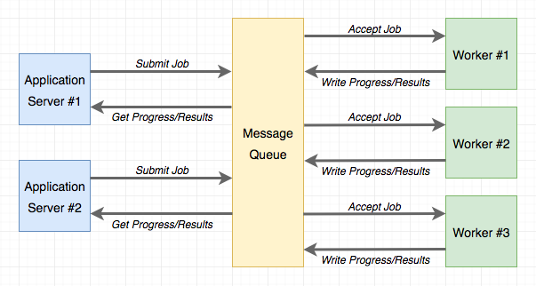
Python Flask - Web Application
Dockerized Python Flask Web Application for flexible deployment options
Optional integration with an AWS backend using Redis as a service worker
Bootstrap CSS for responsive styling
Jquery used client-side for html manipulation
Diagram of Redis Integration with Flask Application

Slide 6
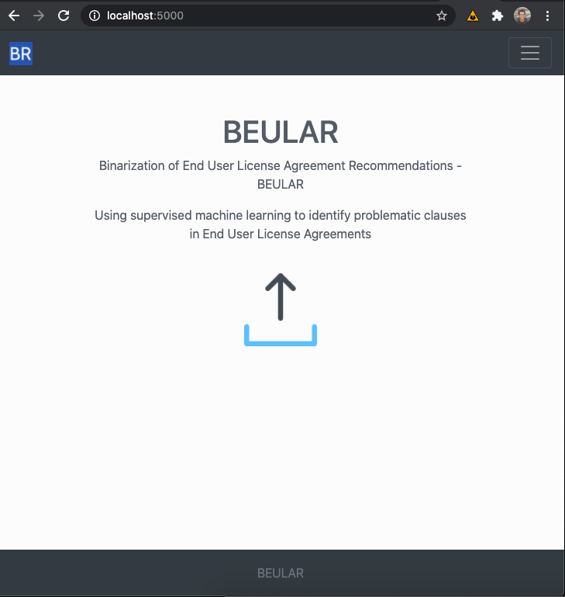
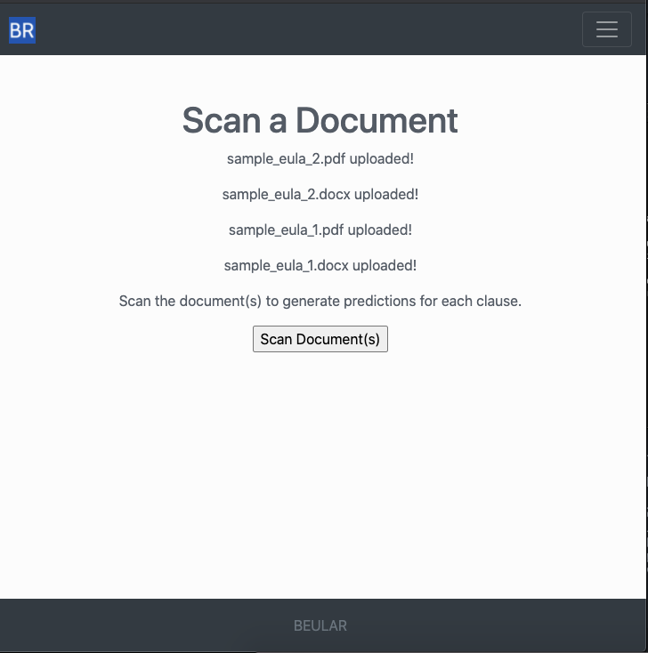
Screenshots - Upload and Scan Documents

Slide 7
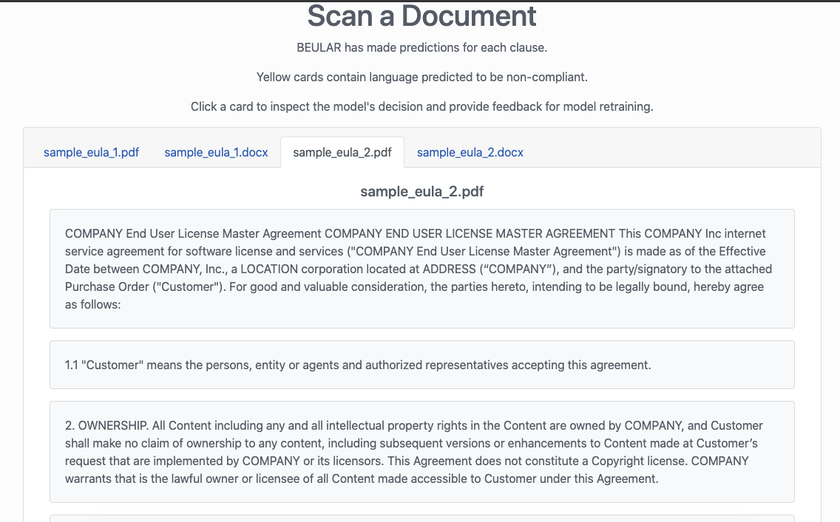
Screenshots - Clause Extraction

Slide 8
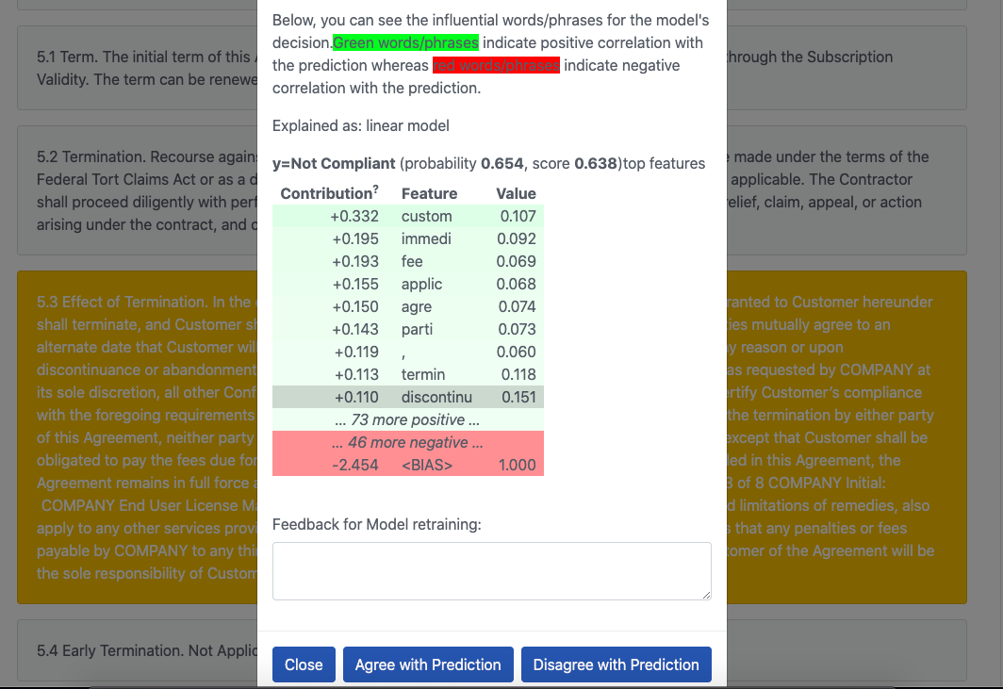
Screenshots - Review Predictions

Slide 9
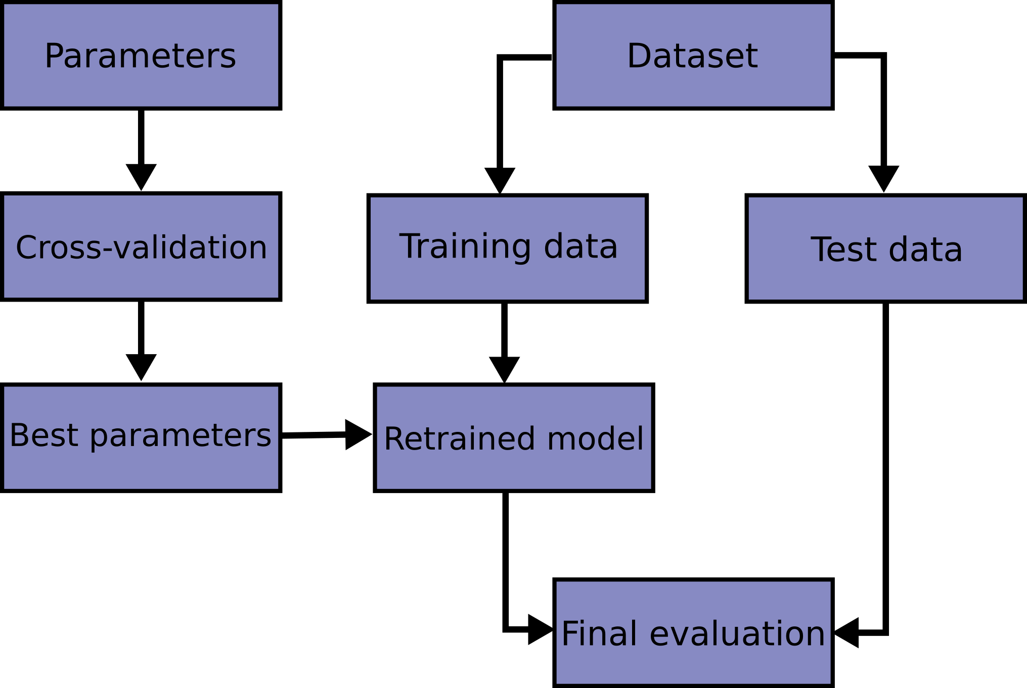
Model Experiments - Train-Test-Split
Training data was randomly split, with 80% used for training data and the other 20% for test data.
Cross-validation (see next slide) was performed with a randomized parameter search to identify the best hyper-parameters for each algorithm in the model pipeline
Evaluation metrics were calculated using the 20% test data.

Slide 10

Model Experiments - Cross Validation (CV)
With k-fold CV, the training set is split into k smaller sets during each iteration of the hyper-parameter search. During the search, the following procedure is followed for each of the k “folds”:
A model is trained using k-1 of the folds as training data
The resulting model is validated on the remaining part of the data (i.e., it is used as a test set to compute a performance measure such as accuracy).
The performance measure reported by k-fold cross-validation is then the average of the values computed in the loop.

Slide 11
Model Experiments - Algorithm Pipeline
Feature Generation
Feature Generation
TF-IDF
Word embeddings (BlazingText only)
Feature Selection
Truncated Singular Value Decomposition (Latent Semantic Analysis)
Average Pooling (BlazingText only)
Estimators
Stochastic Gradient Descent
Support Vector Machine
Logistic Regression
Ensembled Learners
Random Forests
Gradient Boosting
Neural Network
Blazing Text
Feature Selection
Estimator (Classifier)

Slide 12
Model Evaluation
Model | Accuracy | F1 | Brier
BlazingText | .84 | .53 | .12
Logistic Regression | .79 | .60 | .15
Random Forest | .78 | .56 | .15
Gradient Boosting | .83 | .49 | .15
The Logistic Regression model outperformed the rest on the test data, likely due to the high degree of variance in the explanatory and noise variables.

Slide 13
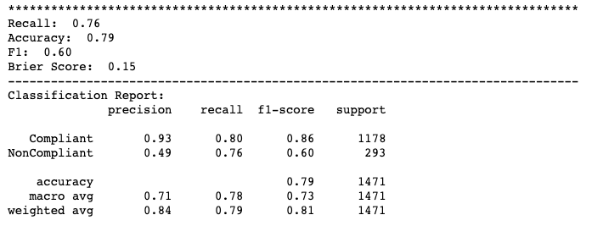
Classification Report - Logistic Regression
This classification report shows the logistic regression model’s performance on the test data.

Slide 14
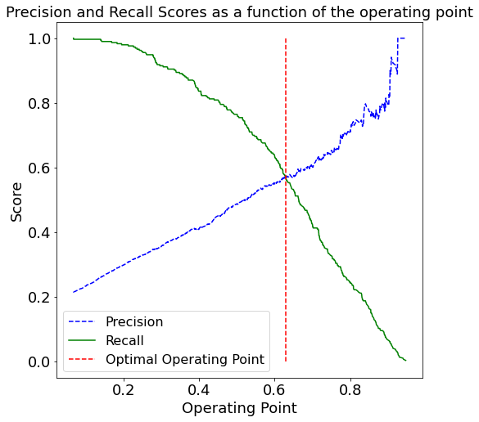
Model Diagnostics - Logistic Regression
Since this is a probabilistic model, this visual demonstrates how it’s possible to make tradeoffs between the precision and recall of the model by adjusting the probability threshold of the classifiers’ prediction. The defualt operating point is 50% - any clause predicted to be non-compliant with a probability greater than 50% is predicted to be non-compliant. We can change this operating point to strike a different balance. This visual shows the optimal point at around 62%. Changing the operating point will change precision and recall and therefore the F1 and brier scores.

Slide 15
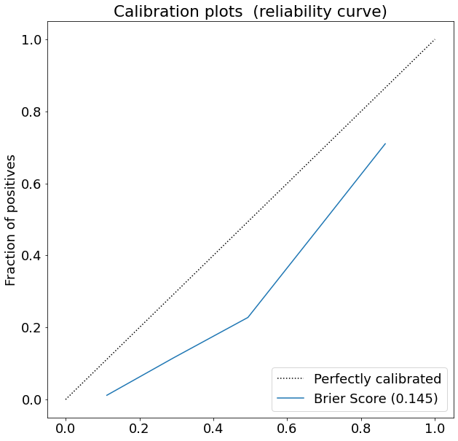
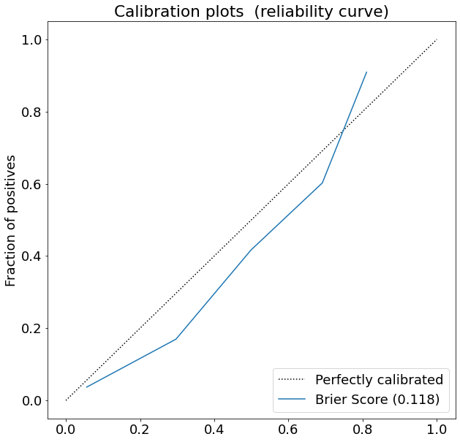
Model Calibration
Operating point = 50%
Operating point = 62%
The model is more calibrated - i.e. lower brier score - but the f1 score has subsequently dropped just slightly to .59. This is due to the imbalanced nature of the data.

Slide 16
Next Steps
Data Cleansing
There were a lot of duplicates and very short “clauses” in the training data. The validity of these samples should be questioned as I believe a tighter definition for clause would lend itself toward defining a better model.
Use the Validation Data
The government could make a better model by combining the validation dataset (assuming it’s already labeled) with the training dataset and then judiciously removing 20% of it for test data. This would increase the amount of training data and enable researchers to better experiment.
API Authentication and Authorization
The REST API for the models could be enhanced with the AWS Cognito service to provide authentication and authorization.
Auto-scaling Group for the REST API
Presently, deployed models sit in a single EC2 instance. Slight configuration changes could deploy models to an EC2 auto-scaling group that sits behind a load-balancer. API Gateway and Lambda would sit in front of this load-balancer to proxy requests. A DNS service such as AWS Route 53 could also be used to give the API a recognizable name.

Slide 17
Thanks!
mcallistercs@gmail.com
github.com/csmcallister

