Slide 2
Consumer Deposit Usability Evaluation
Assessment over three groups:
  Pre-test group (2 + UI review)
    Afterwards, made some text and graphic changes
  “Blue-sky” group (Epson scanner, 4 favourable checks, 5 participants) – (mostly) automatic scanning
    Afterwards, made some more updates to text/graphics
  “Dark cloud” group (Canon scanner, 3 unfavourable checks, 4 participants) – no mercy: graph paper and manual scan

Slide 3
Results…

Slide 4
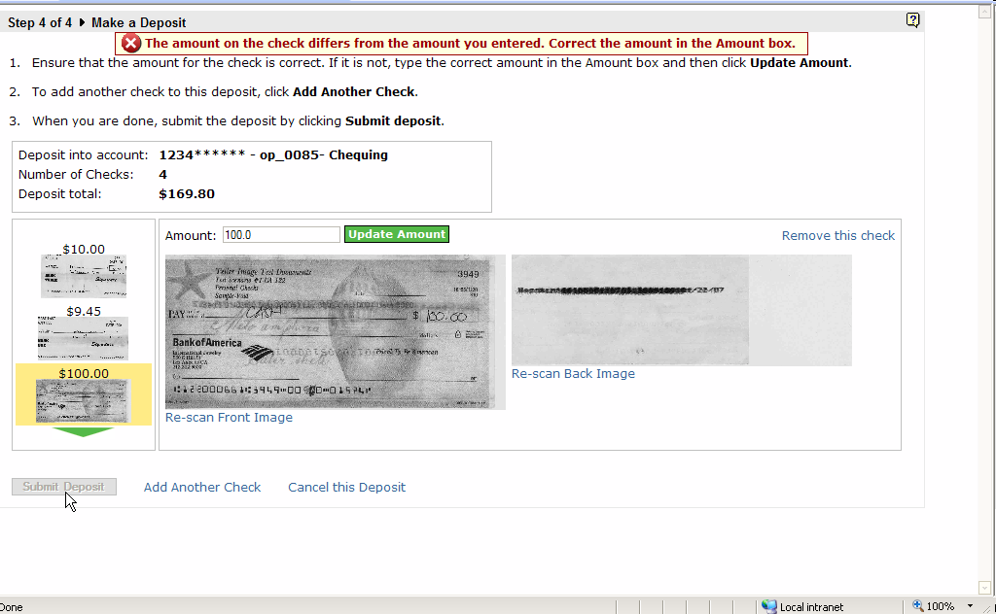
Check Amount Differs/Missed Decimal Point [video]
Notes:
Issue
A status message on the Make a Deposit page indicates that the amount entered for the check is different than what was entered.
The user re-types the amount and clicks the Update Amount button. The error message goes away but the amount is still missing the last decimal place. The user thought there was still a problem with the check and decided to rescan it.
In another case, the user didn't realize that having to re-type the amount (and still have it missing) was the only way to submit the deposit.
[Related problem]
Typically when you scan a check, that check is highlighted on this list. However, this is not always the case. If an old check has an error, it is highlighted rather than the most recent item. So when users come to this page and don't see the last check they scanned, users first go to the thumbnails to find and click on it. When they do that the error message goes away (which they may or may not have noticed) and then they don't understand why they cannot submit the deposit.
References
P2 07:25.3 'The amount of the check differs from what you entered' The user re-typed the amount. The error message went away, but the value in the amount box is still missing a the second digit on the right of the decimal place.
P5 11:43.4 On the third time around, the user noticed the error message left over from the second check. He also noticed and expected that the fourth check would be previewed, not the third one.
P5 14:49.4 User is stuck by not being able to submit the deposit. The amounts look correct the error on the third check is preventing him from submitting the transaction.
P3 06:53.7 User noticed the missing '0' zero in the amount. This caused some hesitation
P4 07:43.4 'It's not!' commenting on the missing '0'
P2 08:10.5 User assumed that because the amount in the amount box was not correct that she had to re-scan the entire check
P2 08:52.3 User assumes missing '0' was her fault and not the fault of the system.
P1 15:04.2 'That's odd...'

Slide 5
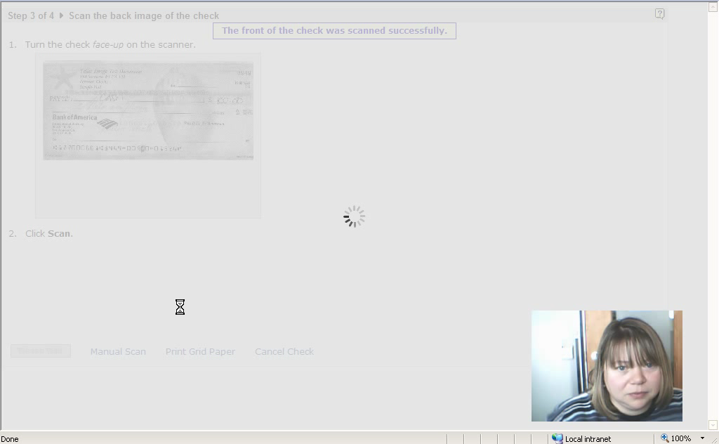
Participant thought the missing decimal point was her problem so she rescanned the whole check

Slide 6
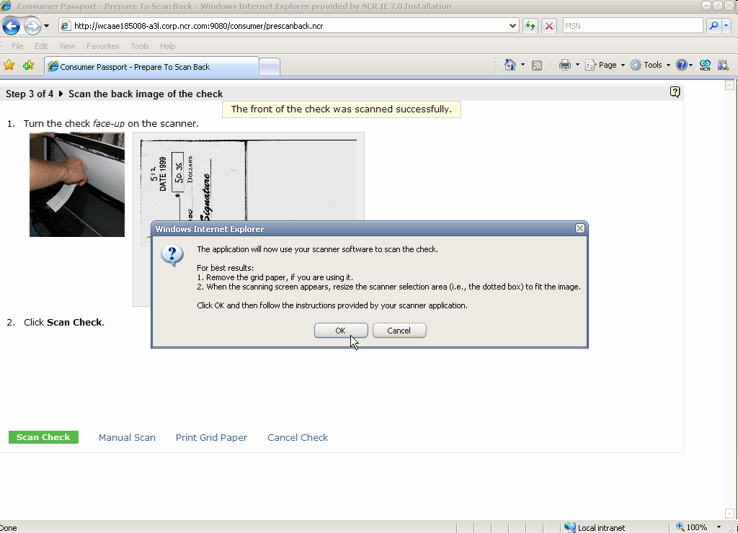
Manual Scan – Popup
Notes:
Issue
Beyond being a nuisance, this dialog had a adverse effect on workflow. The dialog appears as soon as the page with instructions loads and obscures vital information such as placing or flipping the check. Users missed the information and ended up re-scanning the same side. Combined with the issue of the left-over image in the scanner’s UI window, users had a terrible time knowing what they were scanning.
Also, once users get in the manual mode they are confused why they can’t get out of it.
[workflow]
Three participants mentioned that they were confused by manual mode. Why, once they got there they weren’t able to get out again.
References
P7 04:57.8 'As it didn't say leave the check in the scanner...' Consider adding this to instructions so the user knows to leave the check there.
P9 07:53.3 'I don't know why I'm getting this in a dialog box' User confused that he's getting information in a dialog after getting other information on a web page
P8 09:44.5 User ends up with two blank front/back images in the deposit review page because the popup obscured the instructions on the screen and he didn't know to flip the image.
P8 10:03.6 Manual mode popup hell
P7 10:12.1 popup button hell
P9 10:15.5 User confused by popup on the scan back of check... didn't read the page in the background and assumed there was a problem with the scan.
P1 10:53.9 'I'm very confused why this appeared now when it didn't appear last time.
P1 11:00.4 'What the heck?'
P7 11:06.2 'I'm getting fed up with that message'
P9 12:40.4 'It never told me to remove my old check...' Since the popup obscured the screen instructions, the user didn't know he was supposed to put the new check on after typing the amount.
P9 13:11.6 'This familiar dialog box makes me feel like I'm doing something wrong.'
P8 21:26.4 'This is the popup box I found disconcerting'
P8 09:04.9 User confused why he's in manual mode ...probably because the popup obscured the info on the screen telling him to turn the check over
P1 15:59.2 User confused why the first time it worked, then it went to manual scan, then she couldn't get back to auto mode.
P7 18:54.6 Once I got into that manual scan I couldn't get out of it.

Slide 7
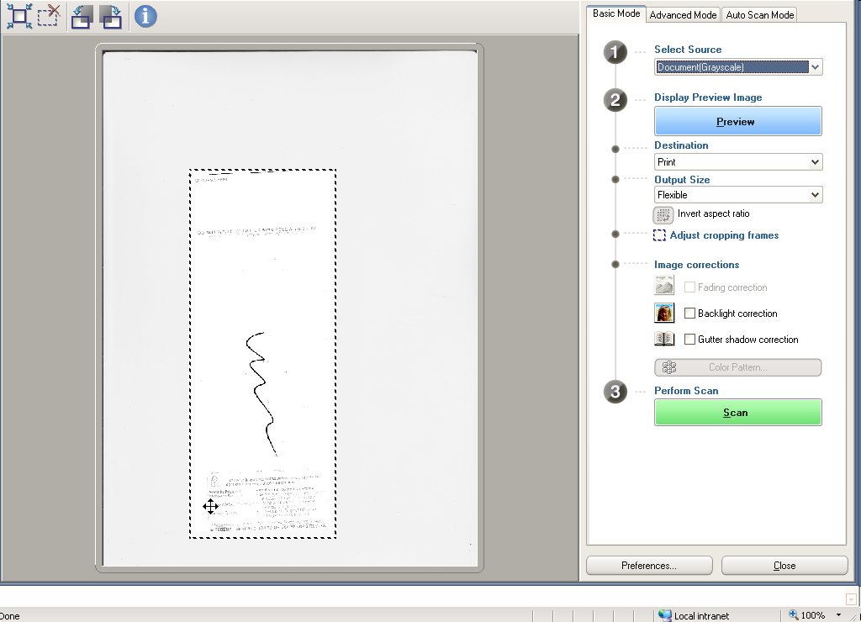
Manual Scan – UI [video]
Notes:
Issue
[canon preview window]
When the scanner UI opens up there is already an image in the preview window. Since users think the image they want scanned is already previewed, they press scan. Then it is completely random if they happened to place the check in the pre-scan area. This issue, combined with the popup, confuses the users and it is not until they are at the review deposit page that they see that they scanned the front or back twice, or neither.
[scanner UI]
Participants were puzzled when left at this screen. After receiving clear steps in the previous screen, they were left here with no direction on what to do.
After being surprised by the new UI, two participants forgot which side of the check they were scanning. One reason is the problem with the preview window, the over could be unfamiliarity with the scanner.
[other]
One user wondered why the scanner was able to do a good preview scan (and presumably a good scan as well) when the smart button wasn’t able to.
Question
Is there any way to clear the scanner UI window “buffer” so that this left-over image isn’t there? Could we also kick off a pre-scan when this screen pops up?
References
P7 04:25.7 When the manual scan dialog appears, an old image is showing in the preview window which confused the user into thinking the preview already happened.
P8 07:14.3 When user got dropped into manual scan, he saw an image already in the previiew window and just clicked the scan button.
P8 08:30.7 'Why's it doing this again?'
P8 21:54.2 'Why couldn't it have done that before [correctly outline the preview image on the window]'
P7 16:25.3 'Sometimes I get [the image from the previous scan]'
P7 08:39.1 'I find it very disconcerting that I'm trying to scan the front image but the back image is displayed'
P9 09:12.0 User assumed the image in the preview window was of the check in the scanner... actually it was from a previous scan.
P7 16:14.1 'It doesn't tell me where I am' [manual scan screen]
P7 04:37.8 User overwhelmed with the manual scanner UI
P9 09:03.0 'Kind of forgot what the instructions on the previous screen were' User presented with native scanner UI and isn't sure how to proceed.
P8 21:40.2 'When I was on this screen I was a little unsure what to do' canon scan screen
P7 11:13.3 'I have no hint as to what it wants here...'
P7 15:39.1 'Disconcerting' flipping between screens (automatic vs. manual)
P7 15:39.1 'Disconcerting' flipping between screens (automatic vs. manual)
P8 09:04.9 User confused why he's in manual mode ...probably because the popup obscured the info on the screen telling him to turn the check over
P1 15:59.2 User confused why the first time it worked, then it went to manual scan, then she couldn't get back to auto mode.
P7 18:54.6 Once I got into that manual scan I couldn't get out of it.

Slide 8
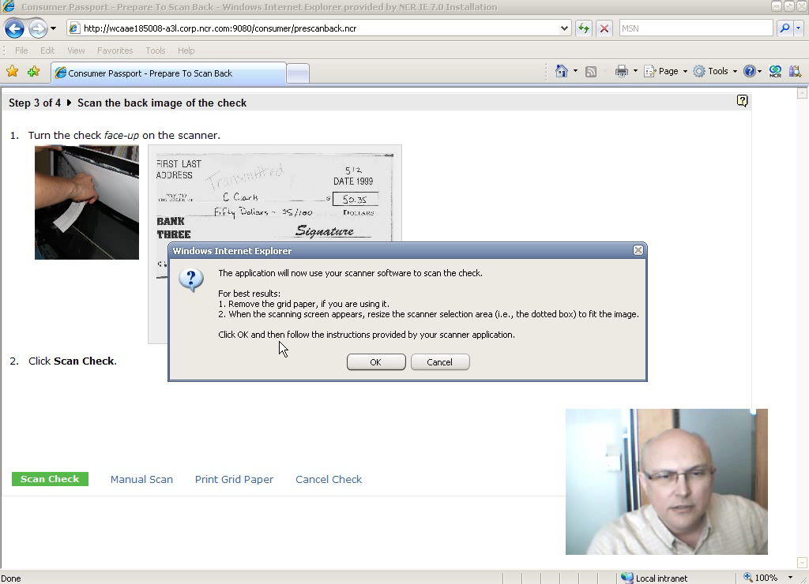
Manual mode gone wrong, popup obscures instructions, old preview image causes confusion

Slide 9
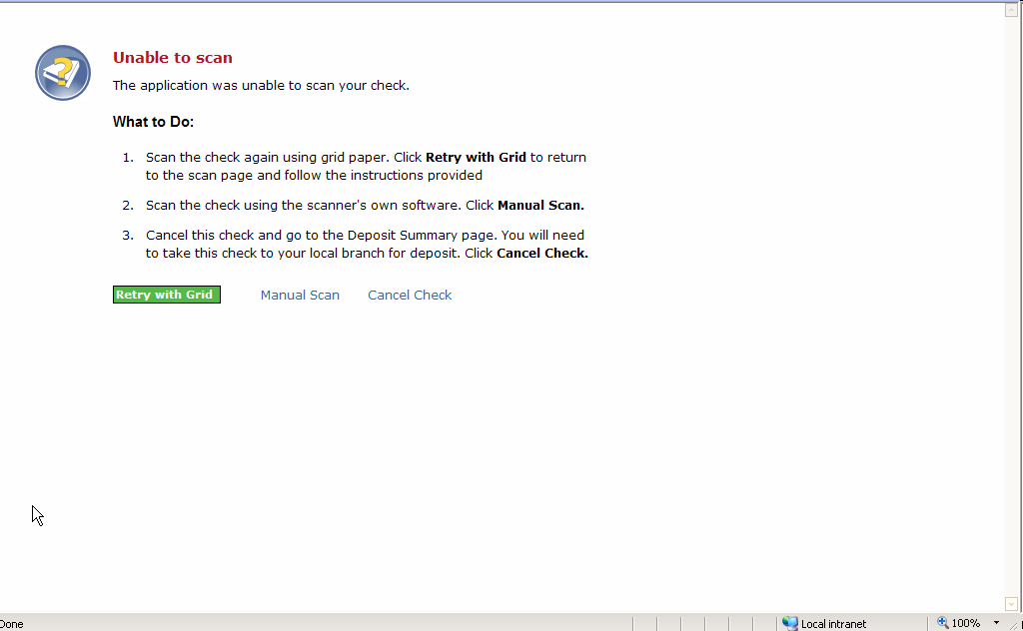
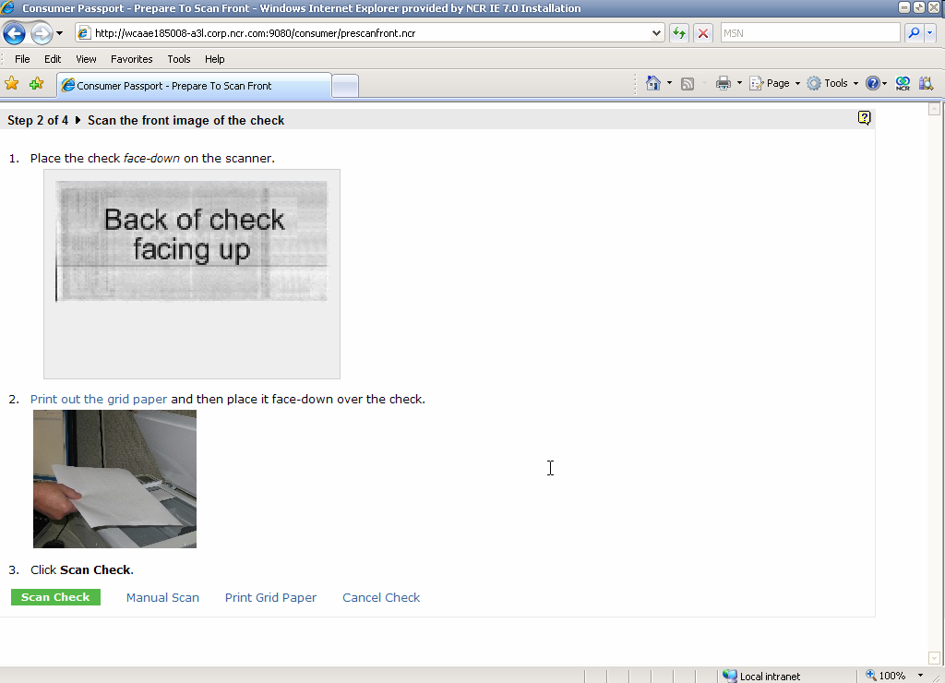
Grid Paper
Notes:
Issue
Two participants skipped the grid paper because there was not enough information to describe what it was, why they were doing it.
Out of 4 participants who tried using the grid paper, only 1 succeeded.
Question
Based on the number of failures of people using grid paper, should we continue supporting it?
References
P9 04:39.8 'I wish I had some idea of what this grid is.' User is looking at the Unable to Scan page and hesitates about trying the grid because he doesn't know anything about it. Perhaps the task requires more text.
P8 04:46.8 Scanning with grid paper
P9 06:15.7 Grid fail
P1 07:56.9 grid paper
P8 23:00.7 why he didn't use the grid paper
P7 03:33.0 Updated instructions don't say where to get grid paper.... maybe add something.
P7 03:55.4 'there's no place to print grid paper' User didn't find anywhere to print the grid paper so he didn't bother.

Slide 10
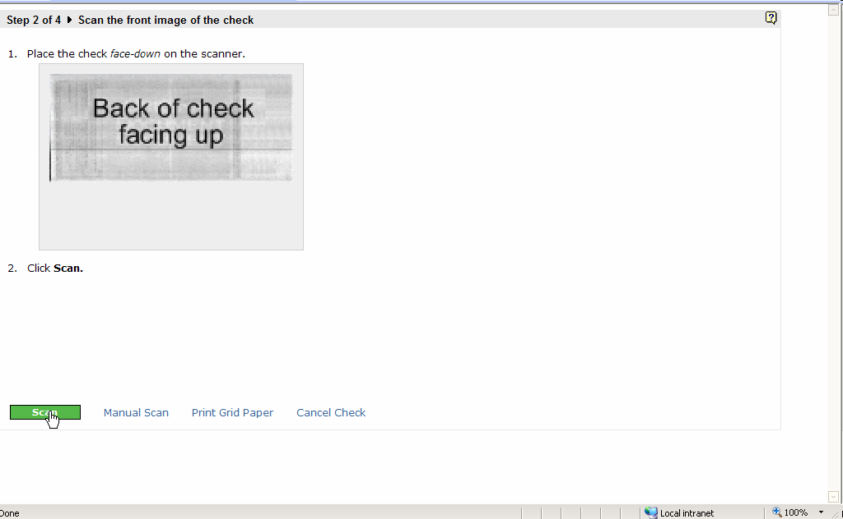
Check Placement on Scanner
Notes:
Issue
We don’t explicitly tell users where to place the image (under the assumption it doesn’t matter?).
Suggestion
Should we suggest they place the image in the corner of the scanner with the arrow (assuming all scanners have that)?
References
P2 02:15.4 'I'm going to put it on the corner with the arrow' User identified starting corner of scanner, based on arrow User indicated she wasn't familiar with the scanner
P4 03:03.1 Scanner has the arrow
P2 03:15.3 'It doesn't tell me if I need to rotate it' User noted there were no directions about placing the cheque. Could indicate an expectation.
P4 03:29.8 User hesitates about where to place the check because they are not told.
P9 03:49.9 'It doesn't specify where' User decided to place it at arrow.
P5 03:50.0 'Arrow is the top-left corner... usually' Maybe we should be telling them to place the check at the corner of the scanner with the arrow.
P5 06:59.2 User placed check in a different orientation (at the corner of the scanner with the arrow) and it still worked... 2 for 2. maybe we should be suggesting this.
P4 16:16.3 There's nothing that tells people to place check in the corner with the arrow.
P7 02:46.4 'Not being used to the scanner...' [I didn't know where to put the check]

Slide 11
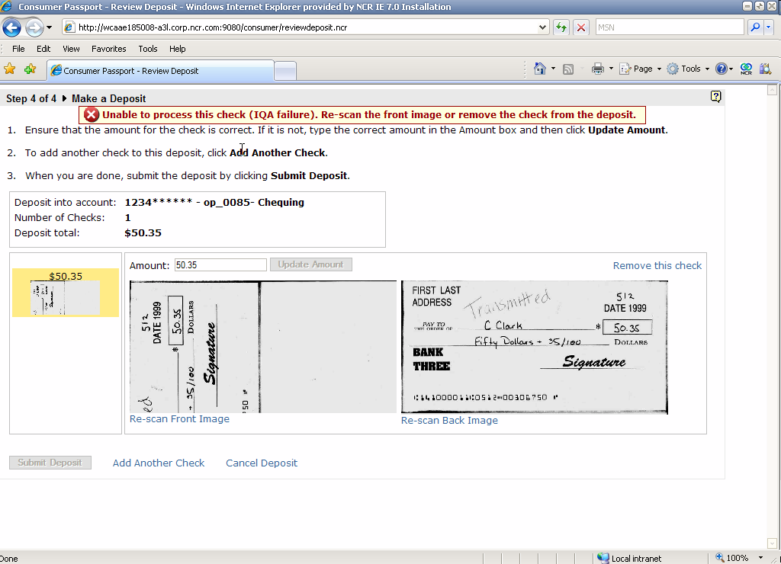
IQA and Other Error Messages [video]
Notes:
Issue
Current error messages leave the user in the lurch with no idea how to contact customer support. They are expressly told this but not how.
Other kinds of error confusion:
Users missed that the error at the top of the page was for a specific check rather than for the whole deposit. When they clicked off the check, the message disappeared and they forgot about it and wondered why the submit deposit button was disabled.
a participant wondered why he was told that the check’s front image was “scanned successfully” but by the time he reached the deposit review page that same check had an IQA error?
[IQA Specifically]
Users were confused by message (“What is IQA?”). One user asked why he was getting this message after the application said the scan was successful (from the pre scan back page)
Beyond telling users to re-scan the front, we don’t provide any information on how to get a successful image. This ties into the error messages and online help.
[General]
One participant noted the inconsistency with error messages. Some are pages, some are message strings. Pop-up dialogs turn out not to be error messages.
References
P9 11:54.3 User is confused by the conflict between the instructions saying to process the check and the red error message. User ignored the error and tried to scan the next one.
P6 12:57.3 'Why doesn't it tell me at the beginning about the IQA. Back there it said it was successful
P9 16:21.8 User confused about errors until he realizes that the errors are check related rather than deposit-related
P4 18:33.9 Is the contact technical support going to be online?
P9 19:36.6 User doesn't know why he can't submit the deposit--won't see the error unless he clicks on the check
P2 17:05.0 Provide help with errors
P1 18:01.2 User can't submit the deposit but she's not sure why
P4 12:55.2 User reached an error saying the check's information contains errors.
P4 13:26.3 User looking for some kind of link or something to say how to contact customer support.'
P2 11:17.8 User is directed to contact customer support, but there is no customer support information provided.
P2 12:14.4 User given message on the page that an error happened but they aren't given any information on what to do next. There's no information on the screen to indicate what to do next.
P6 04:46.9 User tries multiple times to get the check to scan after receiving the iqa failure
P6 06:06.4 'I think I should be told the check wasn't placed correctly and that's the reason why it failed iqa.'
P7 07:00.2 The user accidentally scanned the front both times... when he re-scanned the back image and returned to the deposit summary screen, the check had an iqa error. Why did scanning the back cause an iqa error?
P2 09:07.6 Even though the user scanned correctly the first time and the software messed up, when she re-scanned it, the check failed with 'IQA'
P2 09:08.6 'I don't know what IQA means'
P6 12:40.3 Application generated an iqa error after the user re-scanned the back... Why? The error message says to rescan front.
P3 12:51.3 IQA error
P6 14:29.9 'I might just take this check to the bank. It's been three times. I don't know why it's not able to scan'
P6 16:15.6 Having better instructions on how to re-scan the check after the iqa failure.

Slide 12
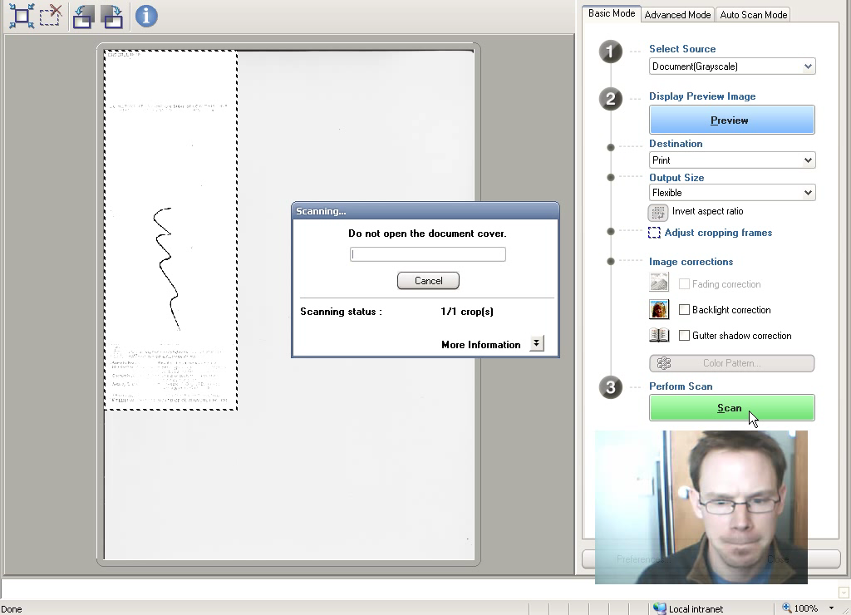
Error message example: last check (with error) highlighted, misses check err with submit disabled

Slide 13
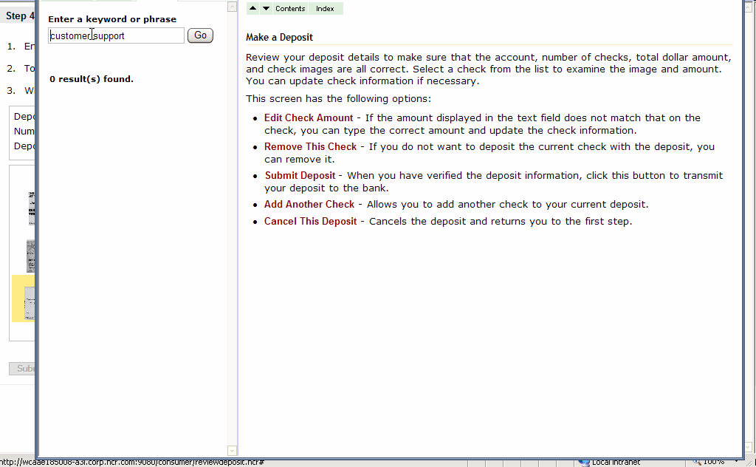
Help
Notes:
Issues
Two (out of nine) participants made any mention of the help. One noticed it after the fact and commented that the help icon was probably too small. The other participant searched help but were unable to find what they were looking for (i.e., customer support). This ties into the problem with the short error messages not providing enough details on how to recover from the problem.
Possible Improvement
Consider an approach like WiseIP Exception Recovery: Have better link between error messages and help to describe process user needs to recover
References
P2 17:21.8 User noticed help but said it was too small
P4 13:26.3 User looking for some kind of link or something to say how to contact customer support.'

Slide 14
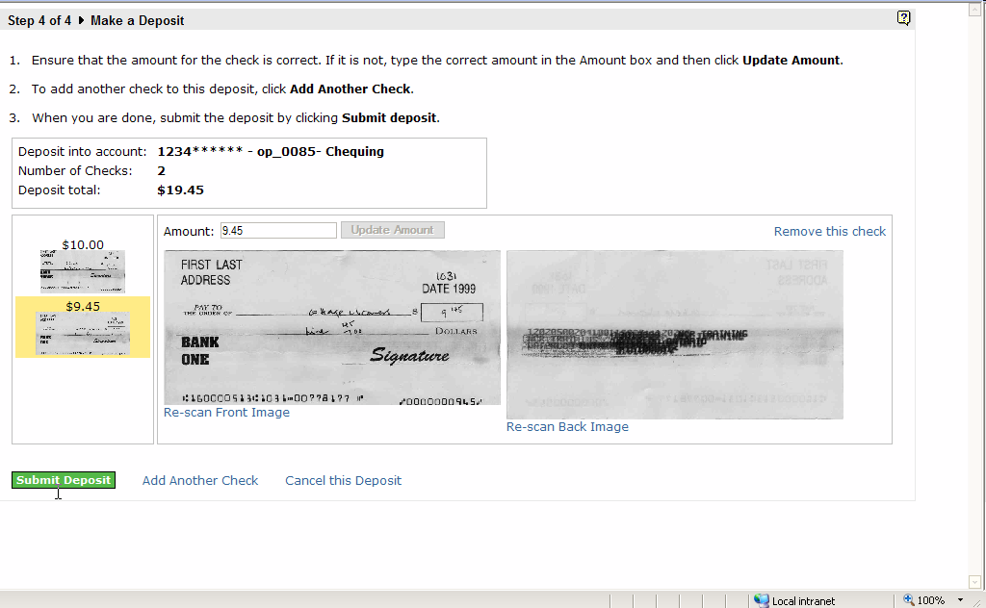
Links vs Buttons [video]
Notes:
Issue
Two participants missed the link, clicking on the Submit Deposit button instead because it is much more prominent. Other participants hesitated before clicking it.
One participant couldn’t find the remove this check link.
(Potentially) Bigger Issue
Do people “get” the buttons vs link, primary vs secondary tasks. Some participants expressly said they liked them, others said they were too distracting.
Suggestion
Adding another check to the deposit is one of the primary tasks for this page. It should be a button.
References
P3 09:51.8 User clicked submit deposit instead of add another check button by accident.
P2 04:13.8 When user when to add another cheque, the pointer first moved to submit deposit button. May indicate that the Add Another Check button should be promoted to button.
P2 05:02.9 User like the green button to show choice but commented that the add another check link should be the same
P4 05:43.0 User hesitates around pressing the Add another check link... indicates that she felt directed to click the submit deposit button.
P3 07:12.9 Some button hesitation about adding a new check
P5 06:11.1 User 'jumped the gun' and placed the check at this screen before pressing the add another check. He also didn't remember the amount of the check before putting it on the scanner. Also, watch the mouse movement--first it goes to button then right to the link. Since Adding cheques is a primary task of the screen, Add Check should be a button.
P2 04:45.7 User like green button to easily get to next step. Commented that the 'Add Another Check' was different. Maybe add another check should be promoted to button as well. Impacted by average number of checks per deposit. The four-check deposit task might be influencing this.
P6 15:10.8 After being shown Add Another check button user said he noticed it but was too
P6 05:50.3 User clicked submit deposit instead of adding another check... another reason to make the Add Another check link a button and place it to the left of Submit Deposit.
P1 17:32.1 User needs help on how to remove check from deposit

Slide 15
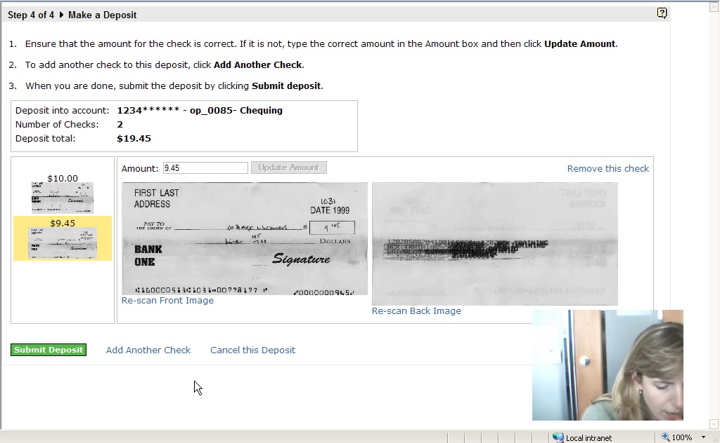
Participant got distracted after second check and missed the add another check link

Slide 16
Unable to Scan
Notes:
Issue
Updated wording but this screen still needs work:
It doesn’t provide enough information about the grid (or at least a call-out to help).
It doesn’t provide the user with enough information about manual scanning
Since the list is presented in numbers rather than bullets, that implies a sequence, which really isn’t the case. Maybe we should just show the grid paper info first (and launch into it from here) if that fails show different information for the manual scan (again, launch the UI from here)
Suggestion
If we decide to bypass the grid, turn this into a full page of instructions for manual scan. Also don’t “remember” manual mode. Need to re-think workflow.
References
P9 04:55.3 Doesn't like the three options presented like this. These are sequenced like steps but should be bullets? Looks like we're expecting them to fail.
P1 09:27.8 After the grid failed, the first item says to try manual scan but the second item says to cancel the check.
P1 09:29.7 The user canceled the check without trying the manual mode. However, the system engaged manual mode anyway which confused her later on.

Slide 17
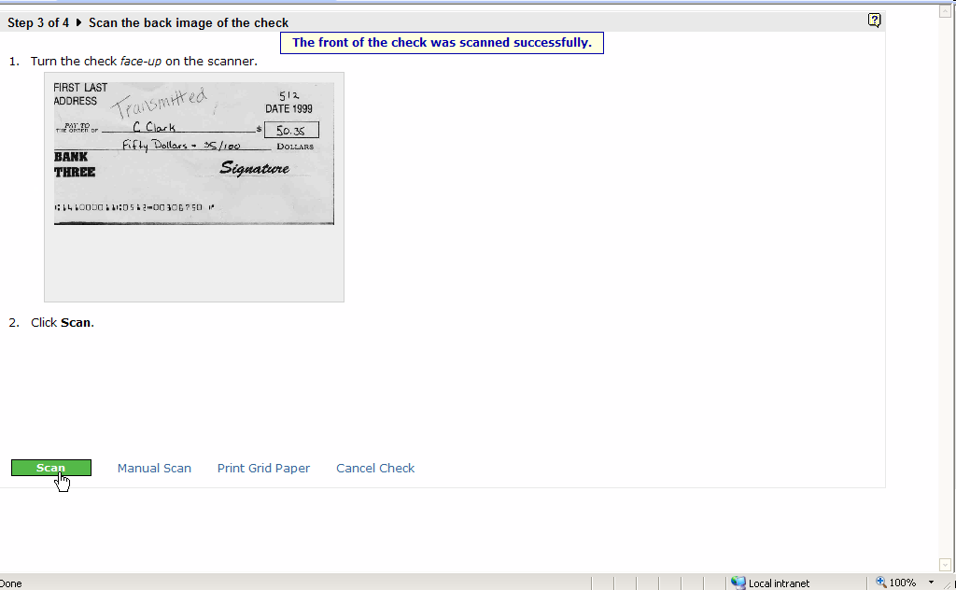
Cropped Check
Notes:
(Potential) Issue
Several auto-scanned images seemed to pass IQA but they are visibly missing their left edge. Is this okay to keep these images since they pass IQA?
References
P4 04:18.3 Check cropped slightly on the left side
P3 05:51.3 front image looks cropped
P5 10:55.8 Check was cropped but message says the check scanned successfully.
P4 12:04.1 Looks like check clipped a little on the left side
P8 14:11.9 'I don't think it got the whole item...'

Slide 18
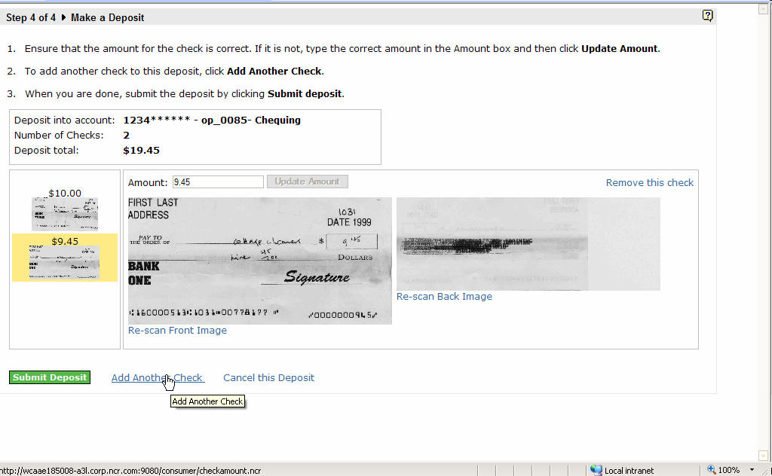
Back of Check On Deposit Summary Page
Notes:
Issue
The back image (auto-scanned) looks like it is missing part of itself and has parts of the background. Participant thought they did something wrong but there is no error message. Is this image okay for a back image?
References
P5 08:09.8 'It looks kind of odd when you have two different sizes beside each other' (talking about the auto scan results for the back of the check
P5 09:54.0 Same problem with the back image not being scanned properly
P5 10:02.8 Follow up to the distorted back image on the deposit summary screen -- 'Looks like you did something wrong'
P1 01:51.4 User did not type the amount with a decimal point. May be due to history with other payment software typing amounts without decimal points.

Slide 19
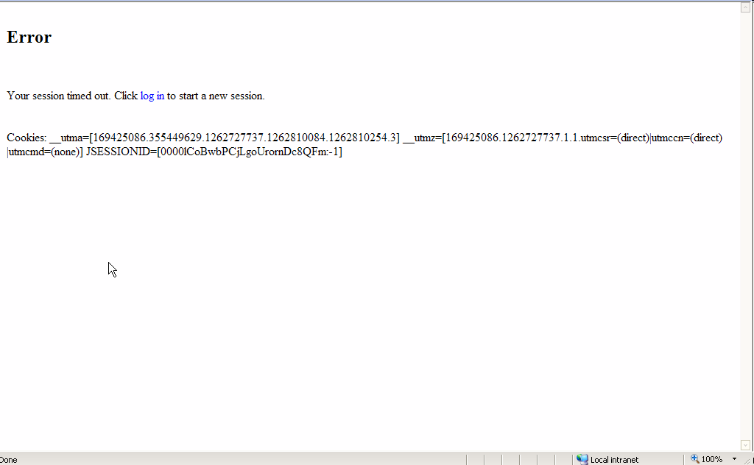
Handling Back Button
Notes:
Issue
Participant clicked the browser’s back button after submitting the deposit and wanted to go back to confirm what they sent. The application displayed this incorrect error message. Clicking the forward button again, the participant was back at the the Successful Deposit page. From there she could add a new deposit.
References
P3 10:02.0 User clicked back button and got an error page
P7 17:07.5 'I can't go back, can I?' [[ to double check the deposit images ]]

Slide 20
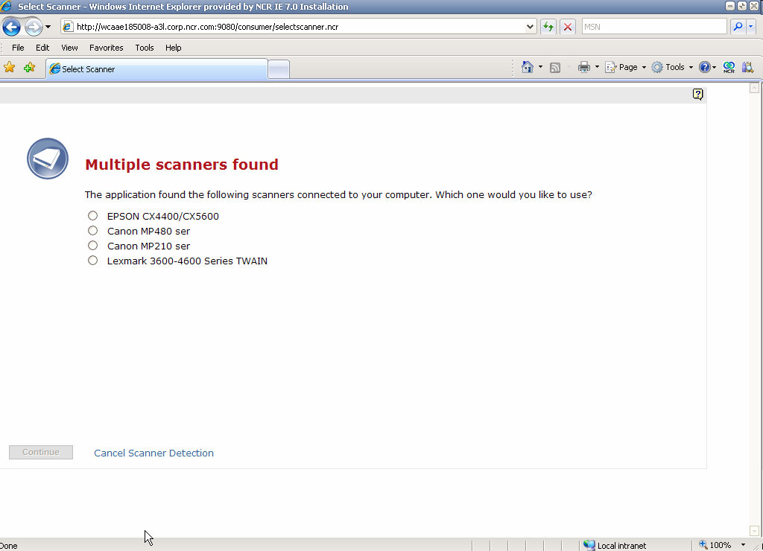
Multiple Scanners Found
Notes:
Issue
This is the multiple scanners found page when I tested users. It includes all twain capture devices whether they are connected or not. Is there a way to filter this list to show only plugged-in scanners?
One participant thought this was an error screen when it’s really not. Consider re-styling it
References
P5 03:25.0 If the epson is the only capture device working, why can't we just show it?
P9 02:50.4 'At first I thought this was an error screen' Why do we list all twain devices rather than just the ones that are plugged in. If this screen's going to be here all the time, consider re-stying the screen so it doesn't look like an error dialog.

Slide 21
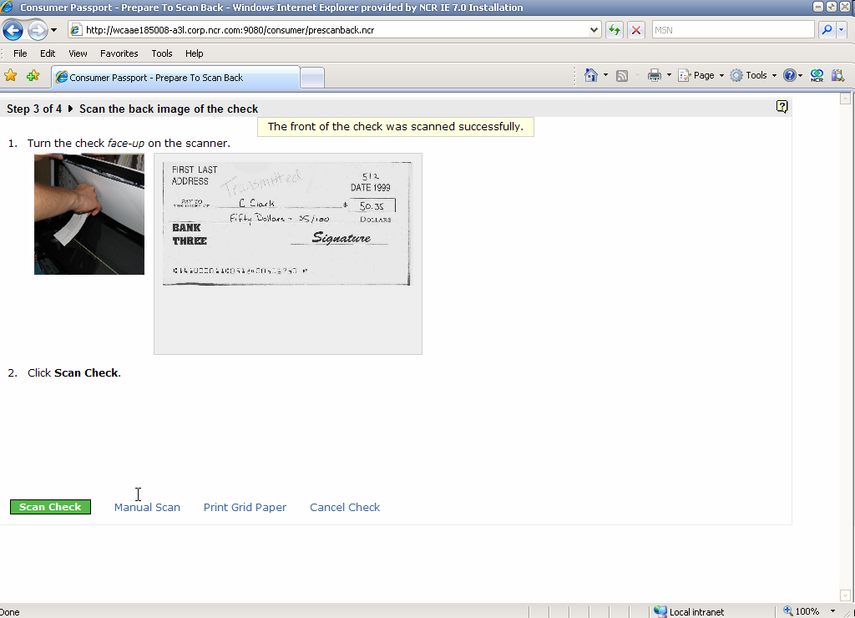
Size of Check on Scan Back
Notes:
Issue
The default width of the check on the pre-scan back page is too small for wider checks.
Solution
Tweak the styles.css to increase the size of the image.
Reference
P8 20:33.2 On the scan back of check page, the check image isn't large enough for extra-wide checks

Slide 22
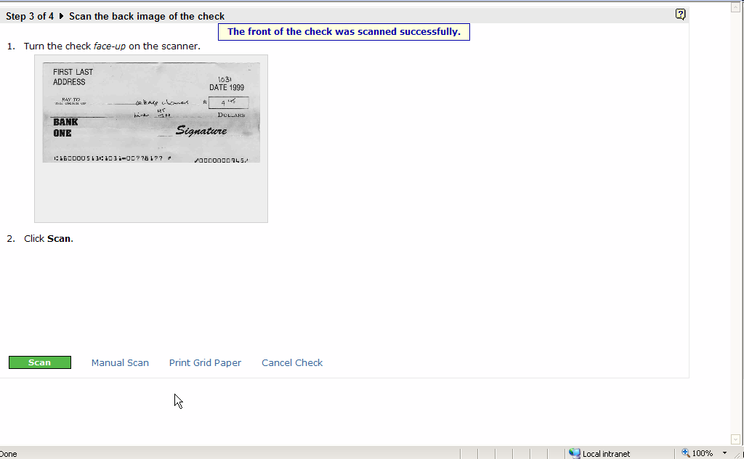
Visual Design
Notes:
Issue
One participant did not like the layout of the scan front/back pages because (without the grid information) it looks too close together
References
P3 08:31.3 'Don't really like the placement... use of whitespace' User
P3 11:38.7 User commented that instructions for turn the check face-up gets drowned out by the message and the green button. This issue was addressed by de-emphasizing the message and adding a graphic that shows the check being turned over. Needs to to be confirmed that this actually addresses the problem.
P3 19:09.4 'If there were a question for if it was visually appealing it would get a low grade'

Slide 23
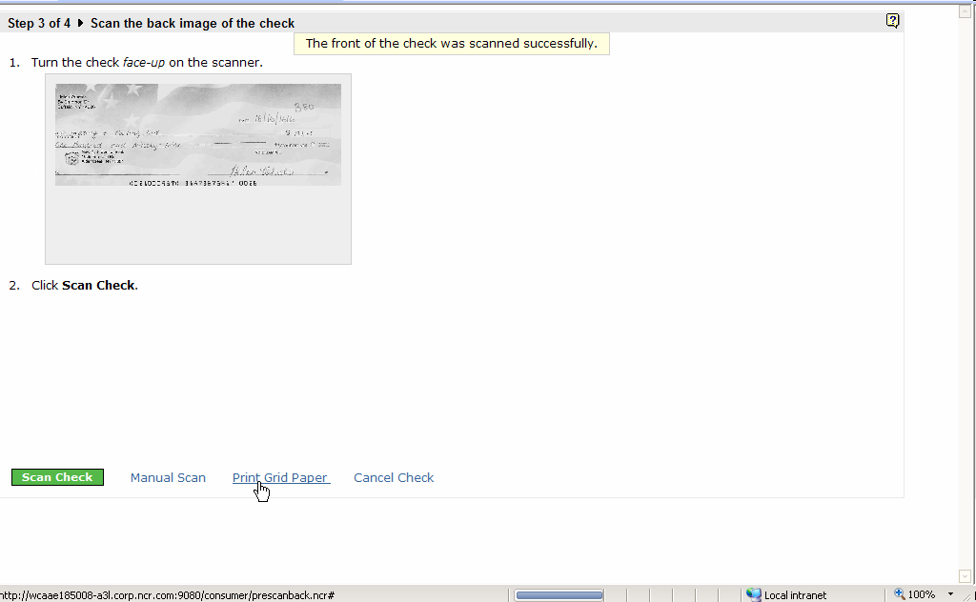
Missed Instructions
Notes:
Issue
User missed the instructions that said to flip the check.
Suggestion
Re-added flip image to add more contrast with first page. Needs to be verified.
Reference
P6 11:06.6 User clicked the button without flipping the image. Re-added image of flipping check--need to confirm whether or not this worked.

Slide 24
Workflow Efficiency
Some comments/observations:
Combine the amount and scan front check
Look for ways to allow adding the next check more quickly (such as from the deposit review page)
Notes:
Issue
Some comments/observations on how to improve workflow efficiency:
Combine the amount and scan front check
Look for ways to allow adding the next check more quickly (such as from the deposit review page)
References
P5 08:39.9 'Probably save a step if you combine the amount and the first check screen'
P2 04:34.6 User placed the cheque on the scanner before typing the amount
P3 07:32.8 On the second check, after typing the amount she already places the item before getting to the screen that tells her to place it on the scanner.
P5 06:11.1 User 'jumped the gun' and placed the check at this screen before pressing the add another check. He also didn't remember the amount of the check before putting it on the scanner. Also, watch the mouse movement--first it goes to button then right to the link. Since Adding cheques is a primary task of the screen, Add Check should be a button.

Slide 25
Random Questions
“I guess it's like my ATM--I don't have to endorse it?” Adds that it would be nice if it told her if she needed to endorse it. Are there any bank requirements for endorsing the back of the check?
“It's not clear to me what I'm supposed to do with these checks that I scanned. Do I shred them? Take them to the bank? keep them for 7 years?“

Slide 26
Usability Score Card
Based on the System Usability Scale (SUS)
Notes:
The System Usability Scale (SUS) in systems engineering is a simple, ten-item attitude Likert scale giving a global view of subjective assessments of usability. It was developed by John Brooke [1] at Digital Equipment Corporation in the UK in 1986 as a tool to be used in usability engineering of electronic office systems.

Slide 27
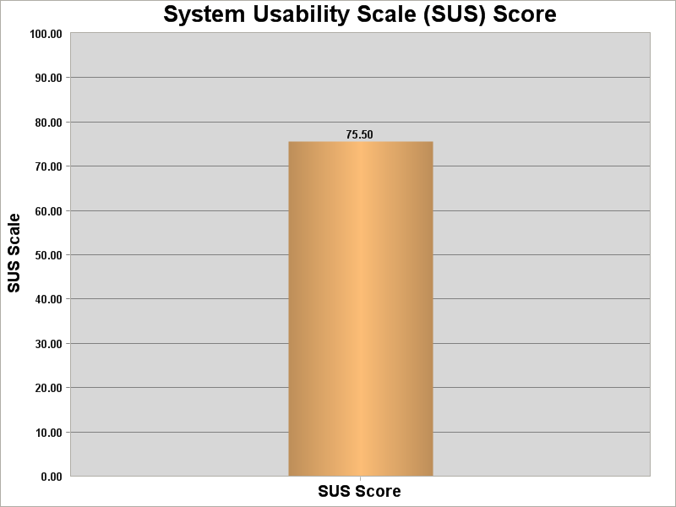
Blue-Sky group
B

Slide 28
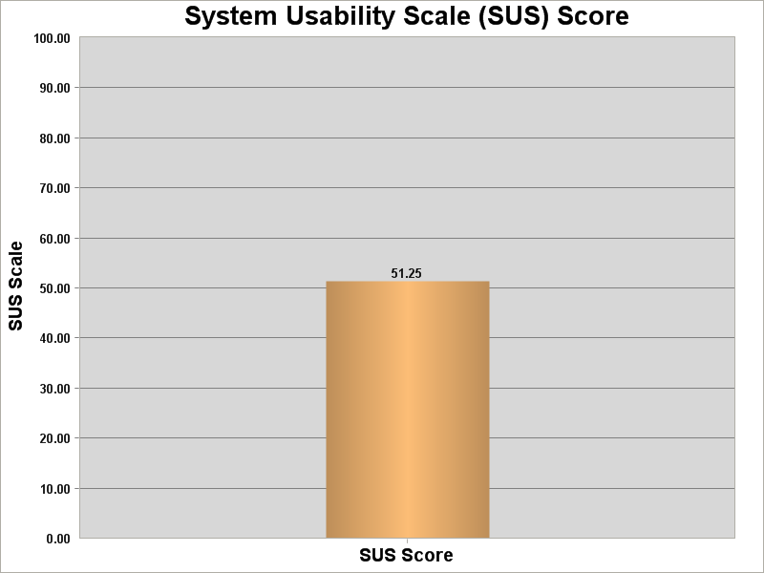
Dark Cloud group
D-

Slide 29
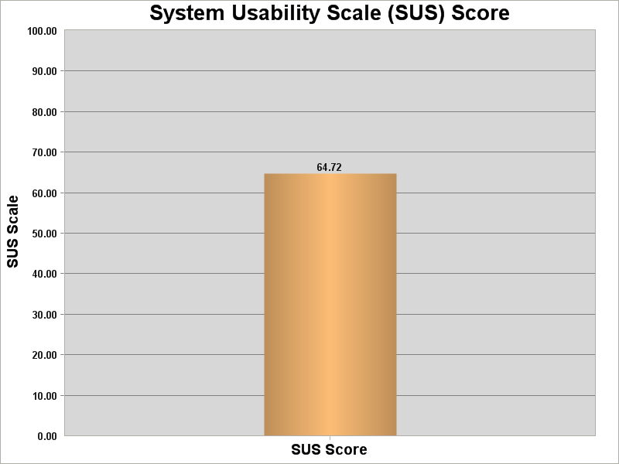
Overall
C-

