Slide 1
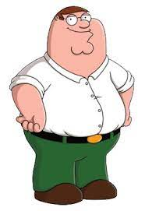
Reviewing what we’ve done

Slide 2
There are a couple things
With SQL being brand new to some, working with someone else’s broken code (which was the wrong one to begin with), and nearly no direction for any of it, there leaves potholes in what people know.
Some people cannot learn things without guidance or help, and as a class in a school, they should not be expected to almost every week.
Notes:
Elaborate on what people may not know or what little they could learn through this

Slide 3
SQLite
I believe this could go into more detail, as it was left to chance to get the needed information.
Some kids haven’t even heard of this before, leaving them at a substantial disadvantage.
Codecademy or a personal lesson would help smooth out some people’s bumps on this topic.
If a personal lesson, it could go into deeper detail.
Notes:
Each line leaves some room for further elaboration, go into more detail about them or explain how it is relevant / true.

Slide 4
Branching from other’s work
Personally, I think of this as a great idea.
Check the code
Add comments
Inform us on what we would be needing to change or where it generally would be at
Notes:
Again, go into deeper detail. Explain how he could check the code, different ways to add comments (teacher does it or has the students go through and comment it themselves), and examples of 3.

Slide 5
Expectations
Throughout the year, everything has been explained in multiple different ways.
Reiterating all the new rules, although not totally necessary, would help those still following the old rules to realign with the rest of the class faster.
Notes:
Time-taker slide, don’t think anyone actually needs this but doesn’t hurt

Slide 6
JavaScript
Python is better.
This is more of a personal opinion than something that desperately needs changed, but if we’re going to work with a language, I’d enjoy python more.
We tend to end up using python eventually anyway, so we should focus on one.
Notes:
Not forcing python on, just trying to kill time and express an opinion. Python is better though.

Slide 7
Personal problems
Not everything must fall unto you to teach, there are some things simple enough for students to learn on their own just fine.
.gitignore is a great example
I’m not asking you to teach every line we need to complete an assignment, but at least a shell of what we’d need to be using.
Notes:
Go into more examples for the .gitignore, or explain what a shell would be (telling us what we might be needing to use to complete our work)

Slide 8

End
Notes:
Spinning Mario sextuplets

Slide 9

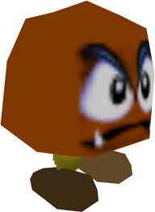
Uh oh
Thank you mario

