Slide 1
How to use the Formbar
By: Chris Mooney
When it works

Slide 2
Main Purpose
The main purpose of the Formbar is to communicate with the class and get feedback, such as using the Thumbspannel to figure out who likes what different things.
There is also Survey mode (When it is actually fixed) and that will allow the class to take a survey with 4 different choices, to figure out who's paying attention and getting the right answers.

Slide 3
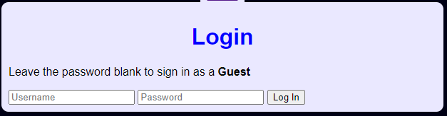
Login page
There is a page on the site so that way everyone can log in and save their information so that way no random people can join and mess up the page.

Slide 4
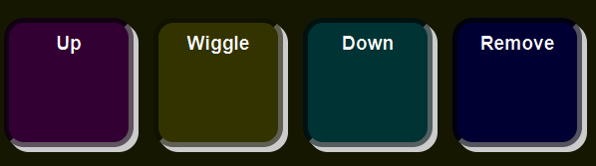
Thumbs Panel Reach max gamer before moving onto next slide
You press Thumbs Up to do Thumbs Up
You press Thumbs Down to do Thumbs Down
You press Thumbs Wiggle to do Thumbs Wiggle

Slide 5
Chat Feature Spend time messing with chat page (2 minutes)
When its actually working:
It gives you the ability to communicate with the entire class
It also has different commands so that you can do interesting things on the page.

Slide 6
What are we doing
When Mr. Smith actually imports data into the page, It will explain what everyone should be doing in class, so if you come in late you can see what is going on without having to ask around.

Slide 7
Formbar games
There are games on the Formbar!
When you are finished all of your work and Mr. Smith says that it is okay, you are normally allowed to play the games, that were mostly made by students.
If you want to make or edit any of the existing games, you can, just make sure they work before you put them on the formbar

Slide 8
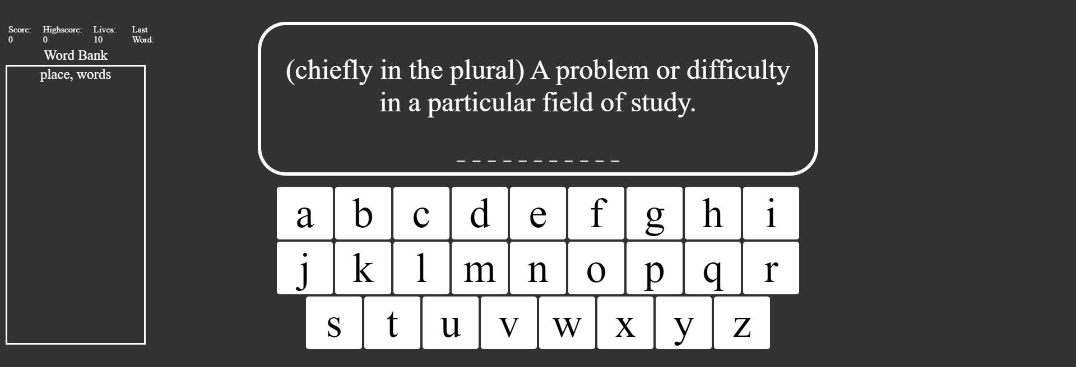
Formbar games continued -hangman
Hangman will load a list of words preset by Mr. Smith, and it will give you hints and definitions on what the word will actually be.
This includes a word bank on the side of the page with all the possible words.

Slide 9
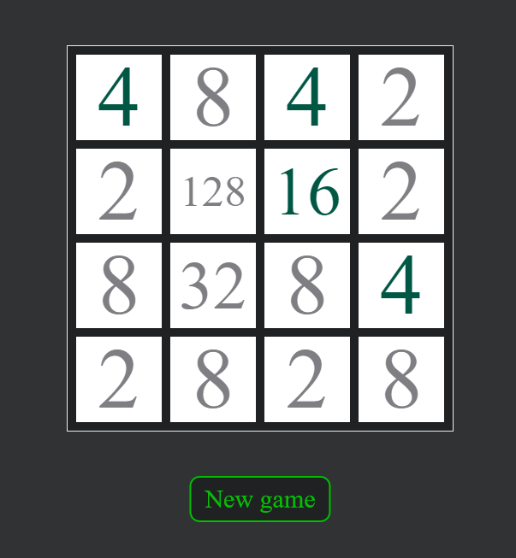
Formbar games continued -2048
Our 2048 was created in class, and it’s a great way to pass the time while learning to think “critically” on all of your moves so that way you can move farther

Slide 10
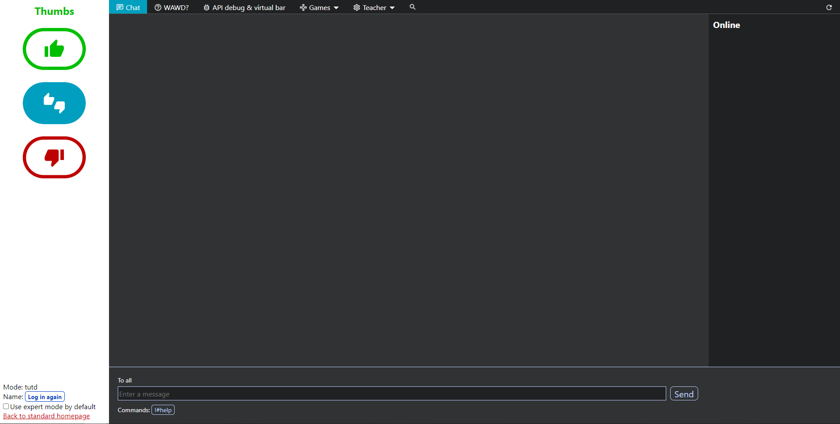
Expert mode
In expert mode, it is a mix of just about everything put together.
You should only use it if you know how to use the formbar, otherwise you would be extremely lost.

Slide 11

Sound Effects
The Formbar has 2 different pages for sound effects. There is short sound effects, and there is background music that you can play on the formbar.

