Slide 1
Javascript Classes
Riley Rorrer w/ Hatsune Miku

Slide 2

What are they?
Classes are guidelines for making Javascript objects, like a template of sorts. You can use them to declare objects as well as execute functions from these objects.
It’s like an EJS template, you insert the data, and it makes the thing that handles everything

Slide 3

Why do we use them?
They have a lot more applicable uses! This is barely scratching the surface! I’ll show you one in the next slide!
They allow us to:
Efficiently create new objects
Store data without the use of JSON
Assign object properties easier

Slide 4
Basic Application
You can use it to make a basic game!
By assigning the class properties such as health and an items array we can make a basic rpg character!

Slide 5
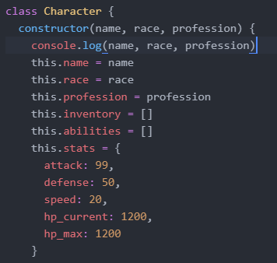
How to do it (Basic App cont.)
We can use the basic syntax for defining a class: class Character{}
We will explain this further in the next slide.
The constructor is what sets the properties we
give the object when we define it.

Slide 6
What are the parameters
name, race, and profession are all things we define when we call the object.
Inventory and abilities are empty arrays we can push strings into
Stats are values attributed to different parameters, these are written and defined.

Slide 7

Calling the object
You can call the object using this piece of code
As you can see we also defined a new array which will store all of our objects, do this multiple times to have multiple characters.
Just make sure you don’t lose to me

Slide 8
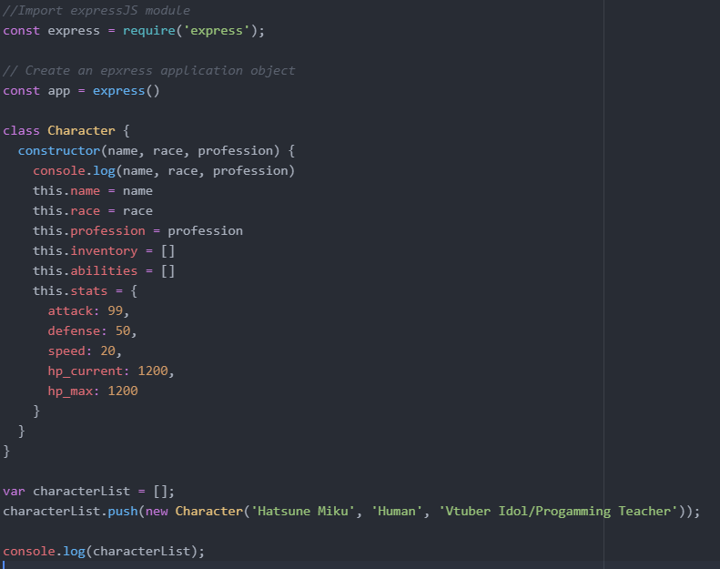
What should the finished product look like?
It should look like this:
if you missed anything please send a help ticket.

Slide 9

The constructor
The constructor is what you control when calling a new object.
You set parameters in the constructor which are then changed when you call it.
It’s why we can use the same class for multiple different objects.
It can also allow functions to be carried out with different params inside the class

Slide 10

The end
Bye Bye

