Slide 1
How to use jQuery
Ethan Shimmel
(Please log on to the formbar)

Slide 2
Why use jQuery
jQuery can be used to make it much easier to use JavaScript on your website
jQuery allows you to shrink your JavaScript programs by taking a lot of common tasks that require many lines into one method
This method usually will take up one to ten lines

Slide 3
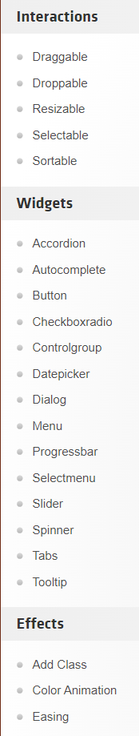
Finding which jQuery you want
Head to jqueryui.com/
On the left hand side of the webpage there are some of the basic templates(shown on the right hand side)
Look through those until you find what you are looking for
There are examples for each template on the page (Take one to two minutes to look around the page to find an example and give a thumbs up on the formbar once done)
Notes:
After last bullet point pause for 1-2 minutes until they all find a template and give a thumbs up

Slide 4
What to do once you found a template
I am going to use the collapse content of the accordion as an example
All templates will have a view source hyperlink below the example.
Click that and it will pull up the code

Slide 5
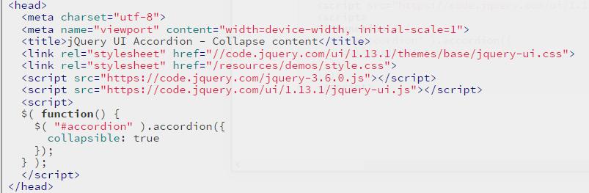
What to do from there
You should copy(ctrl+c) all code inside the head tag as shown below
All of the other code below is to show how to use it
Last paste that into your “.html” file

Slide 6
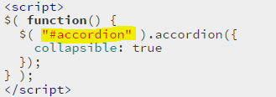
How to use that code
Next you will need to find the id tag used for your template
It will be in the code below what you copied(bottom right corner)
It will also be inside a function as shown in the bottom left(highlight part)

Slide 7
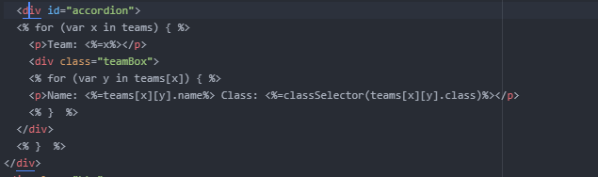
How to use that code (cont.)
Every part of your site that you want to add your template to will have to have that id as apart of it or in a <div> layer
As shown in the code in the bottom right of the screen
Each template will have different uses and therefor editing your code for it to work will be a little different

Slide 8

How to change the CSS
You can still change the CSS of templates id tag
You can use the id tag of the template or add div layers on the inside or outside in order to change the look of the template with the basics still working
In the bottom right is an example of CSS with the accordion template

Slide 9
Polls
TUTD if you were able to get the template to work
TUTD if you understand how to change the CSS of the template
TUTD if you will be able to use this by yourself

