Slide 1
MVC Calculator
Christy Smith

Slide 3
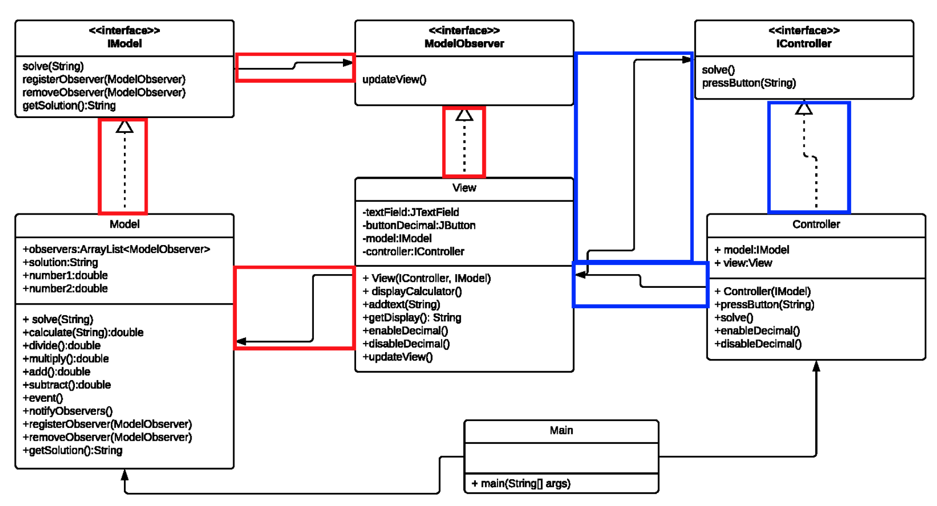
Strategy
Observer

Slide 4



Meet The Interfaces

Slide 5

Main- Starting the Application

Slide 6

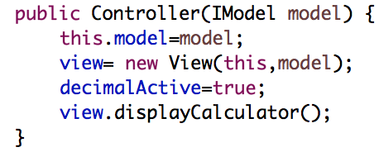
Controller Construction

Slide 7

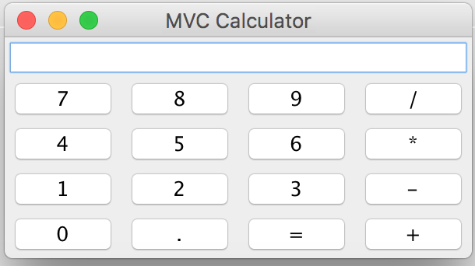
View

Slide 8
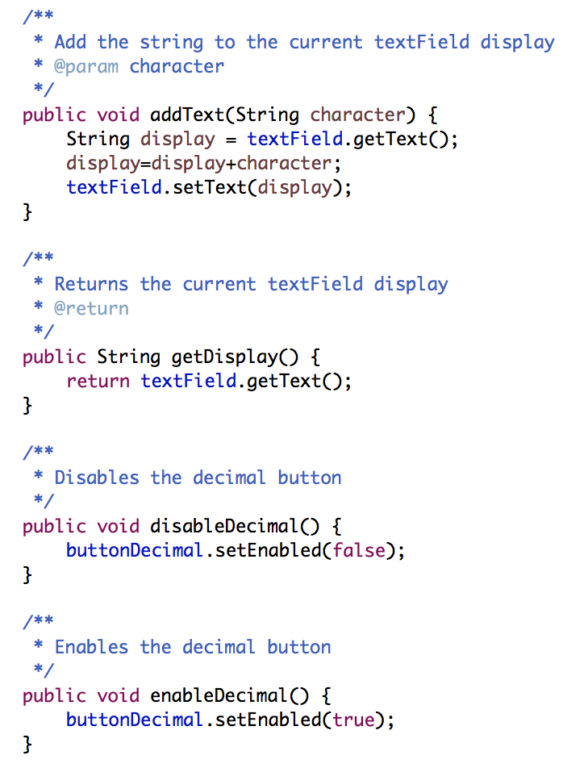
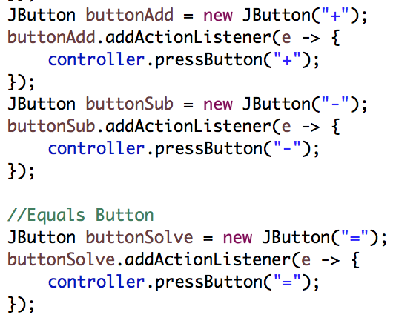
View
Methods to help the Controller

Slide 9
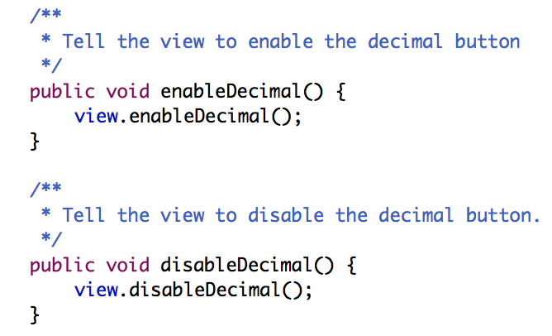
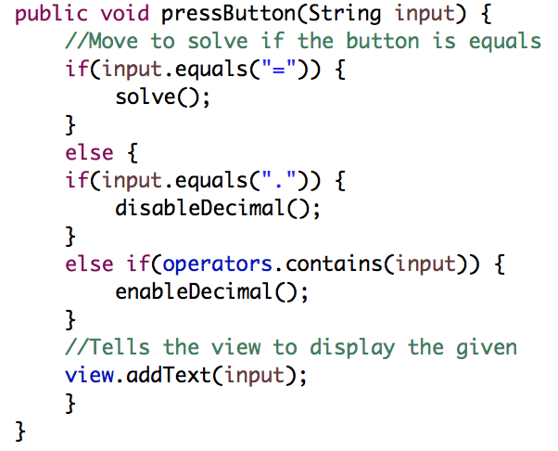

Controller Delegation
Controller handles the double decimal issue

Slide 10
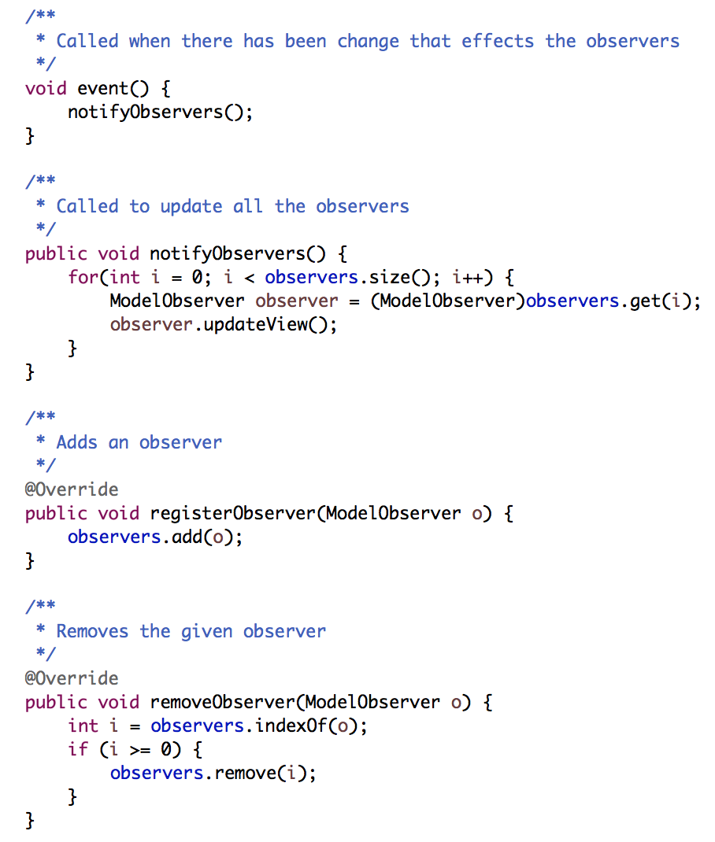
Observing the Model
Tells the observers to update

Slide 11
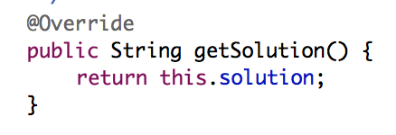
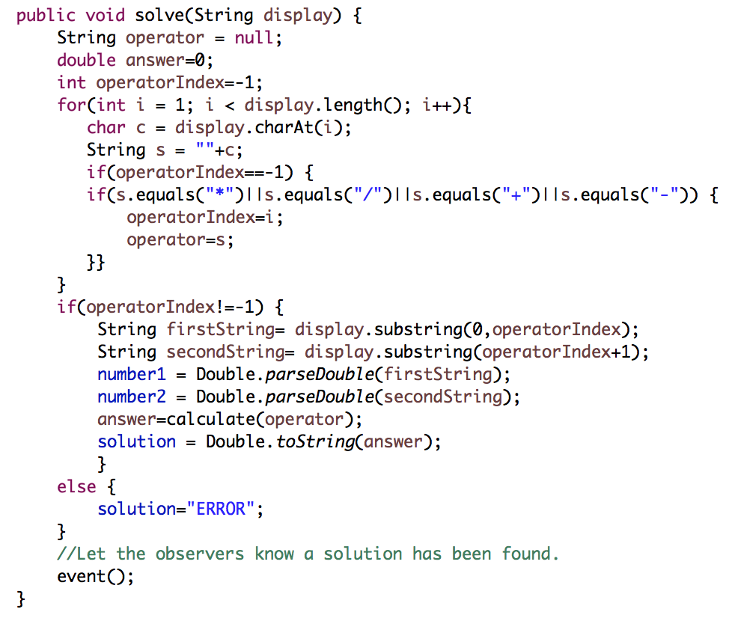

Model

Slide 12
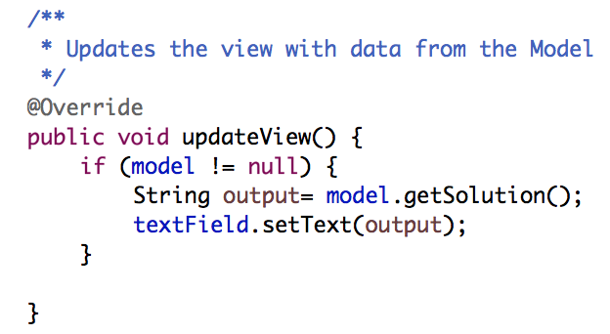
Updating the View

Slide 13
DEMONSTRATION TIME

