Slide 1
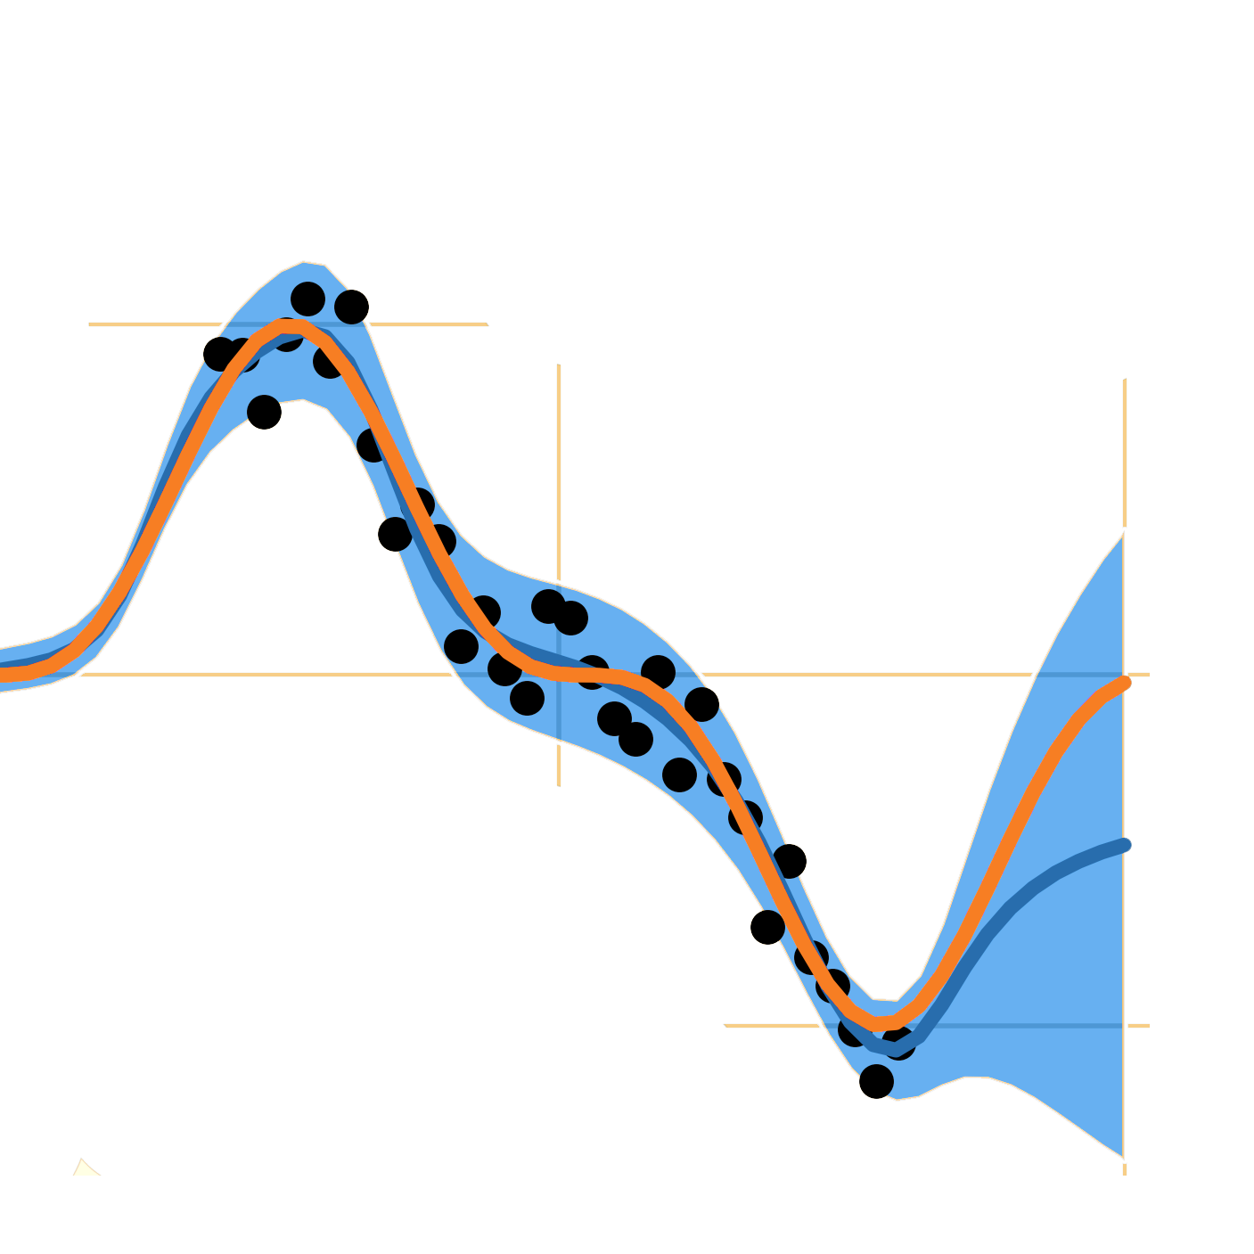






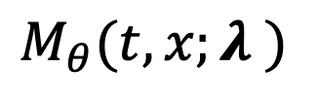

$$M_{θ}(t,x;λ )$$
branch
$$b(t,x)$$
$$t,x$$
$$p(y|t,x;λ)$$
$$p_{0}(λ)$$
$$q(λ)$$
$$τ(λ)$$
trunk

Slide 2
branch
$$b(t,x)$$
$$t,x$$
$$p(y|t,x;λ)$$
$$p_{0}(λ)$$
$$q(λ)$$
$$τ(λ)$$
trunk

Slide 3







branch
$$b(t,x)$$
$$t,x$$
$$M_{θ}(t,x;λ )$$
$$p(y|t,x;λ)$$
$$τ(λ)$$
$$p_{0}(λ)$$
$$q(λ)$$
trunk

Slide 4







$$b(t,x)$$
$$t,x$$
$$M_{θ}(t,x;λ )$$
$$p(y|t,x;λ)$$
$$τ(λ)$$
$$p_{0}(λ)$$
$$q(λ)$$

Slide 5
branch
$$t,x$$
$$M_{θ}(t,x;λ )$$
$$p(y|t,x;λ)$$
$$p_{0}(λ)$$
$$q(λ)$$
trunk

Slide 6
DeepBayONet
Deep Operator Networks
Differential Equations
Variational Inference
Physics-Informed Loss
Parameter Estimation
Uncertainty Quantification

