Slide 1

G-Suite
More than just gmail

Slide 2

Cloud Review
Just Using Someone Else's Computer to Store Information or do Work.
Advantages:Disadvantage

Slide 3
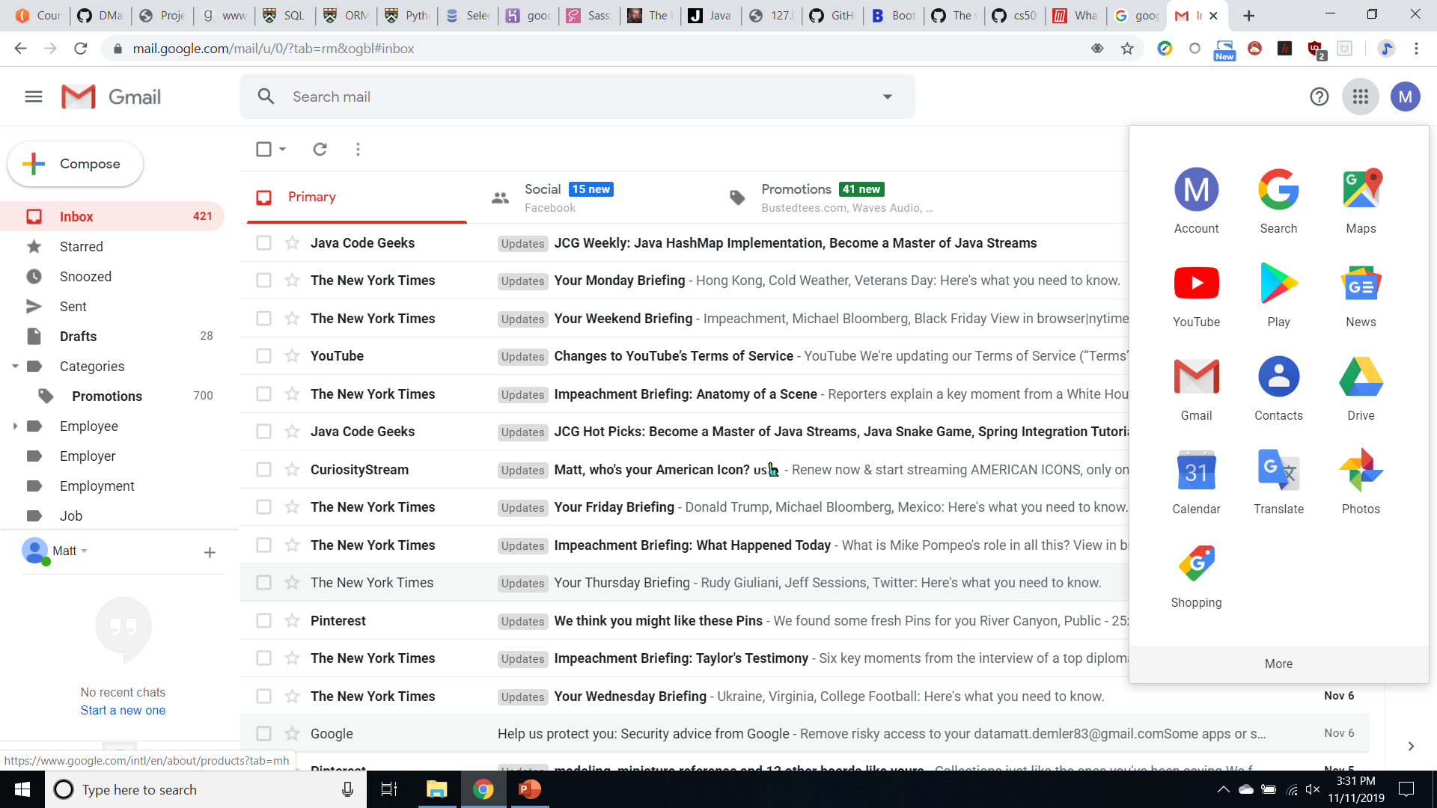
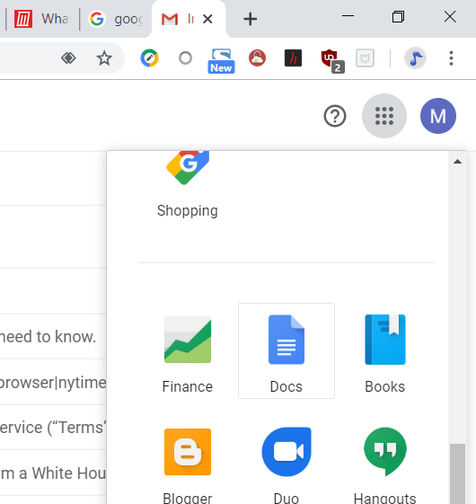
Docs is MS Word but free
1
Start with signing to Gmail or your G Suite account.
Click the 3x3 dots in the upper right of the screen.
Click More then Click on Docs
2

Slide 4
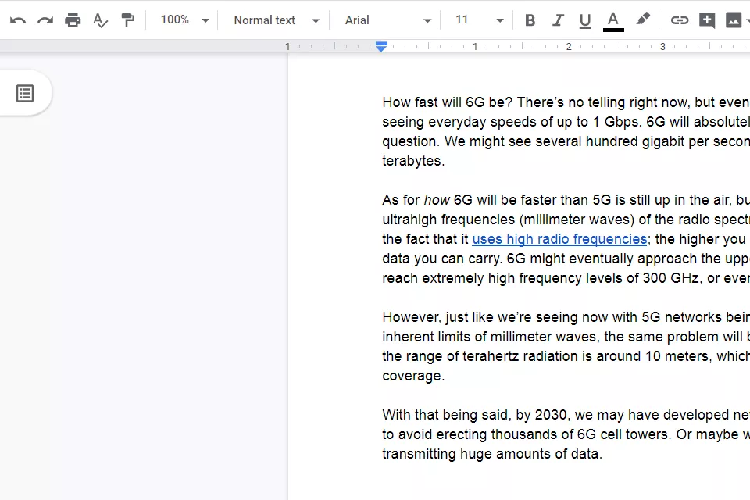
Docs shares features of Word
Saving?
Font Type
Font Size
Alignment
BIU
Lists
Pictures
Links
BookMarks

Slide 5
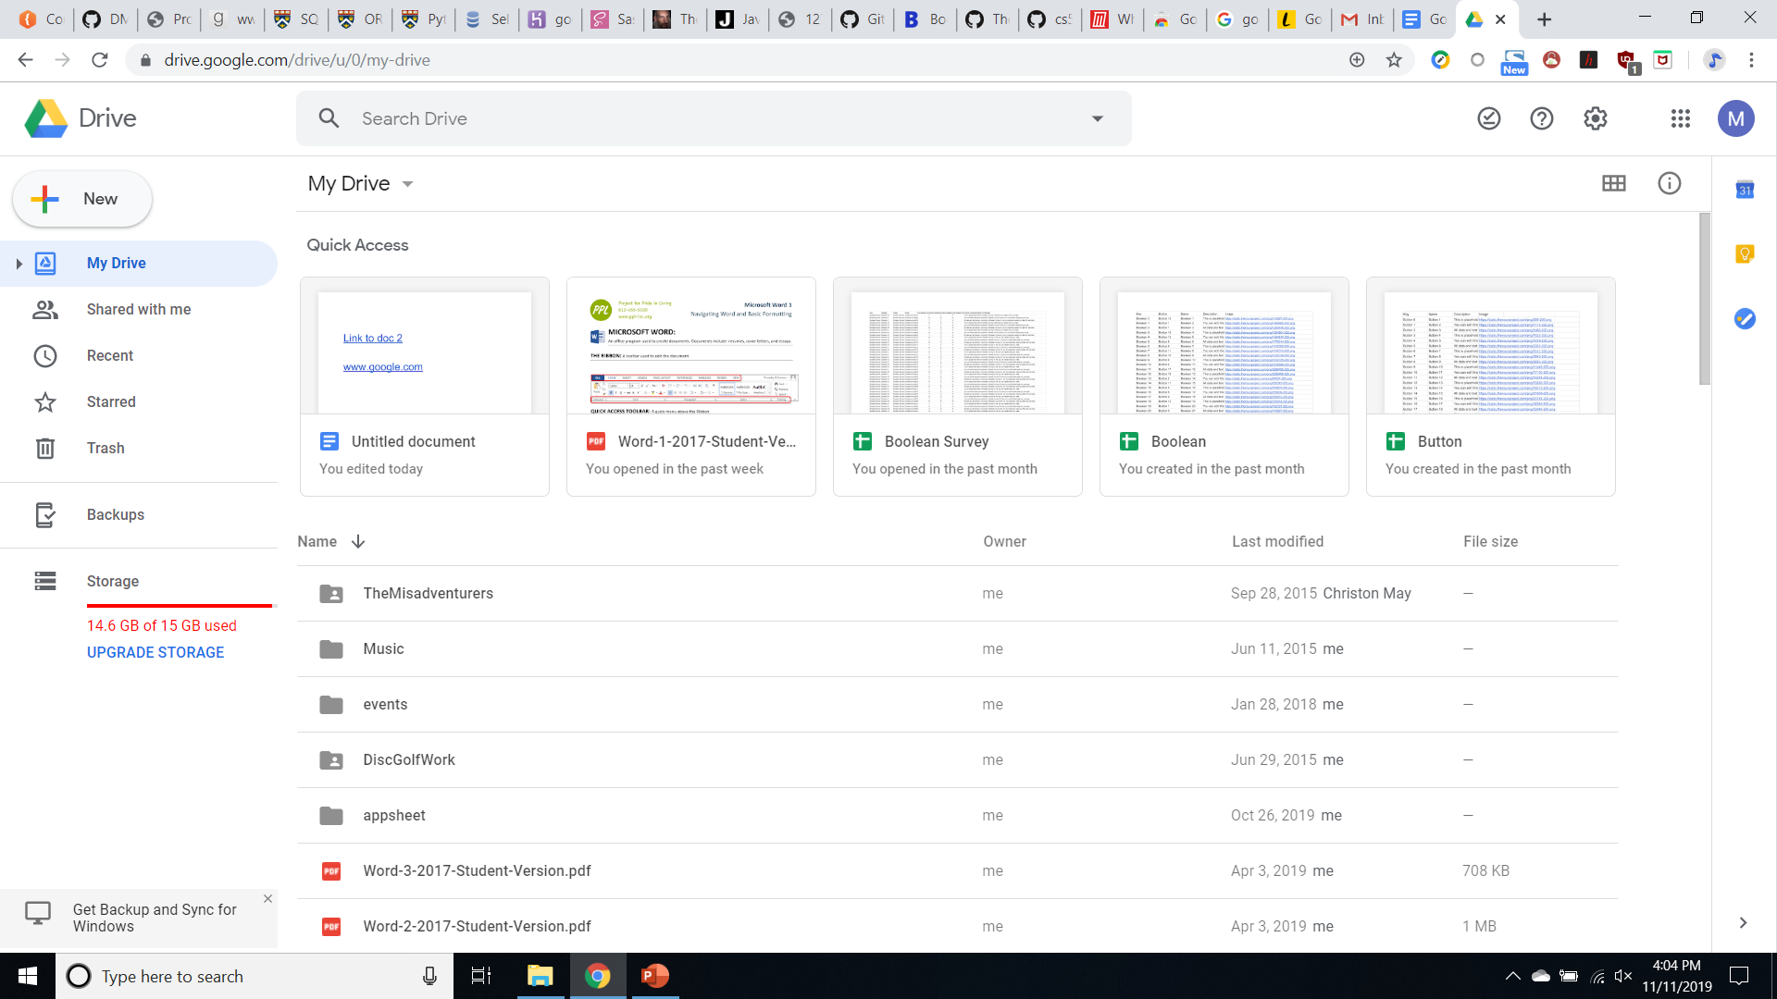
Drive
Storage for you on someone else’s computer.
15Gb Free per account
Access your files from anywhere you can be online

Slide 6
Digital Literacy
Find
Evaluate
Create
Snopes
Factcheck.org
CRAAP
Politifact
TrustPilot
Consumer Reports
MS Word
Docs
Gmail
Blogs
Art
Presentation
Google
Sweetsearch
oercommons.org
YouTube
https://www.schrockguide.net/online-tools.html

Slide 7
Four Digital Do’s
The golden rule. Treat people the way you would want to be treated.
Keep safe. Not just yourself with sensitive information like passwords and credit card numbers. Be aware of what your children are up to! There is no safe way to let a child use the internet without constant supervision.
Follow rules. Make sure to follow terms and policies of sites. Be extra vigilant on message boards that you want to go back to. Following the rules of the room will provide you with the best chance of getting the information you want.
Vigilance. People breaking the rules or engaging in cyberbullying should be reported the sites administrators. Also, keep up on local affairs such as events and elections.
Five Digital Don’ts
Don’t say anything online you wouldn’t say in person. Online comments are often hurtful. Comment sections are not known as a bastion of support. People also get much braver behind a keyboard. Never engage in online arguments, you are just shouting into an echo chamber and people already have their mind set.
Don’t use others material without their permission. Remember bibliographies from school? Copyright laws still exist online! Most people are actually happy to share free materials.
Don’t believe it just because you read it online. Anyone can publish content online. It’s very easy to make things up and while entertaining conspiracy theories and other false information can at best be hurtful and at worst spread ideas that endanger human life.
Don’t forget, everything online is there forever. Even if you delete a message one second after posting it, a copy will still exist somewhere forever. Always ask yourself before adding something to the web, will putting this online forever impact me?
Don’t be online all the time. The internet has a trillion lifetimes worth of information and entertainment. Real life is still better. Spending too much time in front of a screen can be bad for your eyes as well as your brain. Try to use the internet as a tool and not just a toy.

Slide 8
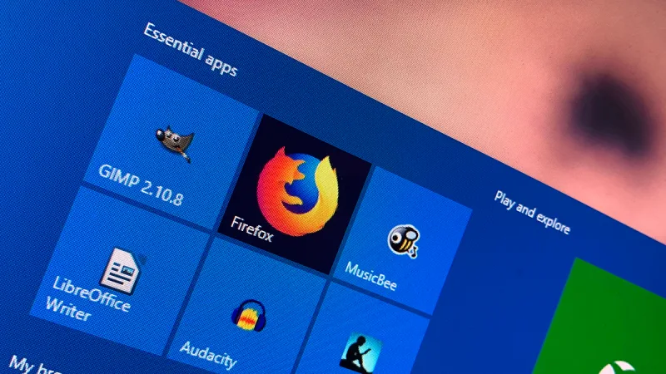
Freeware

