Slide 1
CoordCom™
Fundamentals
Notes:
CoordCom Fundamentals
This book is a training document and contains simplifications. Therefore, it must not be considered as a specification of the system.
The contents of this document are subject to revision without notice due to ongoing progress in methodology, design and manufacturing.
This document is not intended to replace the technical documentation that was shipped with your system. Always refer to that technical documentation during operation and maintenance.

Slide 2
Welcome
Presentation
Practical issues
CoordCom knowledge?
Expectations?
Notes:
CoordCom Fundamentals
Presentation of instructor and all course attendants. Name, Role, Role in CoordCom.
Go through all practical issues (toilets, restricted areas or similar)
Ask about any previous CoordCom knowledge
Discuss the expectations of the attendants regarding the course before changing over to the Course Purpose (next slide)

Slide 3
Module Purpose
Acquire general knowledge about CoordCom
Understand the Roles, Interfaces, Function areas and System layout of CoordCom
Acquire required knowledge for further training in CoordCom
Notes:
CoordCom Fundamentals
CoordCom Fundamentals is a theoretical overview course. It only provides a general knowledge of CoordCom on a high level. To be able to work in CoordCom, further practical hands-on training is required.

Slide 4
Agenda
Day 1 | Day 2 | Day 3 | Day 4 | Day 5
CoordCom Fundamentals | Operation & Maintenance | Business Data Administrator Authorization Reports & Statistics | CoordCom Geography Carmenta ResQMap | OAE Framework Upgrade
LUNCH | LUNCH | LUNCH | LUNCH | LUNCH
CoordCom Fundamentals Q & A | Operation & Maintenance Cluster and External Information | Call Distribution | Resource Management | DB Model Q & A
Notes:
CoordCom Fundamentals

Slide 5
CoordCom Overview
Notes:
CoordCom Fundamentals
This chapter will give an introductory overview of CoordCom as a product. It will give a product definition, purpose and go through the interfaces and roles of CoordCom. Some basic CoordCom concepts will also be introduced.

Slide 6







CoordCom Purpose
Emergency response
Commercial
Fire
Towing
Services
Crime
CoordCom
Locksmith
Services
Accident
On Call
Services
Automatic
Alarm
Notes:
CoordCom Fundamentals
Emergency response is the main area of use for CoordCom. It can be used for all areas within emergency response, the most common ones being fire, police and ambulance services.
It can also be used for commercial services, for example towing, locksmith or On Call services.
CoordCom also handles Automatic alarms which can be both for emergency response, such as automatic fire alarms, or commercial, such as burglar alarms connected to security services.

Slide 7

Emergency Response Requirements
Save lives & minimize suffering
Save property & environment
Cost-effective operation
Notes:
CoordCom™ O&M Course, Product Overview
Main Requirements for a Public Safety Operation.

Slide 8

Operational Challenges
Integration of many separate legacy systems
Continued demand for integration of new systems, databases, etc.
Different and changing workflow processes
Minimize costs for training and maintenance
Notes:
CoordCom™ O&M Course, Product Overview
Today, organizations in charge of handling emergency calls from citizens are under many types of pressures. Although the responsible unit can be a separate emergency organization or police, fire, ambulance etc – the challenges are very similar.
Regardless of current status of the technical systems in place, almost all emergency response agencies have in common that their different systems are not fully integrated into one environment.
In a large number of cases, especially for large accidents, there is a need to involve several agencies in the handling of the case. For example, a major traffic incident requires ambulance to transport the injured, but before that a fire truck that can open the wrecked car, and before that a police unit that can redirect traffic.
Although most systems are modern at the time of their installation, they shall live for many years and be able to incorporate many new technologies. That is, at the same time being a secure and stable system, it must be open for additions of new needs of communication or information.
Integrating different agencies with existing workflow processes that over time constantly will change is something that a emergency response system must be able to handle.
At the same time as governments often are ready to increase spending on Public Safety, there is NO acceptance for the organizations to not constantly increase the internal efficiency. That is, the costs for training staff, doing operation & maintenance, etc is still very important to bring down.

Slide 9

Society Impact Challenges
Management of several languages
Majority of emergency calls from mobile phones
Positioning of emergency
The citizens' education on the emergency number
Increased pressure for handling emergencies more efficiently
Notes:
CoordCom™ O&M Course, Product Overview
Multilingualism
All over the world, there is a constant increase in the number of people in a country that do not speak the native language. Reasons for this are e.g. immigration and tourism.
This can become a problem for the emergency organizations, since every call taker never can speak all languages needed. Therefore, it is important that the system can help to locate operators speaking the specific language of this case, and then the case can be passed on to that operator.
More emergency calls from mobile phones
The main problem with this is that it is not obvious from which location the help seeker is calling. For fixed telephony, it is relatively simple to keep address data bases of A-numbers but that has no effect for mobile calls. The way to solve this is by mobile positioning and is thus dependent on the Mobile Operators of the country. But even with support from the mobile operators, you need a concentrator to connect all the operators to the Public Safety Communication Center. This is provided with CoordCom Location Manager.
And also with a technical solution ready, you must consider local legislation regarding integrity of callers, payment method between Public Safety organizations and mobile operators, and other similar matters.
The citizens' education on the emergency number
A common problem is prank calls. This constitutes a very large number of the calls to a Public Safety Communication Center – often more than 50%! Another problem arises when a new Emergency number is introduced and old number plans are revised. For these problems there are Citizen Education that can help, but also technological solutions of different kinds.
Politicians, media, citizens
Everyone is constantly asking for better protection of the lives and properties of the country/region/city, etc. And every now and then a badly handled accident is blown up in the media and creates a temporary drive for improvements in this area.

Slide 10
Graphical User Interfaces (GUI)
CoordCom
Operator
CoordCom
Business
Administrator
Operation and
Support tools
GIS
Notes:
CoordCom Fundamentals
CoordCom Operator is the main GUI used for the operation of CoordCom, it allows the Operators to handle all telephone and radio communication as well as manage the available resources. CoordCom Operator can be integrated with a map interface (GIS) for visual two-way communication of positions and areas for resources and cases.
CoordCom Business Administrator is the GUI used by the business data administrators for configuration of all CoordCom functions. It is also used to update the system to changes in resources, stations or contacts.
Operation and support tools are a number of software tools used for support of the system for maintenance purposes.

Slide 11
CoordCom work roles
CoordCom
Operator
CoordCom
Business
Administrator
Operation and
Support tools
Call taker
Dispatcher
Customer
Service Agent
Automatic
Alarm Operator
Business Data
Administrator
Operations
Support
Engineer
Emergency Response
Commercial
Notes:
CoordCom Fundamentals
CoordCom Operator is mainly used by four roles. The roles do not have to be separate users.
Call takers main function is to respond to incoming calls from help seekers. They sort out all false calls, identify the type of incident and create a case for the incident.
Dispatchers find a suitable resource for the incident, assign them to the case and verify that the incident is taken care of.
Automatic Alarm Operators receive incoming automatic alarms, in a similar way as incoming calls from help seekers. They create cases for the alarms and pass them over to a dispatcher.
Customer Service Agents receive incoming non-emergency calls for commercial services such as car towing, locksmith services or On Call services
CoordCom Business Administrator is mainly used by Business Data Administrators, who configure all business data for the Operators. It is also used by Automatic Alarm Configurators, who handle the configuration of all automatic alarms.
Operation and support tools are used by Operation Support Engineers for operational support and maintenance

Slide 12
Authorization
No extra verification required for CoordCom
User rights connected to login name
Log out after finished work session
Windows Login
CoordCom Login
Notes:
CoordCom Fundamentals
The purpose of authorization is to control what the users are allowed to do in
CoordCom, for example what applications, functions and groups of views they
are allowed to access. The Authorization Profile can control the access to, for example, applications,
Roles, features and Case Types.
CoordCom uses the same user name as the Windows operating system. The Business Administrator enters the Operator’s Windows user name in the CoordCom system and defines the authorization settings. This means that when starting a CoordCom application you do not have to enter extra authorization information.
The Windows user name is used in information stored in the CoordCom system. Therefore, for security and follow up reasons it is important that the user is logged in to Windows with their own user name when starting CoordCom Operator, and that the user logs out when finished working.

Slide 13
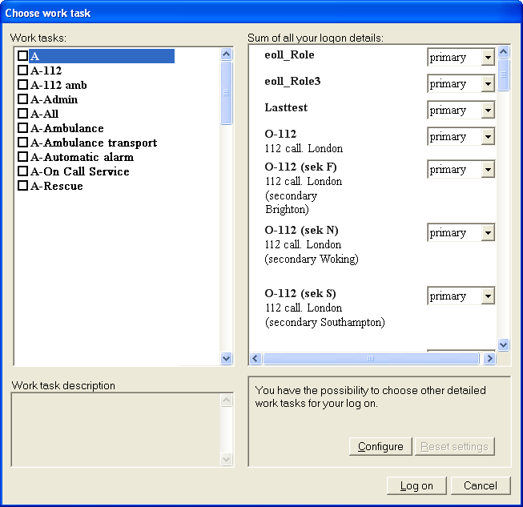
Start Up & Login
Operator selects work choices and roles
Roles selected as primary or secondary
Settings can be changed during operation
Notes:
CoordCom Fundamentals
When you start CoordCom Operator you select one or several Work choices. A Work choice is a collection of one or several work roles. Each work role includes a number of Tasks controlling what type of Calls you will receive.
The authorizations set on the user name decides what work choices you will get when you start CoordCom Operator. The authorization depends on the Operators level of experience, geographical area, witch call center they belong to etc. It also decides other configurable user settings, such as what indexes will be available in the Case folder window.
If you want to change the roles for your login session, click Configure to open the Choose role window.
For each work role, you can set the attribute Primary or Secondary. If you set Secondary, Calls connected to the Role will be distributed to you only if none of the Primary Operators answer the Call within a specified period of time.

Slide 14
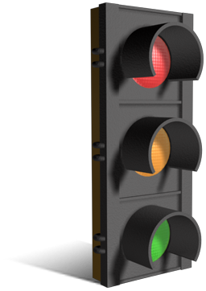
Call Escalation
Visual alert and alarm through colors
Time limits for Call Escalation configurable
Extended distribution:
  Secondary users
  Call center wide
  System wide
Notes:
CoordCom Fundamentals
Visual alert and alarm through colors: A call appears as green in the inbox. After a predefined number of seconds it turns yellow and then finally red to indicate that the call has not been answered
Extended distribution: After a predefined time, the call is first distributed to secondary users, then to entire call center and finally to the entire system.
All visual alerts and call escalation times are fully configurable in CoordCom Business Administrator.

Slide 15
Operator Workflow
Incident
Call
Identify
Sort
Activate
Follow-up
Incident
Call taking
Dispatching
Activate
Follow-up
Dispatching
Call taker collects information and categorizes incident
Dispatcher assigns resources and follow-up incident
Call taking and Dispatching can be performed parallel
Notes:
CoordCom Fundamentals
The workflow for the Operators can be divided into six phases:
Incident: a fire/accident/crime which requires attendance occurs somewhere
Call: Someone calls the emergency number and is connected to the right Call taker through selections
Identify: The Call Taker determines whether the call is true or false and if it is a already known case. If not so, a Case is created
Sort: The Call taker categorizes the case with support from the system
Activate: The Dispatcher locates a suitable resource and assigns it to the Case
Follow-up: The Dispatcher verifies that the situation is taken care of and closes the Case
Call taking and dispatching can be performed parallel and could be performed by the same Operator

Slide 16
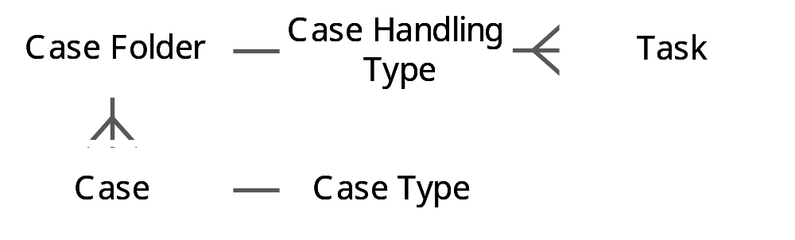
Cases
All vital incident info entered into a case
Case types (Fire, Ambulance, Police)
Case Handling Type
Case folders for incidents with multiple cases
Case folder status: Private, Public and Finished
Cases stored for statistics
Notes:
CoordCom Fundamentals
A Case is managed from the Case folder window. A Case folder contains one or several Cases. Each Case which is associated with a Case folder included as a Case tab. For example if there is a big fire at a shopping mall, the Case folder could contain a Rescue case and an Ambulance case, shown in different tabs.
The layout of the Case tab depends on the Case type, Case Handling Type and Case folder view. When the Case is classified by selecting an index, the Case type layout for the index will be used. This means that the layout, for example a Rescue case looks different from an Ambulance case. The layout of each Case type can be configured in CoordCom Administrator.
Case Handling Type
The Case Handling Types are used to categorize the Calls, matters or incidents on a higher level than the Case Types. They should preferably be configured to correspond to the work processes of the organization running CoordCom.
When the Operator answers an incoming Call, CoordCom creates a Case Folder including a private Case. The number called by the caller defines what initial Case type is to be used.
There are several ways to classify a Case according to Case type, for example:
Answer a Call from an Inbox: Each Inbox has a Case type defined as starting Case type for answered Calls. The inboxes are configured in CoordCom Business Administrator
Request Assistant monitoring: Depending on who you request assistant monitoring from, the Case will be typed for example Ambulance case, Rescue case or Police case.
Click Accelerator button: Depending on which button you click the Case will be typed accordingly.
Select index: In the Index block you classify the Case by navigating in the index structure. The index is set for the Case when you double-click an index or mark an index and press Enter.
The case folders can be Private, Public and Finished.
When a Case folder is created it is considered as Private, which means that only the one Operator can access it. To be accessible for other Operators, and presented in the list of Public Cases, the Case must be publicized. You can publicize a Case manually or done implicitly as a result of the involvement of other Operators (for example through Assistant monitoring). When the case is solved, it will be finished. All the finished cases are stored for statistics.

Slide 17

Caller information
Operators can obtain Location and Name of Caller from the used number
Caller information is retrieved from internal or external Database
Data automatically entered into new case
Also possible to position callers through mobile phone positioning
Notes:
CoordCom Fundamentals
CoordCom can include functions for automatic identification of number, location and location of the incoming call.
The information is automatically entered into the new Case to save time.
Mobile phone positioning can be used to position callers who are lost and can save lives.
Positioning can be done maually.

Slide 18
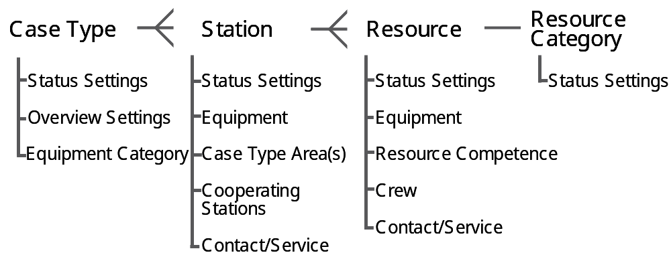
Resource Management
Notes:
CoordCom Fundamentals
Resource management allows Operators to assign Missions to a Resource, and later follow up on Missions through status handling. Dispatchers who select Resources based on skill and geographic position use Resource Views, which are configured in CoordCom Business Administrator.
To each Case Type it is possible to define one or several Stations and their Resources. The features connected to Stations and Resources are described in the following sections.

Slide 19
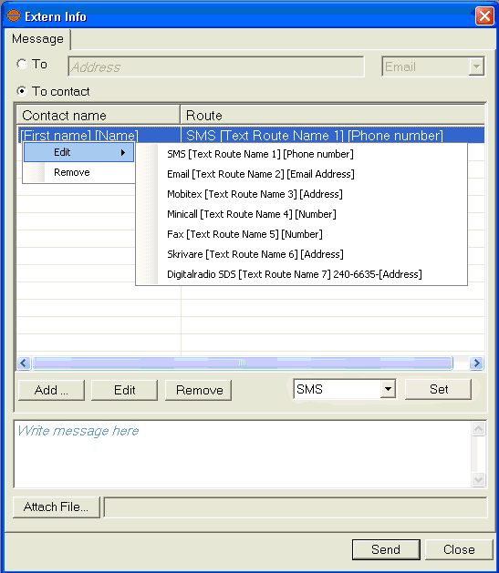
External information
Inform Resources and external contacts
Case info, free text or notes
Information can be sent through:
- SMS
- Mobitex
- Minicall
- Fax
- Printer
- E-mail
- Digital radio
- IP
Notes:
CoordCom Fundamentals
While handling a Case it is often necessary to inform Resources and external parties about details of the Case or to give them other related information. CoordCom therefore includes functions for sending messages.
In the Contact Book open the shortcut menu of a Contact to contact it according to the rules set up in CoordCom Administrator or click Messaging on the shortcut menu to get more options. From the Resource Views it is possible to right-click a Resource and then click ExternInfo to send either Case data, free text or both.
You can add notes to the Case or Case folder in the Notes block. The purpose with the notes is that you can add extra information not entered in other blocks, to the Case or Case folder and send the information to allocated Resources.
An Action plan can contain instructions to send information to a Contact or Resource, for example send Case information by use of e-mail or send a predefined SMS to a predefined receiver.
From CoordCom it is possible to send Case information to a Contact from for example a Contact or Resource shortcut menu, or an Action plan. The data to be sent is defined in a receiver profile in CoordCom Administrator.
You can also send a message to a Contact or Resource from the Extern Info window. If you open the Extern Info window with a Contact selected, the Contact and its Contact routes are displayed in the window. If you open the Extern Info window with no Contact selected, you have to specify to whom you want to send the message. In the Message tab you can attach files to the message if the Contact route to be used is e-mail or fax. On the Advanced tab you can set up the message to be sent as follows:
Save as attached file to current Case.
Send information from current Case.
Use other predefined receiver profile.

Slide 20
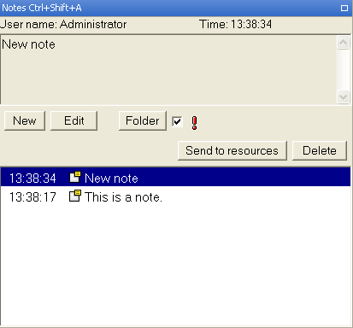
Notes
Additional information not entered in the block can be sent to the resources
Format Text/XML/report/terminal application
Notes:
CoordCom Fundamentals
Sometimes you need to add extra information to a Case and distribute it to connected Resources. This extra information is called Notes and managed from the Notes block. You can choose to add a note to an active Case or a complete Case folder.
Each Contact has a set of defined Contact routes, sorted in order of priority, to be used when contacting the Contact. The CoordCom Business Administrator can define a valid day type and time period for each Contact route. For a Contact associated with a Resource, the validity of a Contact route may also be dependent on one or several resource statuses. That is, Contact routes may be associated with one or several resource statuses and for a specific Contact route to be valid it requires that the resource has one of the associated statuses. An Operator may however override the time and status conditions by indicating a specific Contact route as active.
A receiver profile is a definition of what data from a Case a specific receiver of information should get and in what format it should be sent. For a Contact, receiver profiles are associated with the defined Contact routes. Several Contacts can use the same receiver profile.
The receiver profile includes the following parts:
Format (Text/XML/report/terminal application).
If sending the message should be done with our without involving the Operator. Normally the Operator does not need to be involved.
Labels for the different Case data if text format is used or XML-tag for all included field and piece of information if XML is used.
What data from the Case that should be included and in which order they should be sent.
Types of actions extracted from the Case log that should be included.
Plain text.

Slide 21

Reports
Execute and distribute statistical reports
Retrieve Data from Historical Database
Schedule reports to be sent automatically
Generate and read reports with Crystal Reports®
Notes:
CoordCom Fundamentals
CoordCom includes many options for generating and distributing statistical reports. All Case data is stored into a historical Database, from where the relevant data can be retrieved manually or automatically.
Crystal Reports ® is a statistical report tool commonly used for these purposes.

Slide 22
System Layout
Notes:
CoordCom Fundamentals
The System Layout chapter will go through the system architecture and the basic System components. It will give an overall understanding of the system layout and some basic redundancy concepts.

Slide 23

System Flexibility
Flexible and adaptive system structure
CoordCom can be expanded in terms of:
  Capacity (Operators and covered population)
  Dependability (Redundancy concepts and High Availability solutions)
  Functions (e.g. Positioning, Traffic monitor)
Notes:
CoordCom Fundamentals
CoordCom is a highly flexible system with many options for expansions. It can be configured to fit the needs at installation as well as adapt to the needs that arise with time.
There are several Redundancy concepts available including the possibility for clustered databases and servers, providing a very high level of dependability.
Capacity: the numbers of Operators and thereby the number of serviced population
Dependability: redundancy concepts and solutions to raise the level of dependability
Functions: additional functions such as traffic monitor or advanced resource management

Slide 24
CoordCom System
CoordCom System
CoordCom
site
CoordCom
site
CoordCom
site
Wide Area Network (WAN) Communication
Notes:
CoordCom Fundamentals
A CoordCom system will commonly include more than one site. There is always a main site within the system and besides the main site there can be more sites both for geographical and redundancy purposes. The sites communicate through Wide Area Network (WAN).

Slide 25


CoordCom Sites
Database
CoordCom Site
Servers
Workstations
LAN Communication
Notes:
CoordCom Fundamentals
A CoordCom System can include one or more Sites. A Site includes a number of Workstations and Servers.
The Database stores and includes case data.
The servers handle communication.
The workstations are used by the Operators and Administrators.
The group of workstations can also be called a Call Center and does not have to be at the same geographical location as the site.
There is always at least one Database in the system in the main site, but additional sites do not need their own database. A site does not always include a database.
All communication within the site is carried out through Local Area Network (LAN).

Slide 26
Example of a CoordCom system
System
Medium site
Main site (Large)
Call Center
Central
Clustered
Local
Notes:
CoordCom Fundamentals
A CoordCom system always includes one central database and a central set of servers. Usually there are local databases and servers present as back up.
Some call centers will work against the central database and servers through Wide Area Network (WAN).
The Call Center to the right on the picture is a remote Call Center, without databases and servers.
The system can also contain clustered databases and servers.

Slide 27


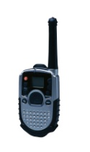
System Redundancy
System
Synchronized
Medium site
Main site (Large)
Small site
Notes:
CoordCom Fundamentals
CoordCom includes several redundancy solutions for high availability. The databases within the system are replicated, which means that they include the same information.
If one database becomes unavailable, another takes over without interruption for the Operators within that site.
If an entire site becomes unavailable, CoordCom will transfer all incoming calls to that site to another available site.
The servers also have redundancy, so that if one becomes unavailable, another server takes over.
It is also possible to include clustered servers or databases within a site. Clustered servers are two completely identical, redundant units for even higher reliability.

Slide 28
Remote Clients and System Sites
CoordCom site
Remote
Client
System site
Notes:
CoordCom Fundamentals
A remote client is a computer at for example a police station. The remote client uses an interface called CoordCom Remote Case Client to access the database externally to view case data.
A system site is a backup setting of servers and databases that could be located at a secure place for back up possibilities.

Slide 29
CoordCom Function Areas
Notes:
CoordCom Fundamentals
This chapter will show the main function areas of CoordCom. The function areas will be briefly presented individually. There are also some supporting function areas which will be introduced.

Slide 30
Function Area Dimensions
Emergency
Call Taker (CT)
Dispatcher (DISP)
”Front”
”Back”
Customer
Services (CS)
Automatic
Alarms (AA)
Commercial
Notes:
CoordCom Fundamentals
The Operator Roles can be divided in two ways:
Front / Back: Front means the Operators that handles the help seekers or Customers directly. Back means the Operators that handle the resources or contacts.
Emergency / Commercial: Emergency means the Operators that work with emergency response and Commercial means Operators who provide commercial services.
The exception is the Automatic Alarms that can be both emergency response and commercial services.

Slide 31
Function Areas Overview
Call Taker (CT)
Dispatcher (DISP)
Communication
Management
Case
Index
Case
Management
Action
Plans
Interview
Support
Contacts
& Services
Resource
Management
Customer
Services (CS)
Automatic
Alarms (AA)
GIS (map)
Interface
Customers &
Contracts
Notes:
CoordCom Fundamentals
This is a rough map of which function areas the Operator uses.
There are a number of ”core functions” that all Operators use:
Communication management
Case management
Contacts & Services
GIS (map) interface (optional)
Call Taker / Customer Services function:
Case Index
Interview support
Two dispatcher / Automatic Alarm Operator functions:
Action plans
Resource management
Commercial function area used by Customer Services / Automatic Alarms:
Customers & Contracts

Slide 32
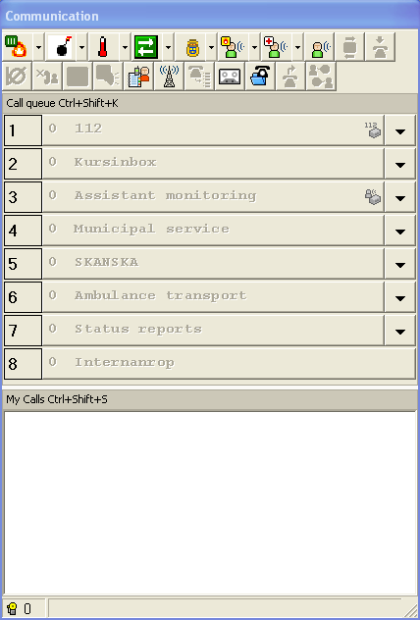
Communication management
Handle all communication (telephone, analog radio, digital radio and alarms)
Separate inboxes for different types of calls
Assistant monitoring and conference
Transfer calls to other Operators
Activate or replay recorded calls
External Assistant Monitoring
CT
DISP
CS
AA
Notes:
CoordCom Fundamentals
CoordCom provides a radio function for communicating with a radio terminal. To adapt to the customer's choice of radio network, the Radio function is always a customer specific solution. This means that the description below only is an example of how the function can be designed.
An example: To contact a Resource, make an open radio call, or start monitoring a radio channel, CoordCom requires input from the Operator, which is entered in the Radio window.
A new entry is generated in the Communication window for all types of calls. The calls are automatically distributed to different Operators according to their work tasks. Each incoming call is directed to an inbox in the Call Queue block. Each inbox bar indicates the number of waiting calls for the specific task. By clicking the bar you answer the call displayed on the bar. If you click the Size arrow to the right on the bar you expand the inbox queue and can select any of the calls in the inbox.
In CoordCom Business Administrator it is possible to configure whether or not Sound Alerts will be activated in CoordCom Operator for certain Calls (new Calls, Calls of different Call priorities, Calls in different Call Inboxes, and status change of a Call in the Inbox) when arriving to the Call Queue.
An incoming call is first displayed in the Call Queue block with a green background. The bar will change to yellow and then red if no Operator answers the call.
If the Call is not answered within a configurable amount of time, the Call will be distributed to a larger amount of Operators. This is called the Secondary Distribution. And if there were no Operators found for Secondary Distribution, the system will try a Call Center Wide Distribution. If a Call is not answered in time when distributed according to the Call Center Wide Distribution, or if there were no Operators found, the system will try a System Wide Distribution of the Call. The Call Distribution Escalation is indicated to the Operator in the Call Queue Block with a black vertical bar to the right of the Call.
The My Calls block lists all active calls, for example incoming calls and assistant monitoring calls. The shortcut menu for a call lists the functions available to manage the call. The available functions vary depending on the type of call.
You can also manage a call by using the function buttons at the top of the Communication window. The buttons are shortcuts to common functions for call management. You also find Call management functions on the Communication menu in the program menu bar.
The Operator can set the Operator Position as Busy or Blocked, meaning the following:
New Calls (created after the Operator Position is set as Busy/Blocked) that are distributed primary will not appear in the Call Queue
New Calls that are distributed secondary will appear in the Call Queue (Busy)
New Calls that are distributed secondary will not appear in the Call Queue (Blocked)
Calls that already are in the Call Queue will remain
New Calls directed explicitly to the Operator (For example transferred telephone calls) will still appear in the Call Queue
This is supposed to be used when the Operator “needs a break” and wants to be able to take care of existing Calls to get an empty Call Queue Window.
Search for Relevant Case: CoordCom searches for existing relevant Cases connected to the a-number. For an incoming, answered telephone call, the Operator has the possibility to start a search for a relevant Case. If configured in Business Administrator, the search can also be performed automatically by the system when the telephone call is answered.
Request for Assistant Monitoring: An Operator in control of a Call may request the assistance of one or several other Operators to handle the Call. An Operator can also request assistant monitoring from one or several external parties.
External assistant monitoring makes it possible to make a better evaluation of an Incident by contacting an officer who can assist during the interview and influence the mobilization.
This is further described on next slide.
Conference: The Operator can create a Conference consisting of two or more participants, internal or external parties, where each participant hears every other participant. Any participating Operator can add new members into a Conference or terminate any existing member.
It is possible to combine Conference with Assistant Monitoring that is, the participants in the Conference can hear and talk to each other including the Operator. The participants in the Assistant Monitoring can talk to each other and the Operator and also hear the participants in the Conference but not the other way around. When the Operator hangs up, the participants in Assistant Monitoring will hang up automatically and the Conference will continue. If the participants in the Conference hang up, the Operator can continue to talk with the assisting Operators.
Request for Assistant Conference: If an Operator needs assistance from other Operators during a Call, the Operator can Request for Assistant Conference. The request will be sent to a predefined group of Operators. The group is preconfigured in CoordCom Business Administrator.
Mediation: A Mediation, meaning a connection of two external parties without any Operator participating, can be created. When the Mediation is made to an outgoing, not yet answered Call, the system will supervise that the outgoing call is answered within a specific amount of time. If not, a Call will be generated to relevant Operators, and when answered, the connection is set up with the calling party. An Operator may see and join ongoing Mediations that are relevant for his/her current Work Choice.
Transfer: A Call can be transferred to another Operator or Operator group. The Call will appear as a Call in the Call Queue Window of the receiving Operator and when answered, the connection is set up and corresponding Case is presented.
Request to join: An Operator may join an ongoing conversation by sending a request to join to the Operator in control of the conversation. The corresponding Case is then presented to the requesting Operator.
Internal voice call: This is a Call from one Operator to another. The Call is presented to the called Operator in the Call Queue. The Case corresponding to the Call will be presented when the Call is answered.
Outgoing call: When making an outgoing telephony call and encountering a busy subscriber, the system attempts to reach the called subscriber by automatic re-dial, until the maximum time limit (set on system level) is reached or until the Operator hangs-up the Call. It is also possible to call back to a Help seeker or Caller using phone number information in a case.
Blocking of Incoming Calls: The Operator can block telephone calls from specific A-numbers from entering the Call Queue. When a Call from a blocked A-number is received in CoordCom the caller can hear a Voice message (or a busy tone if no Voice Message was defined for the blocking).
To be able to handle extensive Cases or to speed up the handling of a single Case an Operator can request assistance from other Operators during an ongoing call. The Operator can choose to select another specific Operator when requesting assistance or select a general request of assistance.
The assistant Operator can hear the conversation and talk to the original Operator but the caller does not hear the assistant. The assistant also receives all Case information which has been entered by the original Operator. The original Operator can let the assistant Operator take over the Case and continue the interview.
The request is presented as a new entry in the Call-queue block. It is also possible to switch function with the assisting Operator, that is Operator 1 will become assisting and vice versa).
The Radio window can be opened in several ways, for example:by clicking the Radio button in the Communication window, from the shortcut menu of an entry in the Contact Book, from an instruction in the Action plan block, from the Resource shortcut menu, or by using shortcut keys.
To monitor a specific channel and base in the loudspeakers, click desired channel and base in the Channel and Base lists, and then click Monitor.
Define Channel/Group Id and Base for making a Group call or Resource Name, Radio Id, Radio System and Base Station for making an Individual call. (See differences here between analogue and digital radio networks. In an analogue network are individual calls made on an open channel, in other words the communication is not individual.)
The Busy bases part of the Radio window lists occupied Channels and Base Stations and which Operator that has locked them. The occupied Channels and Base Stations are not selectable in the lists when setting up radio communication.
Communicate with the Resource using the Push To Talk (PTT) key on the keyboard (F3).
The Active radio call is listed in the My Calls block in the Communication window.
All voice communication on an Operator position is digitally recorded. In the Voice recorder the Operator can listen to a previously recorded conversation. The CoordCom system keeps an association between the voice recordings and related Cases, which makes it possible to replay all voice conversation for a specific Case.
From the Voice recorder you can listen to the voice communication that you are authorized to listen to. All Operators can listen to communication recorded during the current login session. If you want to search for and listen to a voice communication from a previous session or another Operator’s session, you must be authorized to do so. It is possible to search for recordings connected to the current Case or Case Folder, and to open a Case or Case Folder from the list of logged recordings.
Click the Reverse assistant monitoring button when you want to hand over the call to the Assistant Operator. In turn you will act Assistant Operator.
Click the Hang up button to end the call.
Click the Mute button if you want to turn off your microphone.
Click the Isolate button to isolate any other participant in the voice call. As a result the isolated party will not hear any other party.
Click the Put call on hold button to temporarily put a call aside. To pick the call up again, right-click the call in the My calls list and then click Return call to active.
Click the Put call on hold in monitor button if you want to monitor a call in the loudspeakers while put on hold.
Click the Returns call to call-queue button if you want to return a call to the Call queue. This action results in a new Call in the applicable inbox.
Click the Other calls button to list calls that have been mediated and still are ongoing. If you want to take part in a mediated call, click the call and then click Enter call.
Click the Transfer call to other Operator button to transfer a call directly to another Operator or Operator team. Select desired Operator or Operator team in the Select Operator dialog box, and then click OK.
In CoordCom Business Administrator it is possible to configure voice messages that are played to the caller when the call is distributed to a Call Queue and when a call is put on hold.

Slide 33
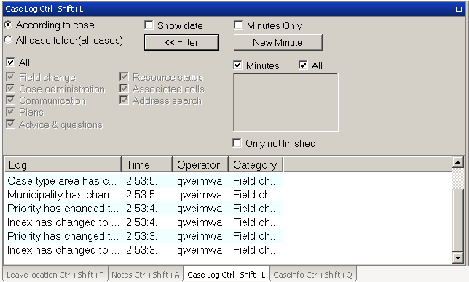
Case management
Case folder
Case classification
Case views
Case Log
Case lists
Case Access Logging
Time scheduling & surveillance
Location
CT
DISP
CS
AA
Notes:
CoordCom Fundamentals
A Case is managed from the Case folder window. A Case folder contains one or several Cases. When a new case is associated with a Case folder it is included as a Case tab in the Case folder. For example if there is a big fire at a shopping mall, the Case folder could contain a Rescue case and an Ambulance case.
The layout of the Case tab depends on the Case type. The number called by the caller defines what initial Case type to be used. When you classify the Case by selecting an index, the Case type layout for the index will be used. This means that for example a Rescue case looks different from an Ambulance case.
When the Operator answers an incoming Call, CoordCom creates a Case Folder including a private Case.
The Case folder window contains a configurable number of blocks for entering Case data. The blocks can be either primary or secondary. If primary blocks are piled upon each other they appear as tabs. Secondary blocks always appear in a pile.
The Case Folder has one view and each Case has two different views (Calltaker and dispatcher view) . A Case is always of a specific type. Examples of common Case types are Ambulance case, Rescue case and Automatic alarm case. Each Case type has its own layout set up in CoordCom Administrator.
There are four ways to classify a Case according to Case type:
Answer a Call from an Inbox: Each Inbox has a Case type defined as starting Case type for answered Calls. The inboxes are configured in CoordCom Business Administrator
Request Assistant monitoring: Depending on who you request assistant monitoring from, the Case will be typed for example Ambulance case, Rescue case or Police case.
Click Accelerator button: Depending on which button you click the Case will be typed accordingly.
Select index: In the Index block you classify the Case by navigating in the index structure. The index is set for the Case when you double-click an index or mark an index and press Enter.
When you create a Case (direct or indirectly by answering a Call) it is considered as Private, that is only you can access it. To be accessible for other Operators, and presented in the list of Public Cases, the Case must be publicized. You can publicize a Case manually, or it is done implicitly as a result of the involvement of other Operators (for example through Assistant monitoring).
Case Access Logging makes it possible to follow up all access to Case information regarding an authority's regulations of personal secrecy information.
Time scheduling and surveillance could be a preordered pickup of a dialysis patient.
Other feathers in CoordCom are for example.
When privacy policy is used there is sometimes a need to share Mission information. It is therefore possible for Organizations working in different Cases in a Case Folder to share for example Resource information, in the Case Folder view. Which information to be shared is possible to configure. It is also configurable which Organization that will allow sharing of information.
CoordCom has a language classification of Case folders. The Operator can set the Language of the Case Folder manually and transfer the Call to an Operator speaking the specific language.
CoordCom can share the incoming information from SDS/SMS with the rest of the Organizations working within the same Case Folder.
Location The CoordCom geography concept helps the Operator to quickly identify the location of an incident and assign appropriate Resource to the Case.

Slide 34
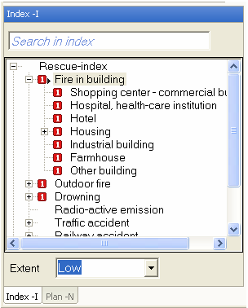
Case Index
Categorize the case
Separate indexes for different Case types
Index level 1-3
Priority level 1-4
Questions, Advice and Action Plans connected to index
CT
DISP
CS
AA
Notes:
CoordCom Fundamentals
In the Index block you classify the case by navigating in the Index structure. The Index is set for the Case when you double-click an Index or mark an Index and press Enter.
The Indexes are defined in up to three levels displayed in a tree structure. Expand an Index to display lower levels of the Index.
An Index can have priority level 1 to 4, where 1 is the highest priority. The priority level is displayed in front of the Index as a number in a colored box. You set the priority level for the Case when you set Index for the Case. The priority of the Case can also be set in the Person block.
If a Case Type Area is selected for the Case, the block will indicate with an arrow that plans are defined for the combination of Case Type Area and Index.
The selection of an Index can set the extent of the Case. The extent is displayed at the bottom of the block.
When you select an index in the Index block, Questions and Advice and Action plans may be connected to the Index. The questions and advice are presented in the Interview support block, see next slide.
There are separate indexes for different case types.

Slide 35
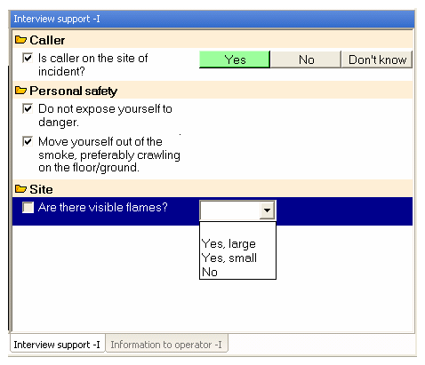
Interview support
Support for the Call Taker during calls
Questions and Advice for the help seeker
Help to estimate the severity of the situation
CT
DISP
CS
AA
Notes:
CoordCom Fundamentals
When an index is marked in the Index block the Questions and Advice provided in the Interview support block gives you indications on how to continue the interview with the calling person.
Select an answer to a question by clicking a button and enter information in the text field below the buttons where applicable.
If configured, the answer to a question generates new questions and advice. The answer can change the Index selection or extent of the Case. If an answer is selected that changes the index node, the questions and advice is changed to support that particular index node. The change of Index selection is only made within the Case Type. Answers and advice given previously, and that exist for the new Index selection, are transferred to the new Index selection.
Some of the answer buttons are marked with a symbol. The symbol indicates for example that if the answer to a question is Yes, the extent of the Case will be changed to a higher extent.
The block Information to Operator, lists information and advice for an Operator to act upon. The block also contains a description of the index selected in the Index block.
The answers filled in in the Interview support block are logged in the Case and useful when the Case is transferred to a Dispatcher or Resource.

Slide 36
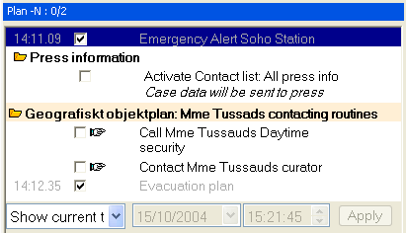
Action Plans
Support for the Dispatcher
Relevant information and Actions for specific incidents
Quick access to relevant competence
Mandatory Actions
CT
DISP
CS
AA
Notes:
CoordCom Fundamentals
When the Dispatcher has a Case, the Action Plan shows the steps that should be taken to solve the Case. The Action Plan can be a general plan or an aggregation of a number of sub plans.
The following types of plans exist:
Calling number (A-number) Plan: This could for example include instructions on how to proceed with a calling party that does not speak any languages that the Operators master. The instruction could be to set-up a 3-party conference with an interpreter. A Calling number can have different Plans for different Case types.
Customer Plan: This is relevant for handling of automatic alarms and On call services. The partial plan could be triggered by a call to a specific B-number (Service number).
Automatic alarm Plan: This is only relevant for automatic alarms. The plan is included in the Case by parameters associated with an incoming automatic alarm, or delivered in conjunction with the alarm as a part of the incoming data.
Index and Case type area Plan: Plan instructions may be connected to the given index in combination with the area where the incident has occurred.
Index, Case type area and Contract Plan: This is only relevant for handling of On call services. It is triggered when a Contract has been selected in conjunction with selection of an index node.
Plan for a Point of interest: A Point of interest can have different Plans for different Case types.
Plan for a Customer object: Objects attached to a Case may also contribute to the Resulting plan by adding correlated Action plans.
Each partial plan includes one or several instructions with descriptions. A number of attributes define instruction actions, for example if the instruction is mandatory and must be executed by the Operator. The actions to be taken in a Plan may be of various kinds. The list below gives examples of possible actions:
Information: Pure information text to the dispatcher. Configurable whether it is written into the Case action log or not.
Contact, Contact list or Service: Activation of a Contact, Contact list or Service.
Dial a telephone number
Send Case information by use of e-mail: The receiver is defined within the instruction.
SMS: The content and the receiver are defined within the instruction.
Link to a document or program: The appropriate program is activated, possibly with parameters defined within the instruction.
Station alert: The Station and Alert category is included in the instruction.
Create new Case: A new Case is created within the existing Case folder. Case type and index node is defined within the instruction.
Request Assistant monitoring: The receivers (that is the Assistant Monitoring group and Case Type) are defined within the instruction. This may also lead to the creation of a new Case (see above) why it should be used very restrictedly in combination with the “Create new Case” instruction; otherwise some unwanted duplicate Cases may be created.
Tie a Resource: The given Resource is connected to the Case.
Resource Proposal: A Resource Proposal propose Resources to the Operator for an active Case. The Operator can with one command from the Resource Proposal window mobilize the selected Resources.

Slide 37
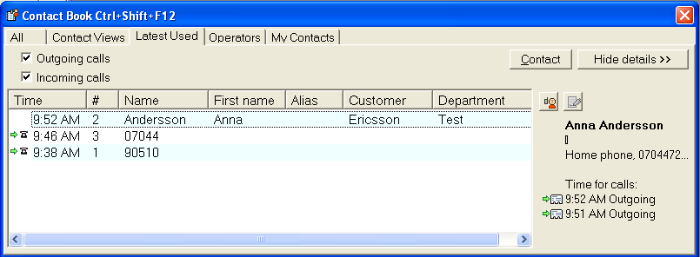
Contacts & Services
Contact book
Contacts, Contact lists or Services
Predefined contact routes (Telephone, E-mail, SMS, Fax)
Time scheduled contact routes
Fast access to specific functions
Mass alert enabled contacts
CT
DISP
CS
AA
Notes:
CoordCom Fundamentals
You can activate a Contact, Contact list or Service in different ways and at different stages in the incident handling process. The Contact Book window contains functions for Contact activation including searching and sorting facilities.
A Contact is typically an individual, but it can also refer to a Resource, such as an ambulance with a crew. A Contact list is a group of Contacts that are activated sequentially or in a parallel. A Service is a group of contacts who share a responsibility for a specific task according to a calendar or schedule.
From the All tab you can search for an entry by entering a name or alias. In the My Contacts tab you can add private Contacts. Private Contacts are not available to other Operators. The Contact Views tab contains a drop-down menu with groups of Contacts, Contact lists or Services. The Contact Views are defined in CoordCom Business Administrator. The Latest Used tab lists the Contact Book entries that have been contacted during the last period of time. From the Operators tab you can contact other Operators in the CoordCom system, for example if you need to contact an Operator with a specific work choice or role, or a specific competence. For each Operator the status, Available, Blocked, or Busy, is presented. On the Address tab you can search for a Contact responsible for the area where an incident has occurred. Enter Case Type, Address and click Search and the Contacts in the Case Type Area of the incident will be listed.
To communicate with a contact, select it in the list and click the Contact button. If configured, an accelerator button allows the Operator to quickly set up the communication with a specific Contact.
Routes and alternative routes can be used when contacting a person. Routes are sorted by priority and defined with valid time slots and resource status settings. Contacts can also be used to send selected Case information from an Operator in a predefined format such as e-mail or text message.
Mass alert enabled Contacts offers an effective way to send information to a large number of Contacts, for example to inform about a coming storm. The Contact list can be either manually defined by the Operator or received from an external system, as the GIS map. In this case the selection is based on both geography and Contact Categories.
Mass alert enabled Contacts can prevent further damage to lives and/or property caused by a geographically escalating Incident

Slide 38

Geographic Information System (GIS)
Display of areas, points of interest, cases, contacts and resources
Operators can:
- Position Cases on map
- Receive Case type area
from map
- Receive coordinates of
mobile Resources
(through optional interface)
Generic Management of Several Coordinate Systems
CT
DISP
CS
AA
Notes:
CoordCom Fundamentals
A map system can be integrated with the CoordCom system. Case type areas, Points of Interest and mobile Resources are plotted on the map.
The map is a third party product, that is other vendors than CoordCom deliver the map.
The Operator can start a positioning request for a single Case or a list of Cases. CoordCom transfers the Cases to the Geographical Information System (GIS), which finds the correct positions (coordinates) of the Cases and presents them on the map view. Per received Case, the Case type area will be returned to CoordCom. When the Operator manually moves the Case to a new position on the map view, the GIS system can send the correct Case type area to CoordCom. Any change of location for a Case will automatically be transferred from CoordCom to the GIS system, so that the Cases at all times are presented on the map view with the latest location.
If position reporting is integrated, for example a radio system with functionality for reporting actual positions for mobile units, CoordCom continuously transfers correct position (coordinates) of the mobile resources to the GIS system. This makes it possible for the Operator to at any time see the resources at their actual position, which supports the Operator to find the most appropriate resource for a Case. Resource data like current status is also transferred and presented in the GIS system as soon as this information is changed in CoordCom.
Position coordinates in CoordCom can be given in RT90 (used in Sweden only) or WGS 84 format.
CoordCom can be configurd to use up to two different coordinate systems.
Use the GIS system menu to search for an identified address on the map and to put current case in focus. The GIS system menu is only activated when a GIS system is connected to the CoordCom system.
Case Related Addresses (address of incident, caller, victim, transport destination etc.) can also be presented on the map using Positioning buttons to the right of the corresponding address field.

Slide 39
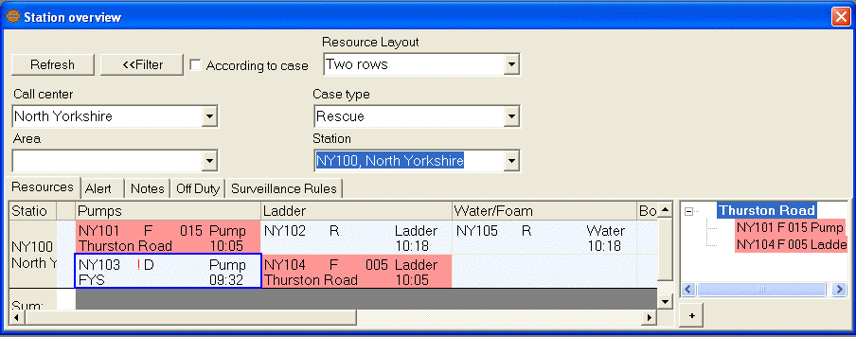
Resource management
Find and assign Resources for cases
Keep track of the available Resources
View and update current Resource status
Locate specific equipment or competence
Get Resource Proposals from the system
CT
DISP
CS
AA
Notes:
CoordCom Fundamentals
Resource Management can be divided into assigning and following up of Resources. Both activities are supported in CoordCom Operator by different functions and windows, dialog boxes or blocks.
Resource suggestion: used when handling On call service cases. The Resources are presented in the Resources block.
Resource Views: The Position Oriented Resource View gives the Operator an overview of the Resource situation, for example where the Resources are and where they will be soon. The Station Oriented Resource View lists Resources per Station according to Resource category and Resources at mission.
Waiting missions: presents suitable Cases based on the profile, status and position of a Resource. This window can be used when there is a heap of work to take care of and a limited number of Resources
Tied Resources block: gives an overview of the Resources connected to the Case, the mission status, as well as the time for when the status was reported. The Operator can also mark a Resource in a Case as Rescue Leader.
Update Resource: used to update the status of a Resource or a Mission connected to the Resource. The update can be made automatically or require the interaction of an Operator.

Slide 40
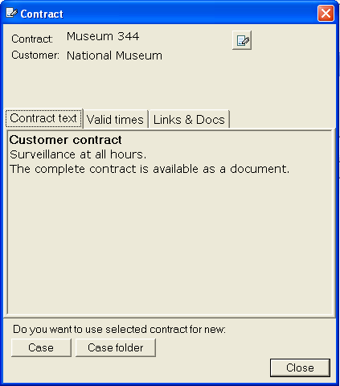
Customers & Contracts
Commercial service customers
Contracts - Information of the agreed services
Customer Objects – Property monitored by CoordCom
Call taker is given relevant information
CT
DISP
CS
AA
Notes:
CoordCom Fundamentals
CoordCom can be used for other services than Public Safety, for example On-call and Automatic Alarm services. For those services CoordCom includes the following features:
Customers
Customer Objects
Contracts
The Operator can search for Customers, Customer Objects and Contracts by entering text in a search field. When a Customer, Customer Object or Contract is found, the Operator have the possibility to read more and to create a new Case connected to the Search.
A Customer could be a company that purchases a Call Taking service and perhaps also a Resource Management service from the organization running CoordCom.
A Customer Object could be a property owned by the Customer, for which the organization running CoordCom receives calls about a need for service, or calls generated by automatic alarm installations.
A Contract including text, links (to document and Web) and validity period, can be configured for a Customer. This means that CoordCom will indicate to the Operator if a Contract is out-of-date.
The Contract can be associated to an incoming line so that the Contract is uniquely identified in the Case for an incoming telephone call.
Contracts can also be configured as associated to parts of a Case Index for a Case Type.

Slide 41
Function Areas
Supporting functions
Supporting functions
Automatic
Call distribution
Interactive Voice
Response
Authorization
Geography
Notes:
CoordCom Fundamentals
Automatic Call distribution: Calls are distributed to an Operator with the right active login. Calls can be distributed to even out the work load for the Operators.
Interactive Voice Response (IVR): Allows recorded messages and interaction from caller through DTMF signals.
Authorization: Controls the active roles for the Operators and what roles they are given to choose from. The roles and work choices can be changed during operation.
Geography: Handles what areas are connected to the different stations and resources.

Slide 42


Geography – Case Type Area & Point of Interest
MAP
Notes:
CoordCom Fundamentals
The smallest building blocks, by which larger concepts are defined, are called geographical areas. For each Case type, the total geographical territory is covered through Case type areas made up of grouped geographical areas. This allows different organizations using the same CoordCom system, to have individual geographical settings with customized shapes and names.
CoordCom offers the possibility to have individual sets of geographical areas for each Case type as different organizations may divide and name the geography differently. In this way geographical territories may keep shapes and names that the respective organization is accustomed to. The areas that different part of organizations (for example rescue stations) cover are then expressed in terms of covered Case type areas.
Points of Interest are geographical objects of special interest with respect to public safety operations. Examples of these may be air­ports, larger shopping centers and so on. Some of the Points of interest may be classified as especially hazardous (Risk object), for example a nuclear plant, and as such highlighted. This function will draw the risk area on a map and works only if the integrated map application supports the risk area function.
A Point of Interest may have one or several addresses but is always connected to only one Geographical area. A Point of interest can also contain one or several Customer objects.

Slide 43



Case Example – Incident
Incident
Call
Identify
Sort
Activate
Follow-up
Incident
Call taking
Dispatching
Notes:
CoordCom Fundamentals
When the Call Taker has answered a Call, identified the Case Type, selected a Case Type index, and so on, the Case is publicized which means that it is no longer private to the Call Taker and that the Dispatcher workflow starts.
The Dispatcher activates the instructions provided by the Action Plan. Then, or at the same time the Dispatcher searches for an appropriate Resource that can be assigned the mission. When a Resource is assigned and it has confirmed the mission, the task of the Dispatcher is to keep track of the mission status. When the mission is reported finished, the Dispatcher can finish the Case.

Slide 44
Case Example – Call taking
Incident
Call
Identify
Sort
Activate
Follow-up
Incident
Call taking
Dispatching
Call answered and identified as authentic
Case type identified, location given by ALI
A new case is created
Case positioned on Map, centered on location
Interview support to collect relevant information
Case index to categorize the Case
CT
DISP
CS
AA
Notes:
CoordCom Fundamentals
First, the call is transferred to the correct Operator inbox through selections made by the caller by DTMF signals.
Then the call is answered by a Call Taker who determines that it is an authentic case and that it is not an active Case.
A Case is created with the correct Case type and the location is automatically retrieved from caller information database.
The Operator positions the Case on the map and centers the map on it.
The Call taker collects all relevant information, aided by interview support.
The Case is categorized in the index tree, and when the correct node is chosen, an action plan is visible in the plan block.
At a suitable time of the conversation, the dispatcher may listen in on the conversation through assistant monitoring.

Slide 45
Case Example – Dispatching
Incident
Call
Identify
Sort
Activate
Follow-up
Incident
Call taking
Dispatching
Action plan presented and executed
Relevant contacts informed
Suitable Resource found and assigned
Status updated for assigned Resources
Follow-up to verify that incident is under control
Case is closed and stored for statistics
CT
DISP
CS
AA
Notes:
CoordCom Fundamentals
Dispatching can be parallel to the call taking. It can also be performed by the same Operator.
It is possible to produce reports and statistics from CoordCom. Normally, this is a task for an administrator.
The Dispatcher follows the Action Plan, which contains instructions on which external parts to contacts and which Actions are necessary in relation to the current incident.
The Dispatcher locates a suitable Resource and assigns it to the Case.
The Dispatcher follows up the case and verifies that the incident is under control.
The Case is closed and stored in the database.
Repeat that the Dispatching phase may be parallel to the Call taking phase and that Call taking and Dispatching can be performed by the same Operator.

Slide 46
Structure and Navigation
Notes:
CoordCom Fundamentals
The structure and navigation chapter shows the structure of the two main GUI´s: CoordCom Operator and CoordCom Business Administrator. It also emphasizes the importance of keyboard shortcuts in CoordCom Operator.

Slide 47
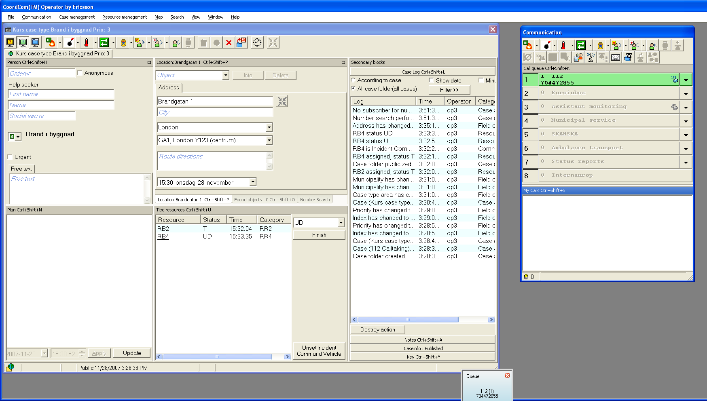
CoordCom Operator
Main window
Menu Bar
Windows
Buttons
Buttons
Tabs
Primary
blocks
Primary
blocks
Primary
blocks
Primary
blocks
Secondary
blocks
Primary
blocks
For information on CoordCom Operator, please refer to Operators Guide
Notes:
CoordCom Fundamentals
CoordCom Operator uses two or three screens during operation.
The screens contain several windows.
The windows can include a configurable number of blocks for entering Case data. The blocks can be either primary or secondary. If primary blocks are piled upon each other they appear as tabs. Secondary blocks always appear in a pile.
The secondary blocks can include multiple tabs.
The menu bar includes all functions and many functions can also be reached through buttons or keyboard shortcuts.

Slide 48
Keyboard Shortcuts
Fast navigation between windows, tabs and fields
Possible to work with keyboard only
Most functions available through commands
All keyboard shortcuts can be konfigured
For information on Keyboard Shortcuts, please refer to
CoordCom Operator Keyboard Shortcuts
Notes:
CoordCom Fundamentals
Keyboard shortcuts is the most efficient way to navigate in CoordCom Operator. All vital functions can be performed with key combinations and it is possible to work with only the keyboard.
All ”normal” windows shortcuts are valid.
The function keys can be used to activate common functions.
There are several ways to navigate in the main window in CoordCom Operator. Keyboard shortcuts for general navigation use the Windows standard format. Block and window navigation, and view changes use keyboard shortcuts specific to CoordCom Operator.
The keyboard shortcuts are configurable in Business Administrator. The following descriptions show the default shortcuts.
The program menus can be opened with the Alt key + the underlined letter in the menu name, for example Alt + F for File.
The Shortcut Menu key (located to the left of the right Ctrl key) on the keyboard corresponds to a right-click (secondary) mouse button and opens context-sensitive shortcut menus. On the open shortcut menu you can select commands by pressing the corresponding underlined letter, or navigate to it using the down arrow.
Navigate between windows using the keyboard shortcut combination Ctrl + Shift + F5-F12. Navigate between blocks using the keyboard shortcut combination Ctrl + Shift + A-Z. The block letter activating the shortcut is shown in the title bar of the block. Change views using the keyboard shortcut combination Ctrl + Shift + F1-F3.
Function commands are displayed as buttons in the main window. Activate function commands using Ctrl + A-Z. Some function commands are activated with just a function key, for example F3 (PTT (Push To Talk), for radio communication), and F5 (Refresh).
Answer a call from an inbox using Ctrl + 1-9 (corresponding to the inbox number).
For more information about keyboard shortcuts, refer to CoordCom Operator Keyboard Shortcuts.

Slide 49
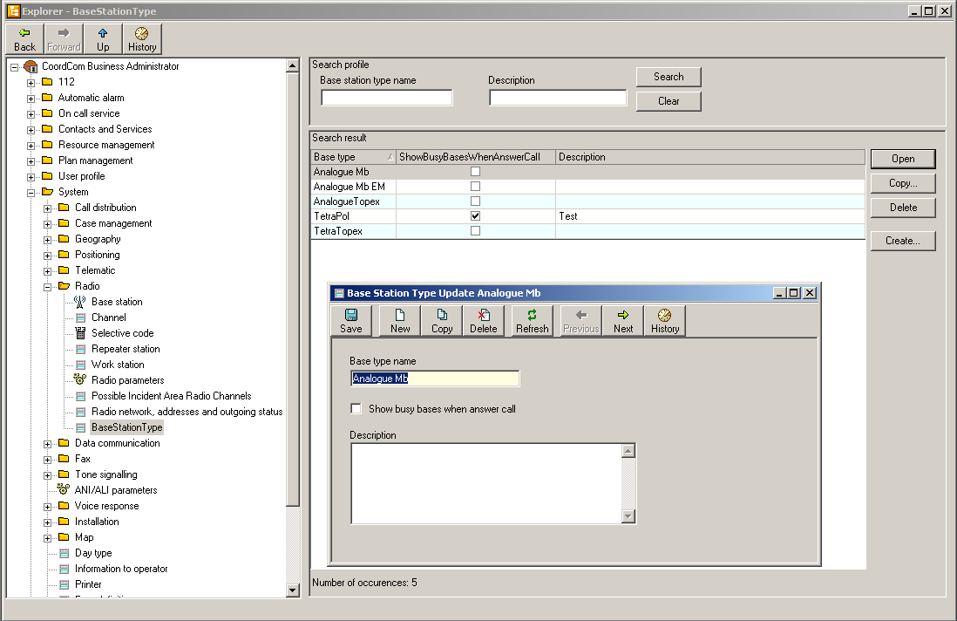
CoordCom Business Administrator
Main window
Index
Tree
Forms
Buttons
Buttons
Windows
For information on CoordCom Business Administrator,
please refer to Business Administrators Guide
Notes:
CoordCom Fundamentals
CoordCom Business Administrator is based on an index tree, divided into different function areas of CoordCom.
The tree contains a number of forms, which are used to configure the system. The forms can be connected to windows containing new forms.
There are a lot of dependencies between the values, so some configurations has to be performed sequentially.
Many functions can be found through different places. Many of the forms adapt to the entered values.

Slide 50
Summary
Notes:
CoordCom Fundamentals
This chapter is a brief summary of some key aspects of the Fundamentals course. It features some basic concepts that are important for a general understanding of CoordCom.

Slide 51
CoordCom Purpose
Emergency response
Commercial
Fire
Towing
Services
Crime
CoordCom
Locksmith
Services
Accident
On Call
Services
Automatic
Alarm
Notes:
CoordCom Fundamentals
CoordCom is an integrated call taking and control system for providers of Public Safety, On Call Services and Security Services.
CoordCom integrates functions for telephony, radio, as well as data communication between the incident reporter, the Call Center Operator and dispatched Resources, such as police, fire brigades, ambulance services, and other service providers.
CoordCom can be used for both Emergency response and Commercially
The most common emergency response functions are fire, crime and accidents.
Three examples of commercial use: towing, Locksmith and On Call Services
Automatic alarms can be both Emergency and commercial

Slide 52
Graphical User Interfaces (GUI)
CoordCom
Operator
CoordCom
Business
Administrator
Operation and
Support tools
Map
Application
Notes:
CoordCom Fundamentals
CoordCom Operator is the main GUI used for the operation of CoordCom, it allows the Operators to handle all telephone and radio communication as well as manage the available resources. CoordCom Operator can be integrated with a GIS interface for visual two-way communication of positions and areas for resources and cases.
CoordCom Business Administrator is the GUI used by the business data administrators for configuration of all CoordCom functions. It is also used to update the system to any changes in resources, stations or contacts.
Operation and support tools are a number of software tools used for support of the system for maintenance purposes.

Slide 53
CoordCom Roles
CoordCom
Operator
CoordCom
Business
Administrator
Operation and
Support tools
Call taker
Dispatcher
Business Data
Administrator
Customer
Service Agent
Automatic
Alarm Operator
Automatic
Alarm
Configurator
Operations
Support
Engineer
Emergency Response
Commercial
Notes:
CoordCom Fundamentals
CoordCom Operator is mainly used by four roles. The roles do not have to be separate users.
Call takers main function is to respond to incoming calls from help seekers. They sort out all false calls, identifies the type of incident and create a case for the incident.
Dispatchers find a suitable resource for the incident, assigns them to the case and verifies that the incident is taken care of.
Automatic alarm Operators receive incoming automatic alarms, in a similar way as incoming calls from help seekers. They create cases for the alarms and pass them over to a dispatcher.
Customer service agents receive incoming non-emergency calls for commercial services such as car towing, locksmith services or On Call services
CoordCom Business Administrator is mainly used by Business Data Administrators, who configures all business data for the Operators. It is also used by Automatic Alarm Configurators, who handles the configuration of all automatic alarms.
Operation and support tools are used by Operation Support Engineers for operational support and maintenance.

Slide 54
Example of a CoordCom system
System
Medium site
Main site (Large)
Small site
Central
Clustered
Local
Notes:
CoordCom Fundamentals
CoordCom includes several redundancy solutions for high availability. The databases within the system are replicated so they include the same information.
If one database becomes unavailable, another takes over without interruption for the Operators within that site.
If a entire site becomes unavailable, the system will transfer all incoming calls to that site to another, available site.
The servers also have redundancy so that if one becomes unavailable, another server takes over.
It is also possible to include clustered servers or databases within a site. Clustered servers are two completely identical, redundant units for even higher reliability.

Slide 55
Function Areas
Call Taker (CT)
Dispatcher (DISP)
Communication
management
Case
Index
Case
management
Action
Plans
Interview
Support
Customer
Services (CS)
Contacts
& Services
Resource
management
Automatic
Alarms (AA)
GIS
Interface
Customers &
Contracts
Notes:
CoordCom Fundamentals
The core functions, which all Operators use are:
Communication management.
Case management
Contacts & Services
GIS interface (map) (optional)
The Call Taker Specific function area is:
Case index
The combined Call Taker / Customer Services function is:
Interview support
Two mutual two dispatcher / Automatic Alarm Operator functions:
Action plans
Resource management
A commercial function area used by Customer Services / Automatic Alarms:
Customers & Contracts

