Slide 1
CoordCom™
CoordCom Communication Framework
Notes:
CoordCom Fundamentals

Slide 2
Agenda
Day 1 | Day 2 | Day 3 | Day 4 | Day 5
CoordCom Fundamentals | Operation & Maintenance | Business Data Administrator Authorization Reports & Statistics | CoordCom Geography Carmenta ResQMap | OAE Framework Upgrade
LUNCH | LUNCH | LUNCH | LUNCH | LUNCH
CoordCom Fundamentals Q & A | Operation & Maintenance Cluster and External Information | Call Distribution | Resource Management | DB Model Q & A
Notes:
CoordCom Fundamentals

Slide 3
Communication Basics
CoordCom services uses MSMQ to communicate with all the services.
CoordCom communication framework is called OAE and COM.
Continuous polling ensures services availability.
Communication Timeouts are adjustable.
Notes:
CoordCom Fundamentals

Slide 4

The APS Service
APS recieves availability messages from all services in CoordCom except for CXE services.
If a Service A cannot reach Service B, Service A will ask APS if the service is available and APS will do a poll.
Services availability is stored in the table oae_LogicalAddress_tab
Notes:
CoordCom Fundamentals

Slide 5
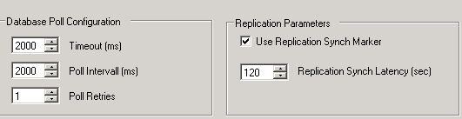
The DBS Service
DBS monitors all databases configured in the system and the replication.
DBS uses replication markers to ensure that SQL peers in the system have the latest information and that there are no latencies in the replication.
DBS can switch primary and Secondary databases based on their status
timeouts are configurable
Notes:
CoordCom Fundamentals

Slide 6
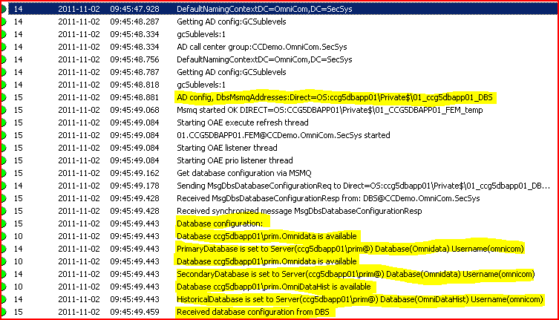
The DBS Service
All services in CoordCom will recieve the location of the DBS(s) from active directory when they start.
Notes:
CoordCom Fundamentals

Slide 7
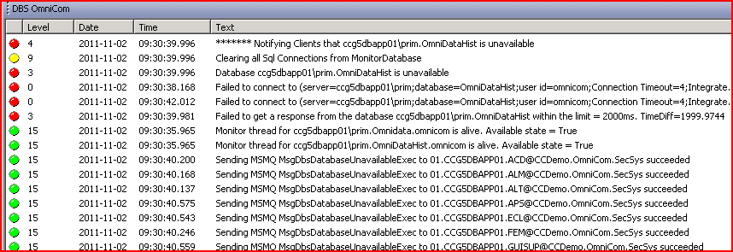
DBS unavailable messages
Notes:
CoordCom Fundamentals
DBS polls the database and realizes that it is DOWN and informs all services in the system.

Slide 8
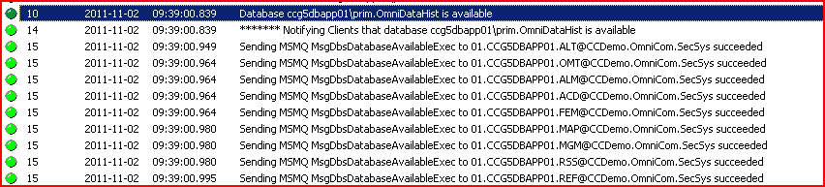
DBS available messages
Notes:
CoordCom Fundamentals
DBS polls the database and realizes that it is up and running again and informs all services in the system.

Slide 9
DBS correction messages to services
DBS will correct Services and Clients if they have the incorrect availability picture.
[Date: 2011-11-02] [Time: 09:34:35.280][Category: 66(DBS)][Group: OmniCom][Level: 4][File Name: MessageHandler.cs][Line Number: 0][Thread: OAE listener][Process: DbsService.exe]
The client was right. Notify the others
[Date: 2011-10-20] [Time: 13:44:16.242][Category: 66(DBS)][Group: OmniCom][Level: 4][File Name: MessageHandler.cs][Line Number: 0]
The client was NOT right. Notify the client that the database is available.
Notes:
CoordCom Fundamentals
A few examples of corrections sent by DBS

Slide 10
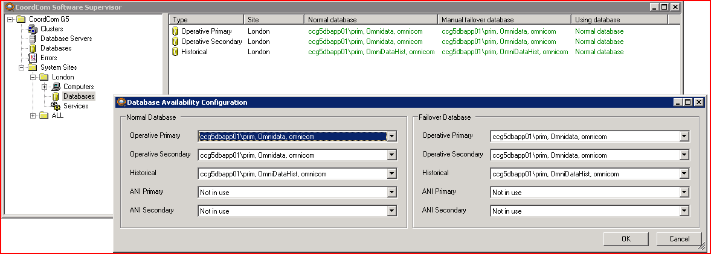
CSS – CoordCom Software Supervisor
CSS is a Monitoring and Supervising tool for CoordCom
CSS can be used for scheduled maintanance tasks
In CSS you can also monitor performance of different tasks on the Clients
View the current status of all CoordCom Databases
Configure timeout values
Notes:
CoordCom Fundamentals

Slide 11
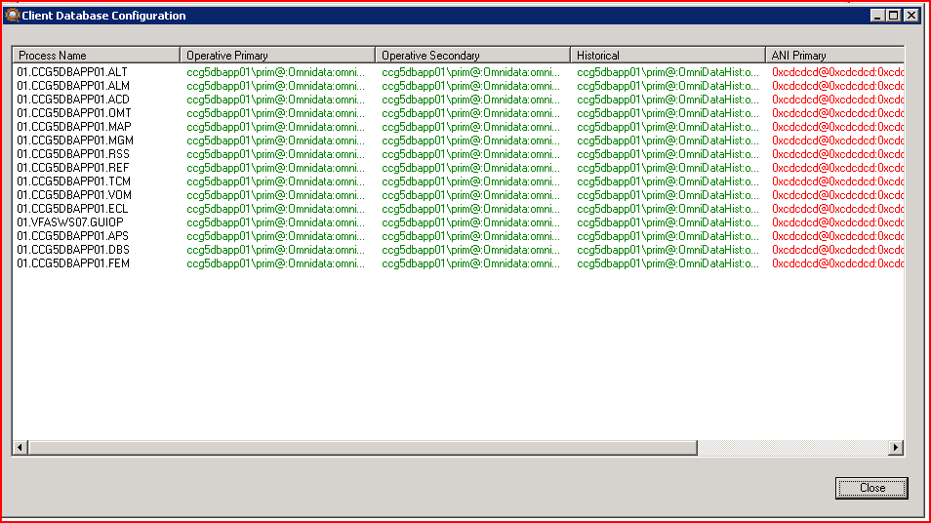
CSS – Query Clients
Notes:
CoordCom Fundamentals
In CSS you can query clients to retrieve their DB configuration.

Slide 12
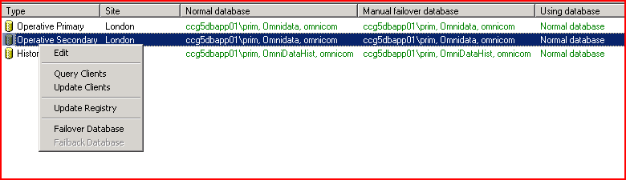
CSS – Update Clients
When changing Database configuration always update clients to they get the correct Database information from DBS
Notes:
CoordCom Fundamentals

Slide 13
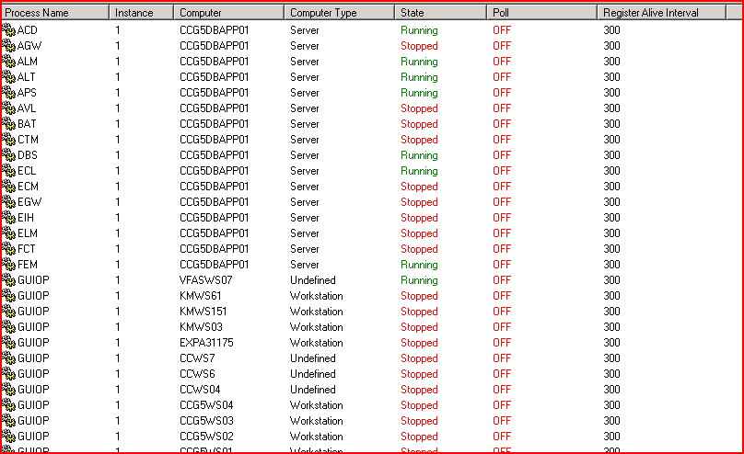
CSS – Services Status
Notes:
CoordCom Fundamentals
Current services status and poll settings can be viewed for each system site.

Slide 14
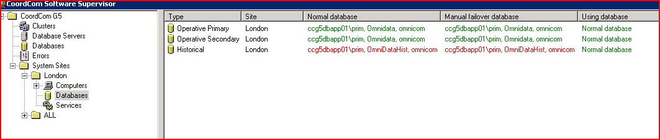
CSS – Monitoring
When a database is unavailable it will be shown with red text
Notes:
CoordCom Fundamentals
C:

Slide 15
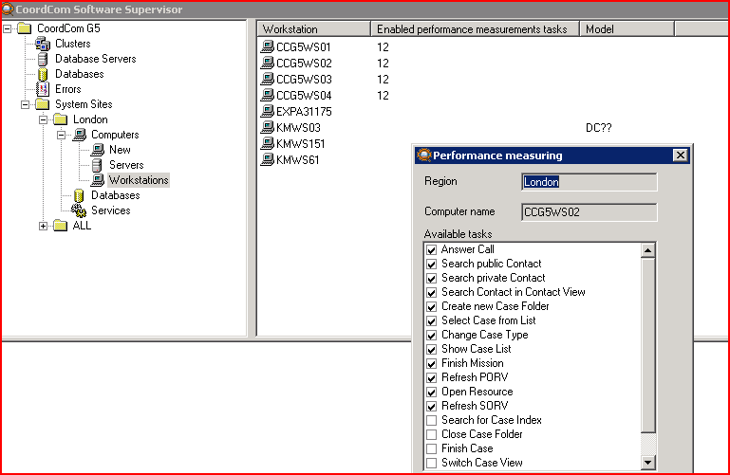
CSS – Performance measurement
Notes:
CoordCom Fundamentals
In CSS you can choose specific clients that you wish to monitor the time it taks to perform tasks like answering calls, search contacts etc.

Slide 16
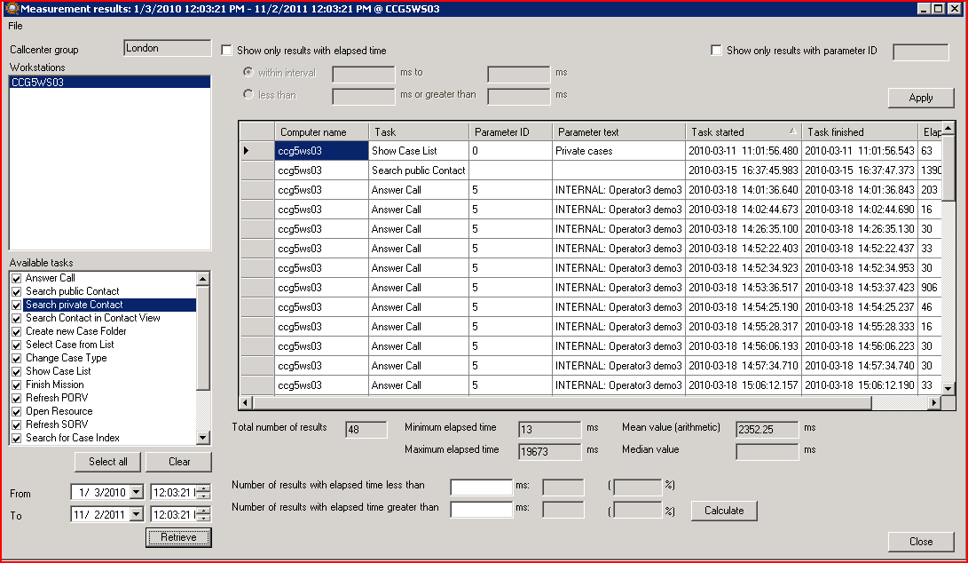
CSS – Performance measurement
Notes:
CoordCom Fundamentals

