Slide 1
Deep-Parsing Chinese
洞穿乔姆斯基大院的围墙​
北大博雅语言学讲座 2017 (北京)
李维（京东硅谷研究院） 12/07/2017 (liweinlp.com)

Slide 2
Outline
NLP History: empiricism vs. rationalism
Chomsky Hierarchy and Its Impact
Multilevel FSA++ Symbolic Parser
Architectures for Parsing
Sample Trees

Slide 3
Outline
NLP History: empiricism vs. rationalism
NLP频道 liweinlp.com

Slide 4
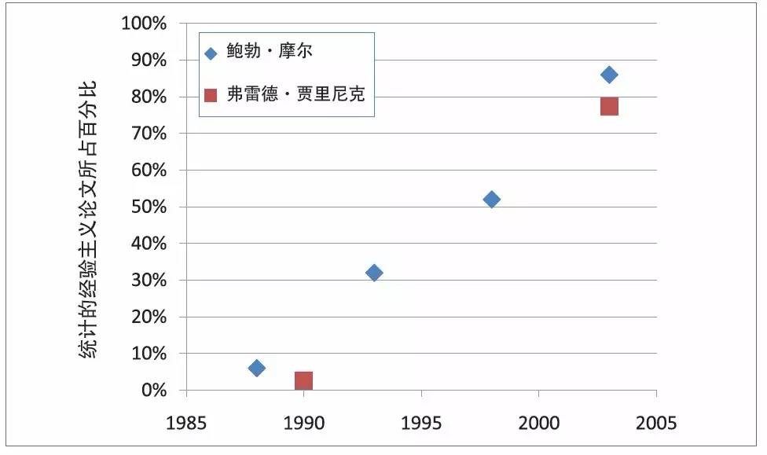
NLP Mainstream Since 1990s
Courtesy of Prof. Church: “A Pendulum Swung Too Far”
http://blog.sciencenet.cn/blog-362400-988692.html
NLP频道 liweinlp.com

Slide 5
Two Basic Approaches to NLP
Approach | Pros | Cons
Complementary rather than competing
Hybrid: Best of both worlds
Balance and configurability between precision and recall
Statistical Learning (based on keywords) | Good for document-level High recall Robust Easy to scale Fast development (if data available) | Requires large annotation Coarse-grained Difficult to debug Fail in short messages Only shallow NLP No understanding
Grammar Engineering (based on sentence structure) | Good for sentence level Handles short messages well High precision Fine-grained insights Easy to debug Parsing and understanding | Requires deep skills Requires scale up skills Requires robustness skills Moderate recall (coverage) Parser development slow
NLP频道 liweinlp.com

Slide 6
Outline
NLP History: empiricism vs. rationalism
Chomsky Hierarchy and Its Impact

Slide 7
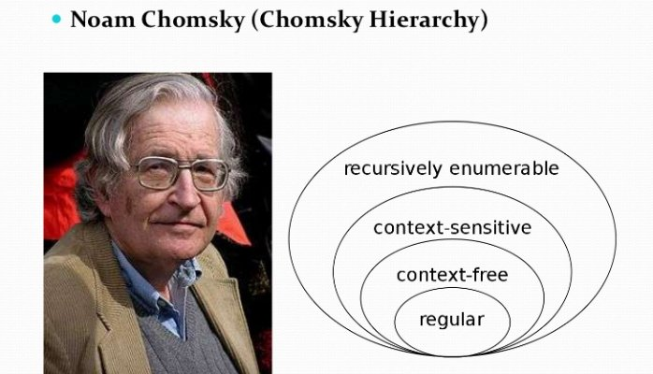
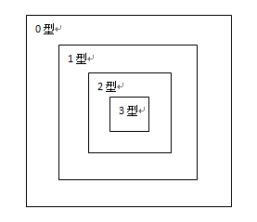
Chomsky's Castle of Hierarchy

Slide 8
Where is Natural Language?
Regular, Context-free, or Context-sensitive?
Bai’s Insights：
Outward fear syndrome: Type-1 & 0 Forbidden City
Inward perfection syndrome: Recursion!
NLP频道 liweinlp.com

Slide 9
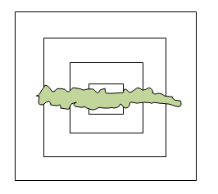
Breaking Through Chomsky's Castle
Bai’s Caterpillar Hypothesis
Outward limited breakthrough
Inward massive compression
Cascaded FSA++
Multilevel for “recursion”
++ for formalism extension
Courtesy of Prof. Bai, Shuo https://www.linkedin.com/pulse/bai-natural-language-caterpillar-breaks-through-chomskys-wei-li/
NLP频道 liweinlp.com

Slide 10
Recursion Fallacy: NL Parsing Requires CFG
Chomsky: parsing at least requires CFG due to recursion
Real life universal language facts:
Center recursion never goes beyond 3 levels
Right-branching recursion never goes beyond 6 levels
Limited by human short-term memory
Cascaded pipeline 10+ levels handles all
Chomsky as a linguistics giant and as a biggest “misleader”
NLP频道 liweinlp.com

Slide 11
Finite State Fallacy: Not “Powerful” Enough
FSA too low-level, not powerful, cannot handle recursion?
What if a cascade of FSAs join hands?
What if classical FSA formalism gets extended?
What if the architecture is designed with flexible mechanisms?
Bottom-up as base, guided by top-down:
robust
powerful
linear
Levels:
just as a ladder vs. also as a priority device
NLP频道 liweinlp.com

Slide 12
Multilevel Fallacy: Error Propagation
Goal-guided: zigzag and converge (corrective measures)
Morphology, Shallow Syntax and Deep Syntax
Lexicon rules vs. grammar: individuality and commonality
Patching device: hidden ambiguity and wakeup mechanism
Data-driven knowledge engineering
vs. supervised training: knowledge bottleneck pros and cons
unit test, regression test, dev corpus, incremental
proven technology near linguist performance
domain adaptability and debuggableness: advantage of symbolic system
exploring hybrid, combining respective pros and cons: e.g. word embedding
NLP频道 liweinlp.com

Slide 13
Outline
NLP History: empiricism vs. rationalism
Chomsky Hierarchy and Its Impact
Multilevel FSA++ Symbolic Parser

Slide 14
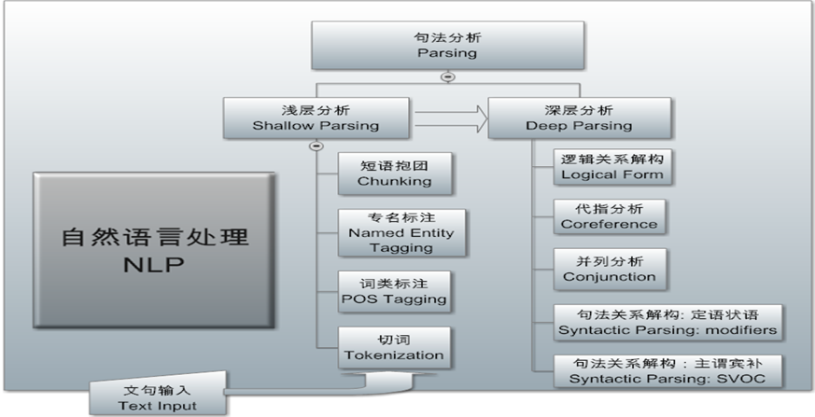
NLP Architecture 1: Deep Parser as Core
Cascaded FSAs break through Chomsky’s hierarchy walls
Robust, linear, F-measure: scale up to big data
NLP频道 liweinlp.com

Slide 15
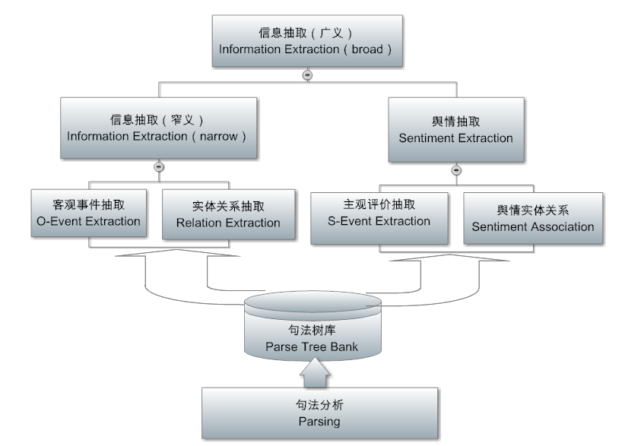
NLP Architecture 2: Information Extraction
Including sentiment analysis （on subjective language）
NLP频道 liweinlp.com

Slide 16
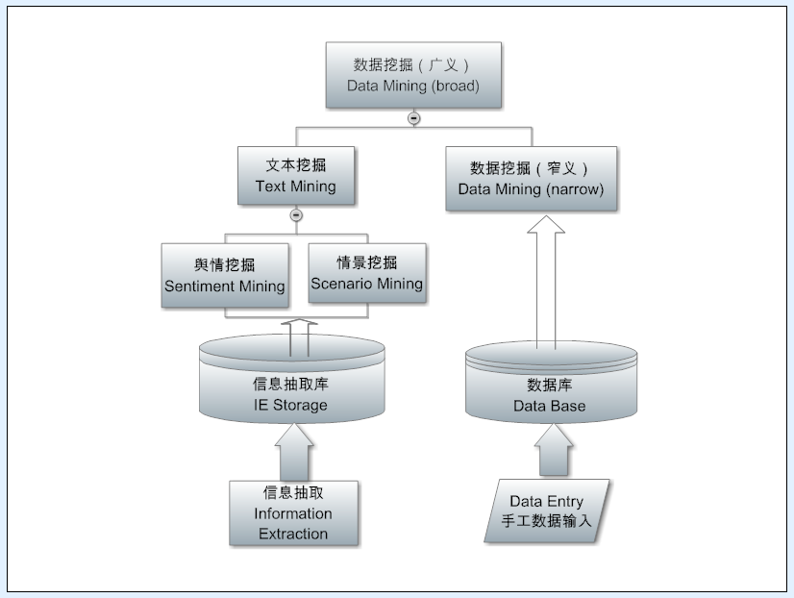
NLP Architecture 3: Text Mining
NLP频道 liweinlp.com

Slide 17
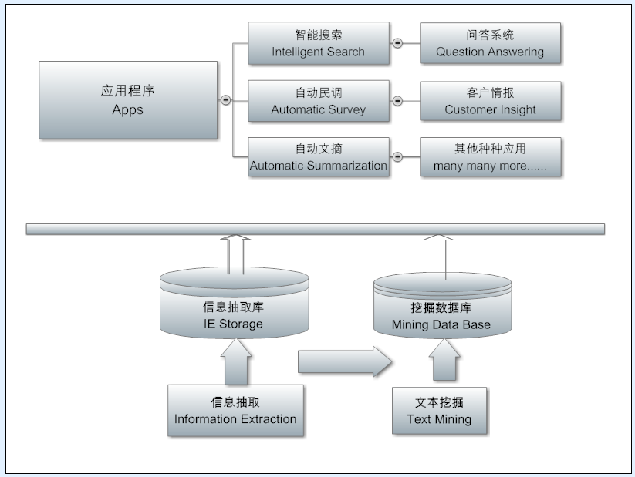
NLP Architecture 4: Landing on Applications
NLP频道 liweinlp.com

Slide 18
Subcat Pattern
Expectation and saturation
Syntactic Subcat: condition
what and where to expect in the pattern
Linguistic features
Literal, esp. function words
Word order
Selection restriction when needed (HowNet, Big Data)
Semantic Subcat: conclusion
Logical semantic roles
IE Templates
HowNet, FrameNet
NLP频道 liweinlp.com

Slide 19
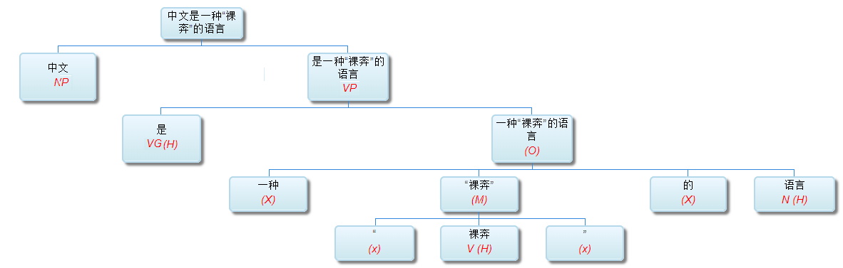
Linguistic Characteristics of Chinese
Lacking explicit forms:
No inflections：烤红薯，学习材料 （VP/NP? plural/singular?）
Function words often omitted：这件事我的看法应该听其自然。 （对于这件事，依我的看法，我们应该听其自然）
Flexible word order: 报告我听了，我报告听了
NLP频道 liweinlp.com

Slide 20
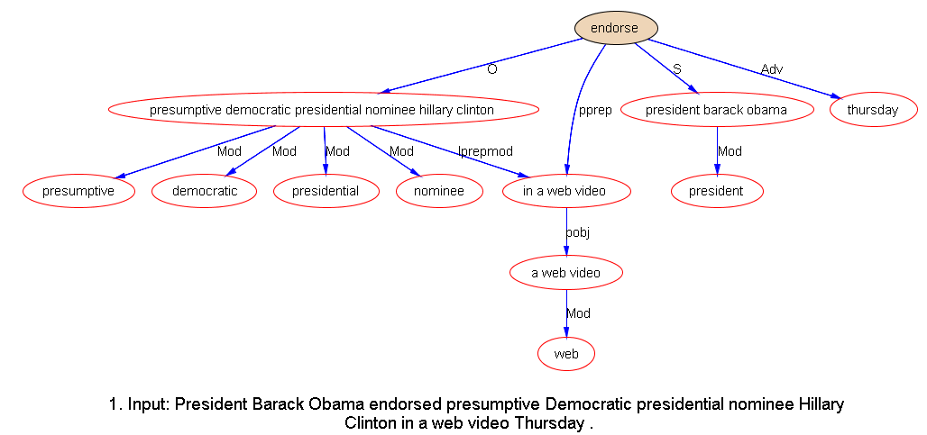
Why parsing? Limited Patterns
NLP频道 liweinlp.com

Slide 21
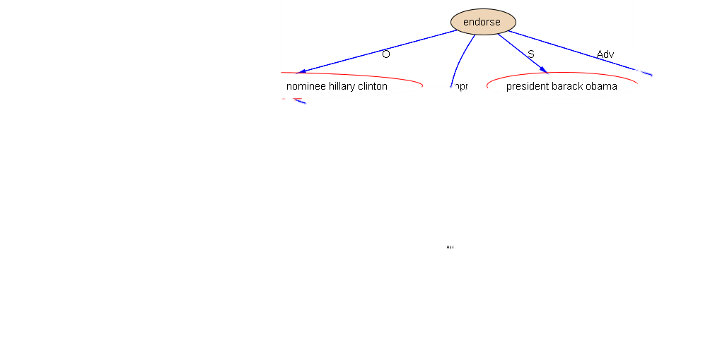

Subtree Pattern: Data to Intelligence
SVO Pattern:
Barack Obama (S)
Endorse (V)
Hillary Clinton (O)
Knowledge Graph
NLP频道 liweinlp.com

Slide 22
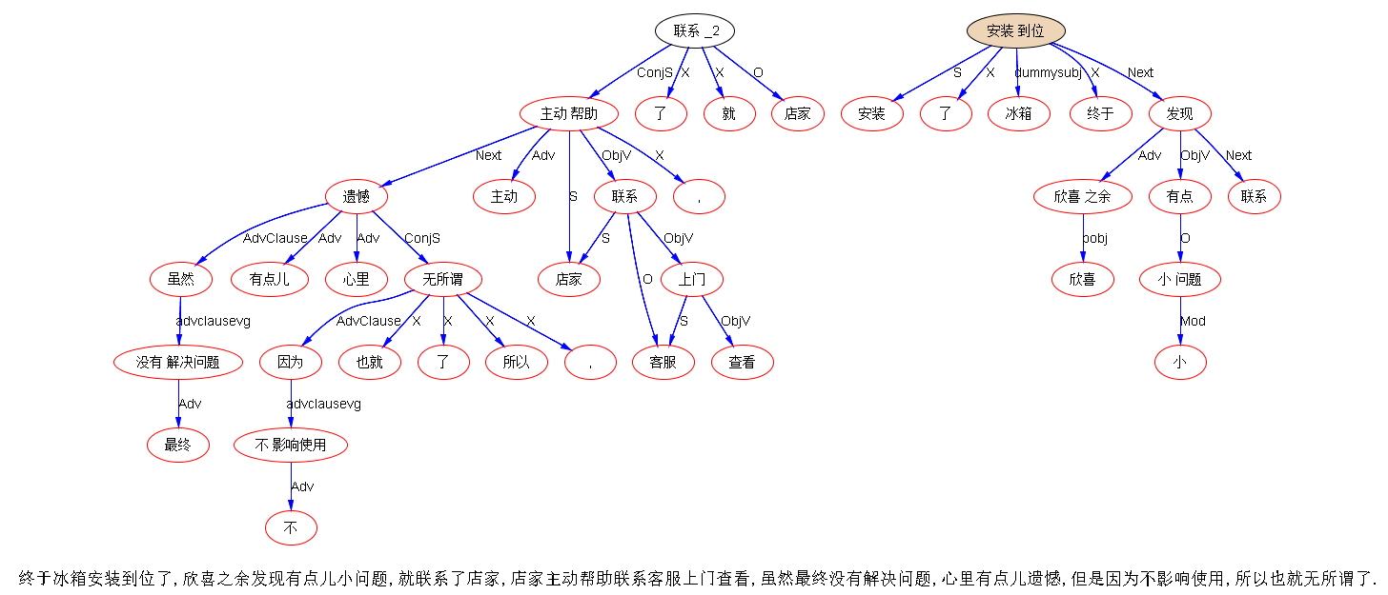
Deep Parsing: Unstructured to Structures
NLP频道 liweinlp.com

Slide 23
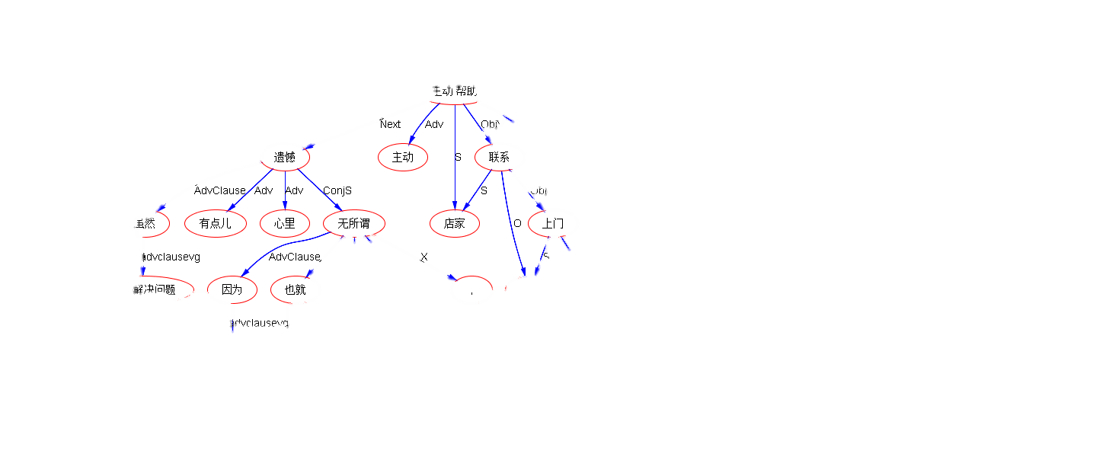
Subtree Pattern: Data to Intelligence
Linear: Infinite number of sentences
Structure: Limited patterns
Data → Intelligence
Inter-Clause Pattern:
虽然 … 遗憾…无所谓…
mild sentiment
NLP频道 liweinlp.com

Slide 24
Outline
NLP History: empiricism vs. rationalism
Chomsky Hierarchy and Its Impact
Multilevel FSA++ Symbolic Parser
Architectures for Parsing
Sample Trees

Slide 25
Sample Deep Parse Tree (dependency)
NLP频道 liweinlp.com

Slide 26
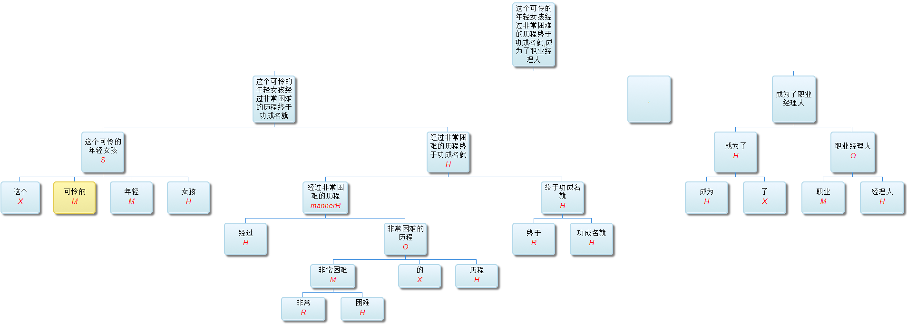
Sample Deep Parse Tree (PS flavor)
NLP频道 liweinlp.com

Slide 27
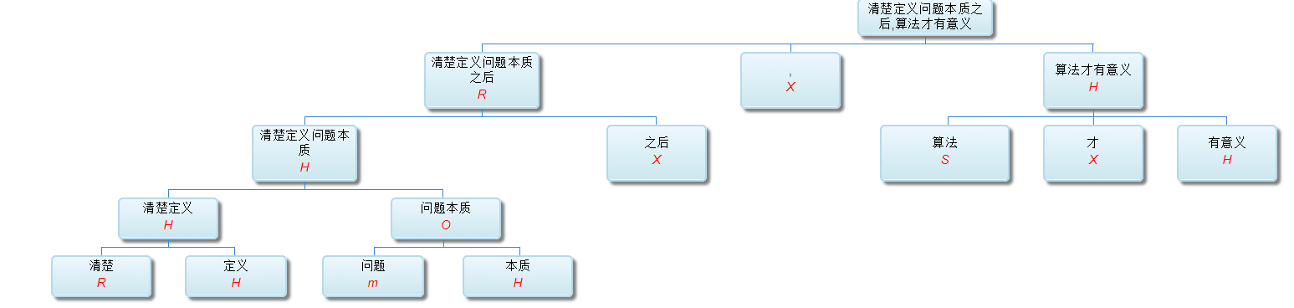
Sample Deep Parse Tree
NLP频道 liweinlp.com

Slide 28
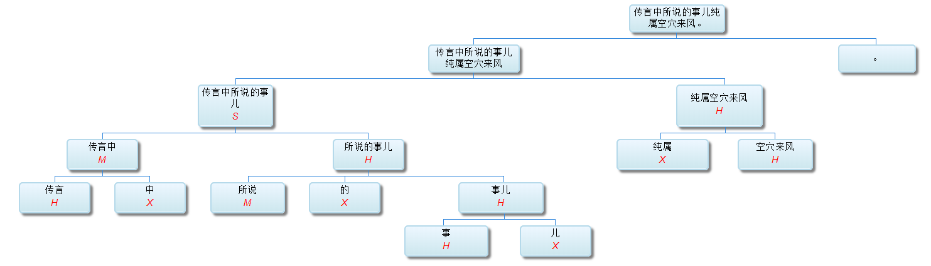
Sample Deep Parse Tree
NLP频道 liweinlp.com

Slide 29
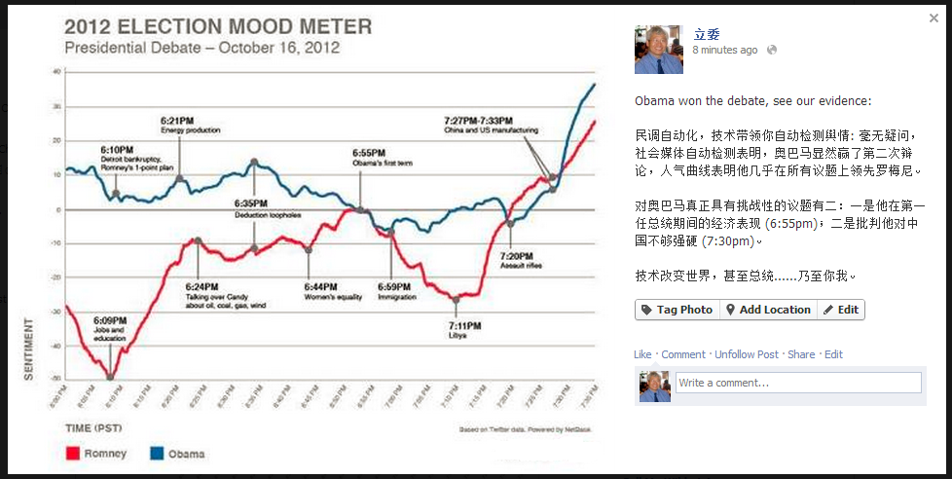
NLP Illustration: Real-time Polls
Challenges observed:
economy topic at 6:55pm;
China topic at 7:30pm
NLP频道 liweinlp.com

Slide 30

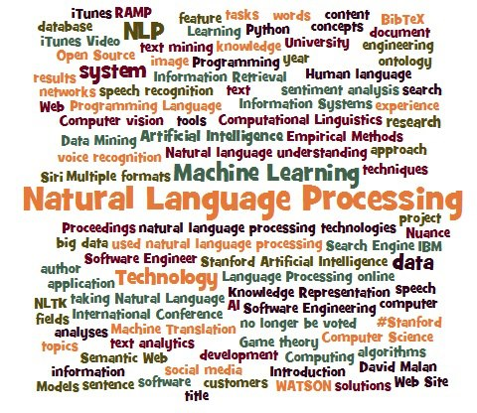

And we are hiring!
At Beijing & Silicon Valley
NLP频道: liweinlp.com
www.linkedin.com/in/liwei4nlp

