Slide 1
BITS Pilani Digital Design
Prof. GSS Chalapathi, Prof. Saurabh Gandhi (EEE department)

Slide 2
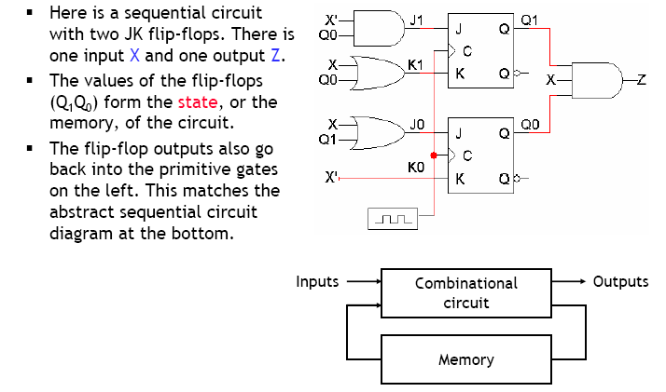
Analyzing sequential circuits

Slide 3
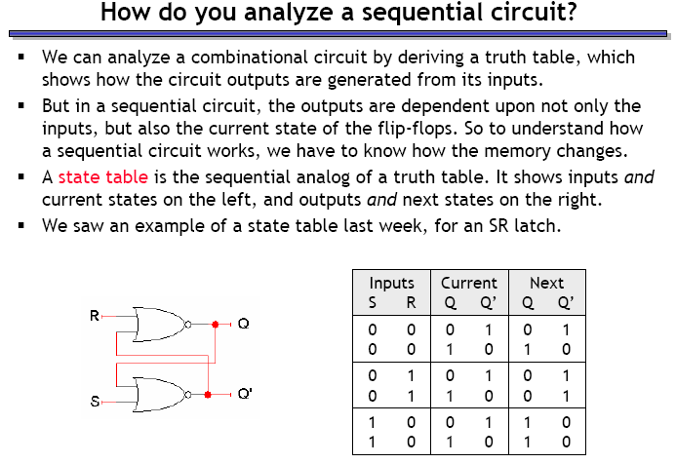
How do we begin analyzing the circuit?

Slide 4
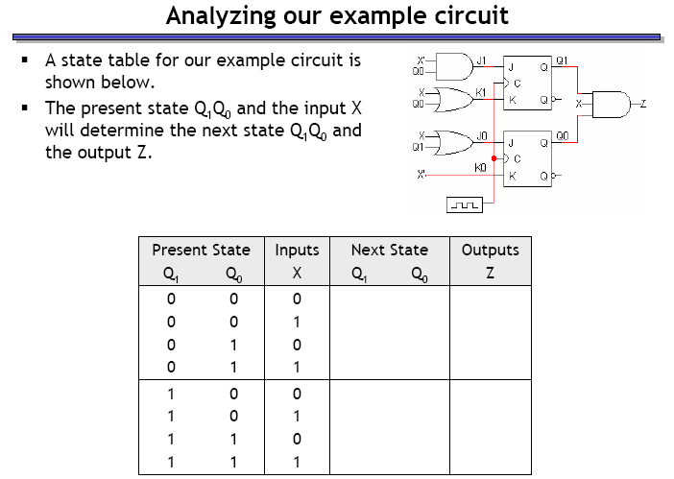
Analyzing our example circuit

Slide 5
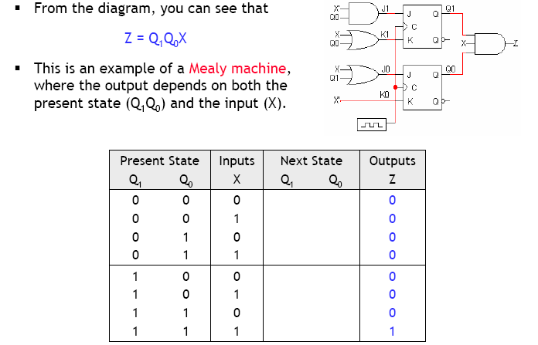
Finding the outputs

Slide 6
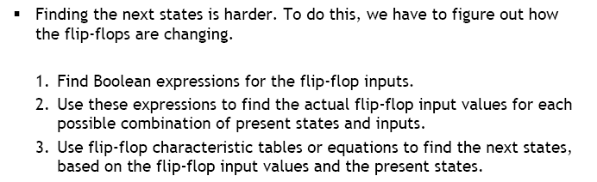
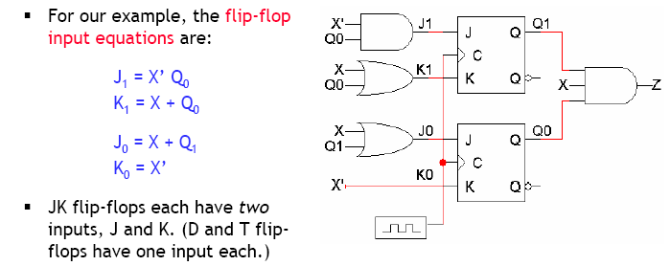
Finding next states

Slide 7
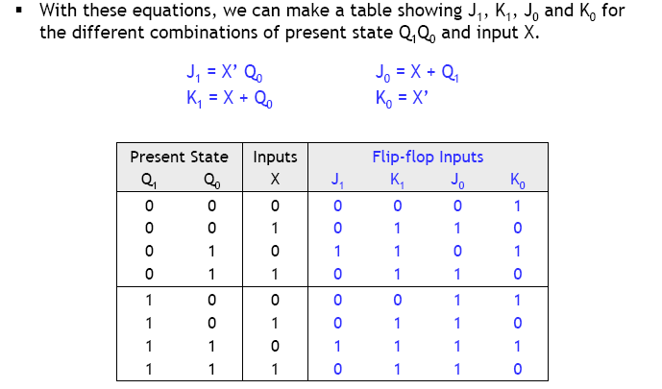
Flip flop input values

Slide 8
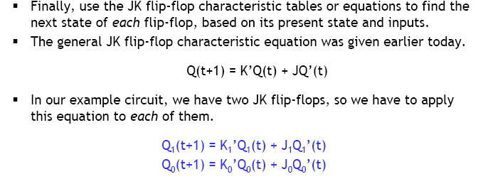
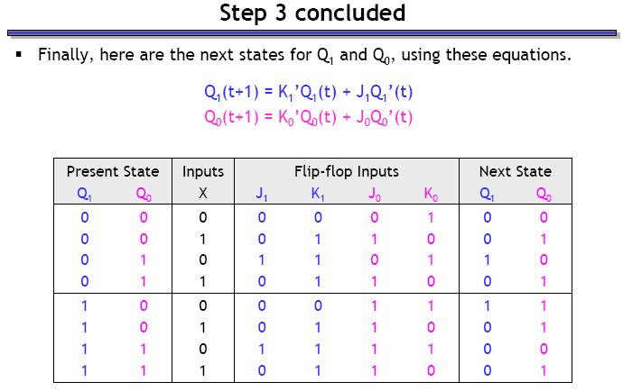
Finding the next states

Slide 9
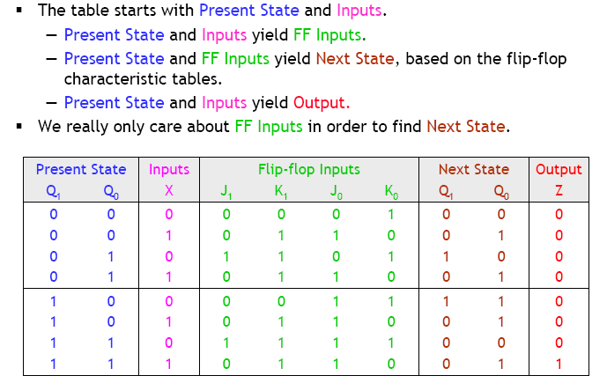
State table

Slide 10
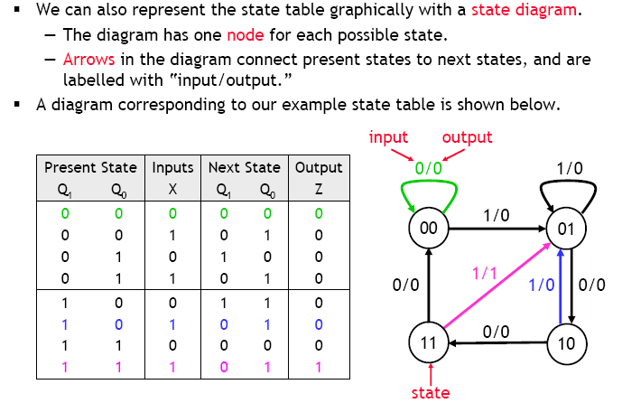
State diagrams

Slide 11
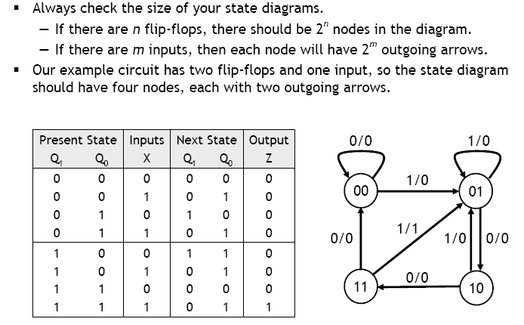
Size of the state diagram

Slide 12
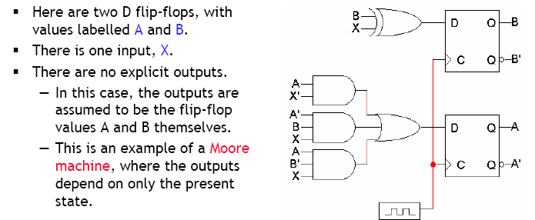
Example

Slide 13
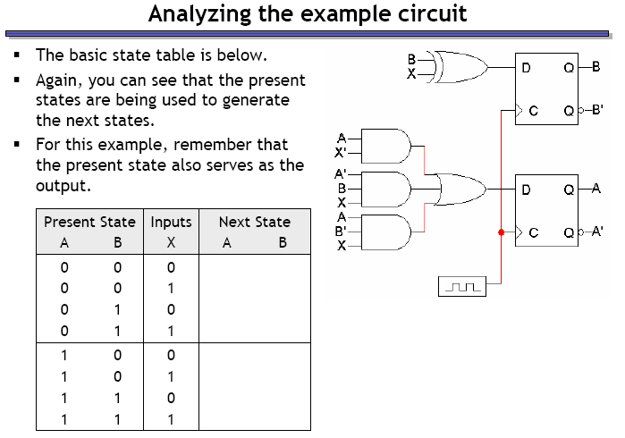
Example – circuit analysis

Slide 14
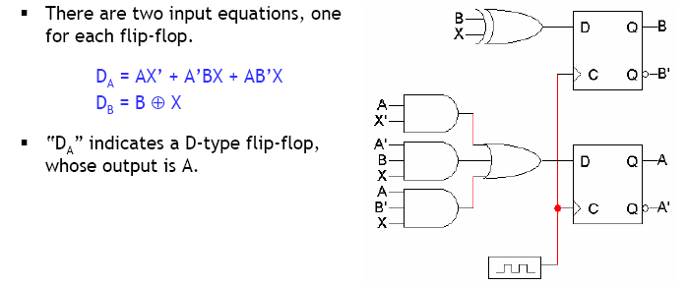
Step 1: Flip flop input equations

Slide 15
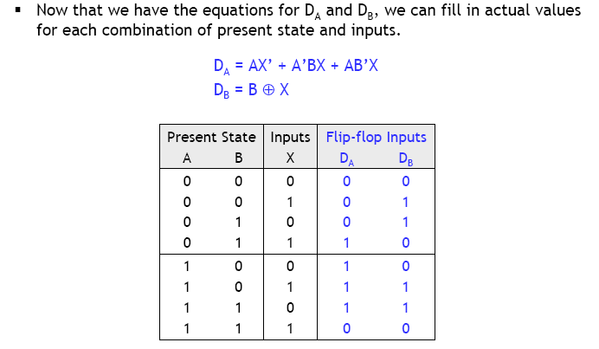
Step 2: Flip flop input values

Slide 16
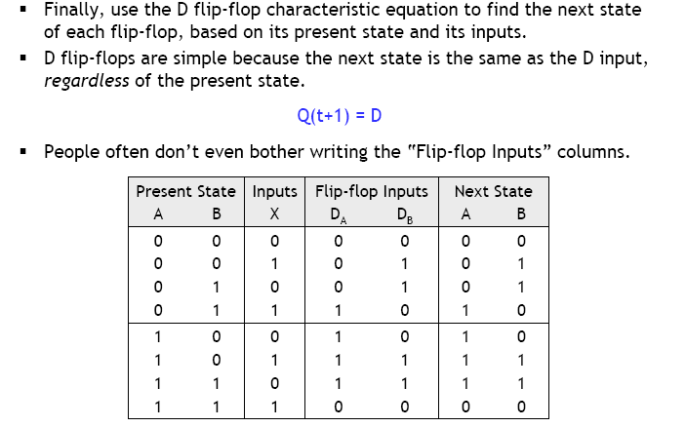
Step 3: finding next states

Slide 17
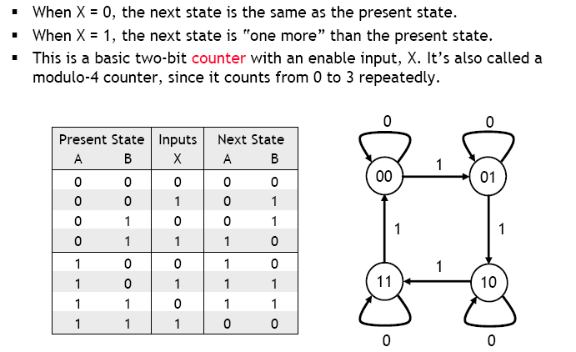
What does this circuit do?

Slide 18
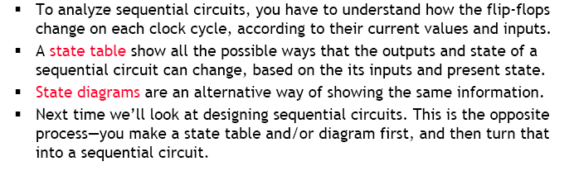
Summary

