Slide 1
BITS Pilani Digital Design
Prof. GSS Chalapathi, Prof. Saurabh Gandhi (EEE department)

Slide 2
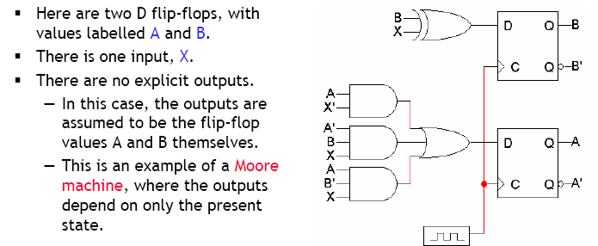
Example

Slide 3
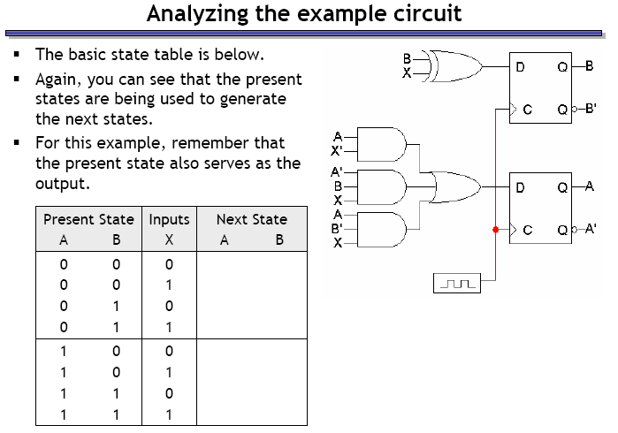
Example – circuit analysis

Slide 4
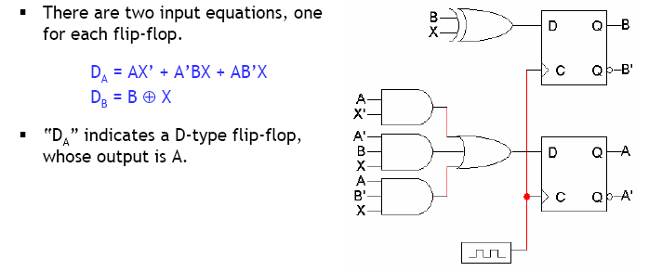
Step 1: Flip flop input equations

Slide 5
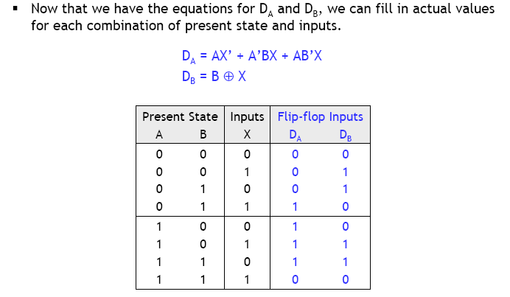
Step 2: Flip flop input values

Slide 6
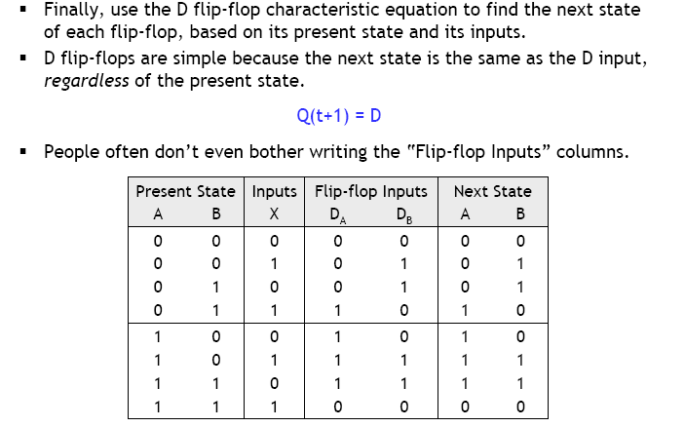
Step 3: finding next states

Slide 7
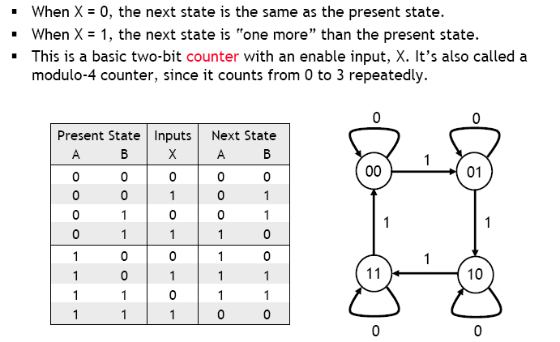
What does this circuit do?

Slide 8
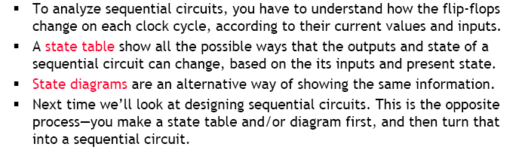
Summary

Slide 9

Attendance!
Will be opened only during the attendance window.
Enable location on your device.
Grant any location permissions requested by the website.
Refresh the page.
Try submitting again.

Slide 10
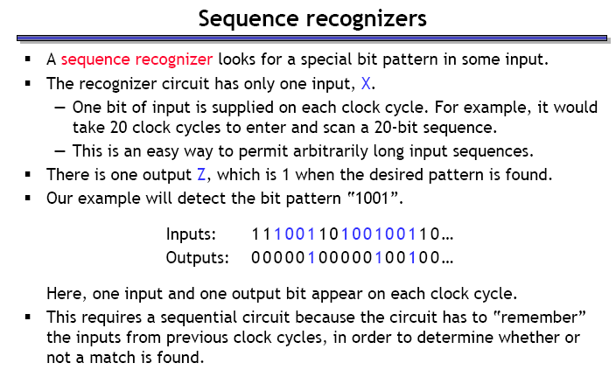
Design of sequential circuits

Slide 11
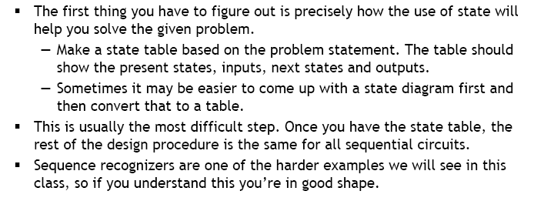
Step 1.1: Make the state diagram

Slide 12
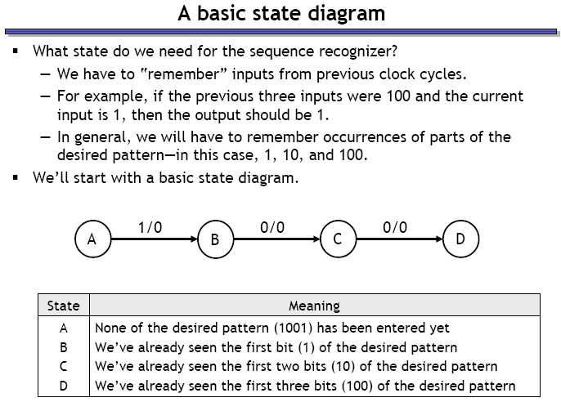
Sequence recognizer state diagram

Slide 13
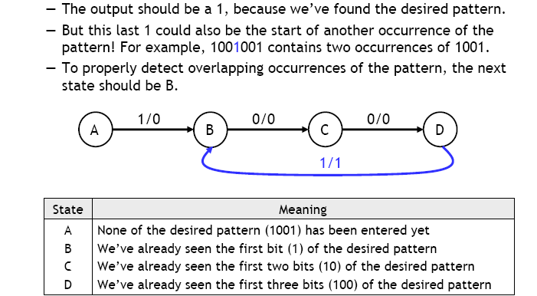
Where should the system go from D?

Slide 14
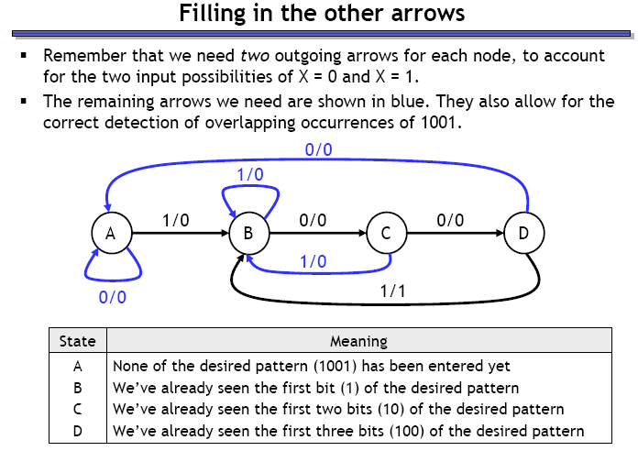
What about other state transitions?

Slide 15
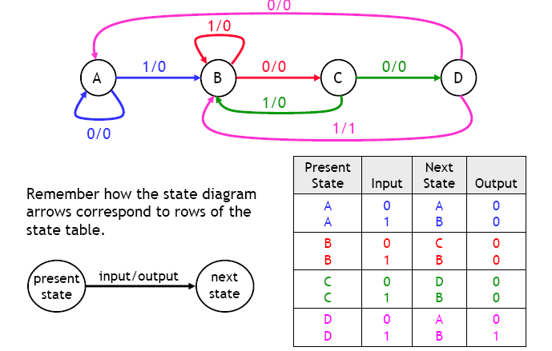
Step 1.2: make the state table

Slide 16
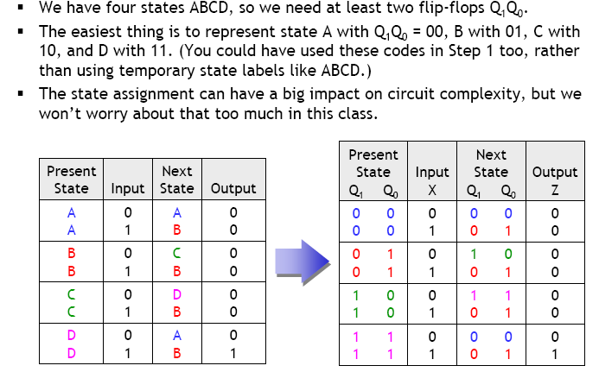
Step 2: Assign binary codes to states (to store them in flip-flops)

Slide 17
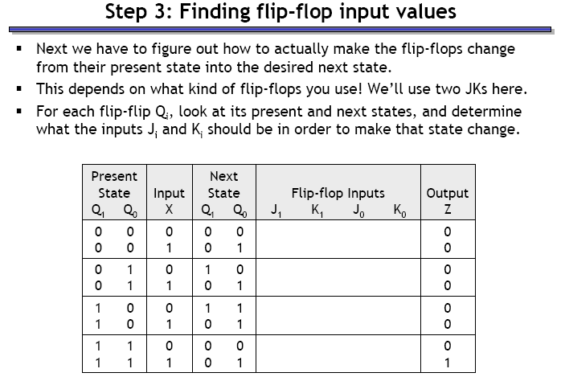
Step 3: Find flip-flop input values

Slide 18
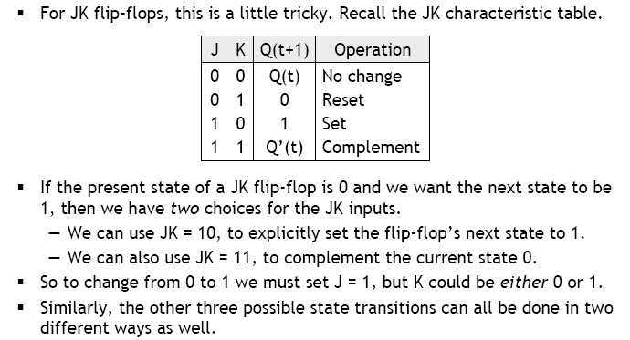
JK flip-flop input values

Slide 19
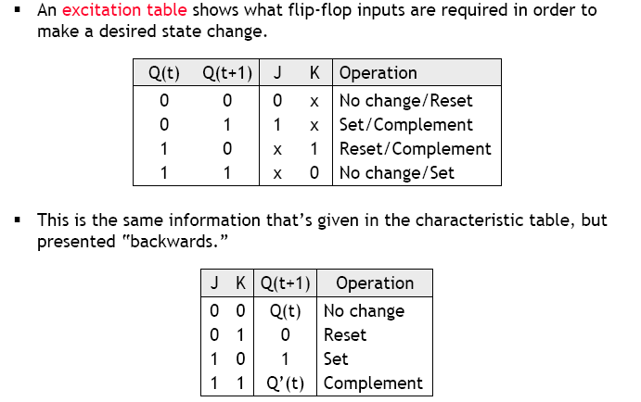
JK flip-flop excitation table

Slide 20
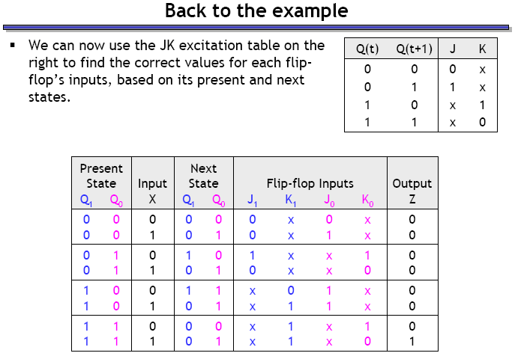
Use excitation table to complete the expanded state table

Slide 21
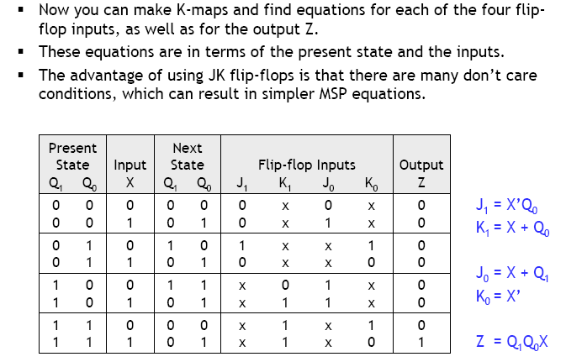
Step 4: Find equations for flip-flop input and output

Slide 22
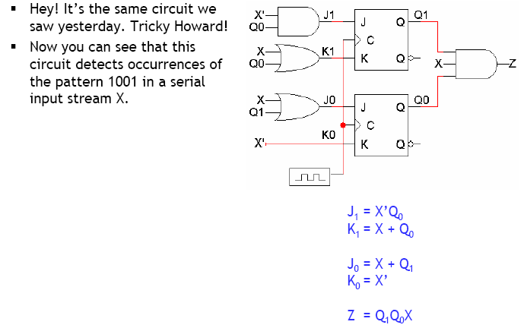
Step 5: Build the circuit!

Slide 23
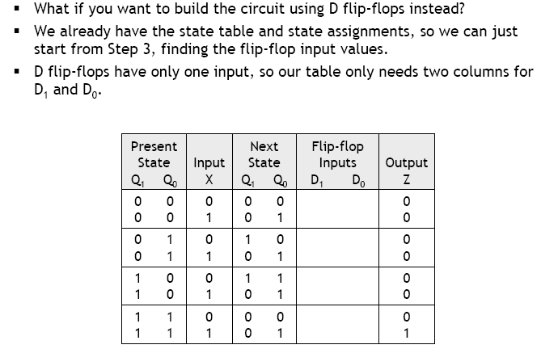
Example: same circuit with D FFs

Slide 24
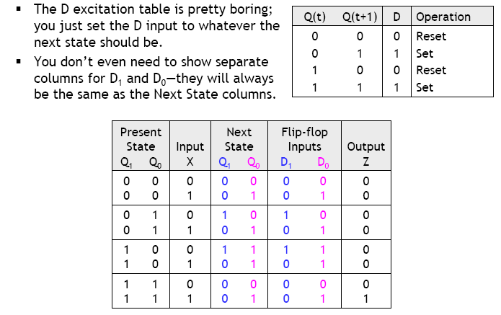
Back to step 3 with D FFs

Slide 25
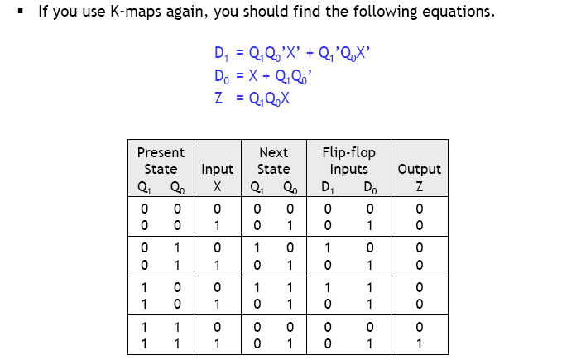
Step 4: Finding equations

Slide 26
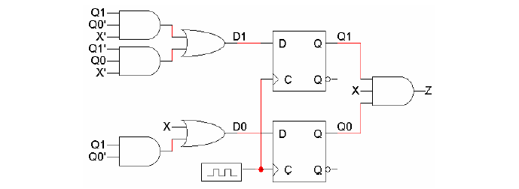
Step 5: Building the circuit

Slide 27
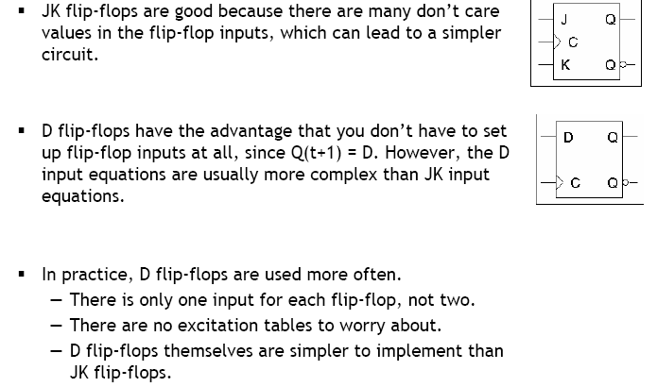
D vs JK flip flops

